Slide 1
Status SLS 2.0
Hans Braun :: Paul Scherrer Institut
Sitzung Leitender Ausschuss Beschleunigeranlagen, 6.11.2020

Slide 2
SLS 2.0, Ziele und Methoden
Ziele: Massiv höhere Strahlbrillianz / Photonenflussdichte
→ bessere räumliche Auflösung
→ wesentlich höhere Kohärenz der Röntgenstrahlung
→ schnellere Experimentdurchführung
Erweiterung Photonen-Energiebereich zu kürzeren Wellenlängen
→ bessere Durchdringung, bzw. dickere Proben möglich
Methoden: Neues Synchrotron im existierenden Tunnel mit «MBA» Magnetanordnung
Erhöhung der Strahlenergie 2.4 GeV→ 2.7 GeV
Neue Undulatormagnete
Drei supraleitende «Superbend» Magnete mit bis zu 5.5 Tesla Ablenkfeld
Neue oder neukonfigurierte bzw. verbesserte Strahllinien
Neue Konzepte zur Datenerfassung und Verarbeitung

Slide 3
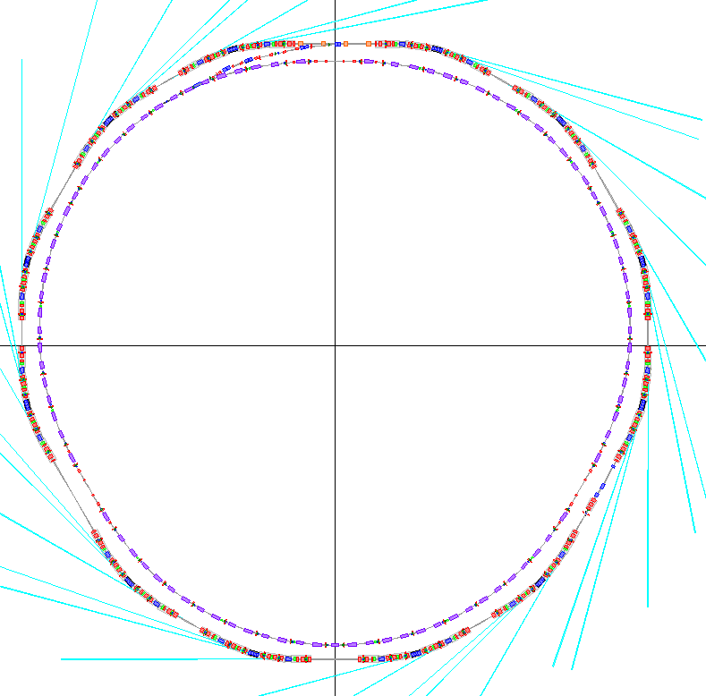
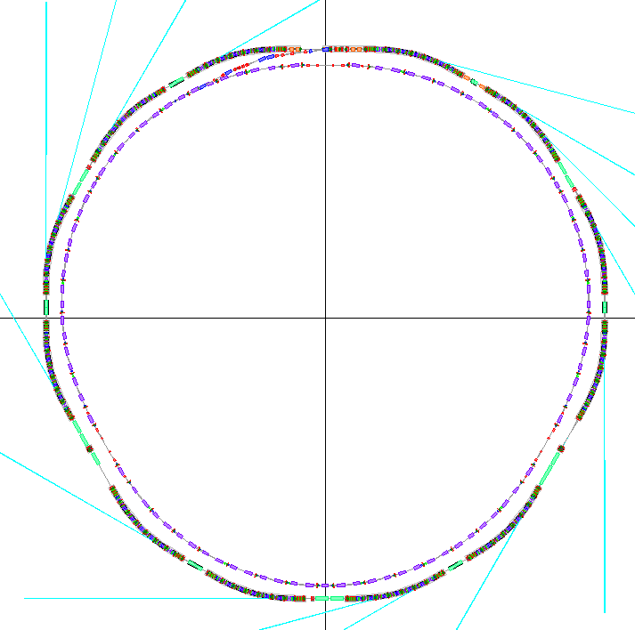
SLS
SLS → SLS 2.0
SLS 2.0
maintained
  Circumference 288 m
  3× long, 3× medium, 6× short straights
  total straight length ∼ 80 m
  Beam current 400 mA
almost maintained
  Source point positions |shifts| < 70 mm
improved
  Emittance 157 pm (from 5500 pm)
  Energy 2.7 GeV (from 2.41 GeV)
SLS today
  Circumference 288 m
  3× long, 3× medium, 6× short straights
  total straight length ∼ 80 m
  Beam current 400 mA
  Beam energy 2.41 GeV
  Emittance 5500 pm

Slide 4
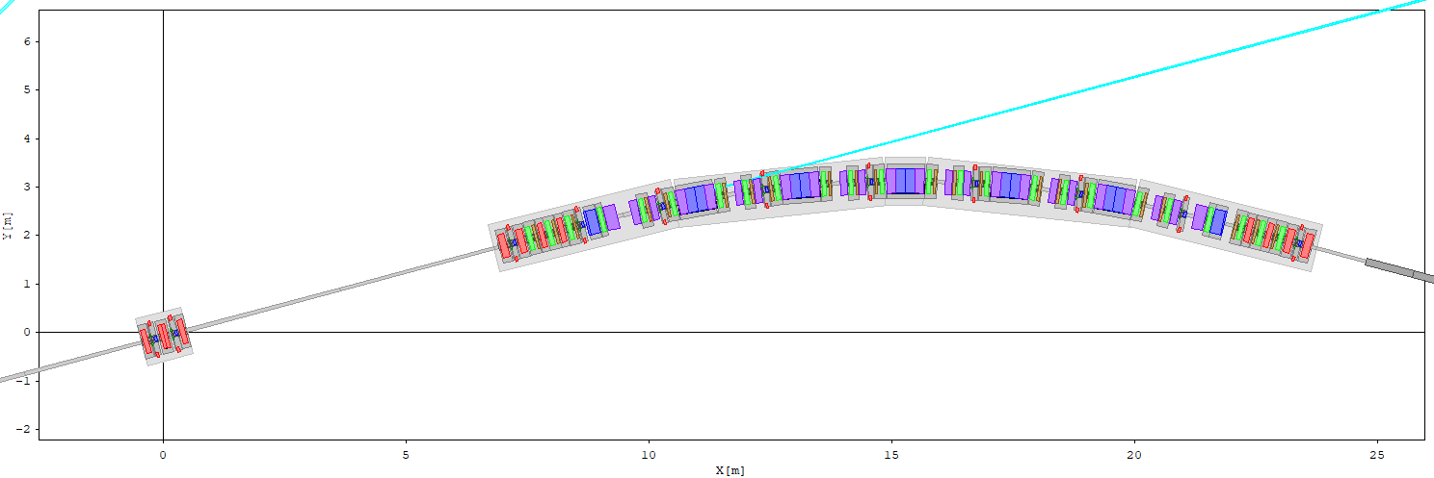
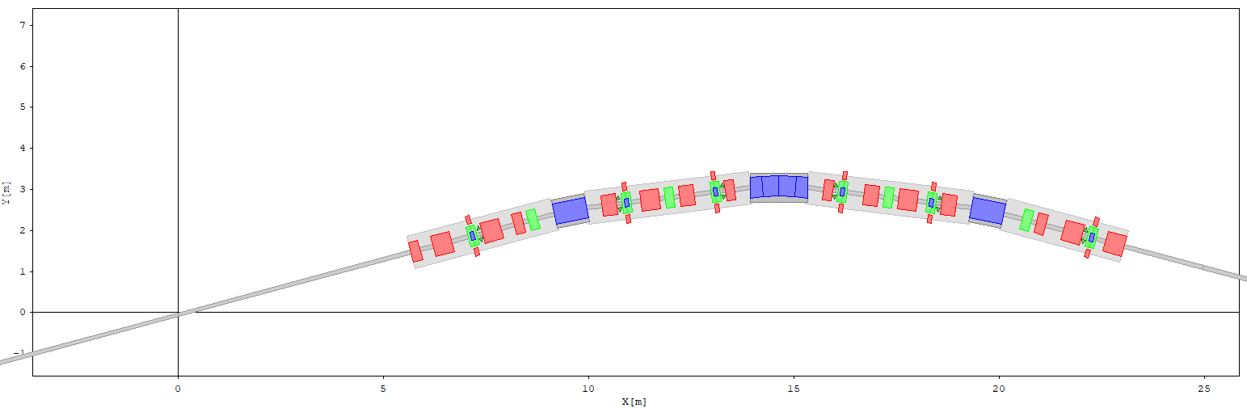
SLS 2.0
7 bend MBA
SLS now
TBA

Slide 5
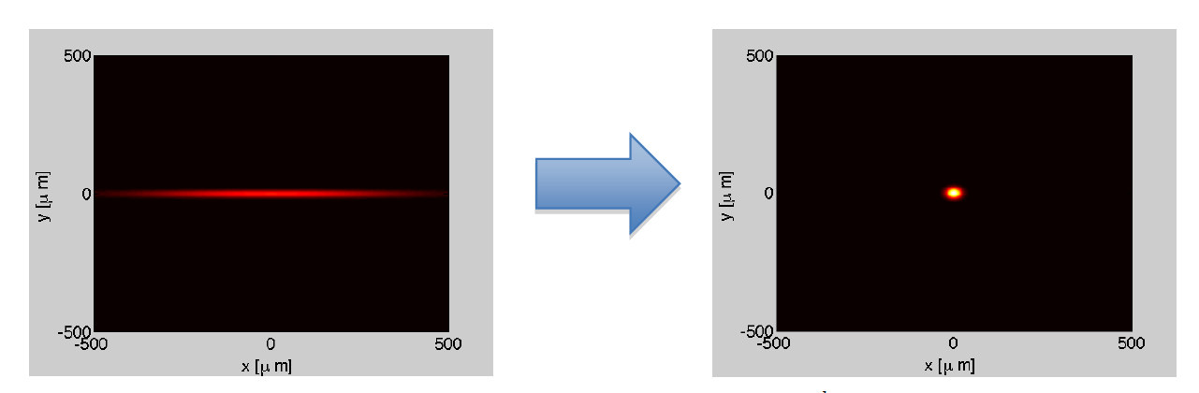
Vorteil SLS TBA* → SLS2.0 MBA**
Vereinfacht zusammengefasst:
Neue Synchrotrons bestehen aus vielen kleinen und komplizierten Magneten,
statt aus wenigen grossen, einfachen Magneten
Vorteil:
* TBA = Triple Bend Achromat
** MBA = Multi Bend Achromat

Slide 6
Beamline layout
Injection
Debye
cSAXS
01
3-5 T
i-TOMCAT
12
02
BL relocations
Stays
Moves
New
s-TOMCAT
3-5 T
SIM
RIXS
11
03
SuperXAS
3-5 T
short straight
medium straight
long straight
superbend
normal bend
10
ID list
2: 1-m U10 (U14 fallback)
3: 4.5-m UE36 K-not
4: 2-m U14, later 1-m U10?
5: 3.5-m UE32 K-not + 2-m UE48
6: 3-m U15
7: 4.5-m or 2 x 2-m UE36
8: 3-m U15
9: 3-m UE36 K-not + 4.5-m UE90 K-not
10: 3-m U15
11: 4.5-m or 2 x 2-m UE36 Knot
12: 3-m U15
PX II
04
MS
NAPP
2027
VUV
09
05
SuperARPES
XIL.
SX-ARPES
08
06
Optics/
Diagnostcs
07
2 T
microXAS
PX I
PolLux/
nanoXAS
XTreme/
Phoenix
PX III

Slide 7
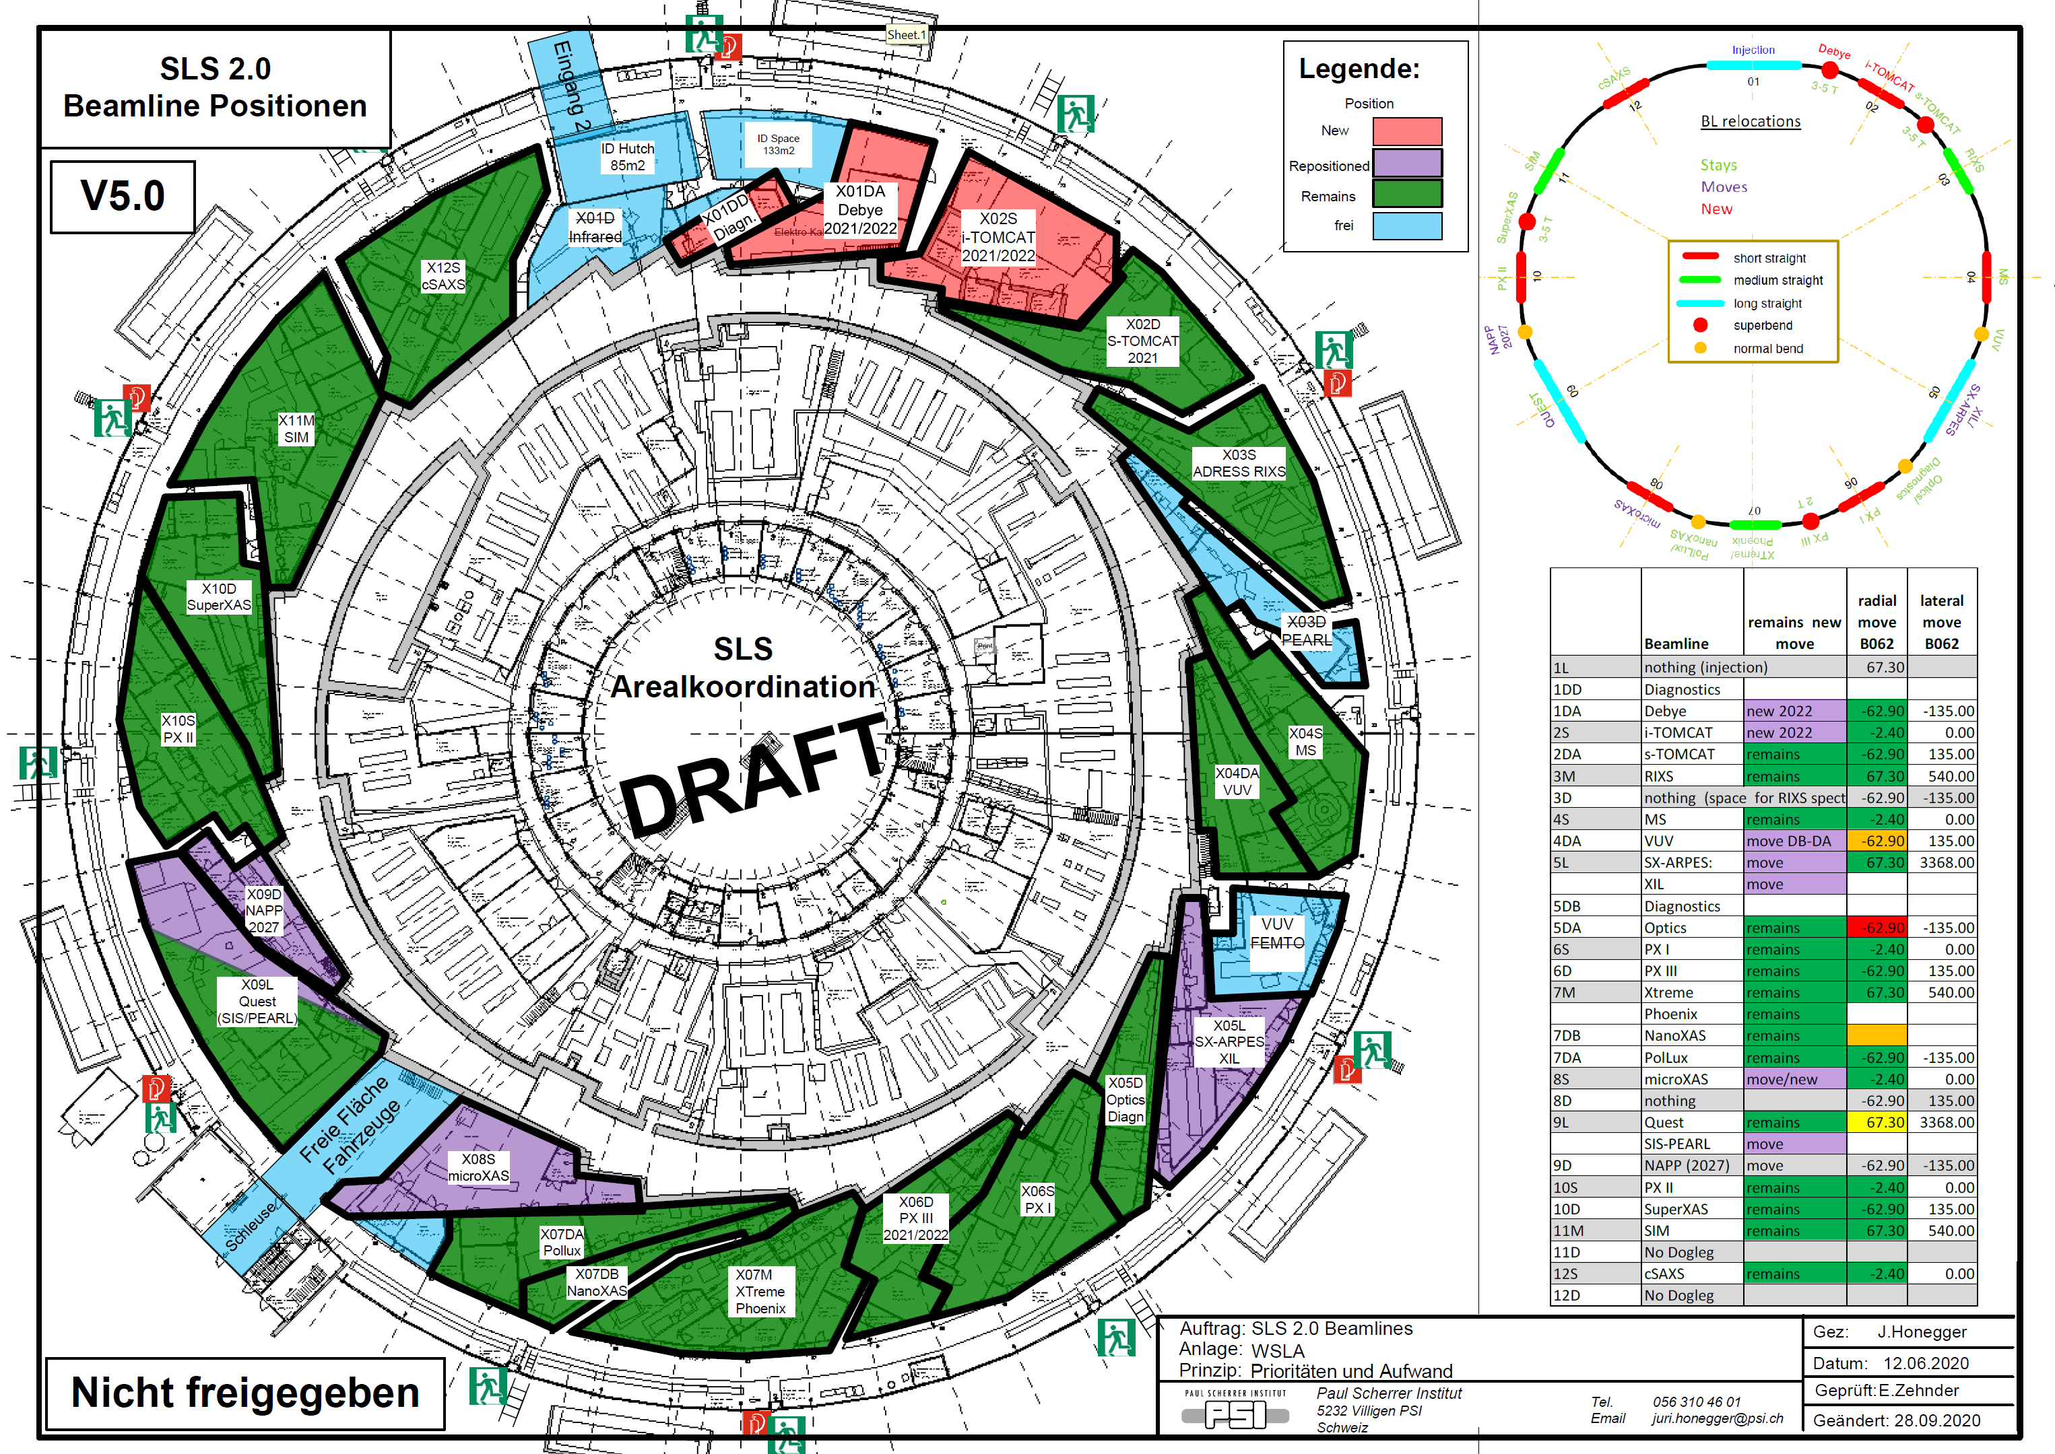

Slide 8
SLS 2.0 Aktivitäten 2020
Zahlreiche Aktivitäten zu Komponentendesign und Prototypenbau
Vorbereitung Ausschreibungen für Speisegeräte, Magnete, Vakuumkammern, HF Anlagen…
Optimierung Abbau- / Aufbauplanung
Vorbereitung Einbau zweiter Kran in SLS
Suche temporäres Lager- und Montagegebäude ausserhalb PSI
Aufbau neue Projektstruktur für Umsetzungphase 2021-2026
Finalisierung Ringdesign
Finalisierung Beamline Auswahl und Anordnung
Aufbau 3D Modell
Entscheid Energieerhöhung 2.4GeV → 2.7 GeV
Up-date Kostenschätzung
Erste Schritte Strahlenschutzstudien und BAG Bewilligungsprozess
Start TDR Dokument
…
Finaler Finanzierungsentscheid im Rahmen BFI Botschaft erwartet für Dezember 2020

Slide 9
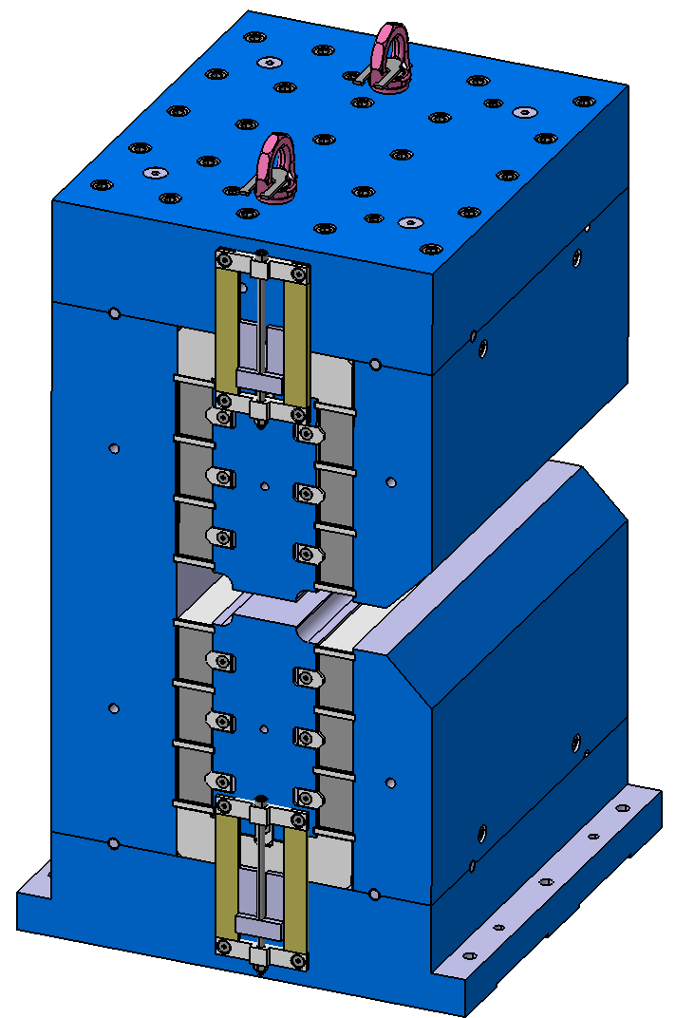
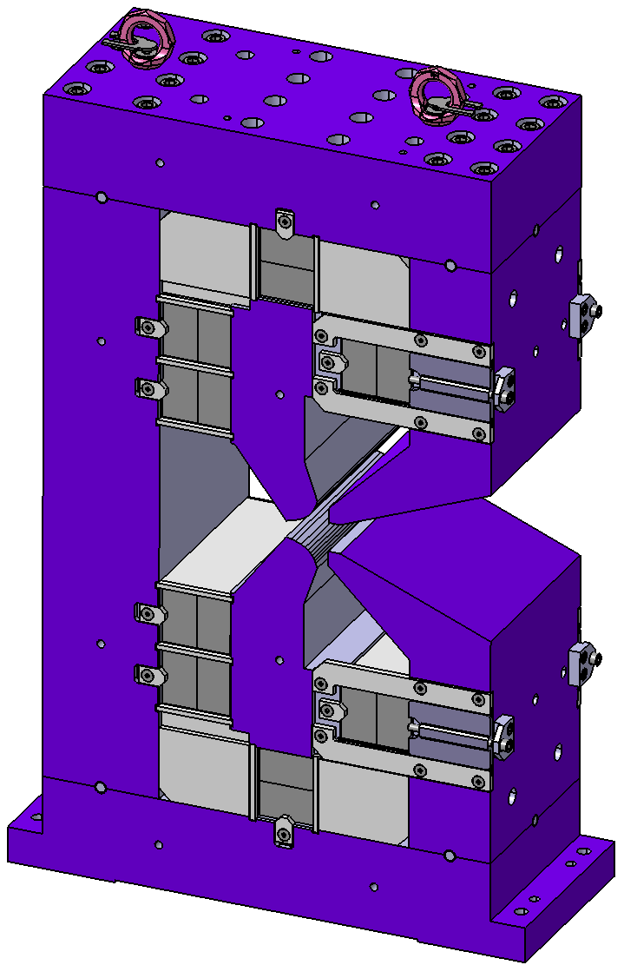
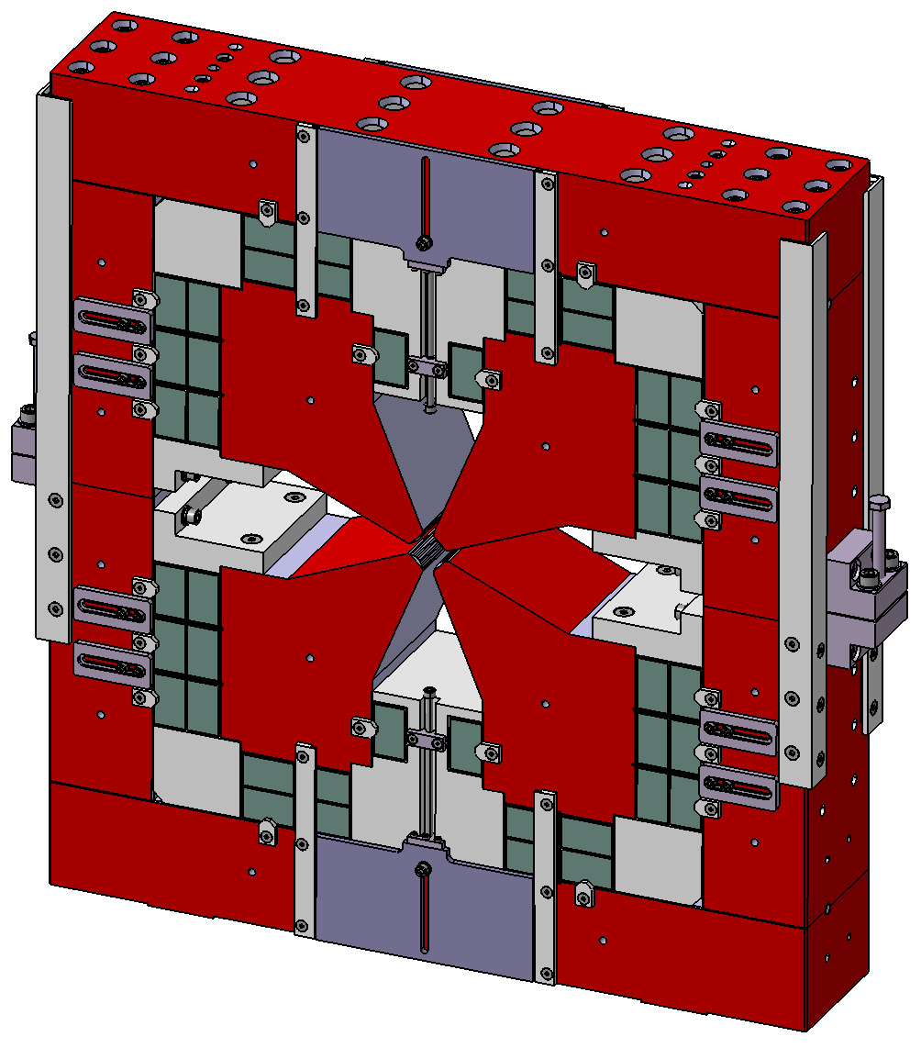
Permanent magnets
BN main dipole
1.35 T
VB combined function
AN reverse bend
(=off centered quadrupole)
NdFeB permanent magnet blocks and NiFe strips for tuning

Slide 10
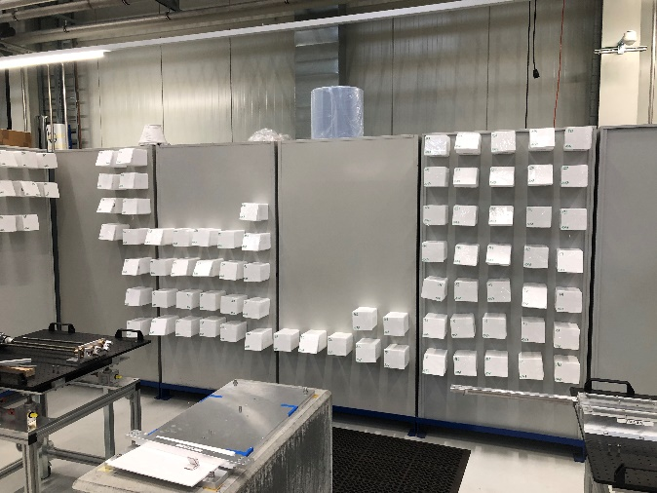
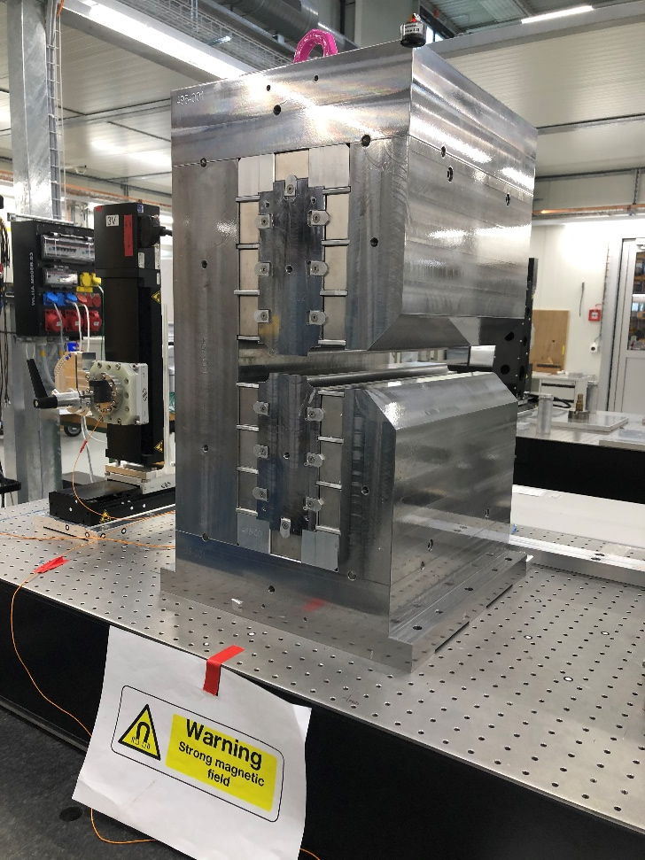
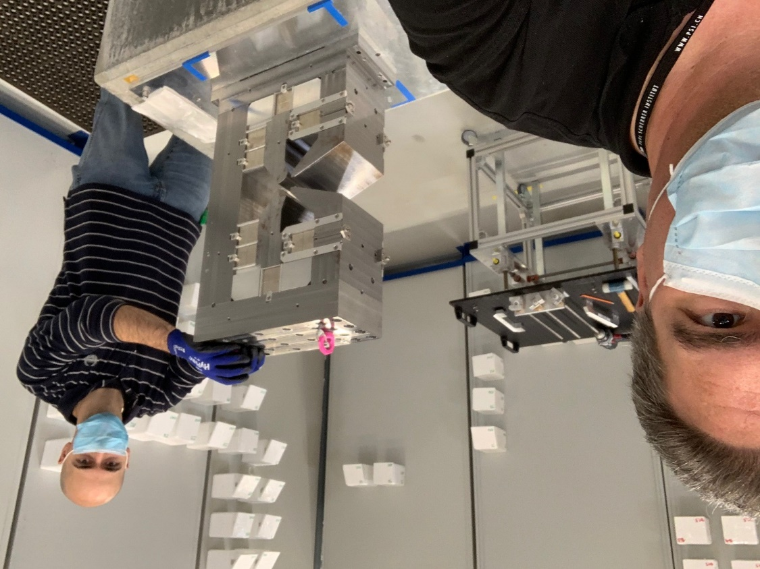
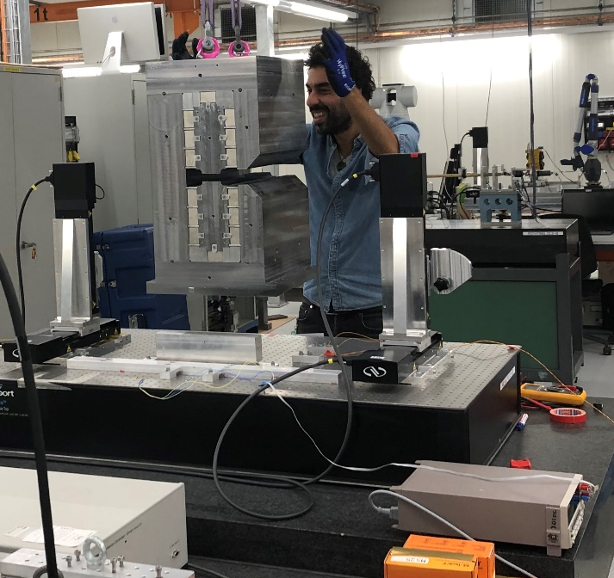
First SLS2.0 full-scale permanent magnet prototypes at PSI
Highly sophisticated PM magnet block sorting panel
First full-scale SLS2.0 PM magnet prototype (Type BN)
First full-scale SLS2.0 VB magnet prototype
Preparing first BN magnet
for field measurement

Slide 11
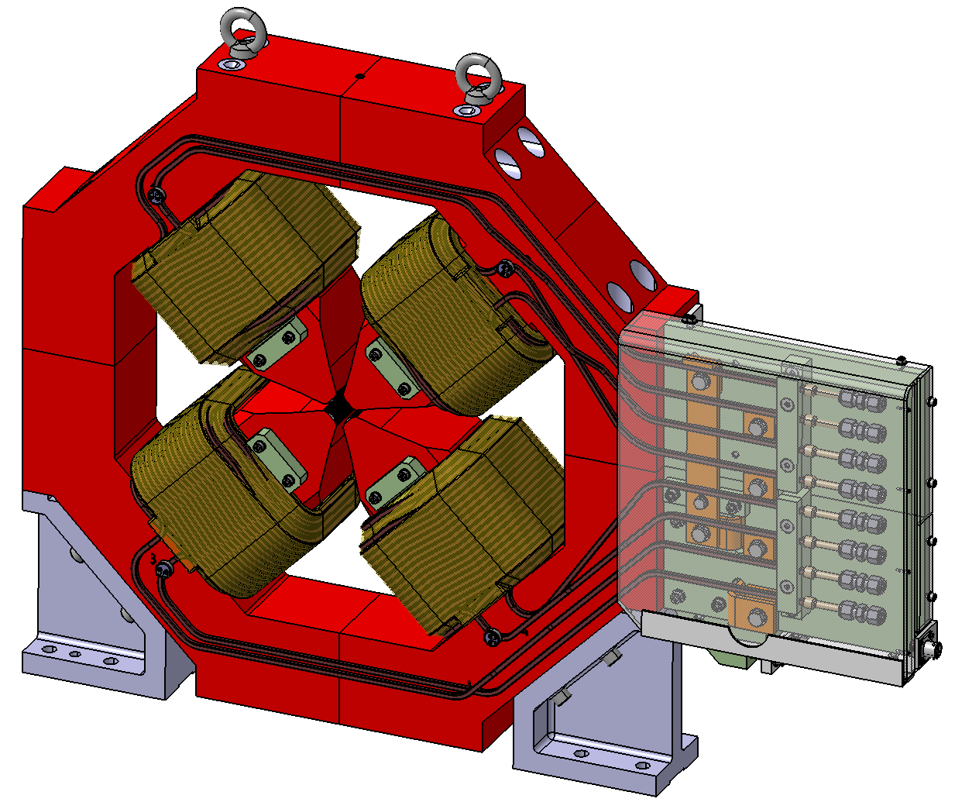
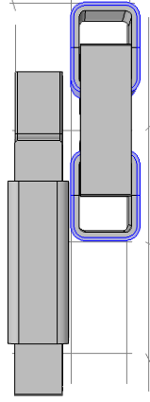
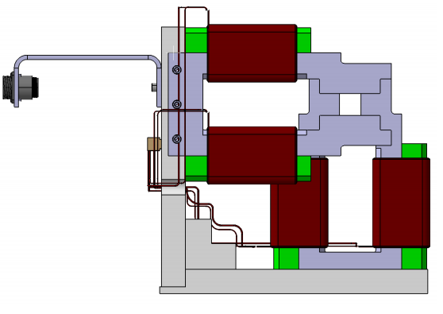
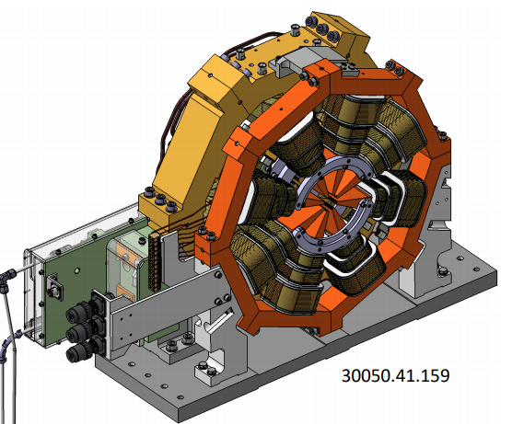
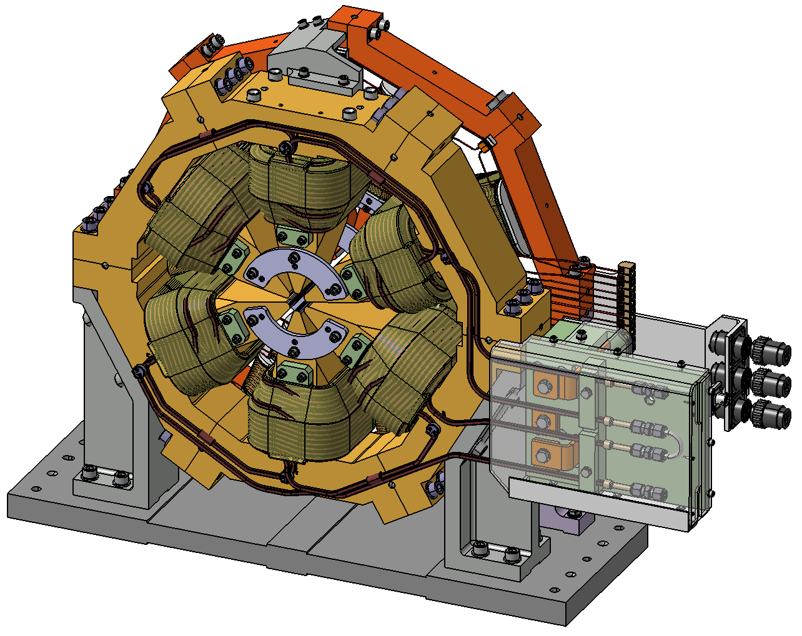
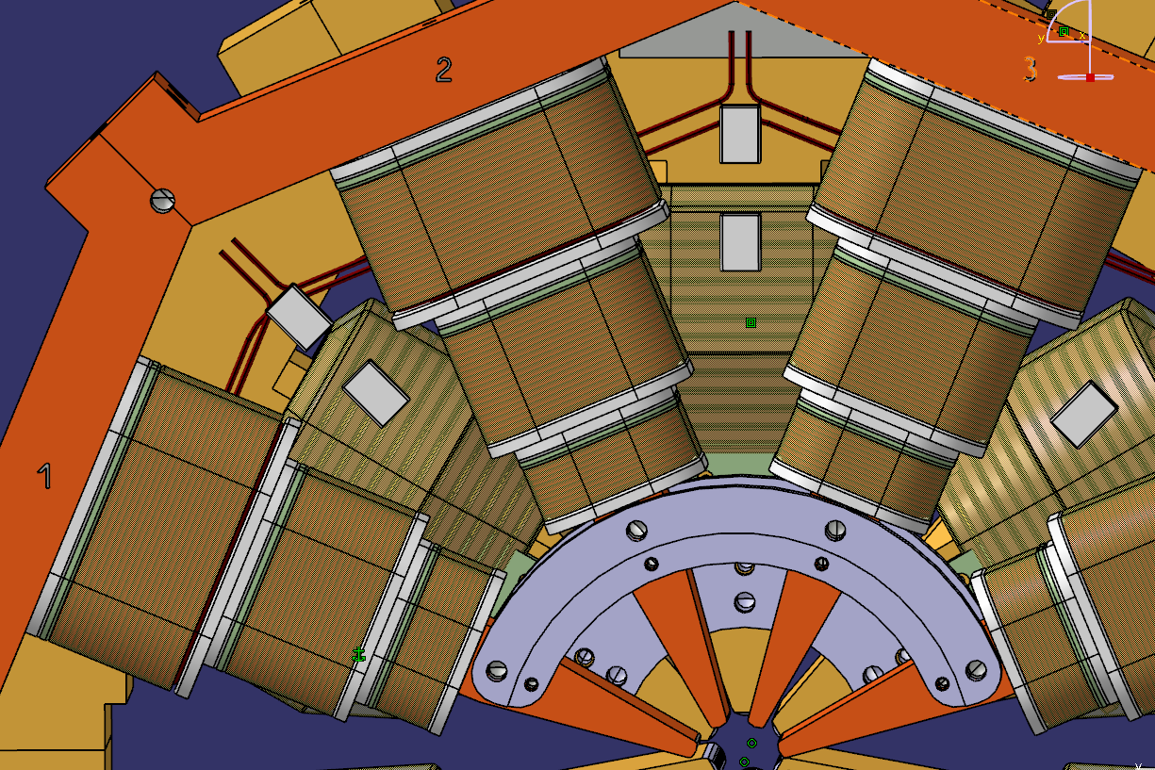
Electromagnets
QP
quadrupole
100 T/m
CHV
orbit corrector
top view
SOQ
sextupole + octupole
with regular and skew
quadrupole correctors

Slide 12
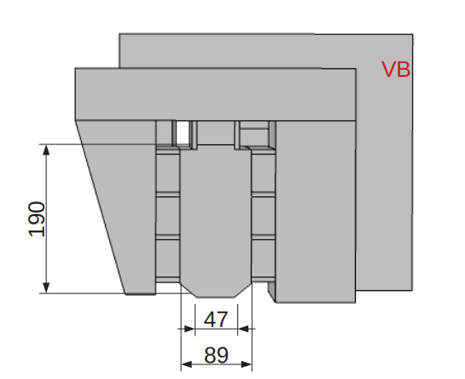
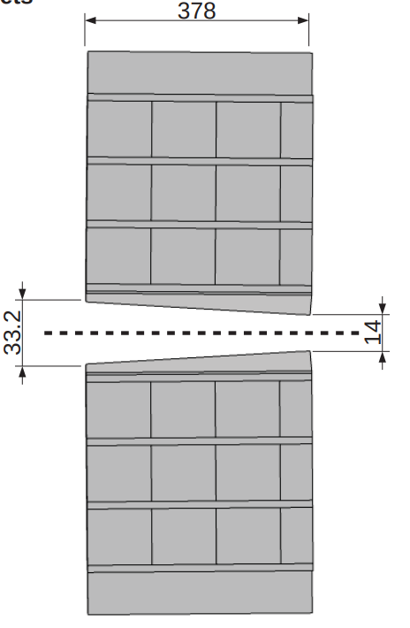
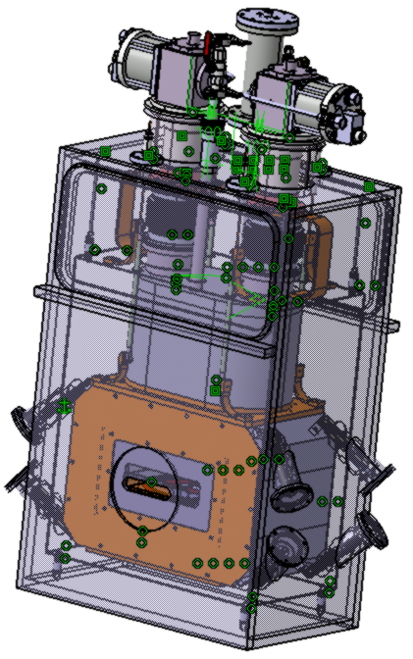
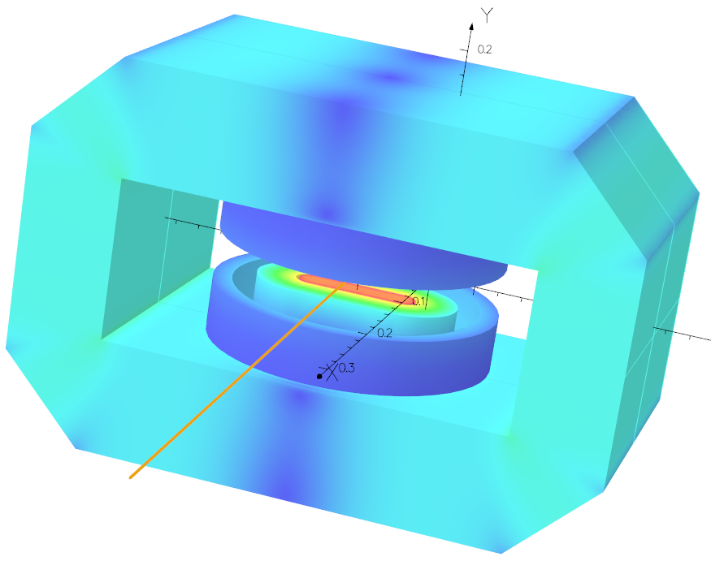
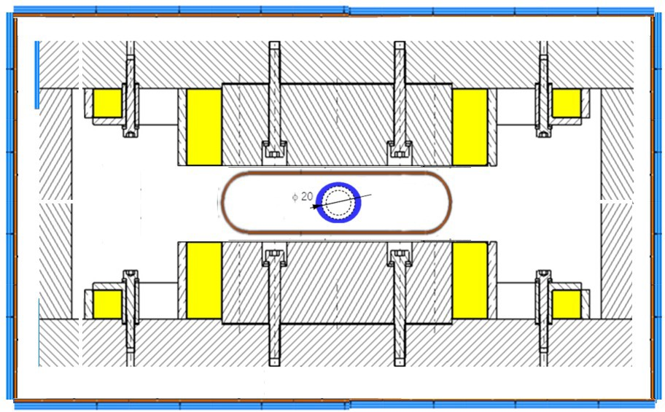
Superbends
BS2
2 Tesla PM-dipole
BS5
5 Tesla SC-dipole

Slide 13
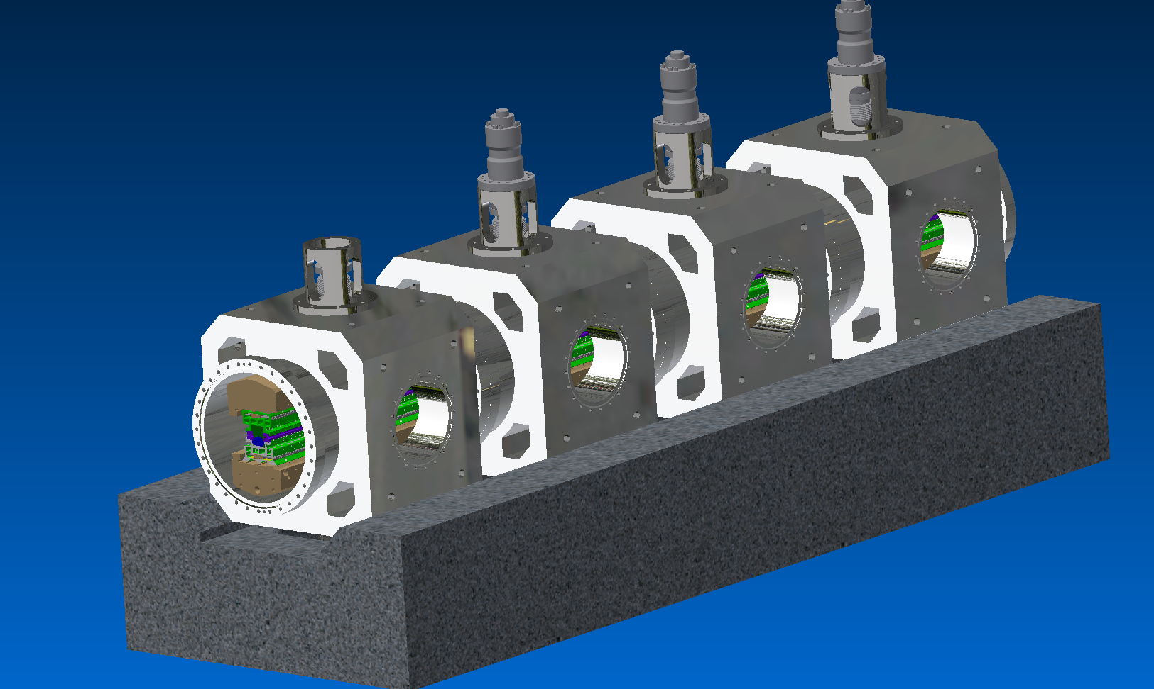
Design Concepts modular in-Vacuum Undulator
modules on a girder
combined function: vacuum chamber & support
multiple drive units (hydraulic)
(low forces, compact)
profit from high machining precision
reduced parts
variable length
cost effective
many suppliers

Slide 14
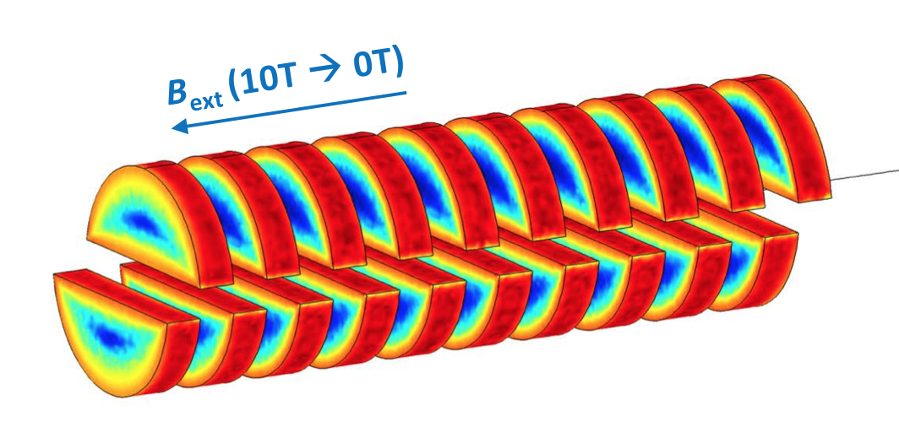
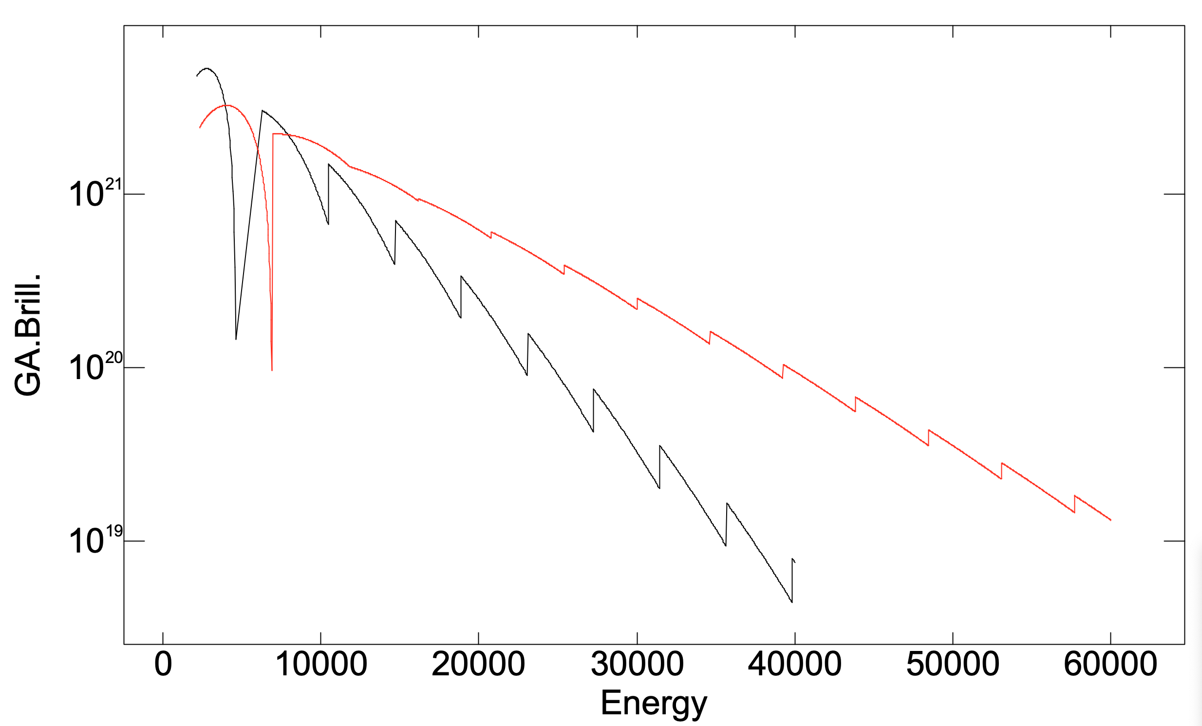
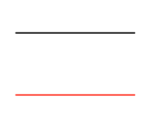
HTS10 for i-Tomcat & MS
U15 RT
HTS10

Slide 15
HTS progress
Collaboration Agreement
PSI - FermiLab
12T Superconducting Solonoid
magnetic length: 1m
solonoid: 1.5m
transition section 2x 300mm
straight 2
to be shared with injection kickers
max. 2m long cryostat

Slide 16
Athos UE38 Apple X → same for SLS2.0 long straights?

Slide 17
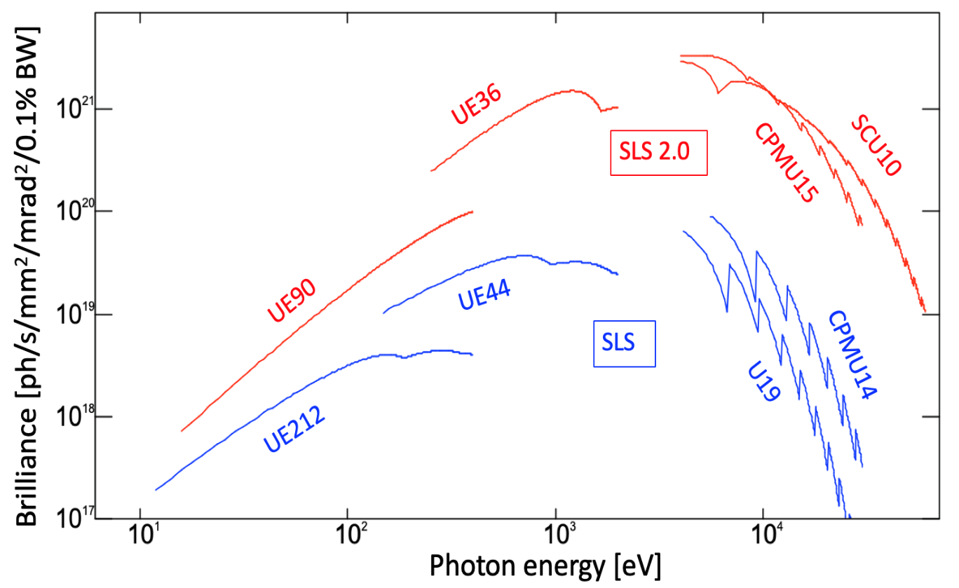
SLS 2.0 brightness
Improvement factors
relative to SLS:
reduced emittance:
× 24 (10...20 keV)
+ higher energy (2.7 GeV):
× 59 (10...20 keV)
+ new undulator
(CPMU15 instead of U19):
× 140 (10 keV) ... 870 (20 keV)
+ upgrade to SCU10:
× >1000 above 20 keV
Calculations and plot by Thomas Schmidt

Slide 18
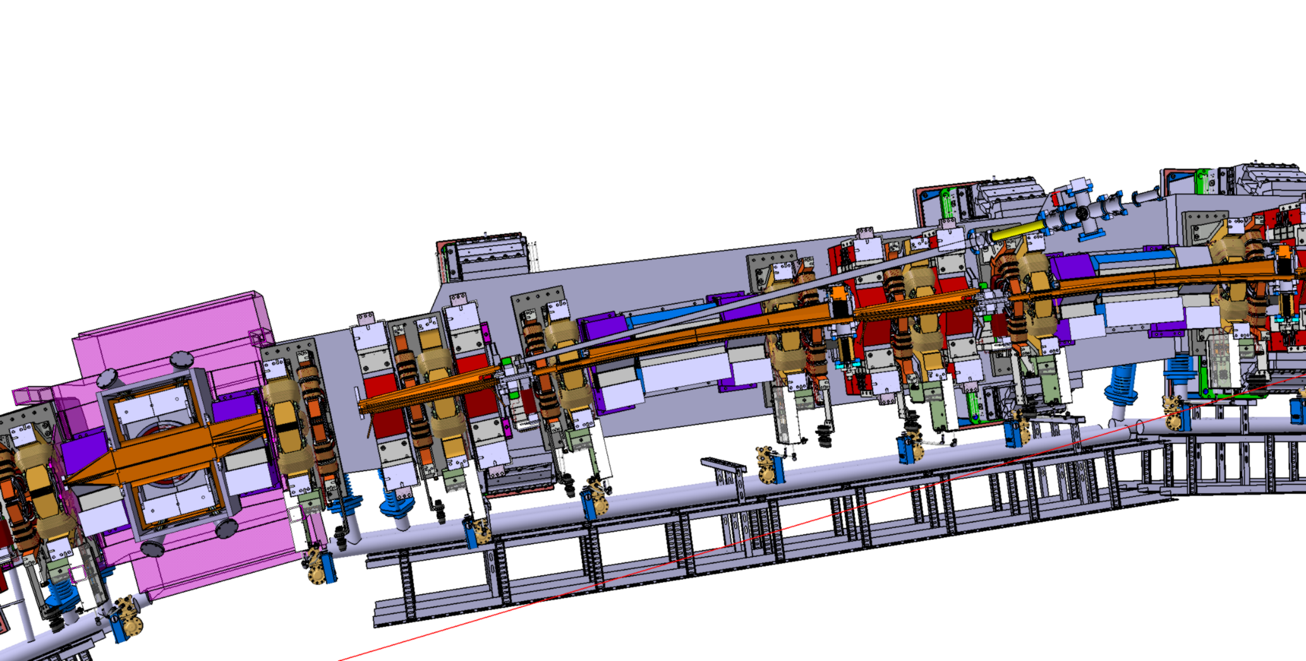
Vacuum Chamber design SLS2.0
12 arcs => 500 Chambers (mainly in copper)
1 mm wall thickness & 18 mm inner diameter
Constrains: Space – Heat Load – Synchrotron Light Extraction - Impedance
Top Cut View of a SLS2.0 Vacuum Arc (near Superbend)

Slide 19
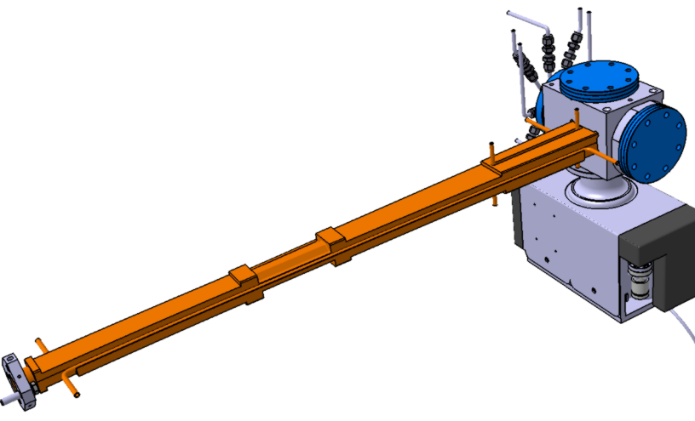
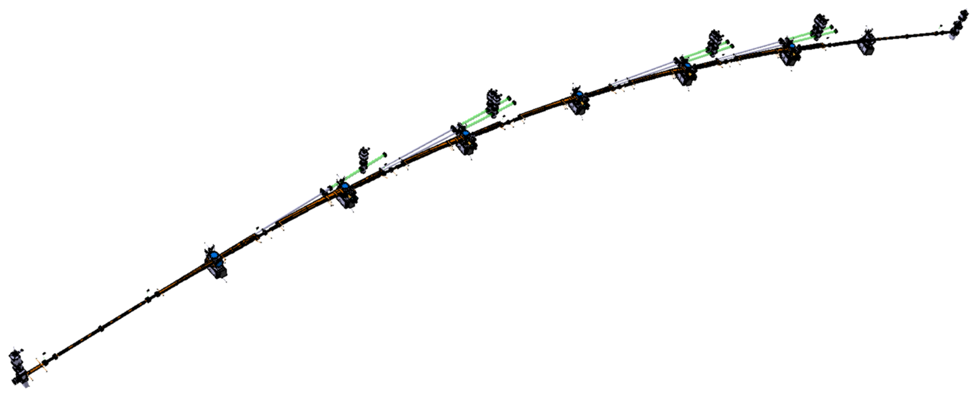
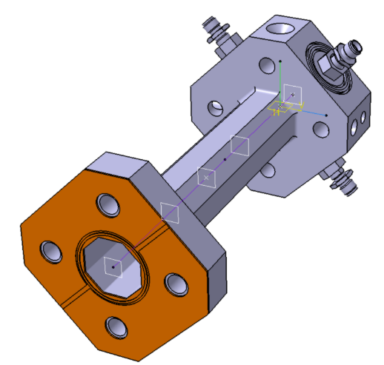
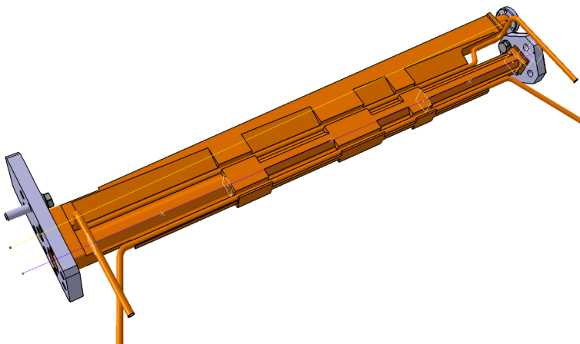
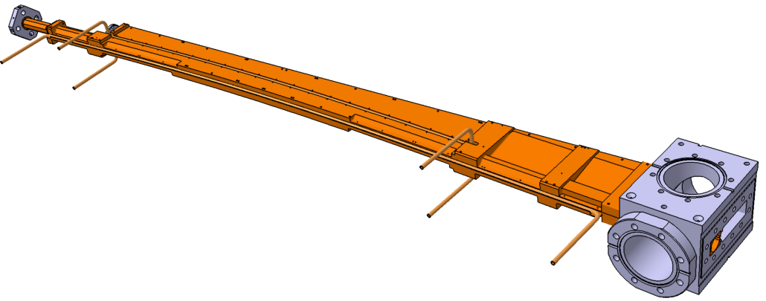
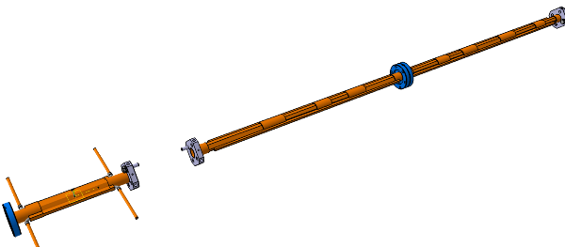
Arc Vacuum Chambers
No bellows; 2 End Gate Valves
Flat gaskets (Vatseal)
7 Ion Getter Pump & 7 NEG Capacitorr
CSS: Chamber Straight Steerers
Octagonal; d=21mm
Stainless Steel, L=130mm
5 um copper coating
0.5 um NEG
CBI: Chamber Bend IN
Slit = 10 mm for Extraction
Octagonal; d=18mm
Cu OFE, L=991mm
0.5 um NEG
CRM: Chamber Reverse Middle
No Slit
Octagonal; d=21/18mm
Cu OFE, L=563mm, Wall_{min}=1mm
0.5 um NEG
CBN: Chamber Bend Normal
Slit = 3 mm for Extraction
Octagonal; d=18mm
Cu OFE, L=1431mm, Wall_{min}=1mm
0.5 um NEG
CSU: Chamber Straight Upstream
Octagonal; d=18mm
Cu OFE, Wall_{min}=1mm
0.5 um NEG

Slide 20
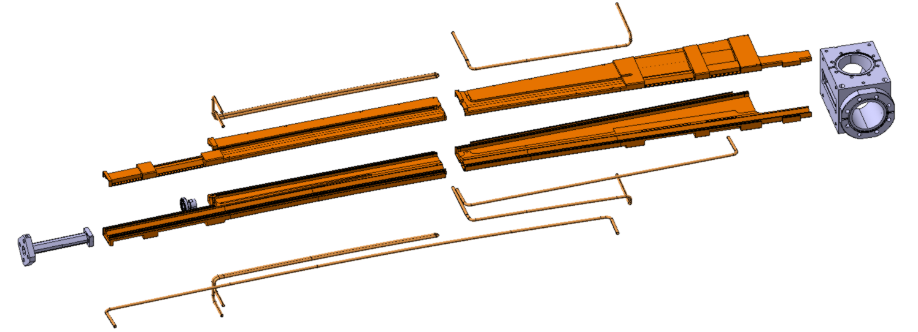
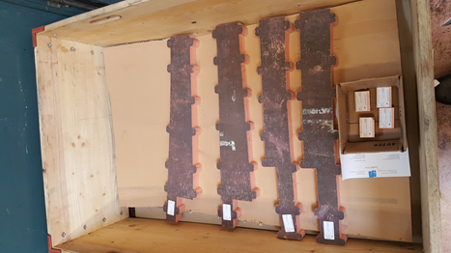
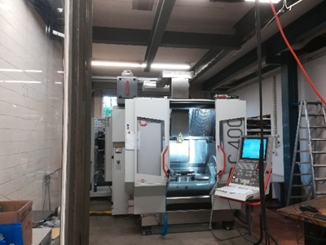
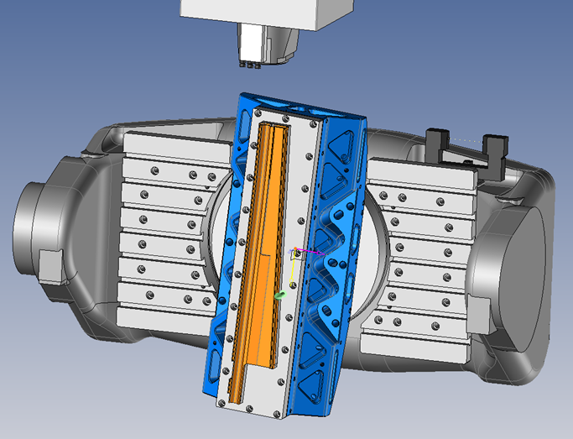
CBN Prototype Production at PSI
1. Pre-machining
  Forged Cu – OFE (CW009A)
  Water Cut to approximate shape
2. Copper Machining
  Rough milling and subsequent
  stress free annealing
  Fine milling (Vacuum Holding Support)
  - 1 mm wall thickness
3. External procurement:
  Stainless steel cube
  flanges
Air-conditioned room and cooling water regulation for stable production conditions
Courtesy of René Siebert
To be ready by December 2020

Slide 21
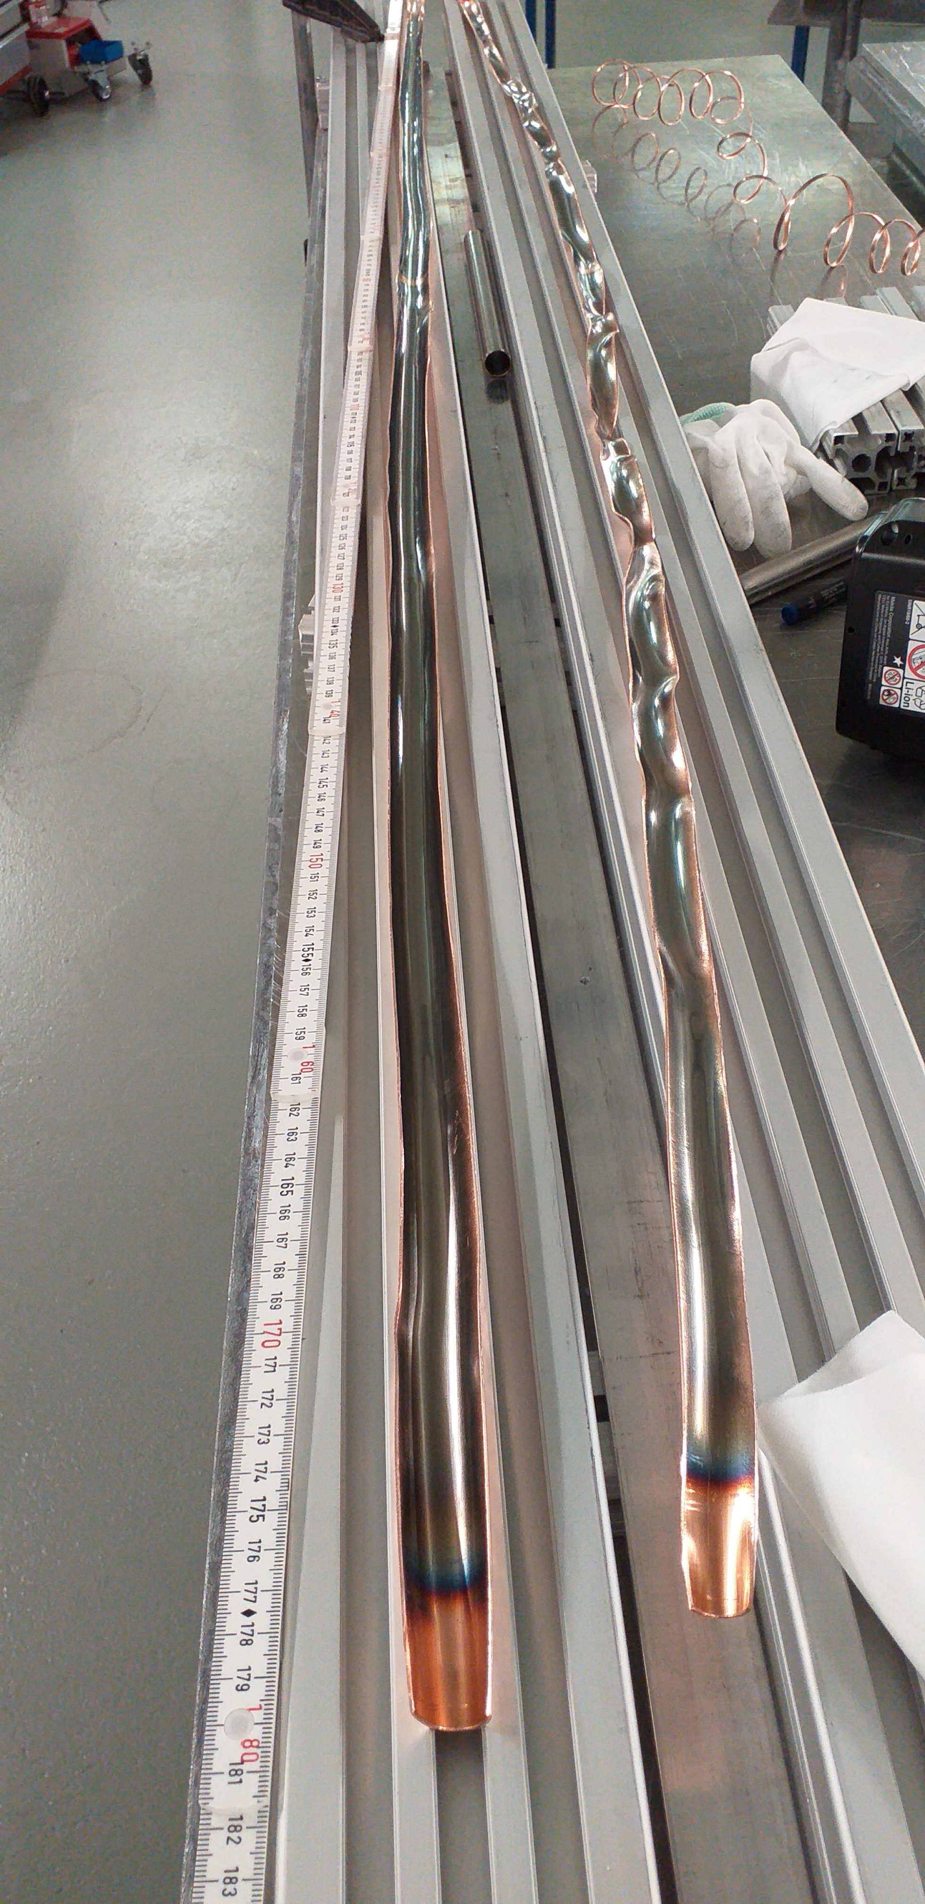
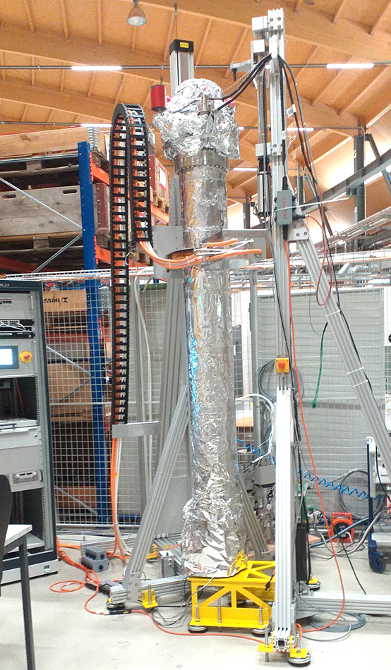
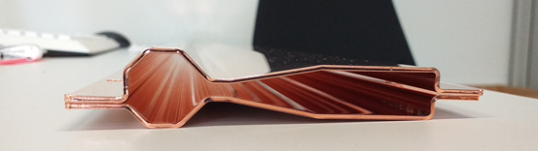
Moving solenoid NEG coating setup
October 2020: 1st NEG coating over 1.5 m length
Coating Setup under commissioning

Slide 22
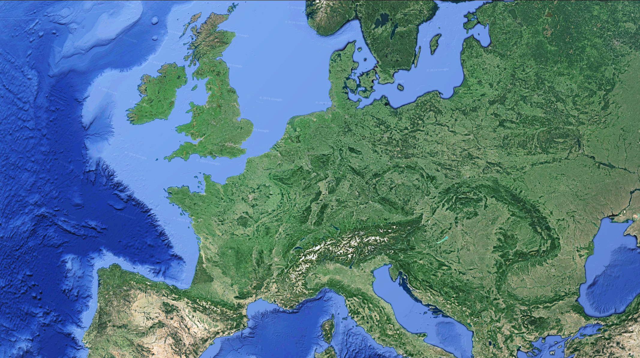
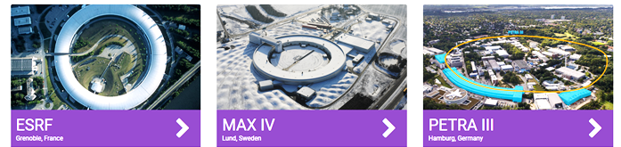
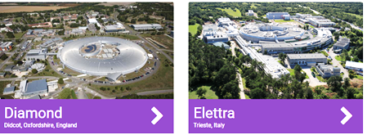
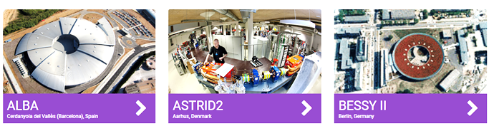
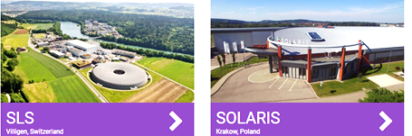
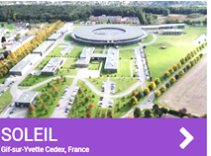
SLS2.0 work done so far

Slide 23
SLS2.0 work done so far

Slide 24
Schedule concept
Start
Gr. 1 Beamline commissioning
Start
Gr. 2 Beamline commissioning
Point of
no return
Start
Dark-Time
Tunnel
Closure
Start
Gr. 1 user operation
Start
Gr. 2 user operation

Slide 25
Reasoning for two group schedule concept
  Superbends are the magnets with the highest risk to arrive late
  because of novel design & first SC magnets designed by PSI magnet section.
  Maybe modifications required after first prototype test anticipated for late 2023.
  Two group concept gives the slack to mitigate schedule risks due to the superbends.
  Beam dynamics commissioning team doesn’t want to mix
  the very evolved first beam based optics correction
  with specific issues of superbend commissioning.
  The second 3 month shutdown in 2026 reduces workload in 2024,
  thus permitting tunnel closure 15 month after start of dark time
  and first user experiments 22 month after start of dark time.
  Resource loading for beamline work more relaxed.
  More opportunities to beef up beamline budget with SNF R’Equip grants.
  Installation planning team believes that tunnel closure end 2024 is possible with this scheme.
  Group 2 has a dark period without user operation of 34 month

Slide 26
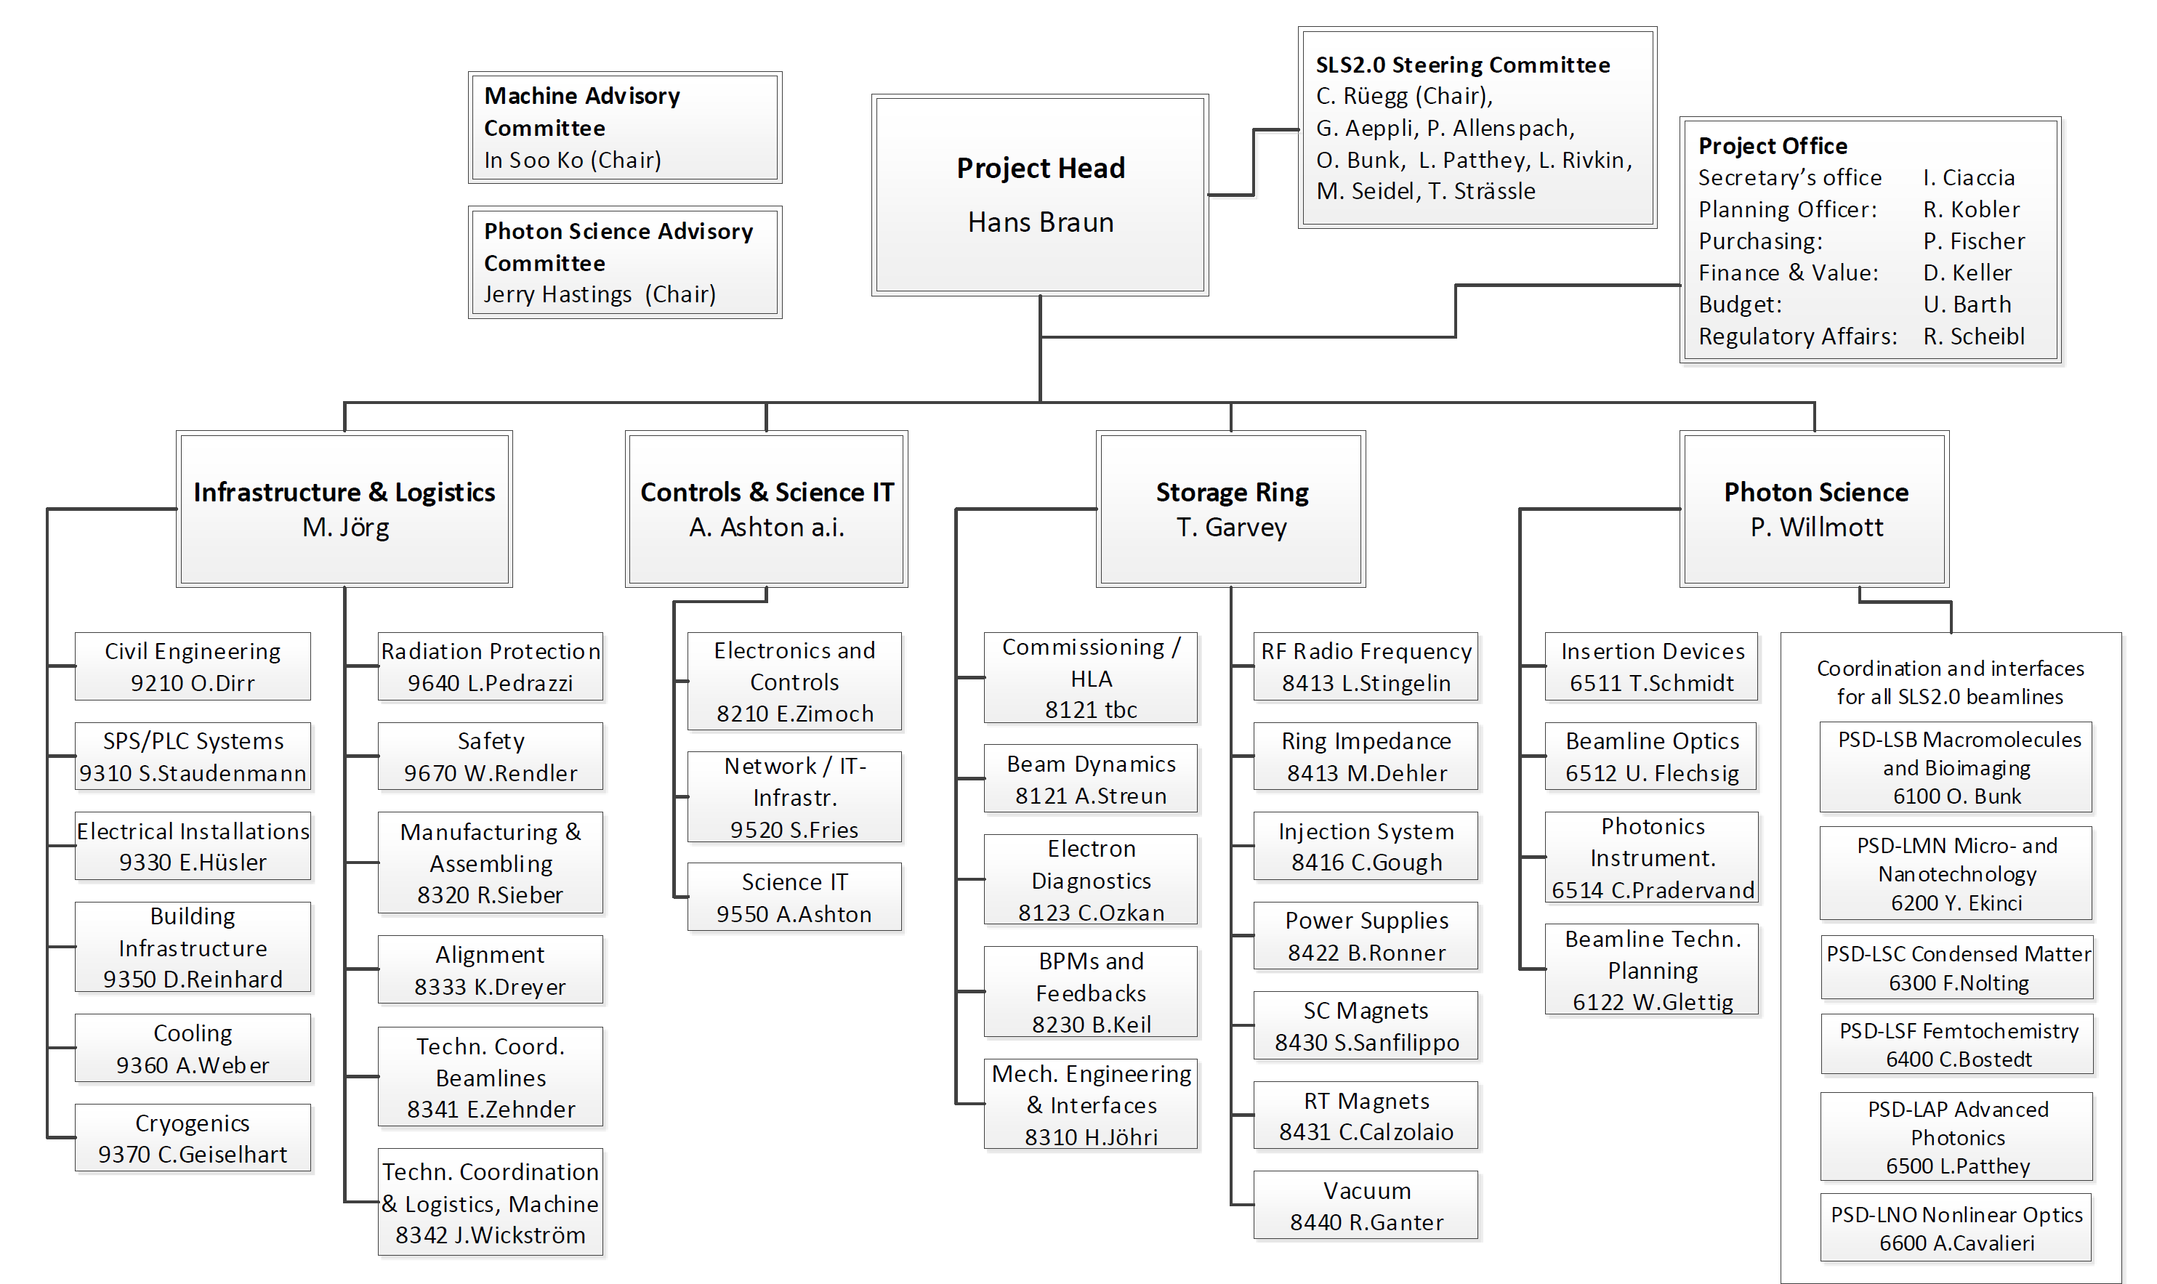
SLS 2.0 Organigramm

Slide 27
Status new cost estimate
Raw data collection completed 28 September
Budget workshop with all subproject leaders on 13 october
Long follow-up list still to be processed before budget estimate can be consolidated!
Time
Problem: the known available budget is 116 MCHF

Slide 28
Änderungen an der SLS vor SLS-2.0
Projekte mit Budgetierungen unabhängig von SLS-2.0
Zeitplan & Umfang z.T. noch nicht definitiv
zwei neue Strahllinien: Debye, I-Tomcat
Änderung S-Tomcat: Bau einer Optik-Hütte (Blei) mit PSYS aussen am Ringtunnel um bestehendes, abgeschirmtes Strahlrohr in 2021
Umbau Userareal PX III: Änderung Raumaufteilung, Vergrösserung Endstation 06D (keine wesentlichen Eingriffe in Ringtunnel oder Optikhütten), Pilot für SLS-2.0 Technologie, Beginn Inbetriebnahme ca. Ende 2022

Slide 29
Danke für Eure Aufmerksamkeit
und
Dank an alle deren Folien ich gezeigt habe

