Slide 1
Beam energy variation on a single C-band module by introducing phase slippage in the accelerating structures
R. Zennaro SPM meeting 19/01/2021

Slide 2
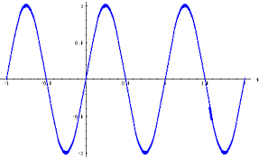




Can we adjust the beam energy in a ±250 MeV range without chirp variation or extra energy spread?
Double (or multiple) station case (Aramis case)
$$θ1$$
Simple energy gain adjustment by adjusting the phases with opposite sign.
$$θ2$$
$θ1=−θ$₂
Accelerating cavity 1
Accelerating cavity 2
Single station case (ATHOS)
$$θ\left(x\right)=θ0+ax$$
Simple energy gain adjustment by introducing a phase slippage and a phase offset.
Variable energy gain with two stations
Variable energy gain with single station (phase slippage)
Structure output
Structure input

Slide 3
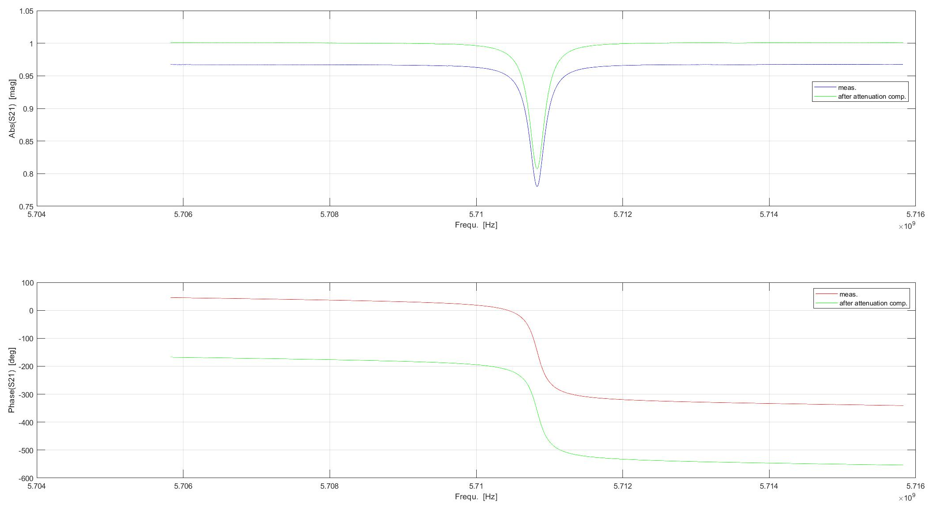
For a perfect rectangular pulse coming directly from the klystron it is straightforward to define the energy gain in case of phase slope, but in our case the RF pulse is compressed by the BOC.
Complications come from the bandwidth of the pulse compressor (BOC).
A phase slope is equivalent to a frequency offset, for this reason the bandwidth of the system must be taken into account.
4
3
2
1
0.56 MHz
0.8 MHz
3.3 MHz
NB: C-band modules are routinely operated with ~ 10 MHz frequency offset because of the phase jump 180°/50ns

Slide 4
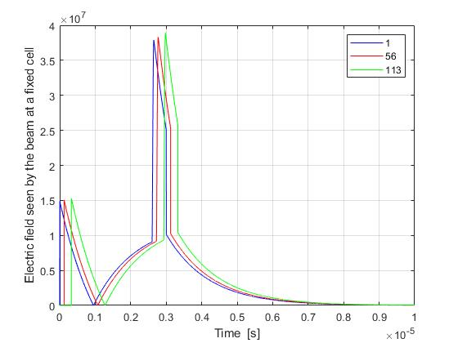
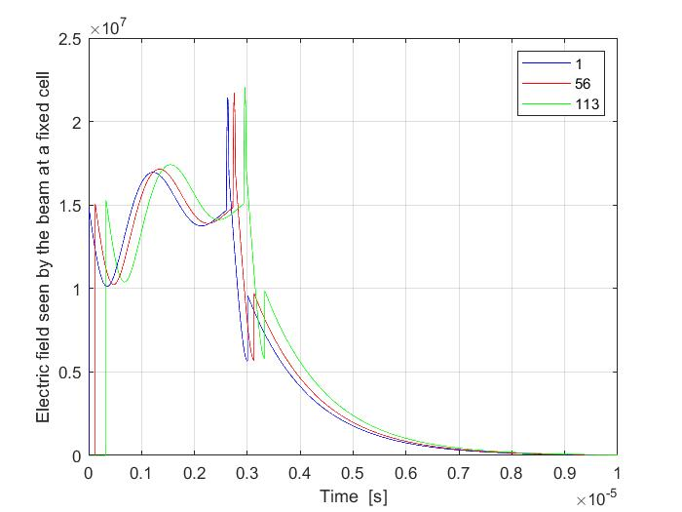
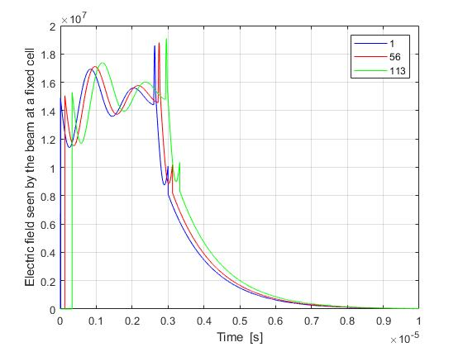
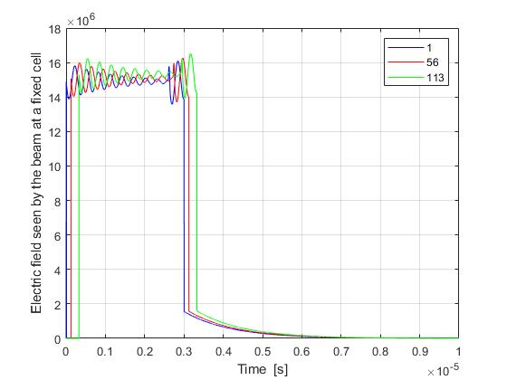
Compresed pulse from BOC for different phase slopes
Model based on differential equations for BOC and matrix formalism for the 103 cells (one accelerating structures)
1
2
Field vs. Time in 3 cells (1, 56, 113) nominal case (no phase slope)
Field vs. Time in 3 cells (1, 56, 113)
slope 0.2 deg/ns
3
4
Field vs. Time in 3 cells (1, 56, 113)
slope 0.3 deg/ns
Field vs. Time in 3 cells (1, 56, 113)
slope 1.2 deg/ns

Slide 5
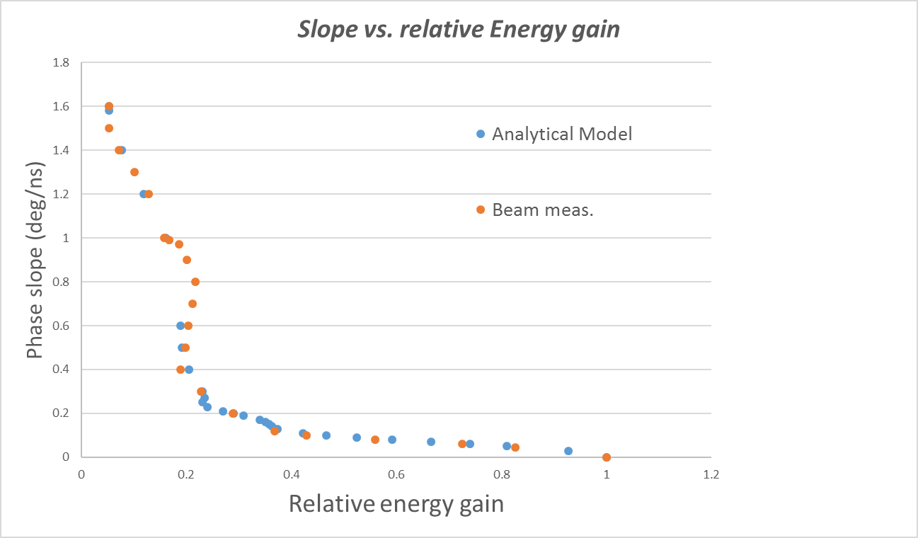
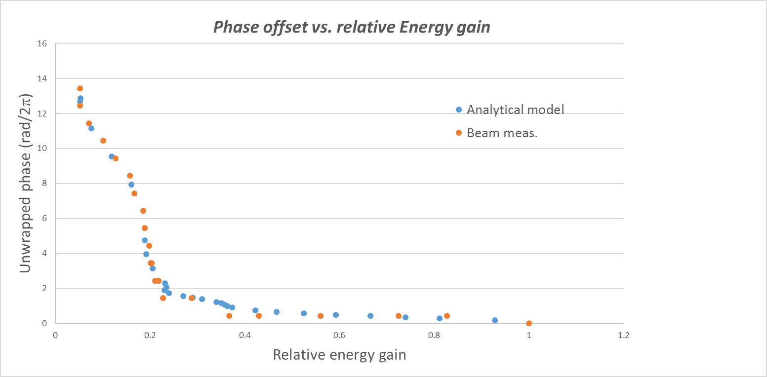
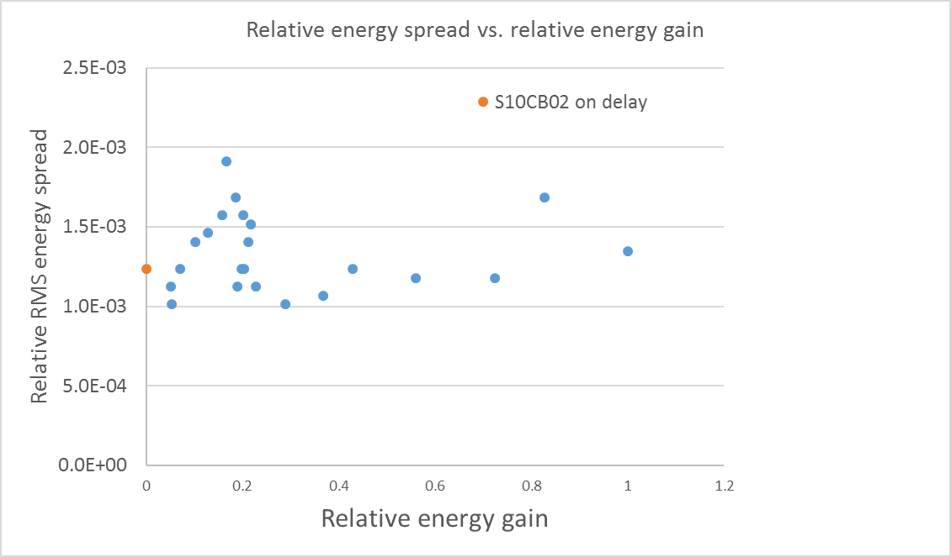
First set of measurements 24/11/2020 (low energy very long beam) P. Craievich, Z. Geng, R. Zennaro
The measurements have been done on S10CB02 operating with the injector on crest and without compression. Xband and S10CB01 has been used to further minimize the energy spread. The idea was to have a long bunch with small energy spread to get good resolution in the measurement of the contribution of S10CB02 to the energy spread. The beam has been measured at the injector dump spectrometer. For every phase slope the RF phase was adjusted in order to find the minimum energy spread. The measured energy variation with the phase slope fits very well with the analytical model.
NB: the measurements have been made only for positive acceleration, to apply an equivalent deceleration the phase should be simply changed by 180°

Slide 6
Second set of measurements 22/12/2020 (beam equivalent to the one in Athos) P. Craievich, Z. Geng, R. Zennaro
The energy and energy spread was measured in Aramis collimator, the shift was in parallel with the Shift of Ferrari and Prat that were working using the bunch 2 in Aramis. The idea was to use S30CB03 for the phase slope and S30CB01 and S30CB02 for the beam energy compensation in order to keep fixed the setting of the collimator chicane.
We had many problems/stops because DRPS.
On top of the many stops due to DRPS we had strong vacuum activity in the waveguide of S30CB03, very likely due to the window on the waveguide side (klystron vacuum was ok). These vacuum activities were clearly related to the introduction of the phase slope, removing the phase slope the vacuum was better.
In this condition was not possible to operate S30CB03, see next slide.
We could get only one point for a slope of 100deg/microsec. which generated an energy gain of 110 MeV equivalent to 46% of the nominal energy gain (240 MeV) in good agreement with the prediction (43%).

Slide 7
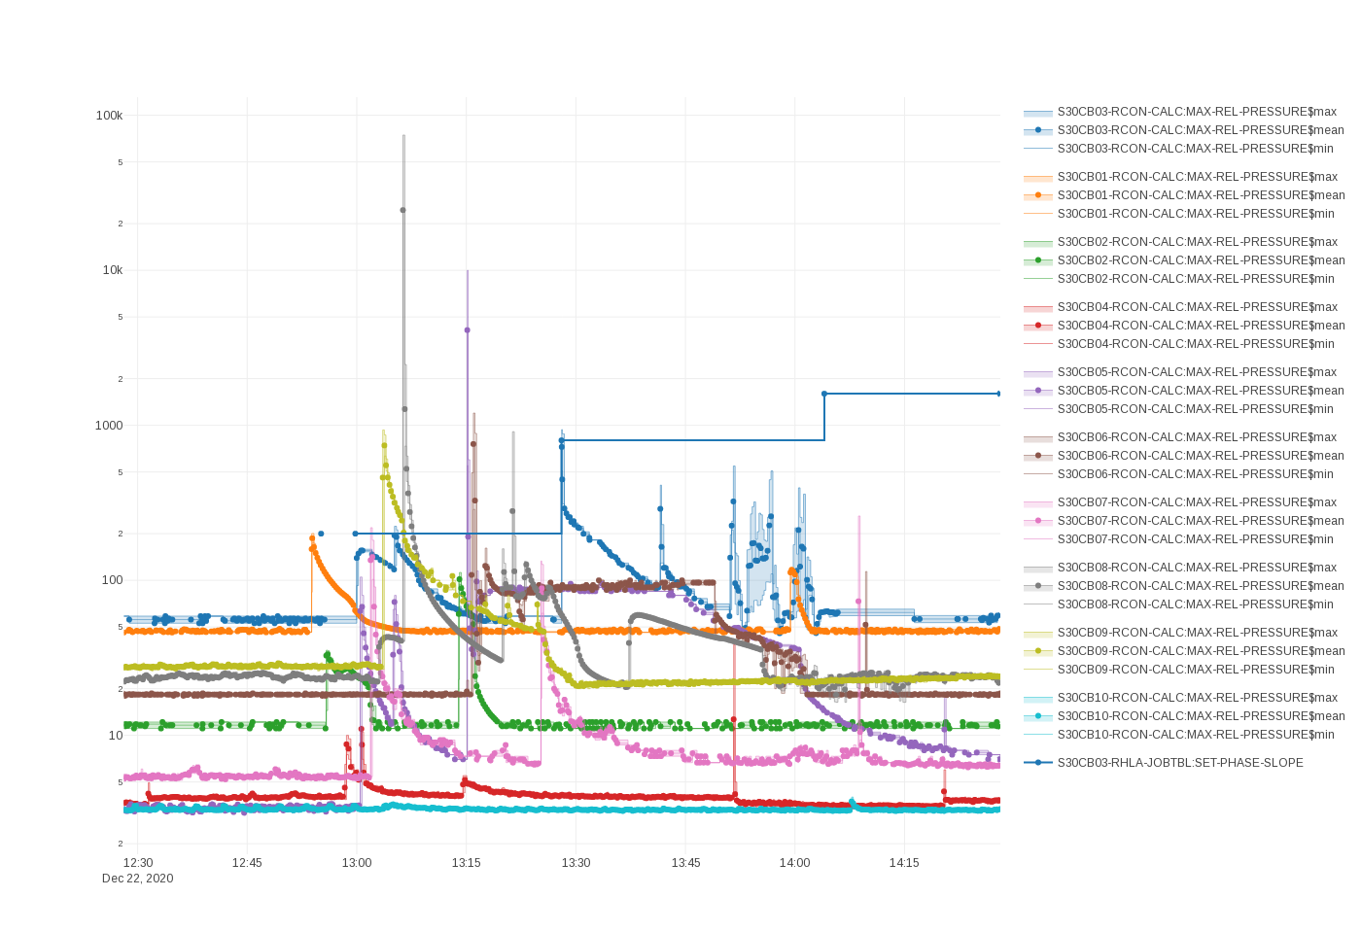
We evaluated the possible problem of the vacuum activity introducing a phase slope in ten modules of Linac3 (S30CB01 to S30CB10). For half of the stations we did not have problems, we had some initial vacuum activities in S30CB03, S30CB05, S30CB06, S30CB08 and S30CB09. The phase slope was changed in 4 steps: 0 deg/microsec; 200 deg/microsec; 800 deg/microsec; 1600 deg/microsec. At every step there was vacuum activity in few stations, the vacuum seems to improve anyway relatively fast.

Slide 8
Conclusions and outlook
The measurements are in good agreement wit the model
It seems possible to change the energy gain of a single module without varying the RF amplitude and without effects on the chirp.
Because of the non-linearity of the system the lookup table are quite difficult to fit and requires many point.
For each new value of the phase slope the phase must be varied over one period to find the minimum energy spread, by doing that the beam energy changes up to 0.5 GeV.
To measure the energy spread a screen in a dispersion region has been used.
For all these reasons this measurements introduce unavoidable beam losses and interruptions due to DRPS.
By using the klystron far from the nominal frequency vacuum activities near the klystron window (waveguide side) can be generated. The conditioning seems to be anyway quite fast.
Waiting for the C-band module in Athos, the measurements should be repeated in Linac 3.
Since the phase that gives the minimum energy spread is the one that provides the larger energy gain (independently from the phase slope) the measurements could be done at only 10 pC (bunch length, profile and charge do not play any rule in this case) and by using a BPM and not a screen. This makes the measurements easier and faster reducing also the radiation problems and avoid DRPS stops.

