Slide 1
First experience with the Tender X-ray Spectrometer (TXS)
Pavle Juranić :: Staff Scientist :: Paul Scherrer Institute
SwissFEL progress meeting 9.2.2021

Slide 2
Credits
AIK:
  David Mueller and construction team: great job on design and UHV chamber work.
  Beat Rippstein: support for setup.
Controls:
  Scott Stubbs: great support for motor and SmarAct implementation and GUIs.
Science IT:
  Dmitry Ozerov: great job on getting the Jungfraus tested and running.
  Ivan Usov: Jungfrau visualization software.
Detector group:
  Aldo Mozzanica and Seraphin Vetter: building the Jungfrau modules, including the new thin stripsel modules, and working with us on installation and design:
LAP:
  Yunieski Arbelo, Lukas Schmid, and Christoph Hess: construction, M-drive cabling, vacuum.
Alvra:
  Chris Milne (co-PI), Claudio Cirelli, Camila Bacellar, Christoph Bostedt, Joerg Schneider: von Hamos geometry design help, curved crystals, experimental time and opportunity, experimental setup and commissioning.
Electron Beam Instrumentation:
  Rasmus Ischebeck, Markus Baldinger: experimental support and setup.
Elektronenanlagen:
  Thomas Schietinger, operations, and the beam dynamics team for helping and setting up the beam.

Slide 3
Motivation
Covering spectral information in 2-4 keV range for users and machine, complementing PSSS’ 4-13 keV range.
Need for a large bandwidth spectrometer for special modes of operation.
Want the possibility of online, transmissive measurement of spectra.
The study and discussions with machine and end-station users resulted in the concept of a von Hamos spectrometer using elastic scattering for the measurement of spectra.

Slide 4
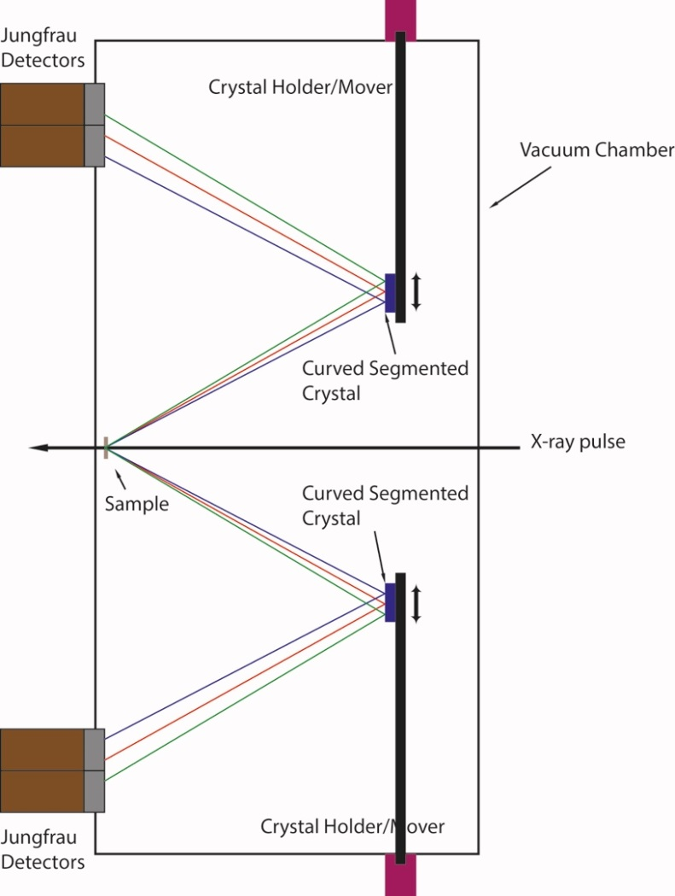
Tender X-ray Spectrometer Concept
A thin foil is used to scatter light elastically. The bent crystals set at the correct Brag angle disperse the light to the pixel detectors (Jungfrau). This leads to a shot-to-shot measurement of the spectrum of the FEL, while letting most of the X-ray light go through.

Slide 5
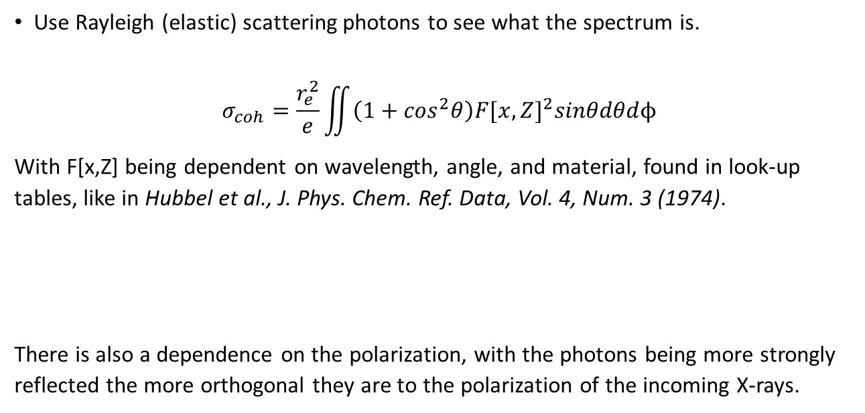
Theory
Use Rayleigh (elastic) scattering photons to see what the spectrum is.
$$σ_{coh}=\frac{r_{e}^{2}}{e}\iint{\left(1+\cos^{2}θ\right){F[x,Z]}^{2}sinθdθd\text{ϕ}}$$
With F[x,Z] being dependent on wavelength, angle, and material, found in look-up tables, like in Hubbel et al., J. Phys. Chem. Ref. Data, Vol. 4, Num. 3 (1974).
There is also a dependence on the polarization, with the photons being more strongly reflected the more orthogonal they are to the polarization of the incoming X-rays.
θ
φ
X-ray
polarization

Slide 6
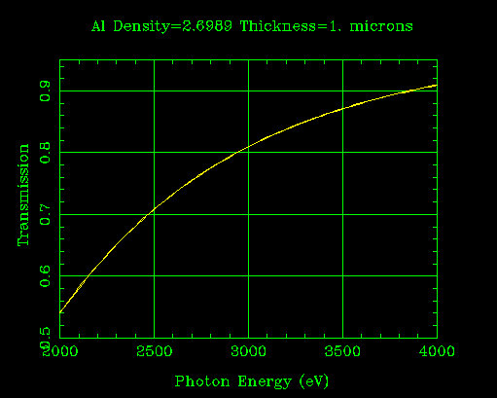
Dimensions
Device was built in the polarization plane due to space and in-vacuum motor issues.
The distance from sample to detector for smaller angles is up to 1.3 times as large as for the largest angles.
The shallower angles also mean that they go through a larger path on the Al layer covering the Jungfrau detectors.
Detector
159.06 mm
200.14 mm
50°
79.53 mm
100.7 mm
44.3 mm
21.15 mm
80°
Sample
120 mm
Curved crystal plane

Slide 7
Practical aspects
Signal is weaker at smaller Bragg angles (high energies) than at large Bragg angles (small energies) for each crystal.
Large field of view for photon energies: several hundred eV from 2-4 keV, up to a thousand eV if higher order reflections are used for higher photon energies.
Jungfraus have some noise issues at lower photon energies due to the noise cutoff, so an occasional bad pixel may pop up.
Jungfraus measure energy, not counts, so a high energy photon has more signal than a low energy photon. The effect can be accounted for but was neglected in the presented analysis
Smaller angles also mean that the effective thickness of the Al on the Jungfrau pixels becomes larger, decreasing sensitivity. This can be fixed fairly easily.
Despite all this, it seems to work fairly well!

Slide 8
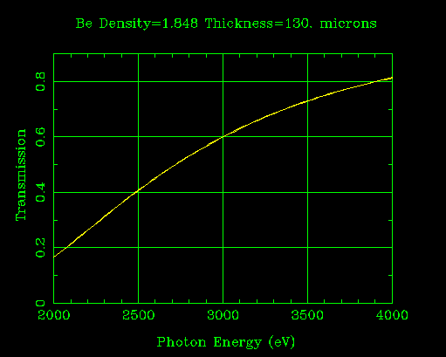
Setup on Alvra
Be window (130 um)
TXS on FLEX
Prime Chamber
KB Mirrors
Monochromator
X-ray
Prime and TXS both pumped down to about 5e-5 mbar
KB focused the beam to about 200 um RMS on the sample
Had to play with slits to get everything nicely through without cutting the beam.

Slide 9
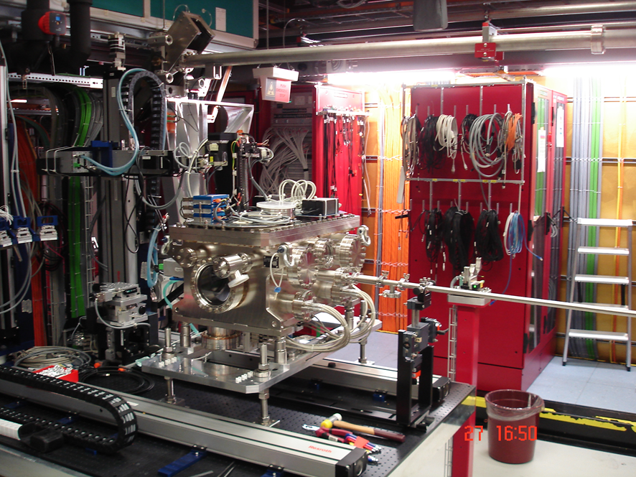
TXS chamber at Alvra Flex

Slide 10
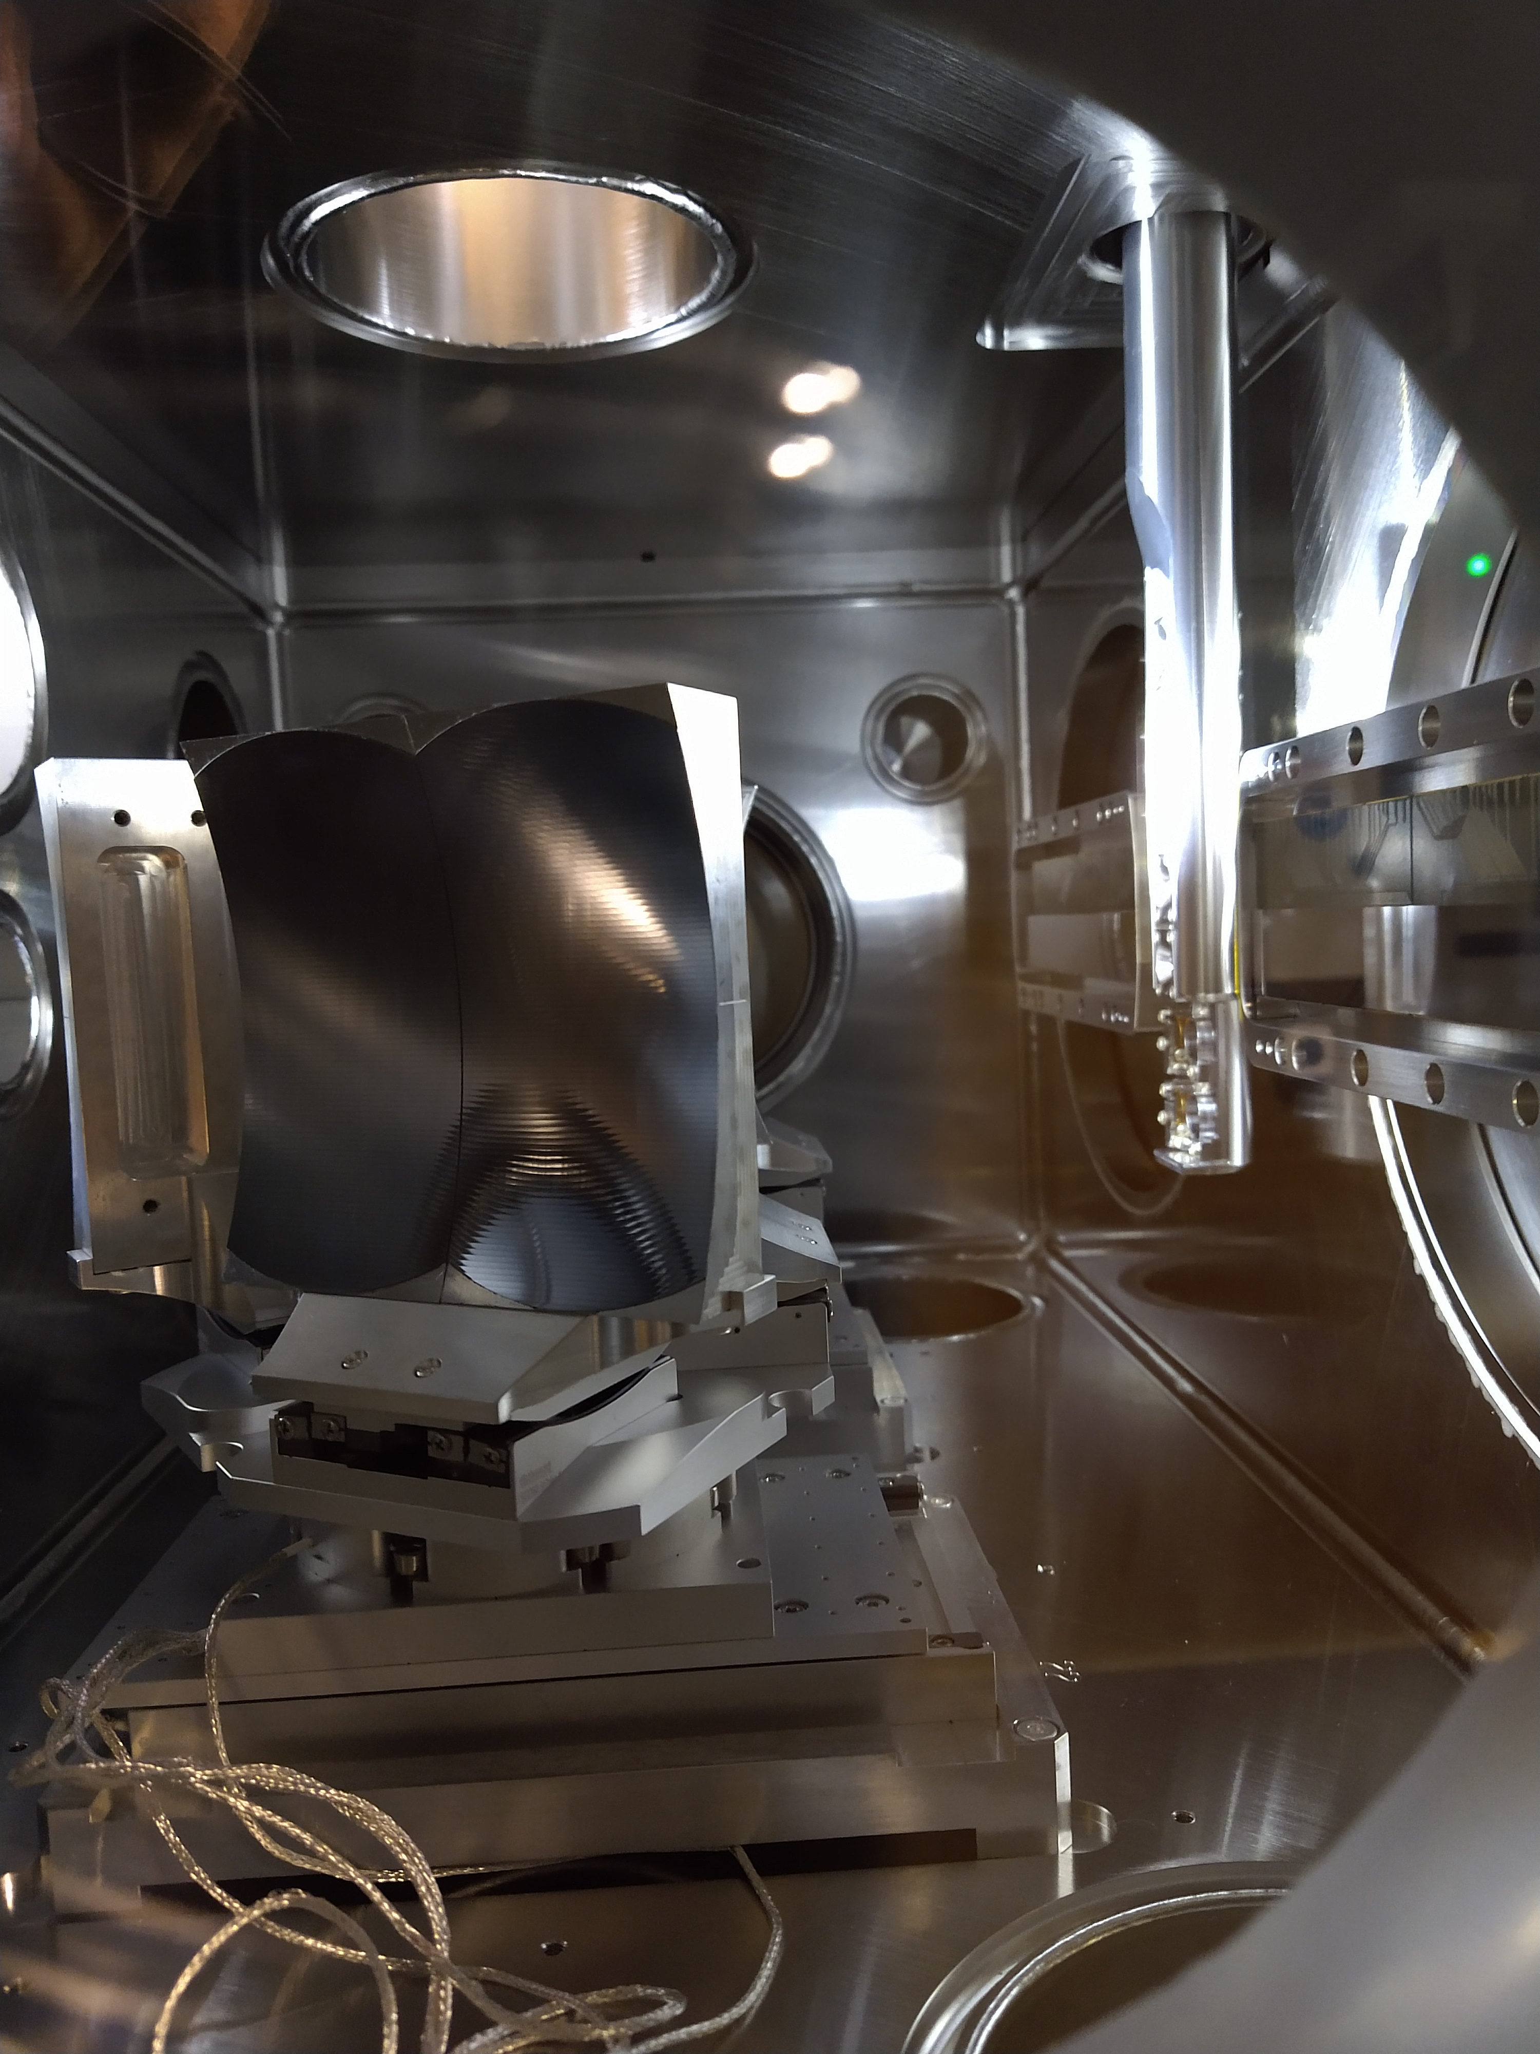
View from the inside
Curved crystals
Scattering foils stage
Jungfrau detectors:
New stripsels with dimension of 25x200 um
Smaract adjustment stages

Slide 11
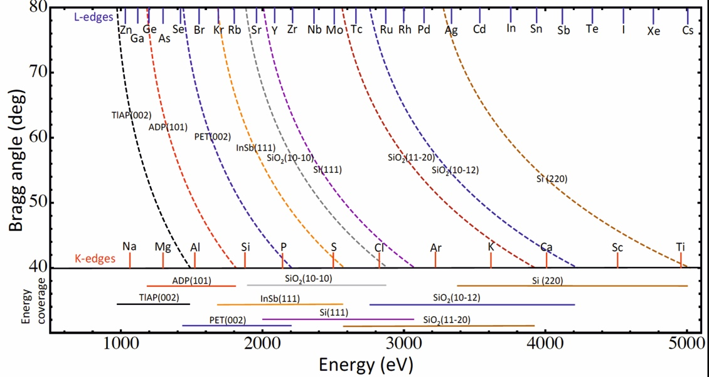
Angles and crystals used
All Bragg angles between 50 and 80 degrees!

Slide 12
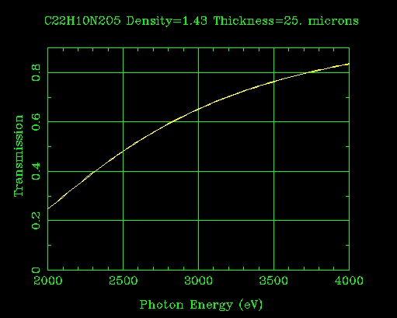
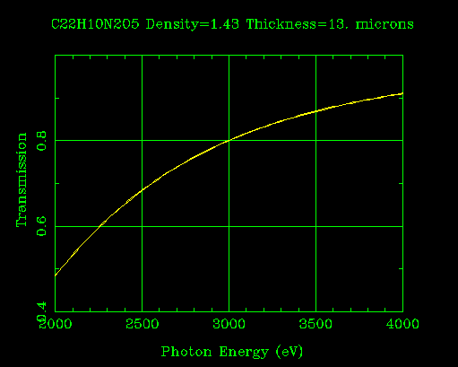
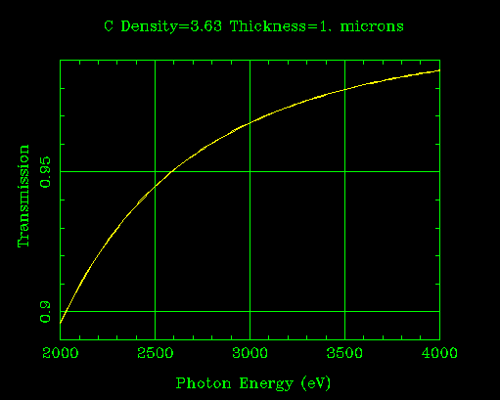
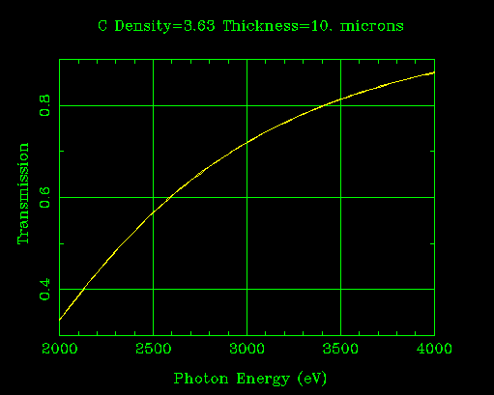
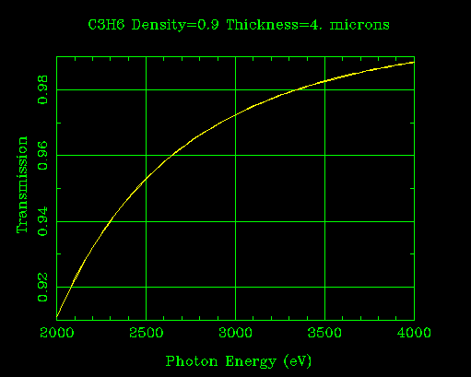
Sample Transmission
Kapton 25 um
Kapton 13 um
Diamond 1 um
Diamond 10 um
Polypropylene 4 um

Slide 13
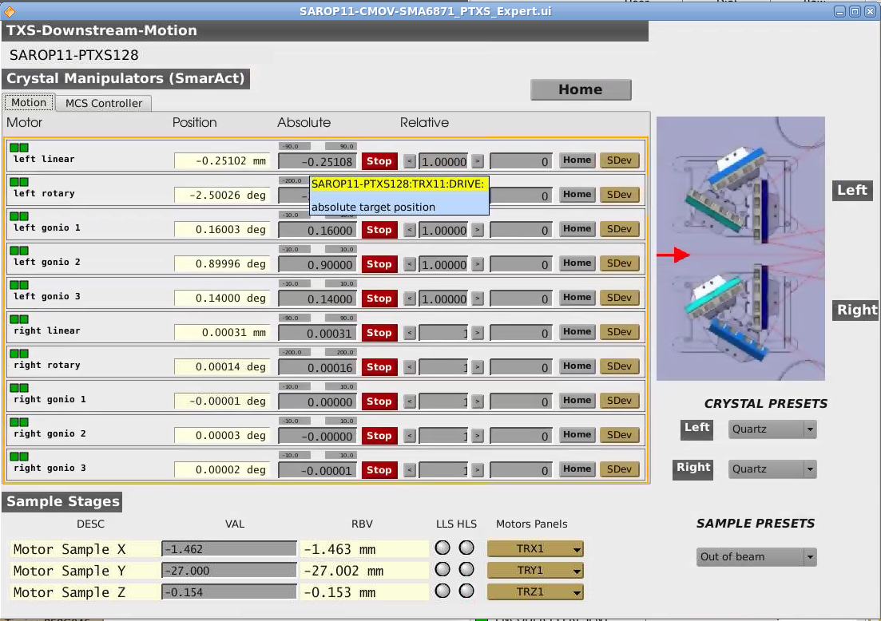
Control GUI setup
SF Launcher > Photons > Overview (expert) > SAROP11-PTXS128

Slide 14
Commissioning
Focus and align all the crystals (thanks Alvra team for the help) using calibration foils (like Pd).
Define energies with the monochromator.
Plot energies vs. pixel on the detector to get a calibration curve for each crystal.
Try out some fun stuff, like higher energies with higher a higher Bragg index (Si 333 for 6-7 keV).
Main point of commissioning was energy calibration—signals were not a main parameter due to parasitic operation and lack of time.

Slide 15
Getting calibration curves
Have to use the geometry, Bragg indices, math and fitting.
pixel=a*cot(asin(λ/d)+c)-b,
  where d is the lattice spacing (provided in the X-ray data booklet), and a, c, and b are fitting constants related to the geometry of the TXS.
We take the measured points and fit them to this formula, and then get the calibration curve. More points is obviously better.
We had time to take four to six points per crystal during the commissioning for the fits. For the final setup, 10 or so points would be better.

Slide 16
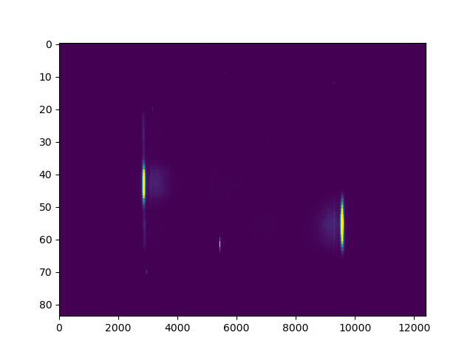
Raw Data (3.655 keV, Si 220, pink beam)
+eV
+eV
Sum vertically over selected areas
Detector 1
Detector 2

Slide 17
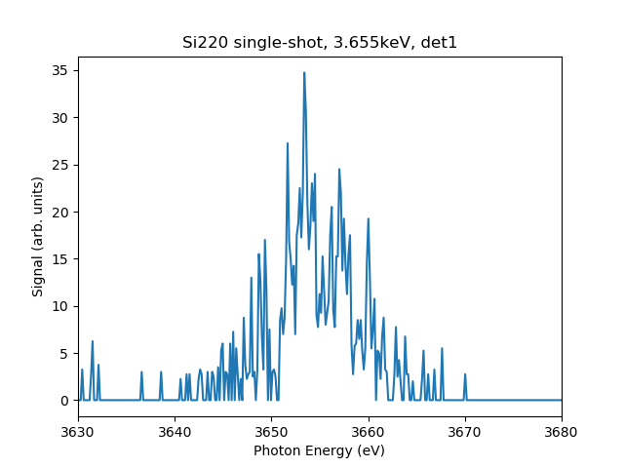
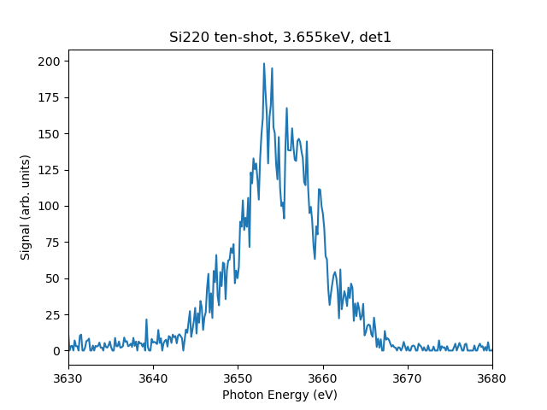
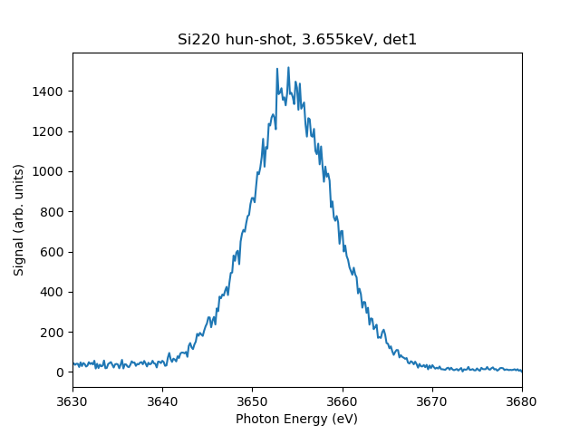
Si (220) data, 3.655 keV, 380 uJ

Slide 18
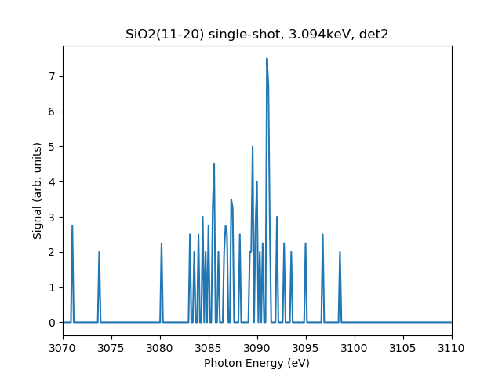
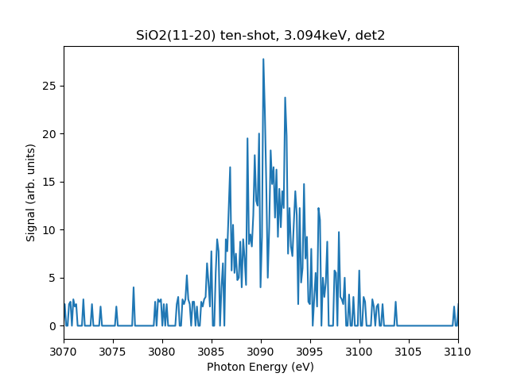
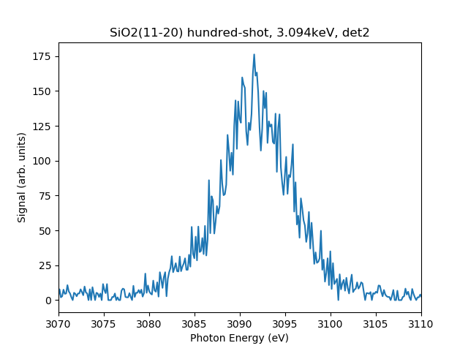
SiO2 (11-20) data, 3.09 keV, 290 uJ

Slide 19
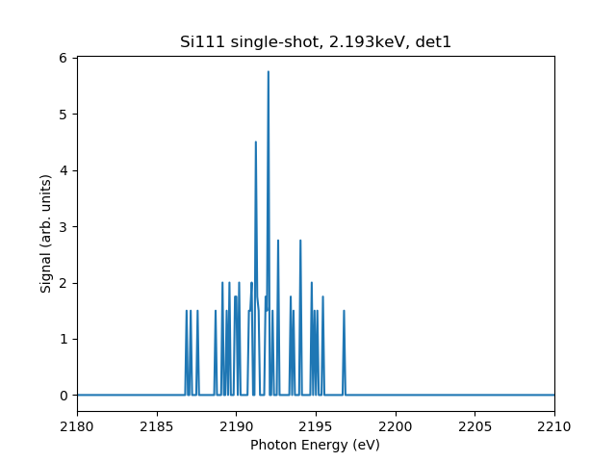
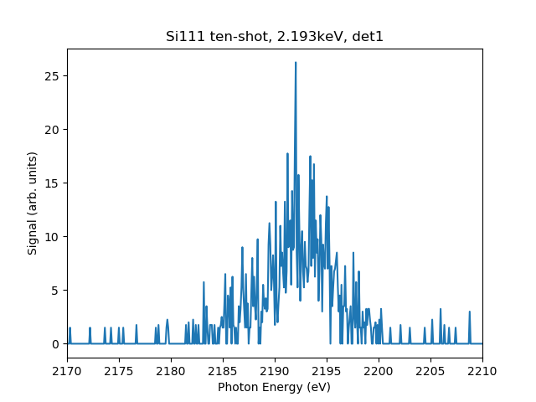
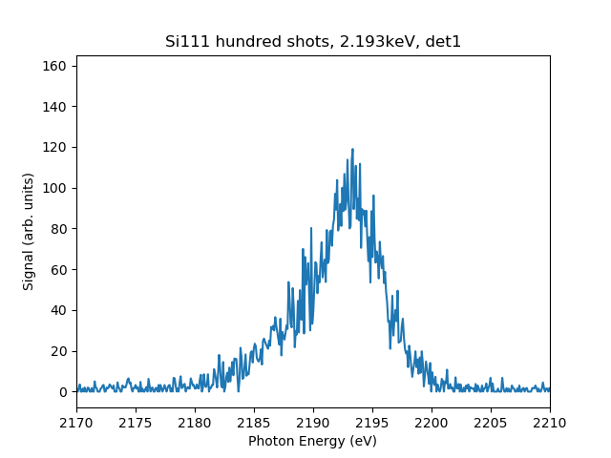
Si (111) data, 2.193 keV, 180 uJ

Slide 20
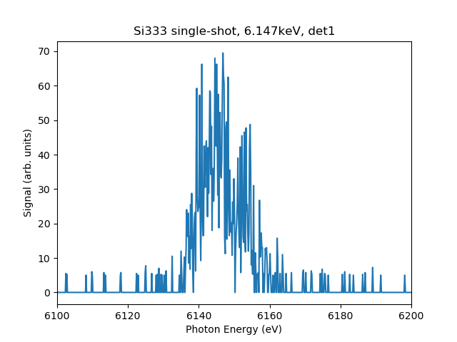
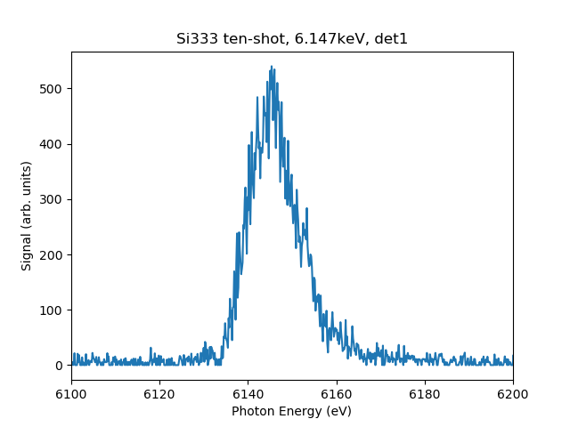
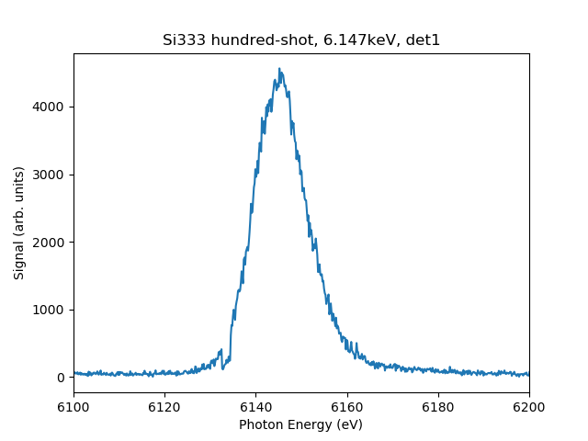
Si (333), 6.174 keV, pink beam, 330 uJ

Slide 21
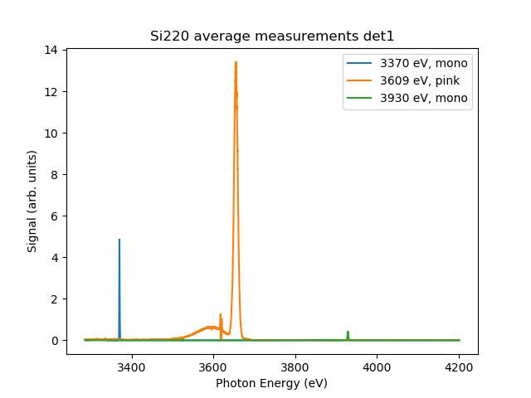
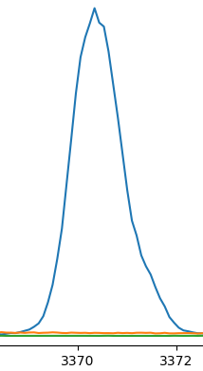
Three energies checked for each crystal: Si (220)
Average measurement, 25 um Kapton foil scatterer.
Transmission due to Be window: 60-80%, Pulse energy: 270-380 uJ.

Slide 22
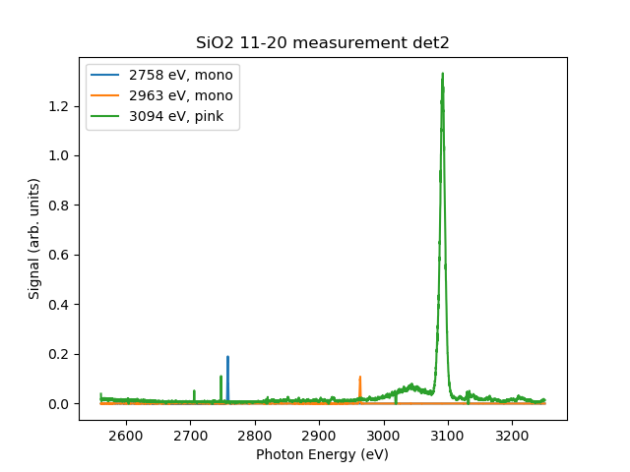
Three energies checked for each crystal: SiO2 (11-20)
Average measurement, 25 um Kapton foil scatterer.
Transmission due to Be window: 40-60%, pulse energy 200-270 uJ.

Slide 23
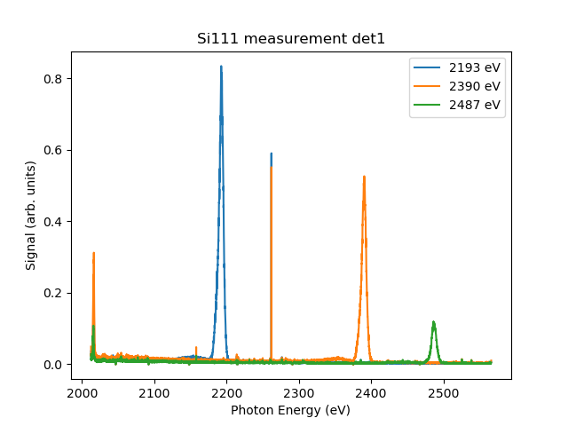
Three energies checked for each crystal: Si (111)
Bad pixel
Average measurement, pink beam, 25 um Kapton foil scatterer.
Transmission due to Be window: 20-35%, pulse energy 140-200 uJ.

Slide 24
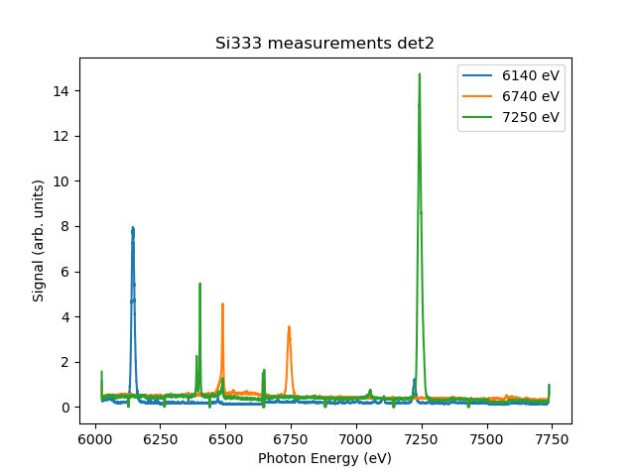
Three energies checked for each crystal: Si (333)
Average measurement, pink beam, metal rod as scatterrer.
Transmission due to Be window: 99%, pulse energy around 330 uJ.
Fluorescence from material

Slide 25
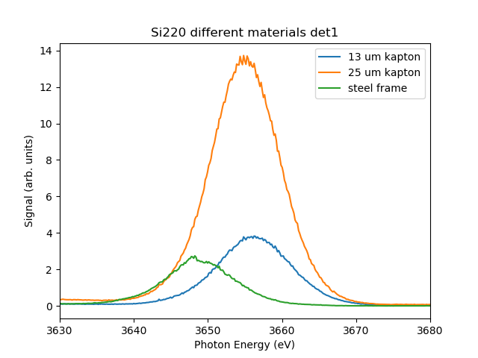
Different materials for scattering
Matches theory fairly well, so we can project other (simple) materials if anyone has anything they would like to try.

Slide 26
Pixel-to-energy calibration

Slide 27
Pixel-to-energy calibration

Slide 28
Pixel per eV

Slide 29
Pixel per eV

Slide 30
Expectations
Photon Energy (eV) | Average Count per pulse | Pulse Energy (uJ) | 130 um Be Transmission | 1 um+angle Al Transmission | Adjusted count | Pulse-energy adjusted
2193 | 111.53 | 142 | 0.247 | 0.613 | 736 | 1987
2487 | 90.6 | 195 | 0.402 | 0.635 | 355 | 697
3090 | 270.2 | 280 | 0.63 | 0.777 | 552 | 755
3600 | 3207 | 383 | 0.75 | 0.88 | 4860 | 4860
What we saw now
What we could have with 380 uJ, no Be window, and no Al on sensor
Bottom line: we would get a decent signal on a shot-to-shot basis if installed in the beamline and a slight change to Jungfrau detector shielding.
Aldo claims the removal of Al is simple to do, and we have another set of Jungfraus that we can prepare for it and swap out for this one—we have two TXS setups.

Slide 31
Conclusion and future
The commissioning was successful, and the TXS concept seems to work well.
D.O. is committed to provide the results of TXS signals beam-synchronously and on-line using the experience of data analysis of commissioning data.
The device can also be used as a large bandwidth spectrometer for higher photon energies, but then we need different crystals (not a hard thing to do).
Jungfraus can be altered slightly to be more sensitive to low-energy photons by removal of Al coating on the pixels.
Should this be installed? If so, where? Front-end could be a good option to provide information for setup. Original idea was to install it in Alvra (infrastructure there ready).
Girder is ready. We would need some cabling, rack space for Smaract and Jungfrau modules, and hole-boring for installation anywhere. A few days’ work.

Slide 32
Wir schaffen Wissen – heute für morgen
My thanks go to
Everyone on the first page of this presentation, and all the unsung heroes who brought us the (FEL) light in the darkness that was 2020.

