Slide 1
Bunch2 Control Algorithms Study
Zheqiao Geng
SPM, 02.03.2021

Slide 2
Motivation
https://ecm.psi.ch/share/page/document-details?nodeRef=workspace://SpacesStore/b674159a-3de2-4dcf-b2d4-2b90a4182938
Stabilize the beam parameters of bunch2 when the bunch1 feedback adjusts the amplitude and phase of the entire RF pulse
Regulate the bunch2 parameters (LH/BC1/BC2 energy and BC1/BC2 bunch length) using the RF pulse step ratio/phase of booster1 (SINSB01/02), booster2 (SINSB03/04), x-band and Linac1
Set up bunch2 with global optimization of the C-band delays (not successful yet with simple random walk optimization)

Slide 3
Transfer Matrix Measurement
Linear scanning of actuators one by one
Random stimulation of all actuators and fit a transfer matrix with CVX

Slide 4
Transfer Matrix Verification
Random inputs to all actuators, and compare the changes of beam parameters of the measurements and the simulations using the transfer matrix
Mnom: transfer matrix obtained from linear scanning
Mcvx: transfer matrix obtained from the random inputs and CVX optimization

Slide 5
Transfer Matrix for Feedback Test
BST1 step ratio
BST1 step phase
BST2 step ratio
BST2 step phase
X-band step ratio
X-band step phase
Linac1 step ratio
Linac1 step phase
laser heater energy (mm)
BC1 energy (mm)
BC1 compression
BC2 energy (mm)
BC2 compression
= M *
sensors
actuators
0.3385 0.1069 0 0 0 0 0 0
0.8773 -0.2133 1.5419 -0.1074 -1.1883 -0.1488 0 0
-0.2595 -0.7758 -0.4646 -0.2012 -0.0350 0.5289 0 0
-0.6611 0.2068 -1.5902 0.0827 1.2065 -0.0745 -1.1228 3.0440
0.3997 -0.2742 0.7233 -0.0470 -0.7852 0.2295 0.8569 -0.5463
M =
Singular values of M: 4.32, 1.77, 1.09, 0.56, 0.30
Condition number: 14.3
Ill-conditioned, the inversion of M suffers from model inaccuracy.

Slide 6
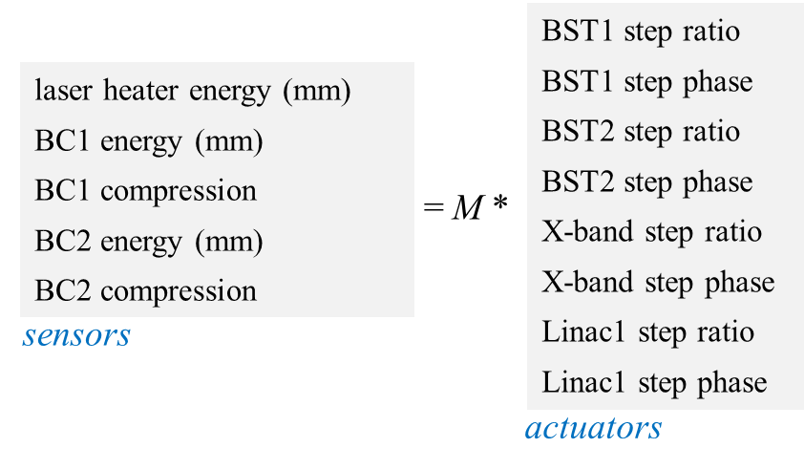
Feedback Strategy
General control architecture for a static MIMO system
Dynamical Control
Transfer Matrix Inversion
r
+
Integral Control
u
Plant
y
-
Plant input u: 8×1 vector
Plant output y: 5×1 vector
Set point r: 5×1 vector
inv(M): 8×5 matrix
Plant: 8 inputs and 5 outputs

Slide 7
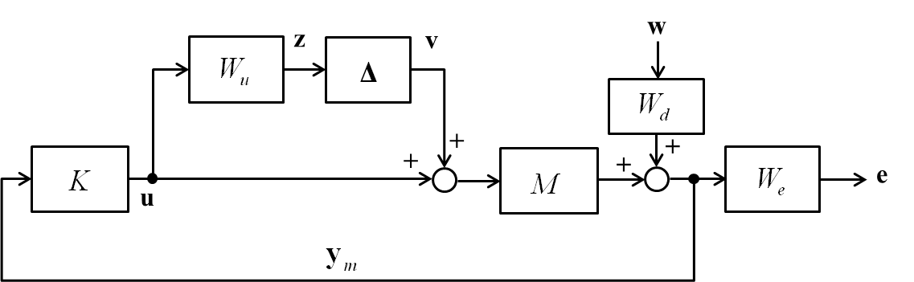
Inversion of Transfer Matrix
Three methods were tested:
SVD-based:
Regularization by λ ≥ 0:
Robust Control:
Design matrix K using the robust control methods and obtain the inversion of M as
inv(M) is directly synthesized from the optimization process.

Slide 8
Step Response - Sensors

Slide 9
Step Response - Actuators

Slide 10
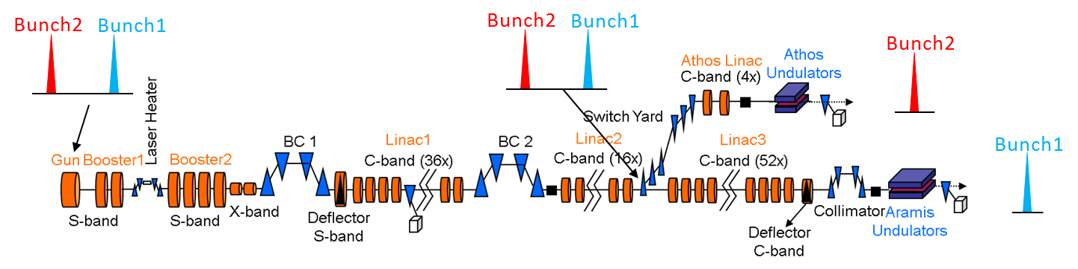
Conclusions
Global MIMO control of bunch2 is possible – feedback tools can be implemented to stabilize bunch2, and therefore, decouple the crosstalk from adjusting bunch1. The results are also promising for Porthos 3- or 4-bunch operation using the RF pulse steps as tuning knobs
The algorithms based on regularization and robust control are available for usage in other similar systems – static MIMO control with model uncertainties

Slide 11
Questions?

