Slide 1
Rf energy calibration
D. Voulot, SPM 02.03.2021

Slide 2
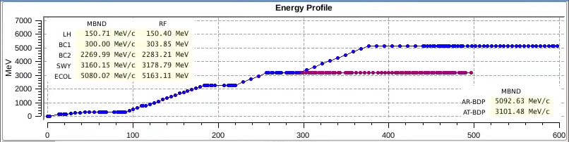
Current status
Rf energy gains which are used for the energy server (epics) and the magnet strength channels (KL channels) disagree with the dipole energies
Error up to 1.5%
Problem for the optics, the gas detector (wrong photon energy) etc

Slide 3
Dipole calibration
Dipole are normally the energy reference
We cannot degauss our beam dump and E-col magnets
Best to calibrate dipoles against photon energy (assuming K is known)
If K is not known we cannot have an absolute calibration
But we can at least make sure that everything (electron energy, photon energy and K) is consistent

Slide 4
B2P-CAL
The MBNDs have a calibration factor channel to tweak the dipole energy:
S10DI01-MBND100:B2P-CAL. 1.00000
S10BC02-MBND100:B2P-CAL. 1.00000
S10MA01-MBND100:B2P-CAL. 1.00000
S20SY02-MBND200:B2P-CAL. 1.00000
SARBD01-MBND100:B2P-CAL. 1.00090
SATBD01-MBND200:B2P-CAL. 1.00000
SATUN14-MBND100:B2P-CAL. 1.00000
SINBC02-MBND100:B2P-CAL. 1.00000
SINEG01-MBND300:B2P-CAL. 1.00000
SINLH02-MBND100:B2P-CAL. 1.00000
SATSY01-MBND200:B2P-CAL. 1.00000
SATSY01-MBND400:B2P-CAL. 1.00000
SARCL02-MBND100:B2P-CAL. 0.99650
SATSY02-MBND100:B2P-CAL. 1.00000
SATCL01-MBND100:B2P-CAL. 1.00000
Calibrated against PSSS
This is changing with the orbit in the ECOL, the MBND needs to be cycled
Calibrated against PSSS

Slide 5
Calibrating energy stations
RF provides two channels to calibrate the RF energy gain
  [STATION]-RSYS:SET-VOLT-POWER-SCALE MW/MV^2
  [STATION]- RSYS:SET-VSUM-AMPLT-SCALE MV/dig
We need to know the energy gain of the station
  Compare beam energy in a dipole with and without the station
  Get energy gain from large phase scan in dispersive section

Slide 6
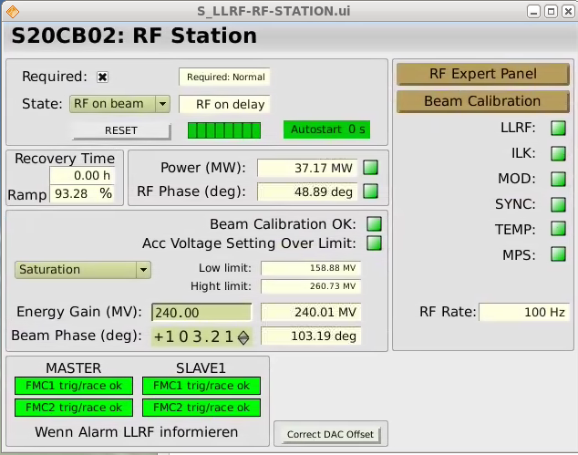
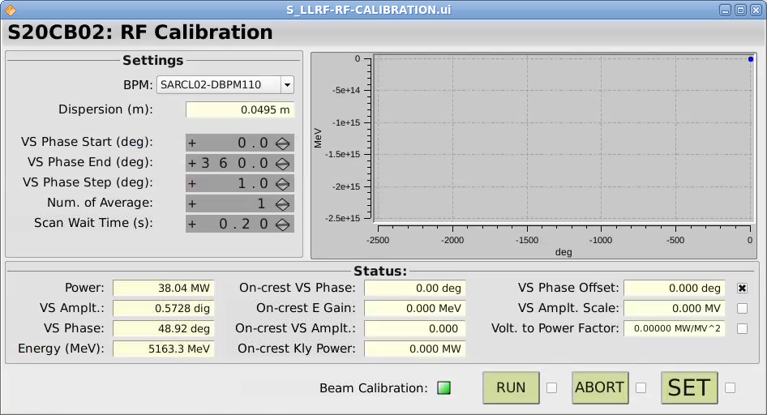
Energy calibration form phase scan
Faster, systematic, relatively precise for high energy (larger phase scan)
Only relative: need to know the dispersion at the BPM
Use pshell script to adjust global energy gain of full linac keeping the relative energy gain distribution

Slide 7
Summary
Calibrate dipoles against PSSS energy
Measure relative energy gain of each station (phase scan or manually)
Scale global energy gain
This can be repeated if dipole/PSSS calibration or K calibration is changed
Adapt reference files (snapshot, optics) to new calibration

