Slide 1
Proposed Current measurement for Diamond II
Alun Morgan

Slide 2
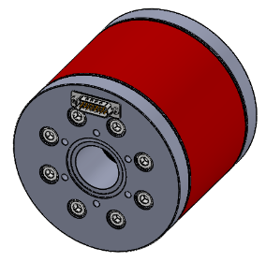
Current measurement
Most likely: in flange NPCT from Bergoz (along with electronics)
  Mainly due to space considerations
    120mm long,
    ~134mm outer diameter (dependent on shielding)
    Inner diameter determined by pipe geometry (20mm in the storage ring)
  Will have to be installed after the vessel bakeout due to a damage temperature of 80ºC
  Bergoz is currently investigating adding additional RF shielding as the DCCT may have to be placed closer to the magnets than before due to the more crowded lattice design.
https://www.bergoz.com/products/non-destructive-dc-beam-current-measurement/

Slide 3
We plan to install a DCCT in each of the booster and storage rings.
  This is to replace the existing devices
 | Diamond | Proposed NPCT for Diamond-II
Temperature drift (μA/K) | < 30 | 5
Magnetic field sensitivity (μA/mT) | 100 | 10 (with standard shielding)
Resolution (μA rms @1 Hz) | 10 | Standard model < 5 High Resolution model < 1 Very High Resolution model < 0.5

