Slide 1


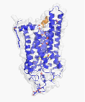
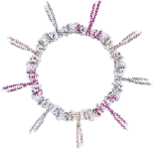
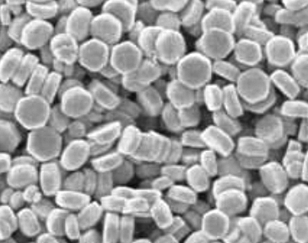
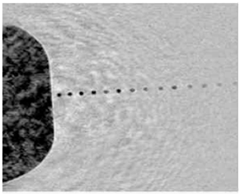
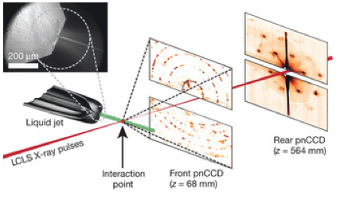
Femtosecond analysis
of protein nanocrystals and supramolecular complexes
Valérie Panneels, Ching-Ju Tsai, Xiao-Dan Li, Guido Capitani, Michel Steinmetz and Gebhard Schertler
Laboratory of Biomolecular Research (BMR)
Screening of nanocrystals
Standfuss et al. Nature 2011
Kitagawa et al. Cell 2011
Nanocrystal Spence gun
~ 1 m
X-ray pulses
>8 keV
>10¹¹ photons/pulse
pulse length < 50 fs
beam size
5-10µm
adapted from Chapman et al. Nature 2011

