Slide 1
MD week 48 report
E. Prat
SEM meeting, November 30

Slide 2
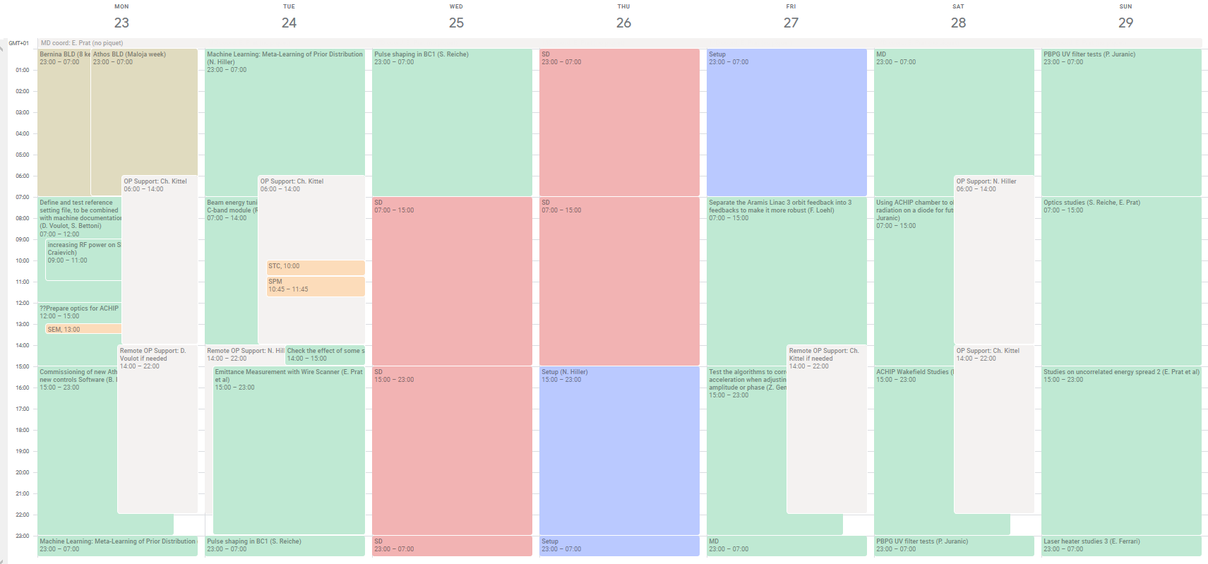
Overview
Machine learning
BC1 pulse shaping
ACHIP wakefield studies
SINSB02 power increase
Linac 3 orbit feedback
OTR in ACHIP
Optics checks with bunch 2
Energy tuning with C-band
Energy spread
laser heater
optics- WS
Startup, design optics
2-bunch LLRF
ACHIP wakefield studies
Athos BPMs
Emittance with WS
Week roughly as planned – few changes (design optics set already on the startup and some other swaps)
No major issues
Notes:
2

Slide 3
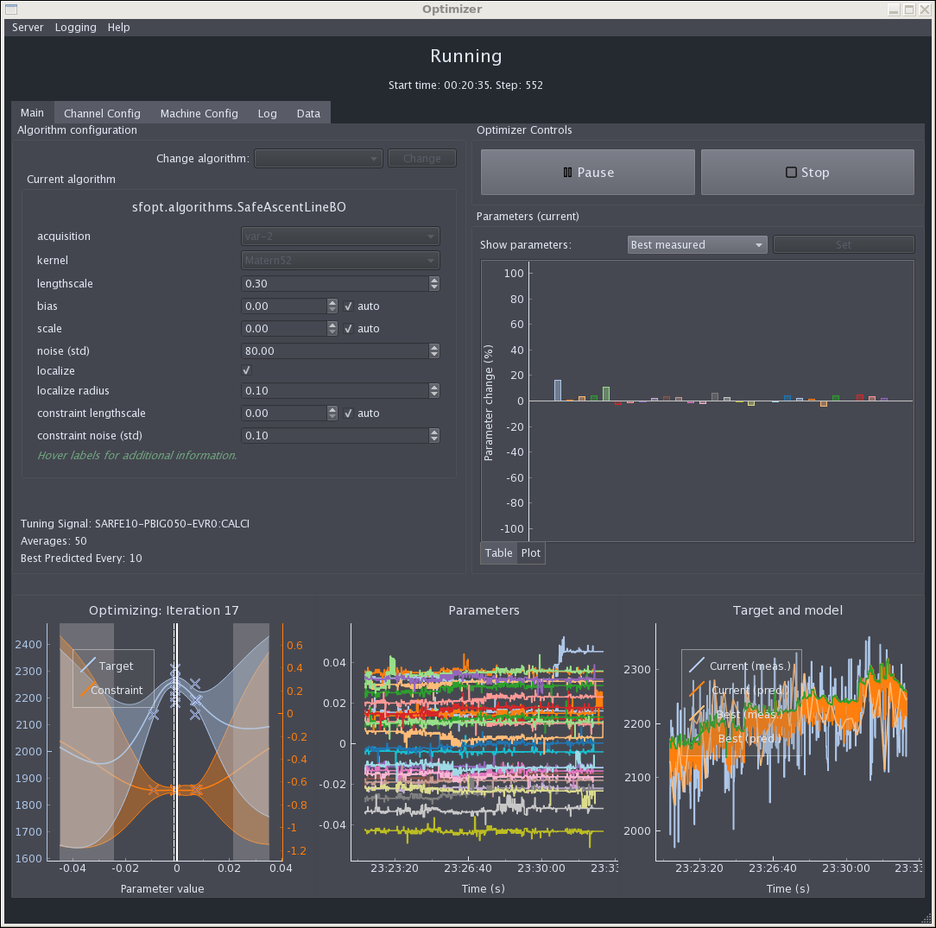
Machine learning
Courtesy of N. Hiller
Tested new server deployment (can now be (re-)started via “restart_mlopt” (the GUI can still be started via “start_opt_gui.sh”
Deployed updated GUI version that now has a more sophisticated data browser and many helpful tool tips concerning the different hyperparameters
Tool is now ready to be used -> Nicole will add documentation
Tested a configuration for Athos -> works in principle, but it’s not yet easy to switch between Aramis and Athos, we will prepare a separate server for Athos to allow parallel operation
Tested a new Bayesian optimization algorithm that does more local sampling which looks also promising
Mon 23.11.2020 Night shift
Participants: Nicole Hiller, Johannes Kirschner (ETHZ)

Slide 4
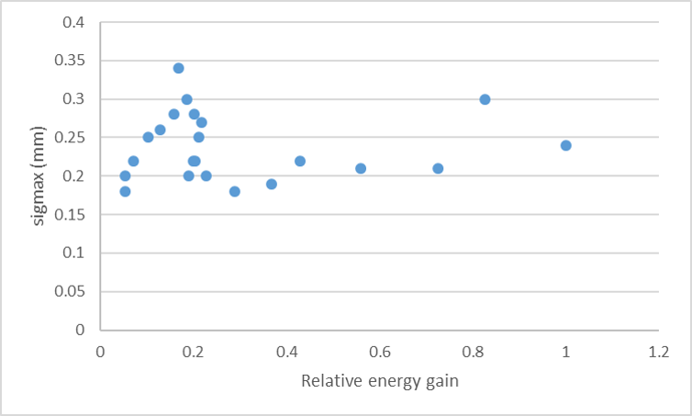
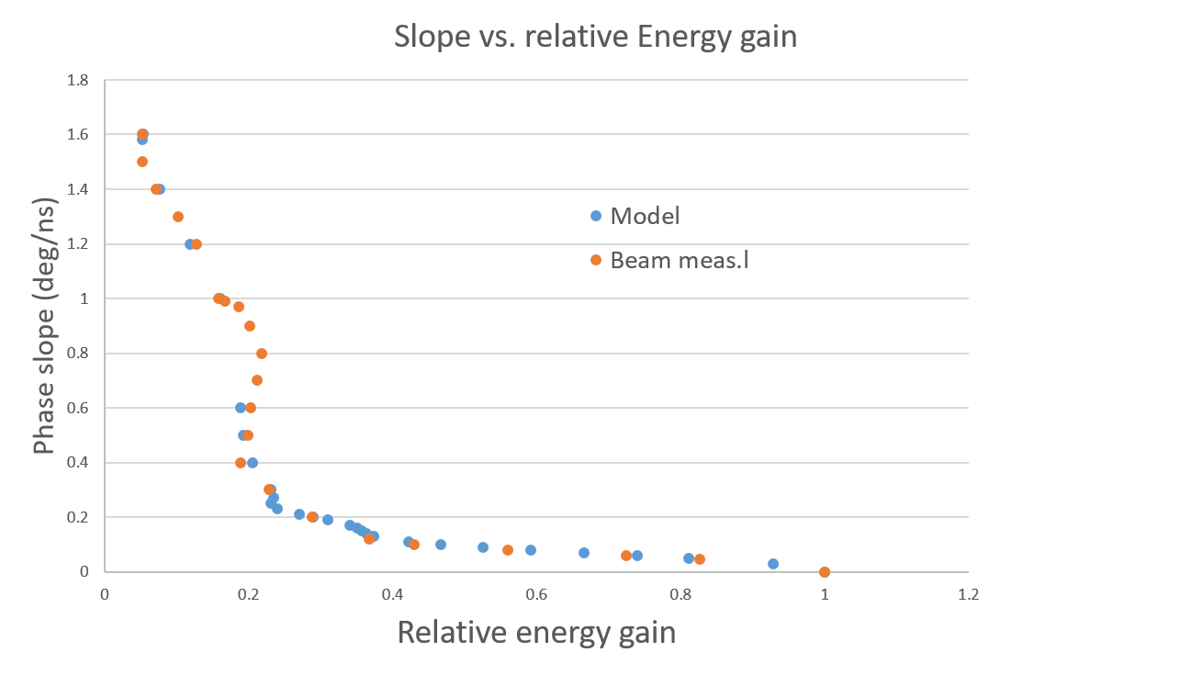
C-band tuning with phase slope and offset
R. Zennaro, Q. Geng, P. Craievich, C. Kittel
Goal: vary energy gain of 1 C-band module without changing energy spread with phase slope and offset – important for Athos tuning
Measurements at S10CB01/02. Energy varied between 13 to 250 MeV
Energy spread constant for different energy gains
Excellent agreement between measured and expected phase slope/offset for different energy variations
Next: create lookup table for LLRF
More info: https://elog-gfa.psi.ch/SwissFEL+commissioning/17181
Energy spread estimation vs energy gain
Model and measured phase slope vs energy gain
Notes:
4

Slide 5
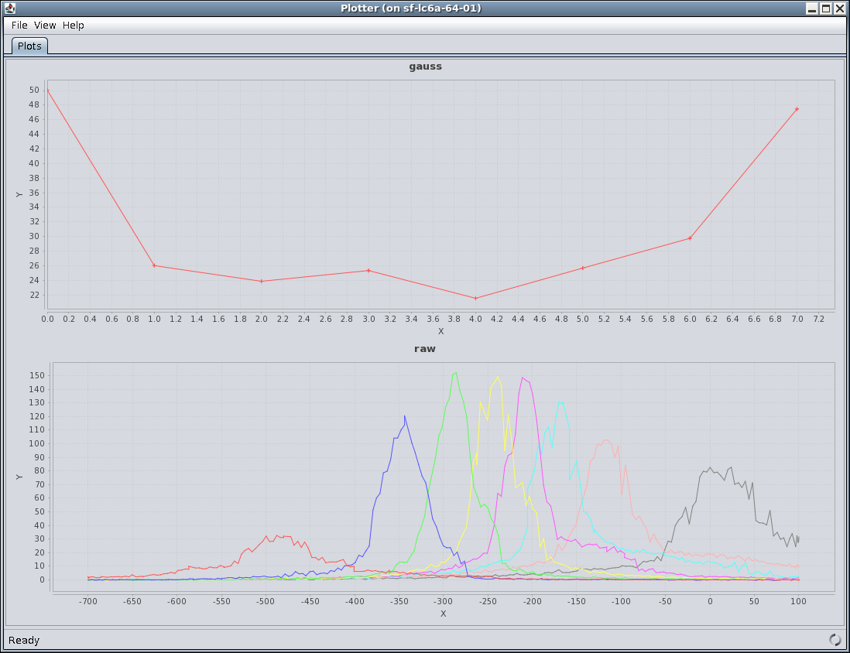
Emittance measurements with wire-scanners
P. Dijkstal, E. Ferrari, B. Hermann, R. Ischebeck, S. Reiche, E. Prat
WS better than screens to measure emittance and match the optics at the linac end
Tested emittance measurements with WS at SARCL and SARMA:
  SARCL not suitable (as seen in the past): signal-to-noise ratio poor, DRPS losses
  SARMA much better: good signal-to-noise, no losses
Measurements confirmed the need to use the WS
Need work to improve robustness and easiness of the measurement
More info: https://elog-gfa.psi.ch/SwissFEL+commissioning/17182
Wire-scanner measurement in X
Results at SARMA | X | Y
Screen | 740 nm, M=2.35 | 1350 nm, M=1.03
Wire | 420 nm, M=1.05 | 245 nm, M=2.0
Notes:
5

Slide 6
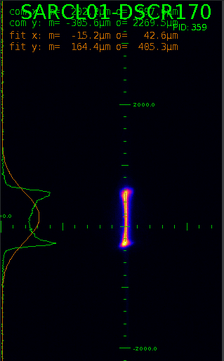
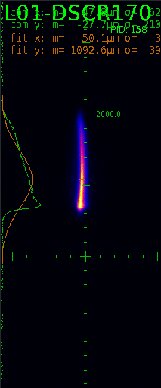
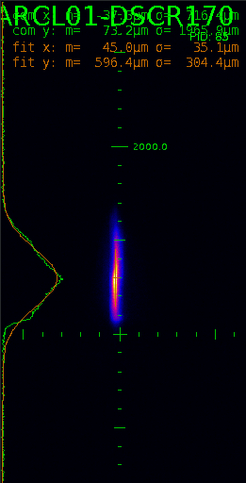
Pulse shaping in BC1
S. Reiche
Scrapping the beam in BC1 can remove the horns, give a smoother current profile and more robust operation
Adjusted BC1 collimator to cut the horns (15% of the total charge). LLM limits rate to 10 Hz
RF adjusted to get symmetric profile
CDR drops a lot, normally running mostly on the horns
Pulse energy reduced from ~400 to ~200 uJ
Next: optimize compression for flatter current profile, maximize pulse energy
After RF tuning
After scrapping
Initial profile
More info: https://elog-gfa.psi.ch/SwissFEL+commissioning/17196
Notes:
6

Slide 7
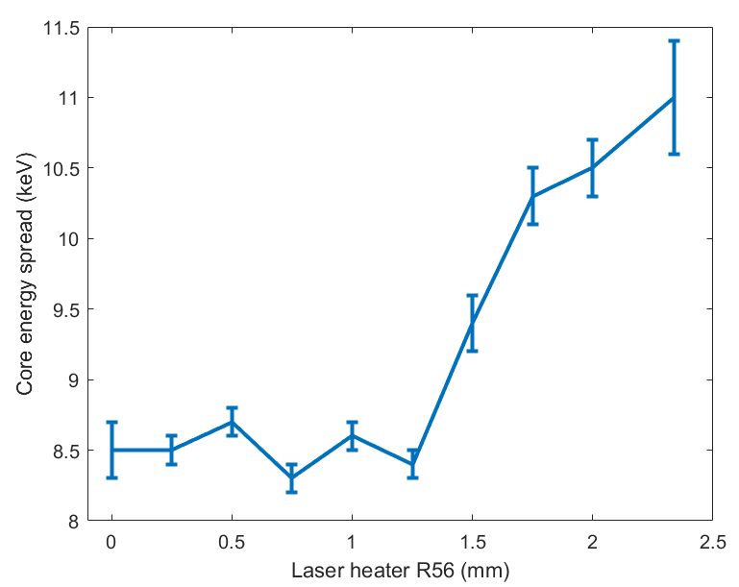
Energy spread & laser heater measurements
Re-measured injector energy spread vs laser heater R56, without laser heater (now with properly calibrated R56) → lower values for R56<1.5 mm (similar as previous meas.).
From 11 to 8 keV → 10-20% higher pulse energies
Measured effect of laser heater on energy spread for nominal and reduced R56
We decided to stay at R56=1.2 mm, laser heater ready to be used (laser heater did not have a positive influence on lasing when we had ~200 uJ)
New point
Usual point
P. Dijkstal, E. Ferrari, M. Huppert, A. Malyzhenkov, E. Prat, S. Reiche
https://elog-gfa.psi.ch/SwissFEL+commissioning/17286
Notes:
7

Slide 8
Others
Increase of SINSB02 power (RF + operations, Monday morning): energy gain increased by ~10 MeV – energy at laser heater is now 150 MeV.
Athos BPMs (Boris, Monday late): scaling factors of SATUN04/06/07/08/09 calibrated in X and Y.
Startup with design optics on Thursday
Linac 3 orbit FB (Florian, Friday morning): feedback split in 3 parts to improve reliability
2-bunch RF setup (Qiao, Friday late): https://elog-gfa.psi.ch/SwissFEL+commissioning/17247
OTR in ACHIP (Pavle et al, Saturday morning): https://elog-gfa.psi.ch/SwissFEL+commissioning/17268, see separate report
Gas detector filter studies (Pavle et al, Saturday): see separate report
ACHIP shift (Benedikt et al, Saturday): https://elog-gfa.psi.ch/SwissFEL+commissioning/17272
Notes:
8

