Slide 1
FCC-ee injector update & Positron source test at PSI
Paolo Craievich on behalf of the collaboration team :: Paul Scherrer Institut
SwissFEL Progress Meeting, 30th March 2021

Slide 2
Outline
Introduction
    Motivations and Swiss CHART Funding
    FCC-ee Injector Complex Update Overview
Positron sources
  FCC-ee Injector parameters and overview of the positron sources
  Adiabatic Matching Devices
  Studies for FCC-ee
Positron source experiment at SwissFEL
    Transfer line and area for the experiment
    Experiment layout
    First simulation results
Conclusion and outlook

Slide 3
Outline
Introduction
    Motivations and Swiss CHART Funding
    FCC-ee Injector Complex Update Overview
Positron sources
  FCC-ee Injector parameters and overview of the positron sources
  Adiabatic Matching Devices
  Studies for FCC-ee
Positron source experiment at SwissFEL
    Transfer line and area for the experiment
    Experiment layout
    First simulation results
Conclusion and outlook

Slide 4
Motivations – just an attempt
First idea to involve PSI came up at FCC week in June 2019 (FCC project leader and GFA management)
  Cost estimate for the Injector Complex as in CDR0 published in 2018: PSI RF technology for RF guns and accelerating structures – PSI had some on-going collaborations
  Proposal to use a SC solenoid instead of a flux concentrator in the positron source. This approcah would also profit from synergies with the CHART activities on superconducting high-field magnets for FCC-hh.
  In addition using large acceptance S-band accelerating structures for the positron capture system
Kick–off meeting in October 2019
  Definition of the organizational structures and administrative aspects → proposal for CHART
  Proposal for a positron source at SwissFEL → synergy with the Porthos beamline (transfer line and beam dump)
End 2019, RF section in charge to write the proposal to be submitted to CHART II

Slide 5
What is CHART?
Curtesy L. Rivkin
Chairman CHART-Council: Prof. Dr. Hans Rudolf Ott (ETH)
Chairman CHART Executive Board: Prof. Dr. Leonid Rivkin (PSI)
Coordinator CHART activities: Stefan Keller (PSI)
12 on-going projects funded by CHART-2, at PSI: HTS bulk undulator, MagDev1, FCC-ee Injector

Slide 6
CHART proposal at a glance
The CHART council approved the proposal in June 2020 to finance the FCC-ee Injector update studies and the proof of principle experiment for a positron source at PSI/SwissFEL facility
  Collaboration between PSI and CERN with several external partners (IJCLab, INFN-LNF, BINP, KEK…)
  Duration 4 years (from September 2020) + to be considered 1 year extension 😅
  Goals:
    review of the actual CDR0/Injector and write a CDR+/Injector with cost estimate (published in 2018) – deadline end 2023
    Positron source at PSI/SwissFEL – deadline end 2024

Slide 7
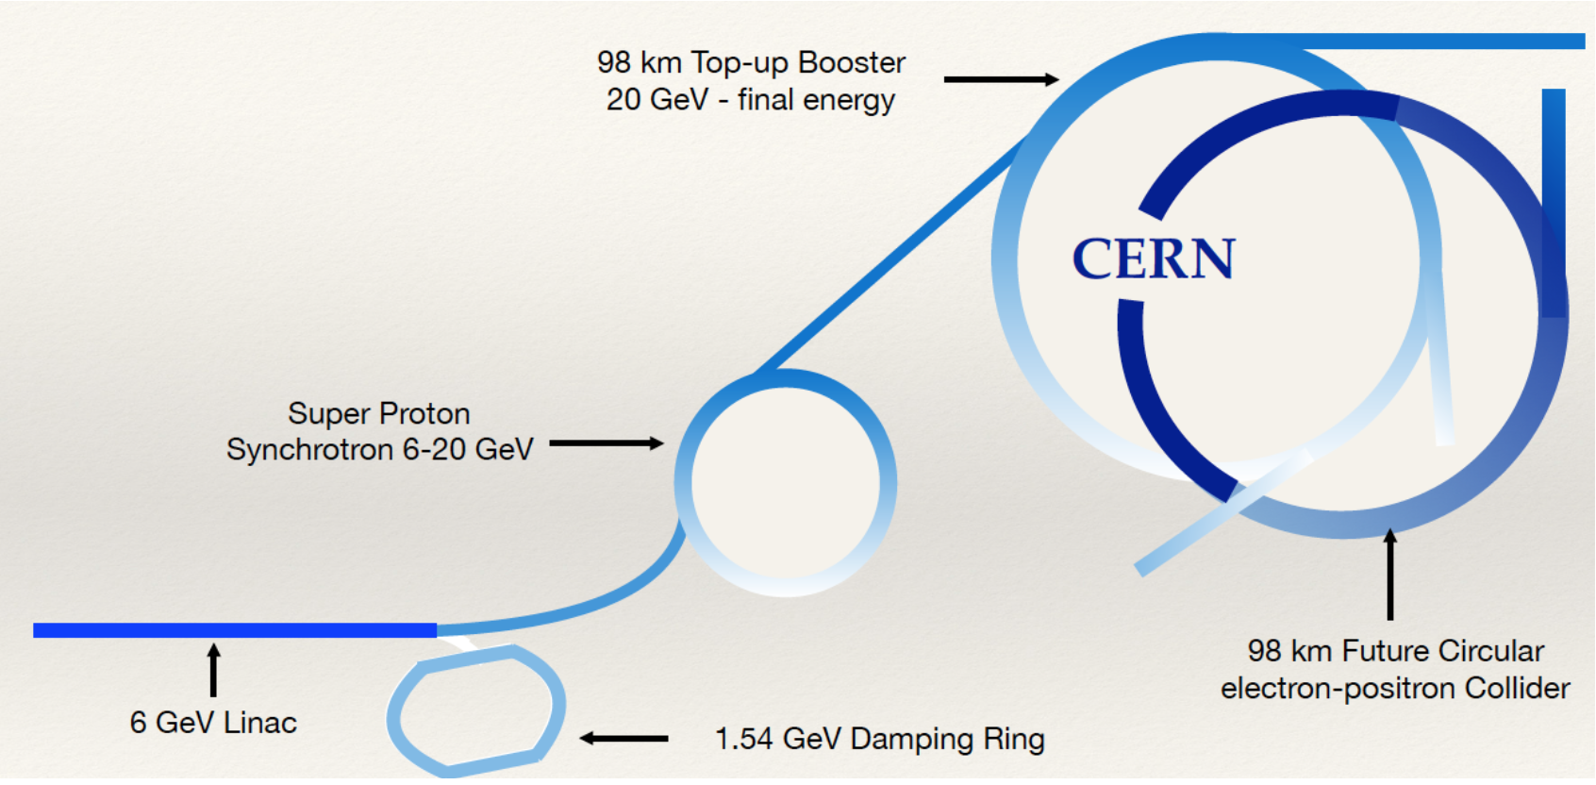
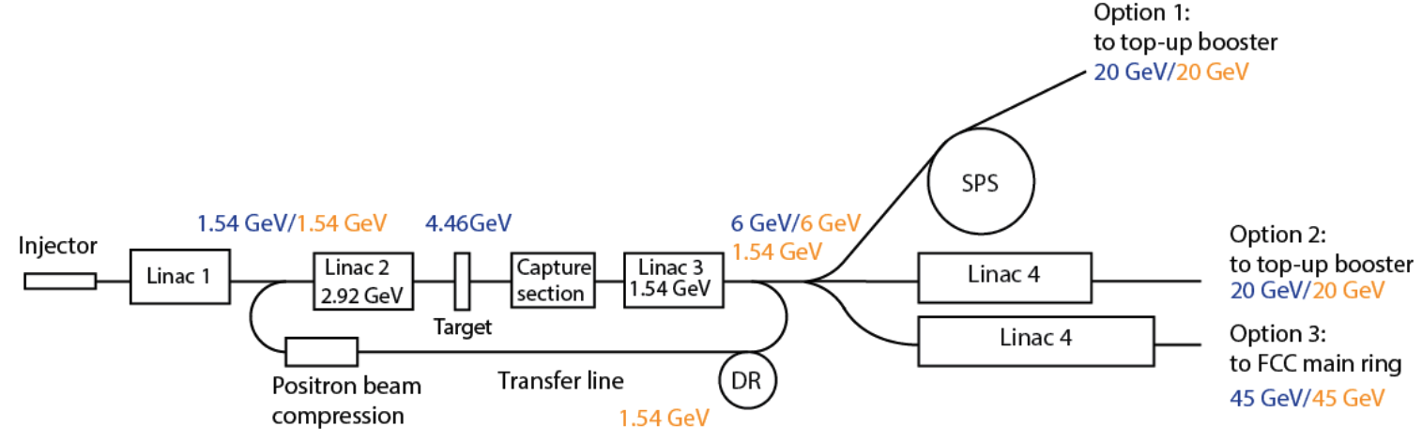
Introduction (FCC-ee Injector Complex Update)
Main Ring and booster ring (98 km) – 45 GeV
e-/e+ linac up to 6 GeV, 1.54 GeV Damping Ring
SPS as a Pre-Booster Ring (6 - 20GeV)
Booster Ring (20 → 45 GeV)
The main 6 GeV linac hosts the e+ source. The positrons are produced with 4.46 GeV e- beam
Baseline in CDR0/Injector
As alternative options for the FCC-ee Injector, a 20 GeV or a 40 GeV linacs are proposed to provide the direct injection into the main booster or main ring

Slide 8
Work packages Overview
WP0. Coordination (PSI/CERN)
Task 0.1 Coordination
Task 0.2 Overall parameter optimization
Addendum between CERN and PSI
WP1. e+/e- 6 GeV Injector Linacs
A. Grudiev (CERN)
WP2. Electron and positron Linac extension study (Linac 4)
J.-Y. Raguin (PSI)
WP3. Positron source: target and capture system
(IJCLAB/PSI)
I. Chaikovska (IJCLab)
WP4. Damping ring and transfer lines
C. Milardi (INFN/LNF)
WP5 CDR+, all partners
WP6. Proof of Principle positron source and capture in SwissFEL
R. Zennaro (PSI)

Slide 9
Layout of the injector 6 GeV (20GeV)
S-band
S-band
C-band
Positron production
Electron production
Outcome from WP0.2 meetings leading by A. Grudiev

Slide 10
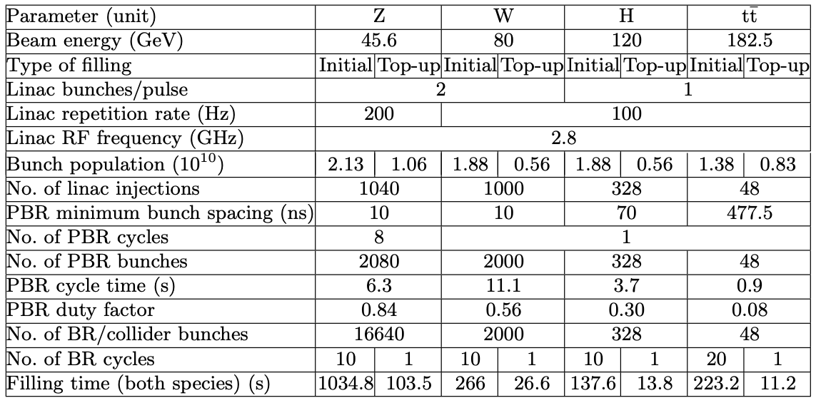
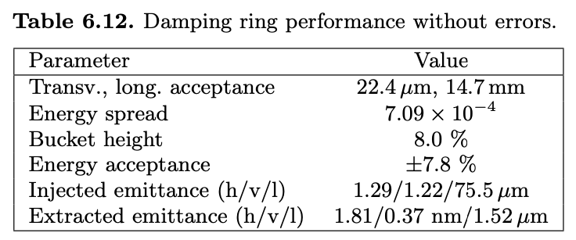
FCC-ee Injector Parameters
Charge both species 3.4 nC
Luminosity in e⁻e⁺ colliders is proportional to the bunch population and to the average flux of particles and inversely proportional to the interaction point beam sizes. A main limitation on the optimization of all these parameters is the positron source!
Damping ring
The normalized emittances of the positrons produced by the source is of the order of 8000-10000μm → necessary a damping ring to reduce the emittances by orders of magnitude

Slide 11
Outline
Introduction
    Motivations and Swiss CHART Funding
    FCC-ee Injector Complex Update Overview
Positron sources
  Overview of the positron sources
  Adiabatic Matching Devices
  Studies for FCC-ee
Positron source experiment at SwissFEL
    Transfer line and area for the experiment
    Experiment layout
    First simulation results
Conclusion and outlook

Slide 12
Overview of (some) Positron Sources
 |  | SLC | LEP | KEKB | SKEKB | DAFNE
Type |  | Linear | Circ. | Circ. | Circ. | Circ.
Drive e- beam | GeV | 33 | 0.2 | 4.3 | 3.5 | 0.19
Charge | nC | 4.8-8 | 0.8-48 | 10 | 10 | 1.9
Rep. rate | Hz | 120 | 100 | 50x2 | 50x2 | 50
Beam power | kW | 20-30 | 1kW (max) | 4.3 | 3.5 | 18
Poistron yield |  | 1.1 | 0.003 | 0.1 | 0.4 | 0.016
SLC (not in operation anymore) is the positron source model for existing and future colliders: DAFNE, KEKB, PEP-II, Beijing Tau-charm, SuperKEKB, FCC-ee, CLIC, ILC and LHeC
SuperKEKB has recently commissioned the upgraded injection system and has achieved a positron yield of 0.5 at 3.5 GeV (status of art of the positron source in operation) → assuming this as a baseline for FCC-ee positron source, this means we need an electron bunch of 6.8 nC to generate the positron!

Slide 13
How the Adiabatic Matching Device (AMD) work
SLC positron source is based on a high current S-band e- linac with DC thermionic gun, a focusing triplet, a high-Z target and a capture system
The capture system:
RF structures and NC focusing solenoids
AMD
Electrons from the linac
target
Electrons hit a small portion of the High-Z target (i.e. tungsten or tungsten alloy)
Positrons are created through bremsstrahlung and following pair conversion
Small spatial and temporal distribution but large angular and energy distribution (shower process and multiple scattering)
Reduction of angular spread with strong axial magnetic field (AMD)
Magnetic field is adiabatically decreased (gradient) → divergence decrease
Matching to the aperture of the RF capture structure (physical limit for the transverse beam size)
2 options to be considered for the Adiabatic Matching Device (AMD): Flux concentrator (Pulsed magnet) and SC solenoid (new approach)

Slide 14
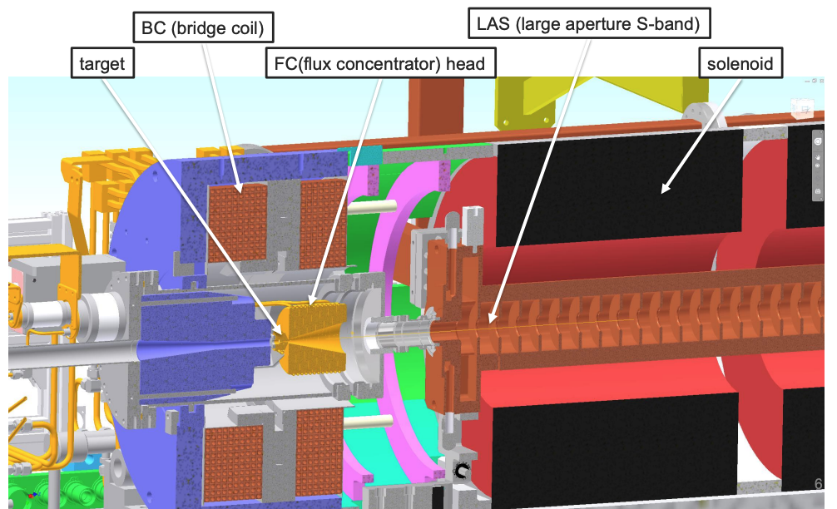
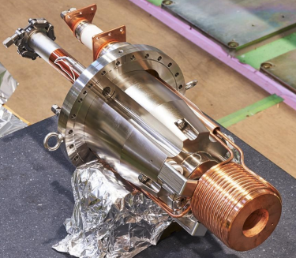
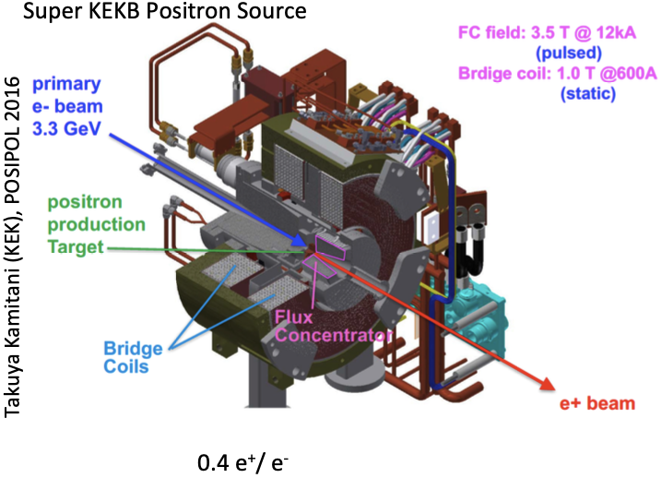
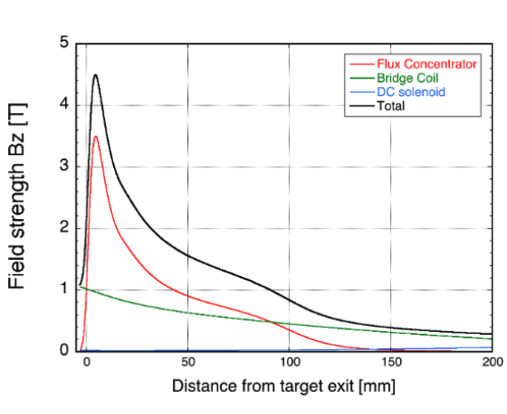
Flux concetrator (Super KEKB Positron Source)
Courtesy of Y. Enomoto (SuperKEKB)

Slide 15
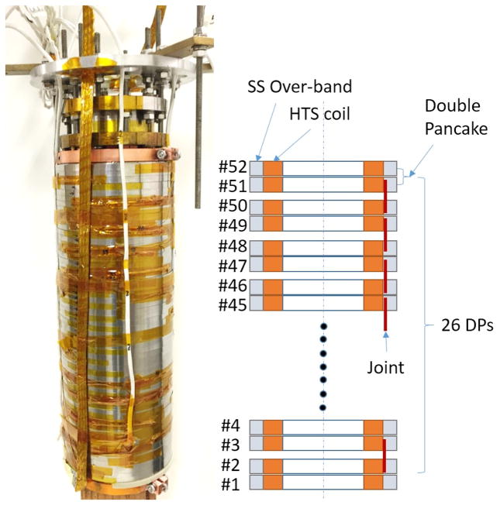
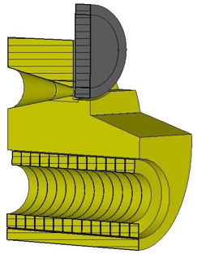
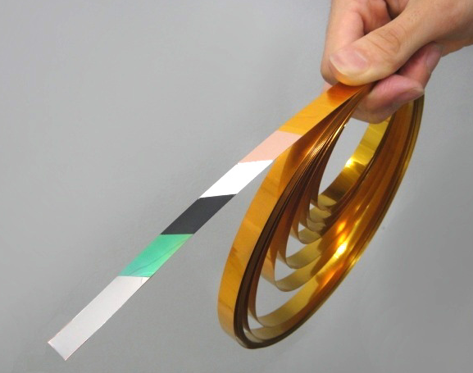
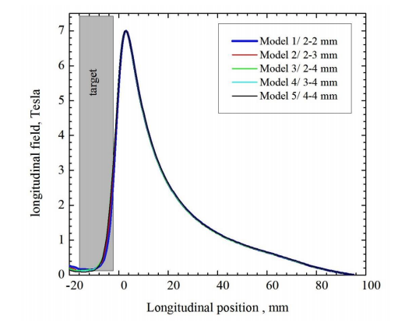
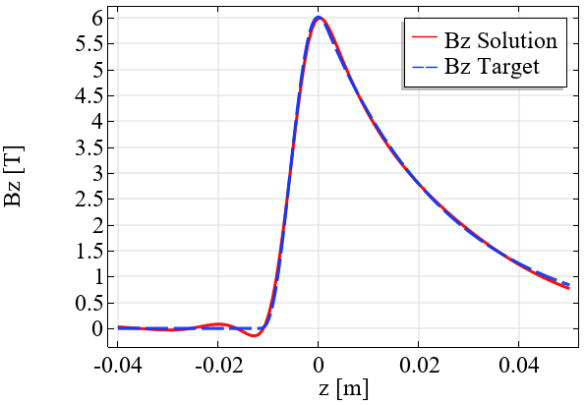
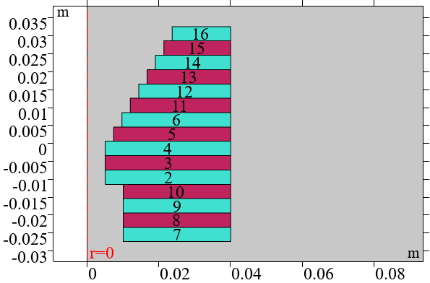
Adiabatic Matching Devices: possible solutions
PSI approach is to use a SC AMD as alternative to the pulsed magnet flux concentrator
Flux concentrator (FCCee)
HTS Solenoid
HTS: tape-shaped conductor
Elliptical cylinder 120x180 mm
Total length is 140 mm
Conical part length is 70 mm
Min cone diameter is 8 mm
Max cone diameter is 44 mm
Cone angle is ≈29 degrees
Cylindrical hole diameter is 70 mm
Coil has 13 turns
Target
Electrons or radiation
https://ieeexplore.ieee.org/document/7762812
8 Coils
Peak field: 7 T
DC solenoid: 0.5-0.7 T
Field on target: ~3 T
Also studies for a 5 Tesla peak field
DC Solenoid: 0.5 T (uniform field)
z
spacers
r
Courtesy of Pavel Martyshkin BINP
Courtesy of Jaap Kosse and Bernhard Auchmann (PSI)

Slide 16
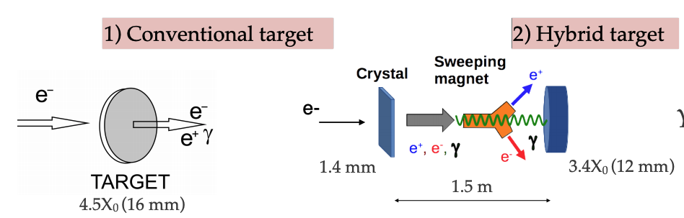
Conventional and Hybrid schemes under investigation
Limitations (numbers to be verified):
Peak Energy Deposited Density (PEDD) for a Tungsten-Rhenium alloy (W74Re26) is 35 J/g
Target Heat Load (THL) is not higher than 15 kW
3) Rotating target, solution for CLIC, ILC and FCC-ee in case of bunch train

Slide 17
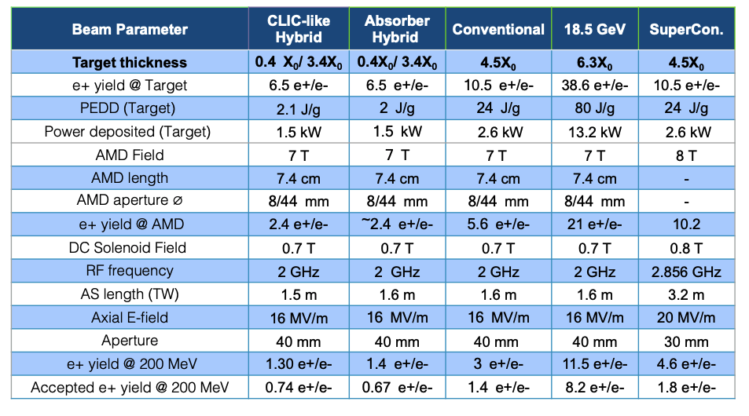
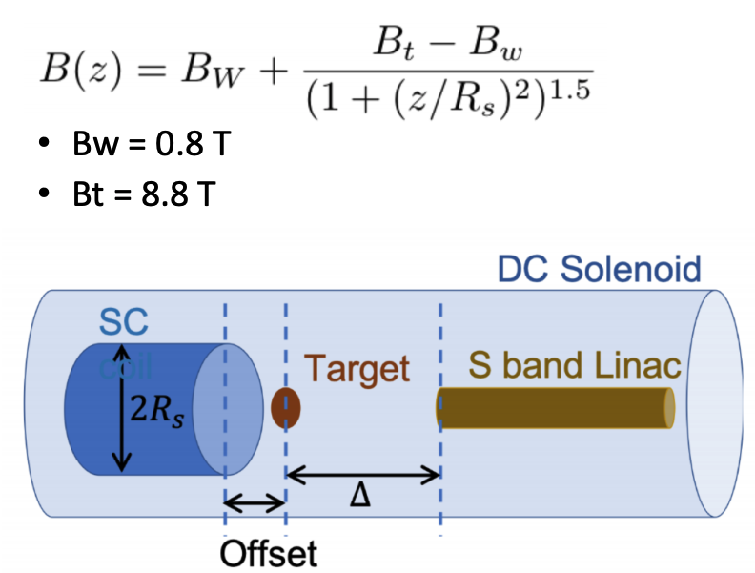
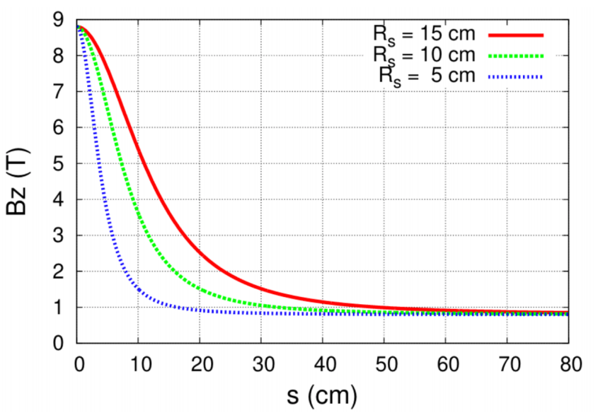
Studies on the positron production (work in progress)
Electron beam energy 4.46 GeV (FCC-ee Injector baseline in CDR0)
Courtesy of I. Chaikovska and Y. Han (IJCLab)
  On going simulations…
We (Riccardo) is performing simulations considering a SC solenoids and new RF capture strcutures (more related to WP6) – following slides
CERN (Yongke) with support from IJCLab (Iryna) and PSI (Riccardo) is performing simulations for the Hybrid scheme

Slide 18
Outline
Introduction
    Motivations and Swiss CHART Funding
    FCC-ee Injector Complex Update Overview
Positron sources
  FCC-ee Injector parameters and overview of the positron sources
  Adiabatic Matching Devices
  Studies for FCC-ee
Positron source experiment at SwissFEL
    Transfer line and area for the experiment
    Experiment layout
    First simulation results
Conclusion and outlook

Slide 19
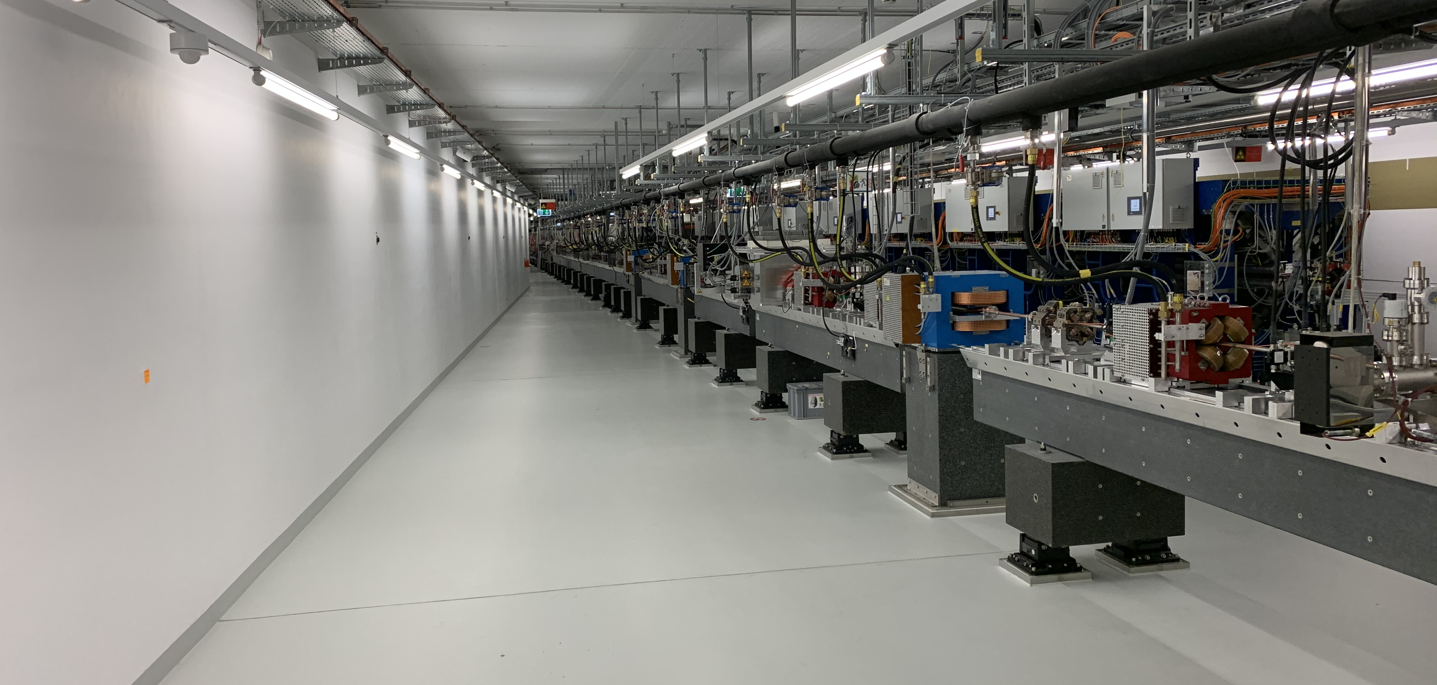
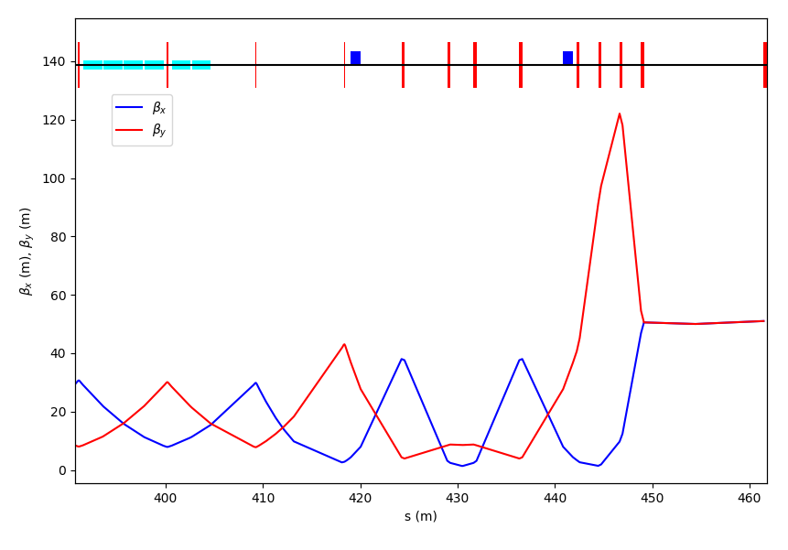
Transfer line to the positron source experiment
quadrupoles
S30CB13/14
target
dipoles
β-function 15m-150m
Transfer line at the linac end: The idea (from Sven) is to have a simple outcoupling and a double bend achromat layout to close the dispersion in the straight line. This solution is the least invasive to the main SwissFEL line, where only the first dipole is placed in the beamline in S30CB16.
8 QFM quadrupoles up to the target to change the beam size at the target itself
Courtesy of S. Reiche

Slide 20
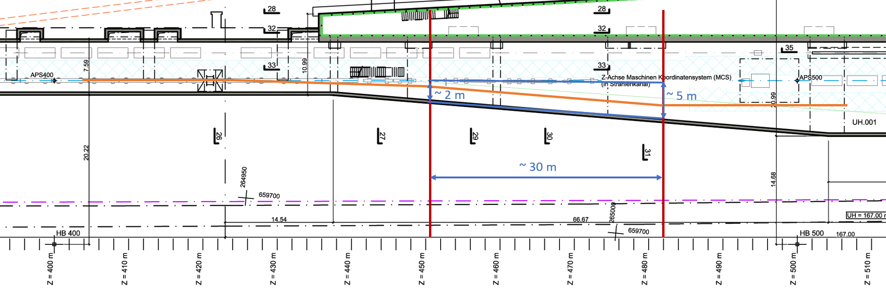
Area for the experiment
Klystron gallery (upstairs)
S30CB013
S-band mod.
30-40 m
End of Linac 3
S-band HV klystron modulator: a full S-band RF system is required, new modulator for the Injector (SF consolidation) and the old one will be used for the experiment/S-band test facility

Slide 21
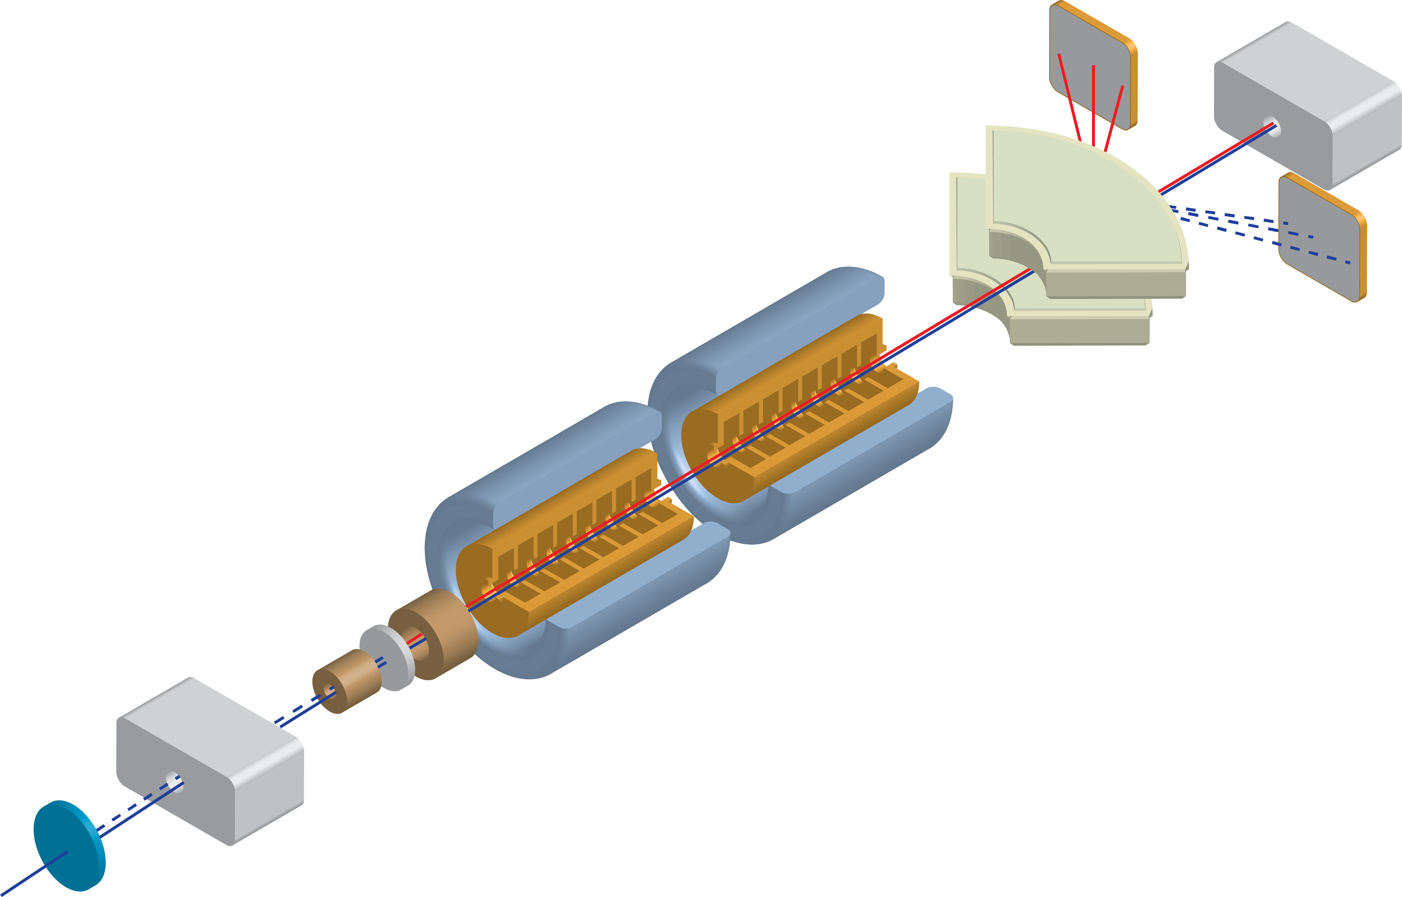
Experiment layout
beam dump or beam stopper + beam dump? (huge e- energy distribution)
Goal: have a comparative study between conventional and hybrid schemes and to test the SC solenoid
Spectrometer
positron beam
electron beam
Radiation from the crystal
SC solenoid with embedded target
RF cavities and NC solenoids
Diagnostic not defined yet (charge measurement)
Both e- and e+ have huge energy spread, beam dump design and shielding problems.
Option: operate with extremely low beam charge <<200 pC, <<100 Hz
Crystal in/out
Beam stopper
and permanent magnet
SwissFEL 6 GeV electron beam
electron beam
Courtesy of R. Zennaro

Slide 22
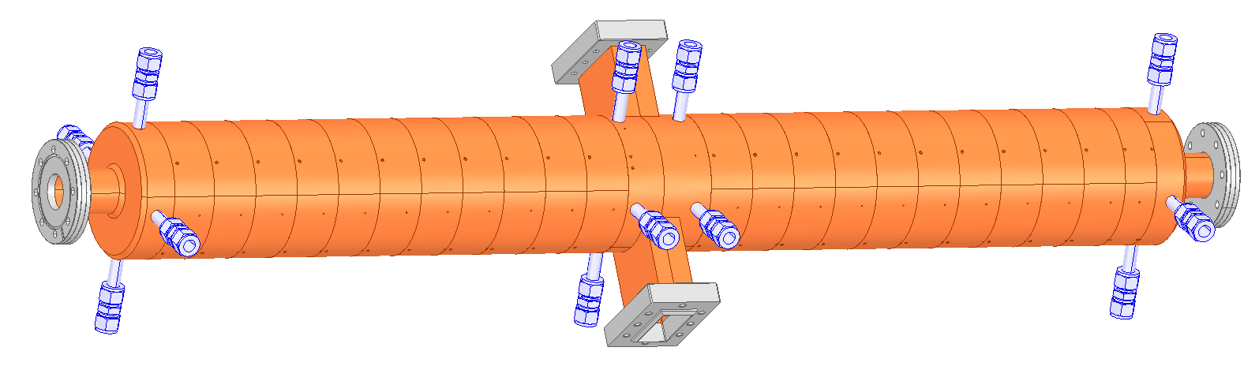
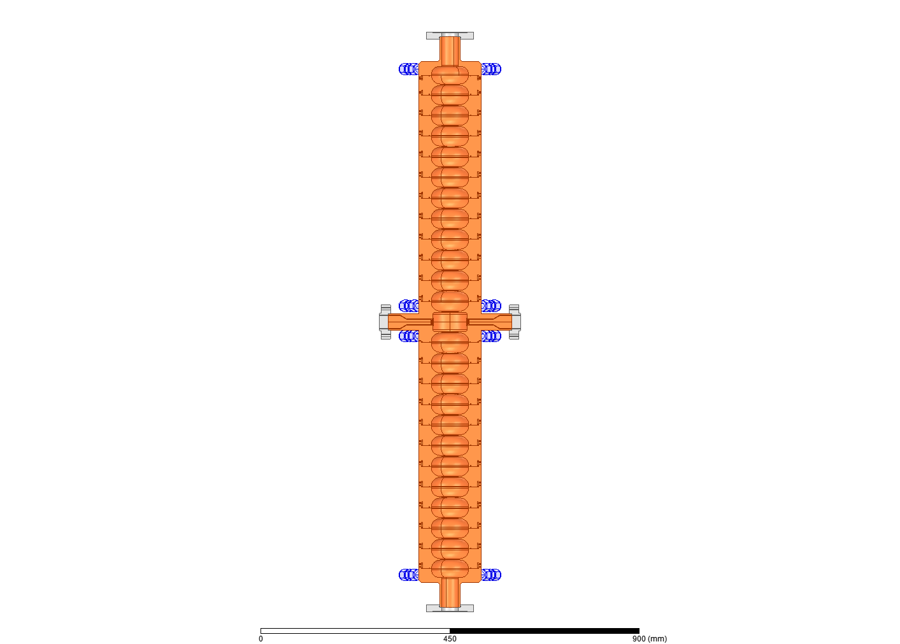
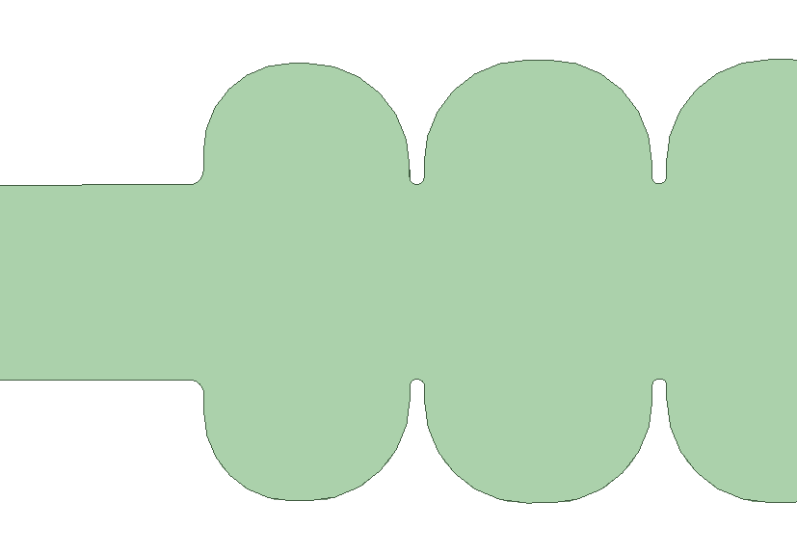
S-band RF module (positron capture)
HV modulator
Klystron 35 MW, 3.5 μs
Phase shifter
Circulator
25 cells max., 2998.5 MHz, Q= 21000
β to be defined, in this example 2
R/Q=939 (for β=2)
mode separation 3.8 MHz
2x SW π-mode cavitiy (18MV/m@15MW for β=2)
Status:
RF design nearly ready (for β=2) (λ/4 waveguide impedance matching missing)
mechanical design well advanced
“conventional PSI” brazing design (machining at VDL)
Ready for ordering the OFE copper
150
3
1400
40
89.7
50
Courtesy of R. Zennaro

Slide 23
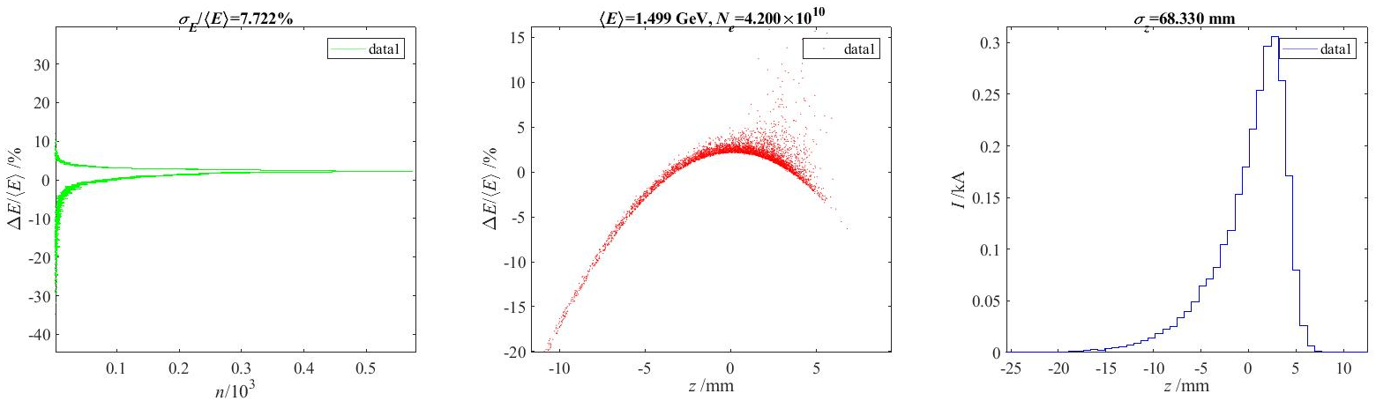
Preliminary simulation results
Codes: Astra up to 200 MeV, LiTrack up to 1.5 GeV (just to estimate the positron yield at the DR injection)
Goal: validation of the SC solenoid and S-band SW cavities (both under development at PSI)
e+ distribution at target (Geant4, courtesy of I. Chaikovska);
Positron Yield at target = 13.8 e+/e- with tungsten target-converter 5X0 (~ 1.75 cm);
Conventional scheme (electrons directly hint the target);
e- energy = 6 GeV;
Bunch length (rms) = 1 mm
Beam divergence (rms) = 1e-5;
Energy spread (rms) = 1e-3;
Beam size on target (rms) = 1.5 mm;
9+52 SW 3 GHz cavities 18 MV/m, 1st and 2nd AS @-30°
7 T peak field for the SC solenoids (5.6 T at target)
26% e+ in the FCC-ee DR longitudinal acceptance (±3.8% dE/E, ±8.9 mm in z-position)
→ Total Positron Yield 13.8*0.26= 3.6 ✓
Courtesy of R. Zennaro

Slide 24
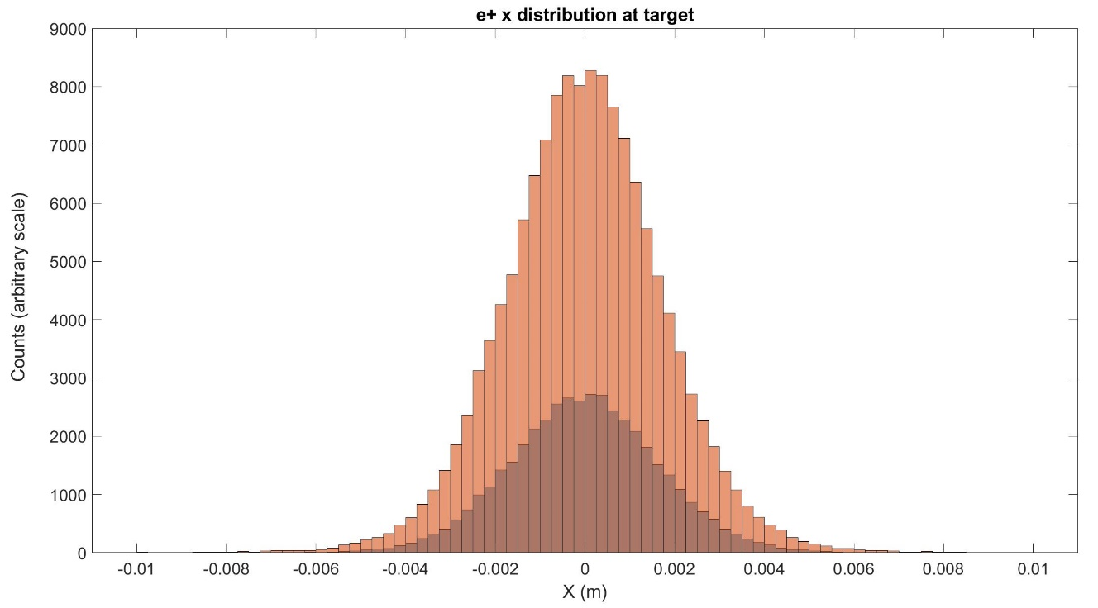
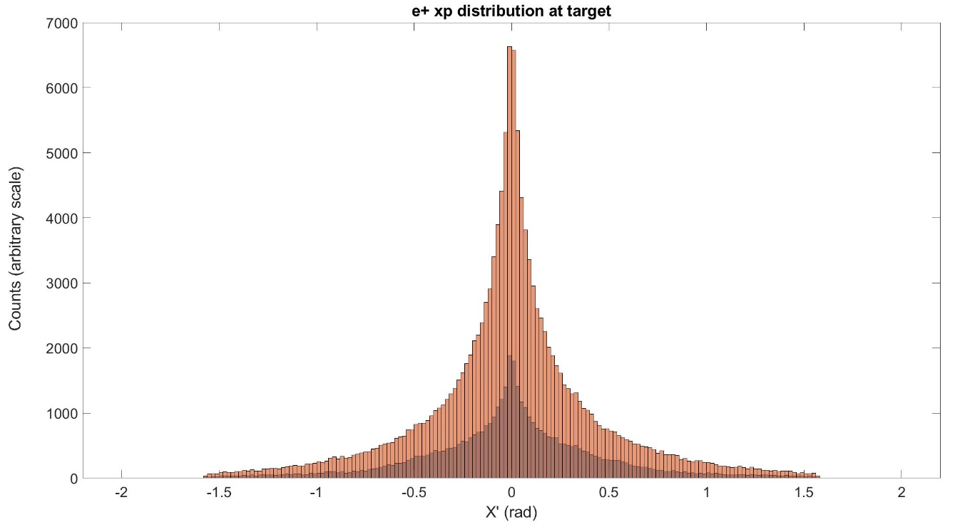
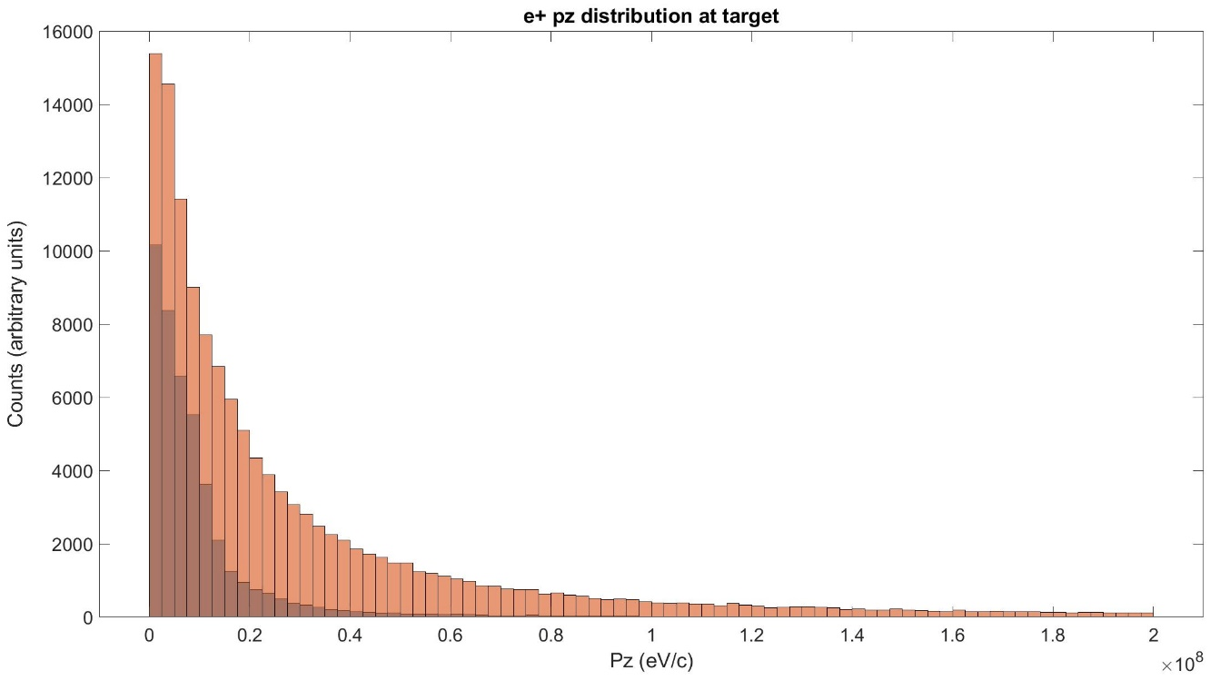
Positron distributions at target and “transmission”
X distribution
X_{p} distribution
3 rad
12 mm
e+ at the target output face:
Total e+ distribution
Only e+ that will reach the capture linac output (200 MeV)
100 MeV
p_{z} distribution
20 MeV
→ 1/3 ot the total positrons created at the target reach the linac end. The particles are cut by the iris of the first RF structure and the divergence remains high (→ DR necessary)
Courtesy of R. Zennaro

Slide 25
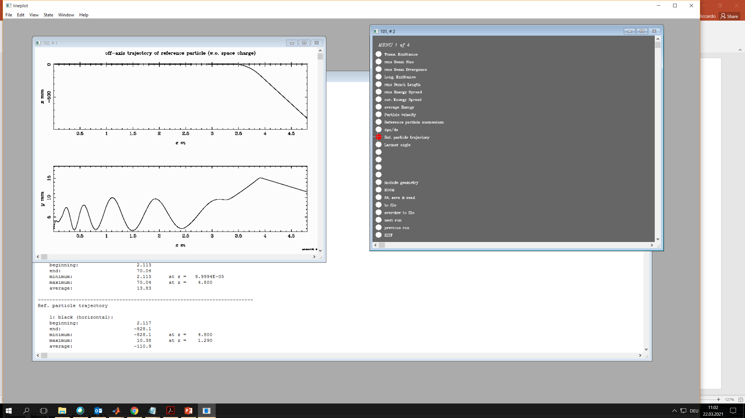
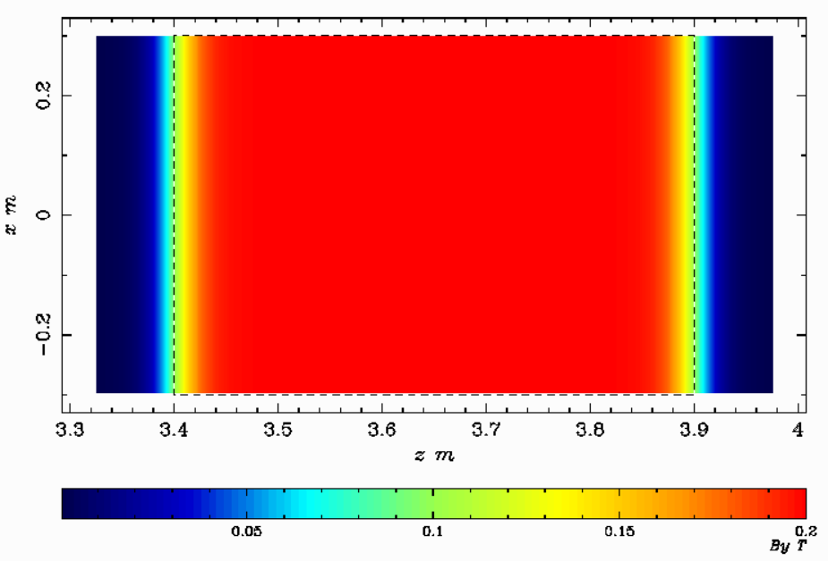
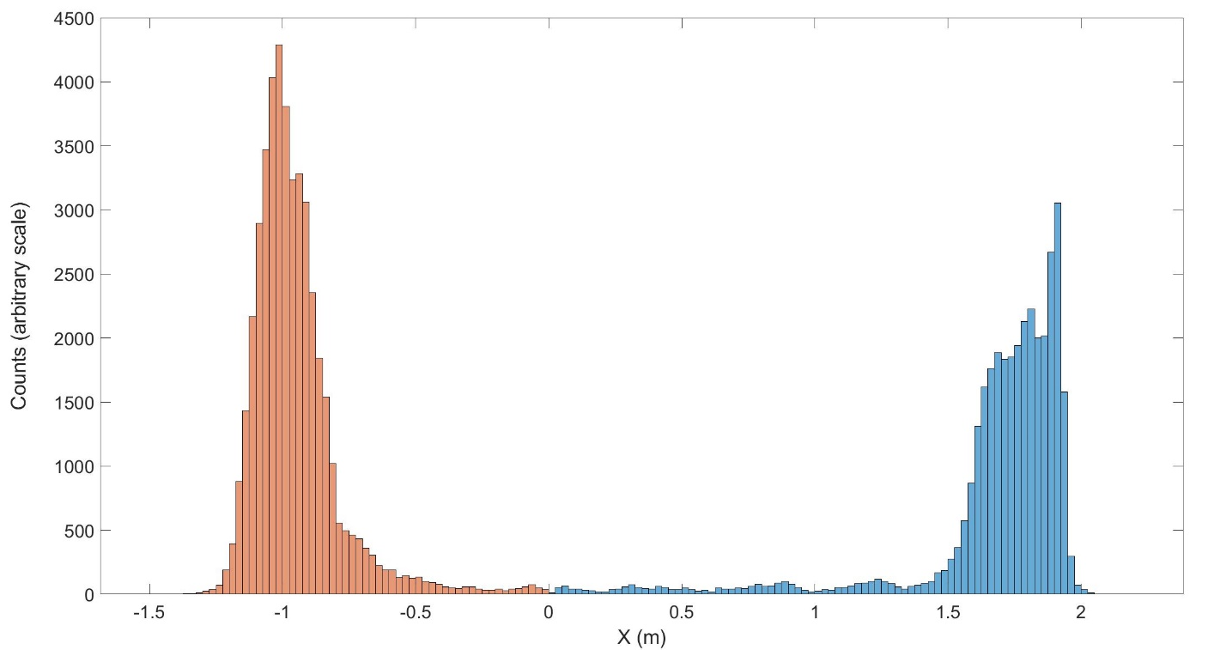
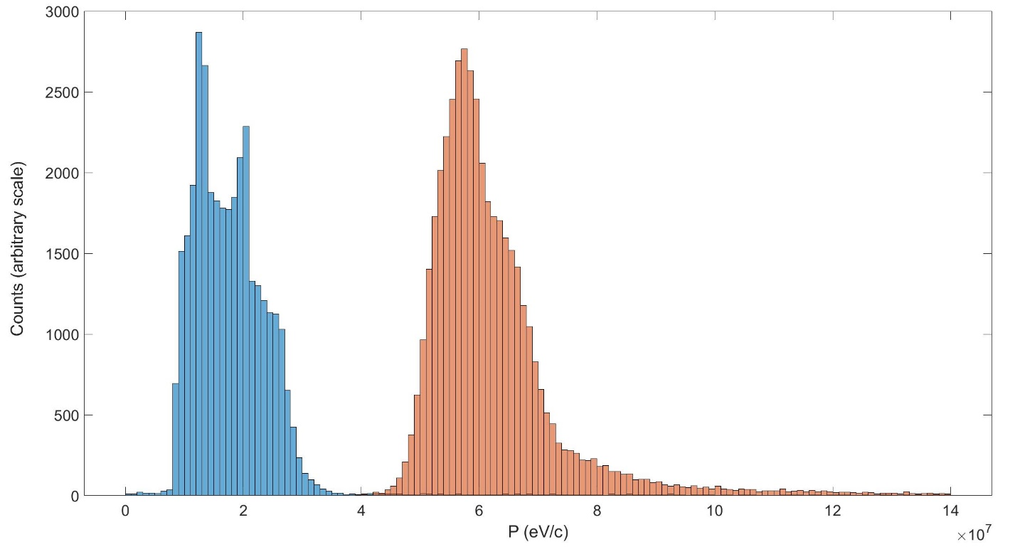
e+/e- separation by spectrometer
Spectrometer:
0.2 T; 0.5 m(z) X 0.6 m (x);
gap = 0.1 m
0
Diagnostic in vacuum or in air? Scintillation fiber?
Special faraday cup?
X [mm]
-500
0
z [m]
4.5
15
y [mm]
Just an example (not optimized)
0
z [m]
4.5
e⁺
Spatial separation
e⁻
e⁺
Energy separation
e⁻
2.7 m
40 MeV
Courtesy of R. Zennaro

Slide 26
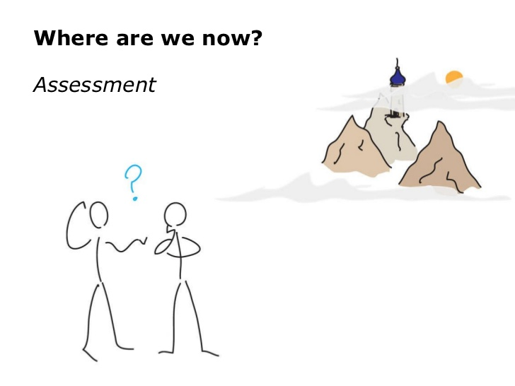
Where are we now? And wehere are we going?
Detailed list with hardware: RF structures, SC and solenoids, beam stopper, diagnostic, support girder… the shopping list
Update the time scheduling based on the procurements of the components and integration in SwissFEL (compatibility with SF operation and SLS-2 project)
Radiation environment studies → impact on SF (…and on SC solenoid)
  Simulation/evaluation of the radiation environment
  Target area shielding
  Energy deposition simulation (average and PEDD) for 6 GeV e- drive beam (target, AMD, acc. structures) => reliability and specifications
Experts have to be already involved in this phase:
  Beam dynamics, Magnet group, Electron instrumentation – photon diagnostic for the hybrid scheme, Target, beamline und simulations (8140), CERN experts can support us on this point
We are hiring two staff members: Accelerator physicist/RF engineer and magnet expert (SC solenoid), a PhD student also starts soon (hopefully)

Slide 27
Outline
Introduction
    Motivations and Swiss CHART Funding
    FCC-ee Injector Complex Update Overview
Positron sources
  FCC-ee Injector parameters and overview of the positron sources
  Adiabatic Matching Devices
  Studies for FCC-ee
Positron source experiment at SwissFEL
    Transfer line and area for the experiment
    Experiment layout
    First simulation results
Conclusion and outlook

Slide 28
Conclusion and outlook
I gave you the motivations for this project at PSI
    Question: are the motivations still valid?
FCC-ee Injector Complex Update
  Big efforts in coordination of the WPs (linacs design, DR, transfer lines and positron source development), even more to draft the CDR+ with the cost estimate
Positron sources
    Basically still an interesting and challenging work to do on this topic
Positron source experiment at SwissFEL
  It is not a demonstrator for the FCC-ee positron source (lower charge and repetition rate)
  But it will be a test bench for the conventional and hybrid schemes using a SC solenoid, mainly for the positron yield (and maybe for the positron beam quality as well)
  Really promising results from Riccardo’s simulations (good agreement with CERN’s results)

Slide 29
Credits
The ideas/outcomes presented in this contribution has been carried out in the last months/year. An acknowledgment goes to all the colleagues who contribute to it: I hope, cited in a right way here and in the talk
R. Zennaro, J.-Y. Raguin, M. Pedrozzi, H. Braun, S. Sanfilippo, B. Auchmann, J. Kosse, S. Reiche, E. Ferrari – PSI
I. Chaikovska, A. Faus-Golfe – IJCLab
A. Grudiev, F. Zimmermann, S. Ogur, M. Benedikt, S. Gilardoni, A. Latina, S. Doebert, T. Gilles, A. Lechner, P. Hilser, Y. Zhao, T. Brezina, H. Pommerenke – CERN
K. Oide, Y. Enomoto, K. Furukawa – KEK
P. Martyshkin – BINP
C. Milardi, O. Blanco, A, De Santis – INFN-LNF
L. Bandiera, M. Soldani, A. Sytov – INFN Ferrara
B. Dalena, A. Chance - CEA

Slide 30

Wir schaffen Wissen – heute für morgen
Thank you for the attention!
Any questions?

