Slide 1
Apple X Undulators for Porthos
Marco Calvi & Xiaoyang Liang :: IDs :: Paul Scherrer Institut
Porthos Working group – 21.01.2021

Slide 2
Apple X
K
K_{y}
K_{x}
Linear Horizontal
Circular +
𝜆_{u} is the period length
B_{ξ} is the amplitude of the first harmonic of the magnetic field in ξ direction
ϕ_{p} is the normalised longitudinal shift between two diagonal magnetic rows
Linear Vertical

Slide 3
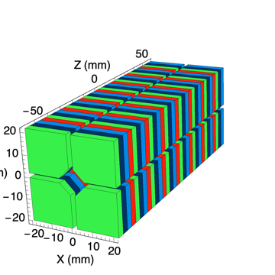
Apple X Cross Section
2.1mm
2.1mm
gap (g)
>20mm

Slide 4
Apple X Undulators
The K is quasi-independent of ϕ_{p} - polarisation
Room Temperature
Cryogenics
2.75
K = 2.0
K = 2.00
2.5
2.50
1.75
2.25
1.50
K = 2.0
1.5
K = 2.00
1.75
1.25
Br = 1.2T
Br = 1.6T
1.5
1.50

