Slide 1
SSO - Keycloack
JF Perrin

Slide 2
SSO Why?
Single Sign On
  Life is simpler for your users, login once.
No more password exchange between users and applications.
  Clear security improvement for the organisation
  Single point where you can strengthen security measures (fail2ban like, 2FA, …).

Slide 3
Keycloack why?
Production ready software since several years
Open Source (easy adoption)
Very active project
Multi protocol: OAuth2, SAML
Different auth flow possible: Paw, OTP, WebAuthn, …
Comprehensive management interface (Web GUI)
Allow easily to map identities

Slide 4
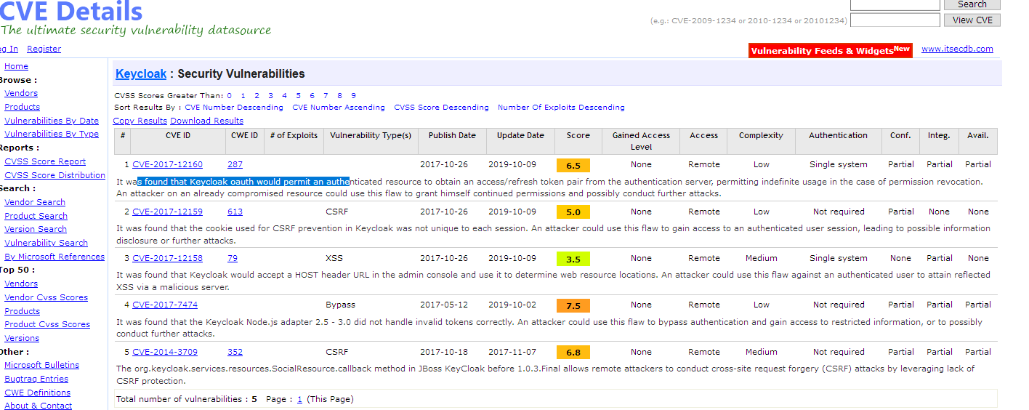
Keycloack why?
Supported by RedHat

Slide 5
You are free to use an SSO or not
Keycloak is one solution, other exists
In use at ILL, ESRF, …

