Slide 1
SwissFEL Exchange Meeting
Machine report
Week 4/2021
Didier Voulot
SEM, 1 February 2021

Slide 2
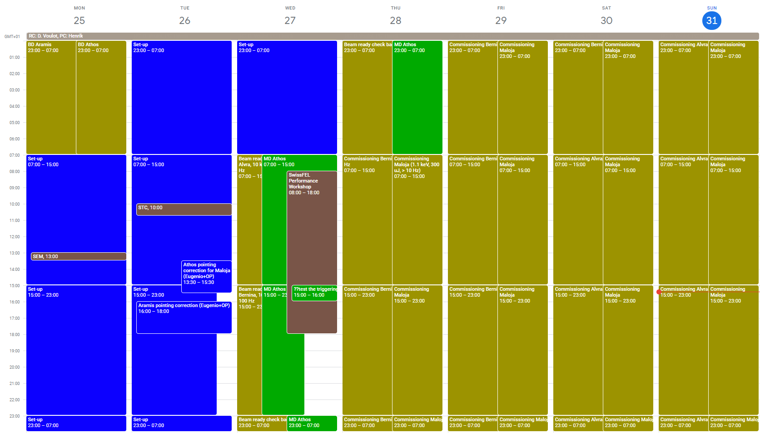
Week overview

Slide 3
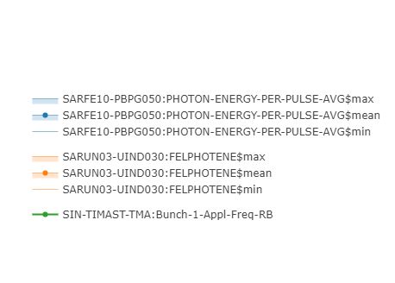
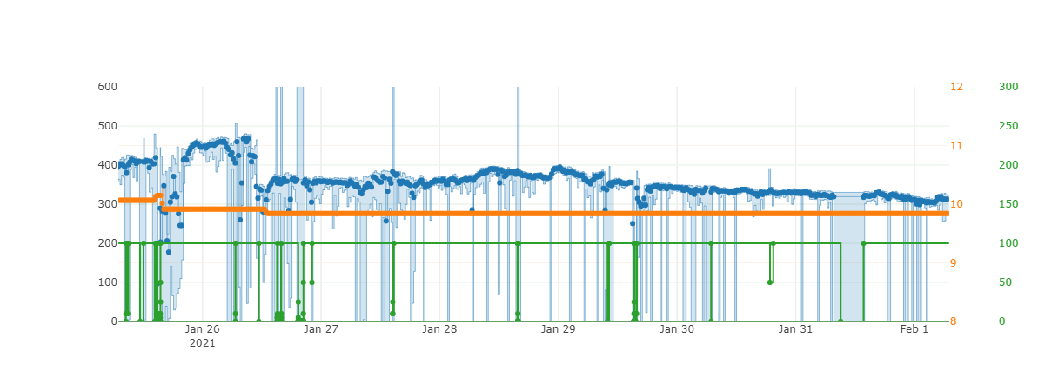
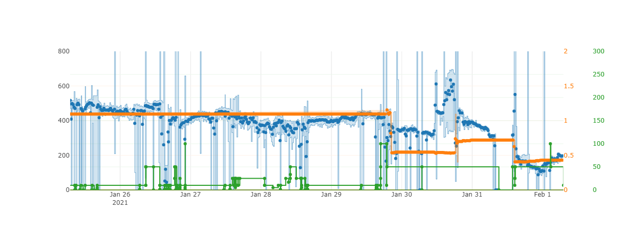
Aramis
Athos

Slide 4
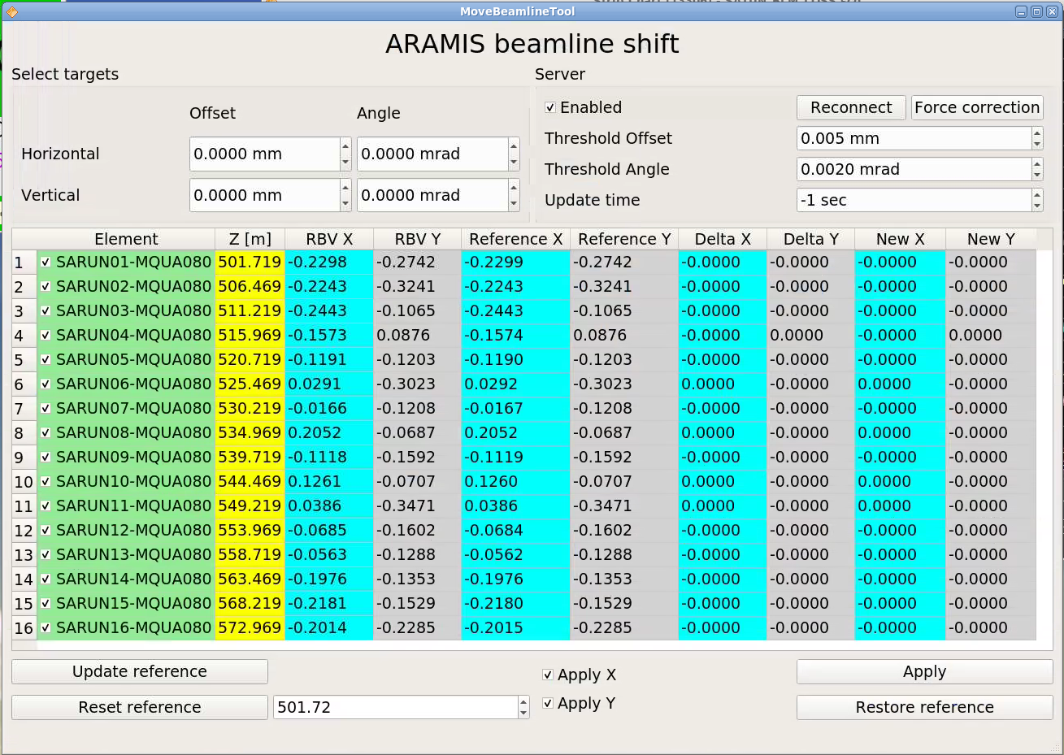
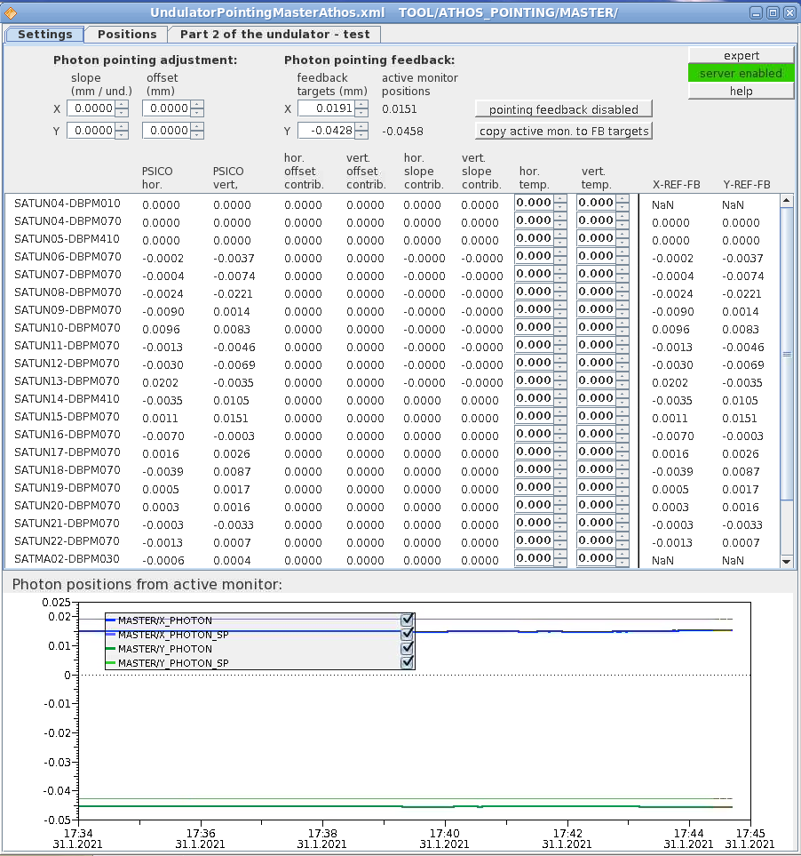
Pointing
Eugenio
  Move full line (quads & undulators)
  Maintain lasing even for large move
  Works well, nice tool!
  Problem: the mover are unreliable (move not applied, difficult to restore when hitting the limit switches)
Florian
  Only acts on electron orbit
  Lasing not maintained for large change
  Less risky

Slide 5
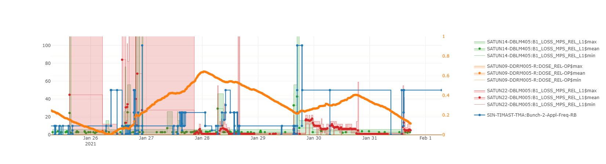
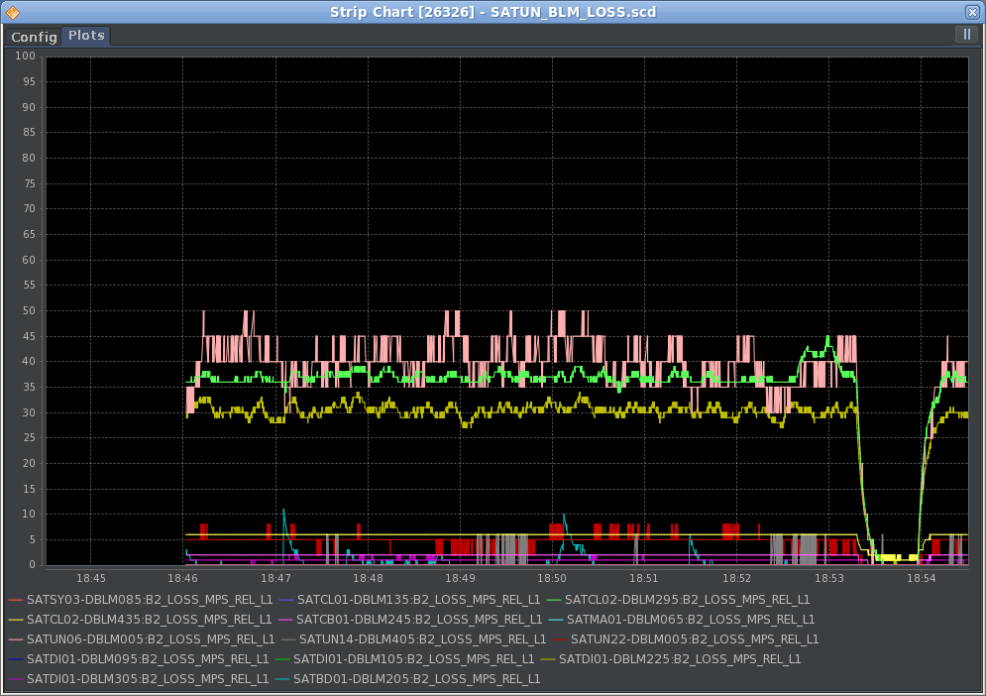
Losses Athos (SATUN09)
Difficult to tune down without BLM readings (DRMs are too slow)
Seems to be mostly beam related, dark current can be mitigated with collimators and dechirpers
Tuned down by Psico (Florian) using optics and orbit, 50 Hz is ok (maybe also 100 Hz)
BLM and LLM have been activated and adjusted during the week
Losses could be easily tuned down on Sunday
Laser on-delay

Slide 6
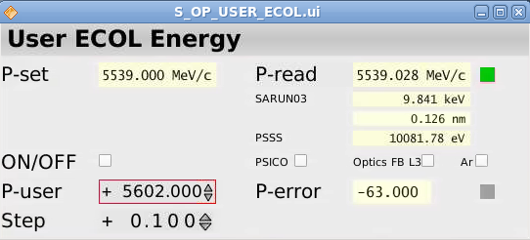
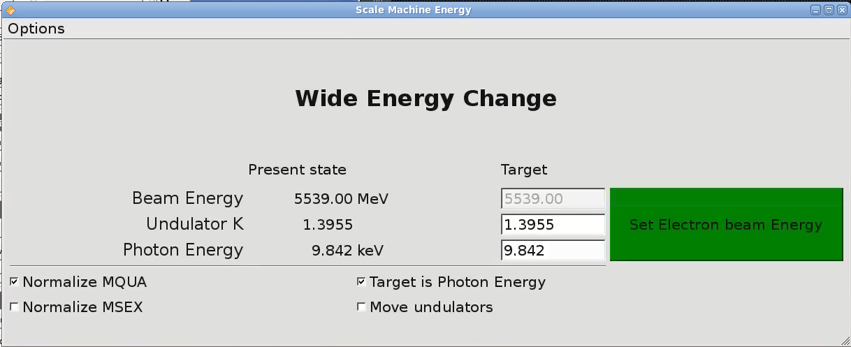
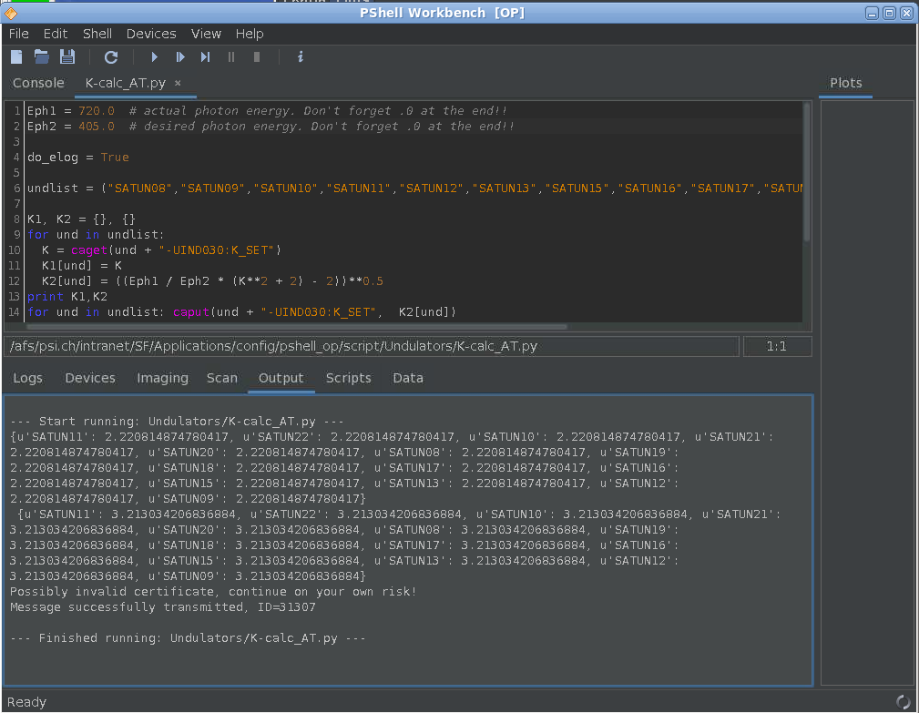
Energy changes
Aramis
  Electron beam energy scaling works well
  Two versions:
    Florian’s: uses feedbacks, ramping
    Eugenio: scaling script, single step
  Large energy change possible
  But tend to generate leaked dispersion, with design ECOL optics
  Undulator K scaling: script exist, could be used for small changes, not much experience
Athos
  Used K scaling during the week (Pshell script)
  Large changes are possible 1.1 -> 0.4 keV
  CHIC settings need readjusting
  Undulator kicks generate losses

Slide 7
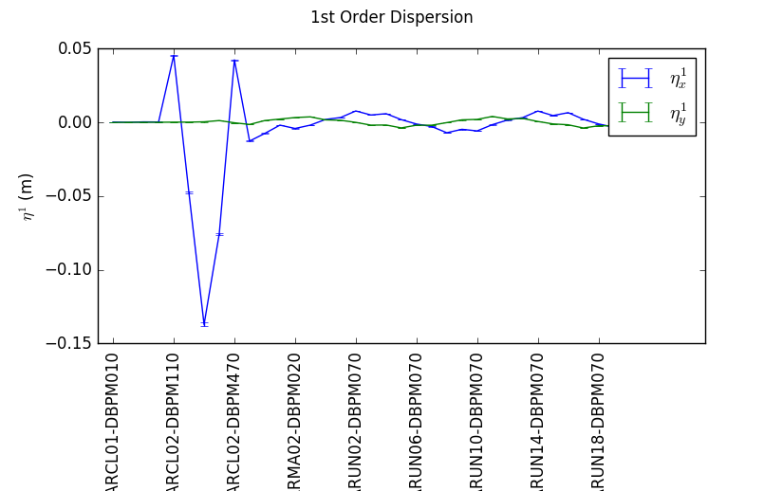
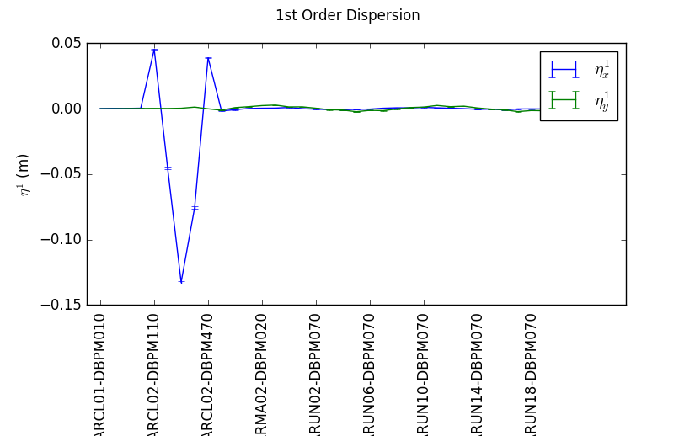
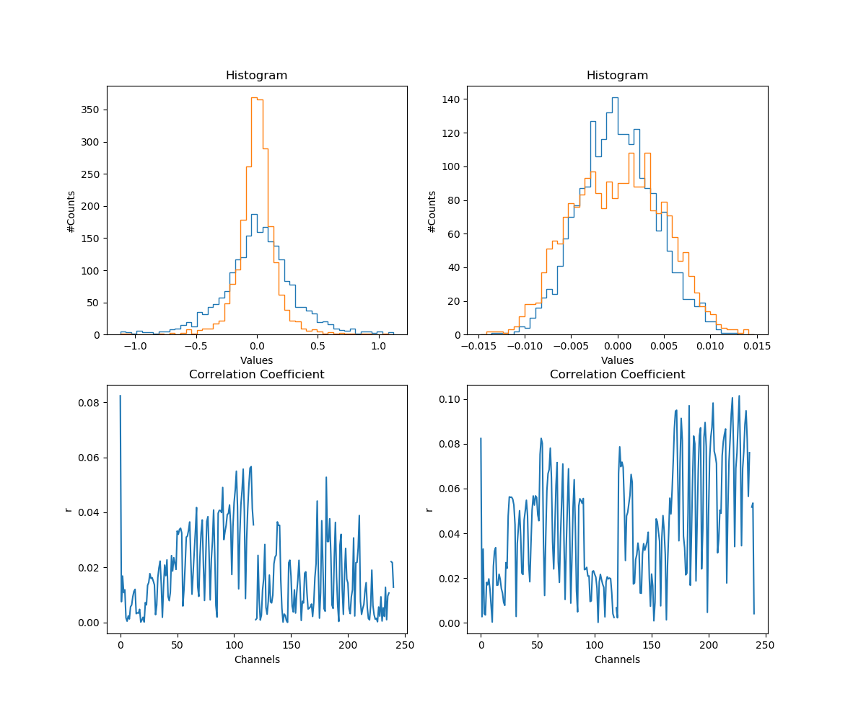
Aramis beam jitter
Problem investigated by Sven on Friday
Large jitter in horizontal
Real effect visible on both PBPS and screens
Closed dispersion in x and y => no improvement for Bernina
Try to correlate beam position jitter with different channels
Conclusions (?)

Slide 8
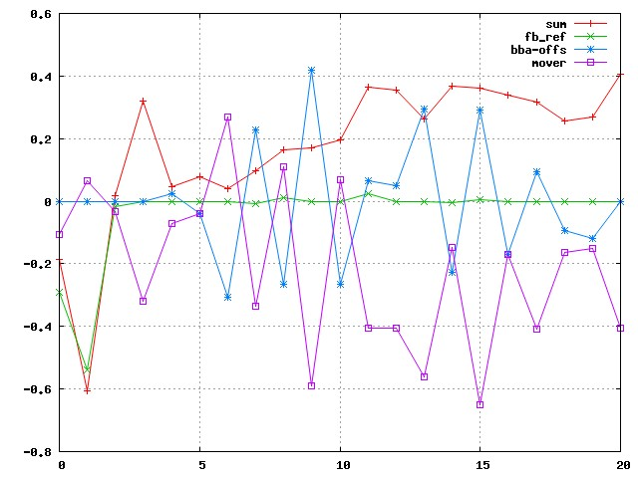
Findings from B. Keil
Quad movers and BBA offsets have zig-zag pattern with opposite values
https://elog-gfa.psi.ch/SwissFEL+commissioning/18066
Movers seem to compensate BBA-offsets
This only happens in x
Not good for BPMs, better performance close to mechanical center
Is it real? Could it be an artefact of the BBA?

Slide 9
Technical difficulties
SINSB03
Thu. Florian notice a phase jump in SINSB03 causing electron beam instability
Confirmed by Qiao => instability comes from the pre-amplifier
Saturday: Down time (1h) due to Klystron Arcs (Lukas Stingelin)
Sunday: Down time (6h), more arcing at Klystron (Lukas Stingelin)
Mizar energies
Mizar UV energy wave-plate is slowly increasing
Could not be recovered with capillary alignment
Possibly some aging UV optics
Intervention on Monday morning (Carlo)

Slide 10
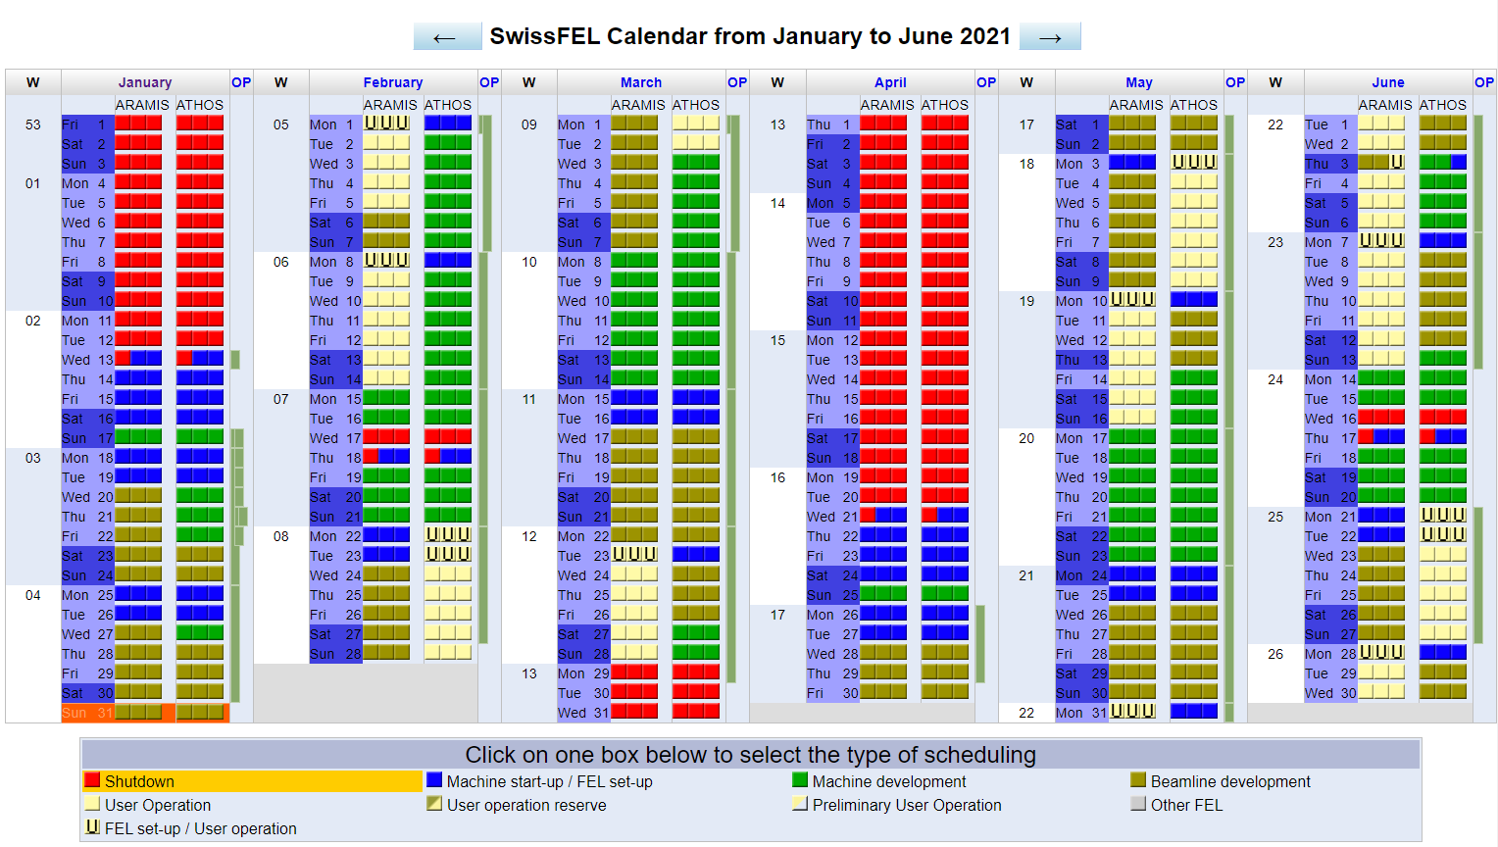
DUO calendar

