Slide 1
Alvra in-house beamtime
Demonstration of high time resolution at Alvra
February 24th to March 8th, 2021

Slide 2
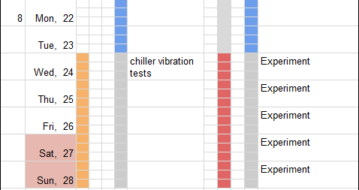
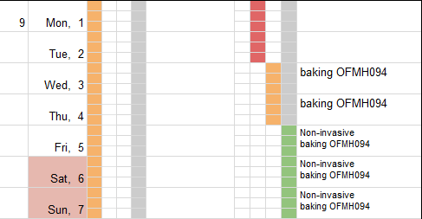
Schedule KW 8 & 9
Aramis
Athos
A B C
D M F

Slide 3
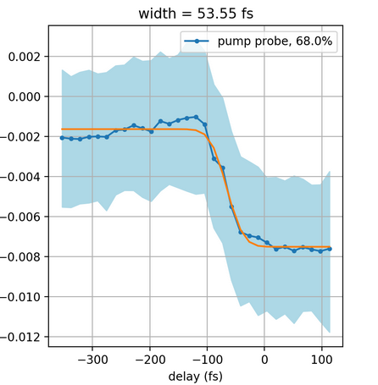
Motivation - To investigate (ultra)fast dynamics
Why do we care about high time-resolution?
  Allows access to fast wavepacket dynamics, transitions through conical intersections and initial relaxation processes in chemical and biological systems. Also, allows for more direct comparison (and be more competitively) with optical experiments
What is our current status?
  ~70 fs FWHM (measured on 2 um thick Si₃N₄
  with the 800 nm)
  raw data show 55 fs,
  TT corrected returned 70 fs FWHM
What is the status of other instruments?
  XPP (LCLS) claims ~30 fs FHWM for one measurement, most experiments are done with ~60-70 fs FHWM IRF
  SACLA BL3 ~70 fs (50 µm jet)
  FXE (European XFEL) ~150 fs (status of last year)

Slide 4
What do we need to achieve & demonstrate high time res?
Short x-rays
  electron bunch lengths estimations:
    ~25 rms (~60 fs FWHM) @200 pC
    11 rms (~25 fs FWHM) @100 pC
Short pump laser
  NOPA (520 nm): Currently ~18 fs FWHM (work ongoing)
  Fundamental (800 nm) < 35 fs
Good jitter and drift corrections (timing tool)
  Now working with monochromatic beam as well
Short response time of the system
  YAG response is limited by physics (~160 fs)
  Si3N4 also seems to bottom out at ~70 fs
  Need a fast molecular system response on a thin jet (Fe(bpy)3 in 25 µm jet)

Slide 5
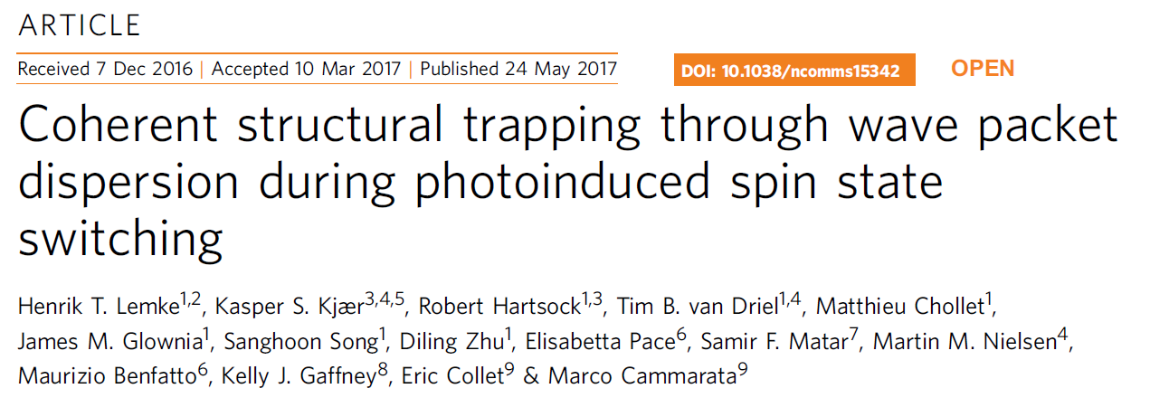
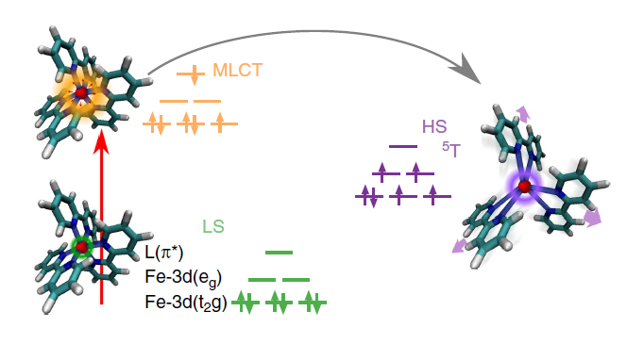
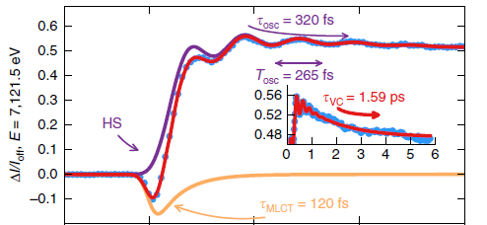
Scientific Case for Fe(bpy)3
Different timescales: 120 fs, 265 fs, 320 fs, 1.6 ps
Excellent temporal resolution and S/N
Benchmark experiment, well studied system and large signals (QE ~ 1)

Slide 6
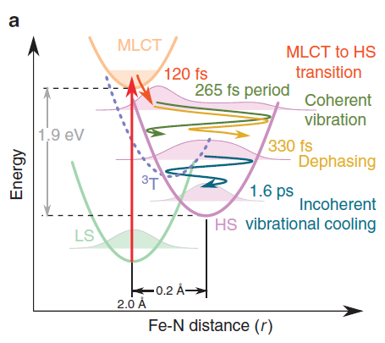
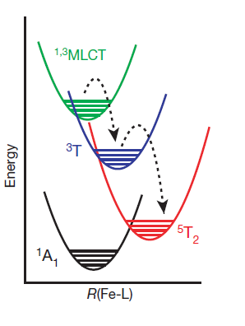
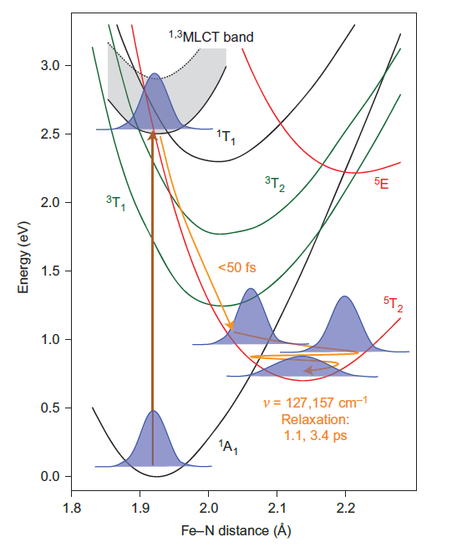
Scientific Case for Fe(bpy)3: still open questions
Xray (XAS & XES)
optical
vs
Optical spectroscopy studies show faster dynamics for the SCO mechanism
Resonant X-ray emission (never performed with this systems) in particular at the pre-edge (resonant with the t₂g and e_{g} states) can show the spins state occupancy and the electron arrival time in the HS state

Slide 7
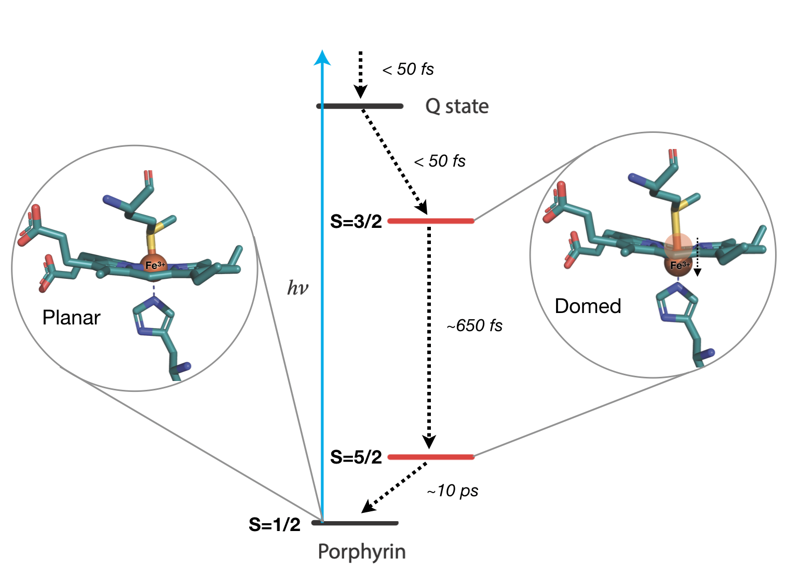
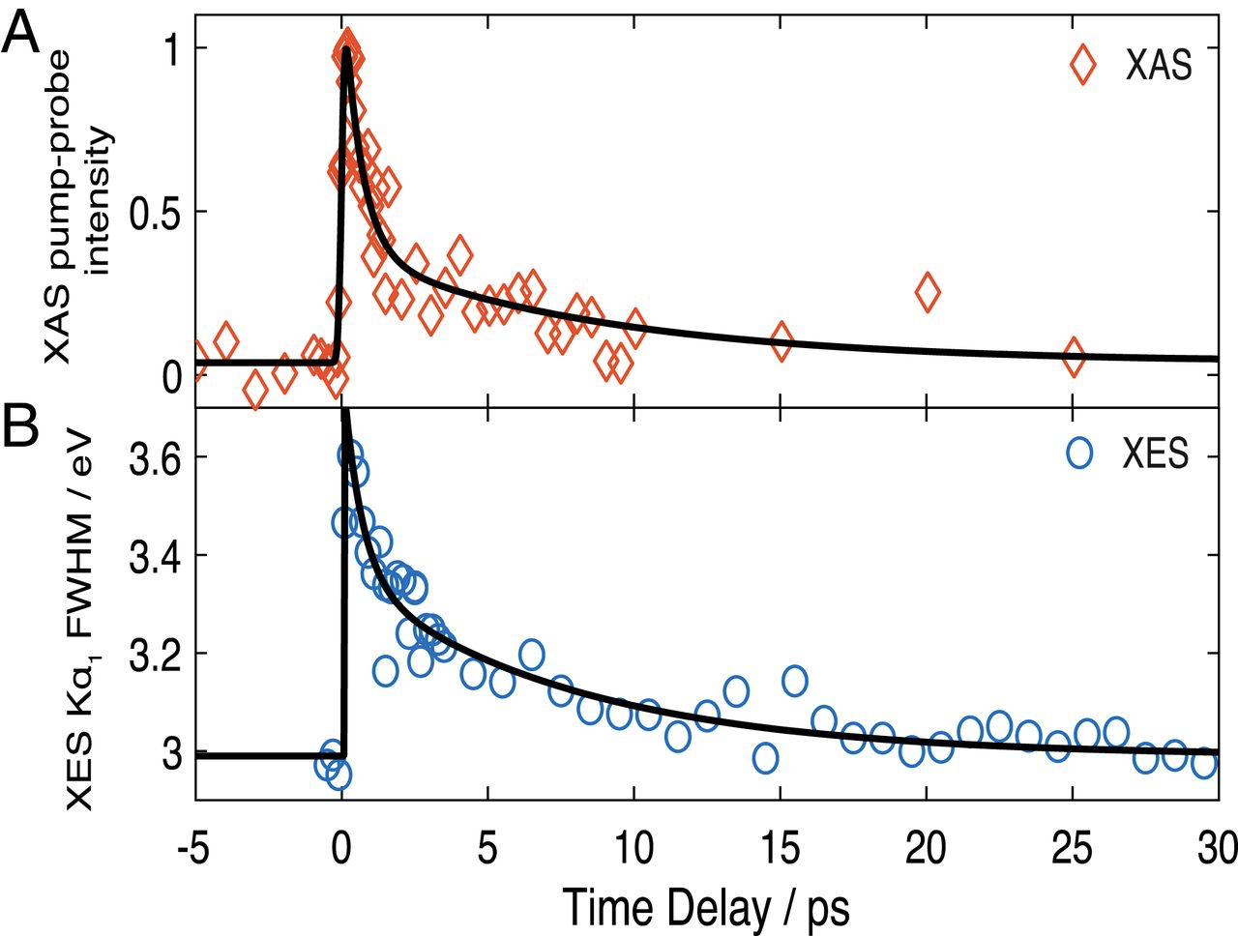
Scientific Case for Cytochrome C
Bacellar C. et al, PNAS 117 (36), 21914 (2020)
Open Questions:
What is the 𝝅-𝝅*→ HS state dynamics?
Is doming instantaneous?
Are the HS state and doming kinetics identical?

Slide 8
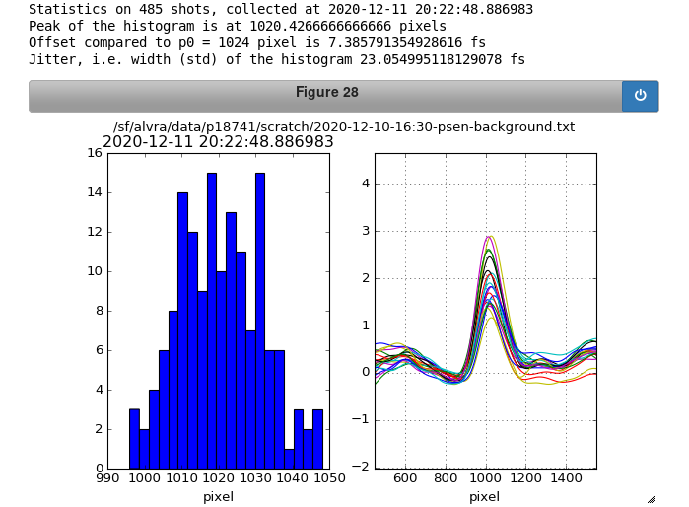
Schedule KW 8 & 9
Aramis
Athos
A B C
D M F
7.1 keV photon energy
  scanning +/- 100 eV
  7.6 keV for non-resonant XES
Narrow bandwidth
~ 600 uJ pulse energy
Short Xray pulses
  100 pC or dechirper
200 pC
Test
dechirper
100 pC
Dec 2020: 3% signal on 20 um YAG (unfocused FEL, 0.15% bw, 600 uJ/pulse)

