Slide 1
SwissFEL Exchange Meeting Machine report Week 8/2021
Didier Voulot, SEM, 1 March 2021

Slide 2
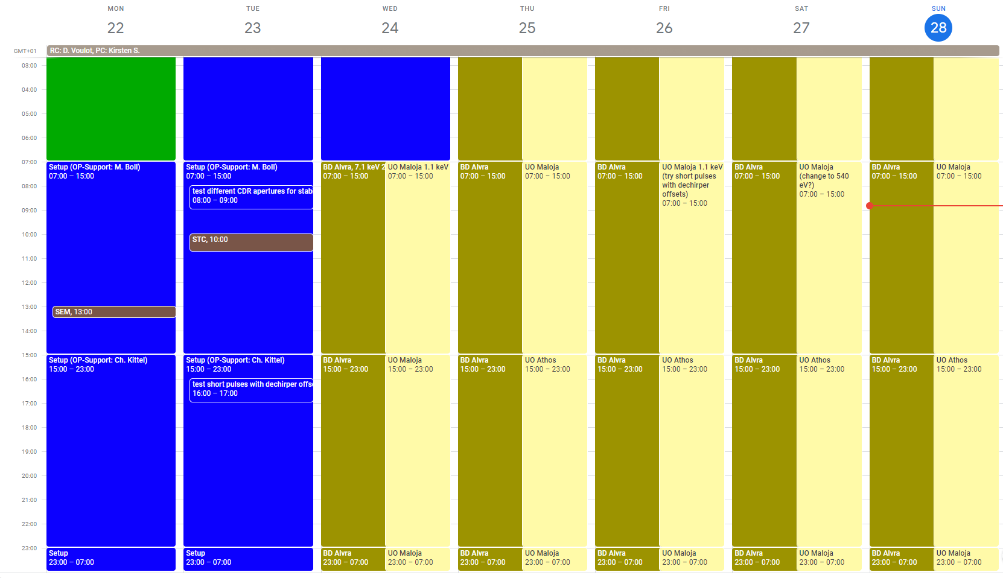
Week overview

Slide 3
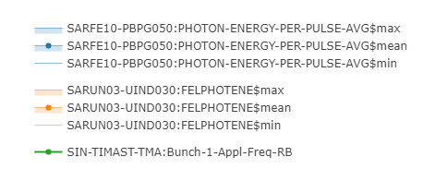
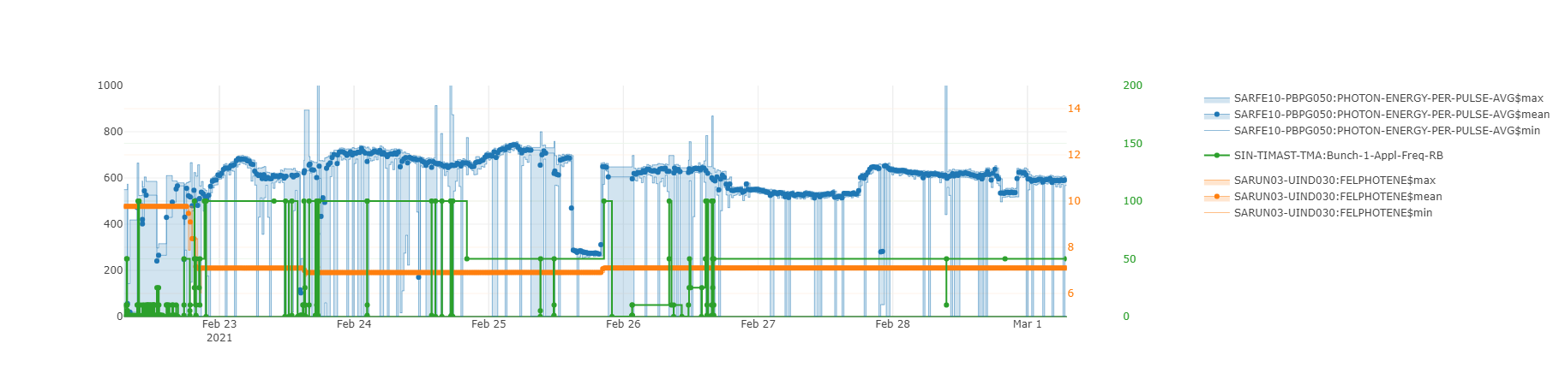
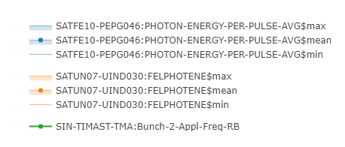
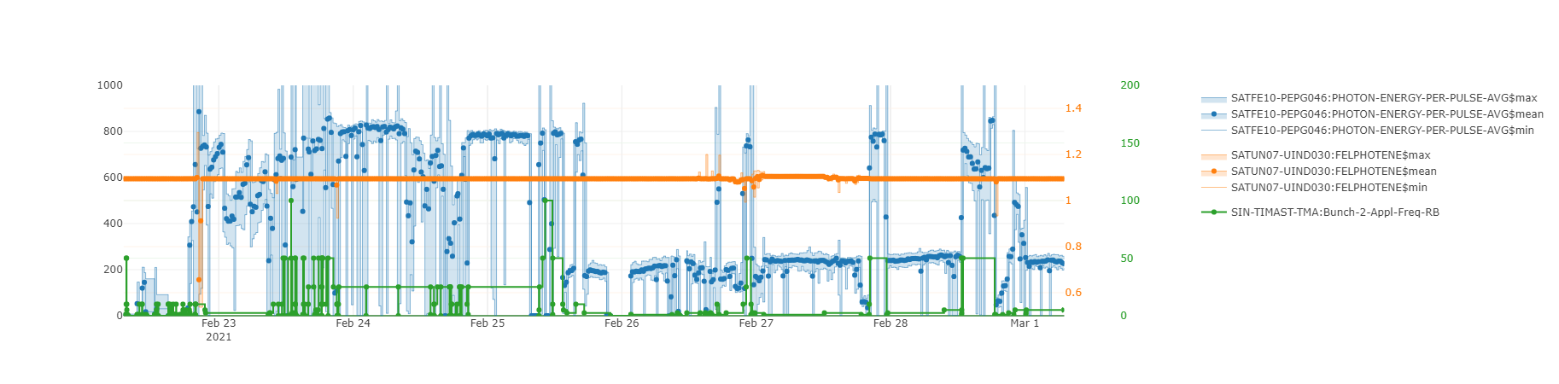
Aramis
Athos
Notes:
Maloja run, priority Athos

Slide 4
Set-up
Started from a reasonably well set-up machine: Aramis 550 uJ at 10 keV with 0.11% BW
Beam dynamics support from: Sven, Eduard and Eugenio. Strong involvement of Beam Dynamics throughout the week.
Systematic set-up (follow check marks defined by Sven), we set-up the two bunches in parallel.
New Athos orbit from last BBA (Friday 19.2)
Use new optics for Athos: reduced R56 in the switchyard, so effectively less decompression and shorter pulses at the undulator entrance. The new optics also affects Aramis (some common quads are used) the lasing goes down a lot but this can be recovered with optics.
Record lasing on Athos: up to 850 uJ at 1.1 keV (C+ mode). Confirmed with E-loss measurement. (Systematic set-up with limited manual tuning, Psico was not used on Athos.)
We still have losses in Athos SATUN07 and 08. 50 Hz possible with nominal settings (100 Hz with one reset per day?) but this is critical for short pulses.
Switch to higher K in Aramis and scale energy down to 7.1 keV. The lasing does not improve as much as expected 650-750 uJ.

Slide 5
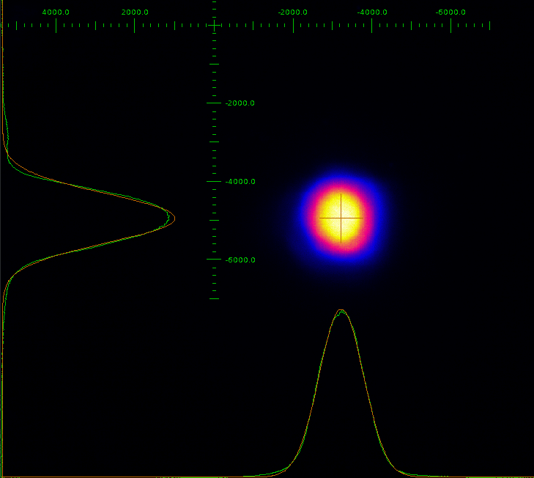
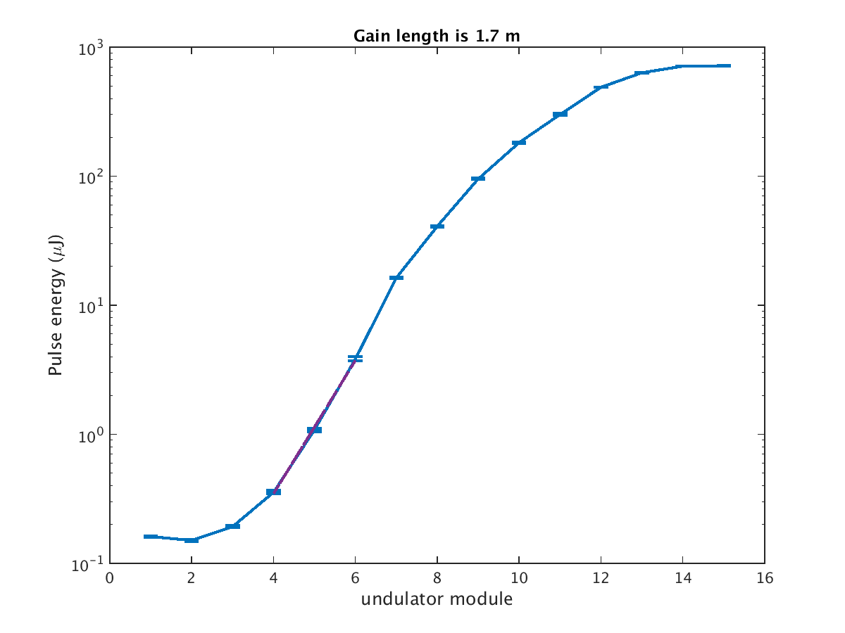
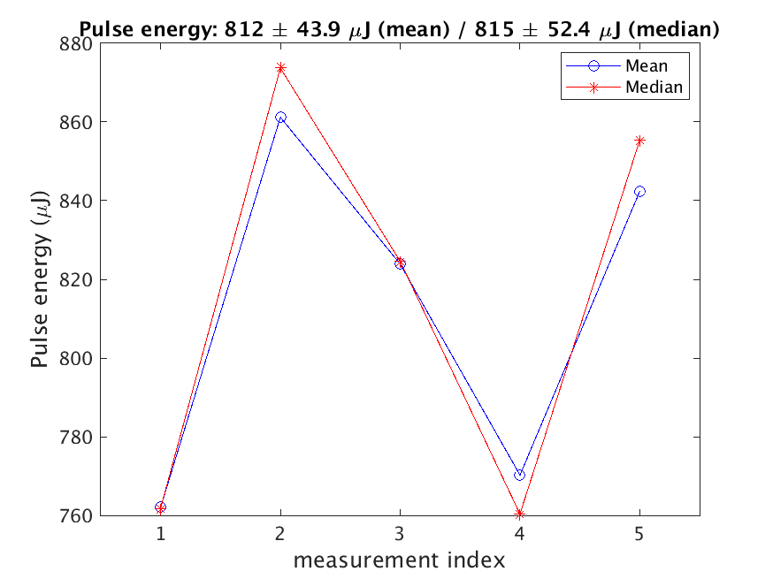
Athos lasing
SARBD01-DSCR210
Gain length, 800 uJ at 1.1 keV
Good photon beam spot, 600x600 um rms
1.3 mJ at 540 eV (scaling undulator K and optimizing taper and CHIC)
800 uJ confirmed with E-loss measurement

Slide 6
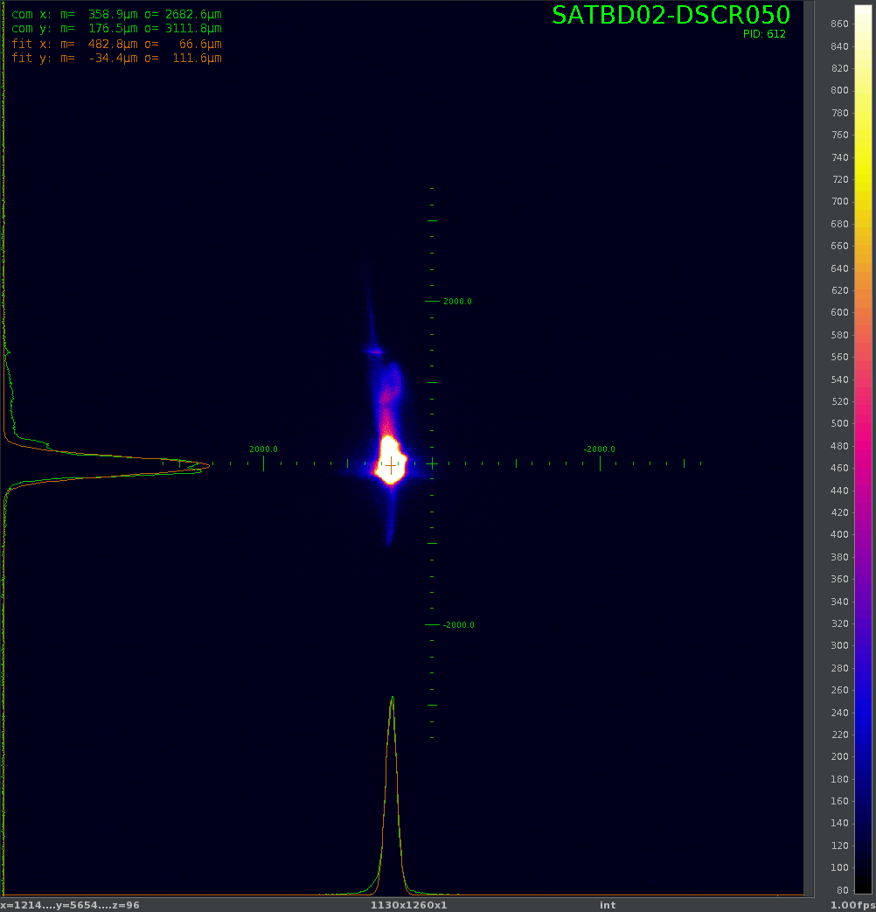
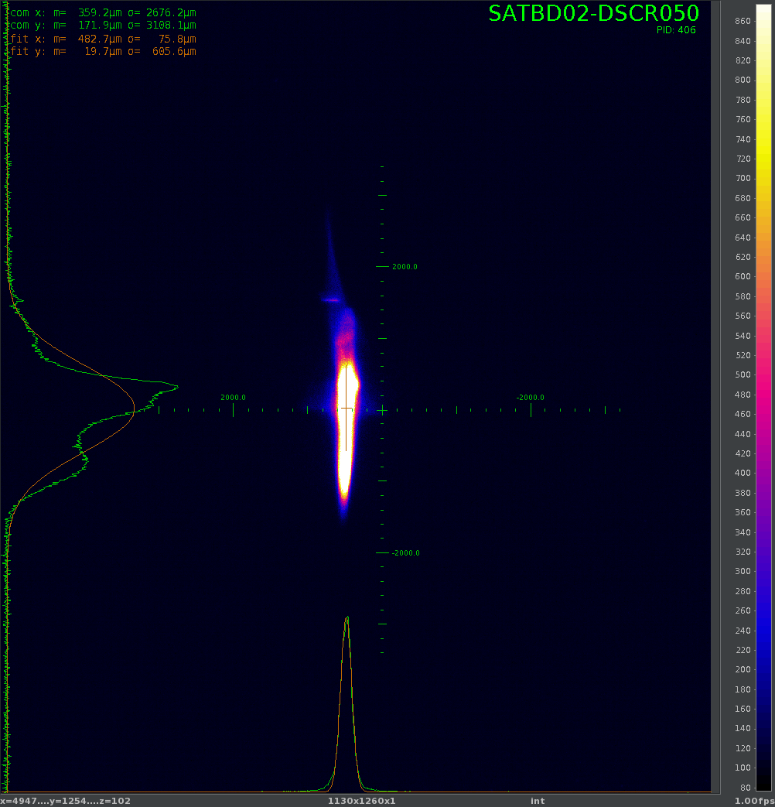
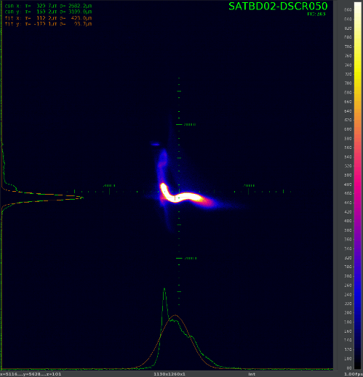
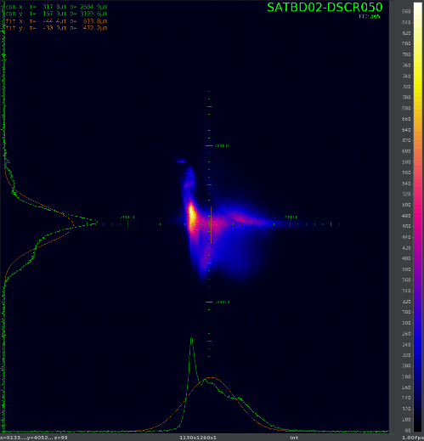
Short pulses with dechirpers (Eduard)
No lasing
Lasing
Use SATMA01 vertical dechirper to streak the beam to generate short pulses.
The pulse length can be controlled changing the dechirper offset between 0.21 and -1.2 mm.
Minimum pulse duration is about a factor of 10 shorter than standard configuration.
Use the horizontal streaker at SATMA02 to diagnose the short pulses
No streaking
Streaking

Slide 7
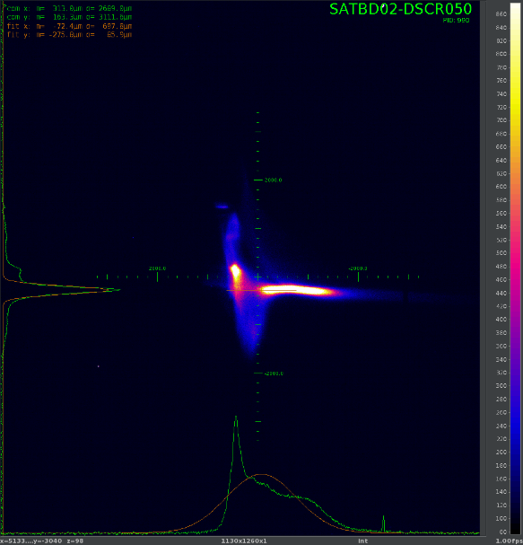
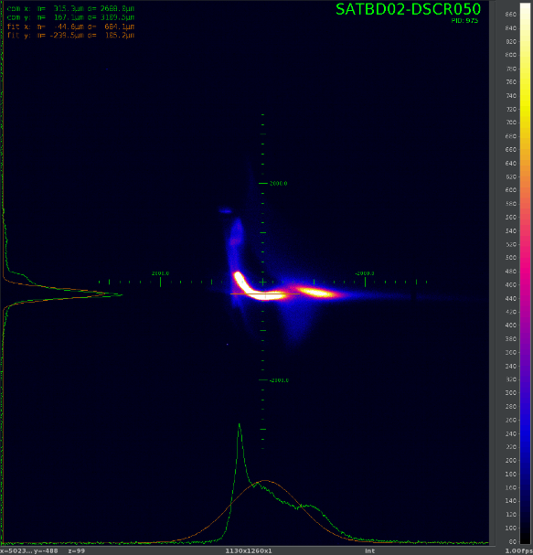
Short pulses with dechirpers (Eduard)
Head
By changing the vertical corrector just after the dechirper we can change the lasing part of the bunch
The pulse energy should vary linearly with the pulse length. This gives an indication of the reduction factor.
Was used on both Aramis and Athos during the weekend.
On Athos the repetition rate needs to be reduced when using the short pulse due to losses: with a reduction of 3-4, 10 Hz seem possible at this moment. For a reduction of 4-5, 2.5 Hz. For 10, 1 Hz for one hour...
Tail

Slide 8
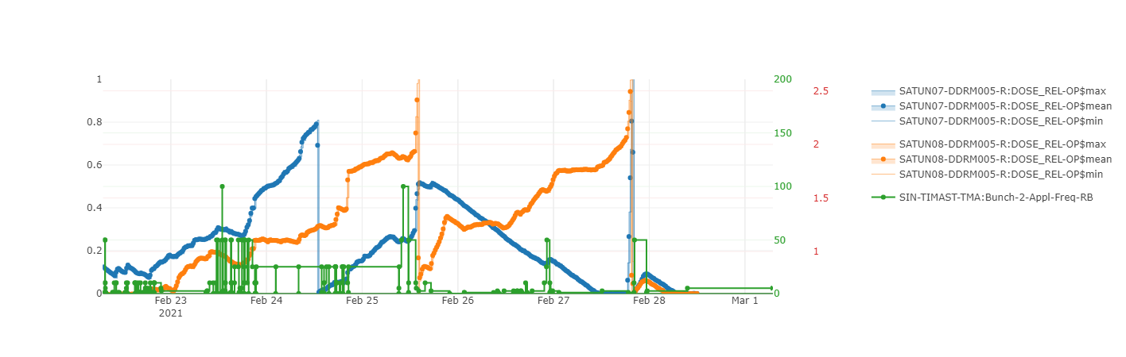
Losses in Athos
Losses in SATUN07 and 08. Other DRMs stay low.
No signal on the LLM in the Athos undulators
Two Athos BLMs see losses:
SATDI01 => dark current coming from the gun (we verify this by going to 180 degrees in the gun)
SATCL02 => electron beam
Dark current can be mitigated with BC1 collimator but this leads to higher losses in BC1 (need to compromise with DRPS limit). Local shielding would help.
Removing gun collimator leads to large loss signal increase. A smaller aperture would help.
Losses are very strong in Athos with the short pulse mode but was improving at the end of the week.
One shift is scheduled to investigate losses in Athos this in the next MD block

Slide 9
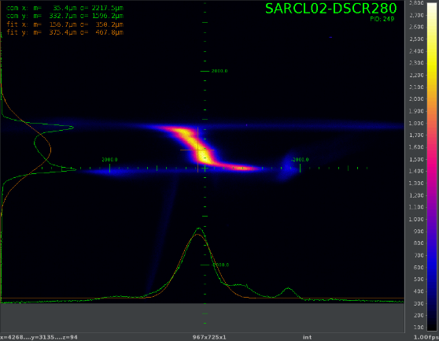
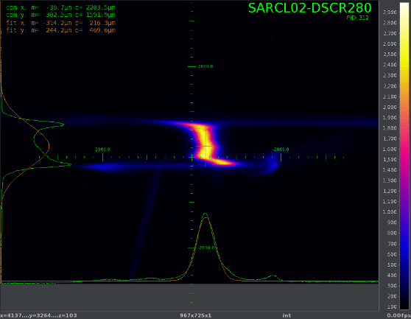
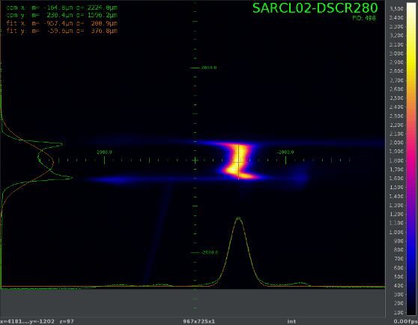
Aramis BW
Some problems with the PSSS set-up: Chris Arrell had to re-optimize the focus and alignment. New set-up script was tested.
Tried optimizing S30CB dechirpers for minimum energy chirp and bandwidth. BW down to 0.13%. We could reduce bandwidth to 0.1% by tilting the beam and thus preventing the horns to lase, but the pulse energy drops significantly.
The BW degraded during the week: difficult to optimize without touching the common part.
S30CB dechirper gap
5 mm
2 mm
1.5 mm

Slide 10
Technical difficulties
DRPS
Several DRPS alarms due to low data rate error.
This is happening always in the same location (ca 80m, close to BC1). Changing the detector unit did not solve the problem.
The error is apparently related to 100 Hz operation. Reducing the repetition rate to 50 Hz seems to solve it?!
SU contacted the supplier to investigate the problem.
Laser
Problems with mirror mover controls:
Wednesday: the in-vacuum mirror moved. Wago controller restarted. Laser alignment redone.
Sunday: Mizar aperture pointing feedback error.
Mizar arrival time was drifting, this could be compensated by adjusting the delay line

Slide 11
Lessons learnt
The machine can be set-up and operated without Psico optimization in the common part. Lasing did not drift too much. But not so good performance in Aramis.
Promising solution for pulse length controls, need to be automatize to have operators taking care of it (it was a busy week)
Need to understand and mitigate losses in Athos
More collimation at the gun
Use BC1 collimator (need some local shielding)
Need a strategy to better control and maintain Aramis BW (in parallel operation)

