Slide 1
Alvra in-house beamtime February 24th to March 8th, 2021
Demonstration of high time resolution at Alvra
SEM Meeting, March 8th 2021

Slide 2
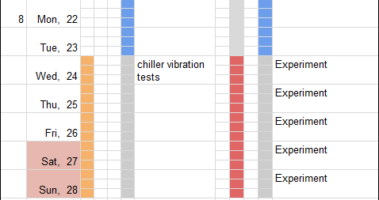
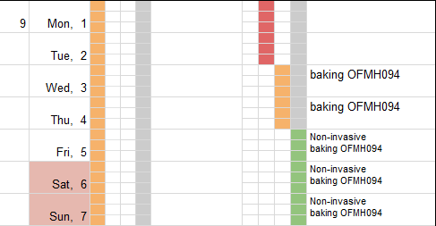
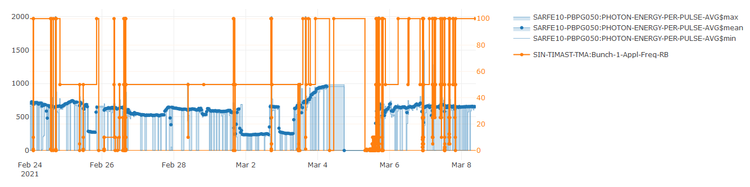
Schedule KW 8 & 9
Aramis
Athos
A B C
D M F
First week: timing tests & XES (pink beam)
    600 uJ
    Large bandwidth
    50 Hz
    Short pulses (dechirper)
Second week: timing test
    Up to 970 uJ (then 700 uJ)
    Narrow bandwidth
    100 Hz
    Short pulses (BC2)
long
long
short
short

Slide 3
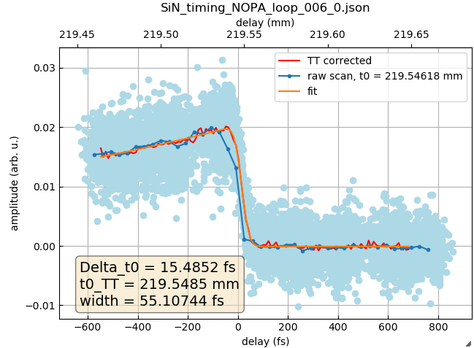
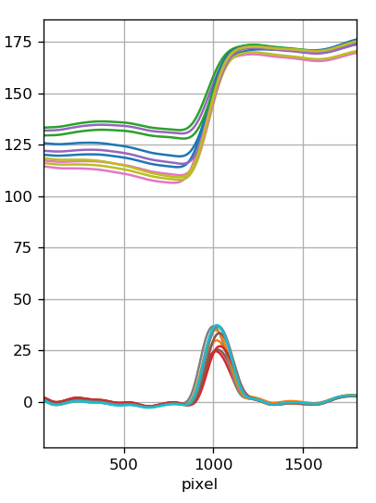
Experimental setup for timing studies
800 nm Globi
NOPA
exp delay stage
White light generation
TT delay stage
2 um Si₃N₄
Laser diode
spectrometer
20 um YAG

Slide 4
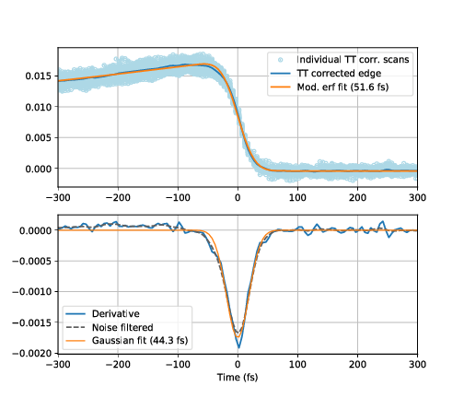
The ultimate SiN timing scans
$$σ_{total}^{2}=σ_{laser}^{2}+σ_{X−ray}^{2}+σ_{sample}^{2}+σ_{jitter}^{2}+σ_{drift}^{2}$$

Slide 5
Timing summary
E-bunch (fwhm) | Laser (fwhm) | Rise time (fwhm) | Expected X-ray fwhm
27 fs (rms!) | < 40 fs (800 nm) | 56 ± 5 | 23.2 fs fwhm!
½ 27 fs (rms!) | < 20 fs (NOPA) | 48.2 | 30.4 fs | Dechirper
63 fs | < 20 fs (NOPA) | 68 ± 4 | 54.5 fs
32.5 fs | < 20 fs (NOPA) |  |  | Compressor
< 32.5 fs | < 60 fs (400 nm) | 84 fs | 39.2 fs | Compressor
32.5 fs | < 60 fs (400 nm) | 80 fs | 39.2 fs | Compressor
Achieved high signal-to-noise, able to measure 1% signals with “quick” scans to beat slow drift effects
Reached a shorter rise time for short laser pulse and short Xray (48 fs, sample limited?)
Observed a clear change going to shorter laser pulses
Did not observe a significant difference between short and long Xray pulses in any configuration

Slide 6
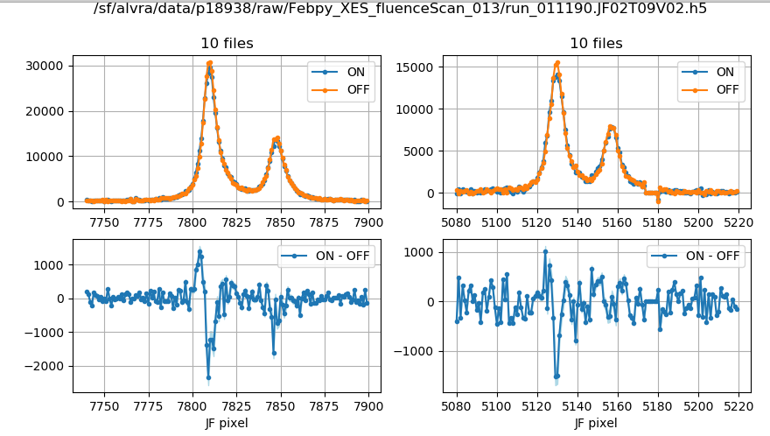
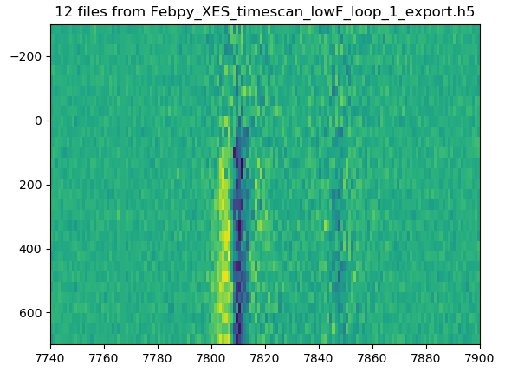
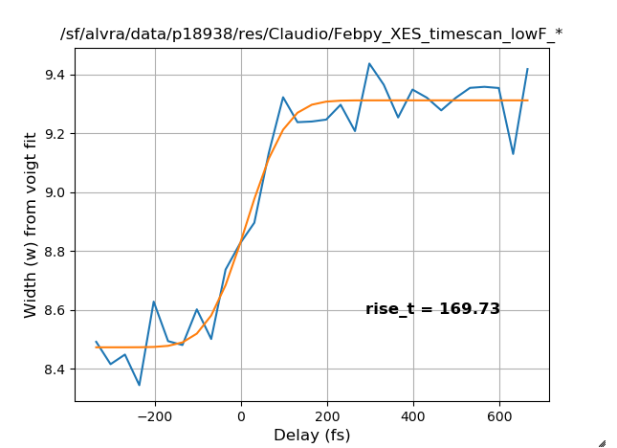
XES on FeBpy, 800 nm (40 fs) - 2 photons pump!
Measured at 1 ps delay
Suffer from uncontrolled drift
Delay (fs)
JF pixel ~ energy

Slide 7
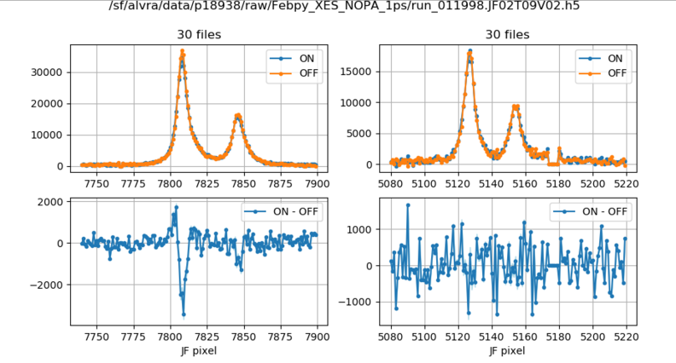
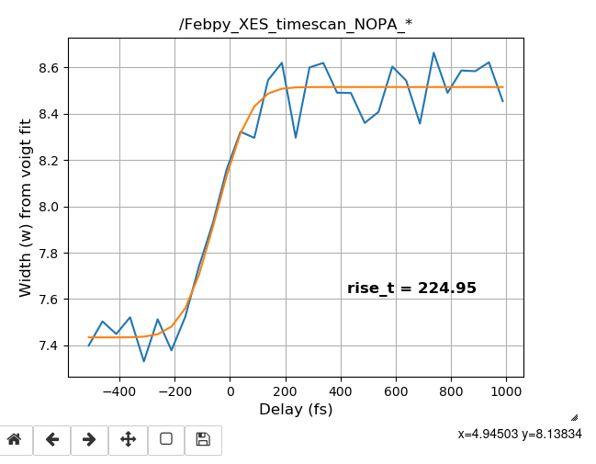
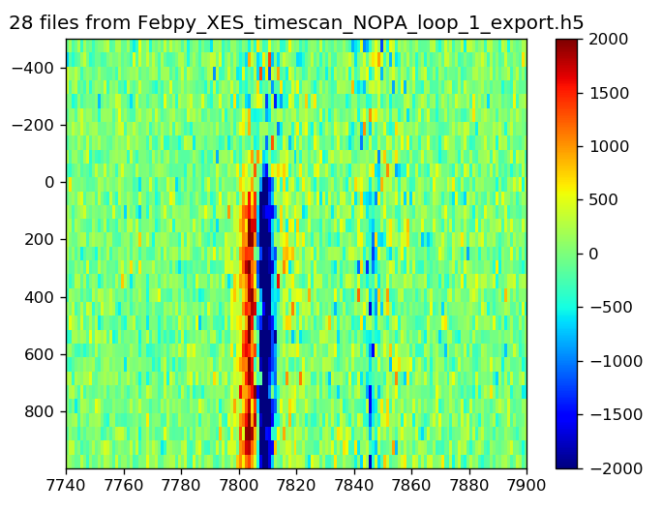
XES on FeBpy, NOPA (20 fs), 520 nm
Measured at 1 ps delay
3 x lower count rate
Suffer from uncontrolled drifts
Delay (fs)
JF pixel ~ energy

Slide 8
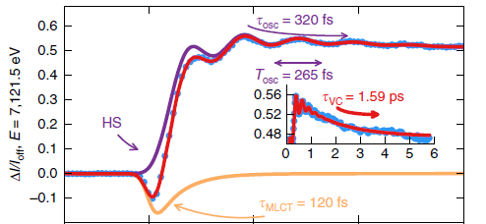
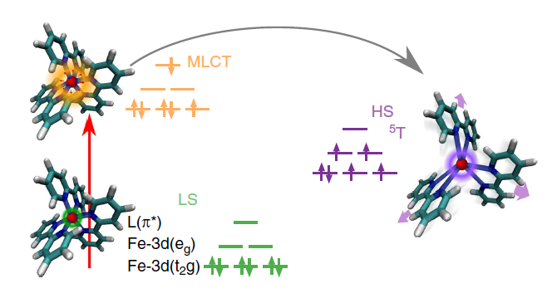
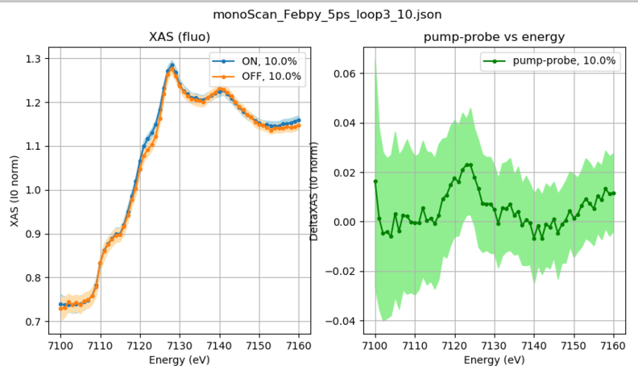
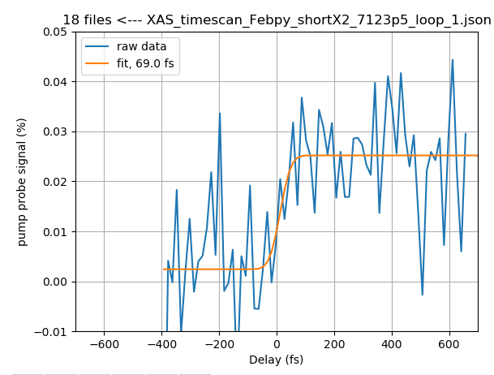
XAS on FeBpy, NOPA laser (< 20 fs)
Lemke H. et al, Nature Comm 8, 15342 (2017)

Slide 9
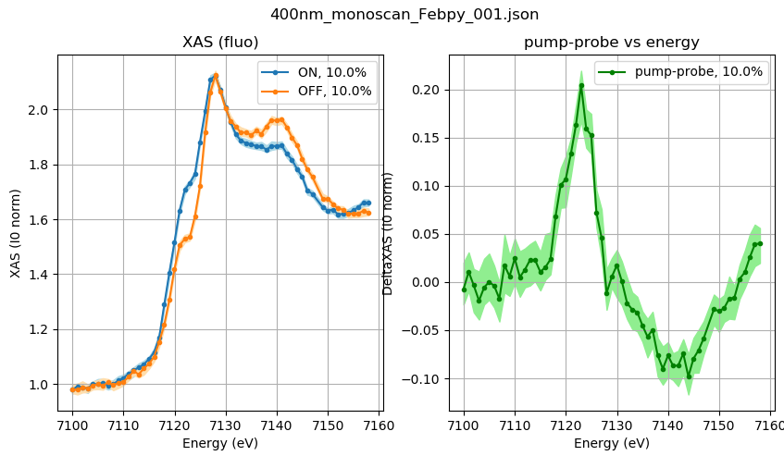
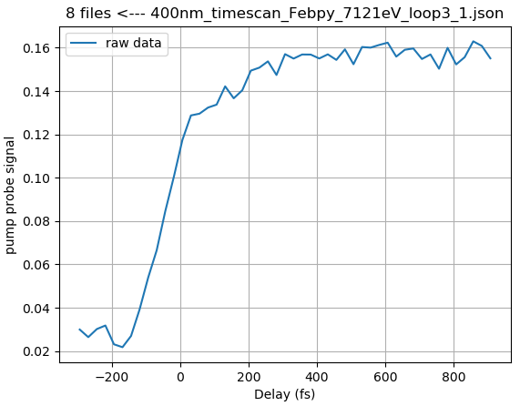
XAS on FeBpy, 400nm laser (< 60 fs)

Slide 10
Summary
First week of parallel operation not yet fully smooth:
        Could not optimize the spectral bandwidth
        Have to operate at 50 Hz
Use of the dechirper worked well (shortest rise time observed)
Second week, higher pulse energy, narrow bandwidth, 100 Hz, no arrival time feedback
Short pulses without pulse energy loss?
Amazing to get beam back only a few hours after 1 day shutdown, unfortunately this interruption forced us to start basically from the beginning with new references for S/N, timing, pump laser, etc etc
Promising data on benchmark sample (FeBpy), did not manage to investigate interesting sample (Cyt-C)
DAQ problem (before and) after forced shutdown: failures over night required intervention from the experts on Saturday / Sunday morning (databuffer restart)

Slide 12
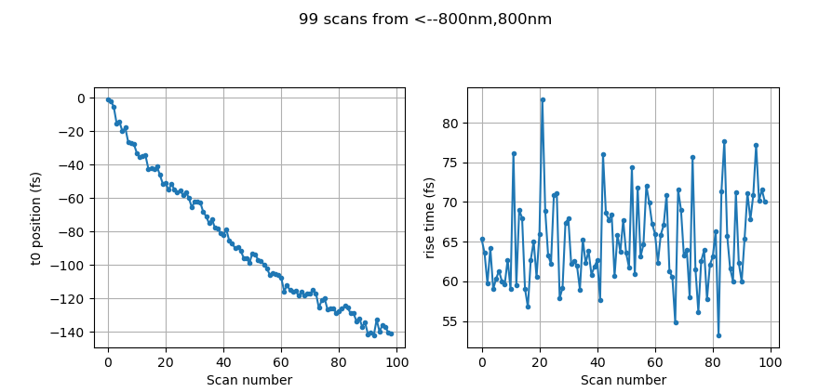
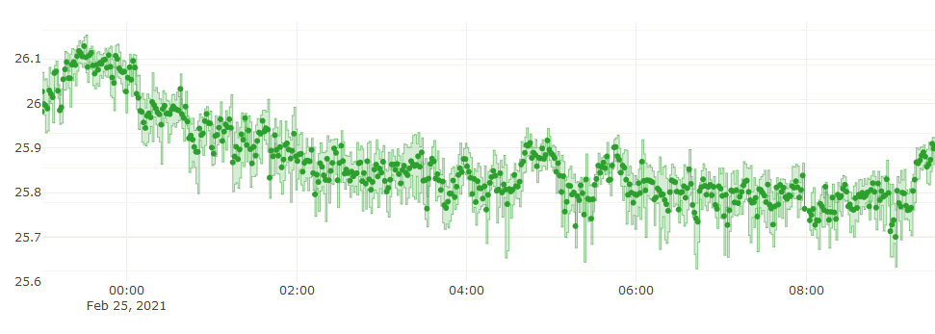
Uncorrelated drifts
~ 8 hours
Temperature

