Slide 1
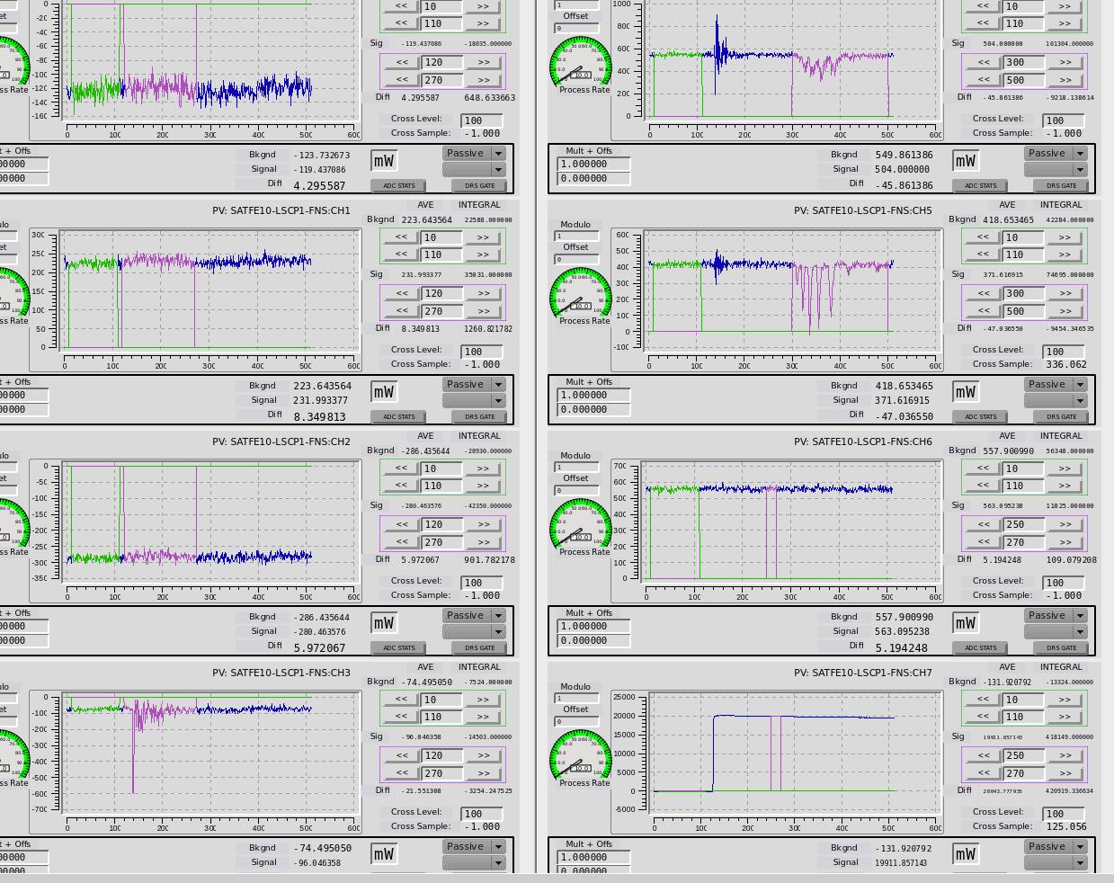
Multiplier showing signs of failure
PEPG fast channels:
This is not supposed to look like it does
The one works fine
Changed pre-amp, works fine

