Slide 1
MD week 40 report
E. Prat
SEM meeting, March 15

Slide 2
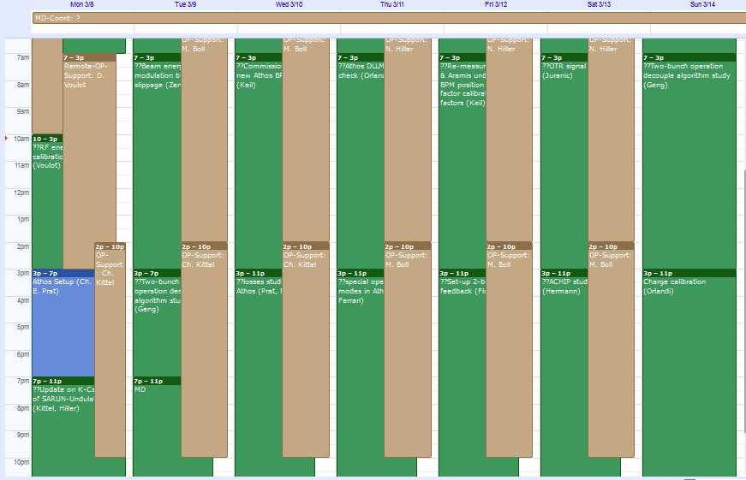
Overview
Energy modulation by phase slippage
RF energy calibration
Athos BPMs
Aramis BLMs
Aramis and Athos BPMs
OTR signal on diode in ACHIP
Two-bunch decoupling studies
Athos CHIC and
Two-bunch decoupling studies
Special operation modes Athos
ACHIP wakefield studies
Loss studies in Athos
Two-bunch feedback
Charge calibration
Athos setup
Week roughly as planned. Exceptions: Monday late (Athos setup instead of SARUN K calibration), Tuesday late (Athos and two-bunch work instead of lasing studies). Thursday morning (Aramis BLMs instead of Athos DLMs)
Notes:
2

Slide 3
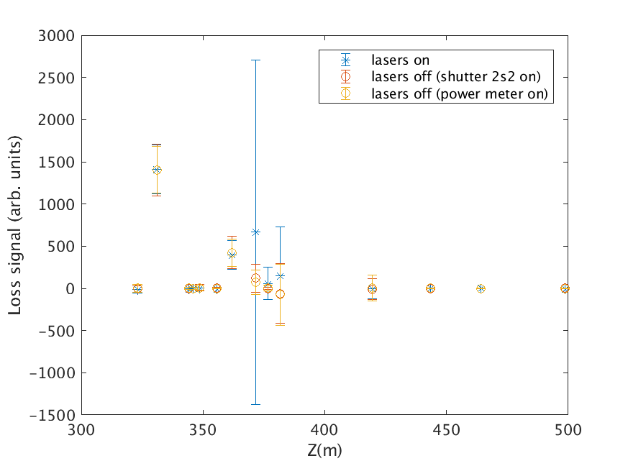
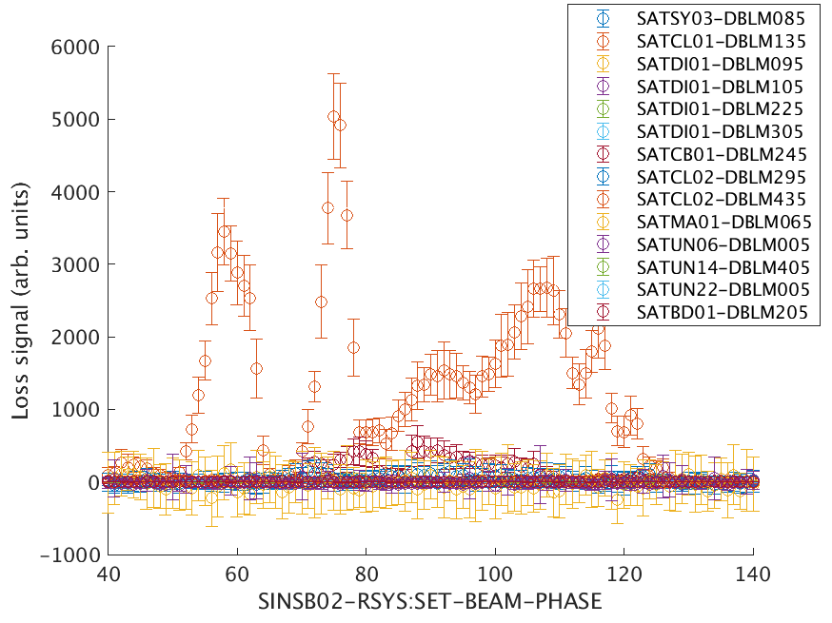
Loss studies in Athos
P. Craievich, E. Ferrari, C. Kittel, N. Hiller, E. Prat, C. Vicario
Beam studies: optics well matched from BC2 exit to Athos line, beam structure generated in BC2
Dark current studies:
  Measured BLM signals with and without laser, for different rep rates, as a function of gun timing, gun phase, SINSB01/02 and linac phase
  Conclusion: dark current from the gun transported to Athos (but not visible in undulator BLMs). It could be reduced with smaller gun collimator or operating SINSB02 at ~80 deg.
More info: https://elog-gfa.psi.ch/SwissFEL+commissioning/18904
100 Hz operation possible last week. Useful knobs: compression and septum
Notes:
3

Slide 4
Aramis BLM setup
Courtesy of F. Loehl
Aramis BLM setup – Thursday morning shift
(G.L. Orlandi, F. Loehl, OP: N. Hiller, D. Voulot)
Many BLMs did not detect beam losses correctly as the regions-of-interest were incorrectly set
  Corrected the setup of all Aramis BLMs
    Timing windows
    First iteration of setting BLM sensitivities / MPS thresholds
  2 BLMs still have a problem

Slide 5
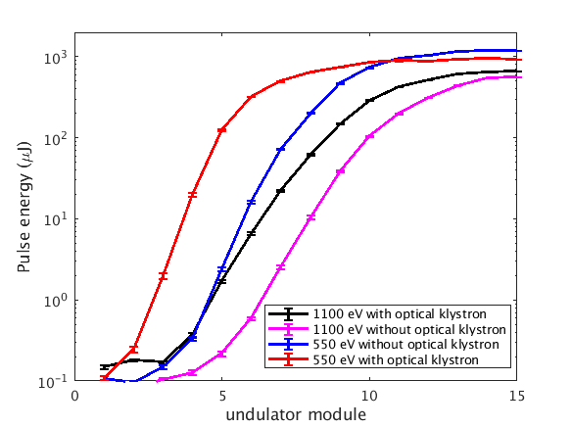
Special operation modes in Athos
E. Ferrari, E. Prat
Optical klystron
Optimized SASE with and without optical klystron for 550 and 1100 eV photon energies → Optical klystron helps to reduce saturation length by ~2 modules.
Measured energy spread from optical klystron curve → Reconstructed values are ~800 keV for both 550 and 1100 eV.
(No time for 2-color mode)
More info: https://elog-gfa.psi.ch/SwissFEL+commissioning/18922
Notes:
5

Slide 6
RF step feedback for Athos
Courtesy of F. Loehl
Setup of RF step feedbacks for Athos (F. Loehl, S. Bettoni, OP: M. Boll, A. Facchetti)
Mario fixed a bug in the LLRF software that caused the functionality of applying RF steps for Athos to freeze (before, sometimes RF steps were tuned but not applied due to a frozen software)
Setup and tested feedbacks for
  Laser heater beam energy
  BC1 beam energy and bunch compression
  BC2 beam energy and bunch compression
Feedbacks allow to bring Athos beam to desired beam energy and compression values (before, this was not the case) and maintain these settings
Feedback significantly simplify the two-bunch setup
Feedbacks de-couple operation of Aramis and Athos and allow for independent tuning. We tested this over a typical tuning range.
  Athos feedbacks are slow (limited by LLRF implementation of steps)
  Tuning range limited

Slide 7
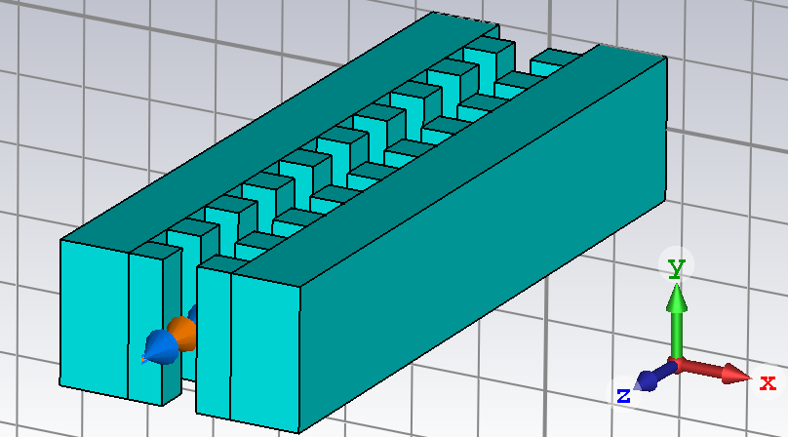
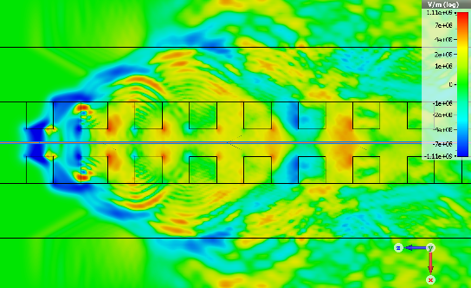
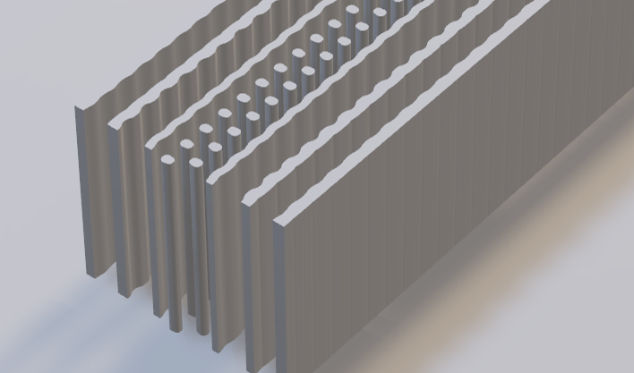
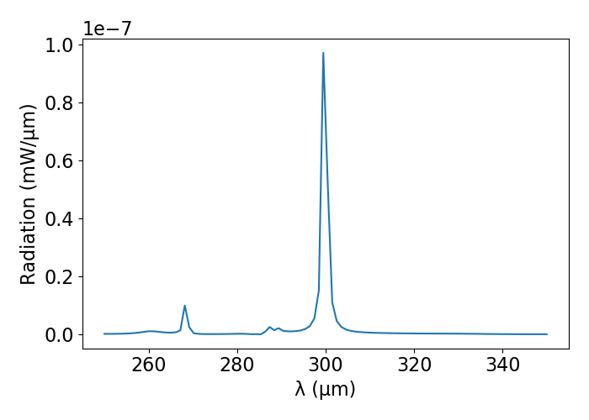
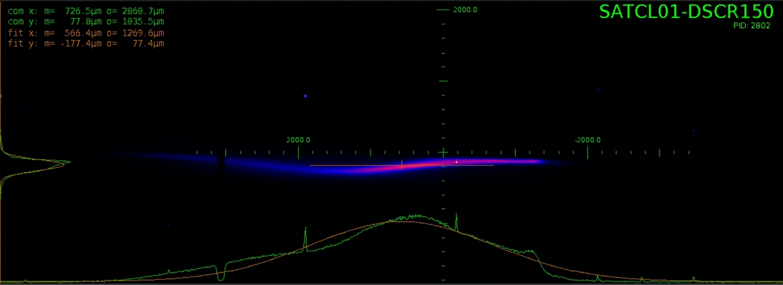
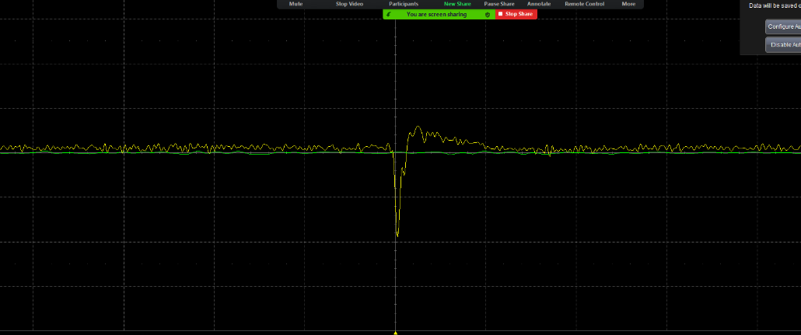
ACHIP studies
Courtesy of B. Hermann
Wakefield shaping with dielectric micro grating, fused silica, 20 micron gap
Narrowband THz generation, inverse design extractor geometry, 3d printed polymer
Transverse and longitudinal wakes observed
first signal on Shottky diode
Participants: B. Hermann, A. Dax, N. Hiller, R. Ischebeck, P. Juranic (PSI); L. Bagnale, T. Egenolf, U. Niedermayer (TU Darmstadt); G. Yadav (Uni Liverpool)
More info: https://elog-gfa.psi.ch/SwissFEL+commissioning/18950

Slide 8
Others
Energy calibration (D. Voulot, Monday morning): adjusted calibration factor of ECOL to match PSSS, measured energy calibration of linac 3. https://elog-gfa.psi.ch/SwissFEL+commissioning/18866
Beam energy modulation by phase slippage in C-band (R. Zennaro, Tuesday morning). https://elog-gfa.psi.ch/SwissFEL+RF/5576
BPM studies (B. Keil, Wednesday and Friday morning):
  Recalibrated BPM charge in Aramis in Athos
  Recalibrated XY scaling factors of Aramis undulator BPMs with quad movers
  Tested and calibrated 4 newly installed BPMs in SATMA01/02. Ready to be used!
  Recalibrated beam angles in SATUN
  https://elog-gfa.psi.ch/SwissFEL+commissioning/18896 and https://elog-gfa.psi.ch/SwissFEL+commissioning/18939
OTR signal on diode (P. Juranic, Saturday morning). Not possible due to broken diode
Two-bunch decoupling (Z. Geng, Tuesday late and Sunday morning): tested algorithms for 2 bunch setup, https://elog-gfa.psi.ch/SwissFEL+RF/5579 and https://elog-gfa.psi.ch/SwissFEL+RF/5581
Bunch charge measurements with FC and WCM (GL. Orlandi, F. Marcellini, P. Craievich, Sunday late): https://elog-gfa.psi.ch/SwissFEL+commissioning/18971
Notes:
8

Slide 9
Main issues
Mizar synchronization issues. Work on Mizar by Cezary on Thursday morning to mitigate the problem, deeper repair may be needed, see https://elog-gfa.psi.ch/SwissFEL+commissioning/18917
Synchronization / timing issues on Thursday evening. Lasing in both beamlines lost after Mizar lost its synchronization. Could be recovered by changing lasers arrival time with FBs on (BC1 settings equivalent but BC2 phase changed by more than 2 degrees). Many thanks to A. Dax and F. Loehl for their help!
Athos quad movers issues: not moving properly on Wednesday (https://elog-gfa.psi.ch/SwissFEL+commissioning/18901 ) and not moving on Friday (solved). https://elog-gfa.psi.ch/SwissFEL+commissioning/18942
Oscillations of BAM signals (solved). https://elog-gfa.psi.ch/SwissFEL+commissioning/18941
Notes:
9

Slide 10
Final comments
It was overall a good week with excellent progress in many fronts
Operation support worked very well. Thanks to Christoph, Didier, Nicole and Marco for a very smooth week
Notes:
10

