Slide 1
SwissFEL Exchange Meeting
Machine report
Week 12/2021
Didier Voulot, SEM, 29 March 2021

Slide 2
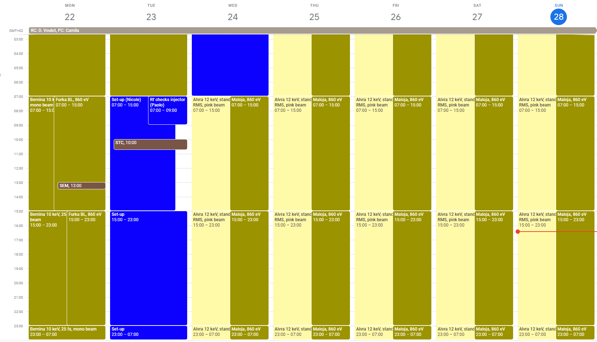
Week overview

Slide 3
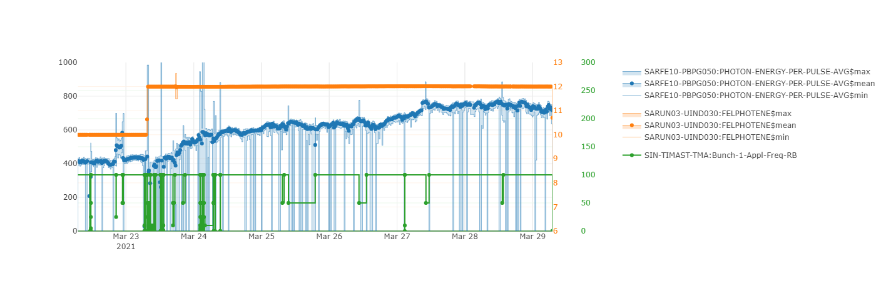
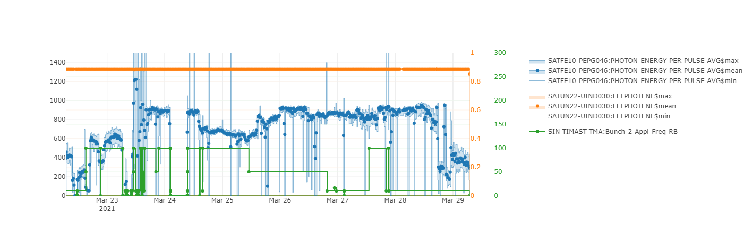
Aramis
Athos
Notes:
Maloja run, priority Athos

Slide 4
Set-up
Started from a reasonably well set-up machine: Aramis 400 uJ at 10 keV
Beam dynamics support from: Simona and Florian.
Scale Aramis from 10 to 12 keV (undulator K and linac3 energy). Went smoothly 200 uJ immediately, 360 uJ after restoring undulator settings.
Standard checks (laser, RF phasing, emittance and bunch length), but not systematic set-up. Keep the machine running. This has been the case in the last week seems to be a good strategy.
Kept all feedbacks on and PSICO running. Record lasing in Aramis 12 keV 780 uJ.
Athos running at a lower pulse energy 650-950 uJ at 0.87 keV. Did not try to maximize lasing.
Instability with Mizar timing. Sudden intensity jumps. Occurred several times during the week.
Both lines could operate at 100 Hz during the week. Still some losses in SATUN07. We reduced the repetition rate when the beam was not used.

Slide 5
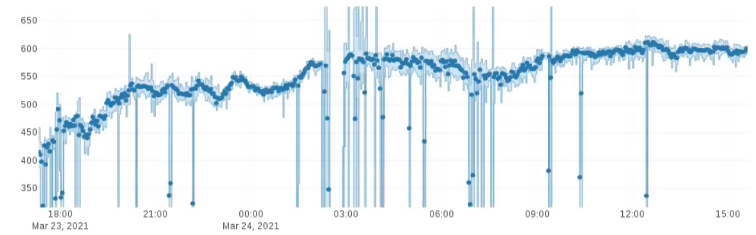
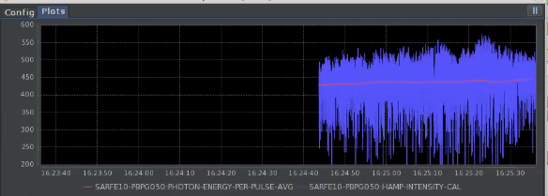
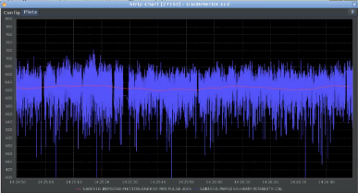
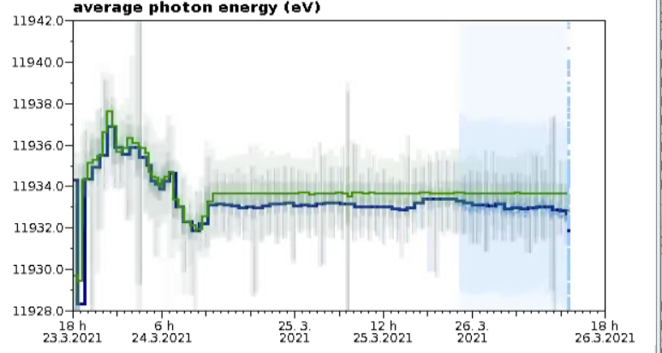
Machine support (from Tue PM)-Aramis
S. Bettoni, F. Loehl,
D. Voulot (RC), M. Boll (in shift)
FEL intensity optimization at 12 keV:
  Machine given in a good state: about 400 uJ at 12 keV
  Florian added the PBPS053 as a sensor for the FEL pointing. Quick manual optimization: 520 uJ
  FEL pointing adjusted degraded FEL intensity
  Lasing up to almost 600 uJ in few hours. Peak of 780 uJ during the week
Manual
PSICO (intensity)
PSICO (BW)
Run at 100 Hz
Run at 100 Hz
Run at 10 Hz
(issue during the night)
615 uJ at 12 keV
Peak 780 uJ
Stability improvement
Pointing adjustment
FEL stability and drift control:
  Laser optimization (with the laser group)
  Opened the dechirper to avoid any orbit jitter
  amplification:
    BW (compression and tilt) and losses re-optimized
  All feedbacks running:
    Longitudinal: arrival time, bunch compression and energy, FEL energy
    Transverse: laser aperture in optimized, optics
  PSICO on:
    To improve the machine, and stabilize it in case of drifts
    Active on the common part: no Athos degradation
Tuesday
(before optimization)
Friday
FB off
FB on

Slide 6
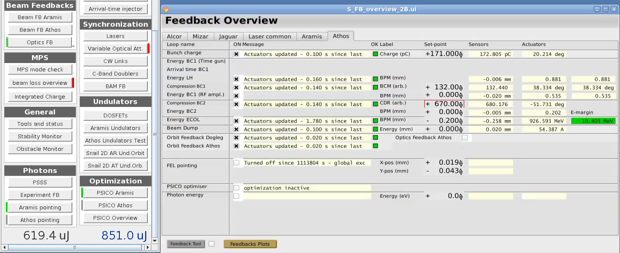
Machine support (from Tue PM)-Athos
S. Bettoni, F. Loehl,
D. Voulot (RC)
FEL intensity optimization at 877 eV:
  Machine given in a good state: about 900 uJ
  Compensated for a drop in FEL intensity
FEL stability:
  No longitudinal feedbacks acting, because RF steps out of range from last week
  Optimized the longitudinal setup of bunch 2 to have all the RF steps in limits and feedbacks running
  Not required to optimize them after Mizar timing jumped, and left off (RC decision)
Not large margin

Slide 7
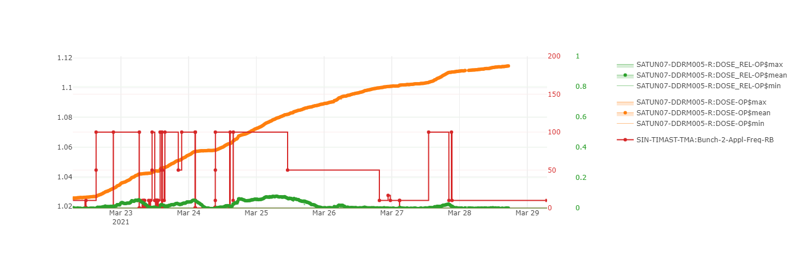
Losses in Athos
AT 100 Hz SATUN07 still sees too much dose.
Still less than 20 mGy per day.
All other DRMs are now ok.
Not clear what has improved: QFU based undulator alignment, new optics, collimator/dechirpers?

Slide 8
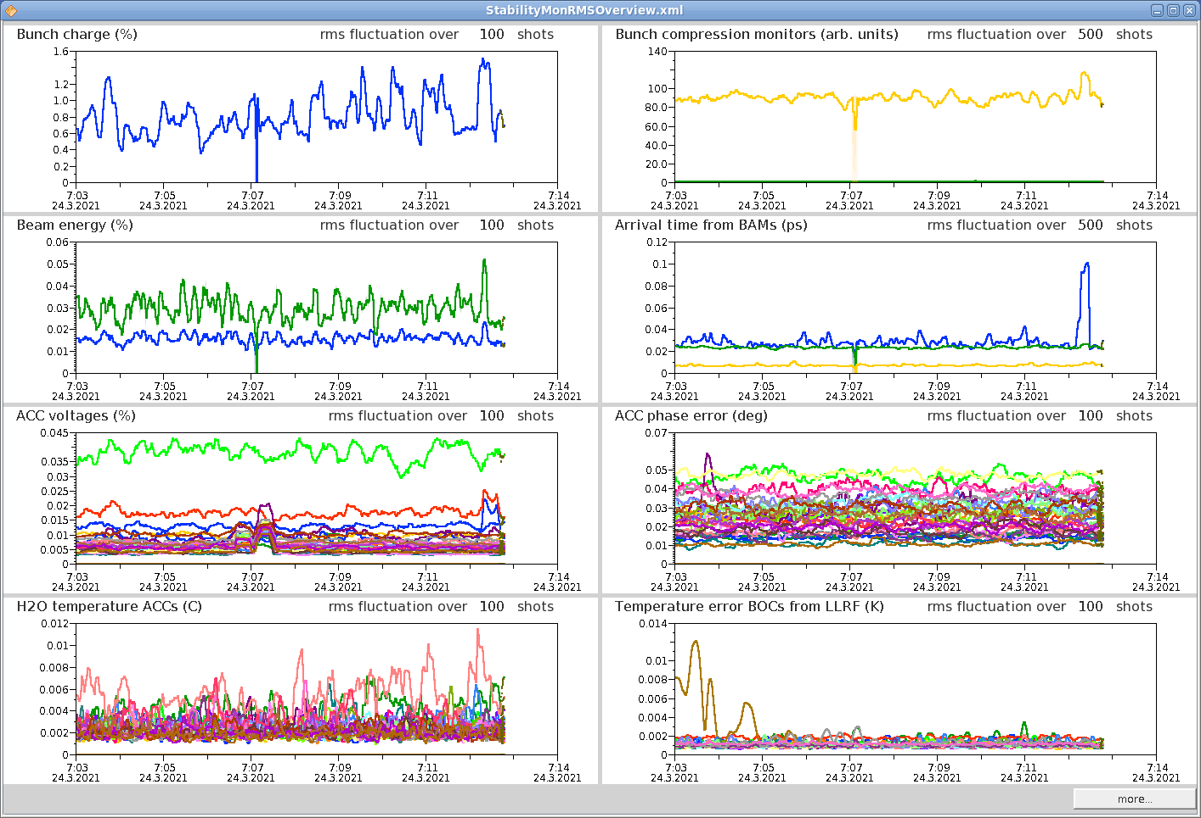
Athos charge instabilities

Slide 9
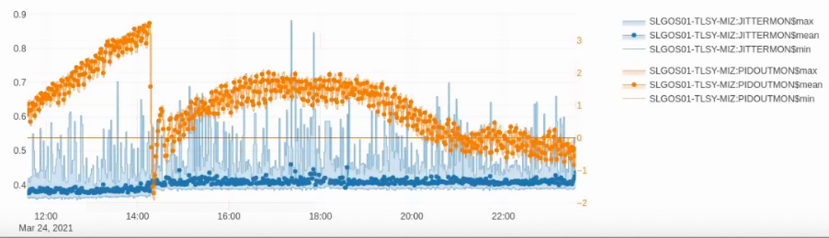
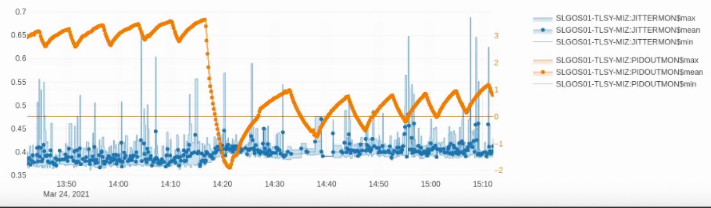
Mizar arrival time/synchro
Florian: Jump was caused by change in the Mizar oscillator when a step to the temperature regulation was applied
Lasing could be recovered using feedback target values, the gun RF steps and the Mizar arrival time (Simona, Florian)

Slide 10
Technical difficulties
Network down. No access to machine controls for 30 min (SLS, Proscan, HIPA SF).
PSSS movers not reproducible/reliable (ioc problems, position hysteresis)
MK failure, could not be reset by the shift crew. Was restarted in the morning by Martin Paraliev. Controls/documentation to be improved.
Data buffer stream stopped
BAM second optical amplifier (EDFA2) turned off. Controls problem?

Slide 11
Lessons learnt
Keep the machine running and only do basic checks in the set-up seems to be a good strategy. The machine has been kept lasing on both lines for several weeks now.
New pulse energy record for Aramis with PSICO running on the main branch. Could maintain the lasing in Athos (bunch2 feedbacks).
100 Hz operation on both lines is now possible. Still need to improve losses in SATUN07.

