Slide 1




Transverse Beam Emittance Measurement by Undulator Radiation Power Noise
Ihar Lobach (UChicago)
LEAPS WG2 Workshop
Ihar Lobach, Sergei Nagaitsev*, Valeri Lebedev, Aleksandr Romanov, Giulio Stancari*, Alexander Valishev, Aliaksei Halavanau, Zhirong Huang, Kwang-Je Kim
*dissertation advisors

Slide 2

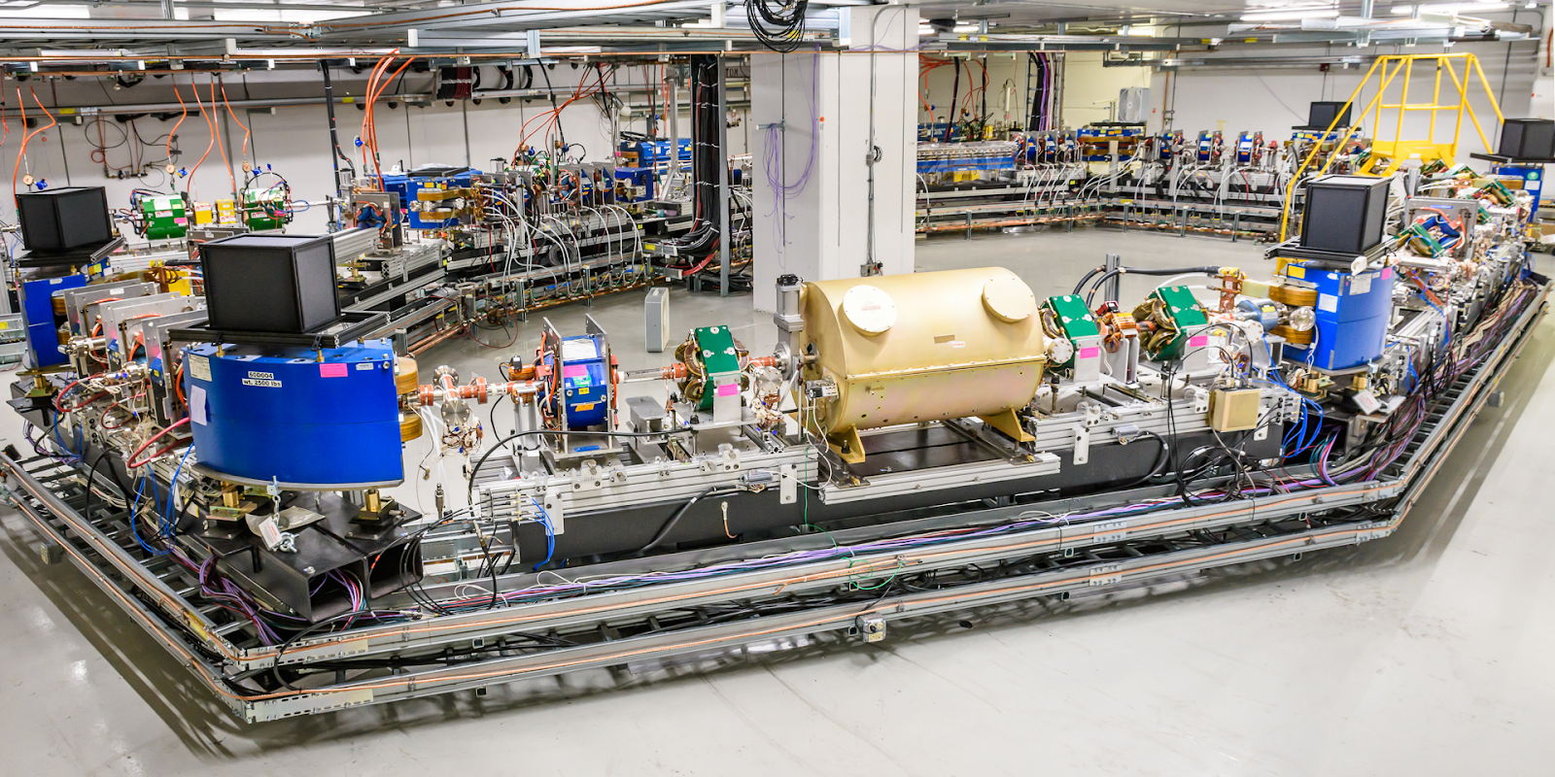
Fermilab Integrable Optics Test Accelerator (IOTA)
First beam Aug 21, 2018
Particles: electrons/protons
Main experiments:
  Nonlinear beam optics
  Optical stochastic cooling
Circumference: 40 m (133 ns)
Electron energy: 100 MeV
In our experiments:
Single electron bunch, up to 0.5 nC
About 30 cm long (rms)

Slide 3
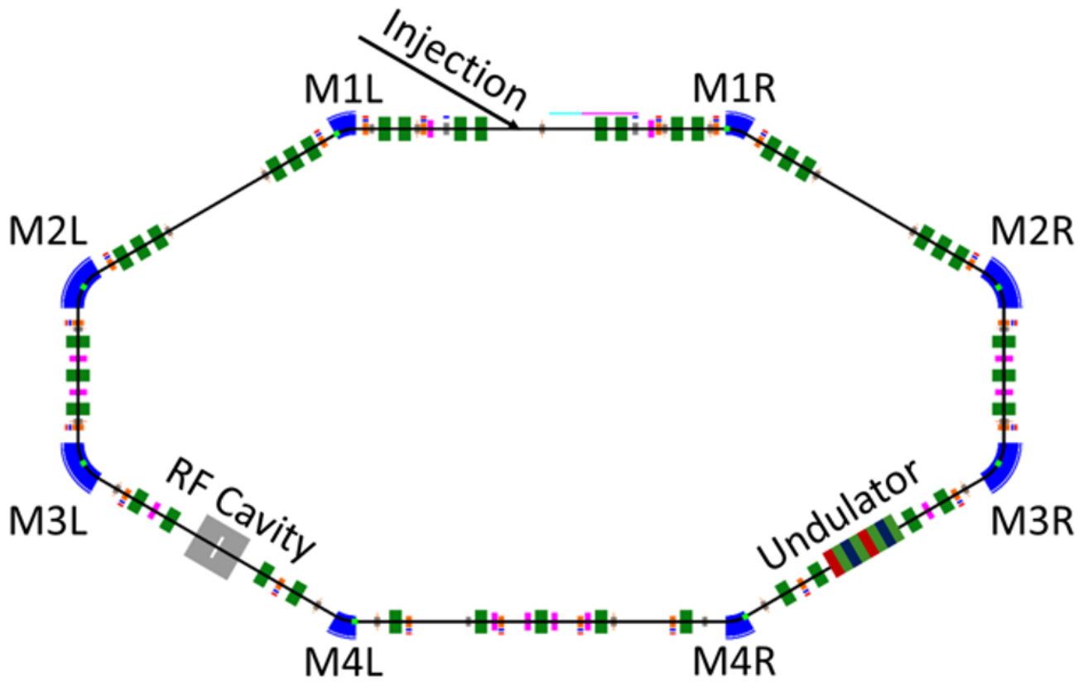
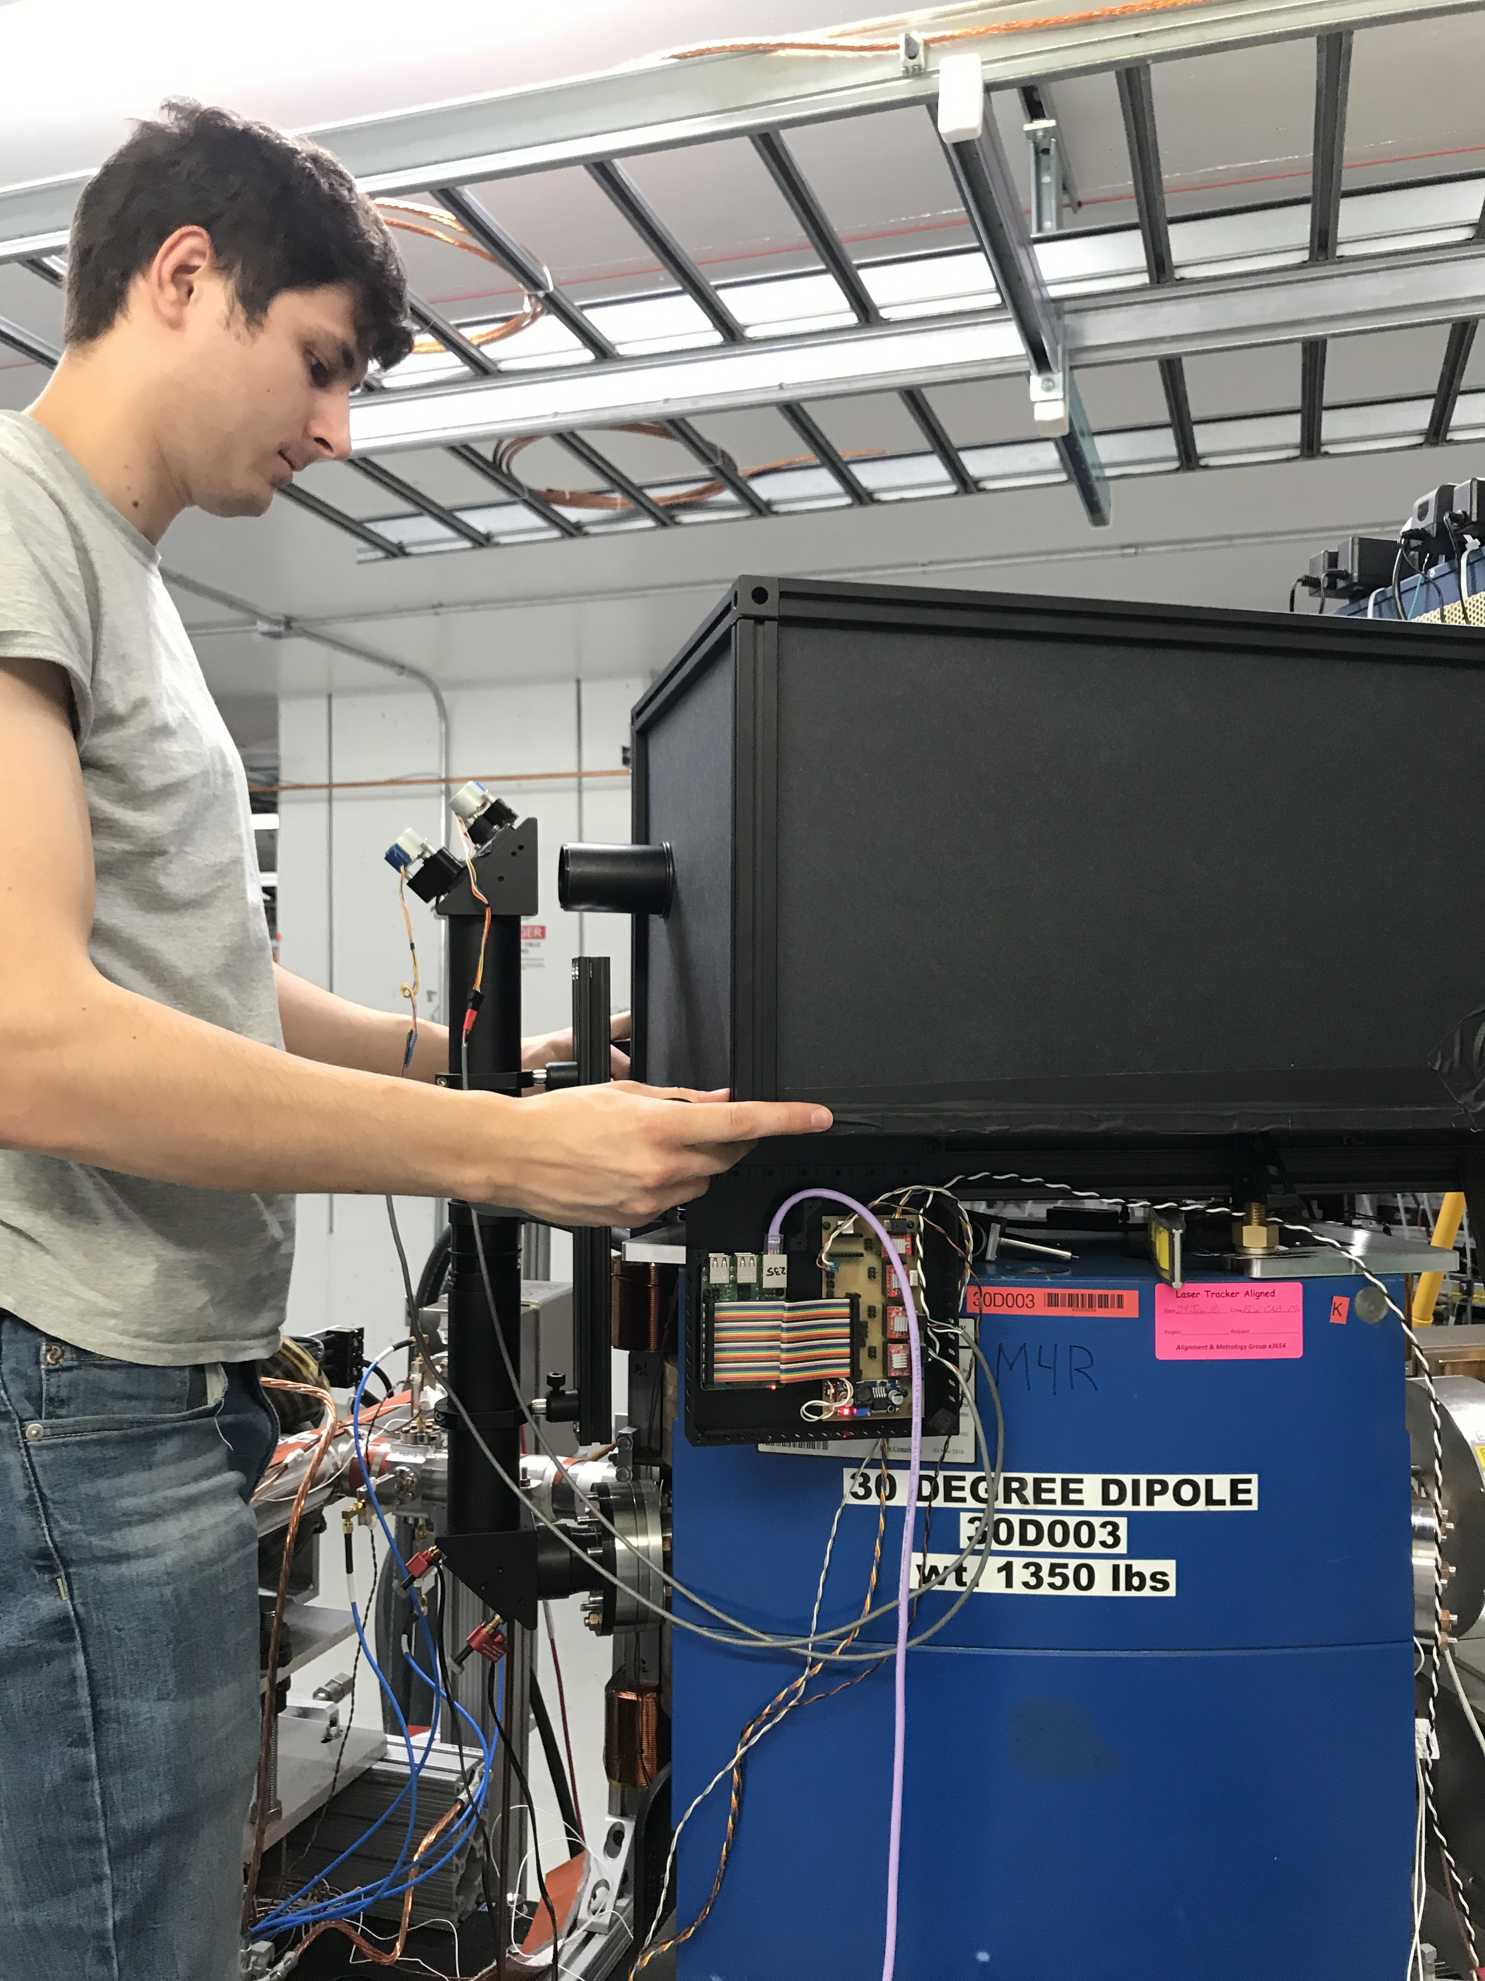
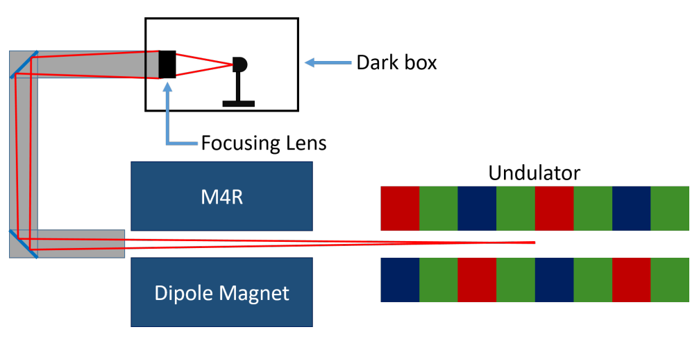
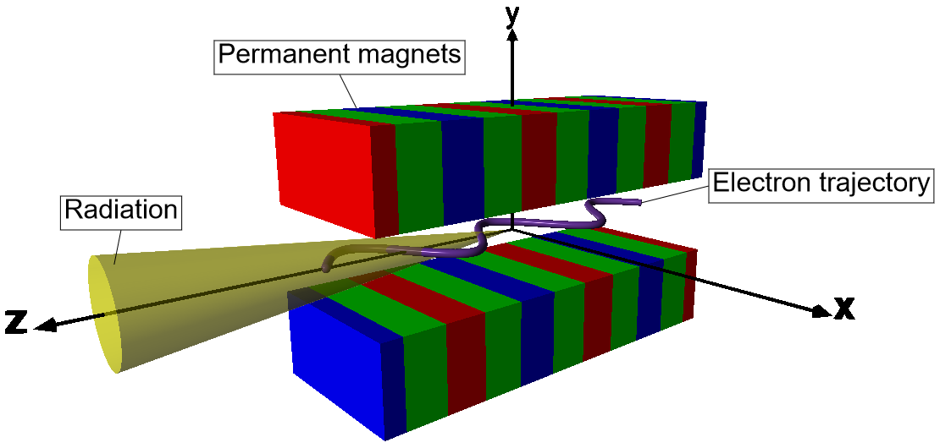
Layout of the undulator section in IOTA
photo credit Evan Angelico

Slide 4
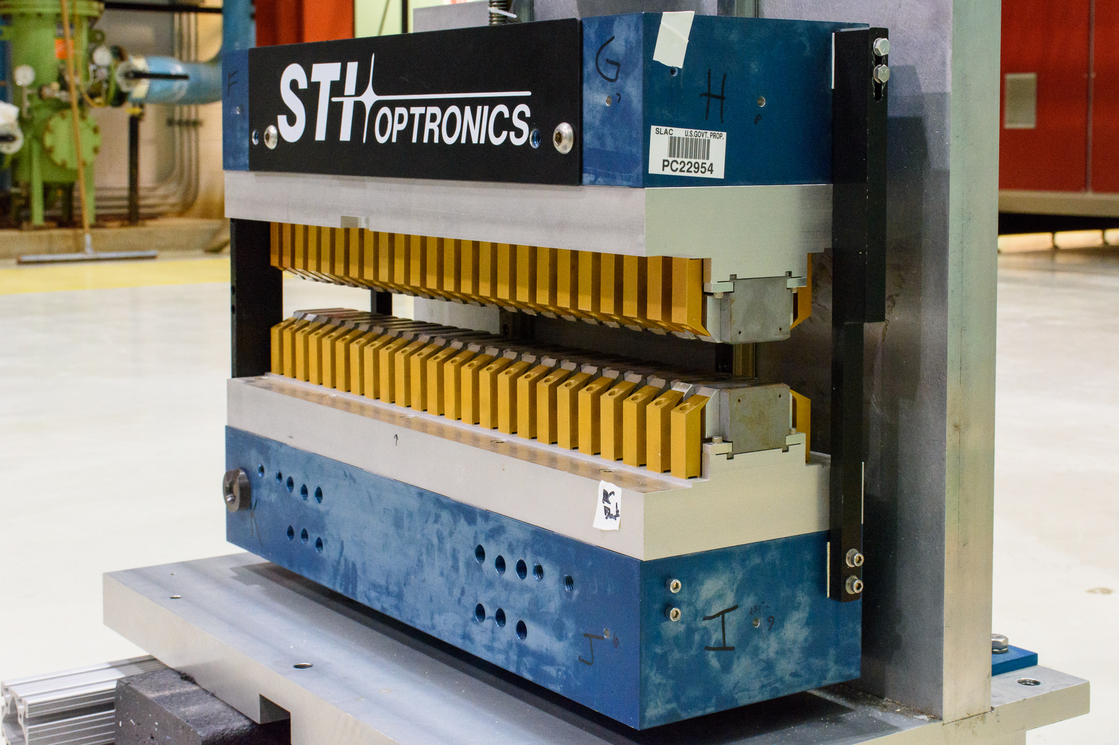
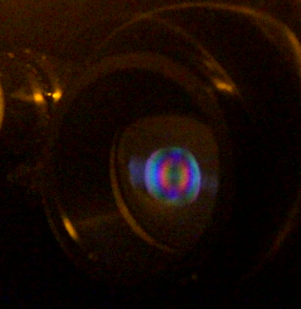
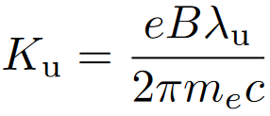
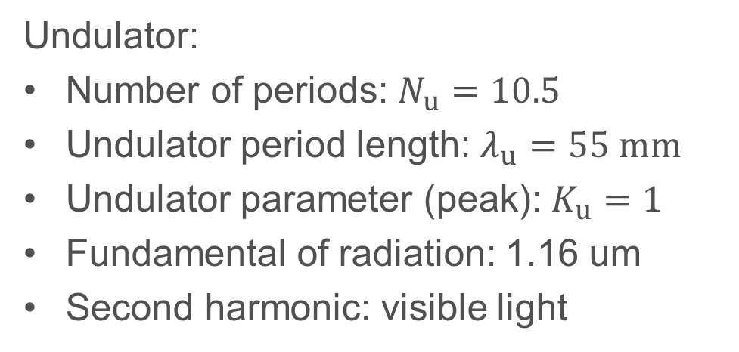
Parameters of the undulator in IOTA
Many thanks to our collaborators from SLAC for providing the undulator
Undulator radiation on the surface of an optical shutter
Undulator:
Number of periods: $N_{u}=10.5$
Undulator period length: $λ_{u}=55 mm$
Undulator parameter (peak): $K_{u}=1$
Fundamental of radiation: 1.16 um
Second harmonic: visible light

Slide 5
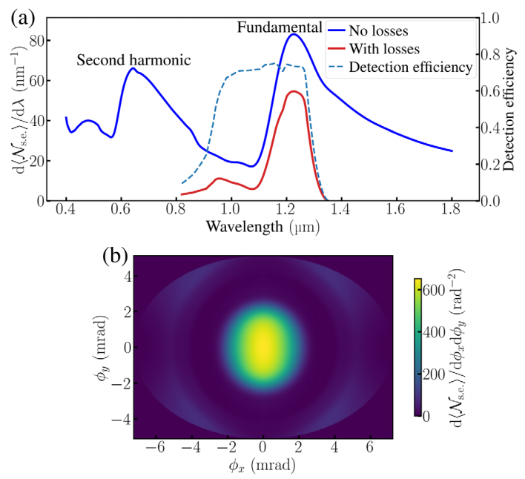
Spectral-angular radiation distribution
In our experiment:
#1
Detect the fundamental ($≈1.16$um). InGaAs p-i-n photodiode
#2
Wide band ($≈0.14$ um FWHM). Large acceptance angle $>1/γ$
Simulated total intensity:
Measured:

Slide 6
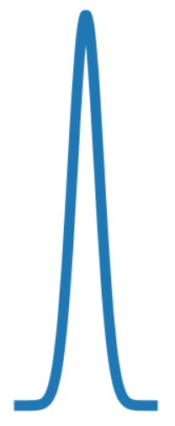
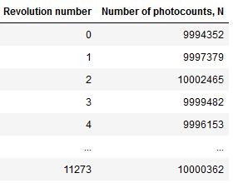
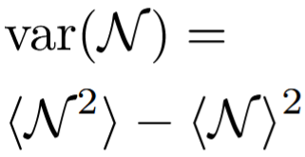
Format of collected data
1.5 ms
The initial goal was to systematically study $var(𝒩)$ as a function of:
Electron bunch charge (0-0.5 nC)
Electron bunch transverse emittances, bunch length
Transmission of optical filters
Then, we realized that we can reverse this procedure and infer the electron bunch parameters from the measured $var(𝒩)$

Slide 7
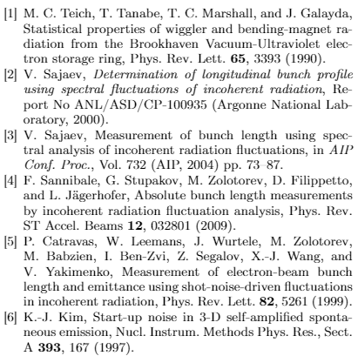
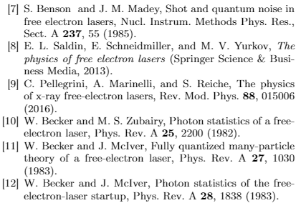
Previous research about statistical properties of synchrotron radiation
Both theoretical and experimental results:

Slide 8
Outline
Theoretical consideration
Details about the apparatus and measurement procedure
Measurements of the fluctuations
Measurements of electron beam emittances via the fluctuations

Slide 9
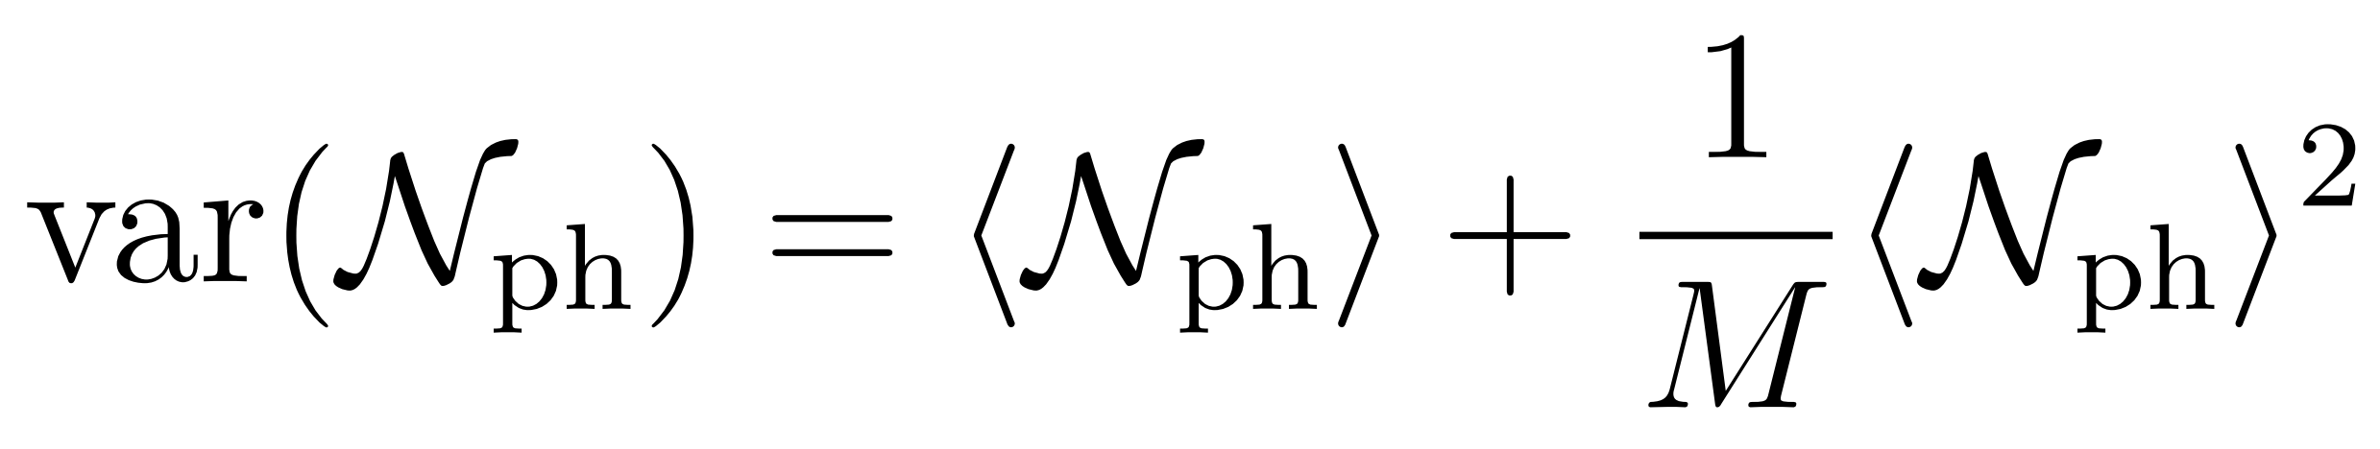
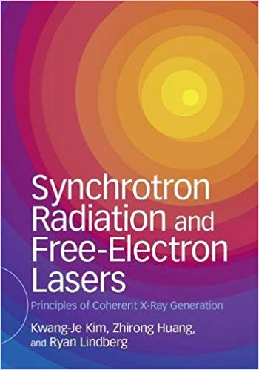
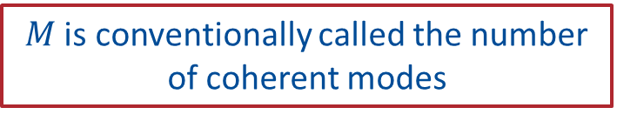
Theoretical predictions
Discrete quantum nature of light
(Poisson fluctuations)
Turn-to-turn variations in relative electron positions and directions of motion
Page 28:
$M$ is conventionally called the number of coherent modes

Slide 10
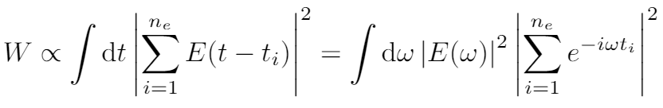
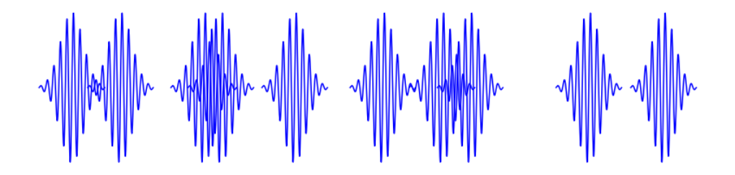



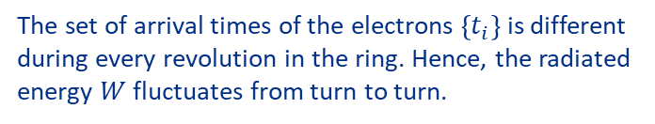
Origin of the second term
Simplified 1D model:
Pulses emitted by the electrons:
The set of arrival times of the electrons $\left\{t_{i}\right\}$ is different during every revolution in the ring. Hence, the radiated energy $W$ fluctuates from turn to turn.
If we also consider transverse electron bunch dimensions and a Gaussian angular radiation profile:
F. Sannibale, et al, Phys. Rev. ST AB, 12, 032801 (2009)
I. Lobach, et al, Phys. Rev. Accel. Beams, 23, 090703 (2020)

Slide 11
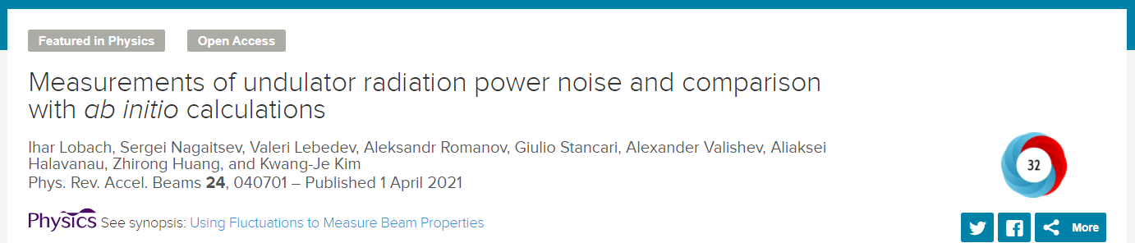
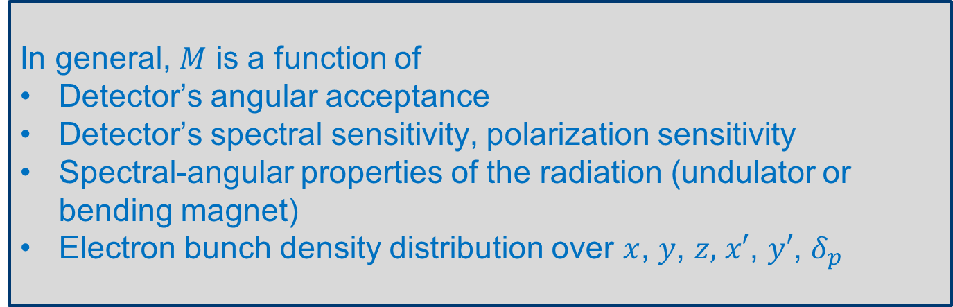
Realistic case
In general, $M$ is a function of
Detector’s angular acceptance
Detector’s spectral sensitivity, polarization sensitivity
Spectral-angular properties of the radiation (undulator or bending magnet)
Electron bunch density distribution over $x$, $y$, $z,$ $x′$, $y′$, $δ_{p}$
We accounted for this part for the first time

Slide 12
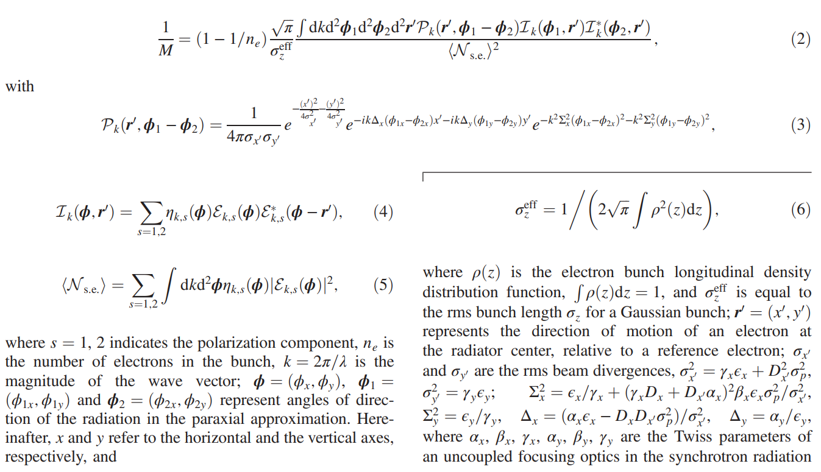



The obtained expression is very complex and includes a multidimensional integral:
Transversely Gaussian beam
Arbitrary longitudinal density distribution
The code for numerical computation is available at https://github.com/IharLobach/fur
Despite the complexity, there is an important conclusion:
If only one parameter of the electron bunch is unknown, it can be inferred from the measured fluctuations

Slide 13
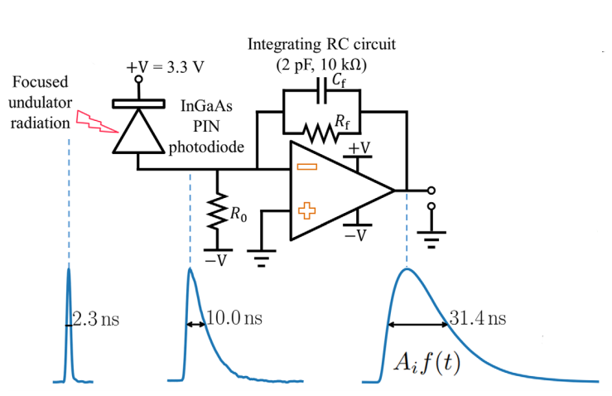
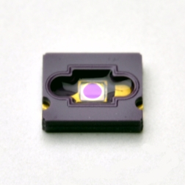

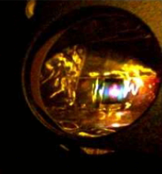



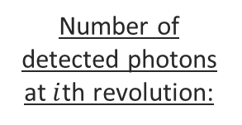
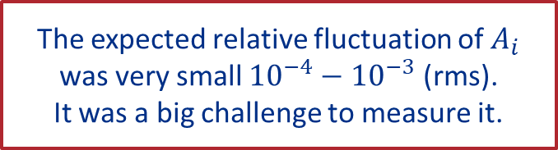

Details about apparatus
InGaAs PIN photodiode
*the circuit was built by Greg Saewert
Number of detected photons at $i$th revolution:
G11193-10R
Sensitive area: $∅1mm$
Quantum efficiency at $1.16 μm$: 80%
The expected relative fluctuation of $A_{i}$ was very small ${10}^{−4}−{10}^{−3}$ (rms).
It was a big challenge to measure it.
*Many thanks to Mark Obrycki, Peter Prieto, David Johnson, Todd Johnson and Greg Saewert for the equipment for the setup and for their help during our detector tests.
*comparable to the resolution of our 8-bit scope

Slide 14
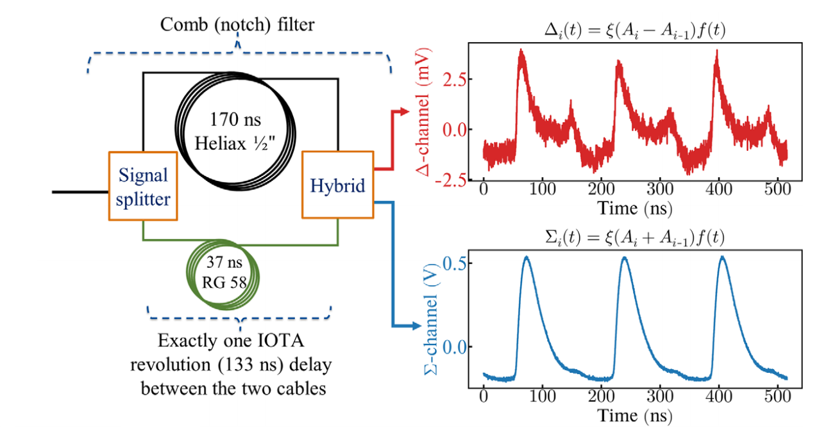

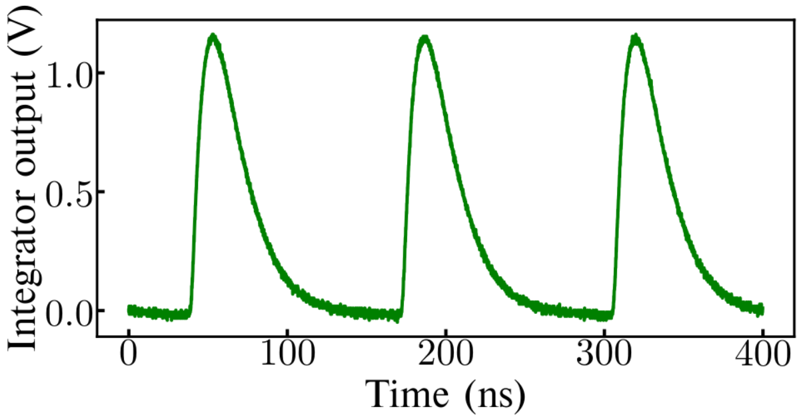
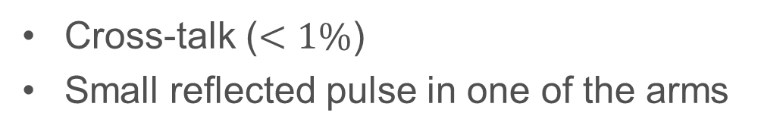
Comb (notch) filter
*the idea to use the comb filter was proposed by S. Nagaitsev.
The components were provided by B.J. Fellenz, K. Carlson, and D. Frolov
Our comb filter had some imperfections:
Cross-talk ($<1\%$)
Small reflected pulse in one of the arms
*they could be taken into account and did not affect final results

Slide 15
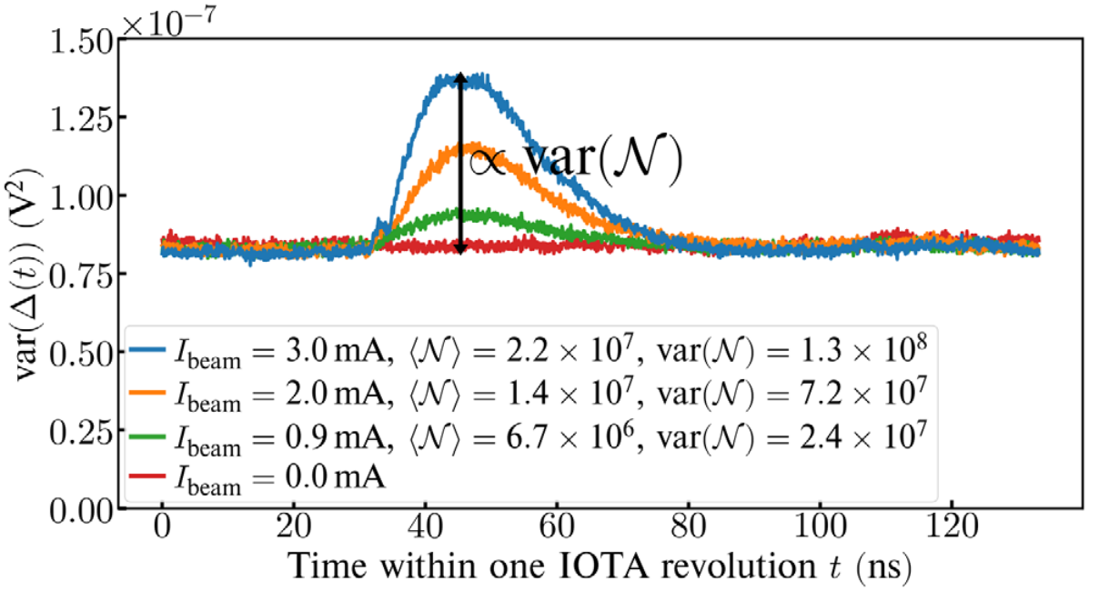
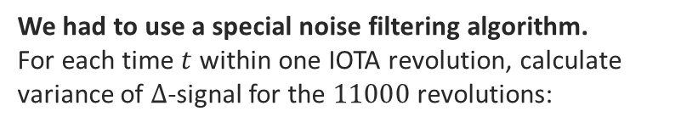
Noise filtering algorithm
The instrumental noise due to oscilloscope’s pre-amp and due to the integrator’s op-amp was about 0.3 mV (rms)
Therefore, signal-to-noise ratio was about 1
We had to use a special noise filtering algorithm.
For each time$t$ within one IOTA revolution, calculate variance of $Δ$-signal for the $11000$ revolutions:
constant noise level

Slide 16
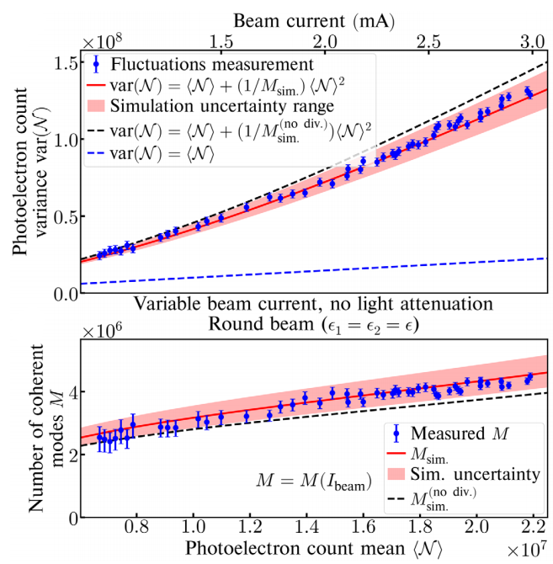
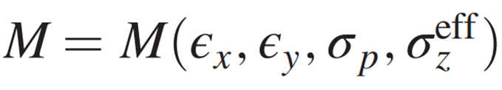
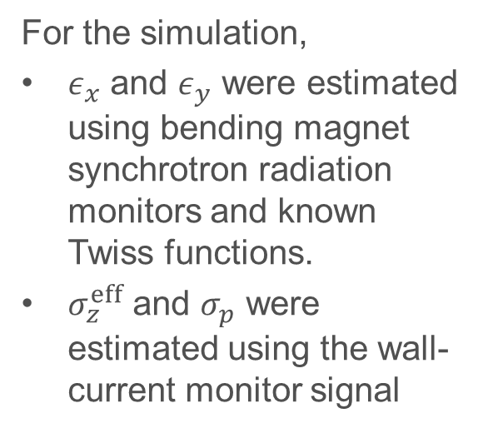
Measurements and simulations
For the simulation,
$ε_{x}$ and $ε_{y}$ were estimated using bending magnet synchrotron radiation monitors and known Twiss functions.
$σ_{z}^{eff}$ and $σ_{p}$ were estimated using the wall-current monitor signal
Note that the simulation with beam divergence taken into account agrees better

Slide 17
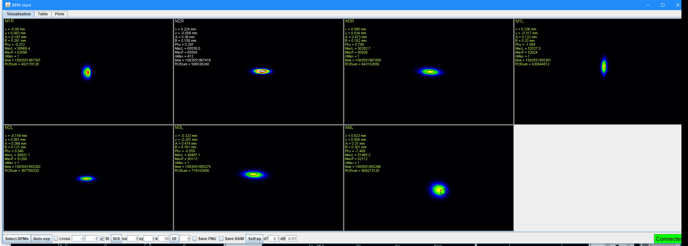
Measurement of transverse bunch size:
7 synclight stations
Bending magnet radiation (not undulator)
*built by A. Romanov, J. Santucci, G. Stancari, N. Kuklev, …

Slide 18
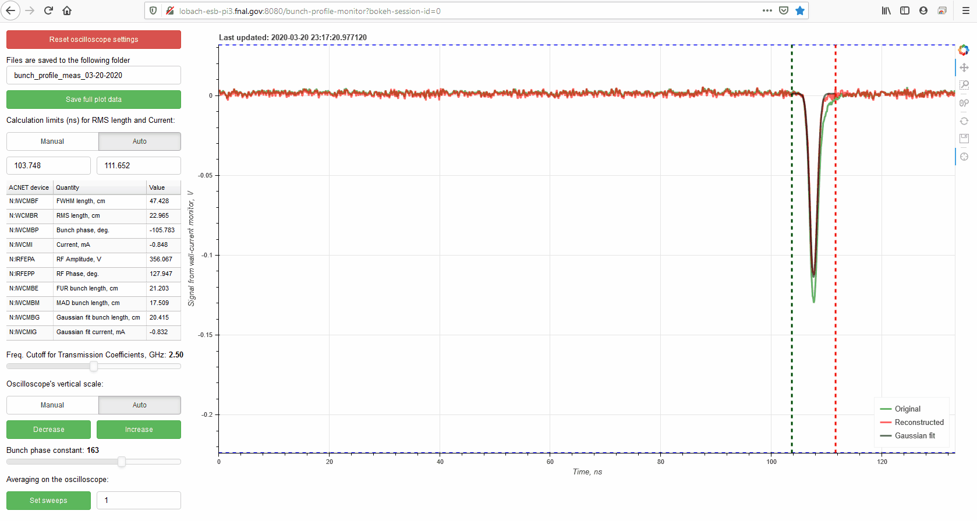
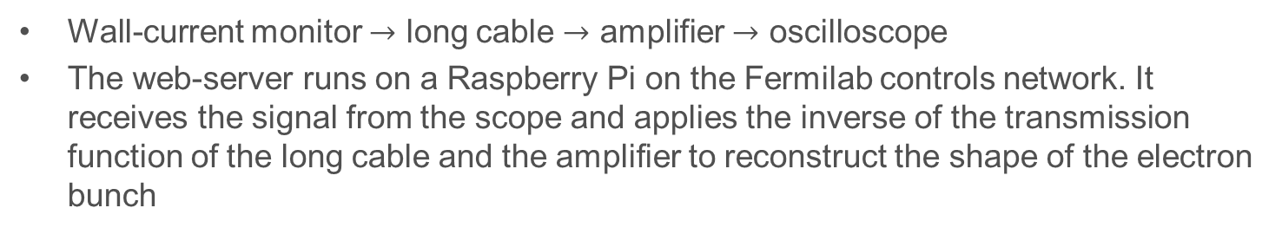

Measurement of longitudinal bunch length and shape: Bunch length monitor
Wall-current monitor $→$ long cable $→$ amplifier $→$ oscilloscope
The web-server runs on a Raspberry Pi on the Fermilab controls network. It receives the signal from the scope and applies the inverse of the transmission function of the long cable and the amplifier to reconstruct the shape of the electron bunch
$σ_{z}=20−30$cm
Valeri Lebedev and Kermit Carlson helped with measurement of the transmission function.
Dean Edstrom helped with network communication with the oscilloscope.

Slide 19
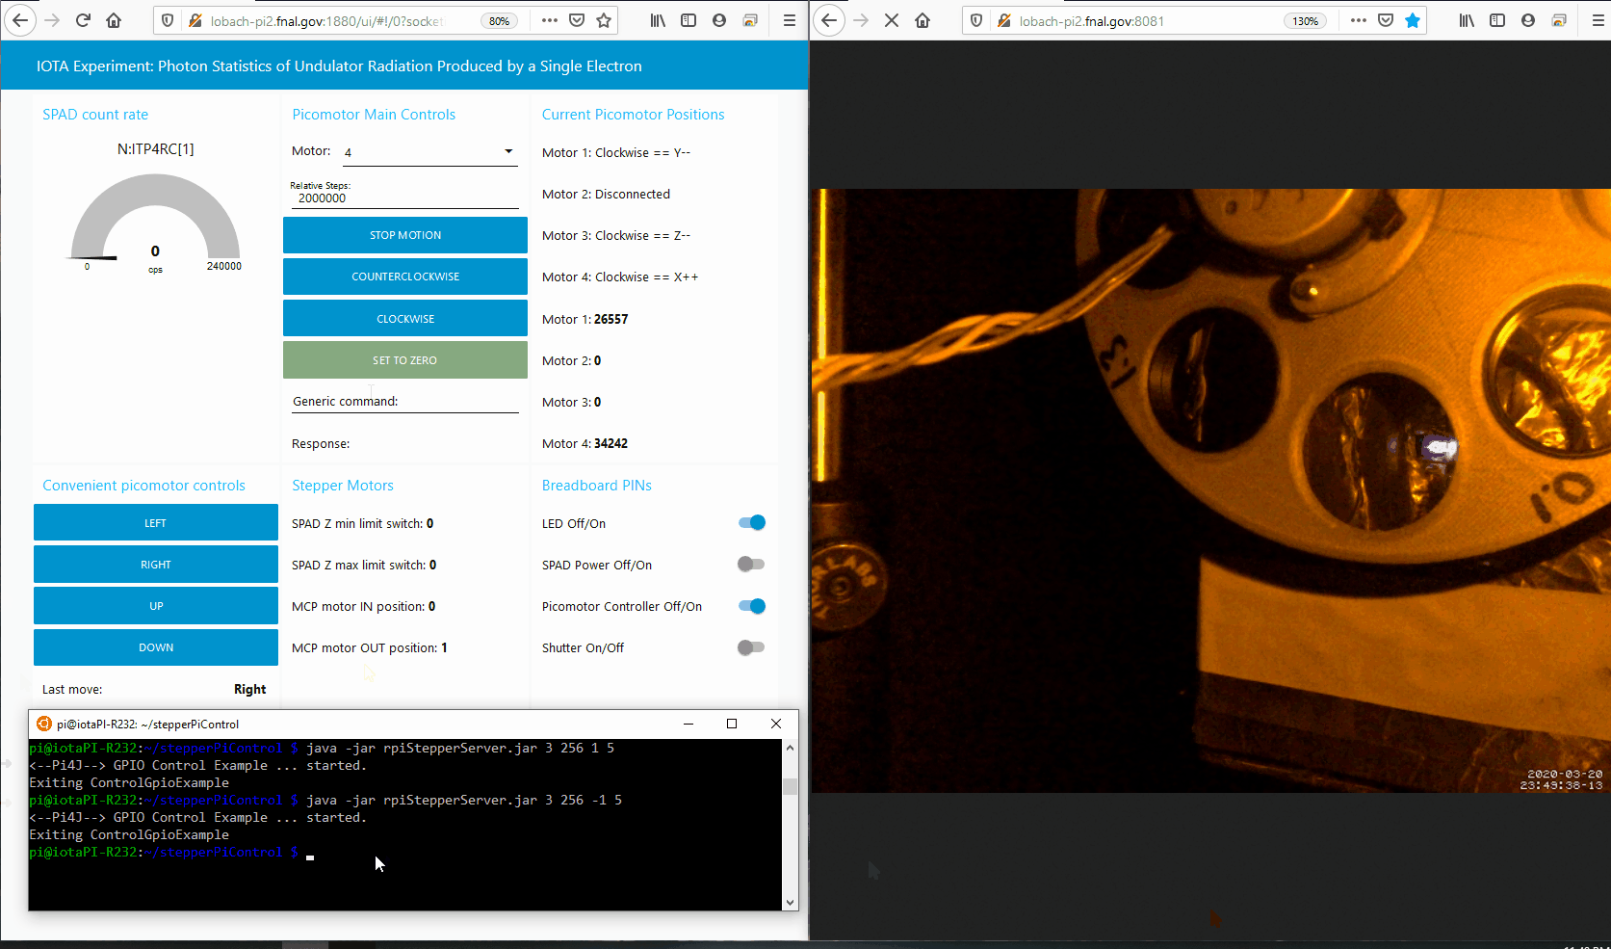
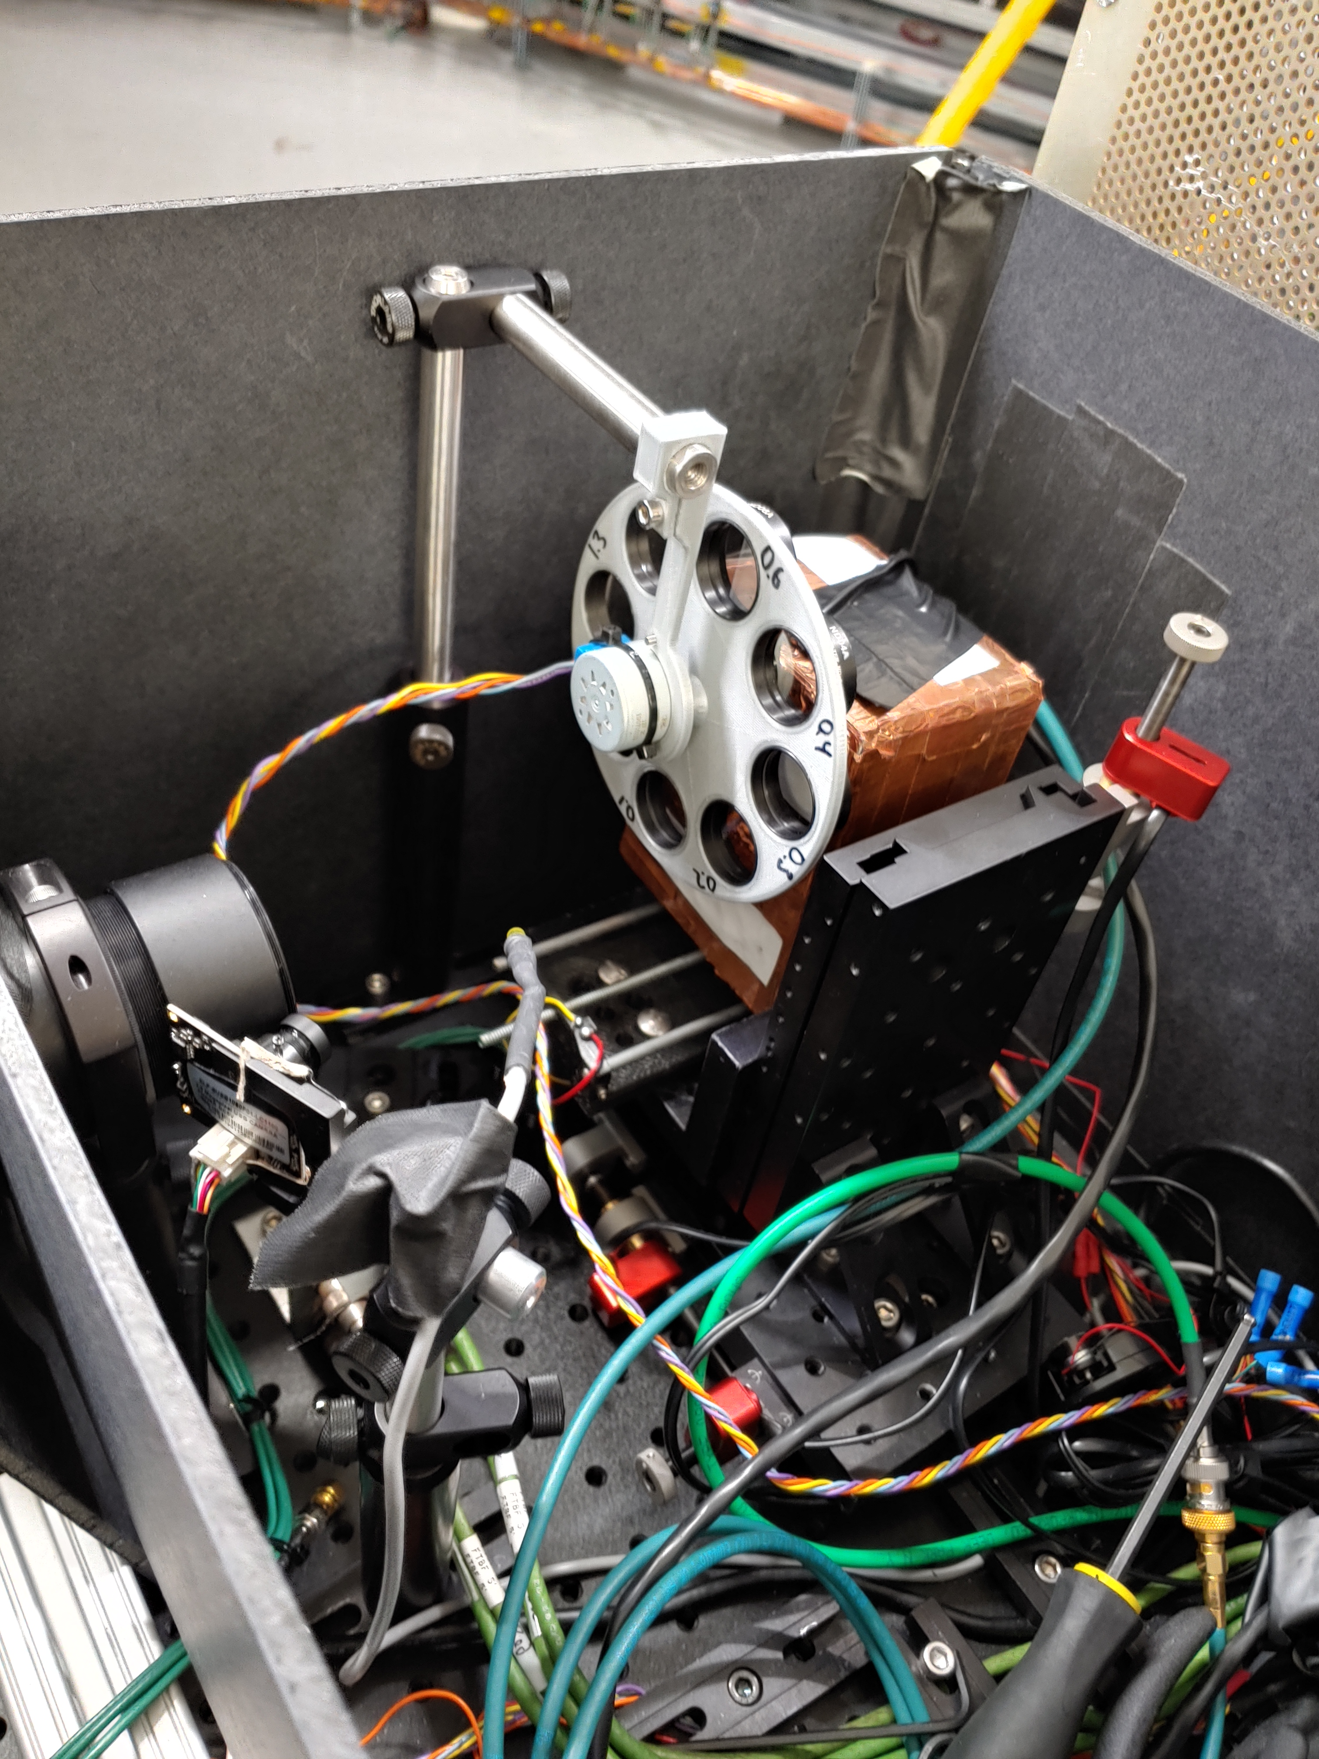
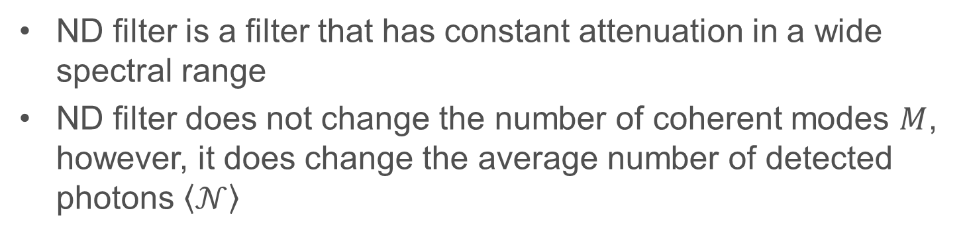
Neutral density (ND) filters
ND filter is a filter that has constant attenuation in a wide spectral range
ND filter does not change the number of coherent modes $M$, however, it does change the average number of detected photons $\left\langle 𝒩\right\rangle$
Remote controls for the apparatus
The filter wheel was built by Sasha Romanov

Slide 20
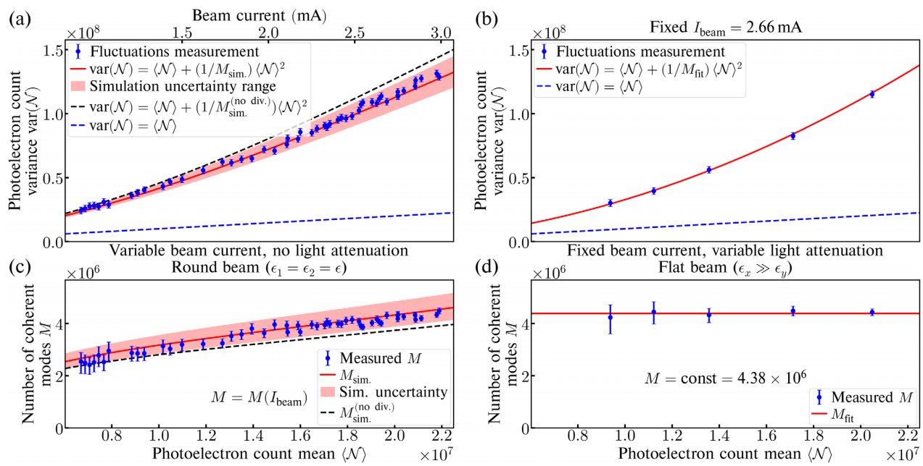
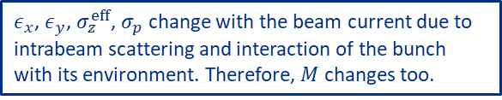
Measurements with ND filters (right-hand side)
$ε_{x}$, $ε_{y}$, $σ_{z}^{eff}$, $σ_{p}$ change with the beam current due to intrabeam scattering and interaction of the bunch with its environment. Therefore, $M$ changes too.

Slide 21
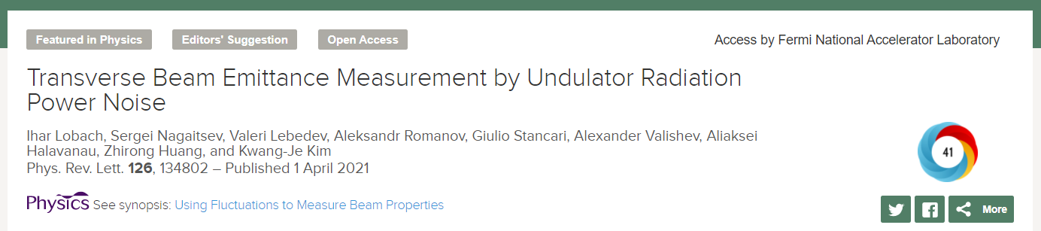
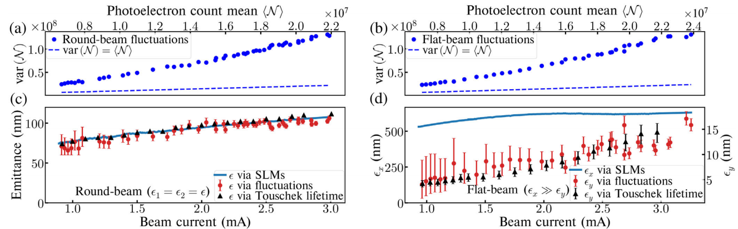

Reconstruction of transverse emittances from the measured $var(𝓝)$
We verified our method with a “round” beam, whose emittances could be independently measured by synchrotron radiation monitors, (a) and (c):
Then, we used our fluctuations to measure the unknown small vertical emittance of a “flat” beam, (b) and (d):
Strong coupling
Uncoupled

Slide 22
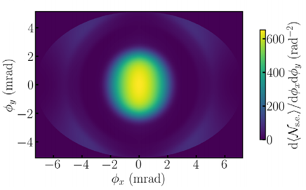

Usage of slits and masks
Measurement of fluctuations with slits or masks would allow measurement of more than one electron bunch parameter.
Original angular distribution:

Slide 23
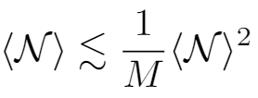
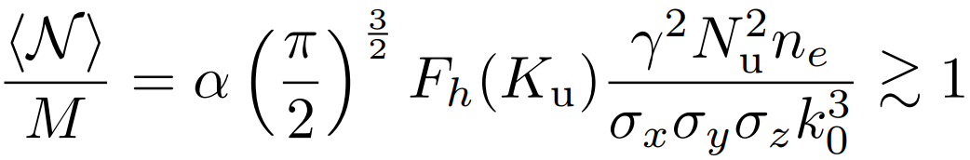


Limitations
The fluctuations must not be dominated by the Poisson noise
$M$ must be sensitive to changes in $σ_{x}$, $σ_{y}$ ($ε_{x}$, $ε_{y}$)
The sensitivity of this technique improves with shorter wavelength. Therefore, this technique may be particularly beneficial for existing state-of-the-art and next-generation low-emittance high-brightness ultraviolet and x-ray synchrotron light sources. For instance, this technique can measure $ε_{x}≈ε_{y}≈30$ pm in the Advanced Photon Source Upgrade at Argonne.

Slide 24

Conclusions
Turn-to-turn undulator radiation power fluctuations have two contributions: (1) quantum due to discrete nature of light and (2) classical due to variations in relative electron positions and directions of motion.
We derived the second contribution, accounting for electron beam divergence, for the first time.
We obtained a good agreement for the fluctuations $var(𝒩)$ between measurements and calculations.
The process can be reversed, i.e., the measured fluctuations $var(𝒩)$ can be used to infer the transverse electron beam emittances. This method can be especially useful for low-emittance high-brightness ultraviolet and x-ray synchrotron light sources.

Slide 25

First undulator radiation at Fermilab!
Thank you for your attention!
Thank you for your attention!

Slide 26
Additional slides

Slide 27





Origin of the first term
For the case of negligible electron recoil each mode of the radiation field is in a coherent state:
-- Poisson fluctuations
However, this is correct only for a deterministic classical current, i.e., fixed relative positions of the electrons in the bunch

Slide 28




Number of coherent modes (in our notation $M$)
Modal decomposition of the transverse radiation coherence function
Effective number of terms in the decomposition:

Slide 29



Testing the setup with an independent test light source --- laser diode with a modulated amplifier
Pulse-to-pulse fluctuations due to pulse generator and amplifier errors are high and can be measured without noise filtering.
By using ND filters, the fluctuations, in terms of $var(𝒩)$, can be decreased down to the level, observed in our experiment with undulator radiation.
At this level, noise filtering is required. However, we can see that the measured $var\left(𝒩\right)$ still agrees with the expected parabola. This proves that the noise filtering algorithm works well.

Slide 30


Bonus plots
Round-beam lifetime
Round-beam emittance and bunch length

