Slide 1
Athos Project
Romain Ganter :: Athos Machine Project Leader :: Paul Scherrer Institut
LAB meeting – 25.06.2021

Slide 2
Outline
Athos key components
Athos commissioning
Budget & Timeplan

Slide 3

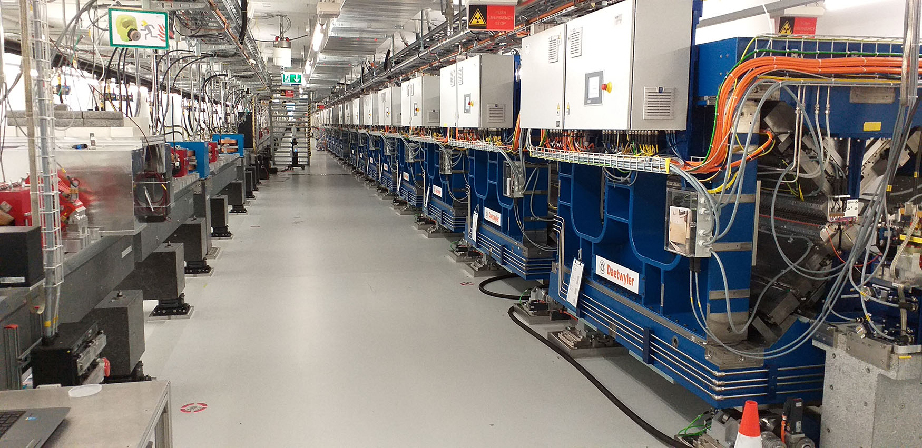
Athos: Laser im weichen Röntgenbereich
Athos
phase
2017–20
Aramis
Hard x-ray
Athos
Soft x-ray
Aramis
phase
2013–16
SwissFEL Tunnel
Two times more experiment (100 Hz)
Soft x-ray domain (250-1900 eV)

Slide 4

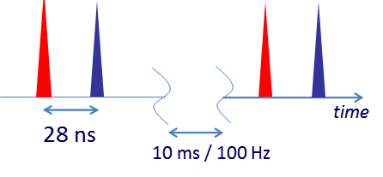

SwissFEL
2nd Construction Phase 2017-20
1st Construction Phase
2013-16
dechirpers
8 UE38 + Chicanes
2-color chicane
8 UE38 + Chicanes
Athos 0.65-5nm
BC1
BC2
user
stations
Injector
Linac 1
Linac 2
Linac 3
0.35 GeV
2.1 GeV
3.15 GeV
2.1-5.8 GeV
Aramis 0.1-0.7 nm
Aramis
  Linear polarization, variable gap, in-vacuum Undulators
  First users 2018
  Main parameters of Athos
  Photon energy 250 – 1900 eV
  Pulse duration 1 fs - 20 fs
  e⁻ Energy 2.65 – 3.4 GeV
  e⁻ Bunch charge 10-200 pC
  Repetition rate 100 Hz
Athos
  Soft X-ray FEL, variable polarization
  First users 2021

Slide 5
SwissFEL
2nd Construction Phase 2017-20
1st Construction Phase
2013-16
dechirpers
8 UE38 + Chicanes
2-color chicane
8 UE38 + Chicanes
Athos 0.65-5nm
BC1
BC2
user
stations
Injector
Linac 1
Linac 2
Linac 3
0.35 GeV
2.1 GeV
3.15 GeV
2.1-5.8 GeV
Aramis 0.1-0.7 nm
Aramis
  Linear polarization, variable gap, in-vacuum Undulators
  First users 2018
  Main parameters of Athos
  Photon energy 250 – 1900 eV
  Pulse duration 1 fs - 20 fs
  e⁻ Energy 2.65 – 3.4 GeV
  e⁻ Bunch charge 10-200 pC
  Repetition rate 100 Hz
Mizar
Gun Laser
Athos
  Soft X-ray FEL, variable polarization
  First users 2021

Slide 6
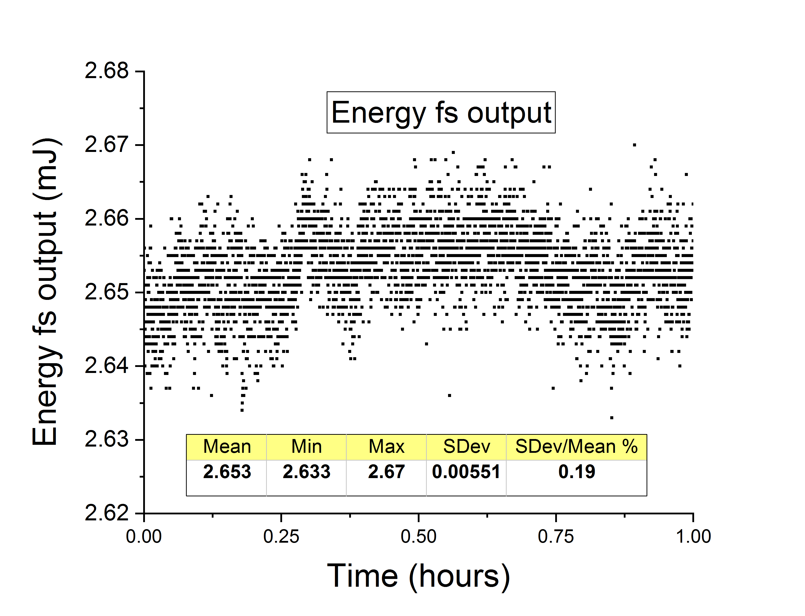
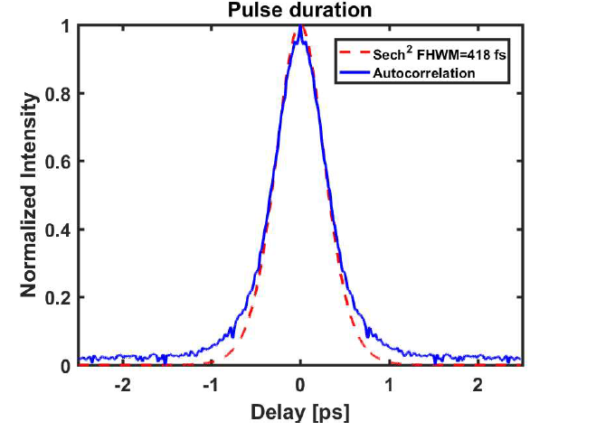
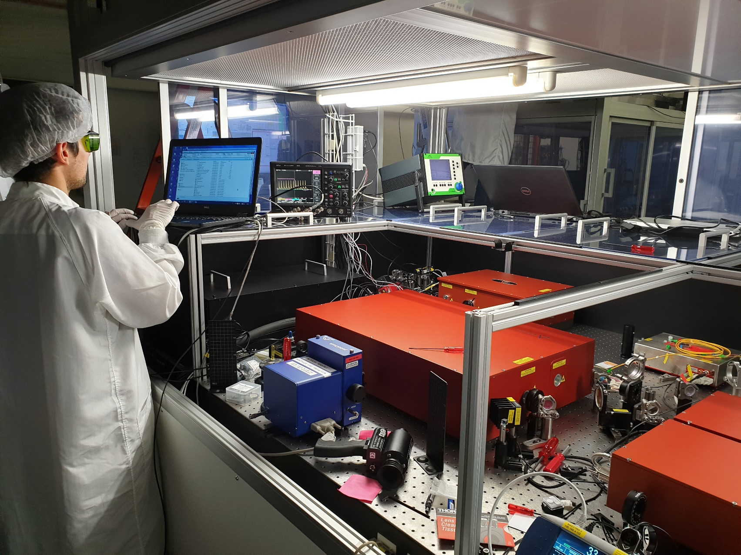
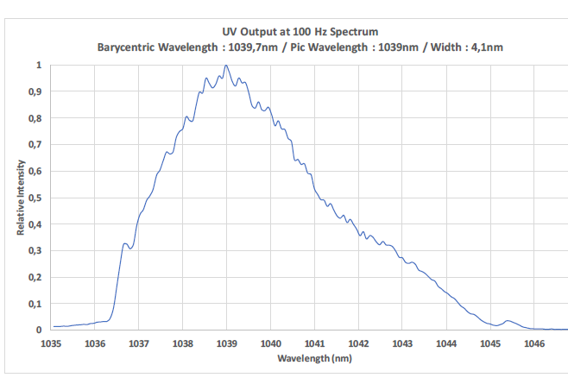
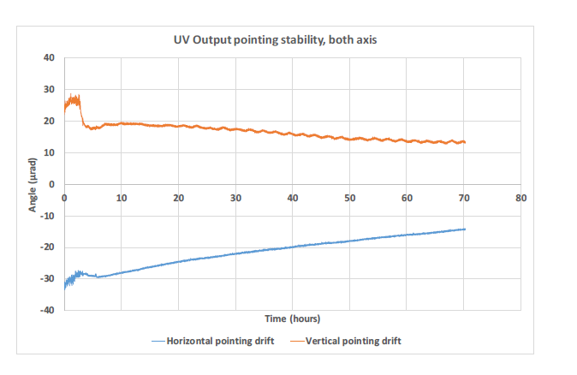
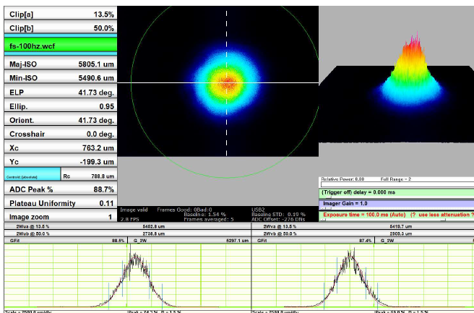
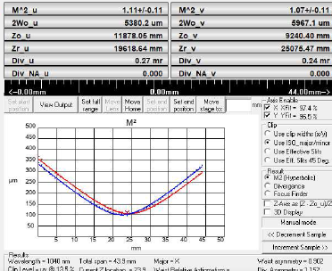
Athos Gun Laser: Mizar
Duration 400 fs
Energy stability<0.2%
Pointing 5.3 urad
Spectrum
Pulse picker
LAM
Oscillator
Amplifier
Gun, LH & diagnostics
outputs
Beam profile
M2=1.1
Courtesy of C. Vicario

Slide 7
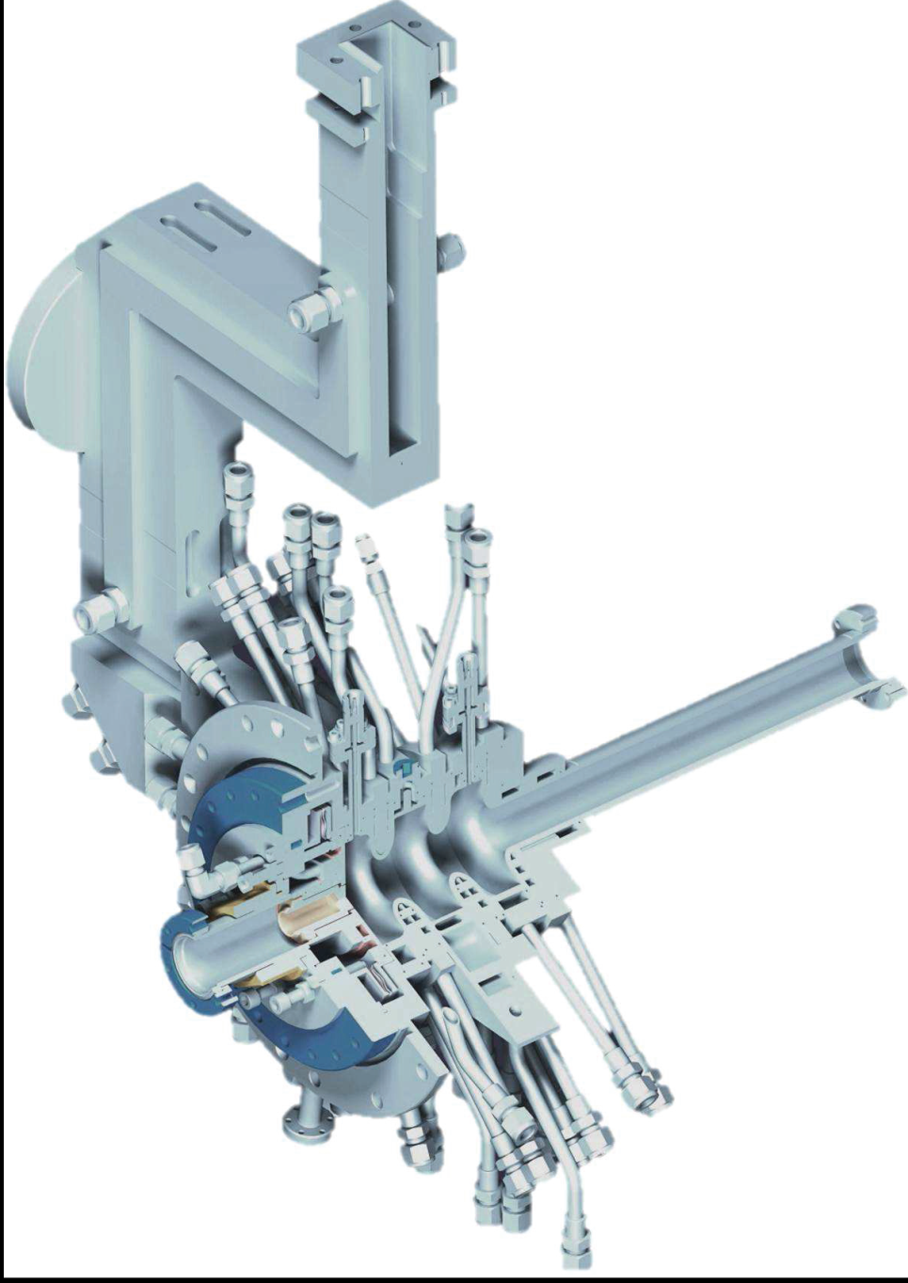
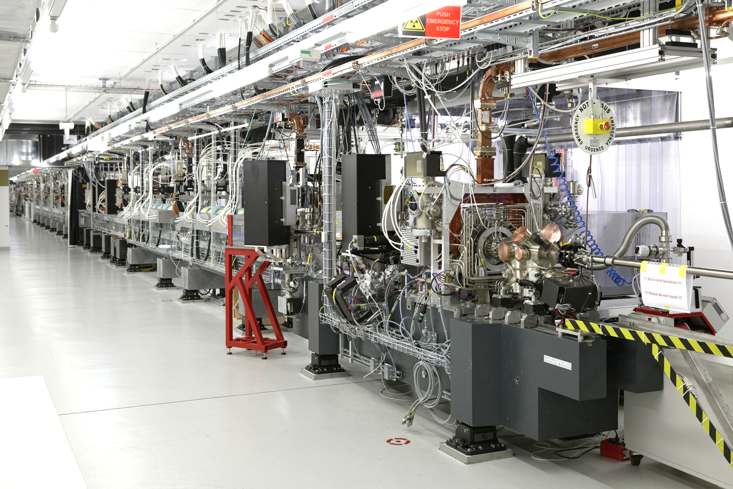
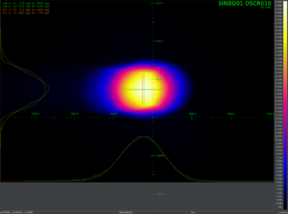
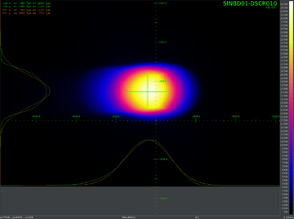
Two identical bunches extracted from Photocathode
Bunch 1 with Alcor (Screen near gun)
Bunch 2 with Mizar (Screen near gun)
Bunch quasi identical same quality !

Slide 8
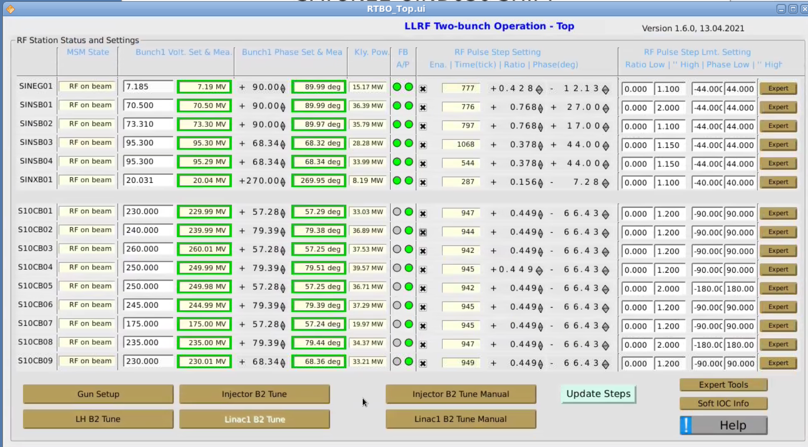
Tuning Bunch „Two“ energy
Both bunches in same RF macropulse
RF
power
=> RF extra-step to tune Bunch „Two“ only !
1 μs
time
Courtesy of Z. Geng

Slide 9
SwissFEL
2nd Construction Phase 2017-20
1st Construction Phase
2013-16
dechirpers
8 UE38 + Chicanes
2-color chicane
8 UE38 + Chicanes
Athos 0.65-5nm
BC1
BC2
user
stations
Injector
Linac 1
Linac 2
Linac 3
0.35 GeV
2.1 GeV
3.15 GeV
2.1-5.8 GeV
Aramis 0.1-0.7 nm
Aramis
  Linear polarization, variable gap, in-vacuum Undulators
  First users 2018
  Main parameters of Athos
  Photon energy 250 – 1900 eV
  Pulse duration 1 fs - 20 fs
  e⁻ Energy 2.65 – 3.4 GeV
  e⁻ Bunch charge 10-200 pC
  Repetition rate 100 Hz
Resonant Kicker
Athos
  Soft X-ray FEL, variable polarization
  First users 2021

Slide 10
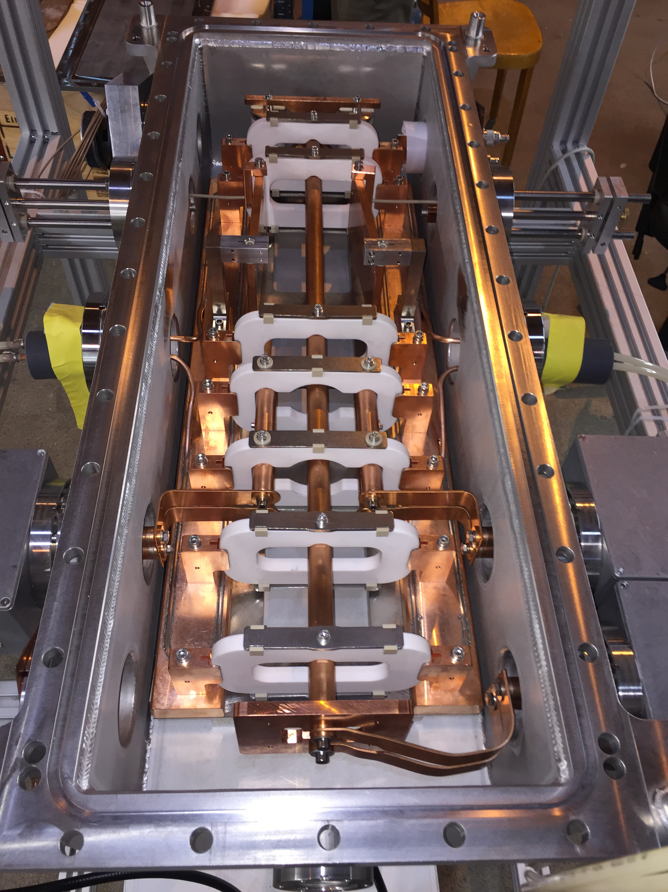
Separation of the two bunches
Two resonant kickers separate the 2 bunches (vertically)
Bunch Athos kicked Up (~ 1 mrad)
56 ns
A
LC resonator
t
Bunch Aramis kicked Down
Courtesy of M. Paraliev

Slide 11
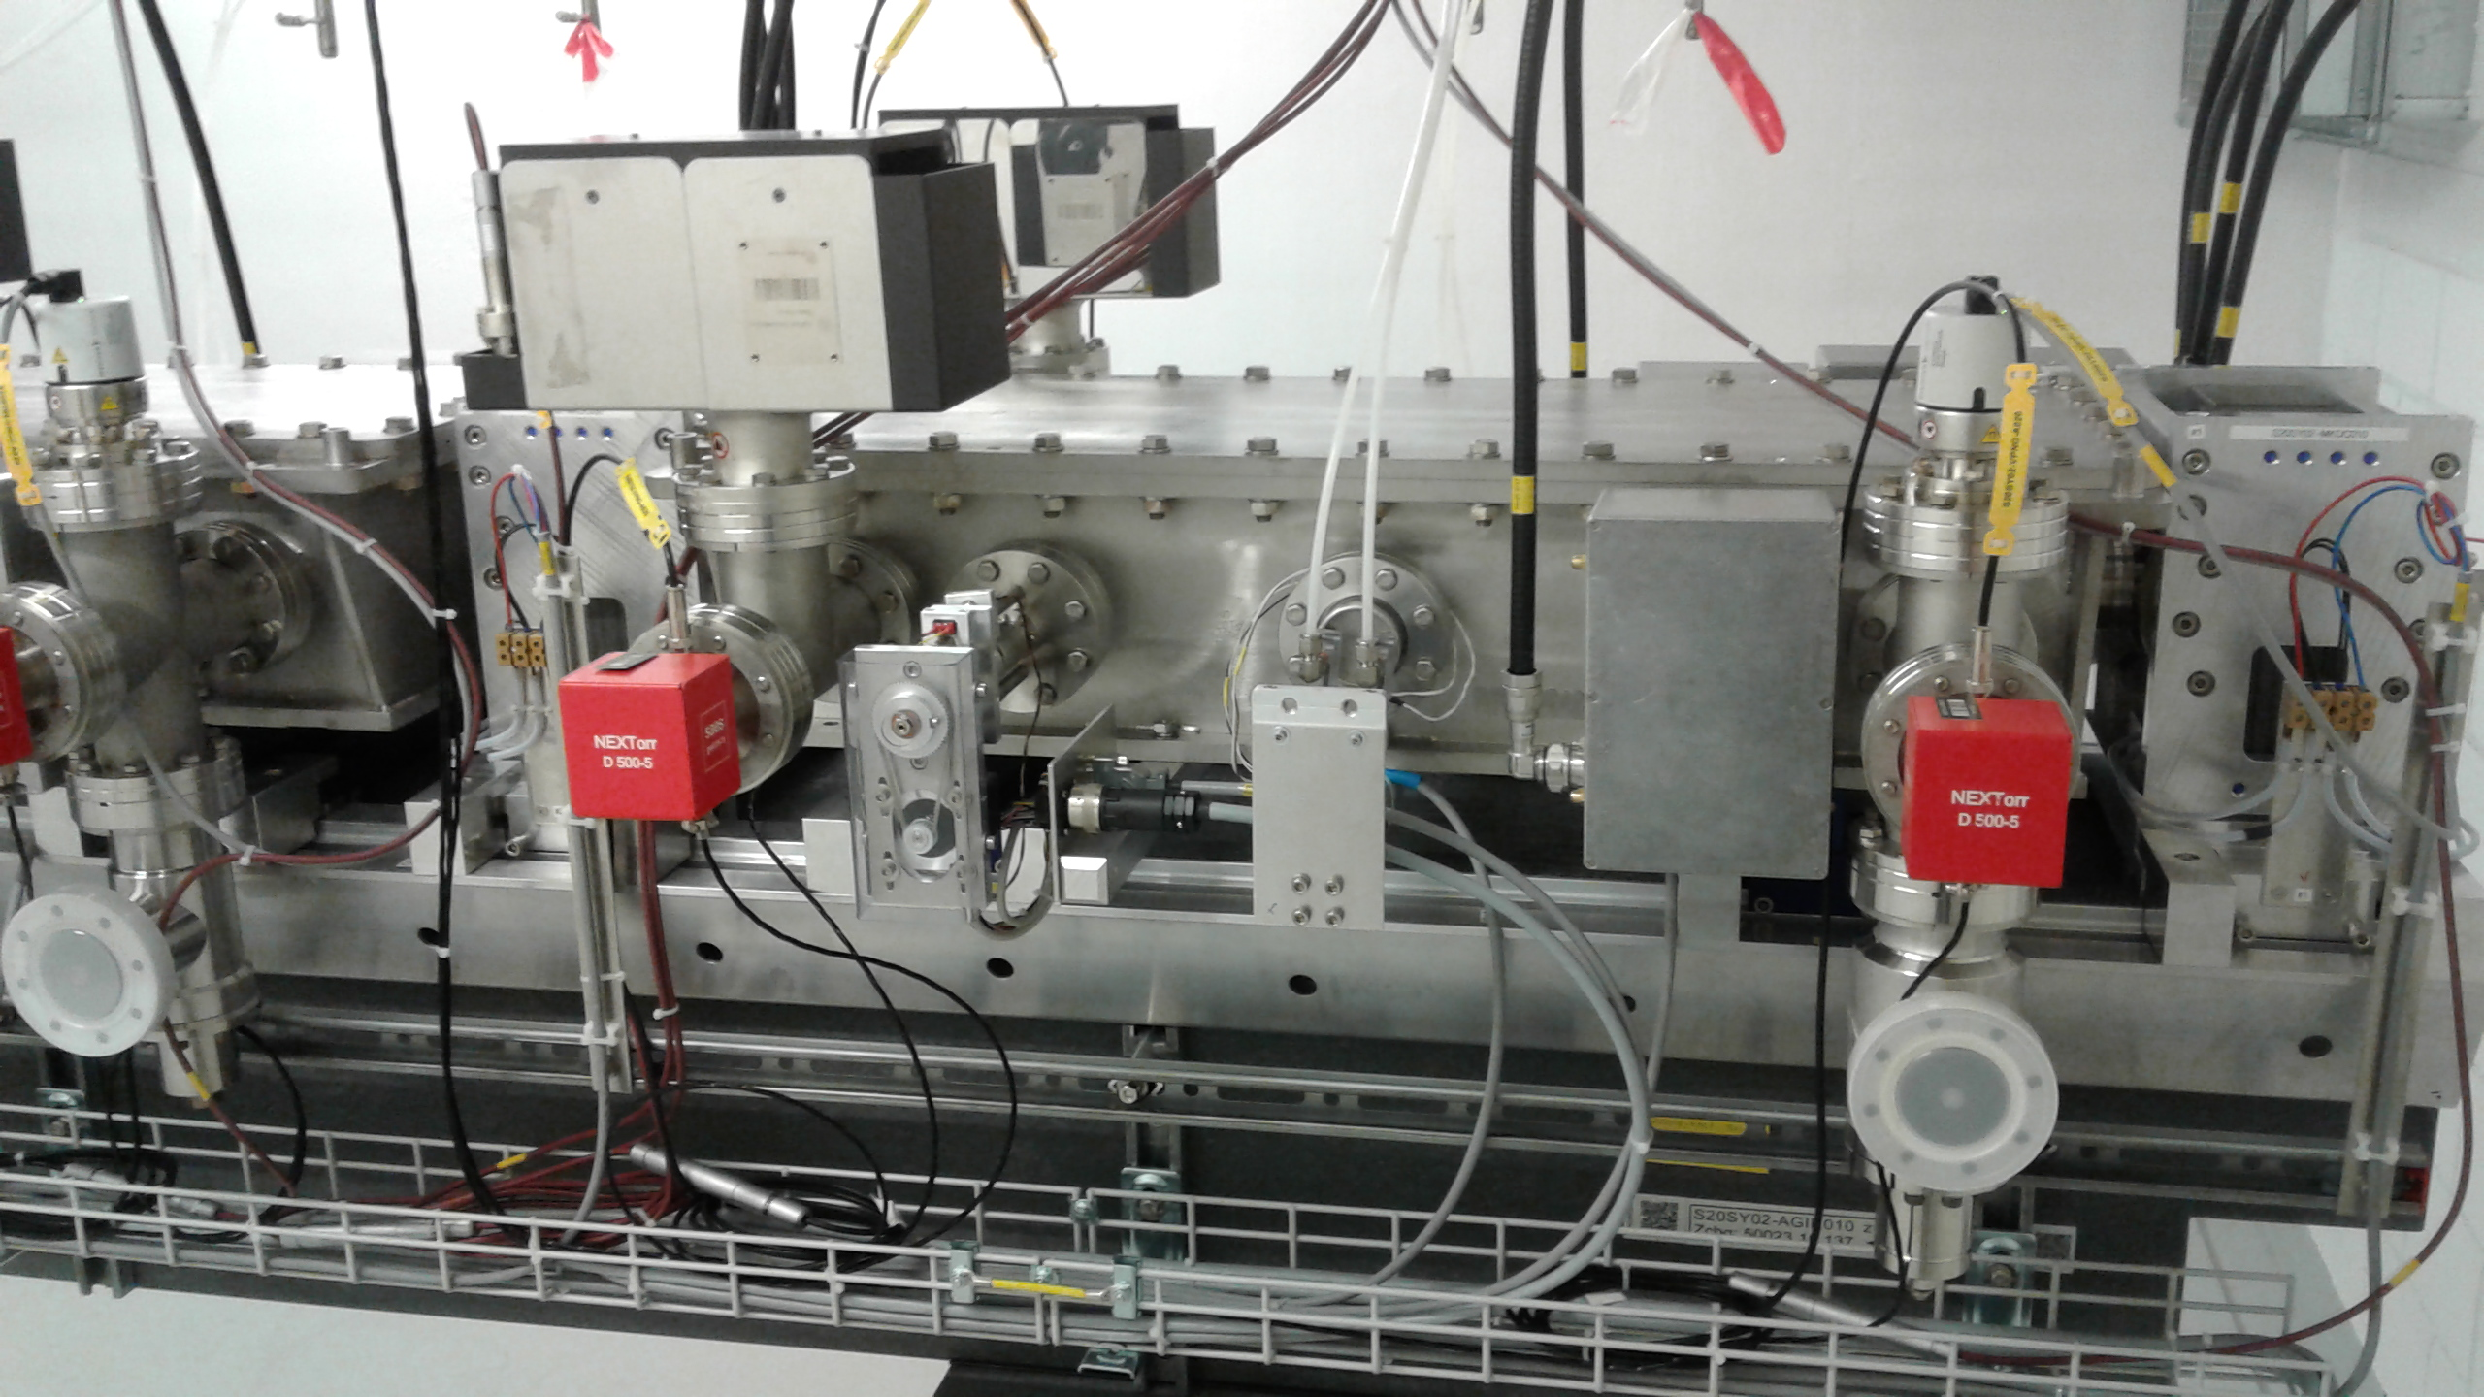
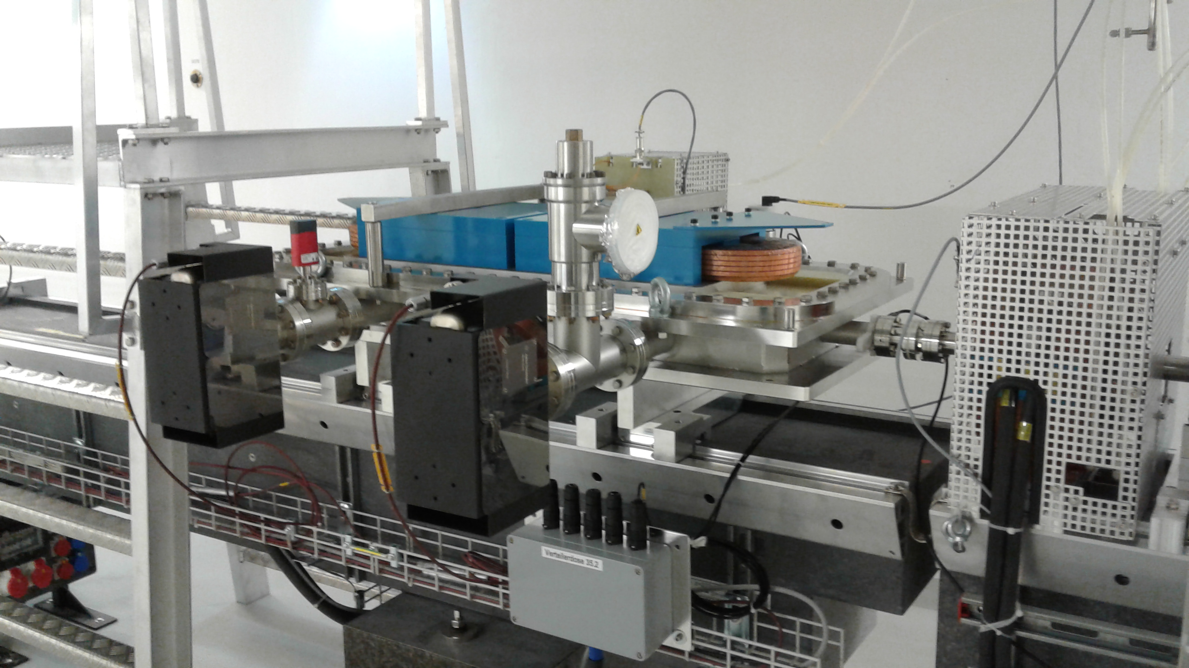
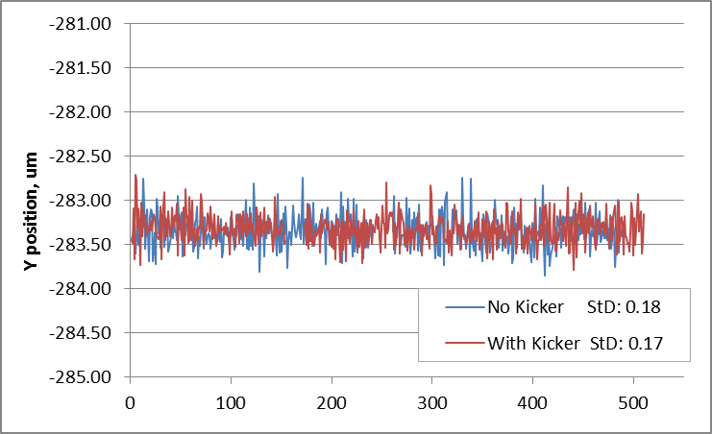
Kicker + Septum
Septum deflects 2nd bunch 10m downstream
Fast kickers with DC correctors in SwissFEL
5 minutes
Influence of Kicker on Orbit stability ?
FEL position stability constant with / without kickers (0.18 μm rms) !
Courtesy of M. Paraliev

Slide 12
SwissFEL
2nd Construction Phase 2017-20
1st Construction Phase
2013-16
dechirpers
8 UE38 + Chicanes
2-color chicane
8 UE38 + Chicanes
Athos 0.65-5nm
BC1
BC2
user
stations
Injector
Linac 1
Linac 2
Linac 3
0.35 GeV
2.1 GeV
3.15 GeV
2.1-5.8 GeV
Aramis 0.1-0.7 nm
Dechirper
Aramis
  Linear polarization, variable gap, in-vacuum Undulators
  First users 2018
  Main parameters of Athos
  Photon energy 250 – 1900 eV
  Pulse duration 1 fs - 20 fs
  e⁻ Energy 2.65 – 3.4 GeV
  e⁻ Bunch charge 10-200 pC
  Repetition rate 100 Hz
Athos
  Soft X-ray FEL, variable polarization
  First users 2021

Slide 13
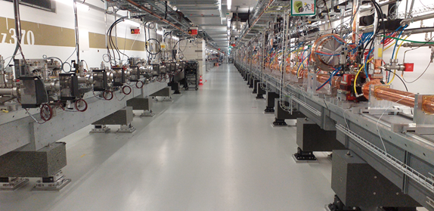
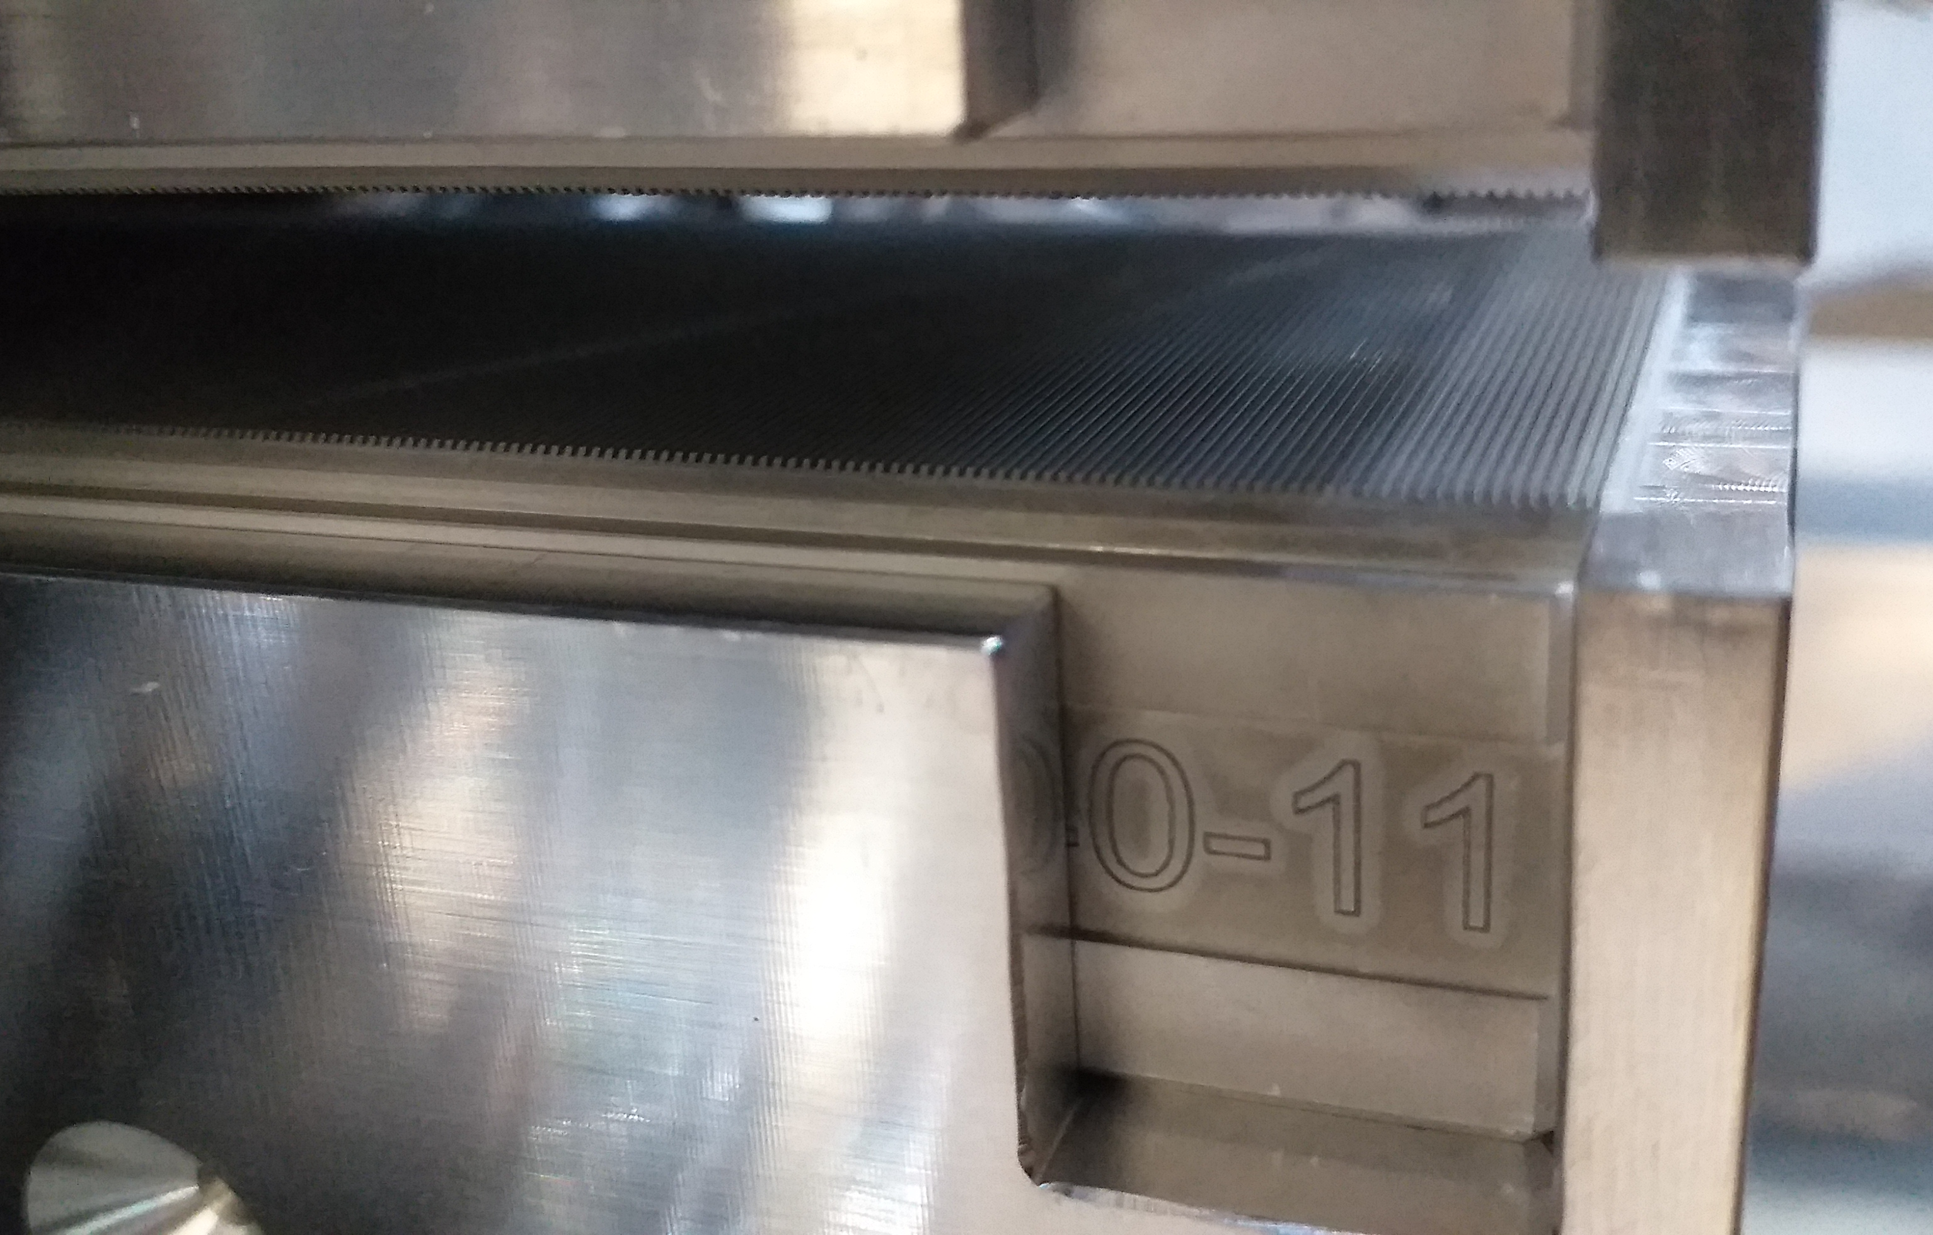
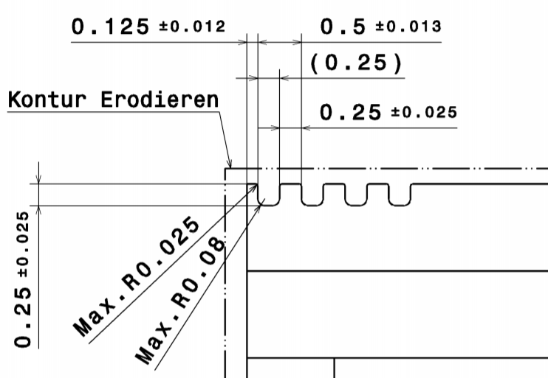
Dechirpers: to control FEL Bandwitdh
To remove CHIRP
8 dechirpers (8 m)
installed in tunnel
To tilt the bunch
Gap: 1-20mm

Slide 14
SwissFEL
2nd Construction Phase 2017-20
1st Construction Phase
2013-16
dechirpers
8 UE38 + Chicanes
2-color chicane
8 UE38 + Chicanes
Athos 0.65-5nm
BC1
BC2
user
stations
Injector
Linac 1
Linac 2
Linac 3
0.35 GeV
2.1 GeV
3.15 GeV
2.1-5.8 GeV
Aramis 0.1-0.7 nm
APPLE X + CHIC
Aramis
  Linear polarization, variable gap, in-vacuum Undulators
  First users 2018
  Main parameters of Athos
  Photon energy 250 – 1900 eV
  Pulse duration 1 fs - 20 fs
  e⁻ Energy 2.65 – 3.4 GeV
  e⁻ Bunch charge 10-200 pC
  Repetition rate 100 Hz
Athos
  Soft X-ray FEL, variable polarization
  First users 2021

Slide 15
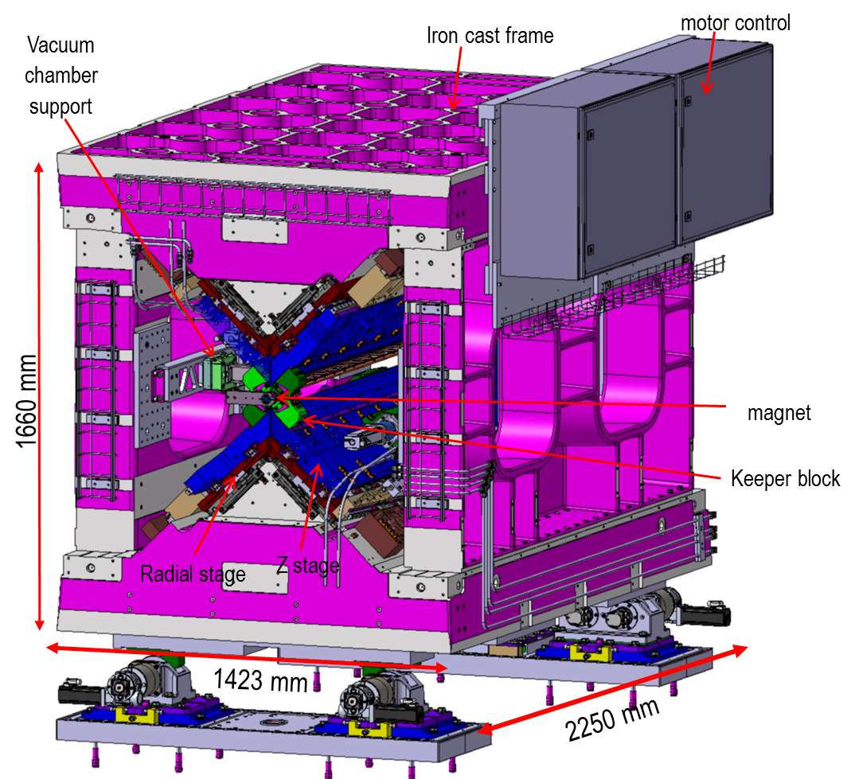
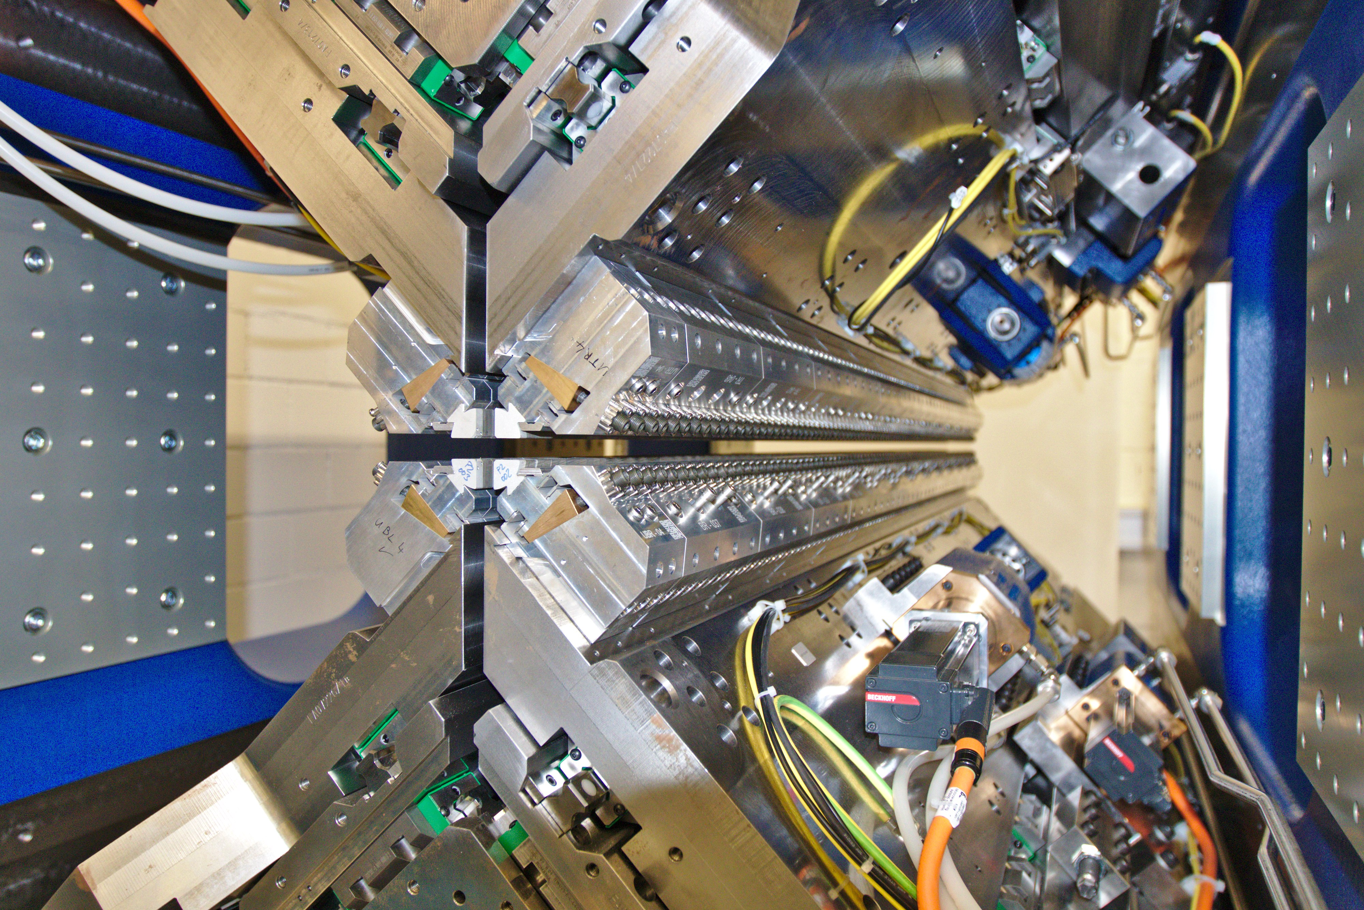
Undulator Apple X – UE38
Characteristics:
12 Tons; Iron cast frame (easier to machine)
Positioning via cam shaft movers (20 um precision)
Radial motion with wedge system (K tuning)
Longitudinal motion with spindle (Polarization tuning)
PLC control (Beckhoff) with EPICS interface
Gap reproducibility < 1 um
Minimum Gap / slit: 3 mm with a 6.5 mm aperture
Polarization Control: circular – elliptical – linear
K_{max}~3.65
Possibility of transverse gradient
12 tons

Slide 16
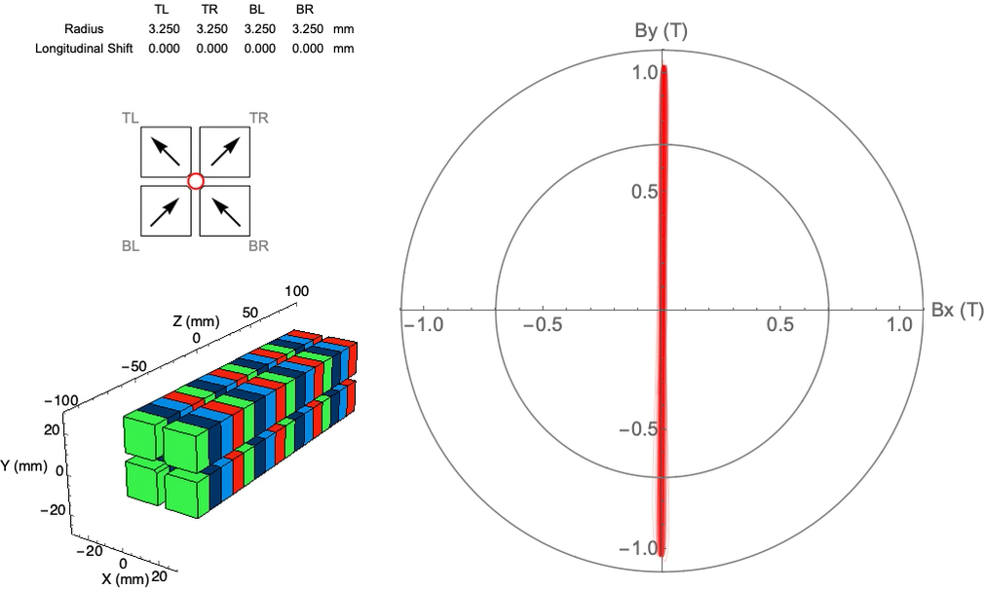
Magnetic Characterisation of the Apple X
Courtesy of M. Calvi

Slide 17
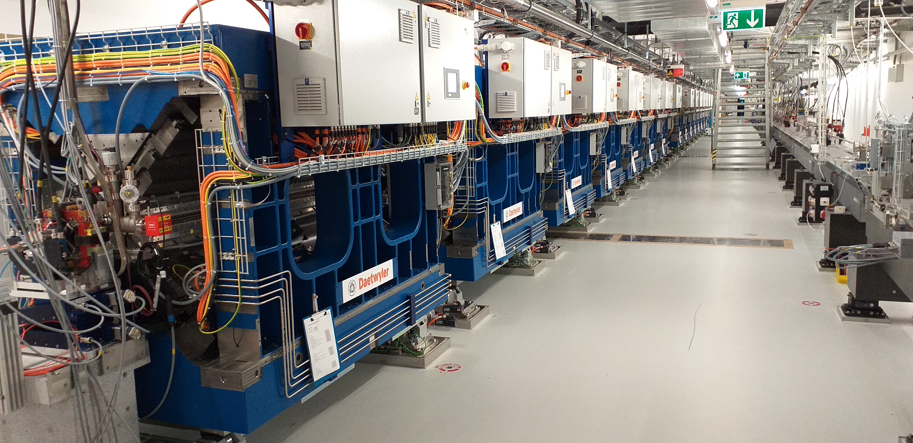
Tunnel Installation
16 Undulator & 15 CHIC chicanes in Tunnel

Slide 18
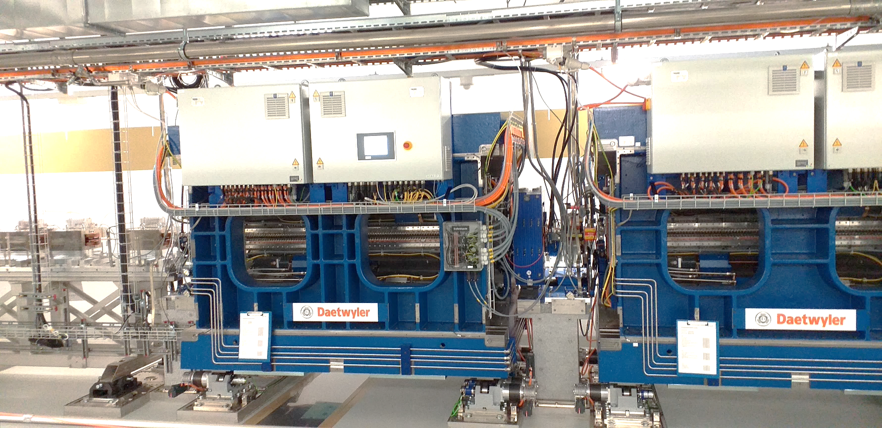
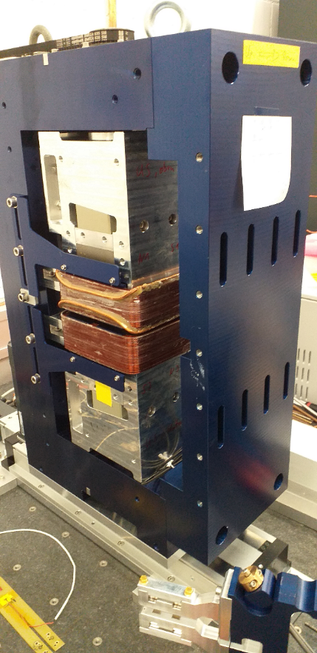
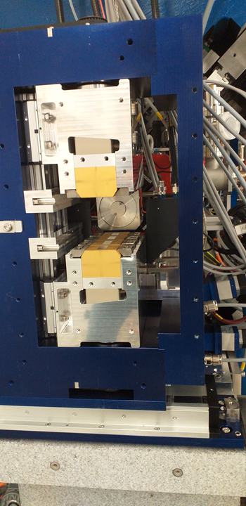
CHIC magnetic chicanes

Slide 19
SwissFEL
2nd Construction Phase 2017-20
1st Construction Phase
2013-16
dechirpers
8 UE38 + Chicanes
2-color chicane
8 UE38 + Chicanes
Athos 0.65-5nm
BC1
BC2
user
stations
Injector
Linac 1
Linac 2
Linac 3
0.35 GeV
2.1 GeV
3.15 GeV
2.1-5.8 GeV
Aramis 0.1-0.7 nm
Maloja
Furka
Aramis
  Linear polarization, variable gap, in-vacuum Undulators
  First users 2018
  Main parameters of Athos
  Photon energy 250 – 1900 eV
  Pulse duration 1 fs - 20 fs
  e⁻ Energy 2.65 – 3.4 GeV
  e⁻ Bunch charge 10-200 pC
  Repetition rate 100 Hz
Athos
  Soft X-ray FEL, variable polarization
  First users 2021

Slide 20
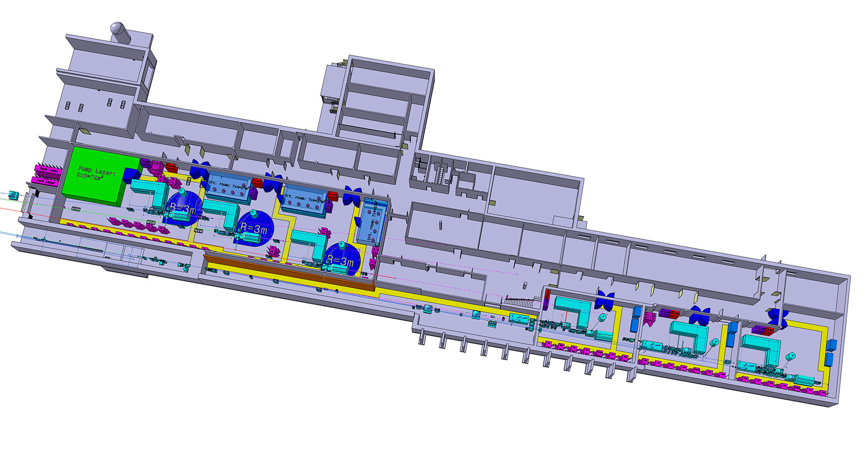
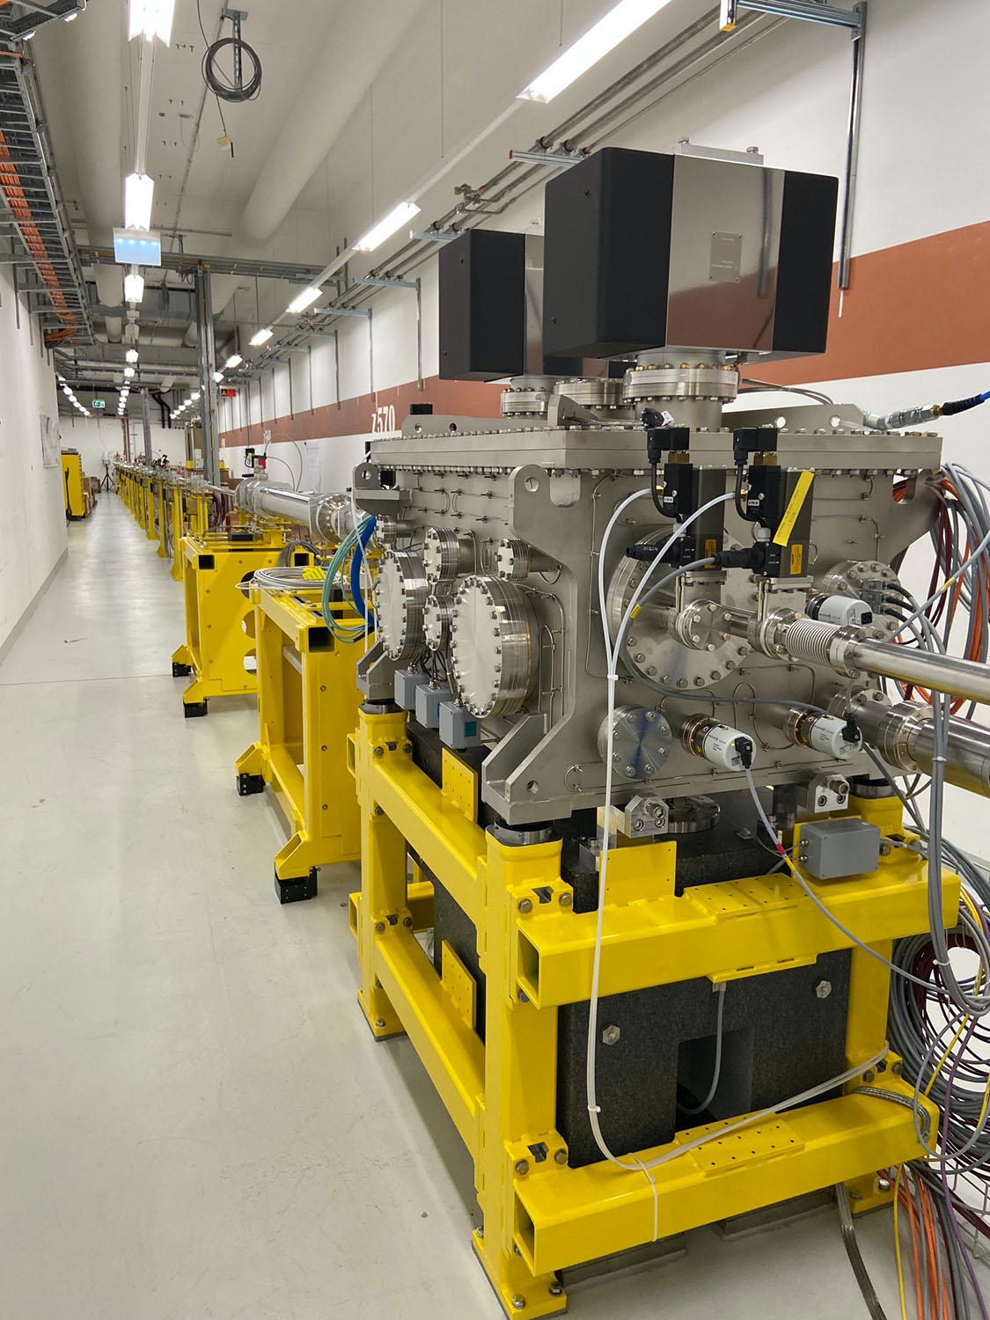
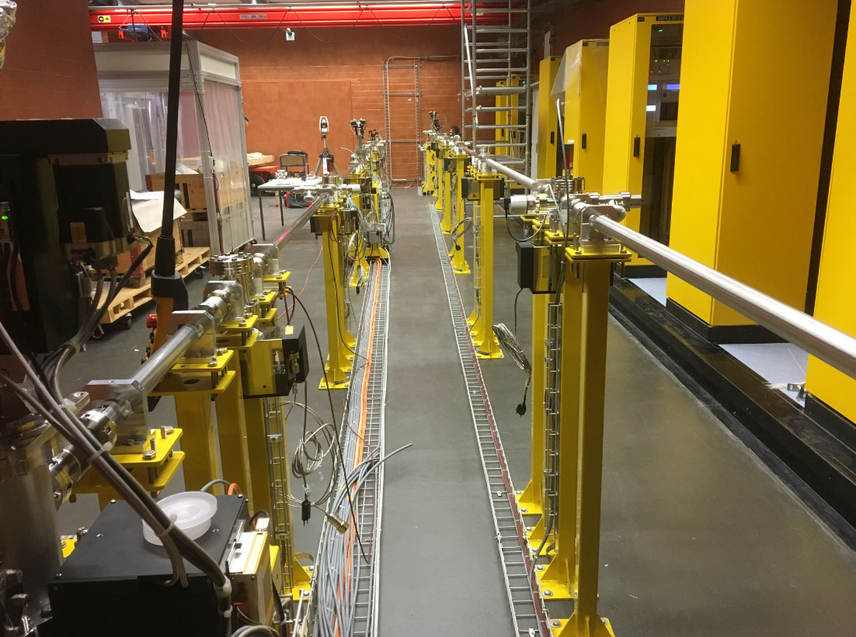
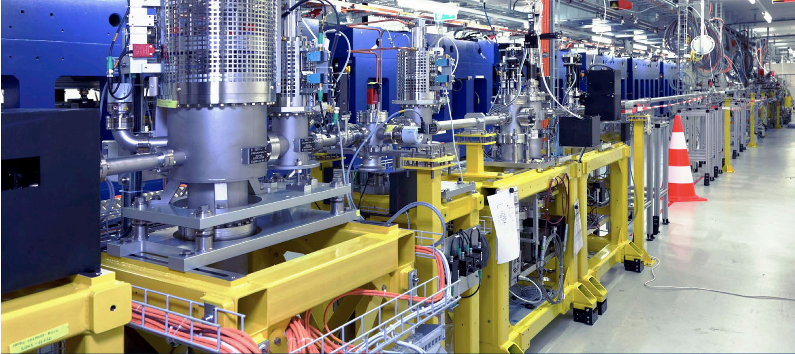
FEL beamline Athos
Athos
2 (3) Endstations: Maloja & Furka
Soft x-ray science from C_{K}, TM_{L} , to Si_{K}
Chemical to solid state research
Pump laser
infrastructure
Aramis
Endstation
Diavolezza
Endstation
Maloja
Endstation
Furka
Pump laser
infrastructure
(1st floor)
Endstation
Alvra
Endstation
Bernina
Endstation
Cristallina

Slide 21
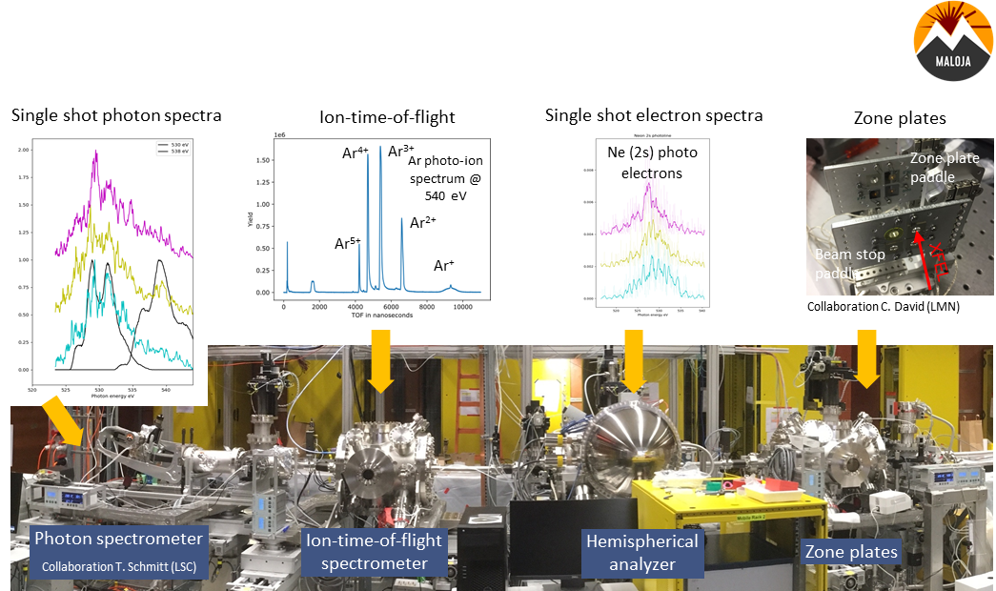
Maloja Commissioning Results
Courtesy of C. Botstedt

Slide 22
Outline
Athos key components
Athos commissioning
Budget & Timeplan

Slide 23
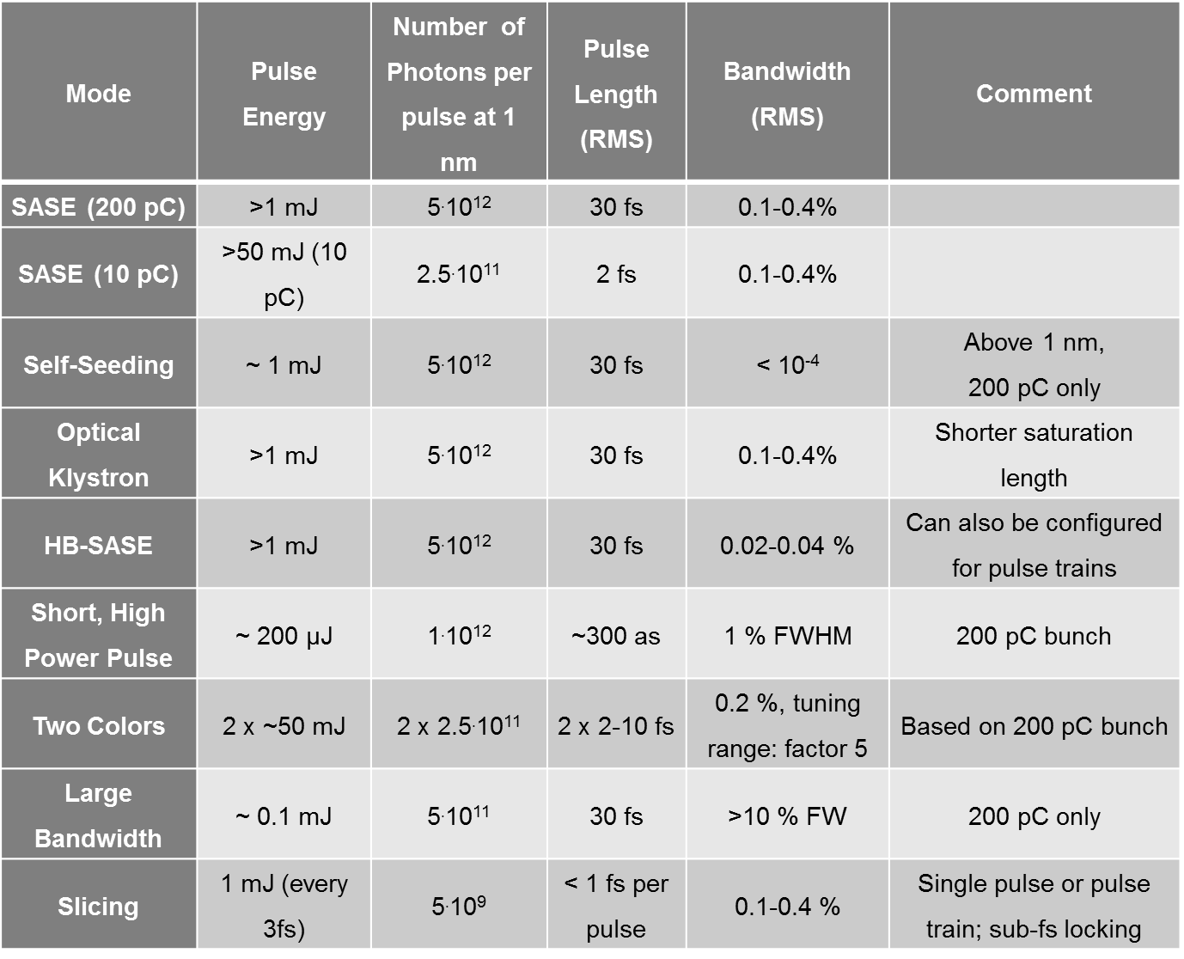
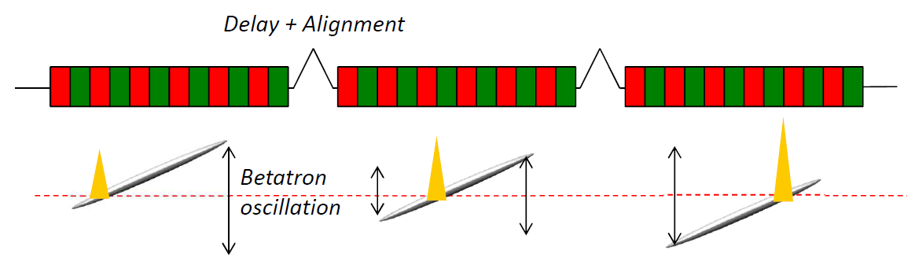
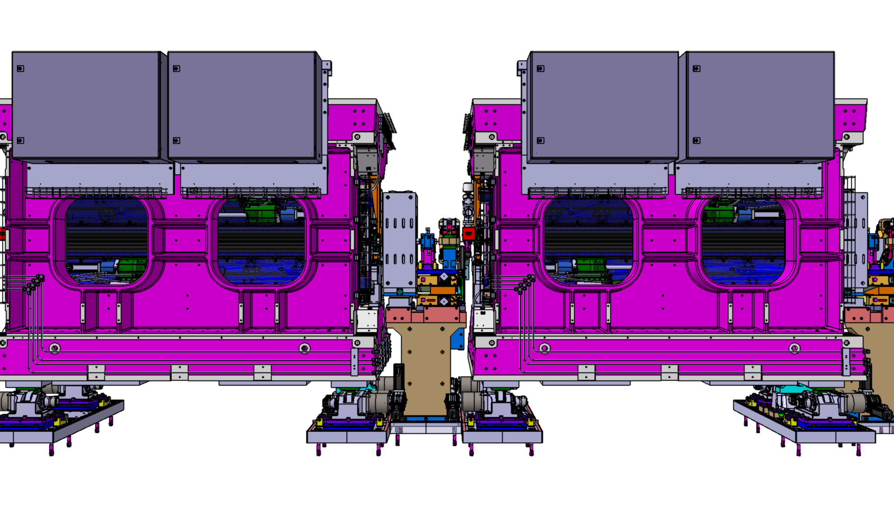
Magnetic chicanes between undulators
CHIC Chicanes: - to delay the electrons
- to shift the orbit transversally
- to compress the electron bunch
2 m
2.8 m
APPLE X:
Transverse Gradient Undulator
Polarization control
Goal: to have flexibility like a table top laser

Slide 24
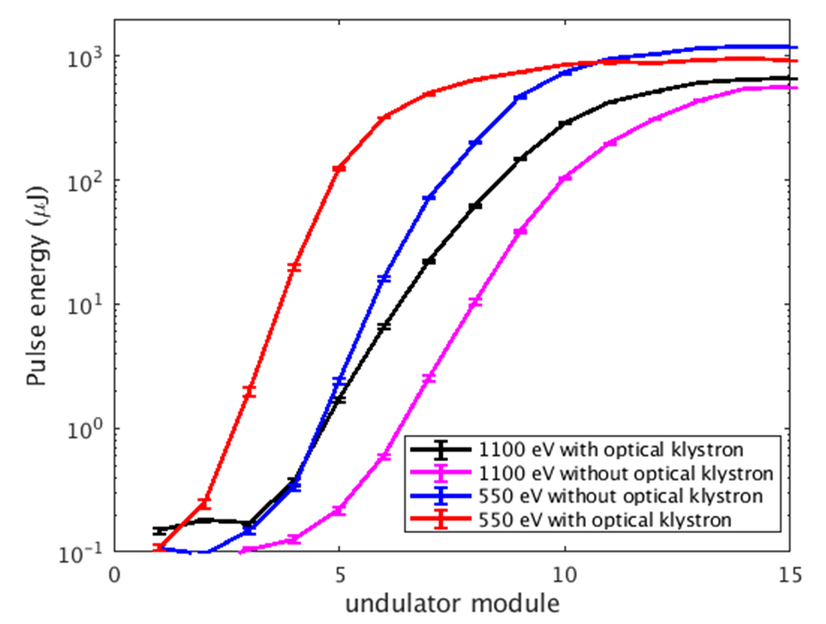
Athos CHIC Mode #1: Optical Klystron
Optical Klystron: Speed up of lasing process
2 to 3 Undulators
2 m
2.8 m
SASE speed up with Optical Klystron !
Courtesy of E. Prat

Slide 25
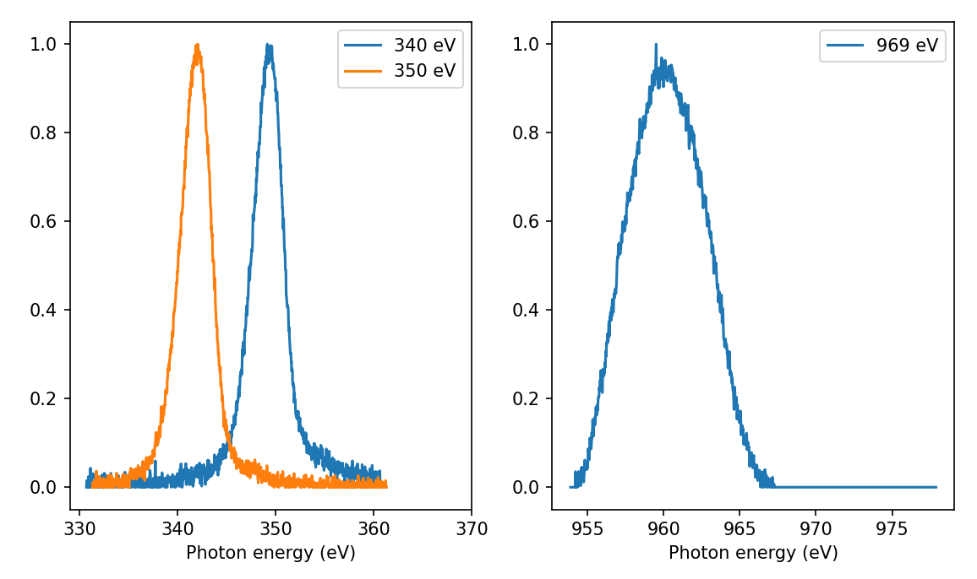
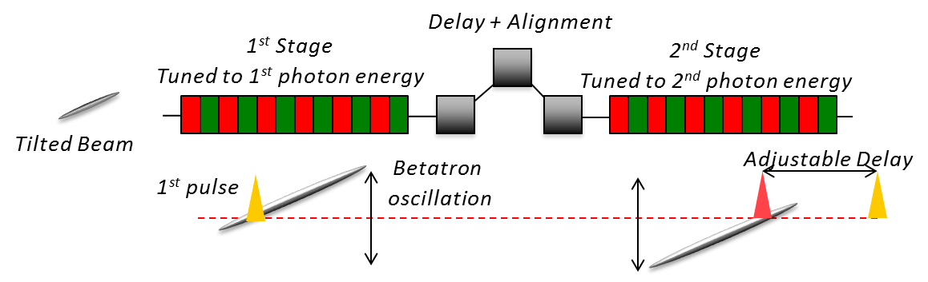
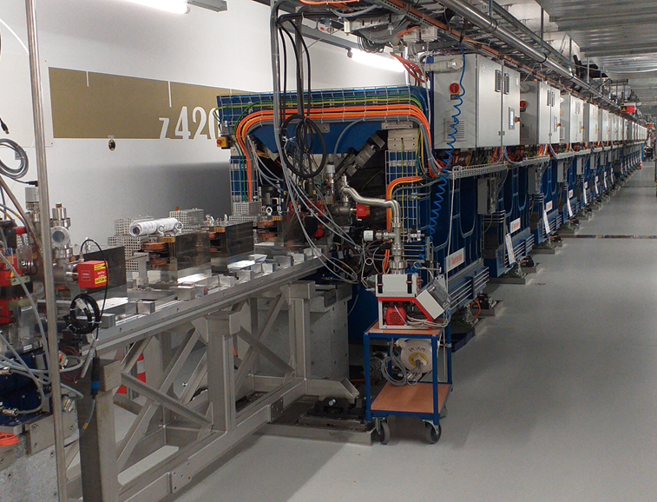
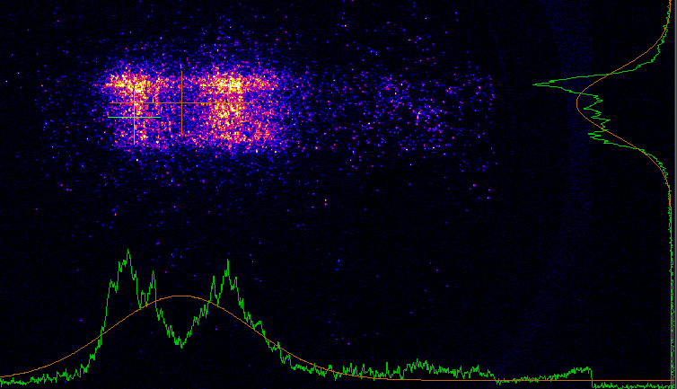
Athos CHIC Mode #2: Two colors mode
Two colors in Maloja‘s Spectrometer
543 eV
531 eV
Two color Chicane
Courtesy of K. Schnorr & E. Prat

Slide 26

Athos CHIC mode #3: Short, high power pulses
Short, high power pulses
(superradiance)

Slide 27
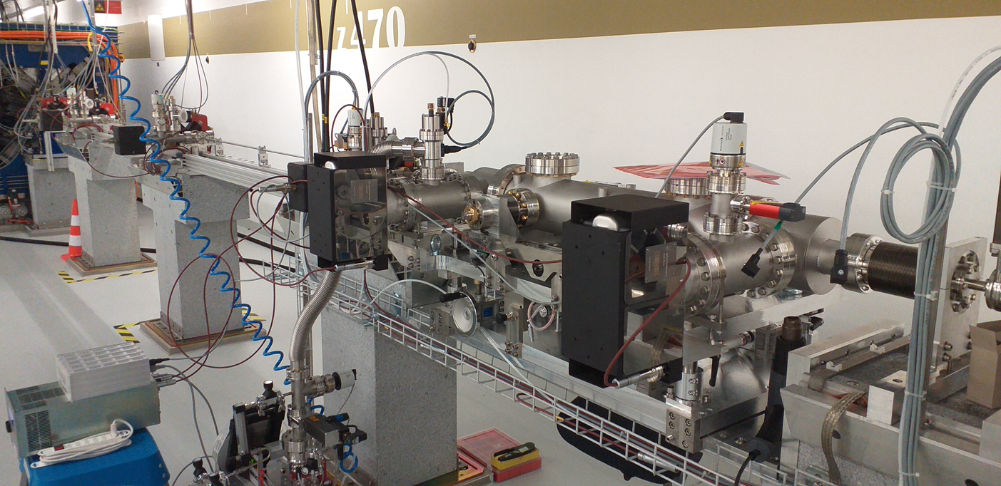
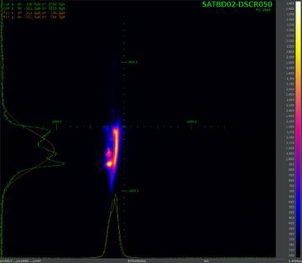
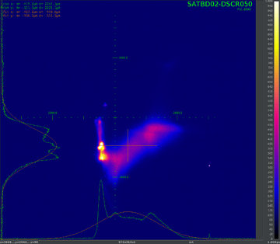
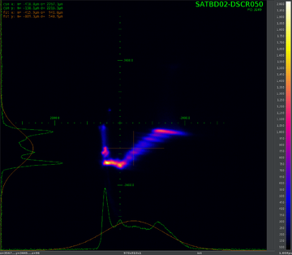
Dechirper as longitudinal bunch diagnostic
Dechirper to tilt the beam (time resolution)
Beam Dump Dipole magnet to see energy spread of lasing electrons
Energy
time
Energy spread increase due to Lasing electrons
Athos Lasing 220 uJ
No streaking
Athos Lasing 220 uJ
Streaking
No Lasing
Streaking
Measurements E. Prat et. al.

Slide 28
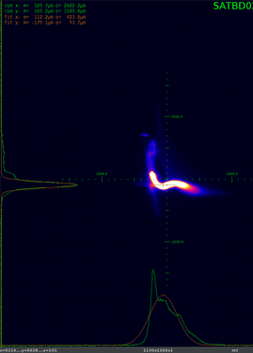
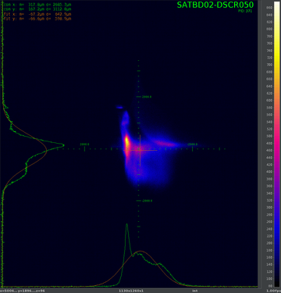
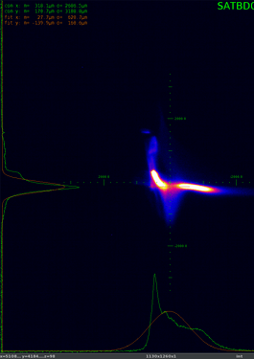
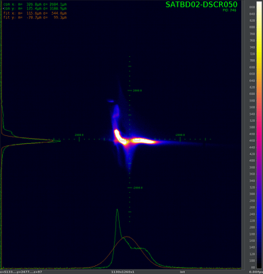
Athos CHIC Mode #3: Short, high power pulse
no lasing
850 uJ
50 fs rms 100Hz
Lasing
Pulse duration control
with tilted beam (dechirper) !
Electron energy
Time
175 uJ
20 fs rms 25Hz
80 uJ
<10 fs rms
10 Hz

Slide 29
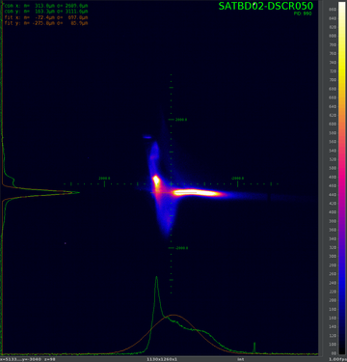

Towards superadiant mode of operation
Shifting the lasing portion of the bunch
Short, high power pulses
(superradiance)
Fresh electron slice after each undulator

Slide 31
Outline
Athos key components
Athos commissioning
Budget & Timeplan

Slide 32
Budget
Machine budget distribution

Slide 33
Athos milestones
Most milestones reached on time before 2020
3 Months delays due to Covid

Slide 34

Conclusion
Positive:
Most milestones reached on time !
Optical klystron very efficient: 1st lasing with only 2 undulators !
Undulators, dechirpers & chicanes are operating as expected.
CHIC modes are promising (e.g. 2 colors mode; tilted beam; …)
Issues:
3 MCHF for Regie not in first budget (=> cut by Furka Endstation)
X band RF modulator: 2 years delay (Company made banckrupt => in house devt)
Repetition rate limited by beam losses:
    5 mm vacuum pipe -> probably 3 mm real clearance !

Slide 35
Wir schaffen Wissen – heute für morgen
Many thanks for your attention
Many thanks to the Athos Team

Slide 36

Athos Operation since summer 2020
Photon Energy
Variation by users
Operation to 100Hz more frequent
2 mJ at 870 eV

Slide 37
Wir schaffen Wissen – heute für morgen
Mein Dank geht an
Vorname Name
Vorname Name
Vorname Name

