Slide 1
SLS Status & Operation 2021
Thomas Schietinger :: Paul Scherrer Institut
(with input from Andreas Lüdeke, Michael Böge, Elmar Zehnder and others)
7th LAB Meeting, 25 June 2021

Slide 2
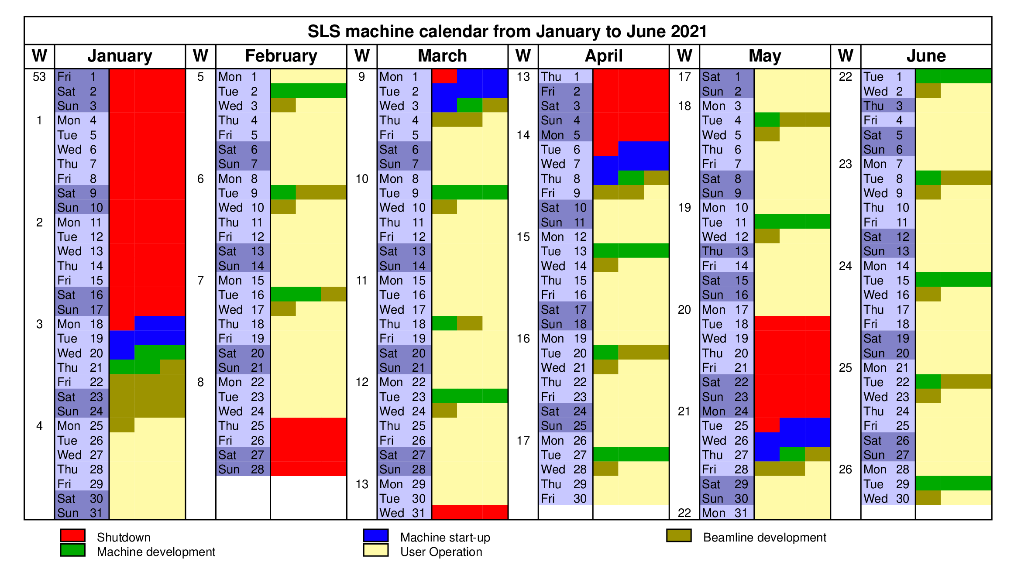
Overview SLS operation 2021/1
Operation under LO-II conditions (limited user access)

Slide 3
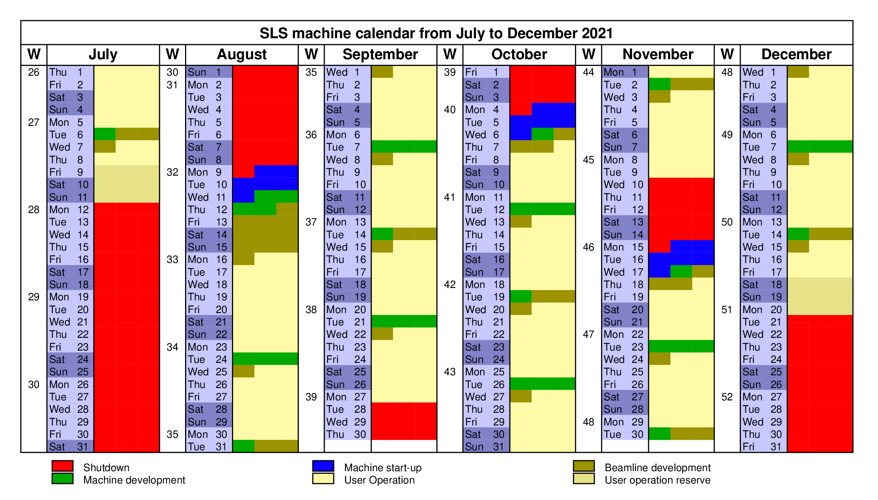
Outlook SLS operation 2021/2
Second half of the year: user operation periods planned according to the normal schedule.
Operation under LO-I conditions (?)

Slide 4
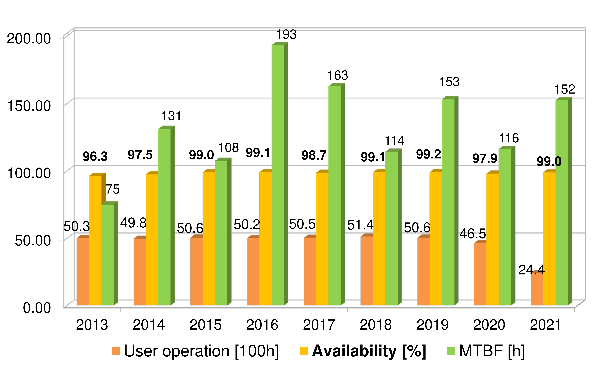
SLS operation statistics
(courtesy A. Lüdeke)
2021 so far a good year:
  Beam availability up to now at 99.0%
  Mean time between failures with 152 hours in the range of good years.
    Dominated by one event (power outage 4/5 March, 15 h downtime)

Slide 5
Major issues
Rocky startup in January:
  Various changes in control system (with insufficient communication…).
  New injector kicker system (C. Gough).
  Problems with charge measurement (PCT electronics).
  New tune settings had to be found.
Long interruptions (more than 1 hour downtime):
  26 January: Magnet power supply failure (ARIMA-QLB-04) (2 hours).
  9 February: RF interlock (station A2, demiwater) (1.5 hours)
  4/5 March: Power outage due to short in 16 kV distribution. (More than 30 hours total downtime, 15 hours user operation)
  26 April: RF interlock (station A4) (1.5 hours).
  29 May: Machine interlock from flow switch in X05LA (1.5 hours).
  8 June: Power glitch after thunderstorm (4 hours downtime, beamline dev. only).
Other problems (few hours of degraded beam):
  22 March: Network failure causes many IOCs to crash (3 hours decaying beam).
  9 May: Failure of regloplus cooling unit in linac (6 hours decaying beam).
  10 June: Failure of filling pattern feedback (8 hours of decaying beam).

Slide 6
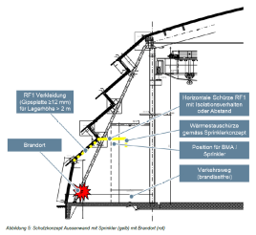
Shutdown work and related activites (1)
(courtesy E. Zehnder & J. Honegger)
SLS 2.0 evaluations: machine, beamlines, area management
InnovAARE coordination with shutdown operations
Various modifications at beamline endstations
Safety patrol (Sicherheitsrundgang) / new fire concept for outer wall:
Implementation of PSI/GFA machine safety:
  See https://intranet.psi.ch/de/
  safety-maschinen-roboter-sicherheit

Slide 7
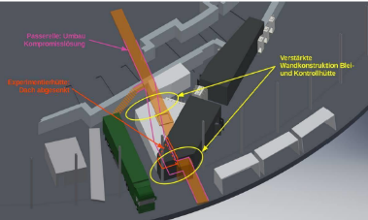
Shutdown work and related activites (2)
(courtesy E. Zehnder & J. Honegger)
Raising of hall ventilation and installation of service bridge at 5 m elevation
  Finishing work on ventilation (temperature stability now ±0.3°C – was ±0.5°C)
  Extension of service bridge in entrance area
  (new positioning of passarelle to accommodate SLS-2.0 beamlines)

Slide 8
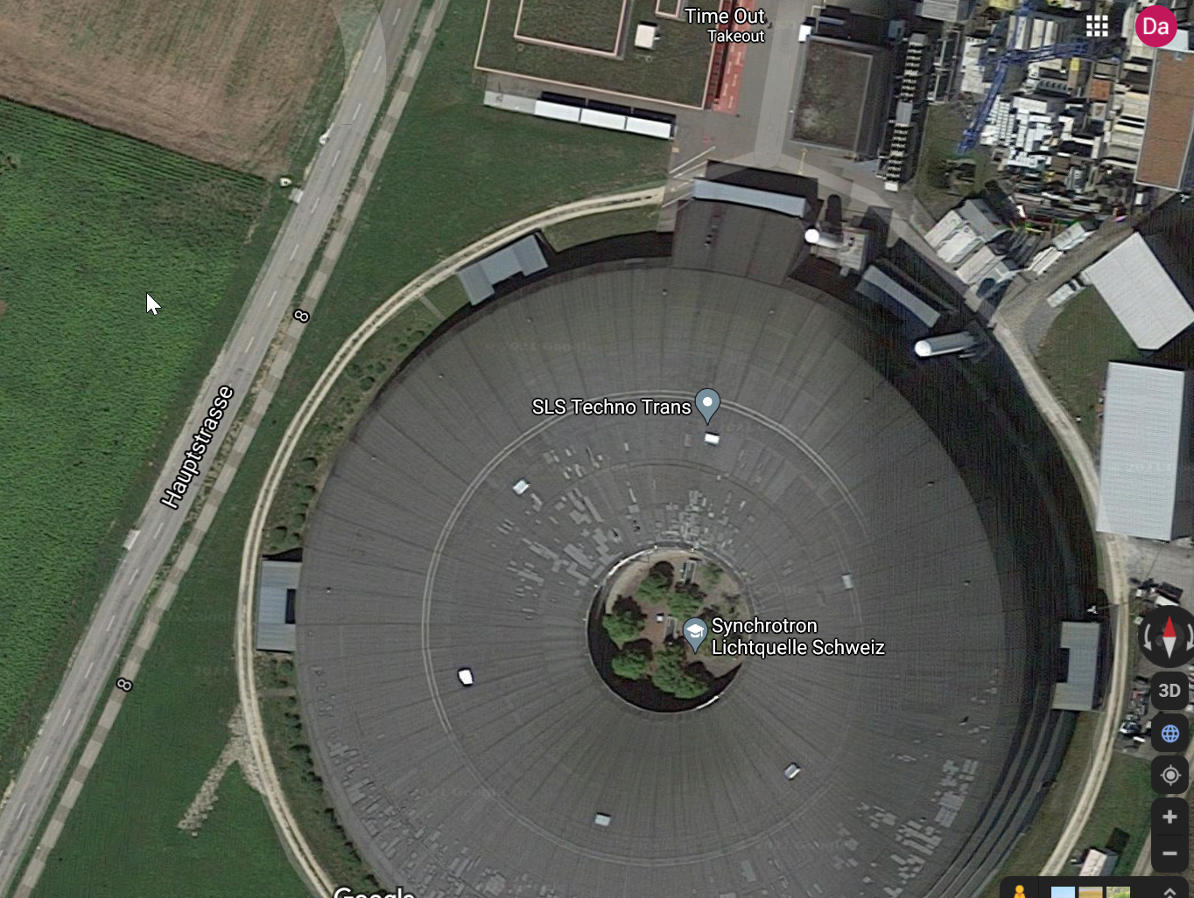
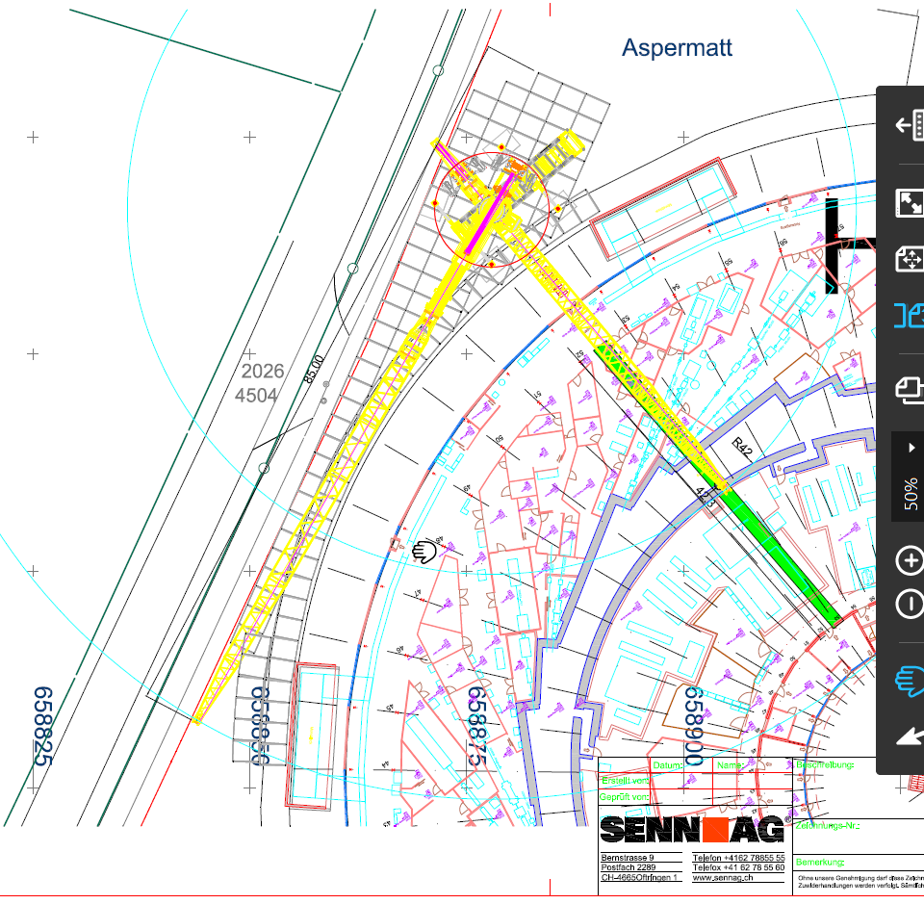
SLS renewal: crane insertion
Insertion of second crane planned for 15 July.
This area closed during insertion! (axes 40–59)
Passerelle and stairways remain accessible
(courtesy E. Zehnder & J. Honegger)

Slide 9
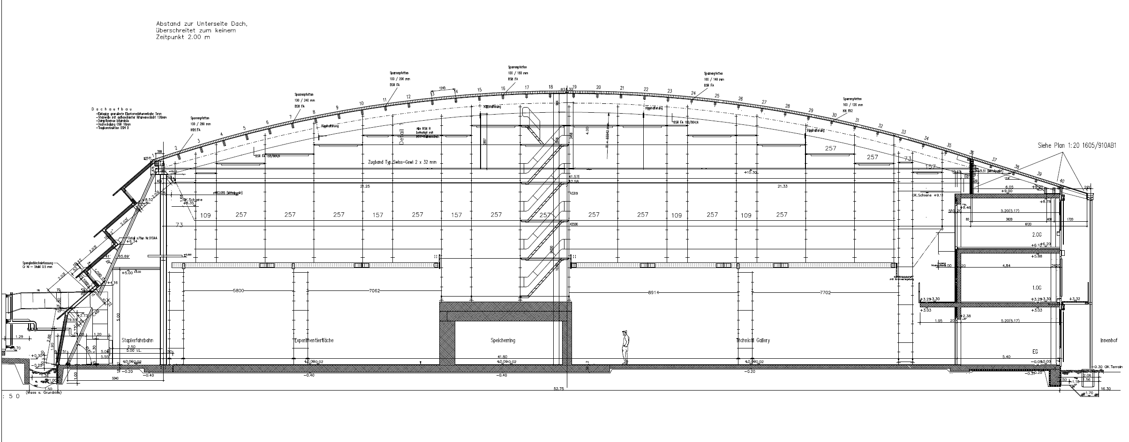
SLS renewal: inner scaffolding
The inner scaffolding fulfils several purposes:
Dust protection for RF amplifier area
Access to inner roof surface for dismantling / roof opening
Storage “catwalk”
Installation platform for crane
(courtesy E. Zehnder & J. Honegger)

Slide 10
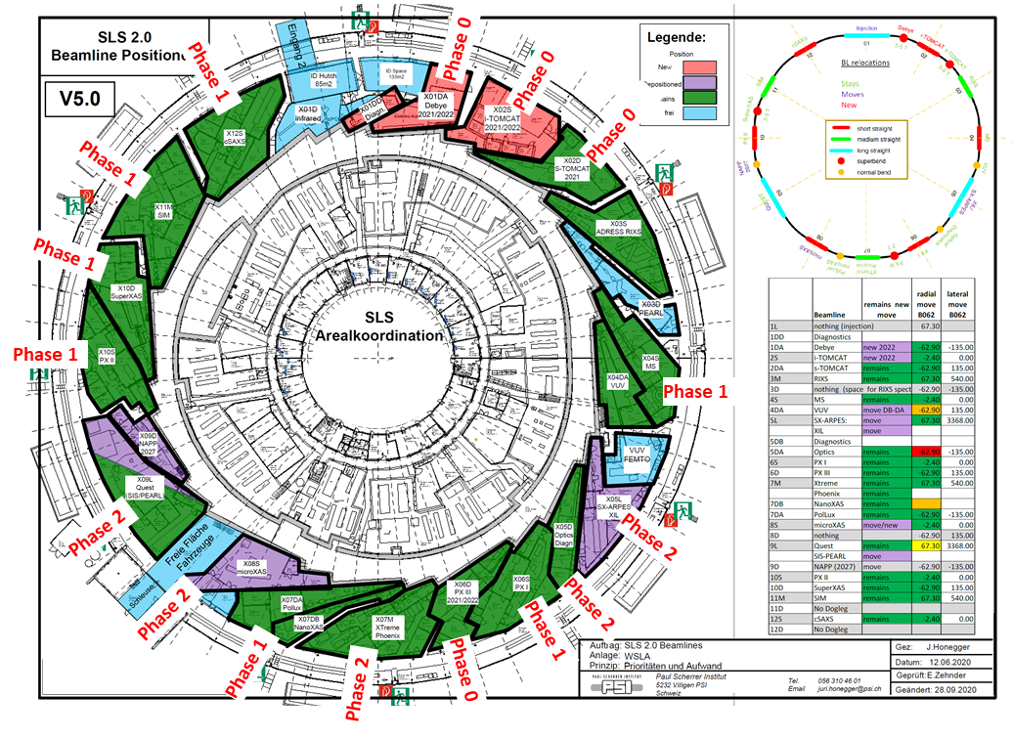
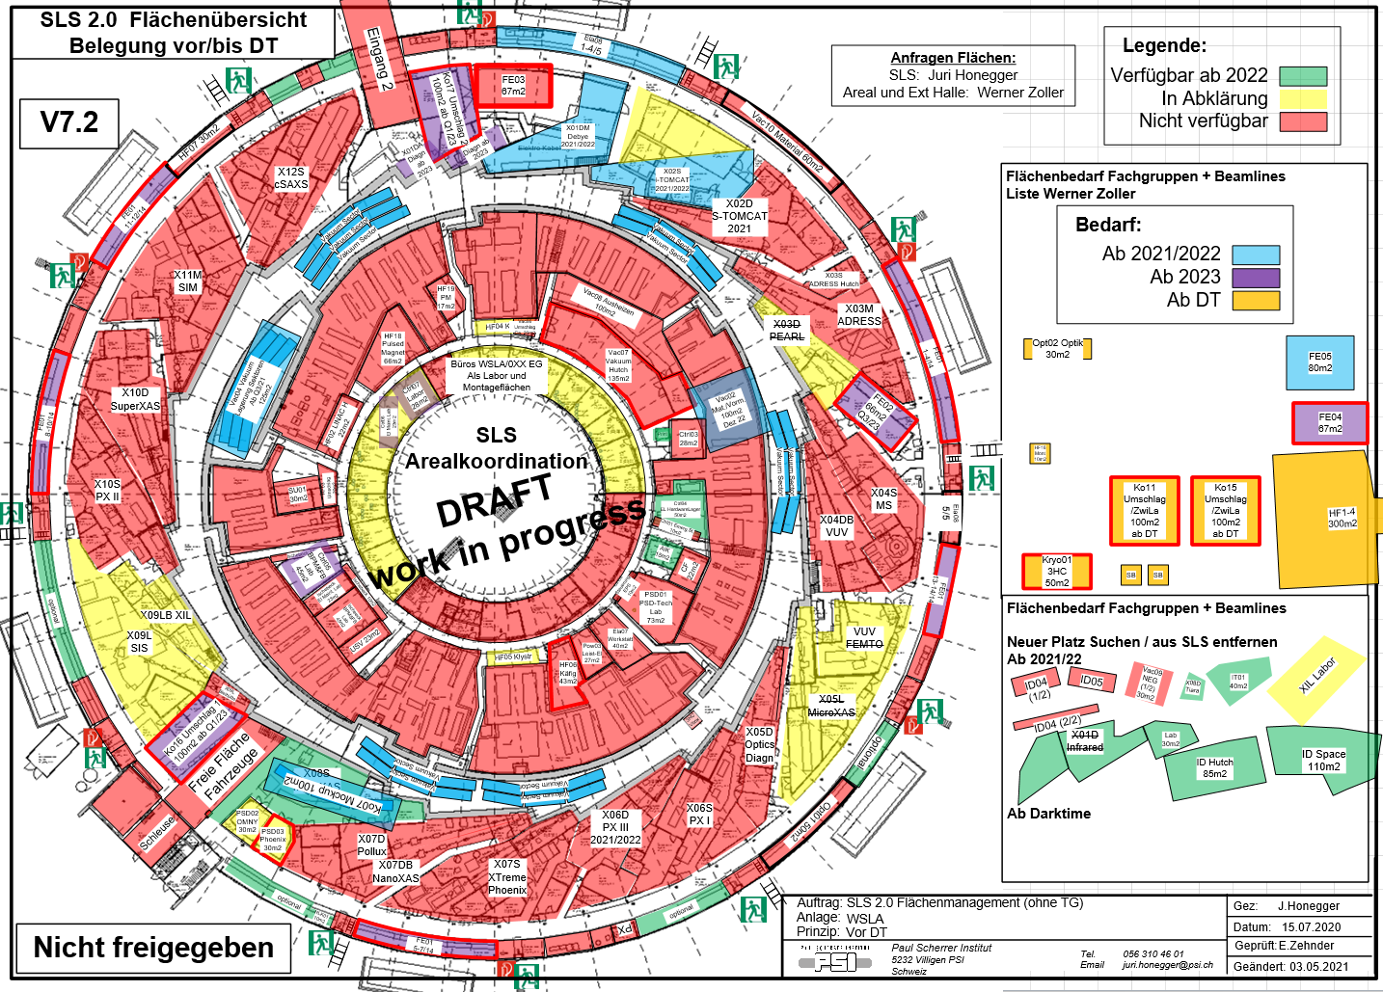
SLS renewal: beamlines
Implementation of the beamlines defined for “phase-0” in coordination with GFA, PSD and LOG (phase-0: PX-III, Debye, s-TOMCAT, i-TOMCAT)
System refurbishments clarified between GFA/PSD/LOG, now being implemented.
(courtesy E. Zehnder & J. Honegger)
Page 15

Slide 11
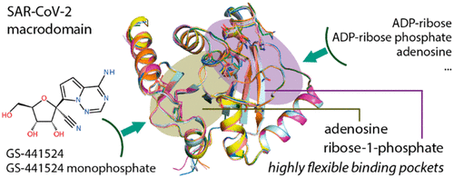
Science highlight:
How remdesivir works agains the coronavirus
Measurements at the X06DA-PXIII beamline by a team from the Goethe University in Frankfurt am Main, Germany, reveal a new mechanism of action of the antiviral drug remdesivir (a.k.a. Veklury)
  Media info: https://www.psi.ch/en/media/our-research/how-remdesivir-works-against-the-coronavirus
  Publication: X. Ni, M. Schröder, V. Olieric, M.E. Sharpe, V. Hernandez-Olmos, E. Proschak, D. Merk, S. Knapp, A. Chaikuad. Structural Insights into Plasticity and Discovery of Remdesivir Metabolite GS-441524 Binding in SARS-CoV-2 Macrodomain. ACS Med. Chem. Lett. 2021, 12, 4, 603–609. https://doi.org/10.1021/acsmedchemlett.Oc00684
(Side remark: I am always astonished at the almost complete disregard with which the light source is treated in such publications!)

Slide 12
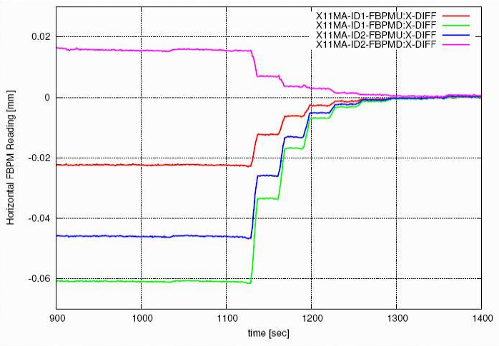
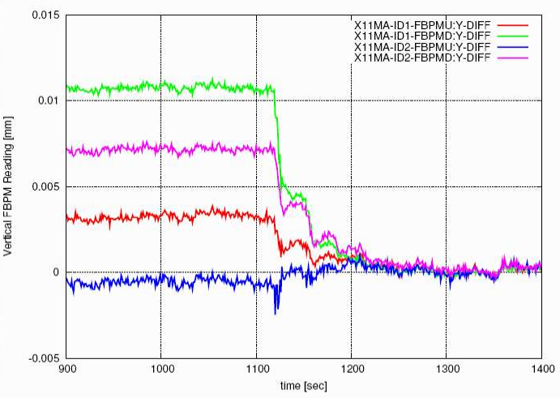
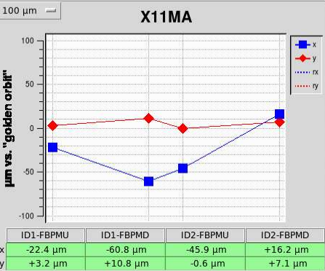
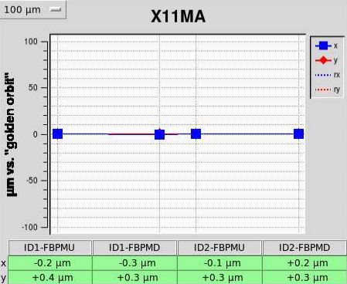
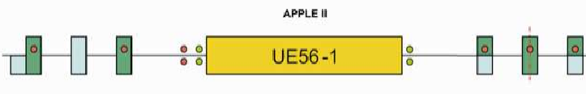
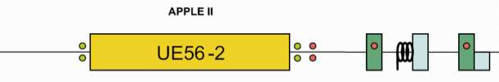
Machine science highlight (1):
11M orbit bump for SIM beamline
(M. Böge)
11M straight with 4 monitors/ local correctors in x/y plane (not included in fast-orbit feedback, FOFB)
Measurement of local 4×4 response matrices with active FOFB → keeps the orbit stable outside of straight
Use inverted matrices for correction
Gain of 0.5 (half of prediction) used for correction with active FOFB
Operation in SOFB loop coexists with FOFB
(Local response matrix measurements can also provide local optics information → useful for localizing errors)
horizontal
orbit
vertical
orbit
Corrector
Monitor

Slide 13
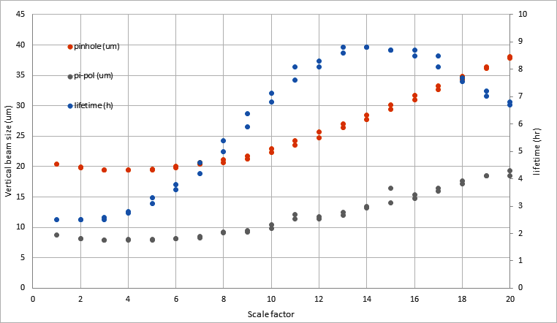
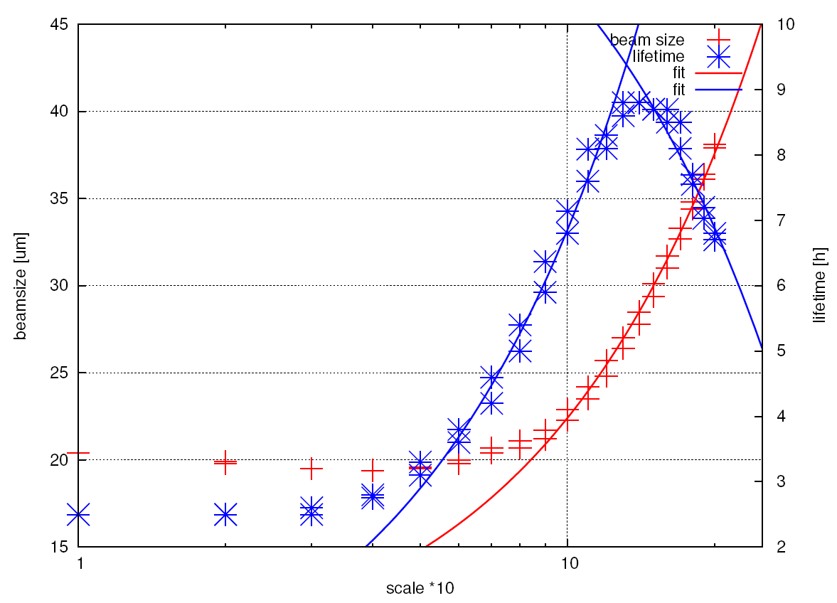
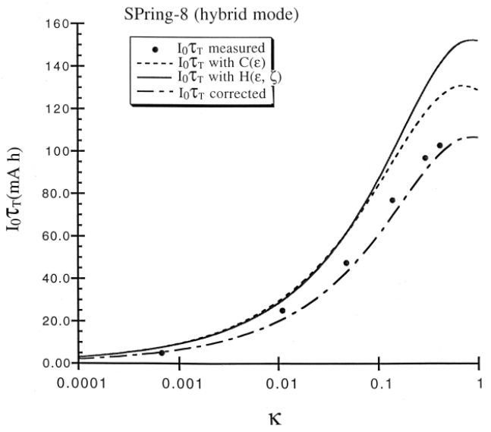
Machine science highlight (2):
Touchek lifetime versus coupling
(M. Böge, C. Ozkan)
lifetime
lifetime
vert. beam size
(pinhole)
(same data
on log scale)
vert. beam size
( π-polarization)
beam size
Coupling (log scale)
~skew quad strength
Plan was to measure point spread function of pinhole, but failed due to sub-optimal machine correction status...
...but interesting result on Touschek lifetime at large coupling!
Lifetime increases due to thinning of beam (less Touschek scattering), but drops again when the vertical aperture comes into play!
We may compare to theory and Spring-8 measurements (Miyahara, EPAC 2000):

Slide 14
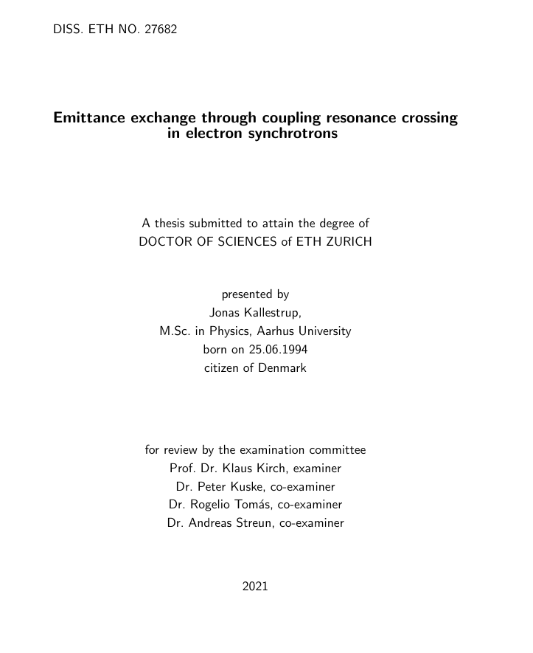
“Released early for good conduct”
Jonas Kallestrup has left PSI on 1 April 2021.
Successful thesis defense on
4 June 2021.
Very comprehensive thesis on SLS topics, in particular the booster synchrotron:
  Emittance exchange and application to SLS booster
  Booster vertical emittance minimization
  Beam characterization in booster-to-ring transfer line
  Experience with 2.7 GeV booster operation

Slide 15
Thank you for your attention
...and many thanks for infos / slides / plots to:
Andreas Lüdeke
Elmar Zehnder, Juri Honegger
Michael Böge, Cigdem Ozkan

