Slide 1
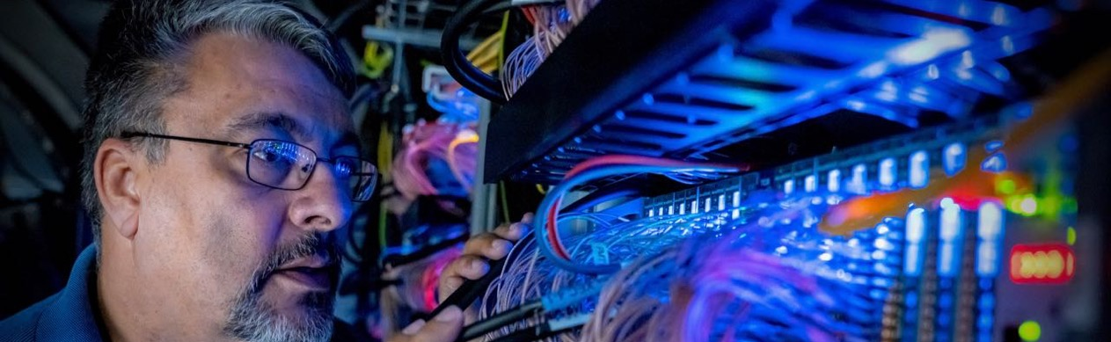
The WaveDAQ System
Markus Fischer, PSI
Stefan Ritt :: Paul Scherrer Institute :: Muon Physics Group
LTP Seminar October 2021

Slide 2
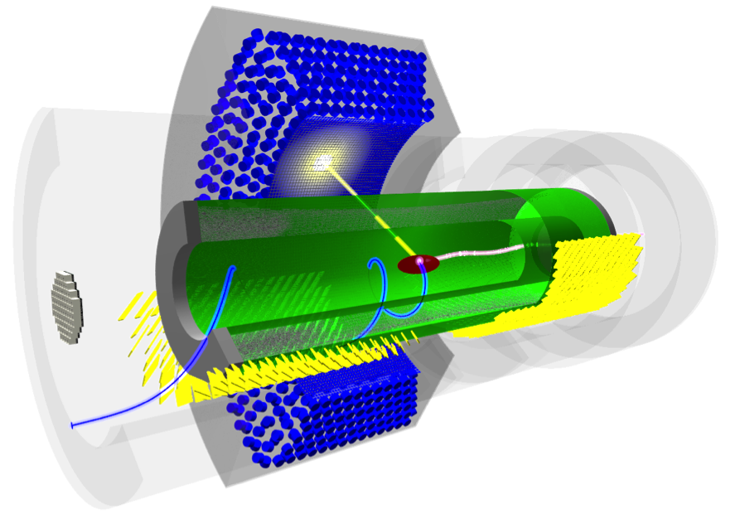
The Challenge: MEG II @ PSI
µ⁺→e⁺ɣ at with sensitivity ≈ 6 x10⁻¹⁴
Calorimeter Signal:
µ⁺→e⁺ɣ E_{γ} = 52.8 MeV
µ⁺→e⁺ν_{e}ν_{γ}
⨽AIF E_{γ} < 52.8 MeV
10⁸ μ/s
0.511 MeV
< 52.8 MeV
Liquid Xenon
Calorimeter
~100ns
t

Slide 3
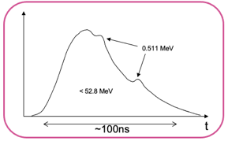

Digitizing detector signals
TDC
QADC
Detector
ADC
250 MSPS
125 MHz
ADC
2 GSPS
Signal:
1 MHz - 1 GHz
(0.3 ns risetime)

Slide 4
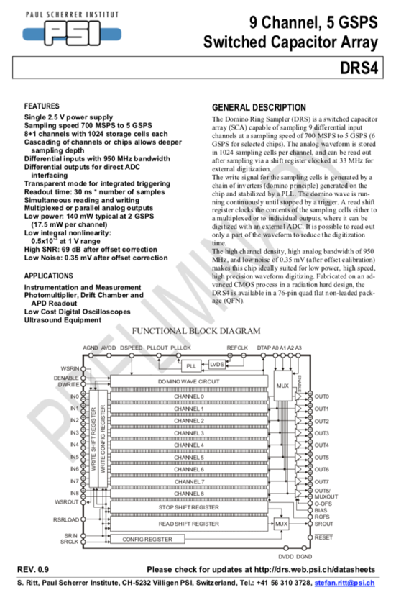
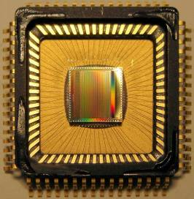
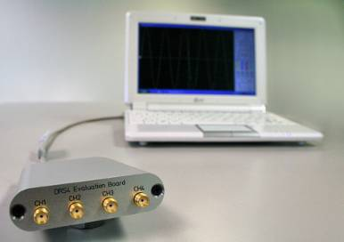
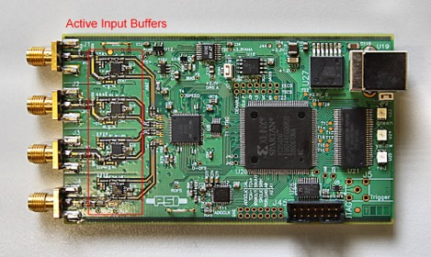
DRS4 Chip 2008
8+1 channels
1-5 GSPS / 12 bits
Typical 140 mW
USB
Evaluation
Board

Slide 5
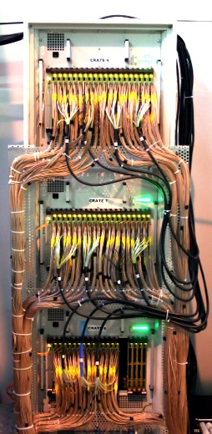
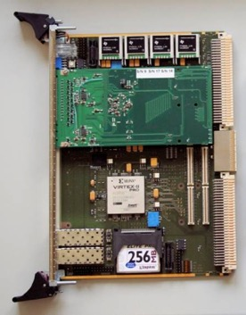
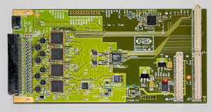
MEG Electronics 2008-2013
Power
Trigger
Active
Splitter
Clock distribution
PMT
Trigger Bus
DRS4
DAQ
HV
Separated
DAQ & Trigger & HV
VME based system
DRS4 piggy-back on general purpose FPGA board

Slide 6
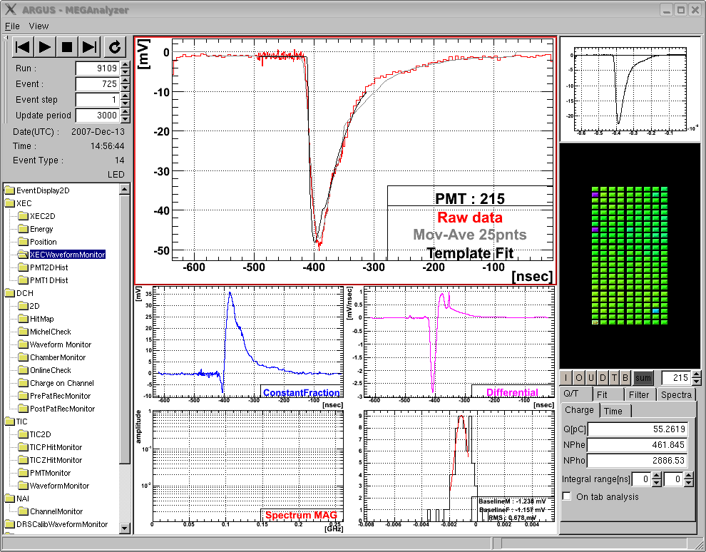
MEG on-line waveform display
“Virtual Oscilloscope”
Σ848
PMTs
γ
template fit
Liq. Xe
μ
PMT
1.5m

Slide 7
MEG vs. MEG II electronics
Power
MEG Experiment 1999-2013
Separated DAQ & Trigger
3000 Channels DRS4
(0.8 GSPS / 1.6 GSPS)
1000 Channels Trigger
(100 MSPS)
5 Racks
Trigger
Active
Splitter
Clock distribution
PMT
Trigger Bus
DRS4
DAQ
HV
MEG II Experiment 2015-
9000 Channels
Same rack space
  Avoid dead space between boards
  Combine DAQ & Trigger
  Integrate high voltage
Timing requirement
  O(10 ps) between any two channels
?
TDAQ
SiPM

Slide 8
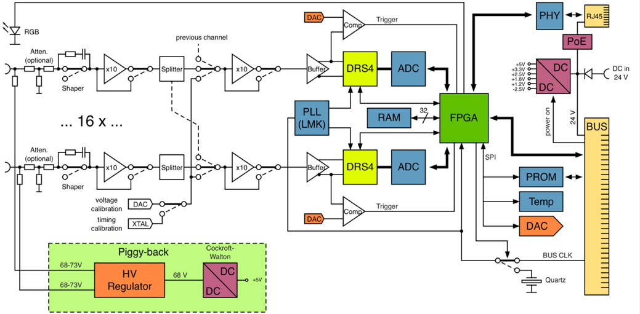
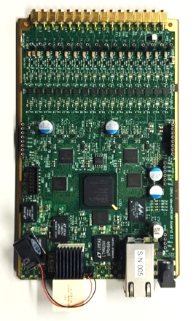
WaveDREAM Baord
5 GSPS
80 MSPS
Drs4 based REAdout Module

Slide 9
Details of the WDB
Trigger
TDC
Scaler

Slide 10
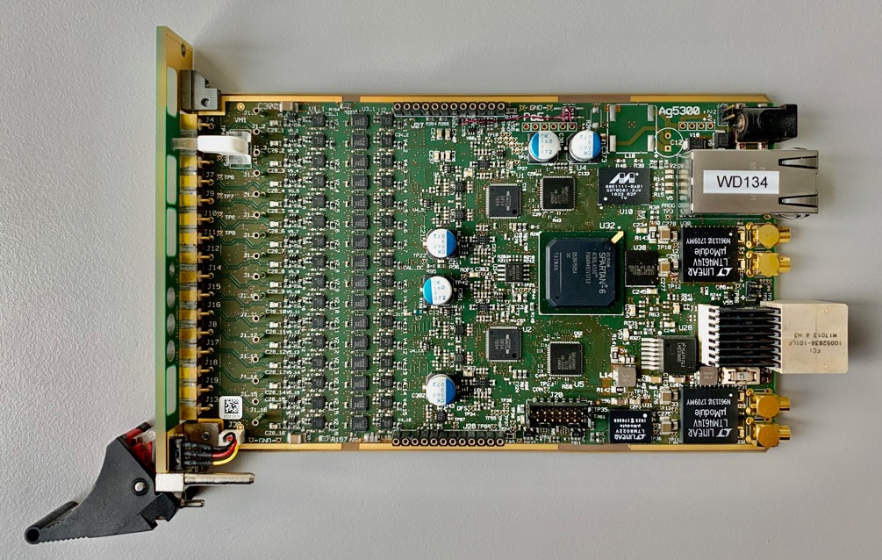
WaveDREAM Board > 2000 parts!

Slide 11
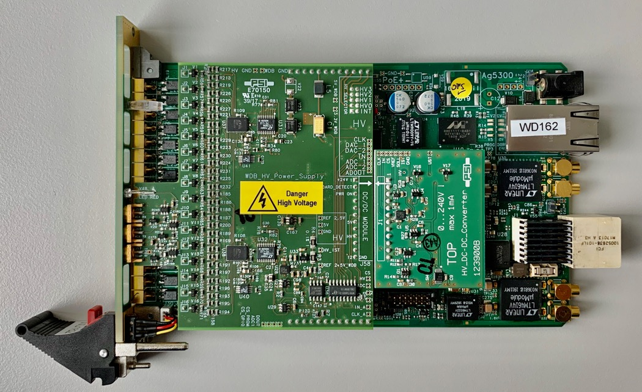
WaveDREQM High Voltage

Slide 12
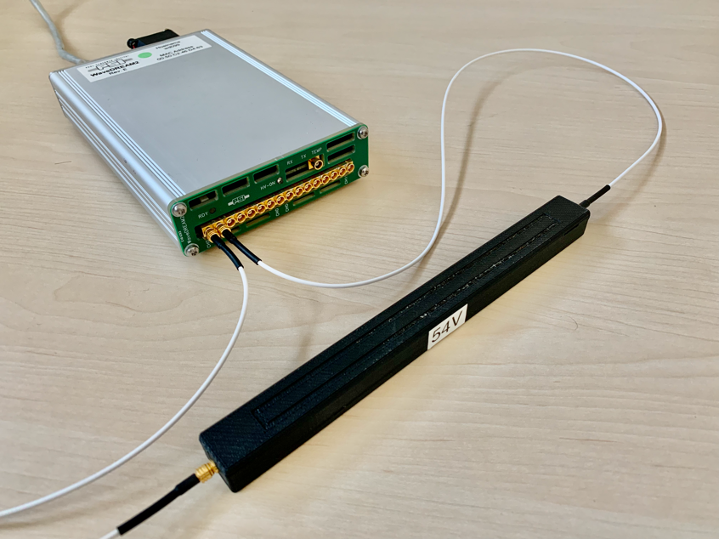
Standalone System
Direct biasing of SiPMs
Preamps / Shaping for 16 SiPM signals
Power-over-Ethernet (PoE+)
“Web Oscilloscope”

Slide 13
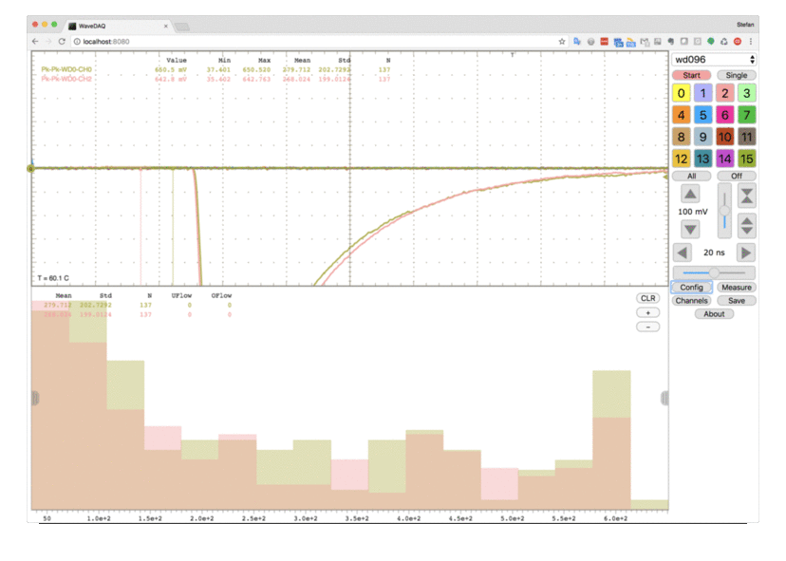
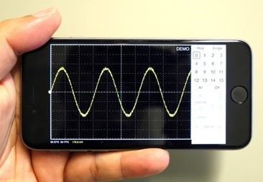
Web Oscilloscope
http://elog.psi.ch/scope
70 frames/s display rate
Integrated measurements with histogramming
Runs on any browser

Slide 14
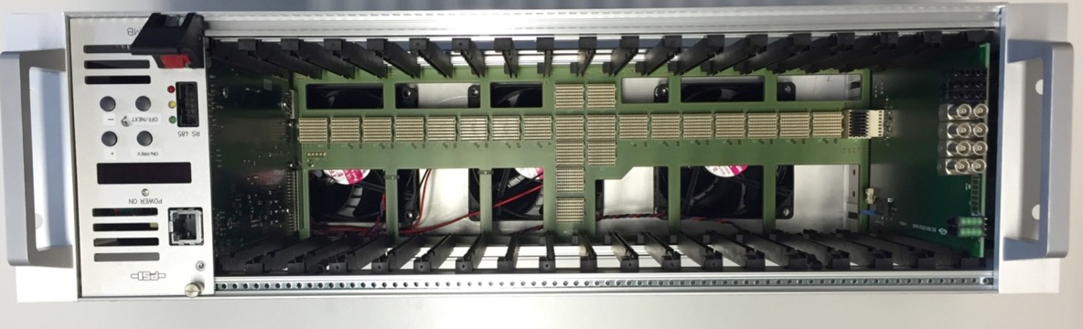
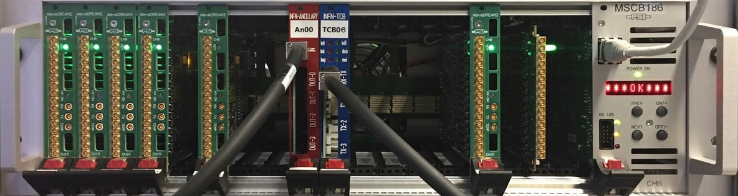
WaveDAQ Crate Standard

Slide 15
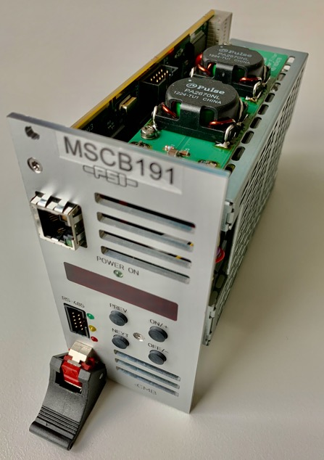
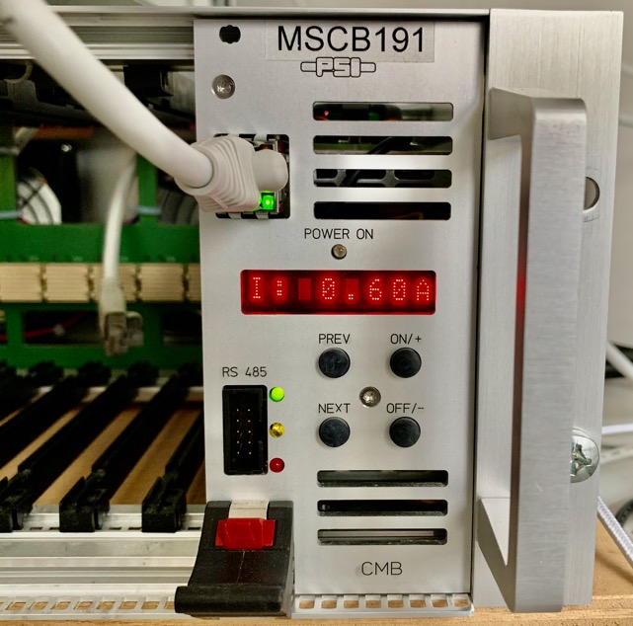
Power Supply (400W) & Crate Controller

Slide 16
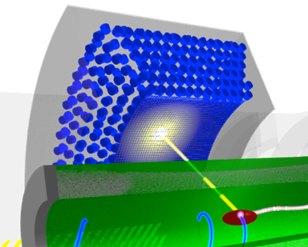
Trigger Scheme
DRS4
ADC
WaveDREAM
Board
80 MHz
serial links
FPGA
Trigger after ~400 ns
Σ
Trigger FPGA
16 inputs
serial links
Σ
256 inputs
total

Slide 17
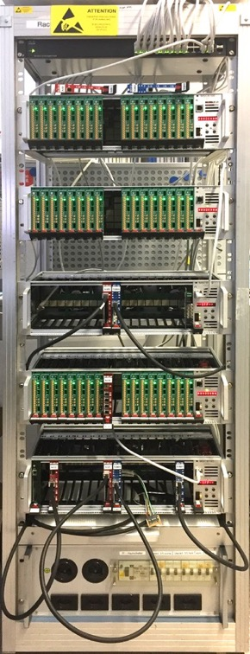
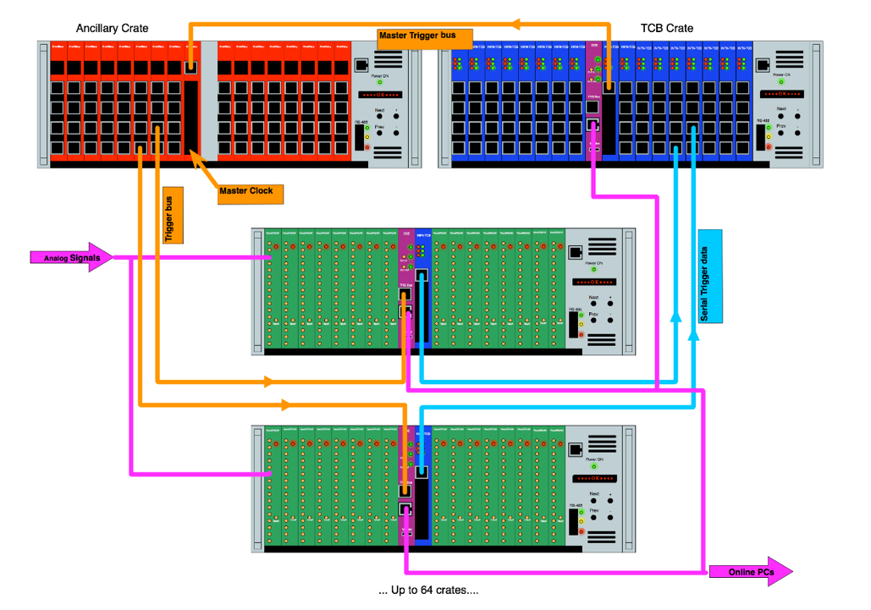
MEG II System
Trigger Boards INFN Pisa

Slide 18
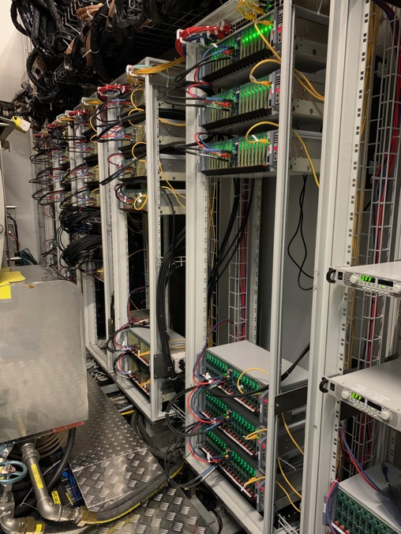
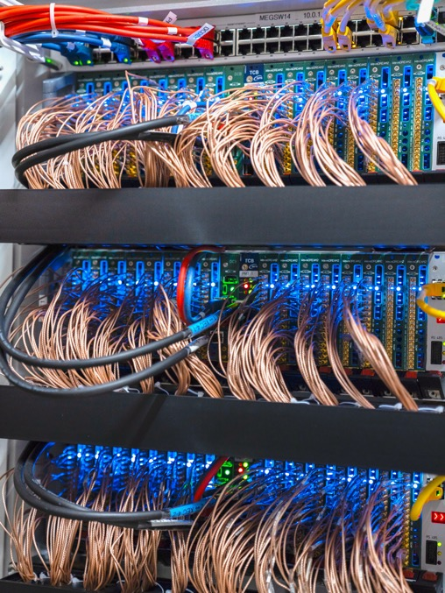
Full system ~9000 channels

Slide 19
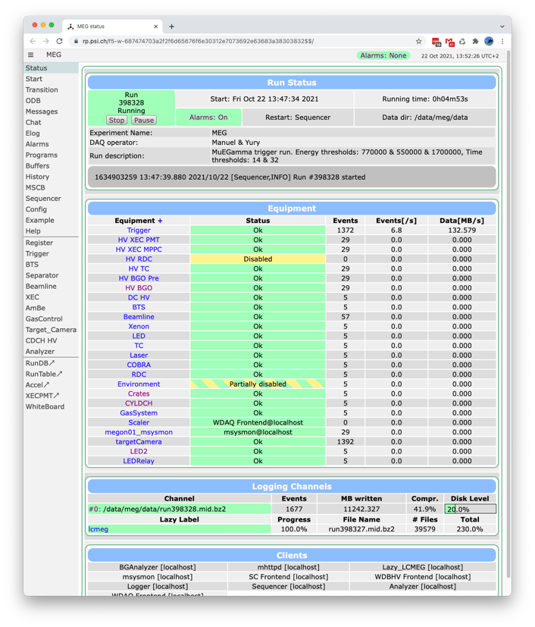
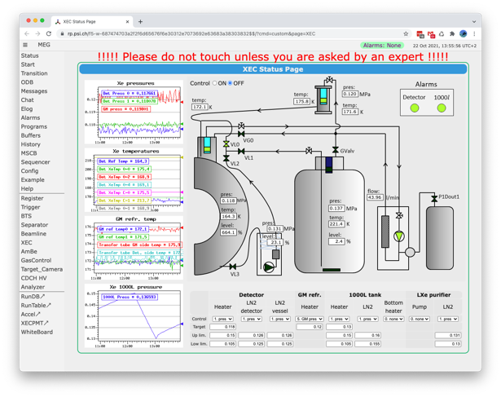
MIDAS at work
~7 Hz event rate
130 MB/s and 50 MB/s compressed
→ 20 TB / week
Tons of slow control (accessible remotely through web)

Slide 20
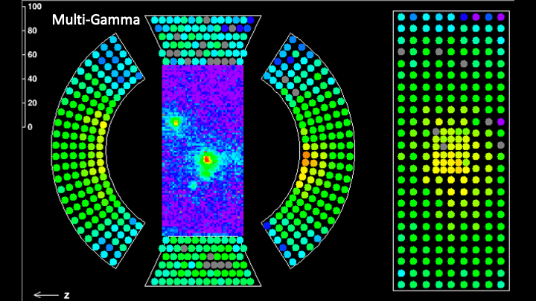
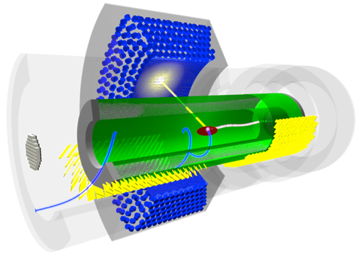
Gamma pile-up
SiPM (MPPC)
PMT

Slide 21
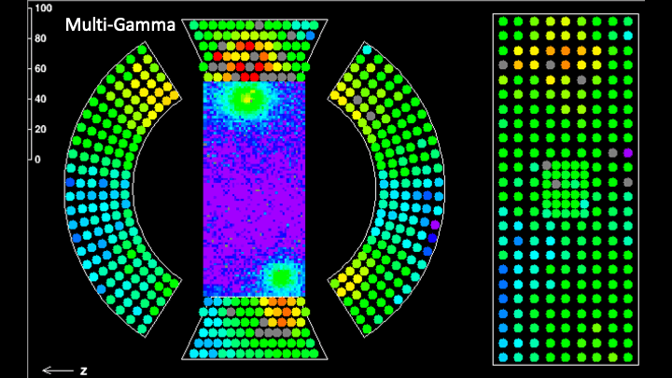
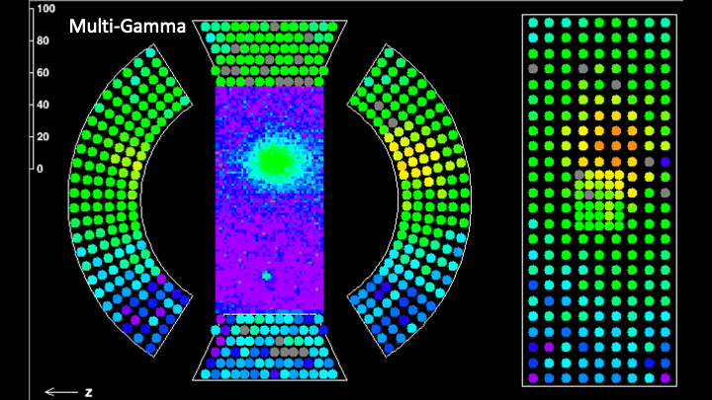
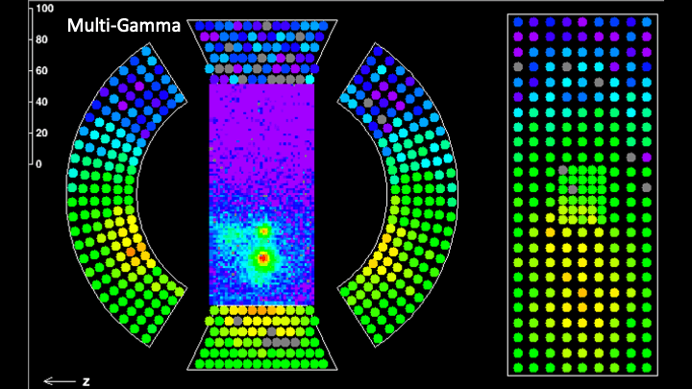
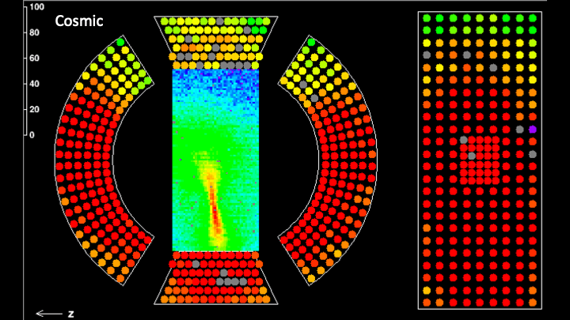
MEG II event gallery

Slide 22
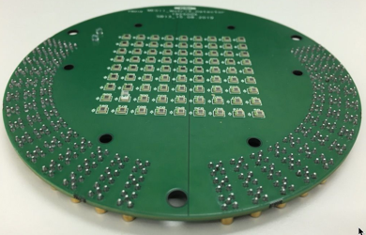
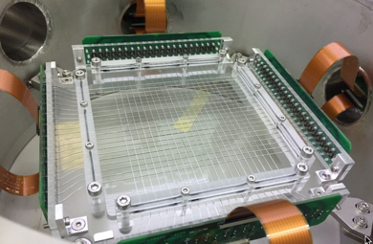
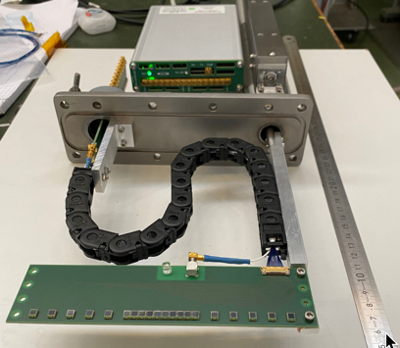
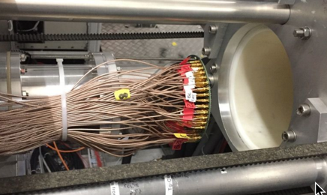
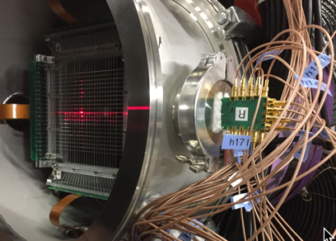
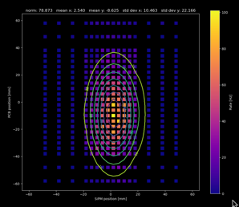
Beam Profile Monitors using WaveDAQ
MatriX, A. Papa et al.
SciFi, A. Papa et al.
SiMon, A. Soter at al.

Slide 23
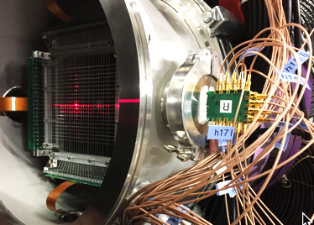
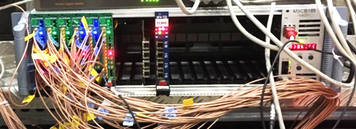
Plans for BPM
Easy-to-use, compact, stand-alone system
Different detector front-ends (fibres, pixels, …), configurable
Use proton RF signal for particle ID
Integrated web server for direct profile display
Build several units for our secondary beam lines

Slide 24

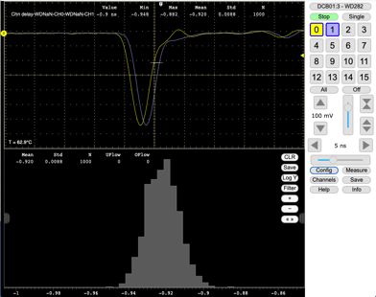
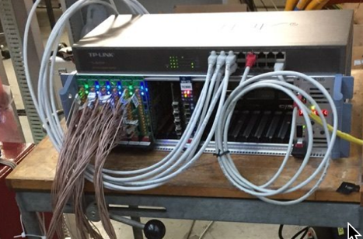
Conclusions
WaveDAQ system successfully deployed in MEG II after
9 years of development
System design is not specific to MEG
Single board (16 chn) and single crate (256 chn) systems useful
for many applications at PSI
Web browser based software constantly extended
8.8 ps

Slide 25
WaveDAQ @ PSI
My thanks go to
Roberto Dinapoli
Ueli Hartmann
Elmar Schmid
Luca Galli
Marco Francesconi
INFN Pisa

