Slide 1
Charge Monitors at SwissFEL
G. L. Orlandi (*)
SwissFEL Electron Diagnostics Review Workshop PSI (Remote), 18-21 October 2021
(*) in charge of the present diagnostics since July 2019
gianluca.orlandi@psi.ch

Slide 2
Contents
Overview of the SwissFEL charge monitors
Milestones towards an absolute measurement of the beam charge in SwissFEL:
      Wall Current Monitor (WCM): experimental characterization and numerical modelling to determine the transfer impedance
      Cavity Beam Position Monitor (Cav-BPM): fit of the measured monopole cavity waveform for an absolute measurement of the charge
Procedure for calibration of the SwissFEL charge monitors
Conclusions and outlook

Slide 3
Charge Monitor in SwissFEL
Turbo ICT (Integrating-Current-Transformer): 4 in Aramis and 2 in Athos
Standard ICT: 1 in the gun section
Cavity-BPM (Beam-Position-Monitor):
~200 units distributed all along Aramis and Athos
Charge measurement by calibrating the monopole cavity signal against charge readout of a reference ICT
Wall-Current-Monitor (WCM, 1 in the gun section):
coarse synchronization photocathode laser timing and RF gun phase
2-bunch charge monitoring @100 Hz
Faraday-Cup (one unit in the Gun section):
      Dark current measurements
      Systematic error in the charge determination probably due to containment and confinement issues

Slide 4
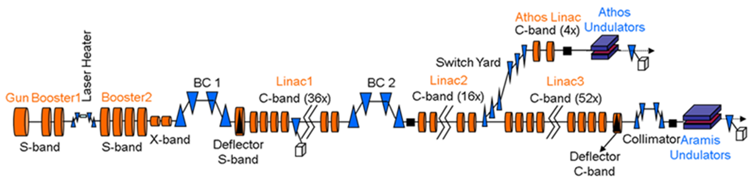
SwissFEL and Charge Monitors
WCM, FC
ICT
ICT
BPM~200 units all along the machine
Beam energy: 6.2 GeV and 3.3 GeV
Beam charge: 10-200 pC @100Hz, 28 ns 2-bunch time structure
Emittance: 0.4/0.2 mm mrad
Bunch length: from a 3 ps up to a few fs
Photon wavelength: 0.1-0.7 nm and 0.7-7.0 nm
Courtesy Bergoz

Slide 5
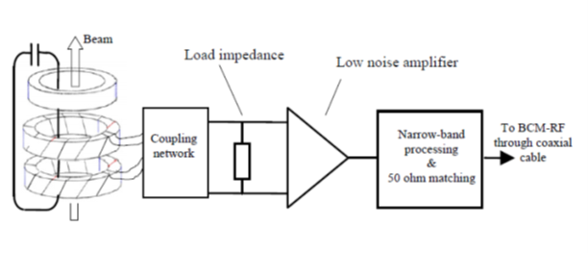
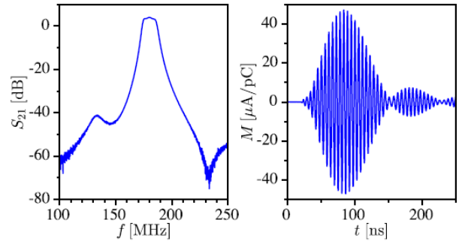
Integrating Current Transformer
Standard ICT (Bergoz, BCM-IHR readout electronics):
          Charge readout from time integration (5μs) of the transformer current
          Broad-band frequency response of the transformer (kHz➔10 MHz)
          no 2-bunch time structure resolution and dark current sensitivity
Turbo ICT (Bergoz, BCM-RF readout electronics):
    Output signal is a resonance of the transformer current filtered by narrow bandpass filter centered at around 180 MHz
    resonance quality factor reduced to discriminate the 2 bunches
    Beam charge determined by measuring the apex of the resonance (sample-and-hold electronics)
    28 ns 2-bunch time structure discrimination, dark current immunity
    rms resolution 0.6% (sensitivity 1.1 pC @180 pC)
    design problem: crosstalk of the bunch-2 against bunch-1 readout because working point of the logarithmic amplifier set by the bunch-1 charge value
Courtesy Bergoz, Artinian et al IBIC2012
F. Stulle, J. Bergoz, Proc. FEL2015

Slide 6
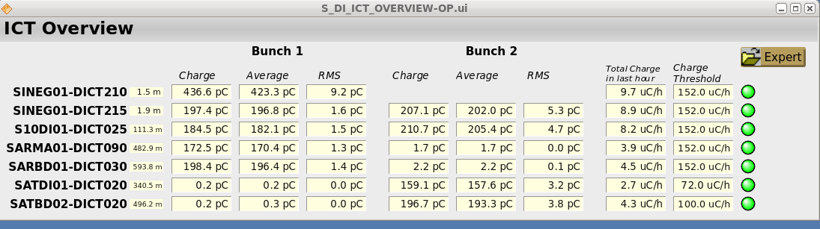
Charge Measurements in SwissFEL
Turbo ICT at SwissFEL:
Calibration of the sensor and backend electronics under responsibility of Bergoz; frontend electronics as well as calibration (attenuation measurement) of the RF cable under responsibility of PSI
Primary instrument for legal certification of the total charge accelerated per hour in SwissFEL (BAG, Federal Department of Health)
Turbo-ICT interfaced with MPS (Machine Protection System): MPS Alarm level enabled when readings of shot-to-shot and integrated charge (per-hour) above a pre-defined signal threshold
Reference instrument for the calibration of other charge monitors in SwissFEL, e.g., cavity BPM (calibration of the monopole cavity signal against the charge readout of a reference Turbo-ICT)
Since the very beginning of the SwissFEL project, the Turbo-ICT showed a relative systematic mismatch of the charge readout (see picture)
July 2019: campaign of charge measurements started with the aim to define a procedure for the absolute measurement of the beam charge at SwissFEL (in collaboration with P. Craievich and F. Marcellini)

Slide 7
WCM in SwissFEL: characterization and modelling
WCM characterization (David Staeger, Summer student traineeship (*), April-July 2021):
CST modelling of the WCM to simulate the time and frequency response
Define a method for fitting the time integral of the WCM waveform (no coupling with DC component of input current and integration of the background machine RF noise)
Study of the effect on the charge determination of a dispersive model for the ferrite permeability: overestimation of the transfer impedance simply based on the value of the gap resistance
VNA measurements of the reflection coefficient S11 at the SMA output port of the WCM: confirmed nominal value of the gap resistance Rgap=3.0 Ω for the spare WCM; Rgap=3.55 Ω for the SwissFEL WCM (possible explanation: 2 resistors disconnected)
Transfer impedance measurements of spare WCM on a test-bench (coaxial wire method): measured transfer impedance 5-6% smaller than the nominal value of the gap resistance (effect of the ferrite dispersion confirmed)
Transfer impedance estimates for the SwissFEL WCM (parallel with 50 Ω included): 3.26 Ω (CST results) and 3.11Ω (6% ferrite dispersion correction of the measured gap resistance Rgap = 1/(1/3.55+1/50) = 3.31Ω)
Conclusion:
    the present estimate of the transfer impedance of the SwissFEL WCM is 3.26 Ω with a very optimistic 5% uncertainty
    On the basis of the present characterization results, the SwissFEL WCM cannot be considered an instrument for the absolute measurement of charge
(*) Co-supervisors, P. Craievich, M.Dehler, F.Marcellini

Slide 8
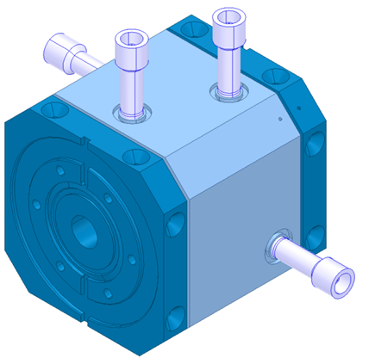
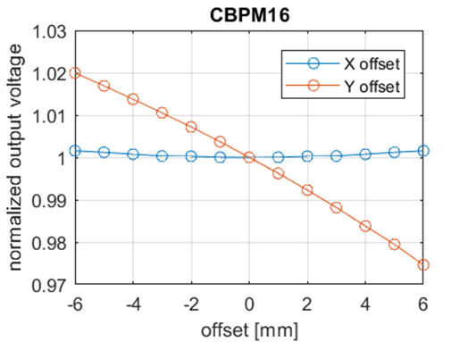
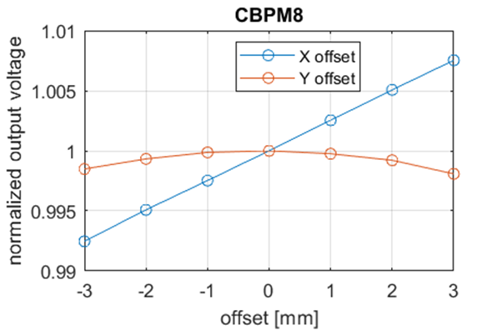
Cavity BPM: for absolute charge measurements (*)
Two cavity device
Reference cavity is designed to get an output signal proportional to the beam charge (monopole mode).
Dependence on beam position is negligible (TM010 mode).
We used:
      CBPM16 type (low-Q).
CBPM8 type (high-Q)
(*) Method proposed and implemented by F. Marcellini

Slide 9
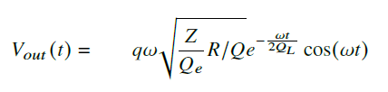
Cavity BPM: for absolute charge measurements
BPM output signal measured with a 16GHz, 40Gs/s oscilloscope.
Bandpass filter at the BPM output to isolate the cavity fundamental mode (TM010) signal.
BPM type | TM010 frequency | Low-pass filter cutoff frequency
CBPM16 | 3.284 GHz | 4.8 GHz
CBPM8 | 4.926 GHz | 6.0 GHz
Voltage induced in the TM010 cavity mode and available at the cavity output port is:
(e.g. see : Cavity Beam Position Monitors, R. Lorenz)
q(charge); Z(50Ω,impedance cavity output line); ω (frequency of cavity mode TM010); R/Q (parameter depending on cavity geometry); Qe (external quality factor); QL (loaded quality factor)
For every single BPM ω, Qe and QL have been measured with VNA.
R/Q is estimated with reliable numerical codes (HFSS and CST, same result).
To better reproduce the measured signal, the expression above is also convolved with a low-pass filter function, same cutoff frequency as the filter used for measurements.

Slide 10
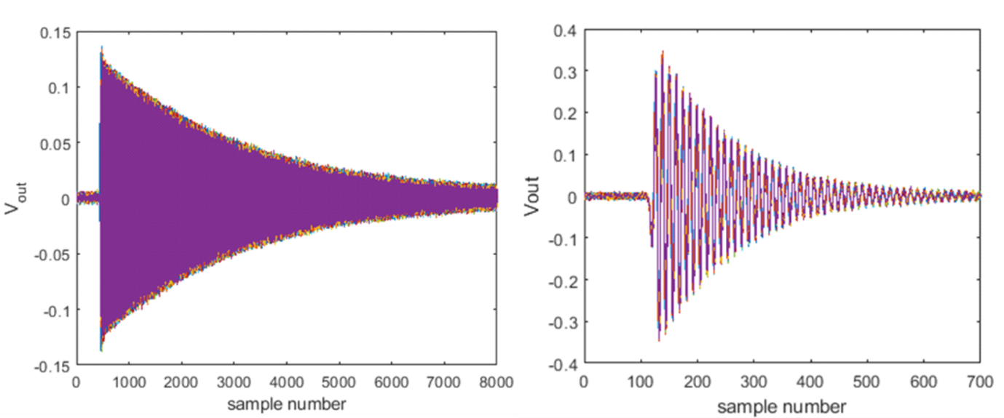
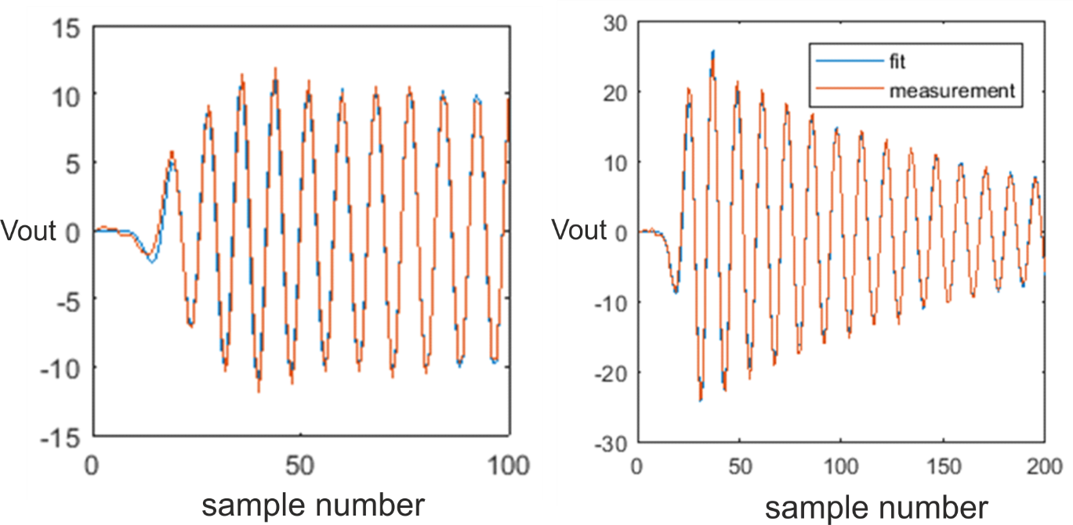
Cavity BPM: for absolute charge measurements
high Q (left) and low Q (right) BPM: waveforms measured with the oscilloscope and fit results

Slide 11
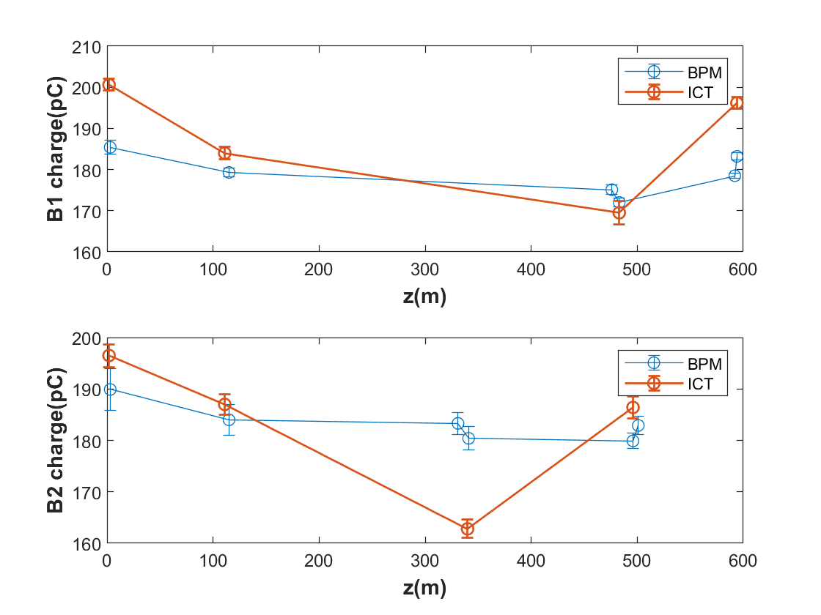
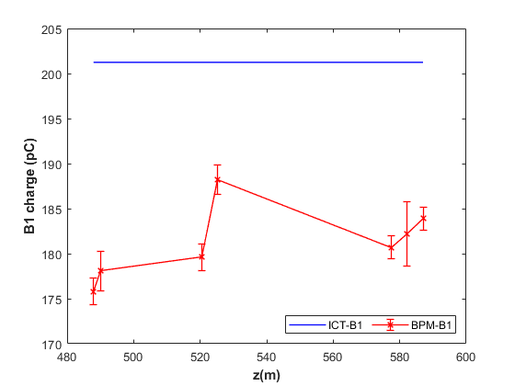
Beam charge measurements at SwissFEL
With respect to first ICT (~200 pC) about 20pC smaller mean charge readout from cavity BPMs:
Left (B1)➔ (10+/-3)%
Right (B1)➔ (10+/-2)%
Left: Charge measurements (B1, B2) of cavity BPMs and closest ICT in ARAMIS and ATHOS (measurements not synchronous but simultaneous)
Right: charge measurements (B1) of cavity BPMs in high energy part of ARAMIS compared with average value of charge readout from the first Turbo-ICT-2 at the gun

Slide 12
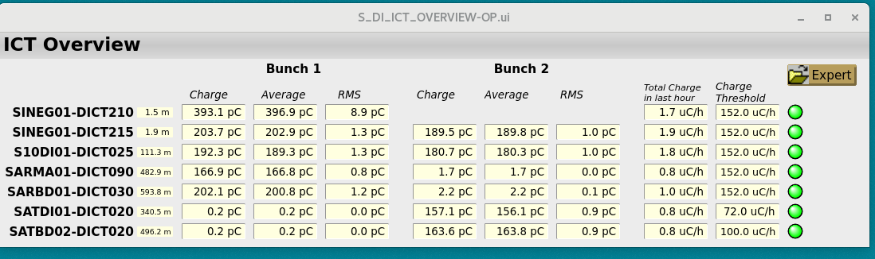
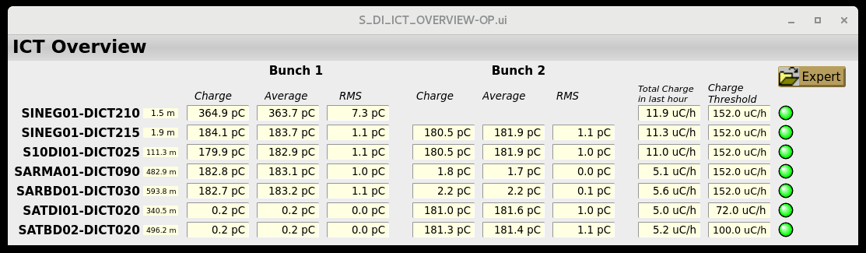
Alignment of the SwissFEL charge monitor (*)
Alignment procedure: 10% reduction (software channel) of the charge readout of first Turbo ICT and alignment of all the charge monitors (DICT, DBPM, DWCM)
Before the charge alignment
After the charge alignment
(*) G.L. Orlandi et al, Charge Measurements in SwissFEL and Results of an Absolute Charge Measurement Method, Talk and Proceeding IBIC2021

Slide 13
Conclusions and Outlook
Turbo ICT
The correction by means of software channels of the Turbo-ICT readings was the most realistic and practical solution to correct a long-time standing systematic relative mismatch of the charge readout
cross-talk of bunch-2 against bunch-1 charge readout occurring when rep rate and/or bunch-1 and bunch-2 charge are different (design feature of the logarithmic amplifier working point setting)
The solution of the ICT systematic mismatch and the consequent software alignment of all the SwissFEL charge monitors were possible thanks to the absolute charge measurement method based on the cavity BPM
Reliability of the EPICS interface should be increased (Controls and AEK are on it)
Cavity BPM
Cav-BPM method (monopole mode) for absolute charge measurements at SwissFEL: robust and statistically consistent results
Would be really useful to have a few cavity-BPMs in SwissFEL dedicated to the routine absolute measurement of the charge
Alignment of the charge monitors (ICT, BPM, WCM) of SwissFEL
Implemented on the last October 1: study the long term time stability to observe possible drifts of the ICT w.r.t. BPM readout

Slide 14
Conclusions and Outlook
WCM: presently, the transfer impedance is known with an uncertainty of 5% at least.
Possible actions:
In principle two identical WCMs are available: one (spare WCM) fully characterized on a test bench; the other (SwissFEL WCM) installed in SwissFEL
the possibility to replace the SwissFEL WCM with the spare one should be considered to allow a full characterization and maintenance of the SwissFEL WCM
Design and built a new WCM:
  to correct the already observed design imperfections (resonances in the frequency response of the spare WCM)
  to fully characterize the magnetic property of the ferrite and possibly consider new ferrite materials
  ideally, redesign the WCM with the goal to get the DC component of the beam current coupled with the WCM signal
Future diagnostics for absolute charge measurements (in perspective, for the new Porthos beam line, 3rd undulator line in SwissFEL):
ICT, WCM, Cavity-BPM?
What is the best strategy for absolute charge measurements at SwissFEL in the near and long term?

Slide 15
Wir schaffen Wissen – heute für morgen
Many thanks to
C.Ozkan-Loch
A.Alarcon
M.Baldinger
K.Bitterli
P.Craievich
M.Daellenbach
E.Divall
M.Dehler
R.Ischebeck
F.Loehl
D.Llorente
F.Marcellini
P. Pollet
M.Roggli
V. Schlott
D. Staeger
D. Voulot
…and many other colleagues…
Thank you for your attention

