Slide 1
Beam Loss Monitors at SwissFEL
G. L. Orlandi (*)
SwissFEL Electron Diagnostics Review Workshop PSI (Remote), 18-21 October 2021
(*) in charge of the present diagnostics since July 2019
gianluca.orlandi@psi.ch

Slide 2
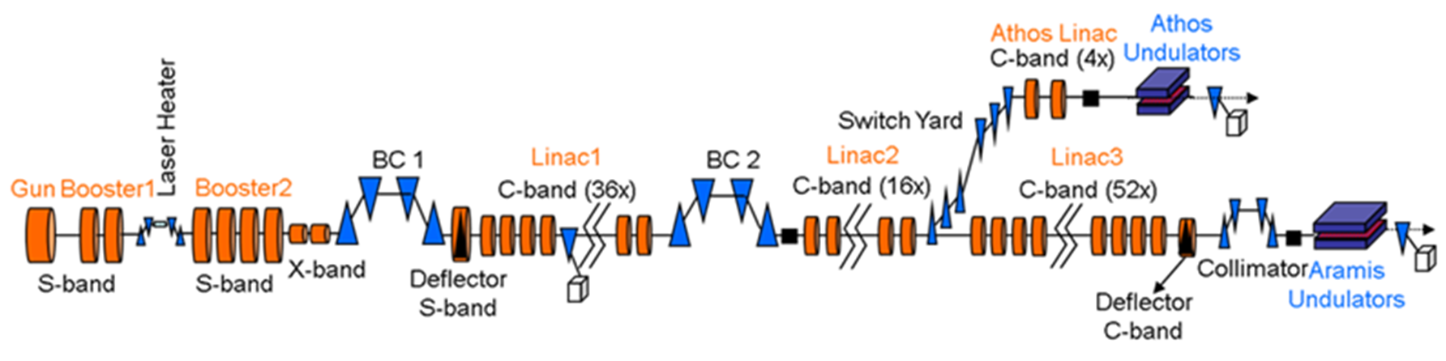
SwissFEL in a sketch
Beam energy: 6.2 GeV and 3.3 GeV
Beam charge: 10-200 pC @100Hz, 28 ns 2-bunch time structure
Emittance: 0.4/0.2 mm mrad
Bunch length: from a 3 ps up to a few fs
Photon wavelength: 0.1-0.7 nm and 0.7-7.0 nm

Slide 3
Contents
Beam Loss Monitors at SwissFEL, 3 different systems for machine operations (*):
        DBLM. Beam Loss Monitor: localized (~cm) scintillator fiber wrapped around the beam pipe
        DLLM. Longitudinal Loss Monitors: Cherenkov fiber stretched all along the beam pipe (~ several 10m)
        DDRM. Dose Rate Monitor: RadFET for a localized and cumulative monitoring of the radiation release on sensitive machine components (mainly undulators)
(*) DRPS. Dose Rate Protection System: array of calibrated dosimeters for personnel protection, out of the subject of the present talk

Slide 4
Beam Loss Monitor at SwissFEL
Beam Loss Monitor (BLM) classification:
      DDRM (RadFET): calibrated (slow time response, 20s):
      DBLM and DLLM:
          not-calibrated (single shot response, 100Hz)
          PMT-gain and attenuation filter dependent signal response
BLM requirements, functionality and machine operation applications:
      Beam loss measurement feature: relative (DBLM, DLLM), absolute (DDRM)
      Beam loss localization along the machine: local positioning (DBLM, DDRM) and linearly distributed positioning (DLLM)
      DBLM sensitivity: to a few percent of beam losses in the charge range 10-200pC and to dark current.
      DBLM signal complement to other diagnostics (wire-scanner). Estimated charge loss sensitivity of 0.01pC in sub-micrometer WS meas (maximum PMT gain)
      BLM signals input to Machine Protection System (MPS): processed beam losses compared with alarm thresholds to protect sensitive machine components and to keep the losses below the DRPS limits

Slide 5
Beam Loss Monitor and MPS
BLM signals and MPS interface:
      Alarm calculation (@100Hz): processed beam loss signals (DBLM,DLLM,DDRM) compared with reference thresholds and generation of alarm signal
      MPS interface (programmable logic controller, PLC): collect alarm states and calculate 3 machine alarm levels:
      Alarm Level 0:
          dynamically slow down of the machine repetition up to 1 Hz to contain the losses below the Alarm Level 1 threshold
          Alarm Level 0 automatically enabled at 1 Hz while a view screen is on the beam line
      Alarm Level 1:
          stop the beam in Aramis and/or Athos to make the machine to recover when beam losses are systematically exceeding the warning threshold
          Alarm Level 1 automatically enabled while a view screen is being inserted into the beam line
      Alarm Level 2: enabled for mean beam losses highly exceeding the warning threshold, laser shutter closed and/or switch off RF gun, operator intervention required to reset the alarm
C.Ozkan Loch et al., Phys. Rev. Accel. Beams 23, 102804 (2020)

Slide 6
Operation Principle of MPS
Timing system
additional actuators for level 2 alarm
laser shutter
gun RF inhibit
Actuators of MPS
Sum alarms: level 0
level 1
level 2
Sum alarm:
level 2
PLC system collecting alarms
Layer 1
Alarms: level 0-2
alarm calculation 1
alarm calculation n
thresholds, etc.
Layer 2
measurement
combined
monitor 1
…….
monitor n
Layer 3
Courtesy of F. Loehl
Notes:
The MPS consists of 3 layers:
Layer 1 is responsible for collecting alarms from different monitors, each of which provide at least 2 signals for level1 and level 2 alarm. Layer 1 collects the alarms and calculates the sum alarms for generating level 1 or level 2 alarms. Then these two alarms are sent to the timing system which then distributes the alarms signals to all systems that are connected to the timing system.
Layers 3 consists of monitors that will be used to detect improtper states of the machine Each monitor provides its measurement result to layer 2 that is responsible for the generation of alarms from the monitor readings. Layers 2 & 3 can be on different platforms.
PLC response ~ 1ms within 1 shot so drops the next shot
Hw connection to plc system

Slide 7
DBLM and DLLM: scintillator and Cherenkov fibers
DBLM:
      Organic scintillator fiber (Saint Gobain BCF-20, decay time 2.7 ns, 2m long, diameter 1mm) wrapped around the vacuum pipe.
      The two ends of the scintillator fiber matched by a plastic optical fiber (POF) with a photomultiplier (PMT) having a remotely adjustable gain (5*10^3−4*10^6) and with a pulsed light-emitting diode (LED), respectively
      PMT signal digitized by an analog-to-digital converter (ADC,12 bit, 428.4 MSa/s, waveform digitization over 2048 sample ⬅➔4μs time windowing)
      ADC synchronized with the machine trigger; a field programmable gate array (FPGA) integrates (@100Hz) the Bunch-1 and Bunch-2 signal waveforms contained into two ROIs (Region-of-Interest) of the whole digitization interval
DLLM:
      Quartz Cherenkov fibers covering all the length of the electron beam lines (Aramis and Athos) by means of several independent fractional sections
      Photon-to-Photon-Electron conversion and ADC identical to the DBLM case but ADC digitation interval fractioned into 8 ROIs where the time to position conversion has been suitably obtained by means of an on-purpose and localized production of beam losses
DBLM and DLLM not calibrated monitors, PMT gain and attenuation filter dependent response:
      PMT gain set to ensure detection of maximum beam loss allowed by Alarm Level 1 without saturation of the ADC dynamic range
      Alarm threshold of DBLM and DLLM in the undulator regions set against the maximum dose rate recorded by the RadFET

Slide 8
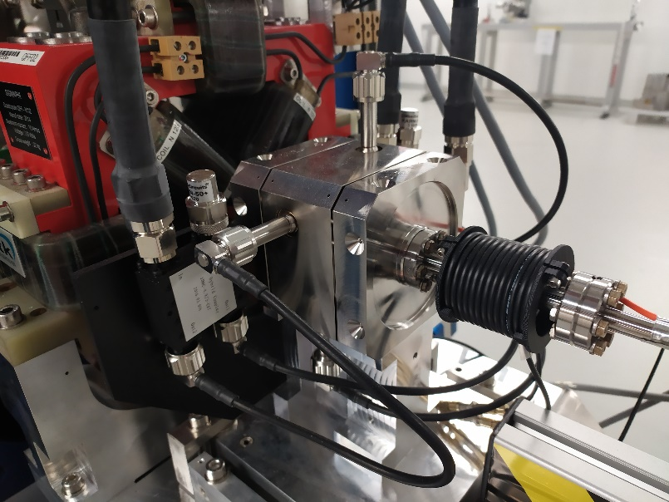
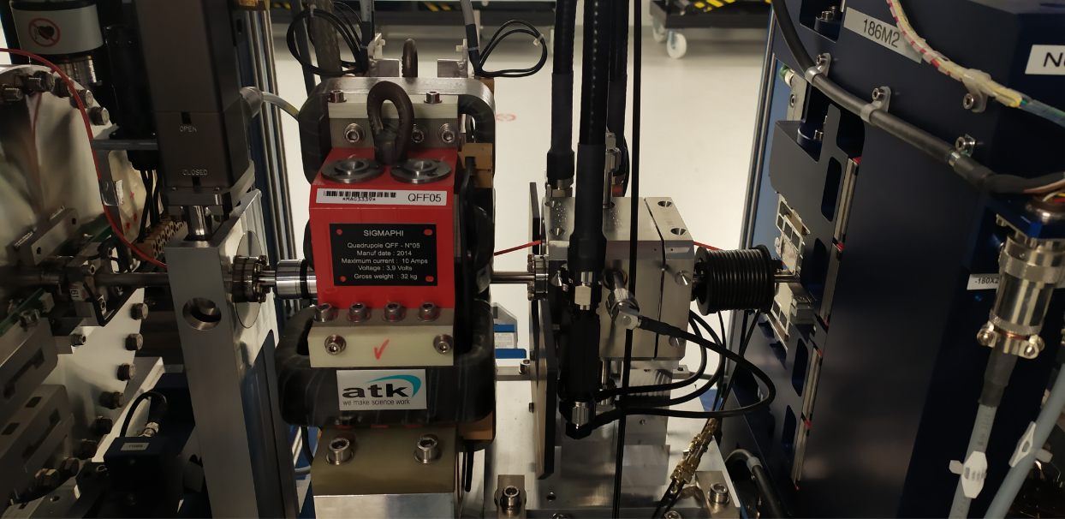
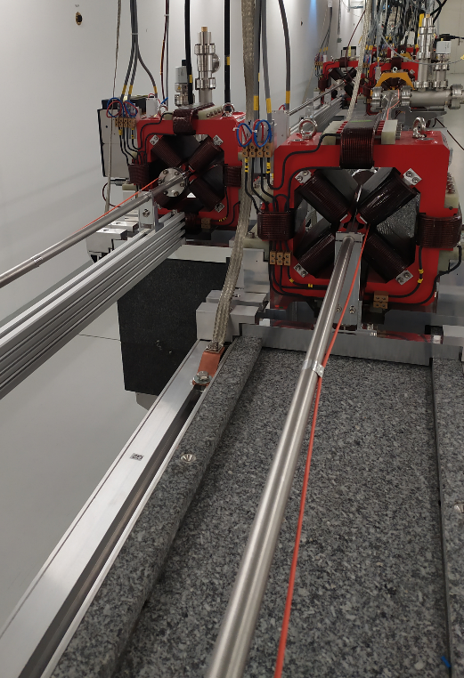
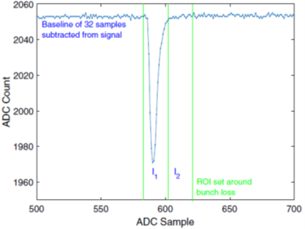
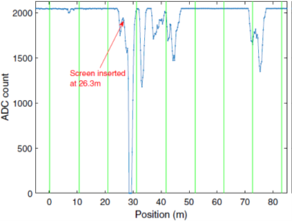
DBLM and DLLM: scintillator and Cherenkov fibers
DBLM
DBLM
ADC traces of DBLM (2 ROI) and DLLM (8 ROI) signals
DLLM
C.Ozkan Loch et al., Phys. Rev. Accel. Beams 23, 102804 (2020)

Slide 9
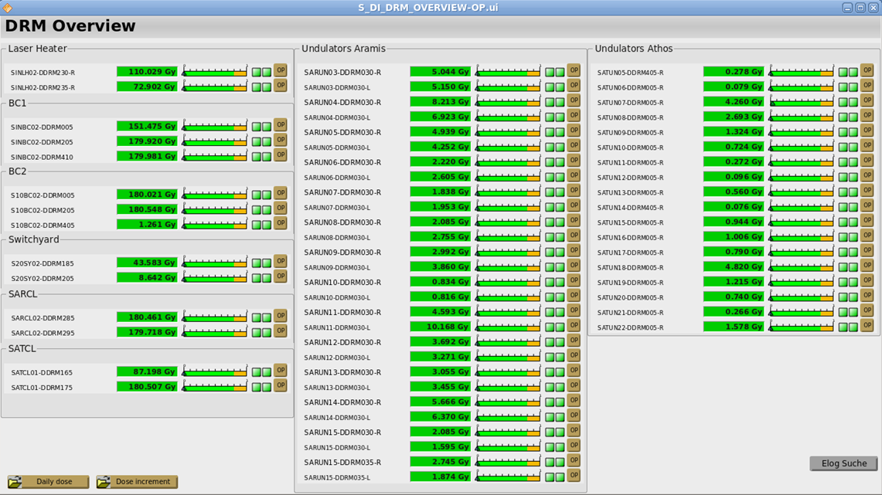
Dose Rate Monitor (DDRM): RadFET
RadFET:
        radiation-sensing field-effect transistor (p-channel MOSFET): high sensitivity to beam losses
        calibrated detectors for a cumulative recording of the measured radiation-dose
        Controller DOSFET-L02, Ethernet readout of the integrated dose over 20s and software interface to MPS
        MPS Alarm Level 1 enabled for dose exceeding 0.05Gy/20s or daily limit (operator intervention needed)
        60 RadFETs installed in SwissFEL, mainly in the undulators (25V bias voltage, high sensitivity)

Slide 10
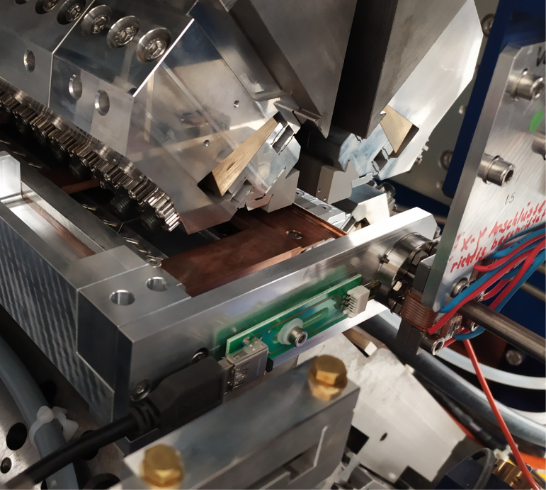
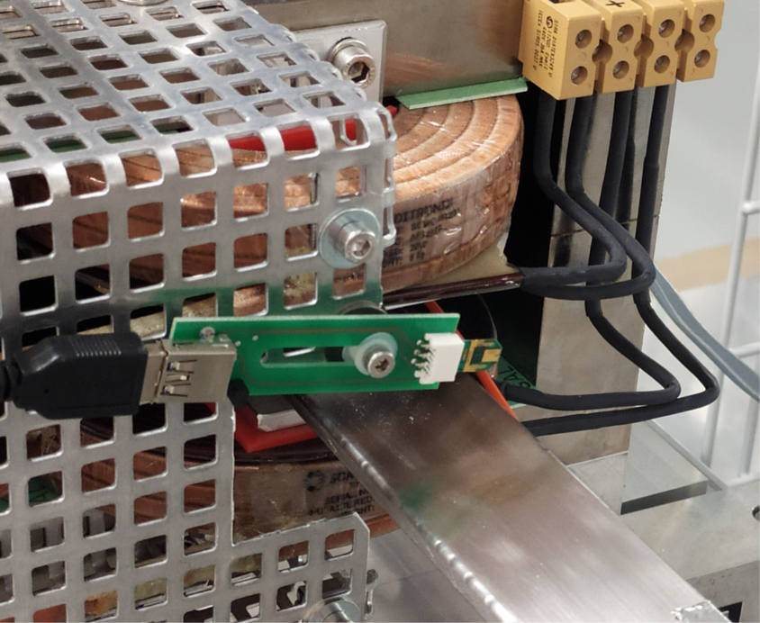
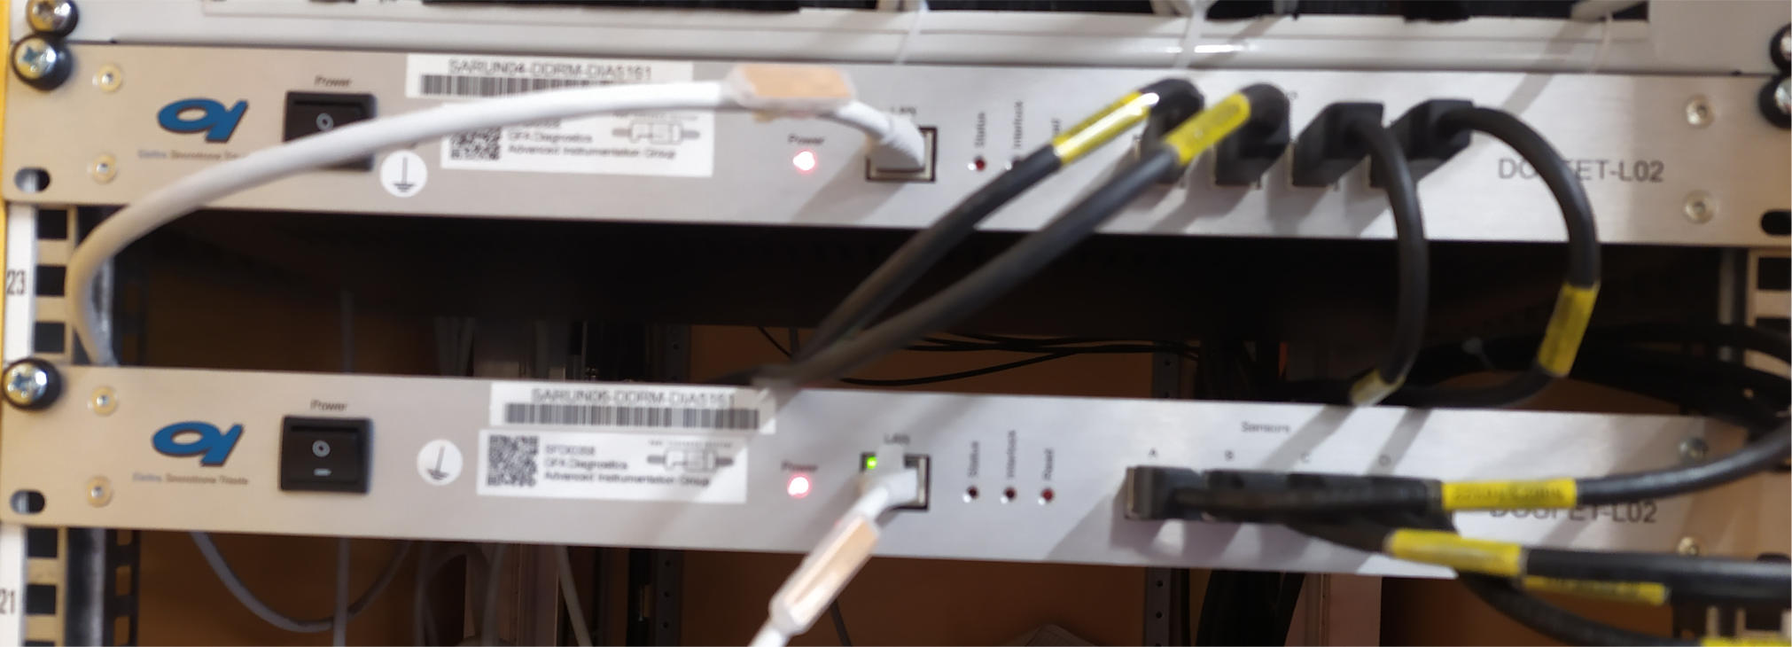
Dose Rate Monitor (DDRM): RadFET

Slide 11
DBLM, DLLM DDRM in Aramis and Athos
DBLM (50 units):
      Critical points of the machine (undulators,chicanes, laser heater, RF cavity, collimators, switch-yard).
      Downstream of wire-scanners
      15 DBLMs for 13 Aramis undulators: DBLMs in front and behind each undulator
      3 DBLMs for 16 Athos undulators: one at the beginning, one at the middle and one at the end of the undulator line
DLLM (8 units in Aramis+3 units in Athos):
      Quartz Cherenkov fibers covering all the length of the electron beam lines (Aramis and Athos) by means of several independent fractional sections
DDRM (60 units): most of them in the undulator lines
C.Ozkan Loch et al., Phys. Rev. Accel. Beams 23, 102804 (2020)

Slide 12
Conclusions and Outlook
DBLM/DLLM:
      Number of DBLMs in the Athos undulator line is insufficient
      The beam based alignment of the Athos undulator suffers from a lack of DBLMs (DDRM too slow for a fast reaction and correction of the orbit)
      PSI allocated money in the 2022 budget to increase number of DBLMs in Athos
      DBLM/DLLM (open issues to be scheduled):
          Insufficient resolution of the FPGA digital readout of the waveform integration in the ROI
          MPS Alarm level calculation suffers from a lack of fine granularity of the FPGA waveform integration
          low charge wire-scanner measurements also affected by this issue
          increase of the significant digits in the FPGA calculation is needed
      DBLM/DLLM (open issue, solution to be scheduled) :
          PMT gain dependence of the DBLM sensitivity prevents an homogeneous and quantitatively consistent determination of the MPS Alarm threshold along the machine
          Loss signal should be scaled w.r.t. the attenuation filter and PMT gain for an uniform settings of the MPS alarm level
      DBLM/DLLM: any change of the machine timing ⬅➔ shift of the ADC acquisition window ⬅➔ shift of the ROI (Region-of-Interest for the time integration) w.r.t. signal waveform. (open issue: no automatized check/adjustment of the ROI)
DDRM:
      accumulated dose rate of 20s makes this calibrated monitor not suitable for fast tuning of the beam orbit in the undulator line.

Slide 13
Wir schaffen Wissen – heute für morgen
Many thanks to
C. Ozkan-Loch
A.Alarcon
M.Baldinger
K. Bitterli
A. Di Giovanna
E.Divall
E. Ebner
R. Ischebeck
D. Llorente
F.Loehl
P. Pollet
M. Roggli
V. Schlott
..and many other colleagues
Thank you for your attention

