Slide 1
Electron screens at SwissFEL: experience and outlook
Pavle Juranić :: Staff Scientist :: Paul Scherrer Institute
19.10.2021, SwissFEL Diagnostics Review

Slide 2
Outline
Original design
Experience and results
Recent improvements, prototypes, and new results
Outlook and conclusion

Slide 3
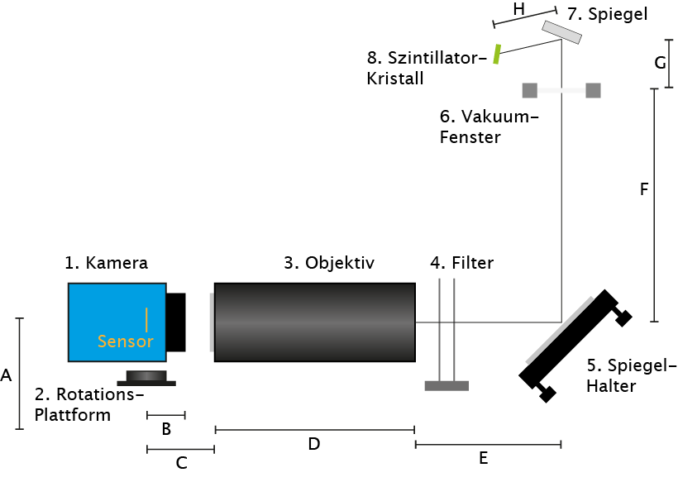
Diagnostics Screens (DSCR) Original design
Vacuum chamber
e-beam
Uses Scheimpflug geometry to protect mirrors, look at only scintillation, and avoid COTR or OTR radiation.
Optics box

Slide 4
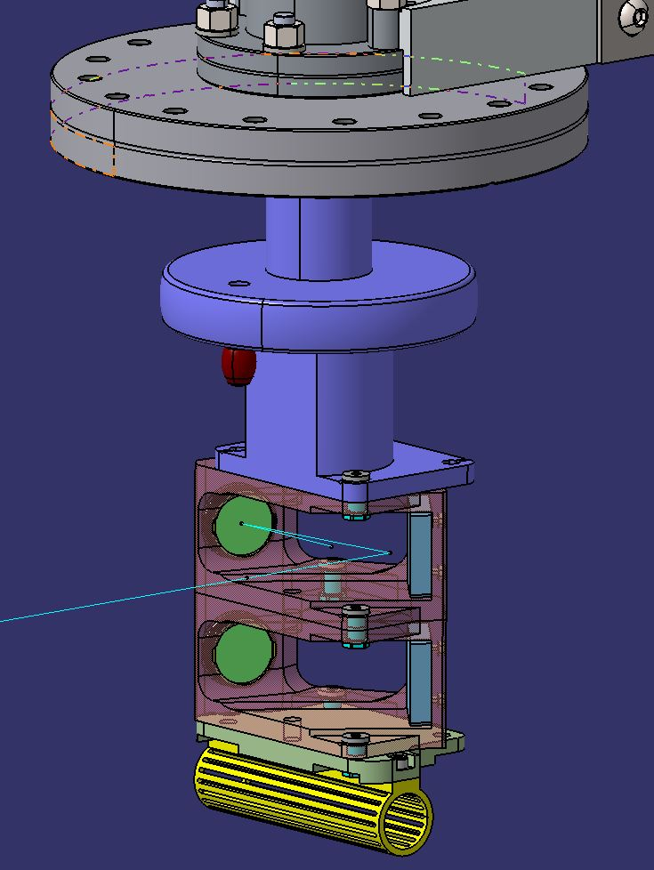
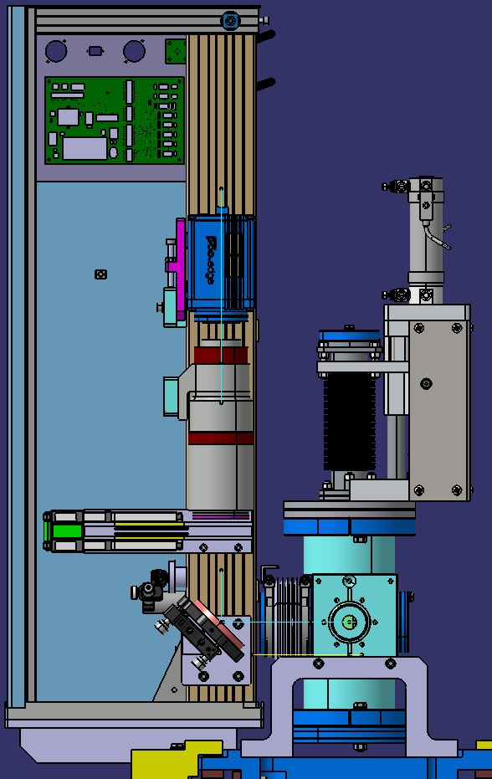
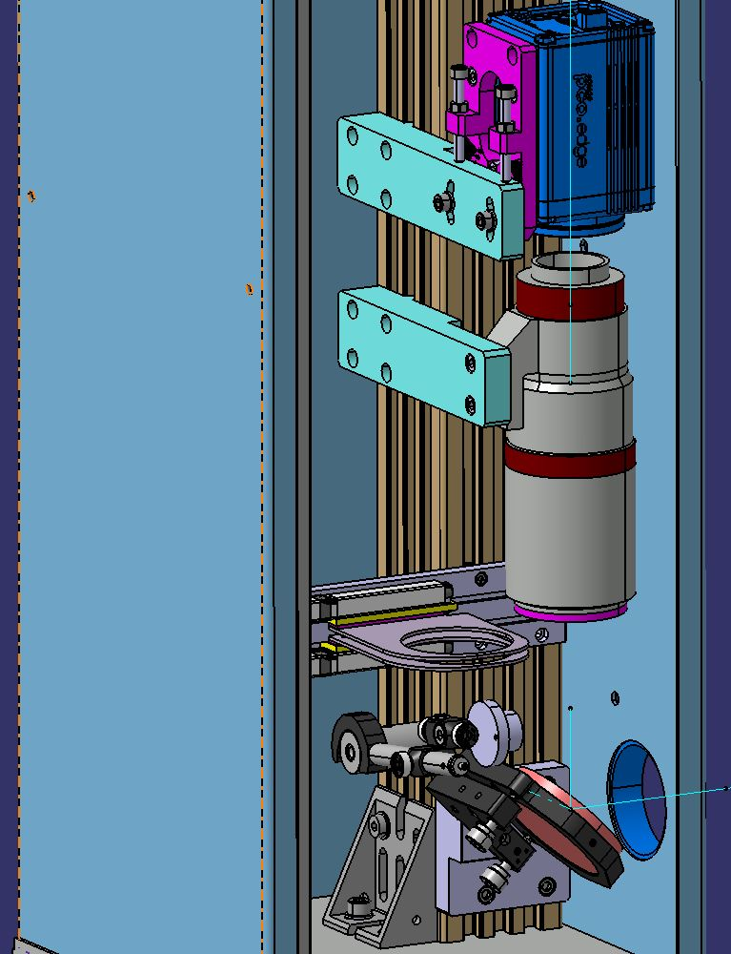
Implementation: 28 DSCR in SwissFEL
Scheimpflug setup in vacuum
Complete setup
Layout of optics box
Images courtesy of Goran Kotrle

Slide 5
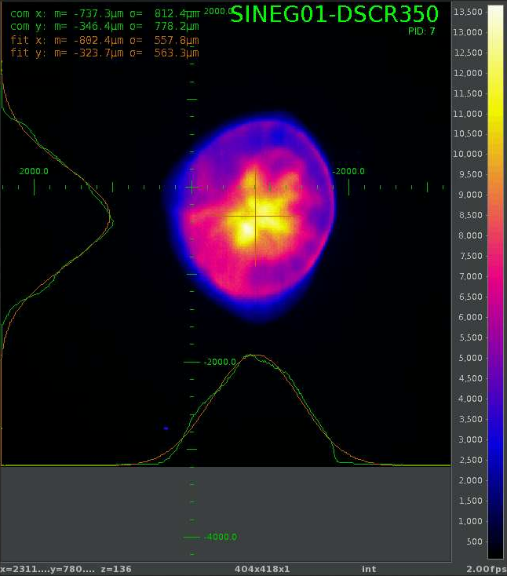
Visualization
Camera images are processed through a camera server. They can be accessed by a controls-developed screen panel to visualize the e-beam profile.
It is often used for alignment and observation, but an important function is supposed to be the measurement of slice emittance.

Slide 6
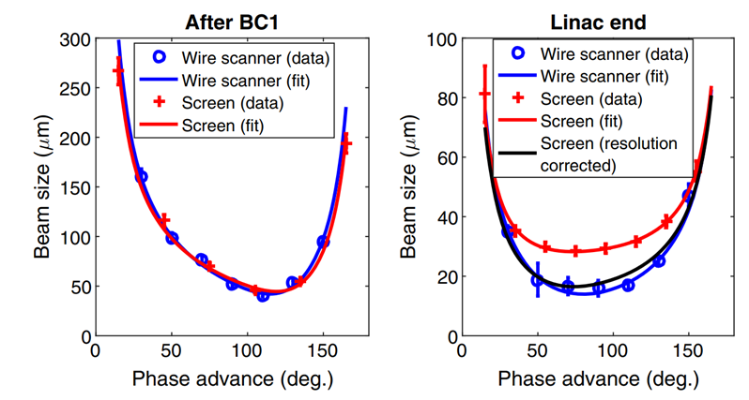
Performance
Filters for 10%, 1%, and 0.1% attenuation of scintillating light set up to avoid saturation. Most measurements are done with attenuated scintillation light.
Expected resolution of about 15 μm. Real resolution of 25-30 μm.
Screens not reaching the predicted resolution, forcing correction evaluations by comparison with wire scanner.
Also means no direct slice emittance measurements.
E. Prat et. al. PHYSICAL REVIEW LETTERS 123, 234801 (2019)

Slide 7
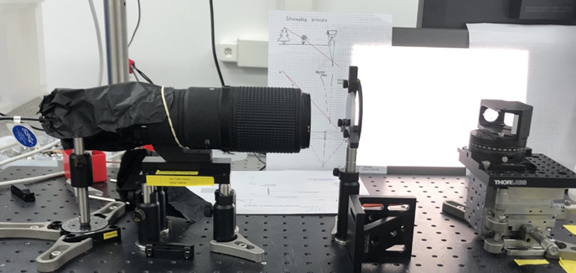
Physics works, so hunt down the error
Re-created the setup in lab, test components one by one.
About 513 mm
About 288 mm
Camera
(PCO Edge)
Screen
Filter foil
Lens (front)
200 mm
Final setup by Riccarda Bohren (student apprentice)

Slide 8
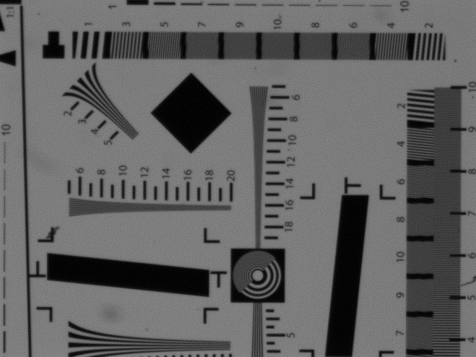
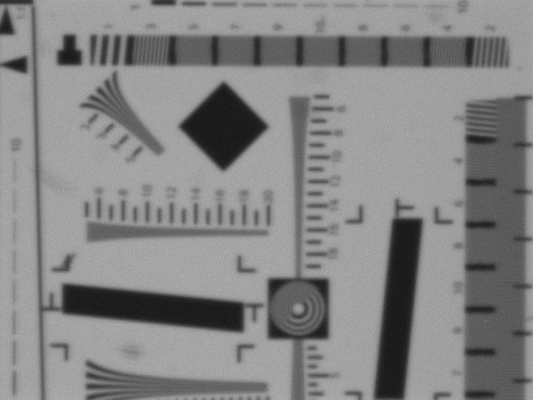
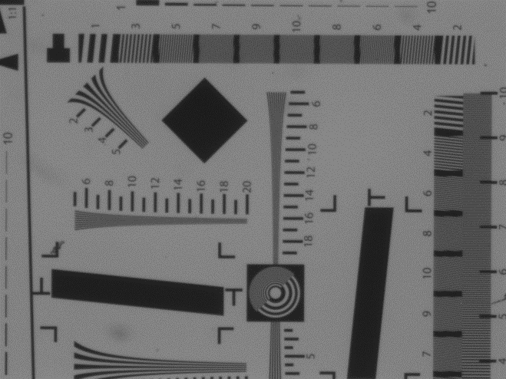
The filters are at fault
No filter, exposure =1000 us
Kodak N2 foil, exposure =1e5 us
Edmund N2 glass filter, exposure =1e5 us
Bad resolution! This is what we use right now.
Glass filters show much better resolution preservation

Slide 9
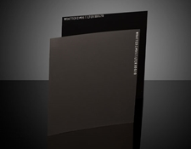
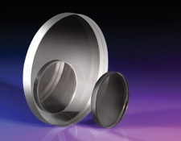
Change filters
Thin films:
Nice: camera does not need refocusing, one optical setup for everything.
Not nice: may cause resolution issues
Glass filters:
Nice: do not cause resolution issues.
Not nice: need to refocus when putting a new filter in.
Switch!

Slide 10
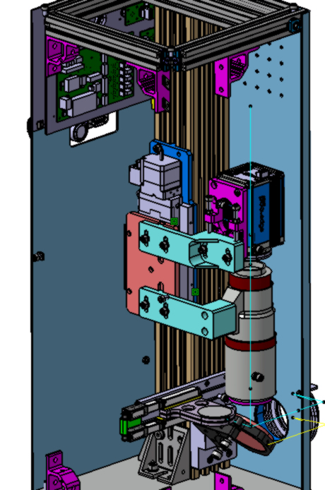
Redesign of the optics box and prototypes
Two screens, SARCL01-DSCR170 and SATBD01-DSCR120, have been upgraded with the new design that uses a Kohzu stage, Schneider motor, and an non-absolute linear encoder.
The response from the operators and beam dynamics has been extremely positive, with emittance measurements and beam profile measurements improving markedly, helping speed up set-up and characterizations of the electron beam.
They would like to have more such screens.
Stage to compensate for lensing effect on filters
New, better quality glass filters
Image courtesy of Goran Kotrle

Slide 11
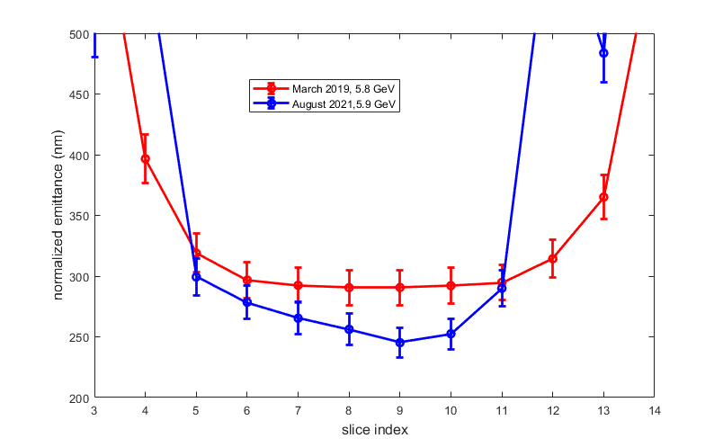
Slice emittance measurement improvement
Courtesy of E. Prat
From around 300 to around 240 nm

Slide 12
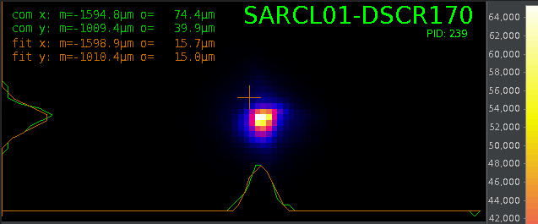
Resolution improvement
Courtesy of E. Prat
Resolution improved to a bit better than 15 μm for an e-beam of 4-5 μm. Can measure emittance that is 80% smaller than before.

Slide 13
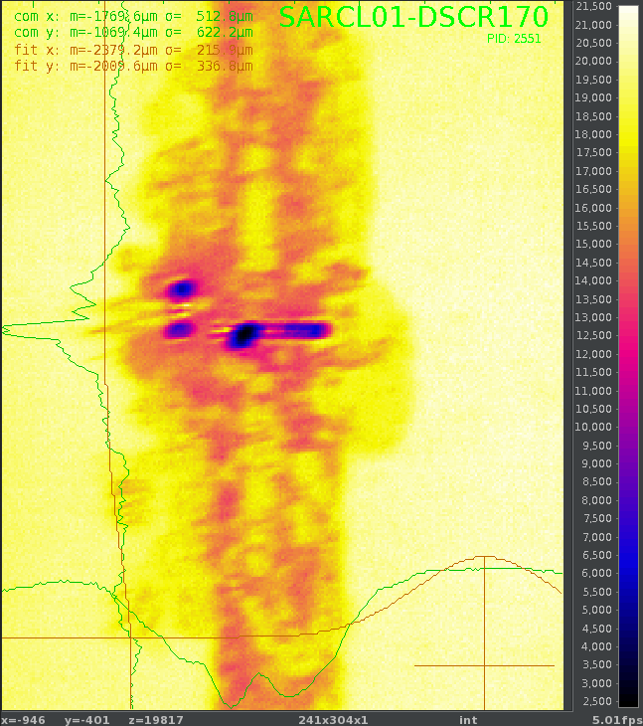
Sacrifices were made . . .
Eduard Prat set up a very small size beam to evaluate the real resolution. Burned some holes in the Ce:Yag . . .
It was due for a replacement anyway!

Slide 14

Upgrade priority (according to beam dynamics)
1) SARCL01.DSCR170 and SATBD01.DSCR120 (slice and projected emittance measurements at high energy, already there)
2) SATMA01.DSCR030 (projected emittance measurements at Athos)
3) S10BD01.DSCR030 (longitudinal phase space measurements at the injector)
4) SARBD02.DSCR050/SATBD02.DSCR050 (long. phase space measurements after Aramis/Athos undulators)
5) SARCL02.DSCR280 (long. phase space measurements after BC2).
6) S10MA01-DSCR090, all in Athos switchyard, S10DI01.DSCR020, SINDI02,DSCR075, etc.
7) All others. There are 28 DSCR screens in total.

Slide 15
Outlook and further improvements
To minimize issues with startup and setup, we will implement absolute linear encoders for the focusing stages on the DSCR.
We are creating an upgrade kit that we can implement one-by-one to all of the existing DSCRs for all camera configurations.
Due to long lead times, need to pull additional motor control cables, and few access days to the SwissFEL tunnel, we hope to upgrade five to ten screens a year starting next year.

Slide 16
Other issue: beam losses
General problem with beam loss for inserting devices into the electron beam. Biggest cause is the regulatory setup from the Swiss BAG.
1 Hz operation of screens is standard, which slows things down.
Even at 1 Hz, high-energy e-beams sometime cause beam losses that threaten to trigger the safety systems.
Started contacting our experts for radiation modeling to figure out what the radiation profile is to see where to put most effective shielding.
Open to other suggestions.

Slide 17
Wir schaffen Wissen – heute für morgen
My thanks go to
Rasmus Ischebeck, Gianluca Orlandi, Cigdem Ozkan, Markus Baldinger, Goran Kotrle, Arturo Alarcon, Niko Kivel, Kurt Bitterli, Eduard Prat, Lukas Schmid, Björn Finsterbuch, Giancarlo Vallero, and many more PSI staff.

