Slide 1
Profile monitors: wire-scanners
G. L. Orlandi
SwissFEL Electron Diagnostics Review Workshop PSI (Remote), 18-21 October 2021
gianluca.orlandi@psi.ch

Slide 2
Contents
    SwissFEL WS: a standard solution with a micrometer resolution
    Nano-fabricated WS: minimal invasive solution with a sub-micrometer resolution
    Beam profile tomography with nano-fabricated WS
    Conclusions and outlook

Slide 3
SwissFEL WS
Summer 2012: preliminary study of the wire mechanical stability (wire-vibration measurements,3-phase motor)
Apr-May 2014: SwissFEL WS prototype fabricated by UHV-Design Ltd and wire-vibration measurements (Delta-Tau PowerBrick motor controller + 2-phase Oriental Motor PK269 JDB).
June 2014: Final Acceptance Review Meeting. Improvement requests: mechanics of UHV-Linear-Stage (frame, bellow) and gearbox (ball-screw 1:25, 6.0 mm Lead-Screw-Pitch)
New motor request OM PK268DB (2-phase, 1.8deg/step, 200steps/turn) to fix a torque limitation above 6 mm/s
Mar-Apr 2015: tests of BSREAD, beam synchronous acquisition of the encoder readout (jitter 0.1ms)
July 2015: wire vibration measurement on 2nd prototype and Site Acceptance Test (SAT)
Jan & Oct 2015: Beam tests at FERMI of WS prototype (5um W and 12.5 um Al(99):Si(1) wires)+BLM
Nov 2015: SAT Meeting with the company and start of series production
July 2016: 24 UHV-Linear-Stage of SwissFEL WSC delivered and ready to be installed in SwissFEL

Slide 4
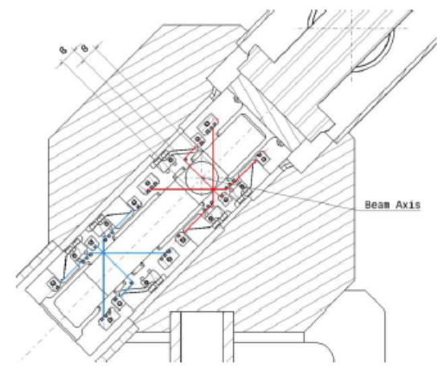
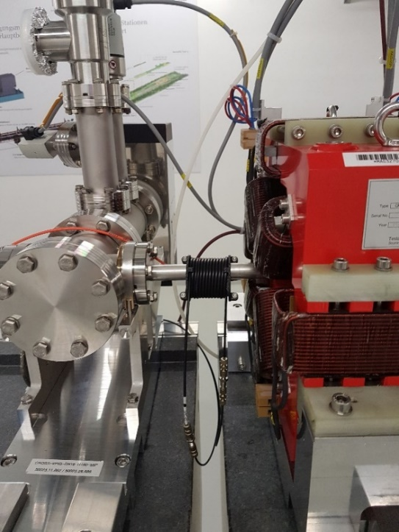
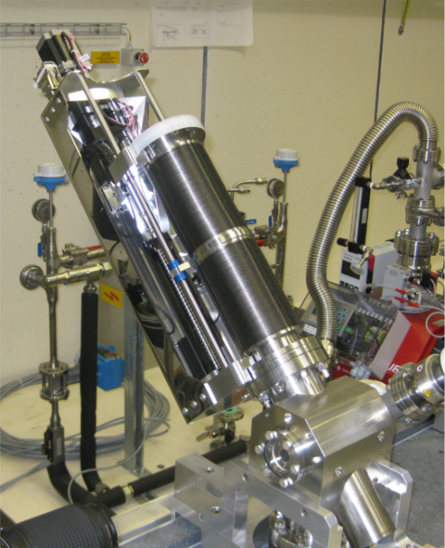
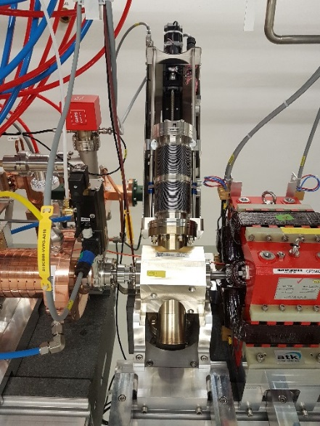
SwissFEL WS: metallic wire stretched onto a fork
  18 WS stations in Aramis, 3 in Athos WS
  2 pairs of wires : 5 μm W and 12.5 μm Al(99):Si(1) wires.
  Resolution: wire (1.25 μm), encoder (0.1 μm), wire vibration (<1.3 μm, in the range 0.1-3 mm/s)
  WS signal: beam loss detection via DBLM [scintillator fiber+POF+PMT+ADC+FPGA(time integration of the waveform)]; possibility to by-pass the MPS for dedicated DBLMs
  Beam profile reconstruction: beam synchronous acquisition (BR_READ) of encoder position and DBLM signal
  WS operations via High-Level Application(pshell):motion control, signal acquisition (encoder, DBLM, DBPM), profile fit (Gaussian and rms), optimization (scanning range, wire speed, PMT gain)
Courtesy P.Heimgartner
BLM: scintillator fiber
License Agreement between PSI and UHV-Design Ltd. for the commercialization of the vacuum chamber+wire fork.
Fully equipped motorized feedthrough produced by UHV-Design

Slide 5
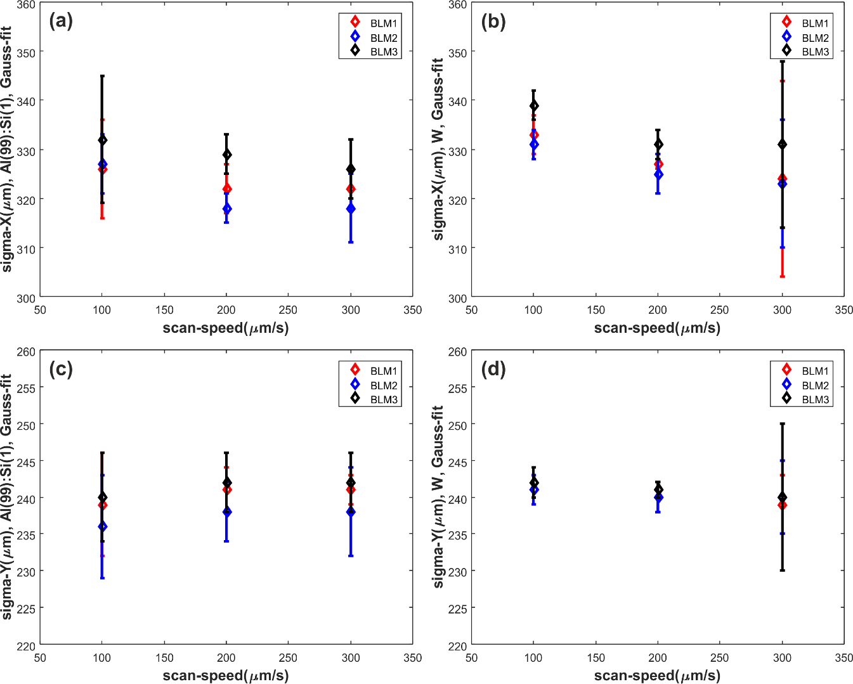
Conventional WS: resolution and invasiveness constraints (2/3)
Beam profile measurements at SwissFEL
Beam energy 300 MeV, charge 20 pC, rep.rate 10Hz
5 μm W wire: scan_X (b) ; scan_Y (d)
12.5 μm Al(99):Si(1) wire: scan_X (a) ; scan_Y (c)
Beam charge 10 pC, beam energy after BC1 ~300MeV, BC2~5.8 GeV
Emittance measurements at SwissFEL: WS vs YAG screen,
E.Prat, et al., Generation and Characterization of Intense Ultralow-Emittance Electron Beams for Compact X-Ray Free-Electron Lasers, PHYSICAL REVIEW LETTERS 123, 234801 (2019)
G.L. Orlandi, et al., First experimental results of the commissioning of the SwissFEL wire-scanners, IBIC2017, Grand Rapids. Mi, USA

Slide 6
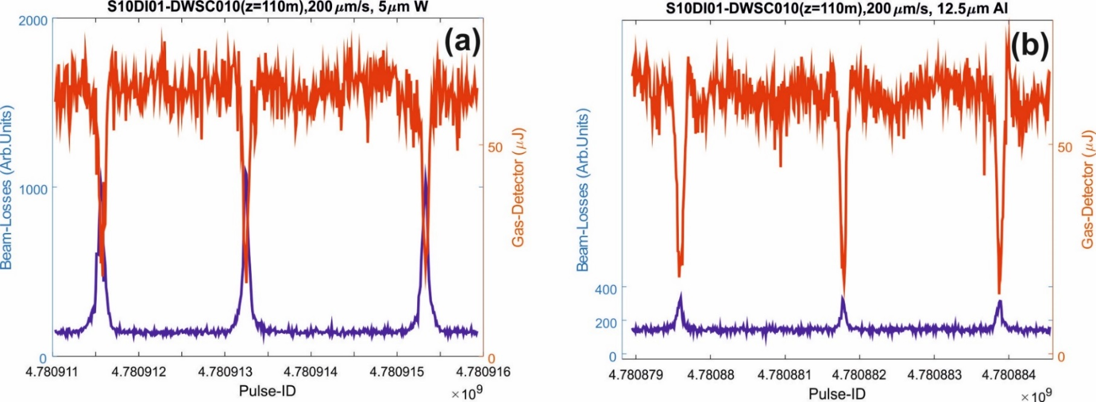
Conventional WS: resolution and invasiveness constraints (3/3)
Simultaneous WS and laser pulse energy measurements with gas detector (*):
Scan electron beam with 5μm W wire and 12.5μm Al(99):Si(1) wire and, in parallel, measure laser pulse energy
Al(99):Si(1) vs W wire➔ beam-loss reduction by a factor 3-4 (beneficial to machine protection)
Al(99):Si(1) vs W wire ➔ despite lower density and atomic number, larger impact surface detrimental to lasing transparency
Higher WS geometrical resolution of the wire ➔ better wire transparency to the lasing
Energy (dE) radiated by single electron with energy E in a thickness dX of matter with radiation length L_{R}
Beam-synchronous measurements of laser pulse energy (Gas-Detector) and e-beam profile (WS):
5 μm W wire;
12.5 μm Al(99):Si(1) wire.
Bunch charge ~200 pC, beam energy ~300 MeV at the WS location, 2.6 GeV at the undulator beamline, photon energy 2.488 keV (wavelength=4.983A) .
(*) P. Juranic, et al., SwissFEL Aramis beamline photon diagnostics,J. Synchrotron Rad. (2018). 25, 1238-1248.

Slide 7
Nano-fabricated WS with sub-μm resolution: a fruitful collaboration between SwissFEL and FERMI
2017-18. Nano-fabricated WS with sub-micrometer resolution “on a membrane”:
  Production at Laboratory for Micro- and Nanotechnology (LMN, PSI); experimental test at SwissFEL
  S. Borrelli, Master thesis, Universita’ degli Studi di Pisa.
  S. Borrelli, et al., Generation and Measurement of Sub-Micrometer Relativistic Electron Beams, Communications Physics-Nature, 1, 52 (2018).
2017-2018. “Free-standing” nano-fabricated WS with micrometer resolution (FERMI and IOM-CNR, Trieste):
  M. Veronese, et al. , A nanofabricated wirescanner with free standing wires: Design, fabrication and experimental results, NIM A, 891, 32-36 (2018).
  Nano-fabrication of the WS and experimental test carried out at FERMI
2019-20. “Free-standing” nano-fabricated WS with sub-micrometer resolution:
  LMN-SwissFEL and FERMI-IOM-CNR: nanofabrication independently carried out by the two laboratories
  Joint experimental test at SwissFEL
  G.L. Orlandi, et al., Nanofabricated free-standing wire scanners for beam diagnostics with submicrometer resolution, PRAB 23, 042802 (2020)
2020-21. Beam profile tomography with nano-fabricated WS with sub-micrometer resolution (LMN-PSI):
  B. Hermann, PhD thesis, PSI and University of Bern
  B. Hermann, et. al, Electron beam transverse phase space tomography using nanofabricated wire scanners with submicrometer resolution, PRAB 24, 022802 (2021)

Slide 8
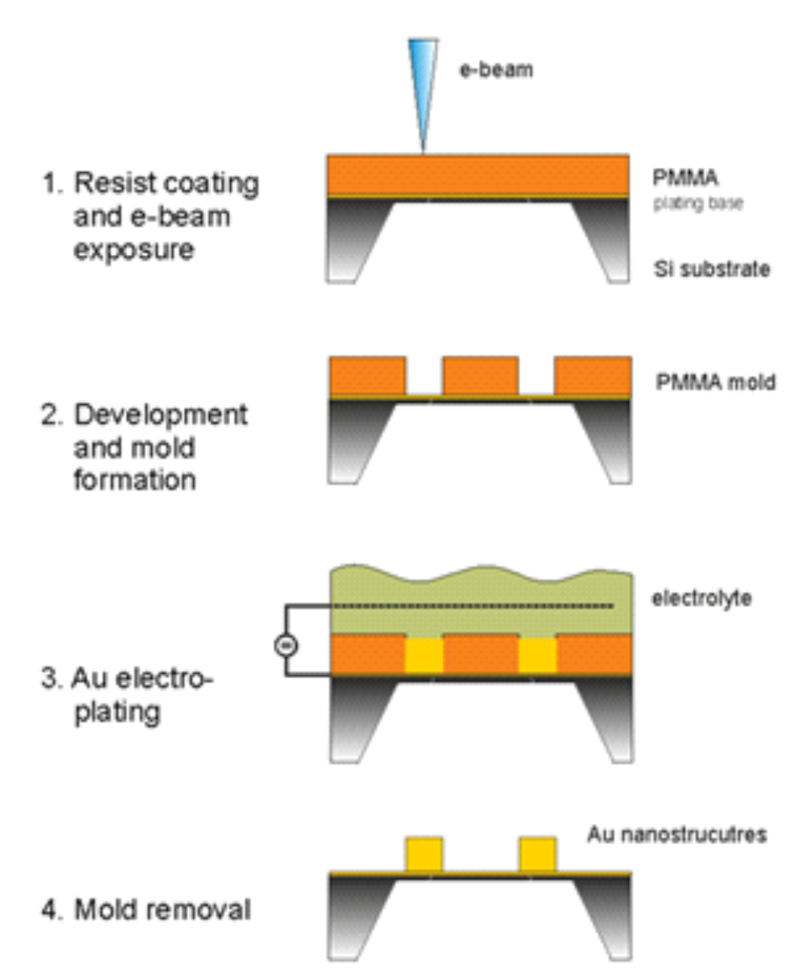
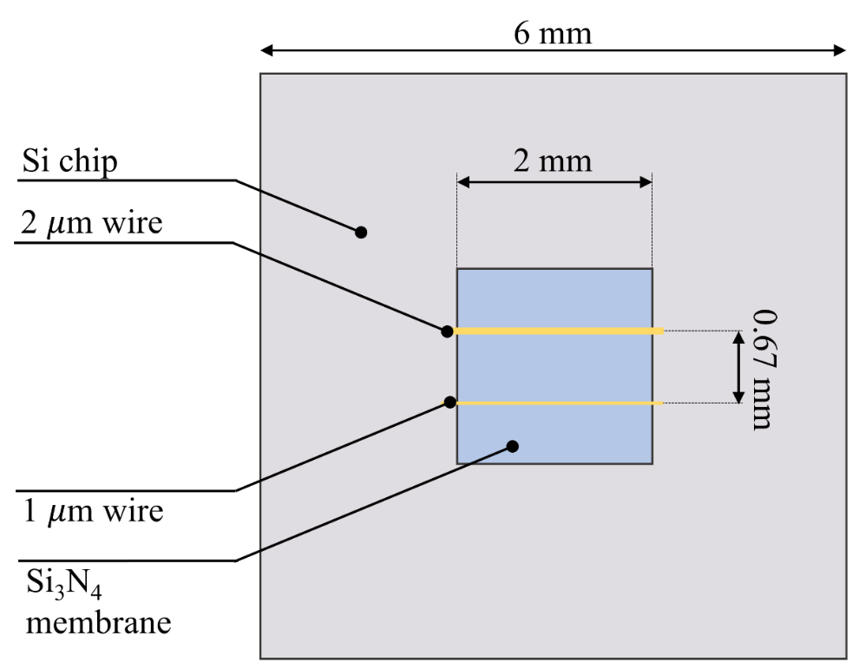
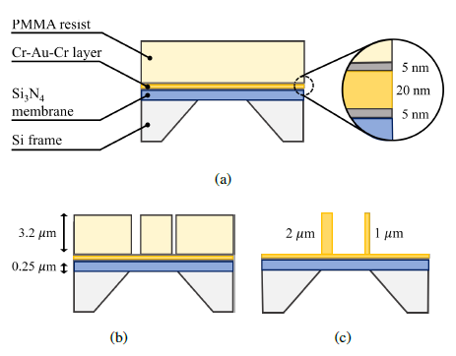
First nano-fabricated WS at PSI: WS on-a-membrane with sub-μm resolution
WS nano-fabrication at Laboratory for Micro- and Nanotechnology (LMN, PSI):
(a) Si3N4 membrane + Cr-Au-Cr coating + PMMA resist spin-coating
(b) e-beam lithography of PMMA to write parallel stripes (isopropanol+water treatment to develop exposed resist)
(c) Developed membrane trenches filled with Au by electroplating (PMMA resist removed by oxygen-plasma)

Slide 9
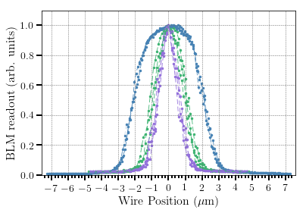
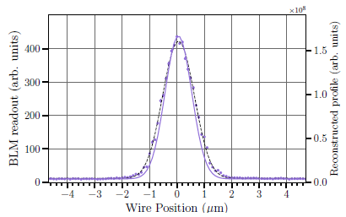
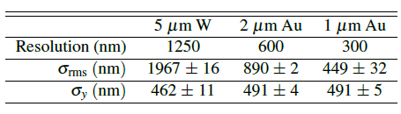
Sub-μm WS on-a-membrane: e-beam test at SwissFEL (*)
Low charge and emittance machine setting: 330MeV, <1pC, emittance ~50 nm, vertical beam size ~500 nm
Beam profile analysis: fit with a Gaussian profile convoluted with a rectangular shaped distribution function
5μm wire
2μm wire
1 μm wire
1μm wire
(*) S. Borrelli, et al., Generation and Measurement of Sub-Micrometer Relativistic Electron Beams, Communications Physics-Nature, 1, 52 (2018).

Slide 10
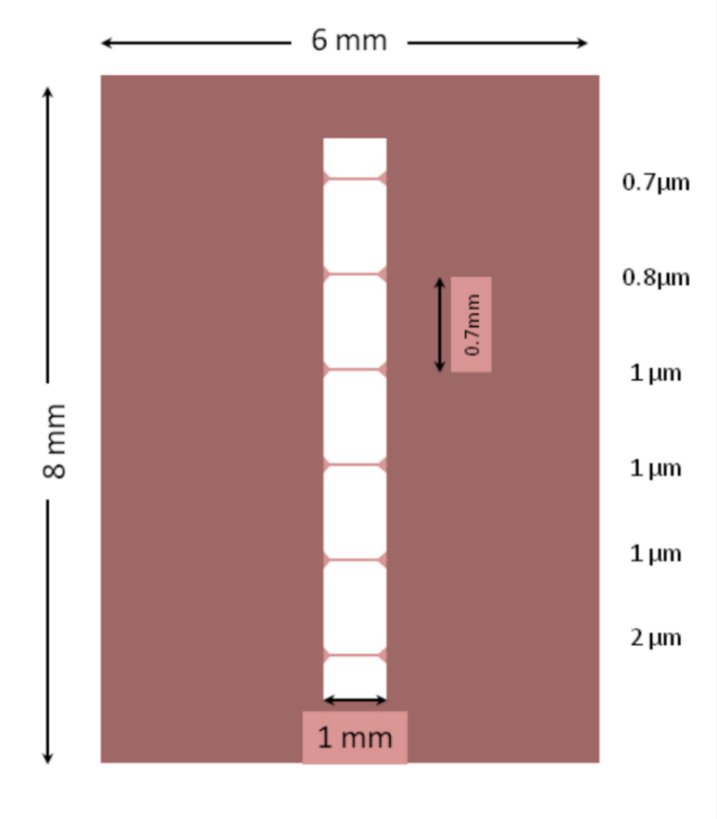
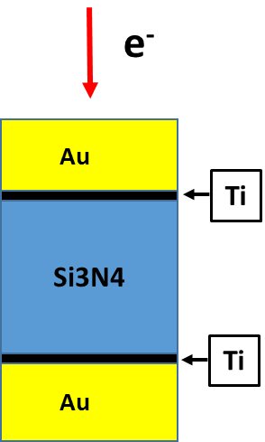
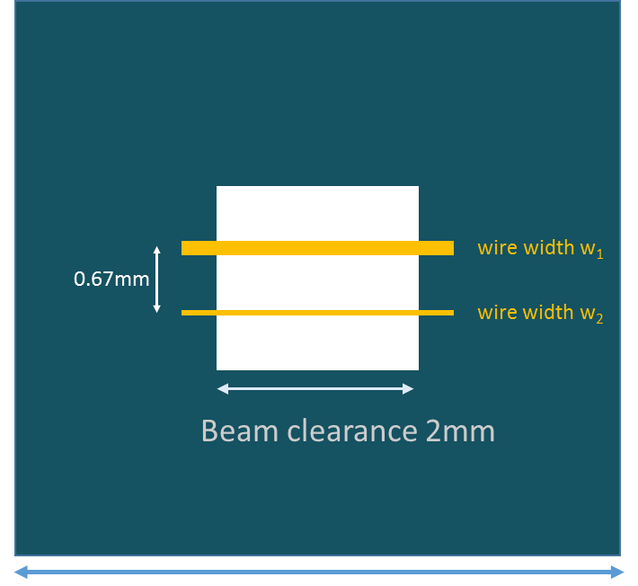
PSI and FERMI nano-fabricated free-standing WS
PSI WS chip: bulk Au stripe; width 800nm and 500nm; thickness ~2μm
FERMI WS chip: sandwich Au/Si3N4/Au;
thickness ~3μm [Au(1μm),Si3N4(2μm),Ti(20nm)]
6mm
Bulk Au vs sandwich Au/Si3N4/Au:
    Higher signal-to-noise ratio (see WS measurement slide)
    Possible minor mechanical stability when increasing the beam clearance

Slide 11
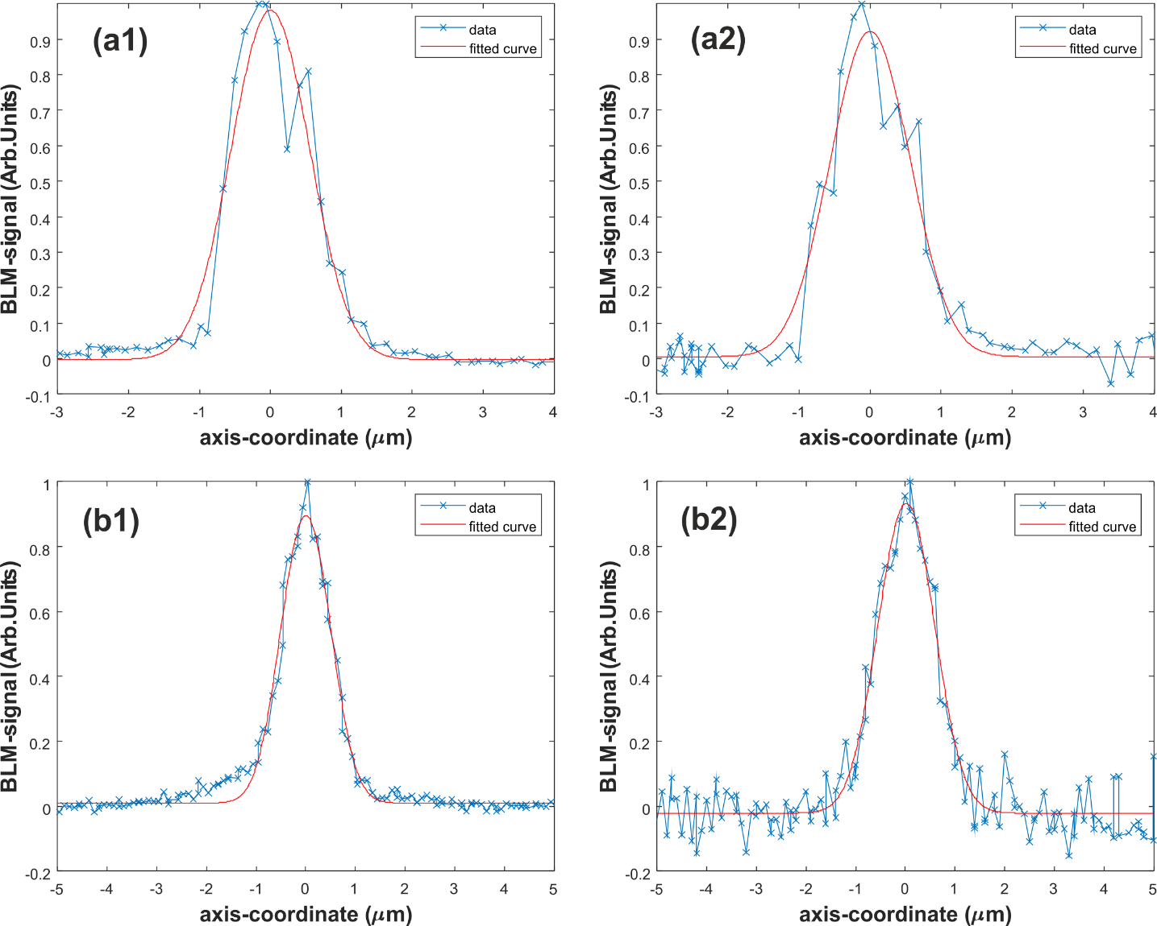
Free-standing sub-μm WS: experimental test at SwissFEL (*)
Beam profiles acquired with PSI (1) and FERMI (2) WS in two different measurement sessions (a, b):
  low-charge (<1pC)
  low emittance (ε_{y}~55 nm) ➔beam size~500nm
  beam energy ~300 MeV
Error-function-fit: convolution of Gaussian distribution with rectangular shaped distribution with a width w:
Heat-loading resilience test (200 pC, 1Hz): no damage observed in WS structures
(*) G.L. Orlandi et al., Nanofabricated free-standing wire scanners for beam diagnostics with submicrometer resolution,
PHYSICAL REVIEW ACCELERATORS AND BEAMS 23, 042802 (2020)

Slide 12
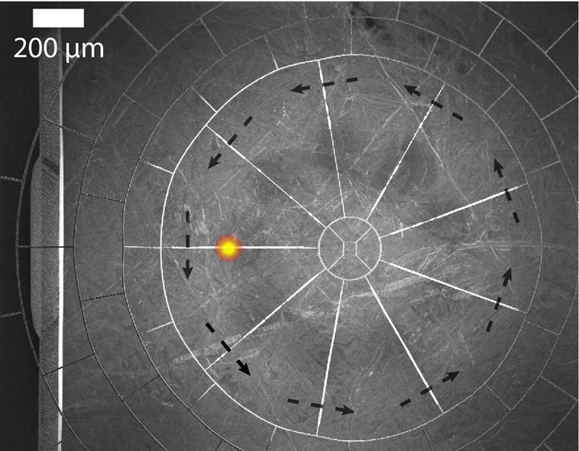
Beam Profile Diagnostics with Nanofabricated Wire Scanner - Tomography
9 Gold wires oriented at different angles
Wire width: 1 μm
Free-standing spider web
Fabricated at PSI by Laboratory for Micro- and Nanotechnology with e-Beam lithography
Measure 1D beam projections with downstream loss monitor
4D Beam tomography:
B. Hermann, et al., 2021, PRAB https://doi.org/10.1103/PhysRevAccelBeams.24.022802

Slide 13
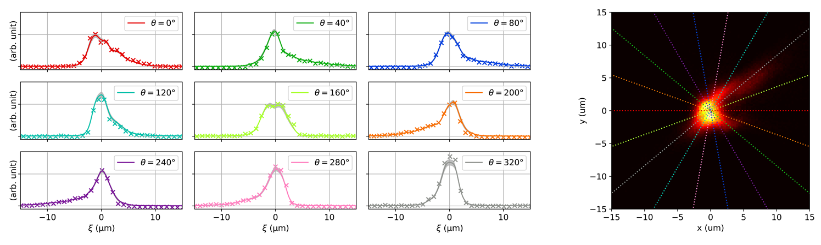
Beam Profile Diagnostics with Nanofabricated Wire Scanner - Tomography
Charge: 10 pC, Energy: 3 GeV
B. Hermann, et al., 2021, PRAB https://doi.org/10.1103/PhysRevAccelBeams.24.022802

Slide 14
Conclusions and Outlook
SwissFEL WS based on conventional technique (5um W wire, resolution 1.25um, double pair of wires in the same fork) fulfil the resolution constraint and design requirements of SwissFEL
Determination of resolution limit of the screen possible thanks to the SwissFEL WS
WS operated by means of a High-Level Application (pshell script): beam profile measurements
WS High-Level Application (HL-App) interfaced with the pyscan routine for emittance measurements: minimal emittance measurements possible thanks to WS and HL-App (PRL publication)
Users judged too slow and not perfectly matched the combination WS HL-App and pyscan routine.
HL-App is still normally used for profile measurements
A new WS EPICS server developed, managed and maintained by Beam-Dynamics for beam profile and emittance measurements recently tested

Slide 15
Conclusions and Outlook
Nano-fabricated WS with sub-micrometer resolution have been successfully developed and tested at PSI
Fruitful collaboration with FERMI on nanofabricated WS (independent fabrication project between FERMI and PSI) and room for further joint development are welcome and can be envisaged
Nano-fabricated WS joint two relevant features: sub-micrometer resolution and minimal invasiveness
Minimal invasiveness of the nano-fabricated WS can be exploited in the FODO WS stations of SwissFEL for routine emittance measurements during normal machine operations.
Preliminary agreement with Laboratory for Micro- and Nanotechnology (LMN, PSI) for nano-fabrication of WS (beam clearance larger than 2mm). Possible collaboration with FERMI and IOM-CNR (Trieste) on this project would be very welcome
Tomographic reconstruction of the beam profile with nano-fabricated WS is also a further method that can be extended from the experiments to the conventional diagnostics of SwissFEL

Slide 16
Wir schaffen Wissen – heute für morgen
Many thanks to
A.Alarcon
S.Borrelli
H. Brands
M.Baldinger
S.Dal Zilio (IOM-CNR,Trieste)
C.David
S.Ebner
M.Ferianis (FERMI)
E.Ferrari
A.Gobbo
V.Guzenko
P.Heimgartner
B. Hermann
R.Ischebeck
C.Ozkan-Loch
E.Prat
B.Rippstein
V.Schlott
M.Veronese (FERMI)
R.Vintar(Cosy lab)
…and many other colleagues…
Thank you for your attention

