Slide 1
Synchrotron Radiation Monitors at SwissFEL
G. L. Orlandi
SwissFEL Electron Diagnostics Review Workshop PSI (Remote), 18-21 October 2021
gianluca.orlandi@psi.ch

Slide 2
Contents
Synchrotron Radiation Monitor (SRM) in SwissFEL
Specifications
Design applications: non-invasive and shot-to shot measurements of the energy and energy spread of the electron beam
Special applications: non-invasive and shot-to shot monitoring of the electron bunch-length (thanks to Beam synchronous acquisition of camera images and RF parameters)
Conclusions and Outlook

Slide 3
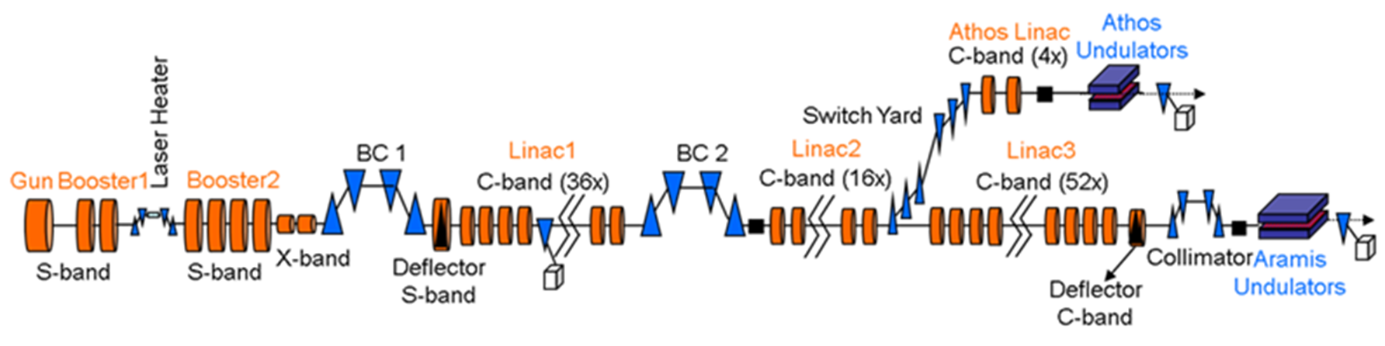
Synchrotron Radiation Monitor (SRM) in SwissFEL
SRM
Beam energy: 6.2 GeV and 3.3 GeV
Beam charge: 10-200 pC @100Hz, 28 ns 2-bunch time structure
Emittance: 0.4/0.2 mm mrad
Bunch length: from a 3 ps up to a few fs
Bunch Compression factors (BC1+BC2): ~150 (@200pC) and ~300 (@10pC)
Photon wavelength: 0.1-0.7 nm and 0.7-7.0 nm

Slide 4
SRM in SwissFEL
SRM set-up in the Aramis phase (single bunch operations):
BC1: bending-angle 0➔4.6deg, operation setting: 300MeV and 4.1 deg (η=-448mm)
BC2: bending angle 0➔3.8-deg, operation settings: 2.2GeV and 2.1 deg (η=-280mm)
SwissFEL BC1 SRM set-up same as the 250MeV SITF one (SwissFEL injector Test Facility)
sCMOS PCO.Edge camera (100fps, Optical Fiber Camera Link)+300 mm lens+BW UV/IR cut filter
Visible Edge Synchrotron Radiation from the entrance edge of the 3rd dipole of the chicane
Charge sensitivity range 10-200 pC, beam size 6.0mm (rms, @BC1), 1.2 mm (rms, @BC2)
Monitor the beam transverse profile over the entire range of the bunch-compressor bending angle to determine the beam energy and relative energy spread
Relative energy spread resolution BC1= 1.4x10^-4 ; BC2= 1.8x10^-4
Real time (100Hz) processing of the images with C/C++ analysis algorithm running on the camera server and interfacing the IOC/EPICS channels
SRM operations in the Aramis+Athos phase (2 bunch operations):
BC1 SRM: sCMOS camera replaced with PCO.Dicam C1, fast gated MCP camera to resolve Bunch-1 or Bunch-2
BC1 SRM resolution: same as in previous phase
BC2 no camera upgrade, camera image superposition of Bunch-1 and Bunch-2

Slide 5
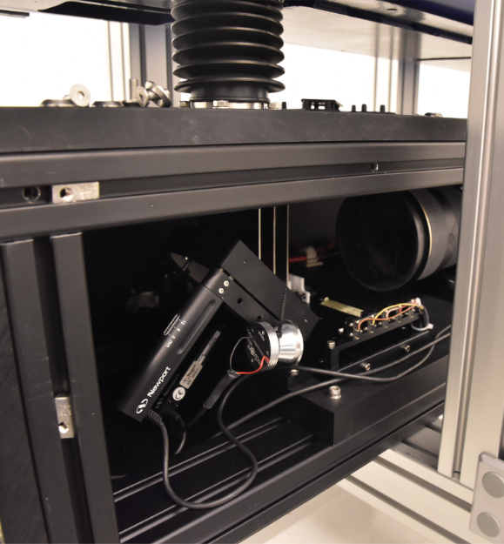
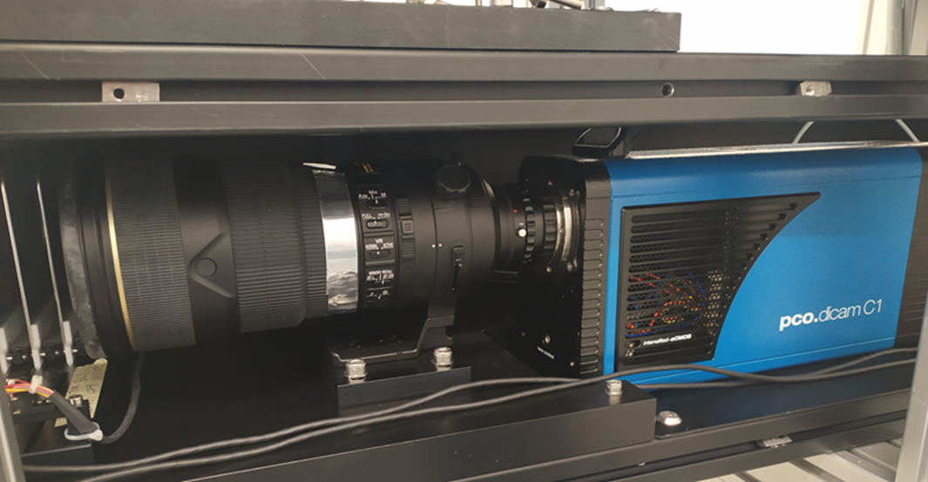
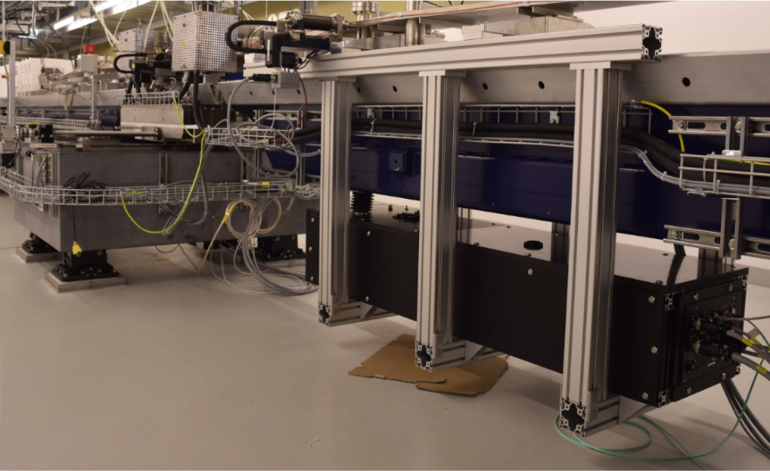
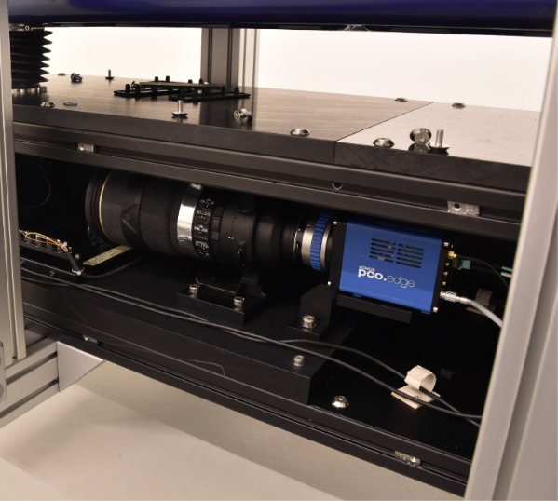
BC1 SRM set-up at SwissFEL
2-bunch camera set-up: PCO.Dicam C1
Single bunch camera set-up: sCMOS PCO.Edge

Slide 6
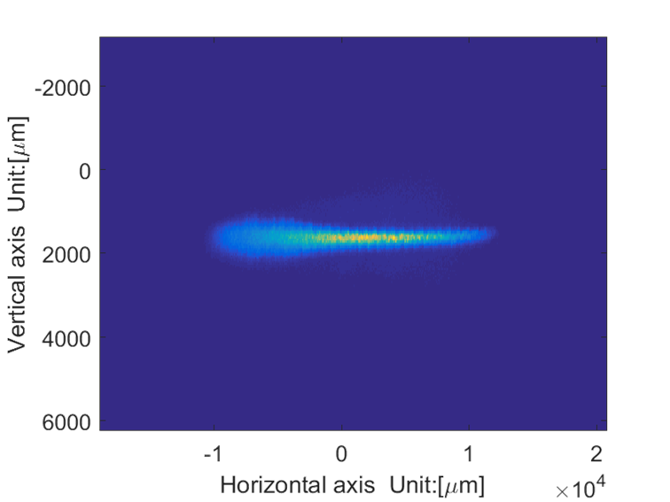


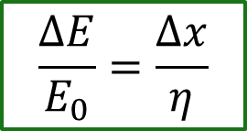
SRM BC1: mean energy and energy spread characterization
shot to shot and not invasive monitor of the beam transverse profile.
Mean energy (E₀)➔ centroid of the SR light distribution
Energy spread (ΔE/E₀) ➔ sigma (rms) of the horizontal distribution of the SR light
beam synchronous acquisition of the camera images at SwissFEL (time stamp and ID number)
Centroid and sigma (rms) (⬅➔ mean energy and spread) can be processed in real time @100Hz by means of a C/C++ analysis algorithm running on the camera server and interfacing the IOC/EPICS (function developed and tested for single bunch camera but not yet implemented in the 2-bunch camera)
Possibility to use the shot-to-shot processed SR light centroid and sigma (rms) for feedback of the RF
$$\frac{ΔE}{E_{0}}=\frac{Δx}{η}$$
$$μ$$
$$σ_{x}$$

Slide 7
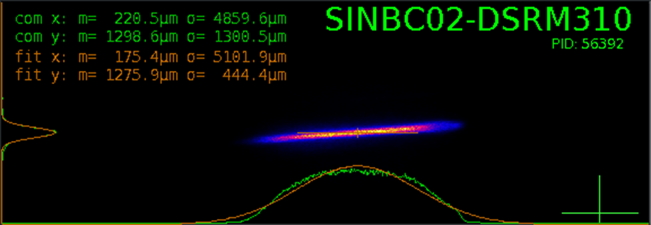
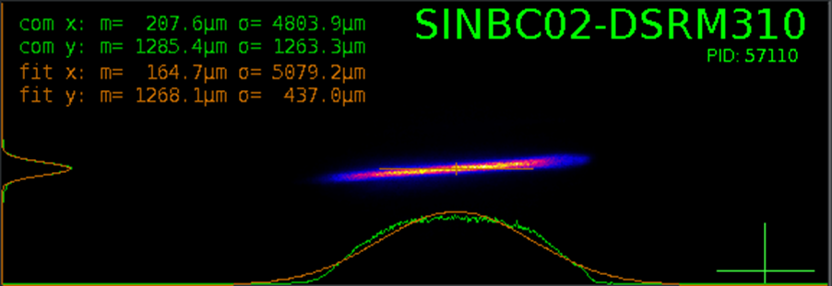
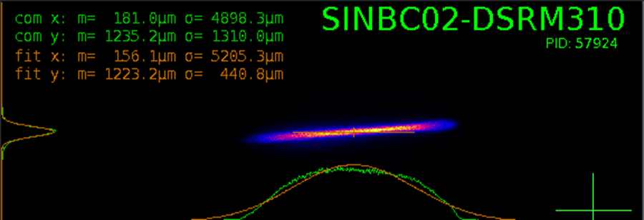
BC1 SRM: 2-bunch camera images
SRM 2-bunch camera commissioning:
B1 ON, B2 OFF
B1 ON, B2 ON (B1 imaged)
B1 ON, B2 ON (B2 imaged)

Slide 8
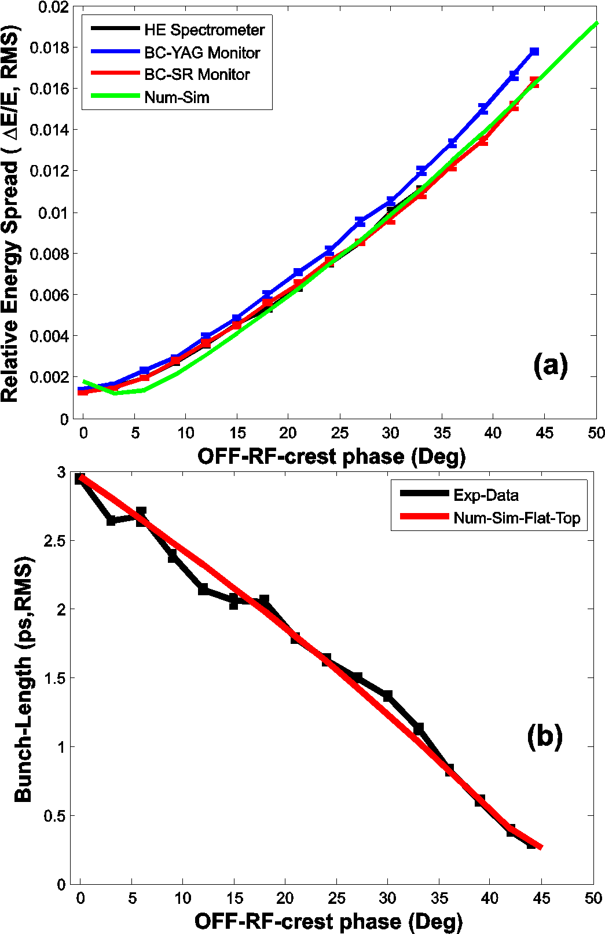
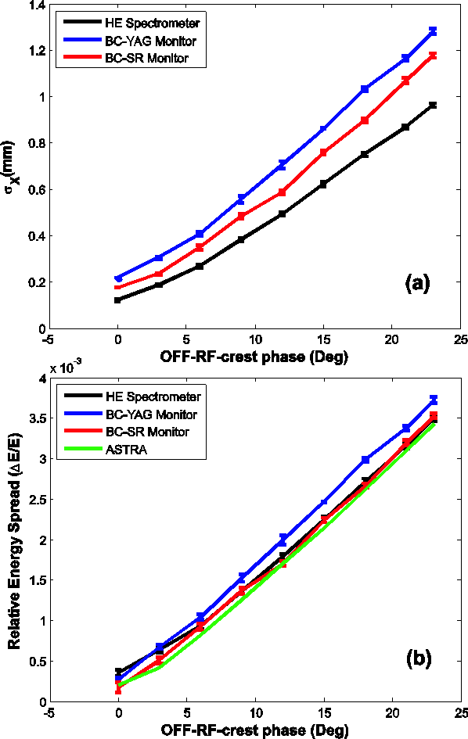
SRM BC1: Energy spread characterization
250MeV SITF: 200MeV, 180pC
250MeV SITF:230MeV, 12 pC

Slide 9
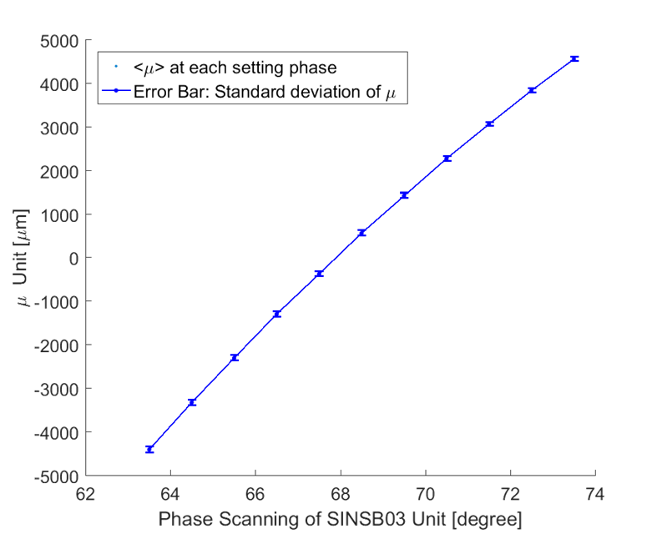
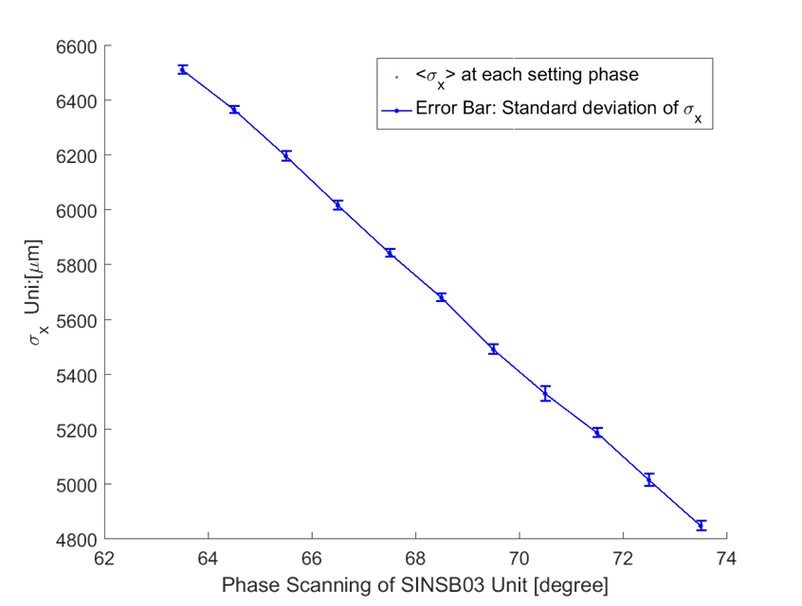
SwissFEL SRM BC1: Mean energy and spread characterization vs compression
BC1-SRM measurements vs S-Bands Phase (SINSB03/04) at SwissFEL:
single bunch camera (July,2018)
Energy feedback – OFF
Compression feedback – OFF
SINSB03/04: off-crest nominal phase setting 69.7 deg

Slide 10
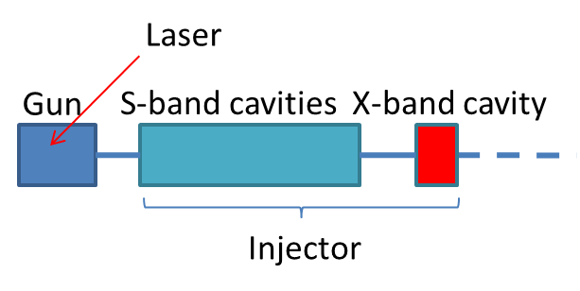
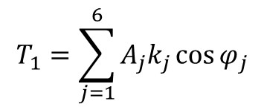

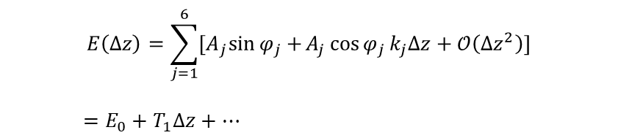
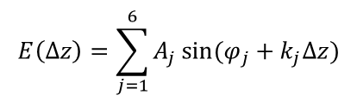
BC1 SRM:non-invasive and shot-to shot monitoring of the electron bunch-length (*)
Modelling of the RF Chirp: Linear Approximation
Energy gain in the SwissFEL injector:
$$E\left(Δz\right)=\sum_{j=1}^{6}{A_{j}\sin{(φ_{j}+k_{j}Δz)}}$$
Taylor Expansion
$$E\left(Δz\right)=\sum_{j=1}^{6}{{[A}_{j}\sin{φ_{j}}+}A_{j}\cos{φ_{j}}k_{j}Δz+𝒪\left({Δz}^{2}\right)]$$
$$=E_{0}+T_{1}Δz+…$$
Nominal Settings:
Setup | Frequency (GHz) | Phase (deg) | Amplitude (MV)
SINEG01 | 3 | 90 | 7.5
SINSB01 | 3 | 90 | 65.5
SINSB02 | 3 | 90 | 68.5
SINSB03 | 3 | 69.7 | 96.2
SINSB04 | 3 | 69.7 | 96.2
SINXB01 | 12 | 269.7 | 19.3
Linear approx.: $ΔE=T_{1}Δz$
$$T_{1}=\sum_{j=1}^{6}{A_{j}k_{j}\cos{φ_{j}}}$$
(*) G. L. Orlandi, et al., Bunch length and energy measurements in the bunch compressor of a free-electron laser, PHYSICAL REVIEW ACCELERATORS AND BEAMS 22, 072803 (2019)

Slide 11
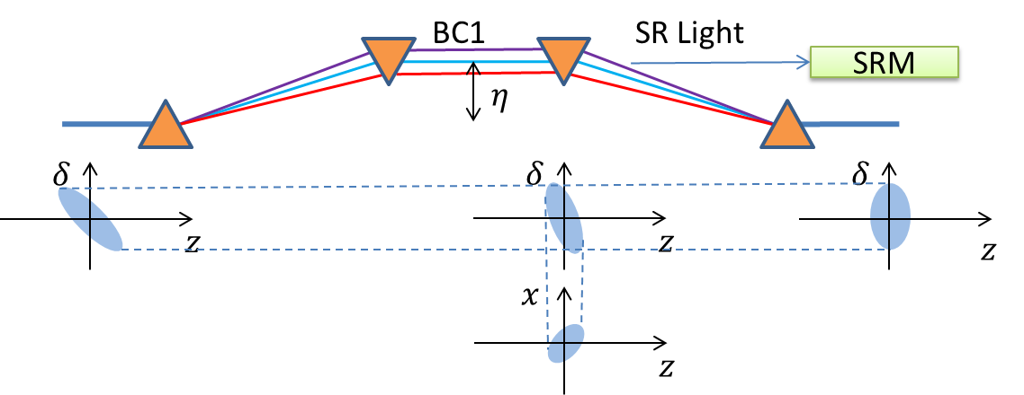
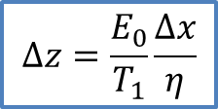
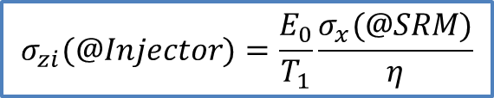
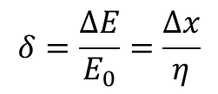
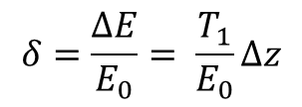
BC1 SRM:bunch length monitoring…
Relative energy spread @Injector:
$$δ=\frac{ΔE}{E_{0}}= \frac{T_{1}}{E_{0}}Δz$$
$$Δz=\frac{E_{0}}{T_{1}}\frac{Δx}{η}$$
Relative energy spread @BC1-SRM:
$$δ=\frac{ΔE}{E_{0}}=\frac{Δx}{η}$$
$$σ_{zi}(@Injector)=\frac{E_{0}}{T_{1}}\frac{σ_{x}(@SRM)}{η}$$

Slide 12
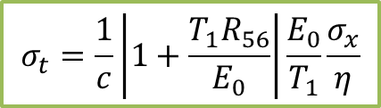
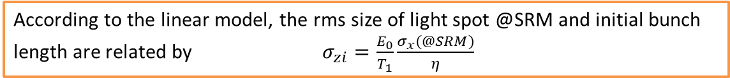
BC1 SRM: bunch length monitoring…
Linear approximation of energy chirp at the injector: $\frac{ΔE}{E_{0}}=\frac{T_{1}}{E_{0}}Δz$
Bunch length after BC: $σ_{zf}=\left|1+{AR}_{56}\right|σ_{zi}=\left|1+\frac{T_{1}R_{56}}{E_{0}}\right|σ_{zi}$
According to the linear model, the rms size of light spot @SRM and initial bunch length are related by $σ_{zi}=\frac{E_{0}}{T_{1}}\frac{σ_{x}(@SRM)}{η}$
Bunch length at exit of BC1:
$$σ_{t}=\frac{1}{c}\left|1+\frac{T_{1}R_{56}}{E_{0}}\right|\frac{E_{0}}{T_{1}}\frac{σ_{x}}{η}$$
BC1-SRM measurements:
mean energy and energy spread of the beam, from the knowledge of the dispersion η;
absolute measurement of the bunch-length from R₅₆ and BS-READ of RF parameters of the injector (“energy chirp”T₁/E₀) and the camera images.
Comparison with TDS bunch length measurements at injector

Slide 13
Conclusions and Outlook
BC SRM in SwissFEL:
BC1 SRM (PCO.Dicam C1 camera) discriminate bunch-1 or bunch-2
BC2 SRM (sCMOS PCO.Edge camera) measure the 2 bunch superposition
BC1 SRM: non-invasive, shot-to-shot (100Hz) determination of the mean energy and energy spread for bunch-1 or bunch-2
(functionality implemented: normalization w.r.t. chicane dispersion to be applied to the measured beam size)
BC1 camera: potentialities for feedback the phase and amplitude of the injector RF structures…
...BPM spatial resolution higher than BC1 SRM resolution for determining mean energy jitter…
…the non-invasive determination of the beam energy spread is instead a peculiar feature of the BC-SRM…an online monitoring of the bunch length could be for instance a chance to exploit such a feature…
Method for a non invasive and 100Hz monitoring of the bunch length after BC1:
Beam synchronous acquisition of the BC1-SRM camera image and the parameters of the injector RF structures (phase and amplitude)
Linear approximation of energy chirp at the injector
(functionality not yet implemented in BC1-SRM)

Slide 14
Wir schaffen Wissen – heute für morgen
Many thanks to
A.Alarcon
M.Baldinger
S.Bettoni
H.Brands
S.Ebner
C. Gerth (DESY)
P.Heimgartner
N. Hiller
R.Ischebeck
N.Kivel
V.Schlott
T.Stapf
R. Xue
..and many other colleagues…
Thank you for your attention

