Slide 1
Positron Production Instrumentation
Rasmus, Pavle, Gian Luca

Slide 2
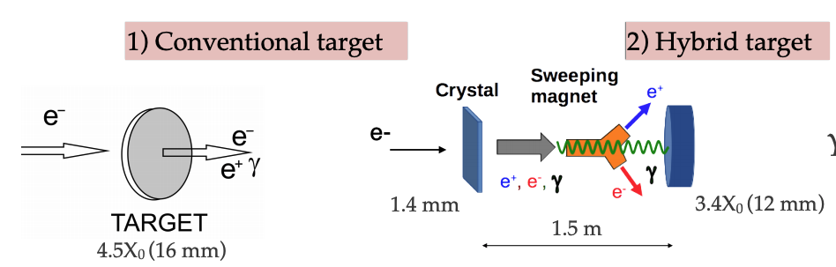
Positron Production at PSI = P³
Goal: demonstrate positron production for a future circular collider (FCC)
Experiment in SwissFEL

Slide 3
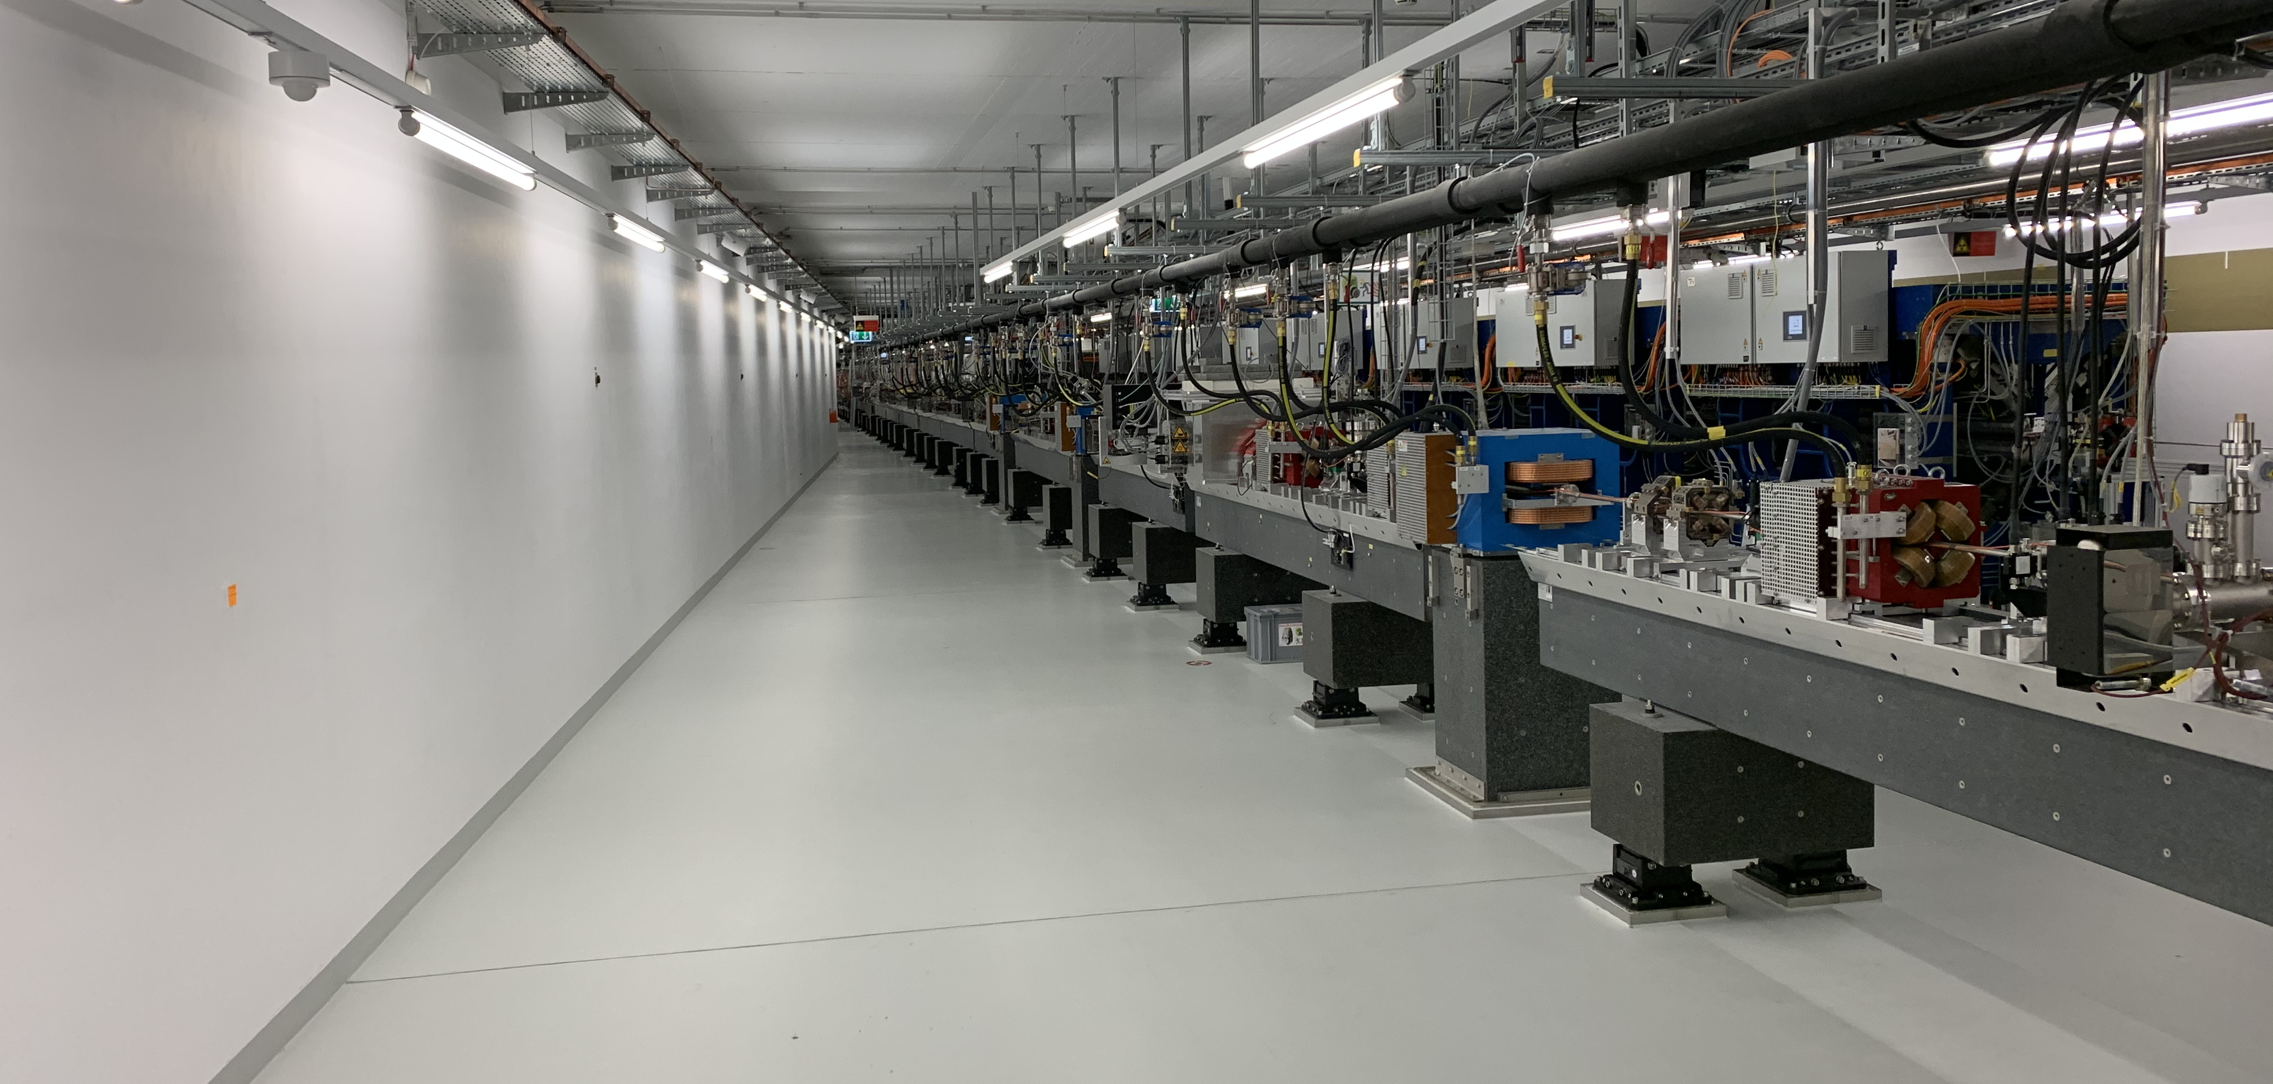
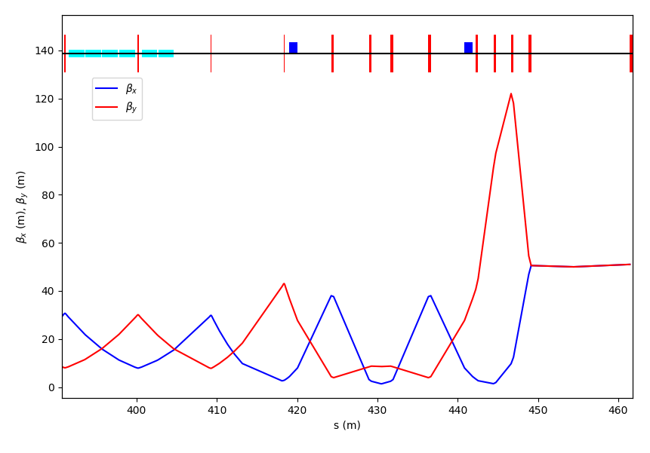
Transfer line to the positron source experiment
quadrupoles
S30CB13/14
target
dipoles
b-function 15m-150m
Transfer line at the linac end: The idea is to have a simple outcoupling and a double bend achromat layout to close the dispersion in the straight line. This solution is the least invasive to the main SwissFEL line, where only the first dipole is placed in the beamline in S30CB16.
8 QFM quadrupoles up to the target to change the beam size at the target itself
Courtesy of S. Reich

Slide 4
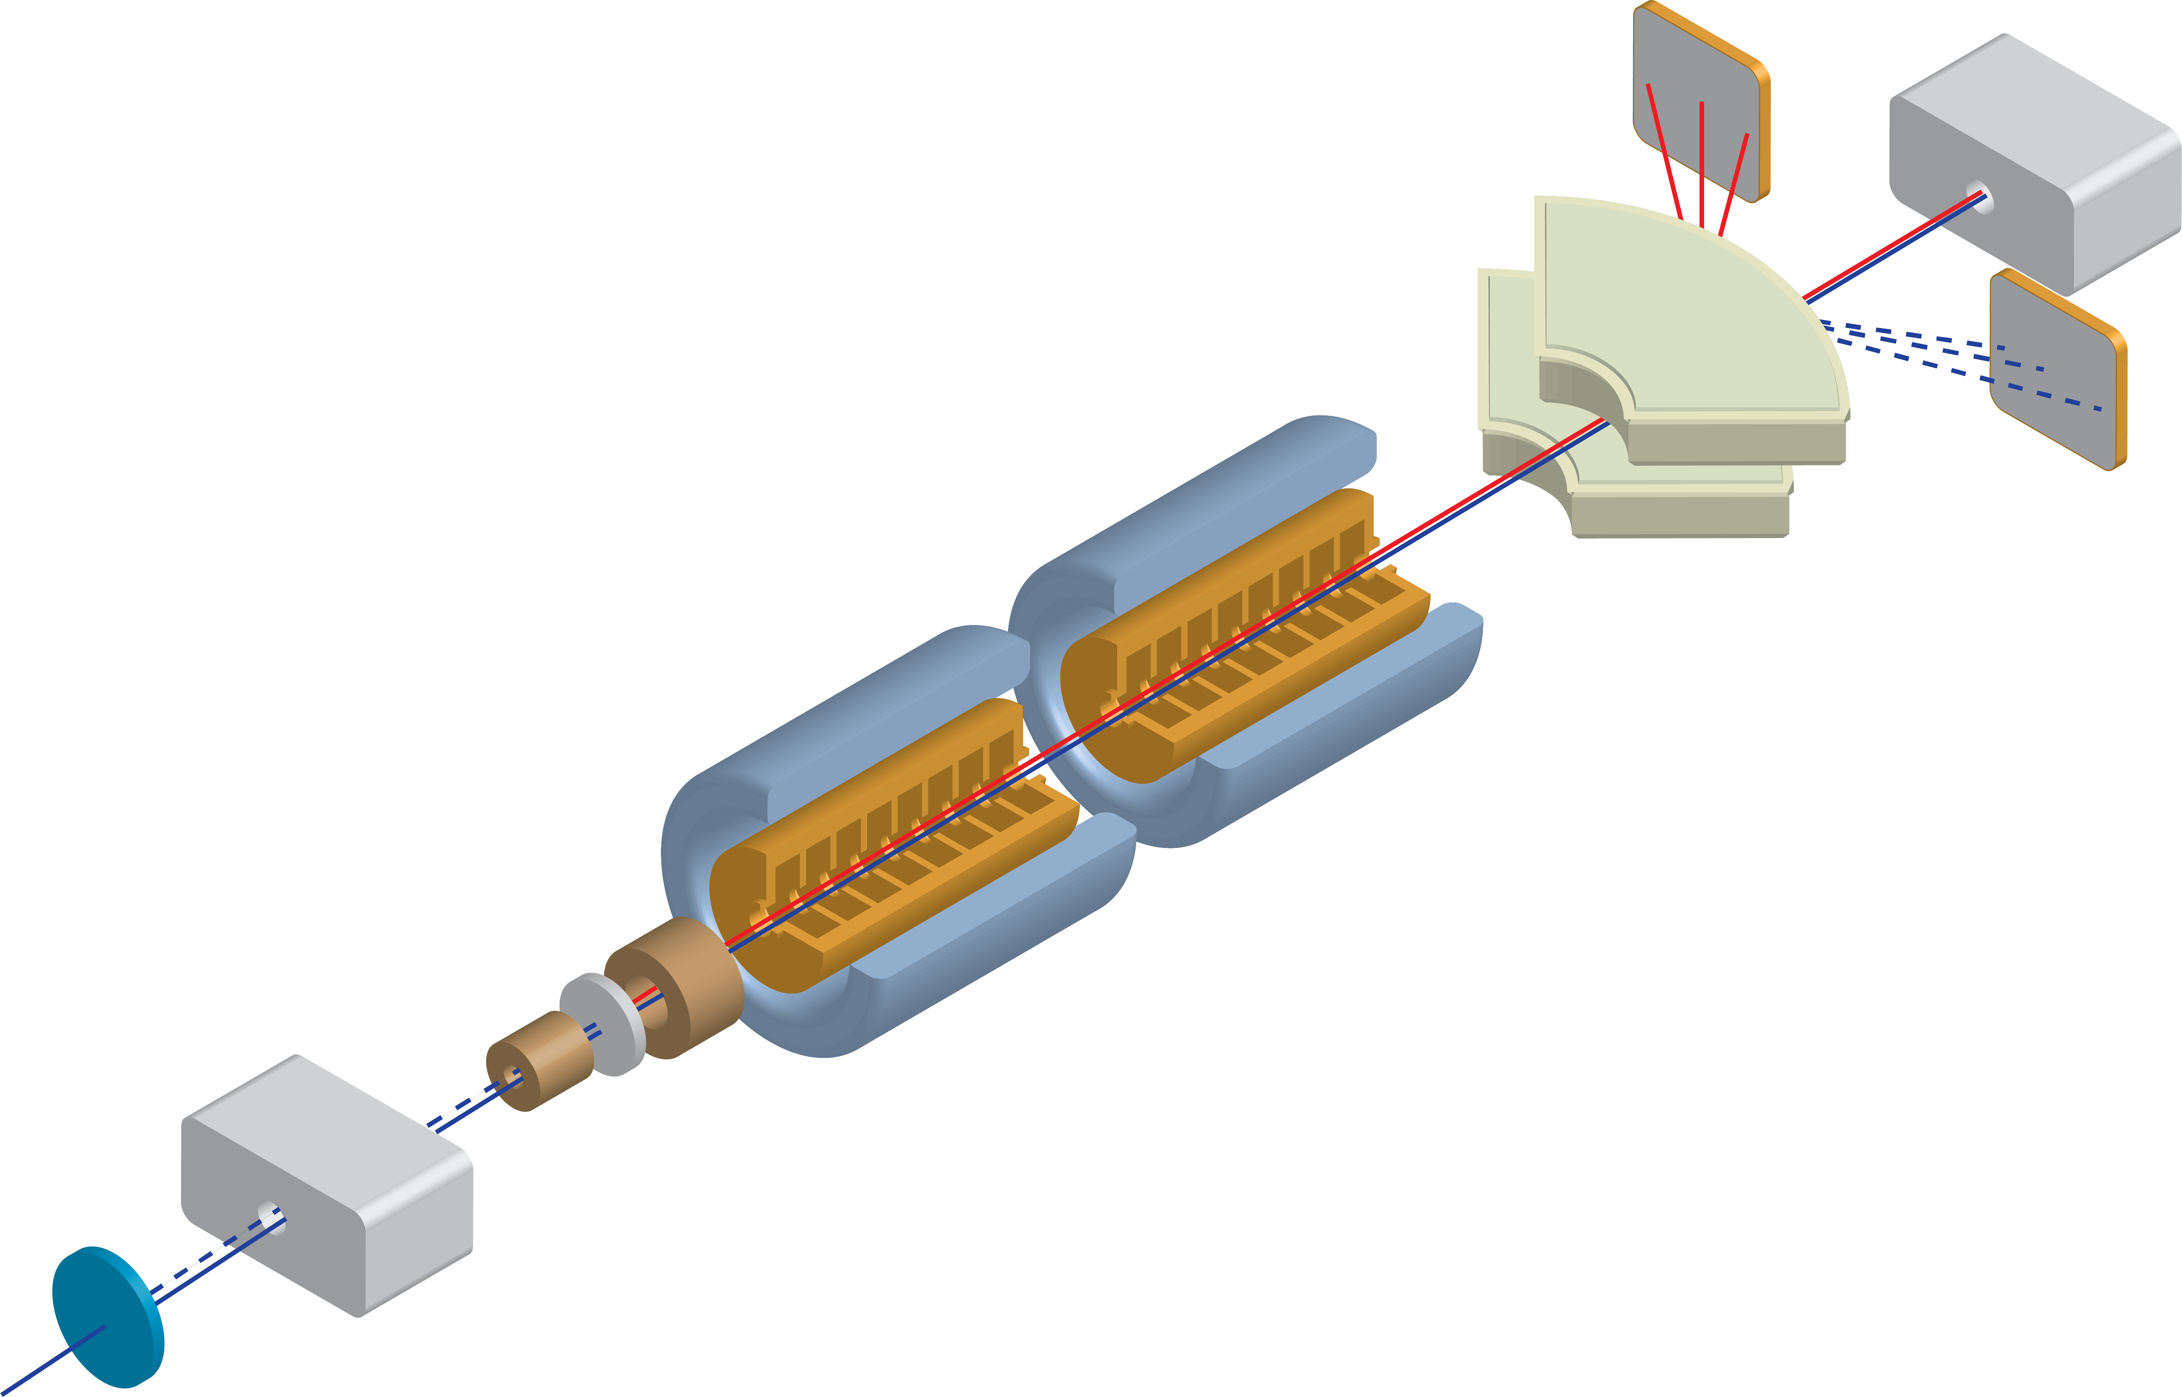
Experiment layout
Experiment goals:
e+ production yield measurement
Test of a superconducting solenoid as adiabatic matching device
Test of large aperture RF cavities (a=40 mm a/ʎ=0.4)
e+
e-
Spectrometer
Expected yield > 3
RF cavities and NC solenoids
Vertical magnet
SC AMD solenoid with embedded target (amorphous tungsten ~5 X0 i.e. 17 mm)
Crystal in/out
Drive beam:1 Hz 200 pC single bunch 6 GeV e-

Slide 5
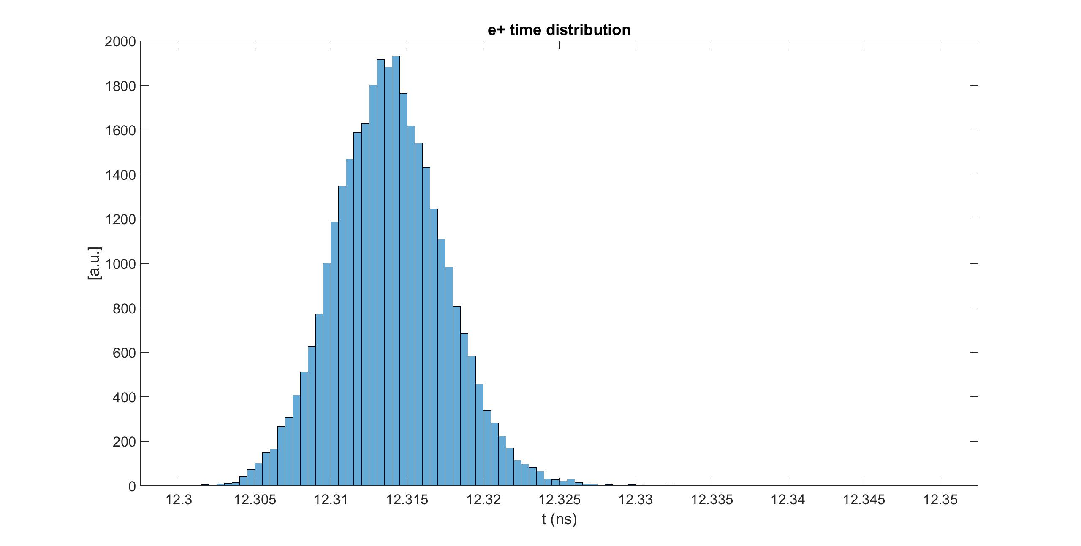
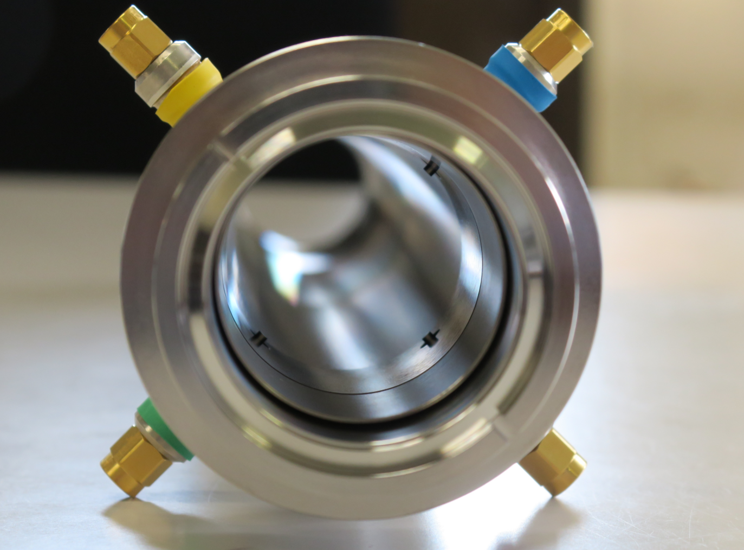
E+ charge measurement with fast time resolution
Appropriate RF phase adjustment of the two RF cavities allow to collect the e+ and e- generated at the target in different RF buckets.
High time resolution is required to measure separately each single bucket (half RF period @ 3 GHz ~160 ps)
Suwada, T., Rehman, M.A. & Miyahara, F. First simultaneous detection of electron and positron bunches at the positron capture section of the SuperKEKB factory. Sci Rep 11, 12751 (2021). https://doi.org/10.1038/s41598-021-91707-0

Slide 6
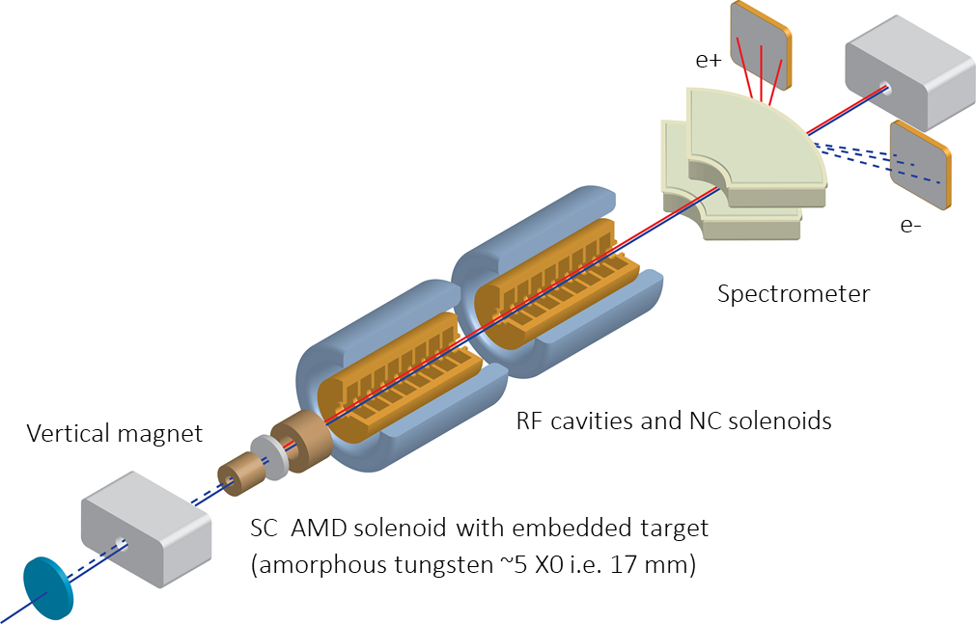
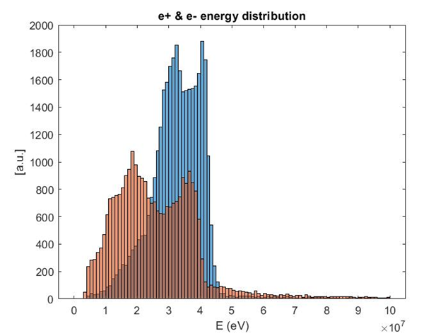
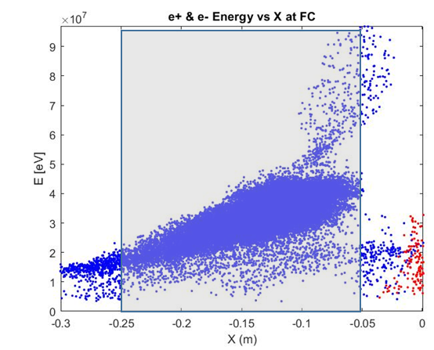
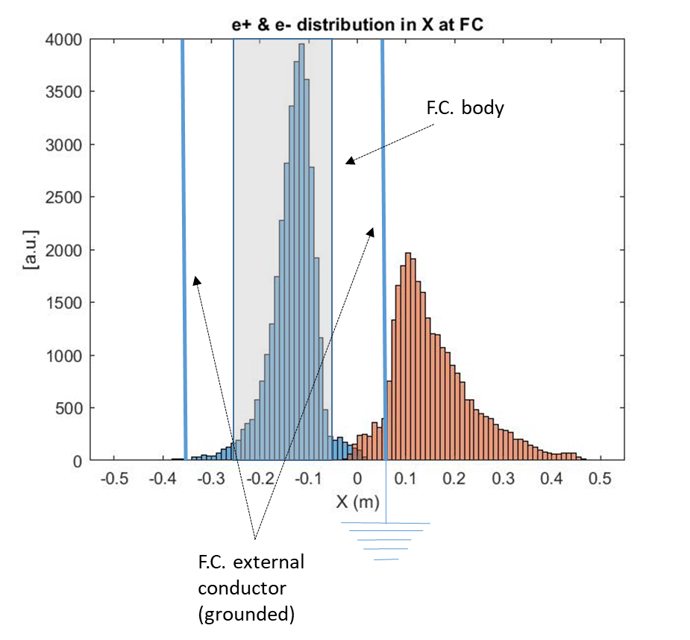
Measurements of e-/e+
Positron (blue) and Electron (red) after the spectrometer and at the entrance of the Faraday-Cup
Faraday-Cup is a diagnostics planned by the P^3 team.

Slide 7
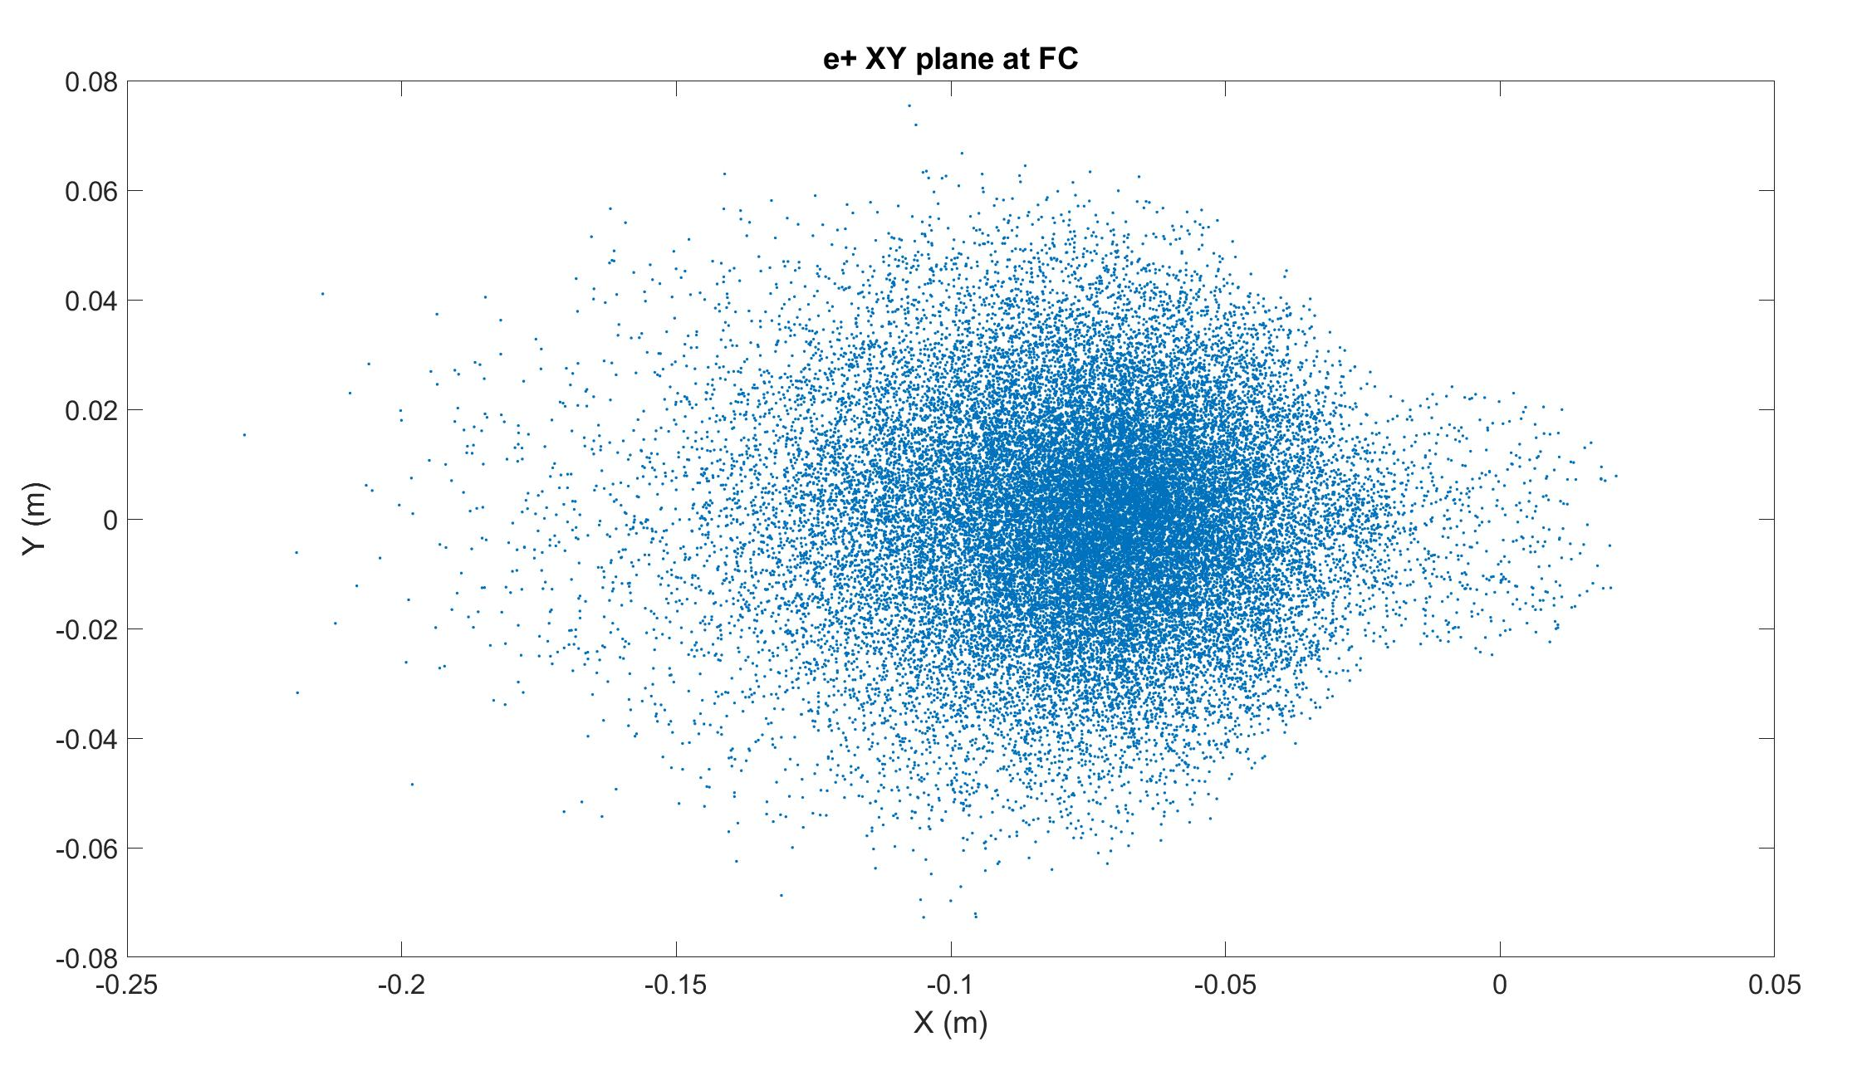
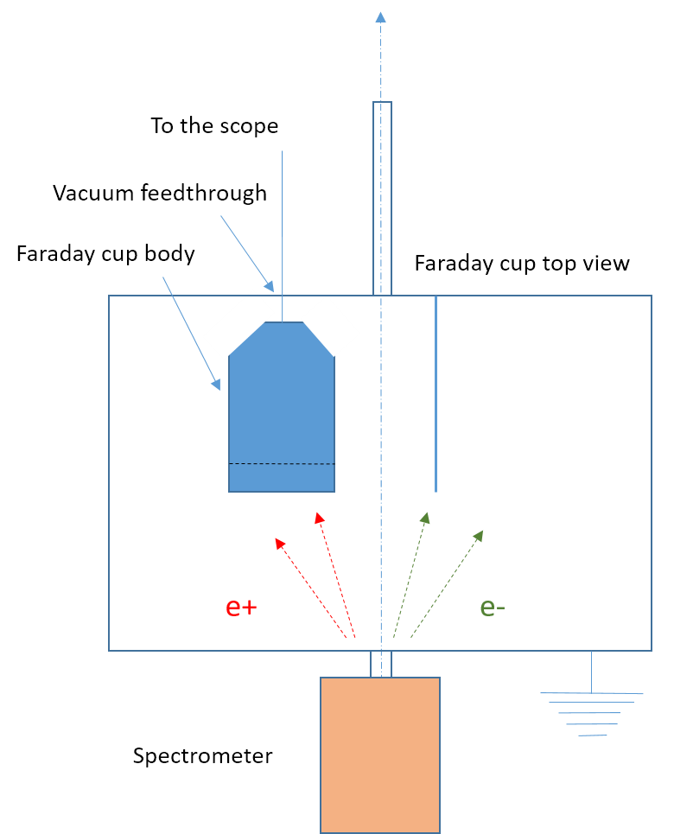
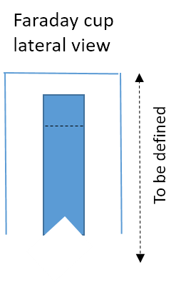
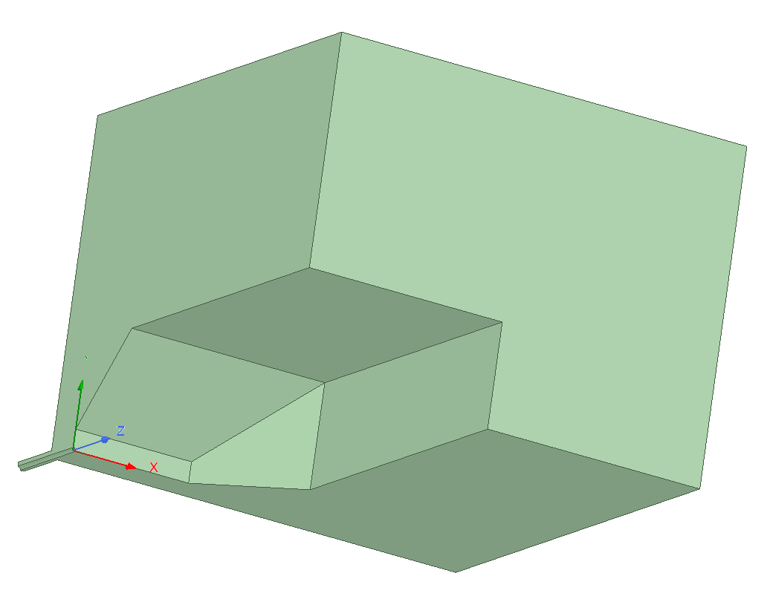
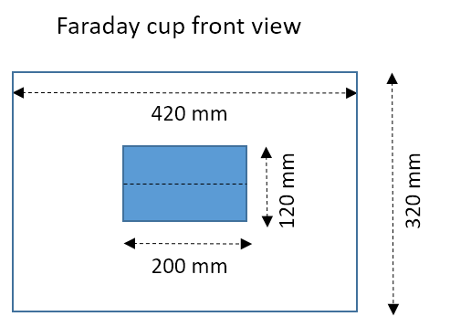
e⁺ Charge Measurement with Faraday cup
Absolute e+ charge measurement after spectrometer
Use of a large geometrical acceptance faraday cup (200m H x 120 mm V)
50 Ohm coax. design, large bandwidth (DC to 800 MHz)
Conceptual design of a 50 Ohm coax. in vacuum Faraday cup
Internal conductor FC body to collect all the e+
External conductor grounded vacuum chamber
Vacuum feedthrough

Slide 8
e⁺/e– Spectrum: Camera
Paint the front of the Faraday cup with a scintillator?
Physics of Plasmas 21, 056704 (2014); https://doi.org/10.1063/1.4875336

Slide 9
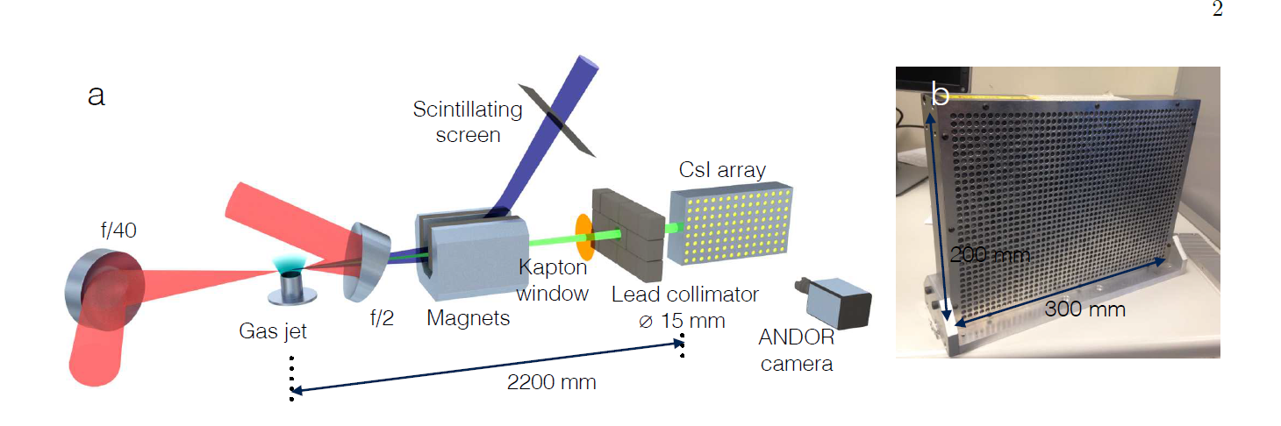
Gamma spectrometer
Need to measure the spectrum of the high-energy gamma radiations (1-100 MeV photons) that would produce the positron/electron pairs.
Recent developments have shown some examples of such spectrometer, like that presented in Behm et al., in Rev. Sci. Inst. 113303 (2018).

Slide 10
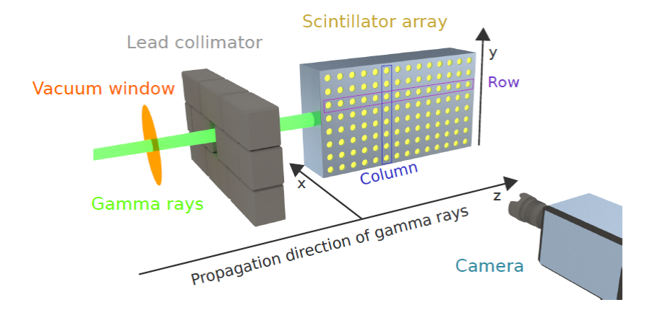
Gamma Spectrometer
Spectral information encoded by depth of scintillation along a row.
Columns encode spatial information
Camera for observation of CsI rod scintillation.
Shielding and collimation.
Can be done outside of vacuum.
Courtesy of Elias Gerstmayr
Work needed to model the scintillation and gamma interactions to optimize design, develop the best spectral reconstruction algorithm.

Slide 11
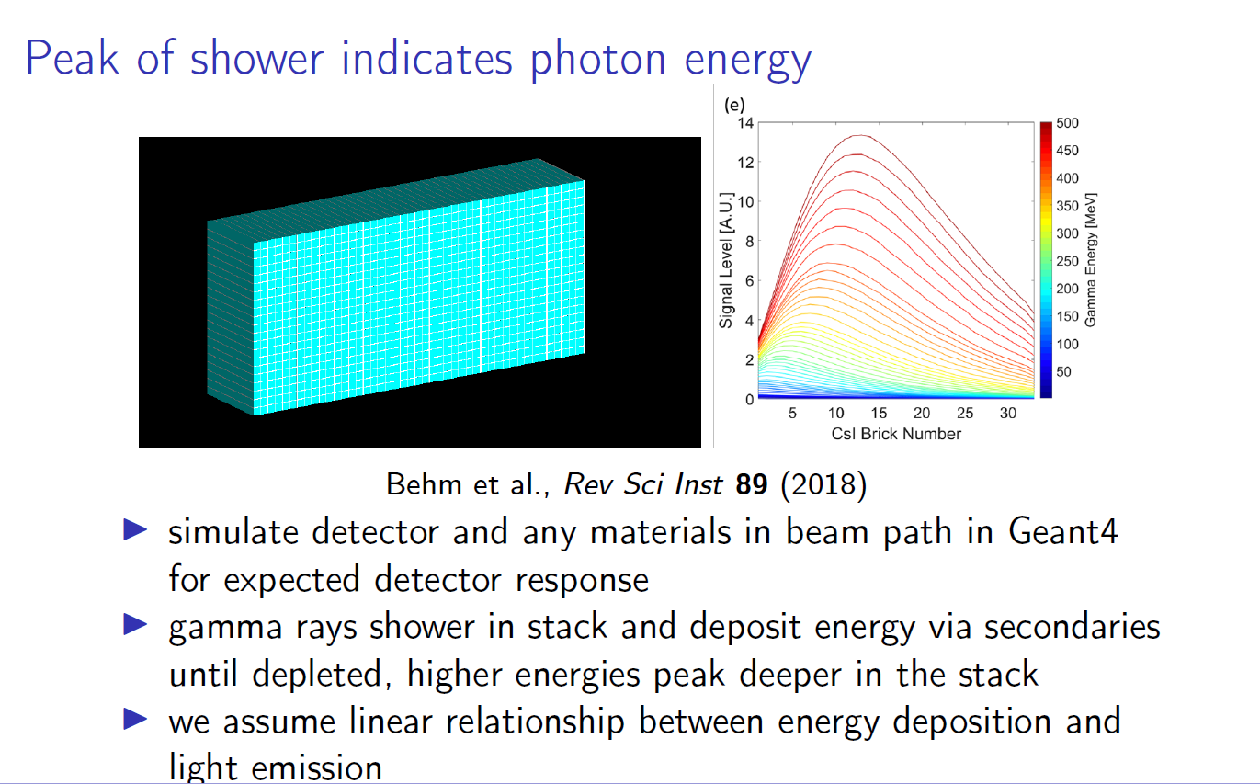
Gamma Spectrometer
Courtesy of Elias Gerstmayr

Slide 12
Cherenkov fiber to monitor the charge and energy distribution of e-/e+
Experimental set up: electron/positron beam produced by the SwissFEL electron beam hitting a target. The resultant e-/e+ beams are analyzed by a dipole magnet spectrometer.
Diagnostics requirement: determine the charge and energy distribution of the e-/e+ beam at the exit of the spectrometer and at a suitable distance from it
Goals of the monitor:
  First goal: measure the spatial distribution (along the dispersion direction X) of the e-/e+ beam analyzed by the spectrometer to determine the energy distribution of the beam
  Second (main) goal: determine the charge distribution vs X (i.e., vs positron/electron energy)
Proposed solution (presently in a conceptual phase):
  Linear array of equidistant Cherenkov fibers perpendicularly distributed along the dispersive X axis
  each fiber equipped with PMT+ADC for the readout of the light intensity
  multi-mode step-index fibers with pure silica core of high OH-content (Proceedings of DIPAC 2007, TUPB25 , Venice, Italy) or PMMA fiber (APPLIED OPTICS / Vol. 48, No. 18 / 20 June 2009)
  Cherenkov fiber with a diameter of 1 mm ⬅➔ geometrical spatial resolution 250um (rms)
  Cherenkov light intensity:
      proportional to the square of the charge
      electron speed dependent (kinetic energy of the electrons/positrons)
      ~1/λ^2 for a given wavelength (λ)

Slide 13
Cherenkov fiber to monitor the charge and energy distribution of e-/e+
Operation principle (in the ideal case of a beam with a low emittance, i.e., small angular divergence):
  use pre-calibrated Cherenkov fibers:
    Calibrate the Cherenkov light intensity signal in the fiber vs charge and vs kinetic energy of the electron beam (after the spectrometer, kinetic energy at a given position X of the dispersive axis is known)
    Determine for every fiber - placed at a given dispersive position X after the spectrometer - the proportionality relation between the amount of charge hitting the fiber and the Cherenkov light intensity
  Light signals of the calibrated linear array of Cherenkov fibers should hence allow to reconstruct the charge and spatial (⬅➔energy) distribution of the electron/positron beam along the dispersive direction X of the magnetic spectrometer
Practical difficulty (in the case of a real beam with angular divergence):
  According to information from the P^3 team, the electron and positron beam analyzed by the dipole spectrometer is characterized by a huge angular dispersion
  As a consequence it cannot be excluded that the same Cherenkov fiber placed at a given dispersive coordinate X can be hit by electrons/positrons having different kinetic energy but simply converging at the same X coordinate because of the different emission angle.
Possible solution to this practical difficulty (real beam with angular divergence):
  Instead of using a single linear array of Cherenkov fibers, use at least three parallel arrays of Cherenkov fibers
  The Cherenkov light intensity of each fiber get encoded the information about kinetic energy and angle of the emission of the electron/positron hitting the fiber.
  The comparison (decoding) of the light signal individually recorded by the three parallel linear arrays of fibers should permit to correct, at a given X coordinate, the contribution of the angular divergence of the electron/positron to the light signal in the front row of fibers.

Slide 14
Cherenkov fiber to monitor the spatial and energy distribution of e-/e+
Ideal case
X
E1, E2, E3: different electron energy
(e-,E1)
(e-,E2)
(e-,E3)
Real case
X
(e-,E1)
(e-,E3)
(e-,E2)

Slide 15
Cherenkov Fibers — Conclusion and Outlook
Linearity of the Cherenkov light intensity vs number of electrons is, in principle, an intrinsic feature of such a relativistic electromagnetic radiative mechanism
For the proposed experimental set-up (including PMT and ADC), the linearity of the Cherenkov light output vs input charge should be investigated as well as the charge sensitivity (minimum charge detectable, PMT gain and ADC SNR dependent)
The calibration of the Cherenkov fibers vs charge and kinetic energy of the electron beam should be experimentally carried out, possibly in a metrology lab
Method of the three rows of Cherenkov fibers (to be quantitatively studied): from the analysis of the light distribution in the 2 back rows of fibers, decode in the light distribution of the fiber front row the contribution due to the kinetic energy of the electrons/positrons from the contribution due to the angular divergence of the particles
Montecarlo analysis method for decoding the signals from the 3-row Cherenkov fibers: vary input energy and angular distribution of the beam to get the maximum likelihood between simulated and measured distributions for the 3 fiber rows

Slide 16
Conclusions
Positron production at PSI: experiment in SwissFEL, for the design of FCC-ee
Measure
    Photons (Gamma) generated in the crystal
    Yield: number of positrons generated
    Time structure
    Positron energy spectrum
Additional instrumentation required
    Loss monitors
Do not measure
    Positron beam emittance

