Slide 1
Bunch Compression Monitors at SwissFEL
G. L. Orlandi (*)
SwissFEL Electron Diagnostics Review Workshop PSI (Remote), 18-21 October 2021
(*) in charge of the present diagnostics since July 2020
gianluca.orlandi@psi.ch

Slide 2
Contents
Overview of the Bunch Compression Monitor (BCM) in SwissFEL
Design Specifications and Machine Operation Applications
BCM under construction
Conclusions and Outlook

Slide 3
BCM: Machine Operation applications
Bunch Compression Monitor (BCM) at SwissFEL:
    DBCM: Coherent Edge Synchrotron Radiation (SR) from the entrance edge of the 4th dipole of a chicane
    DCDR: Coherent Diffraction Radiation (DR) from a 45 deg tilted metallic screen with a hole (4mm and 6 mm) in a straight section
BCM main functionality and machine operation applications:
    BCM signal:
        No absolute measurement of the bunch length
        Bunch length variation sensitive: detector signal integrate the coherent radiation threshold over the full transmission bandwidth of the monitor
        Input to the machine feedback to stabilize the compression phase

Slide 4
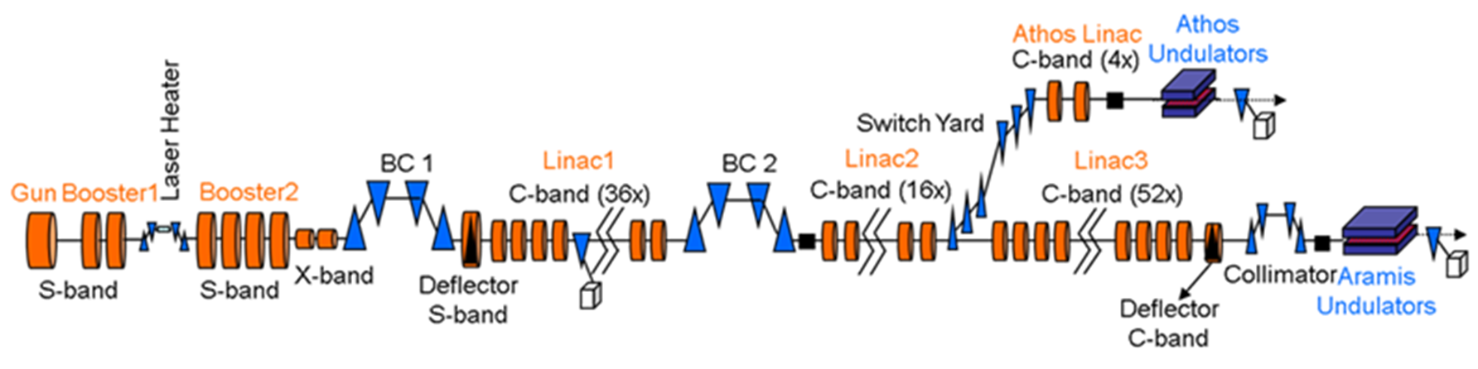
Bunch Compressor Monitors (BCM) in SwissFEL
DBCM
DCDR
Gun:
σ_{z}(10 pC, rms) = 334 μm
σ_{z}(200 pC, rms) = 871 μm
BC1:
σ_{z}(10 pC, rms) = 66.8 μm (C.F.=5)
σ_{z}(200 pC, rms) = 87.1 μm (C.F.=10)
BC2:
σ_{z}(10 pC, rms) = 1.0 μm (C.F.=300)
σ_{z}(200 pC, rms) = 5.7 μm(C.F.=150)
Beam energy: 6.2 GeV and 3.3 GeV
Beam charge: 10-200 pC @100Hz, 28 ns 2-bunch time structure
Emittance: 0.4/0.2 mm mrad
Bunch length: from a 3 ps up to a few fs
Bunch Compression factors (BC1+BC2): ~150 (@200pC) and ~300 (@10pC)
Photon wavelength: 0.1-0.7 nm and 0.7-7.0 nm

Slide 5
BCM in SwissFEL
Bunch Compression Monitors (BCM) for machine operations:
    BC1-DBCM, SINBC02-DBCM410: compression phase stabilization (machine feedback)
    BC2-DCDR, S10MA01-DCDR080: compression phase stabilization (machine feedback)
    EC-DBCM (Aramis Energy Collimator), SARMA01-DBCM030: full compression monitor after the EC chicane and before the injection into the Aramis undulators
BCMs for special applications:
    BC1-DCDR (SINDI02-DCDR065): used as test-bench of detectors
    BC2-DBCM (S10BC02-DBCM410): equipped with an FIR spectrometers and MCT detector array (liquid nitrogen cooled,100Hz acquisition, not so fast to resolve the 2-bunch 28 ns time structure)
BCMs under construction:
    DCDR in the Athos switchyard (dispersion closed region):
        in-vacuum hardware (pneumatic feedthrough+DR screen)+optical hardware+detector aligned and installed; MPS interface ready
        Controls Electronics (pneumatic, monitor filters, detector) to be installed
        Beckhoff electronics for Motion Control and signal ADC to be installed (under development)
        Main bottleneck of the project: construction of VLAN (SwissFEL and SLS2 new Virtual-LAN network infrastructure) needed for a centralized booting of all the Beckhoff servers
    DCDR in Aramis before the chicane of the Energy Collimator (complementary to EC-DBCM):
        in-vacuum hardware (pneumatic feedthrough+DR screen)+optical hardware+detector aligned and installed; MPS interface ready
        installation: second priority w.r.t. the Athos DCDR and conditioned by the VLAN construction

Slide 6
BCM for machine operations
BC1-DBCM (SINBC02-DBCM410):
  BC1: bending-angle 0➔4.6deg, operation setting: 300MeV and 4.1 deg
  Design optimized for bunch lengths of 223 fs (10pC) and 290 fs (200 pC) and to discriminate the 28ns 2-bunch time structure
  Extracted radiation (HRFZ-Si window) split into 2 optical paths equipped with 2 different high-pass filters (0.3 and 0.6 THz, to increase the detection sensitivity) and 2 broadband Schottky diodes (0.3-2THz)
  Monitor sensitivity: from 0.03 deg to 0.07 deg of the off-crest phase of the last 2 S-band structures of the injector (bunch length from 600 fs (rms,200 pC) to 120 fs (rms, 10pC)
Expected spectral distribution for a measured (TDS S-band) bunch length of 120fs (@10pC) and plot BCM signals (0.6THz left, 0.3THz right) vs off-crest phase injector RF structure
F.Frei, R. Ischebeck, Electron Bunch Compression Monitors for short Bunches-Commissioning Results from SwissFEL, Proceeding IBIC2019, Malmoe, Sweden

Slide 7
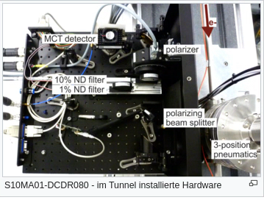
BCM for machine operations
BC2-DCDR (S10MA01-DCDR080):
  Installed in a straight section after BC1 (Energy 2.1 GeV)
  DCDR screen: 1 mm thick titanium foil with hole diameter 4 mm (6 mm hole also available)
  Design optimized for electron bunch length 3-25 fs (rms) and sensitivity to bunch length variation of 8%
  Diamond window + wire grid polarizer+ motorized polarizer for signal attenuation
  Detector: fast Mercury Cadmium Telluride (MCT) for 2-bunch detection and sensitivity for wavelength 2-12 μm
Expected spectral distribution for a measured (TDS C-band) bunch length of 7fs (@10pC) and correlation DCDR signal vs bunch length (TDS) for +/-0.5deg phase variation of LINAC1
F.Frei, R. Ischebeck, Electron Bunch Compression Monitors for short Bunches-Commissioning Results from SwissFEL, Proceeding IBIC2019, Malmoe, Sweden

Slide 8
BCM for machine operations
EC-BCM (SARMA01-DBCM030), Aramis Energy Collimator (EC):
  EC: single bunch @100 Hz, 6.1 GeV, fixed bending angle 1 deg,
  vacuum chamber cutoff of the radiation (<4μm)
  Design optimized for bunch length 0.7-3 fs (10 pC), resolution: 5% of the bunch length
  Detectors:
        Pyroelectric sensor for integrated signal readout
        Spectrometer (Ocean Optics) covering the range 0.9-2.5 μm (bunch-length <3fs)
For bunch length >4fs the spectral region 0.9-4 μm exclusively contains side maxima of the coherent spectrum ➔monitor sensitivity to the shape but not to bunch length change.
Only for bunch length <4 fs the main part of the coherent spectrum is detectable in the spectral region 0.9-4 mm
F.Frei, R. Ischebeck, Electron Bunch Compression Monitors for short Bunches-Commissioning Results from SwissFEL, Proceeding IBIC2019, Malmoe, Sweden

Slide 9
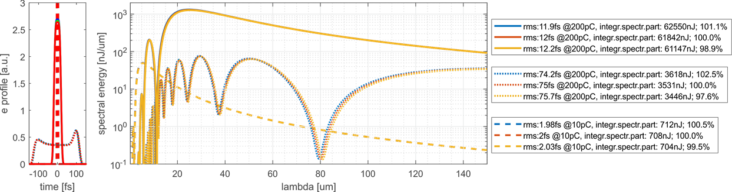
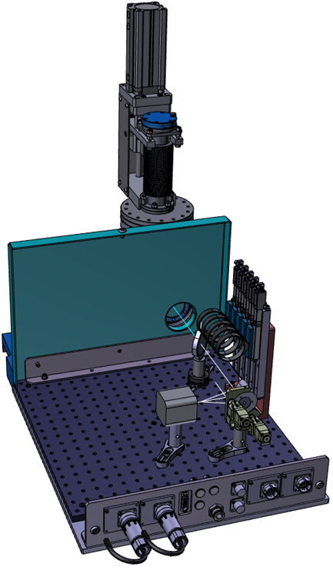
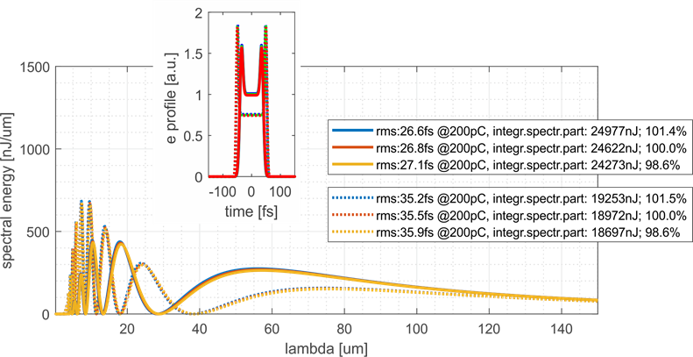
BCM under construction in SwissFEL
Athos switchyard (SATSY03-DCDR050) and Aramis (SARCL01-DCDR105)
  Monitor installed in a region of the switchyard where the dispersion is closed
  Monitor intended to be used not for shot-to-shot feedback but for slow feedback to compensate for drifts
  Designed for bunch length 12-75fs rms @200pC (resolution 1%) and ~2fs rms @10pC (single bunch @100Hz)
  Transmission and detection covering 2-100 μm: diamond window, pyroelectric sensor (Phluxi Pyro) and ND filters (no spectrally flat)
  Aramis DCDR is a replica of the Athos one (to be installed before the Aramis Energy Collimator)
Courtesy F.Frei and G. Kotrle

Slide 10
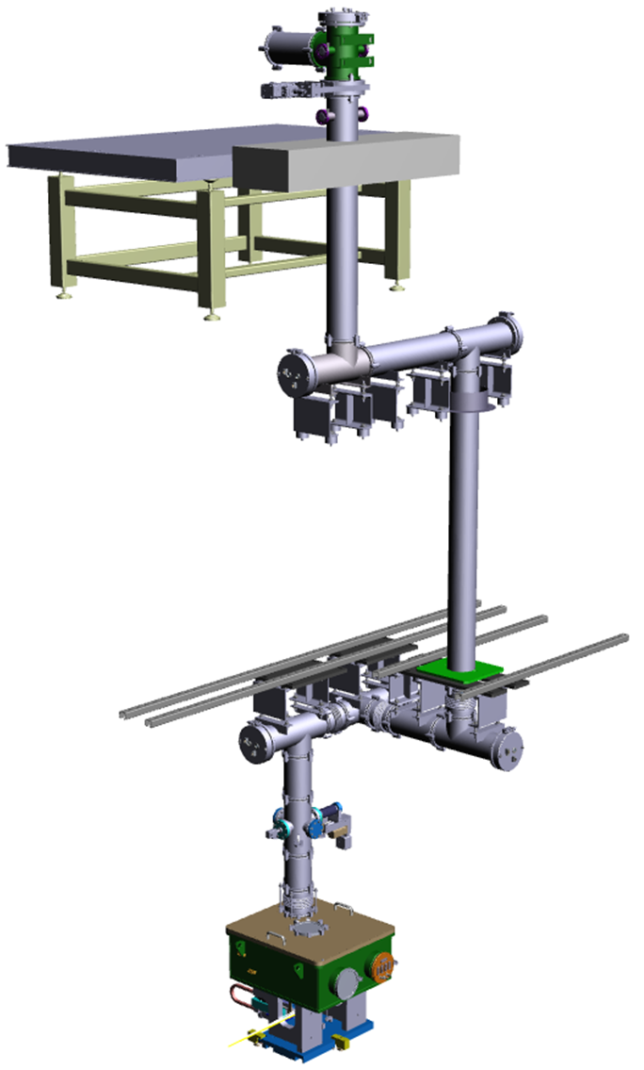
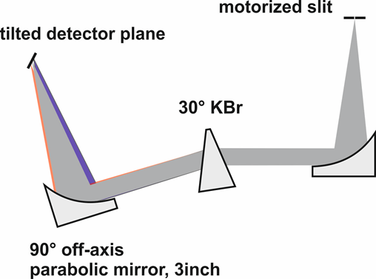
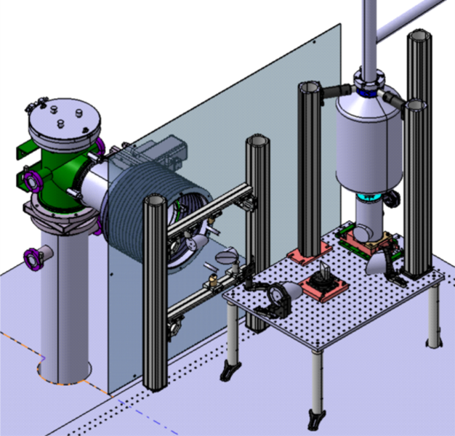
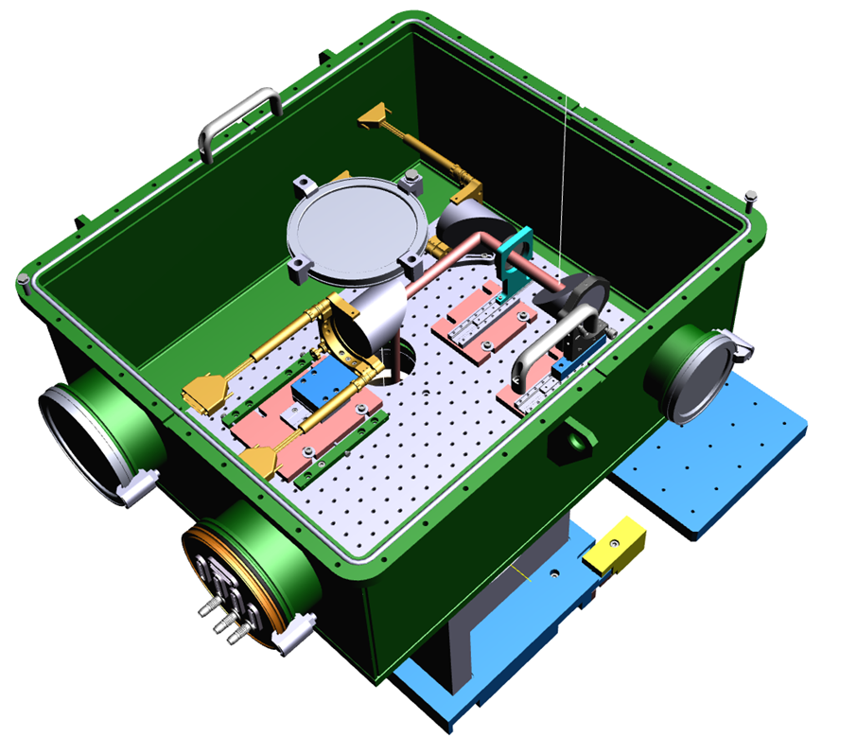
BCM for special applications
BC2-DBCM (S10BC02-DBCM410)
  BC2: bending angle 0➔3.8-deg, operation settings: 2.2GeV and 2.1 deg
  Detector MCT detector array (liquid nitrogen cooled,100Hz, no 2-bunch resolution)
  Complex optical transfer line for the Edge SR from the linac tunnel to the service gallery
  IR spectrometer
Conceptual Design of an IR Prism
Courtesy of F.Frei,

Slide 11
Conclusions and Outlook
  BC1-DBCM (SINBC02-DBCM410) and BC2-DCDR (S10MA01-DCDR080):
    cover the requested dynamic range (charge and bunch length) and resolve the 2-bunch time structure
    fully integrated in the machine feedback and used for the phase stabilization of the compression
    Very stable and reliable, controlled by state-machine code
  EC-DBCM (SARMA01-DBCM030):
    Designed to be a full compression monitor before the Aramis undulator line
    Design optimized for bunch length <3fs (10 pC)
    Monitor operational and equipped with:
          Pyroelectric sensor (signal integration over a large spectral bandwidth)
          Optical fiber spectrometer (operational for bunch length <3fs)
  Athos switchyard (SATSY03-DCDR050) and Aramis (SARCL01-DCDR105) (under construction):
    Designed to cover the full dynamic range (charge and bunch length) of the machine
    Intended to be integrated in the machine feedback (slow drift corrections of the compression phase)
    Aramis SARCL01-DCDR105, placed before the Energy Collimator, as a complement to SARMA01-DBCM030
  BCM equipped with spectrometers:
    BC2-DBCM (S10BC02-DBCM410): IR spectrometer, detector not discriminating the 2-bunch time structure
    EC-BCM (SARMA01-DBCM030): NIR spectrometer (operational for bunch length <3fs, 10 pC)
  Pending Questions:
        How the spectrometer signal analysis can be usefully exploited for routine machine operations?
        For what special machine operations are spectrometers particularly eligible and/or essential?

Slide 12
Wir schaffen Wissen – heute für morgen
Many thanks to:
F.Frei
A. Alarcon
M.Baldinger
K.Bitterli
T.Humar
R.Ischebeck
N.Kivel
W.Koprek
G.Kotrle
S.Schnabel
V.Schlott
D.Trayer
…and many other colleagues…
Thank you for your attention

