Slide 1
The SwissFEL Bunch Arrival-Time Monitors
Vladimir Arsov:: T&S, Bunch Arrival-Time :: Paul Scherrer Institute
SwissFEL Electron Diagnostics Review Workshop, PSI, 20.10.2021

Slide 2
Requirements and Specifications of the
Bunch Arrival-Time Monitors (BAMs)
Requirements:
High precision (<10 fs rms) arrival-time measurement at selected locations (see next slide) relative to the reference distribution system
Use of the arrival-time information to understand machine drifts, study of jitter sources and as an aid for the machine setup
Use of arrival-time information in feedback systems to stabilize the amplitudes and timings in the machine
Provide arrival-time information for pump-probe experiments
BAM Specifications :
Two channels:
  CH1, “high resolution”, ~1 ps dynamic range
  CH2, “large dynamic range”, ~7 ps dynamic range
  Full dynamic range: up to 300 ps using optical delay-stage
  (required for BC angle changes)
  Bunch timing overlap using a delay stage or a vector modulator ( 7 ns)
Charge range: 10 pC – 200 pC, resolution better than 10 fs over the entire range
Two bunch operation (28 ns bunch separation)
Non-destructive, bunch synchronous, 100 Hz operation

Slide 3
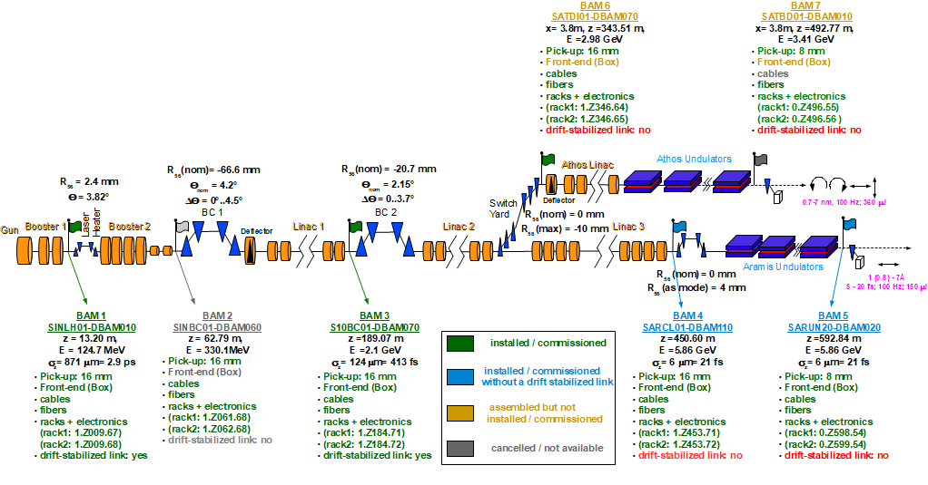
SwissFEL and BAM Locations

Slide 4
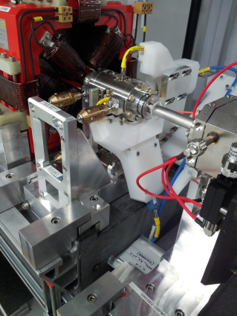
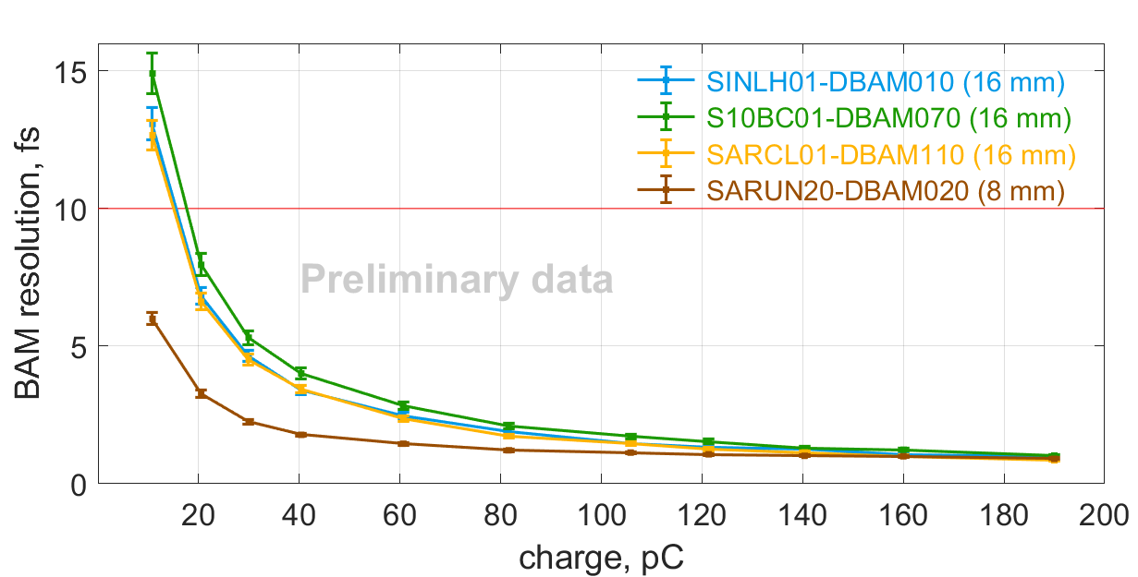
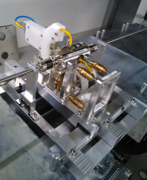
BAM Resolution – Charge Dependence
16 mm beam pipe diam.
~ 1.0 fs @ 200 pC
~ 6.0 fs @ 10 pC
The values are repeatedly confirmed during standard operation
8 mm beam pipe diam.

Slide 5
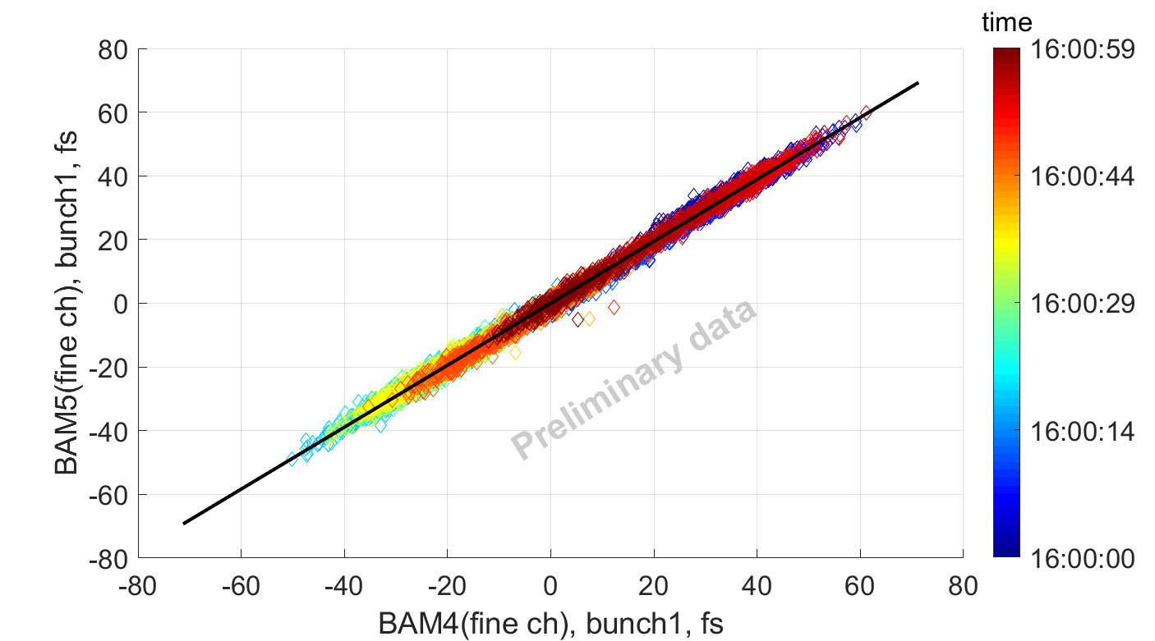
Correlation of two BAMs
Correlation between two BAMS over 1 minute (100 Hz, 6000 pulses, 200 pC):
SARUN20-DBAM020 vs. SARCL01-DBAM110
    Correlation coefficient: R² = 0.9977;
    Correlation width: s_{corr} = 1.7 fs;
    Upper resolution limit of a single BAM: s_{BAM} = s_{corr} /sqrt(2) = 1.2 fs;

Slide 6
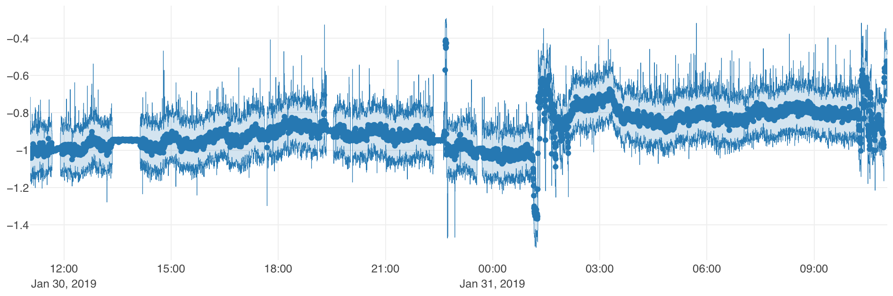
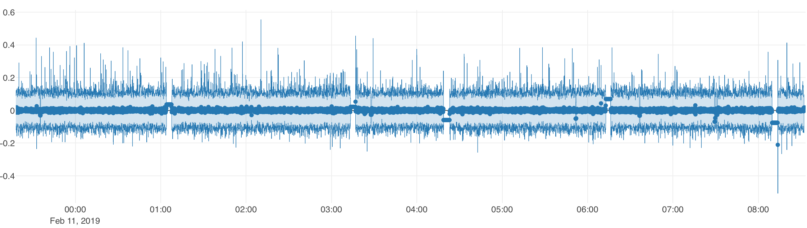
Bunch Arrival-Time Stability
Bunch arrival-time feedback introduced in February 2019:
Uses S10BC01-DBAM070 (“BAM3” at LINAC1, upstream BC2)
1 ps
24 h
9 h
Arrival-time jitter downstream of BC1:
  2019: 35-40 fs rms
  2020, 2021: ~20 fs rms / 5 fs rms after upgrade of master oscillator, improvements to laser lock, and BAM upgrades

Slide 7
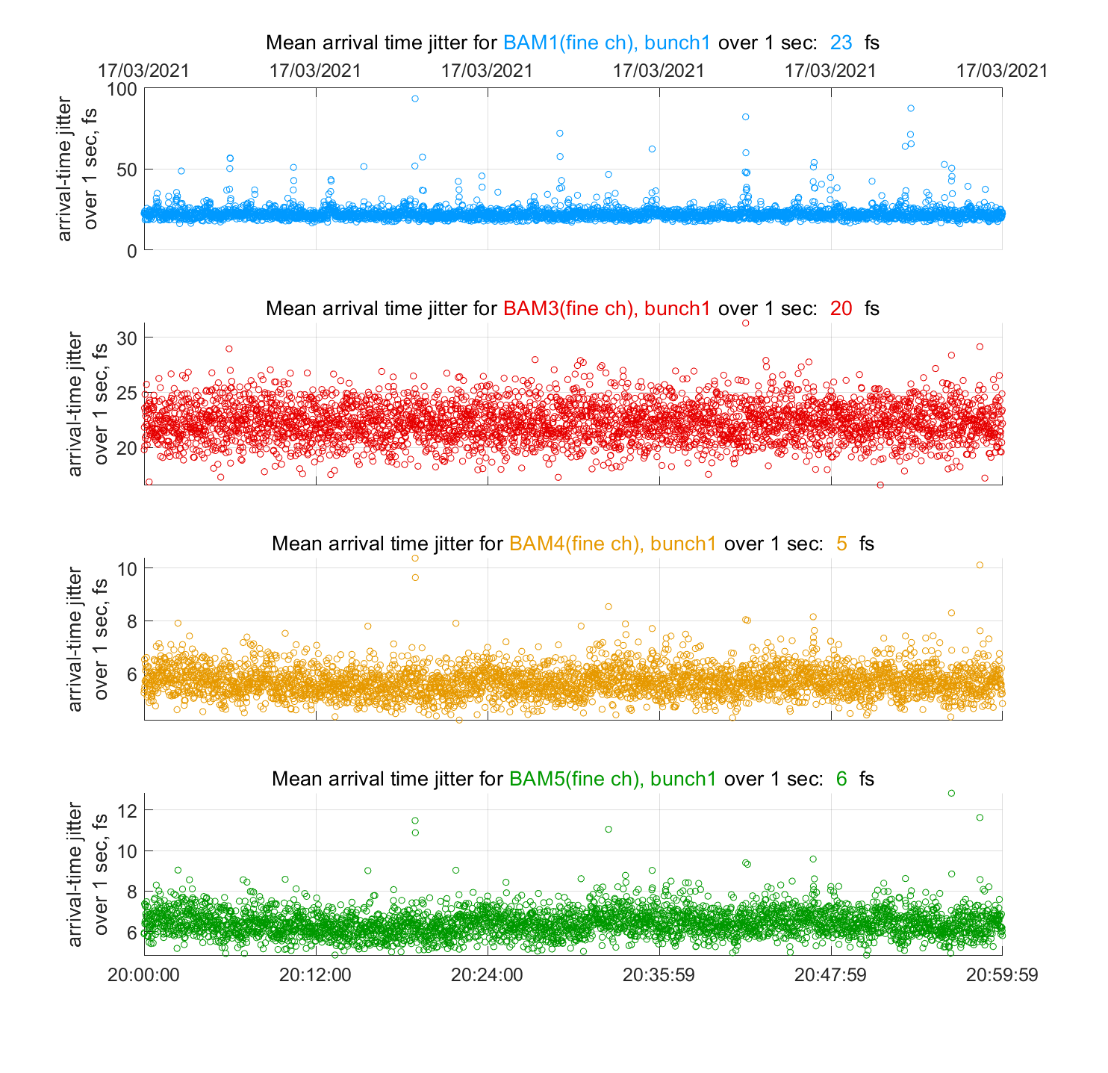
Arrival-Time Jitter
Since Feb.2021 SARUN20-DBAM020 and SARCL01-DBAM110 are referenced to OMO1 (main SwissFEL optical reference)
SINLH01-DBAM010 and S10BC01-DBAM070 are referenced to OMO2 (machine jitter relative to the OMO synchronization accuracy)

Slide 8
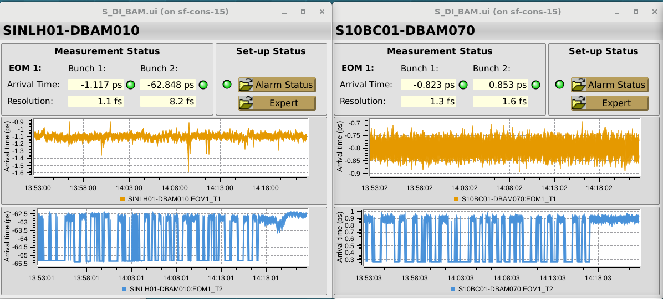
Two Bunch Operation: Current Status
B1: 100 Hz
B2: 25 Hz
B1, B2: 100 Hz
Current implementation and difficulties:
Bunch specific triggering of the HW, but the data processing for the two bunches is not de-coupled (work in progress)
  Problematic if different machine rates are applied
Cross-talk from bunch-1 to bunch-2 when both bunches are present
  Wake-fields from bunch-1 cause a systematic offset for bunch-2
  This offset is constant for fixed conditions for bunch-1 (e.g. charge, orbit)
  Is a concern only for the BAMs which “see” both bunches (Laser-Heater, Linac-1)

Slide 9
Re-cap
Requirements:
High precision (<10 fs rms) arrival-time measurement at selected locations relative to the reference distribution system ✓
Use of the arrival-time information to understand machine drifts, study of jitter sources and as an aid for the machine setup ✓
Use of arrival-time information in feedback systems to stabilize the amplitudes and timings in the machine ✓
Provide arrival-time information for pump-probe experiments ✓
  Improvements of the fiber link reference distribution required (to do)
  A re-design of the reference distribution system required (to do)
BAM Specifications :
Two channels:
  CH1, “high resolution”, ~1 ps dynamic range ✓
  CH2, “large dynamic range”, ~7 ps dynamic range ✓
  Full dynamic range: up to 300 ps using optical delay-stage ✓
  (required for BC angle changes)
  Bunch timing overlap using a delay stage or a vector modulator ( 7 ns) ✓
Charge range: 10 pC – 200 pC, resolution better than 10 fs over the entire range ✓
Two bunch operation (28 ns bunch separation) ✓
Non-destructive, bunch synchronous, 100 Hz operation ✓

Slide 10
    Thank you for your attention!

