Slide 1
Diagnostics for HERO
Pavle Juranić :: Staff Scientist :: Paul Scherrer Institute
17.10.2021, SwissFEL Diagnostics Review

Slide 2
Outline
What is HERO?
Requirements
Tests, design
Outlook and conclusion

Slide 3
What is HERO?
ERC grant: Hidden Entangled and Resonating Orders.
Undulator(s) for e-beam/laser overlap to create new FEL modes and bunch/pulse structures for exploring and discovering new material properties.
From the website:
. . . aims to uncover "hidden" quantum properties in known materials, meaning properties which could not be seen by methods employed up to now. The scientists also plan to design new materials displaying specific quantum effects. Such effects could be of use for data processing, transmission and storage in the future and thus become the backbone of future electronics, which need to be faster, smaller and more energy-efficient.

Slide 4
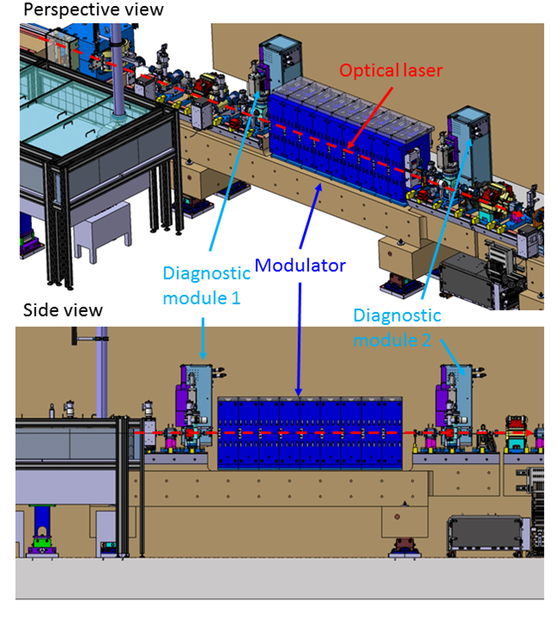
HERO working parameters
Central Wavelength | Duration ( fs rms) | Pulse energy (mJ) | Laser beam dia. at diagnostic module 1/2 (mm) 2xσ/FWHM | Electron beam diameter 2xσ at diagnostic module 1/2 (μm) | Electron beam energy (GeV)
784-816 nm | 100 fs | 0.1-5 | 0.94/1.10 1.10/1.23 | 52 - 59 | 2.6 – 3.4
261-272 nm | 100 fs | 0.05-0.5 | 0.51/0.54 0.60/0.64 | 52 - 59 | 2.6 – 3.4
Budget ~ 95 kCHF
Important design driver

Slide 5
Requirements: spatial overlap
Desired requirement | Concept | Likely outcome
Non-destructive monitoring of laser beam | Holey Cromox screen | May cause losses, may restrict function to just 1 Hz.
Destructive position measurement of electron and laser beam | Standard DSCR screens | Destructive position measurements of electron and laser beam
Spatial resolution of 5 um | Standard camera setup for DSCR screens | Size resolution of about 20 um, position resolution (finding a center) should be better.
DSCR screen is an existing, standard solution at SwissFEL to visualize the electron and laser beams, like at the laser heater. The only difference is addition of one more screen position and a stepper motor instead of a pneumatic stage.

Slide 6
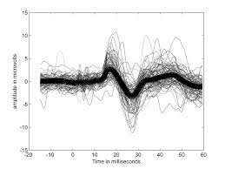
Requirement: temporal overlap
Need to find relative temporal overlap to within ± 500 ps for e-beam and for all of the possible laser/UV beams.
Concept:
Reflecting surface (polished)
E-beam/laser beam
OTR/laser
Window Flange
Oscilloscope
PMT

Slide 7
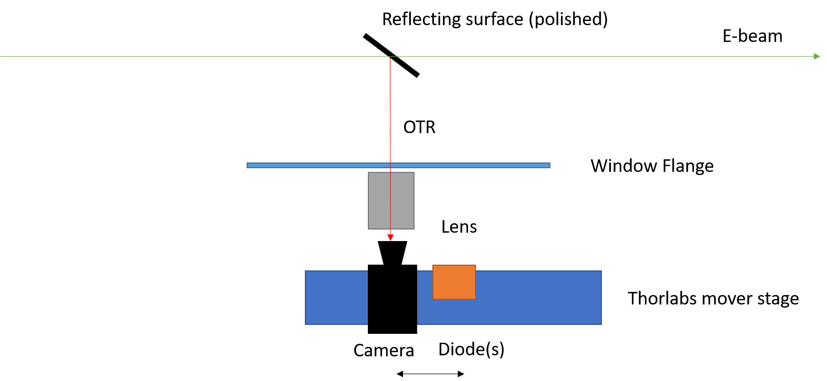
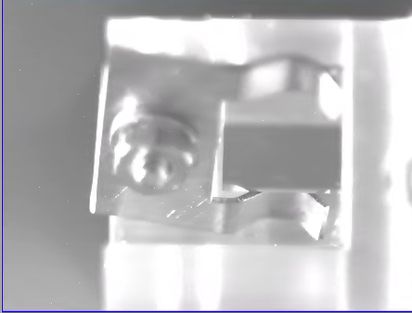
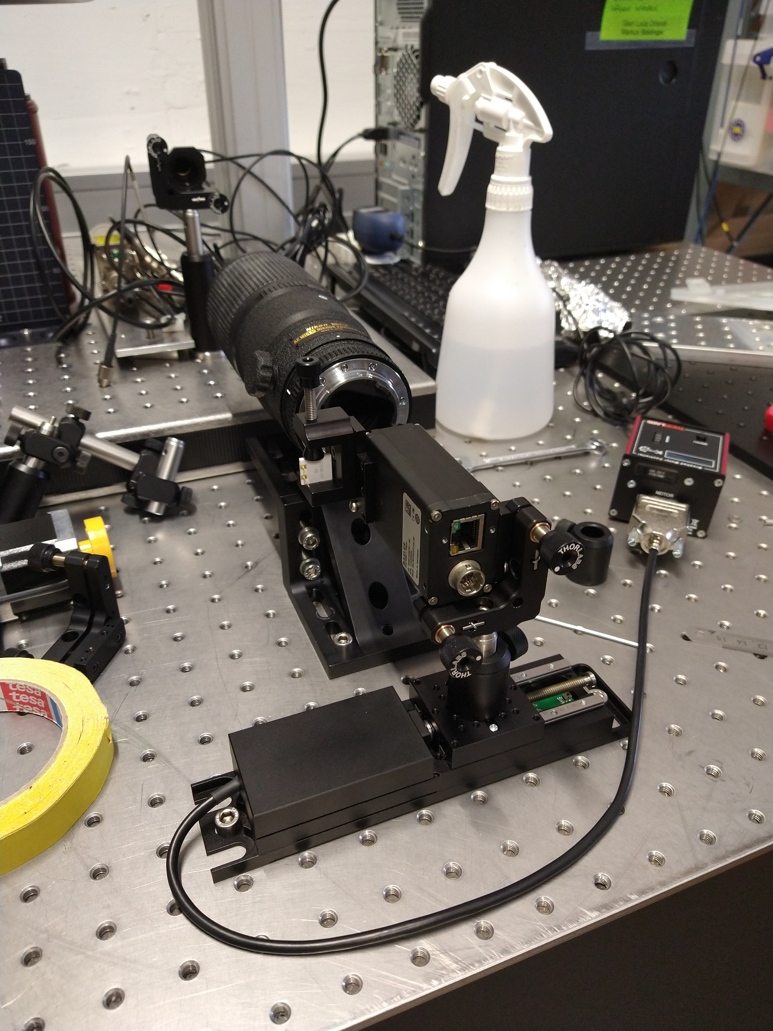
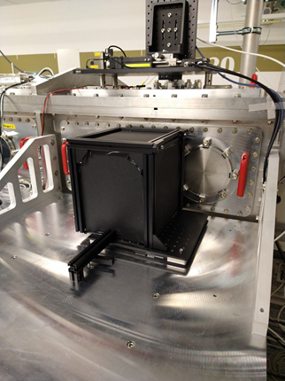
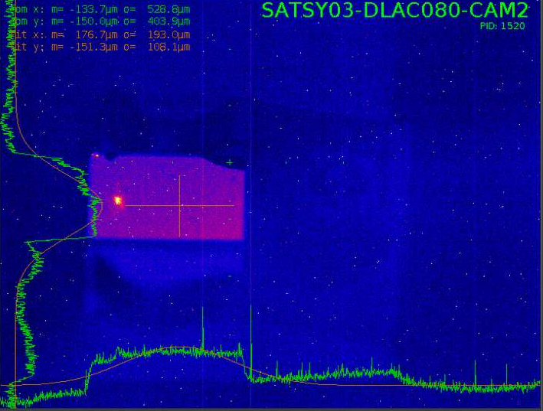
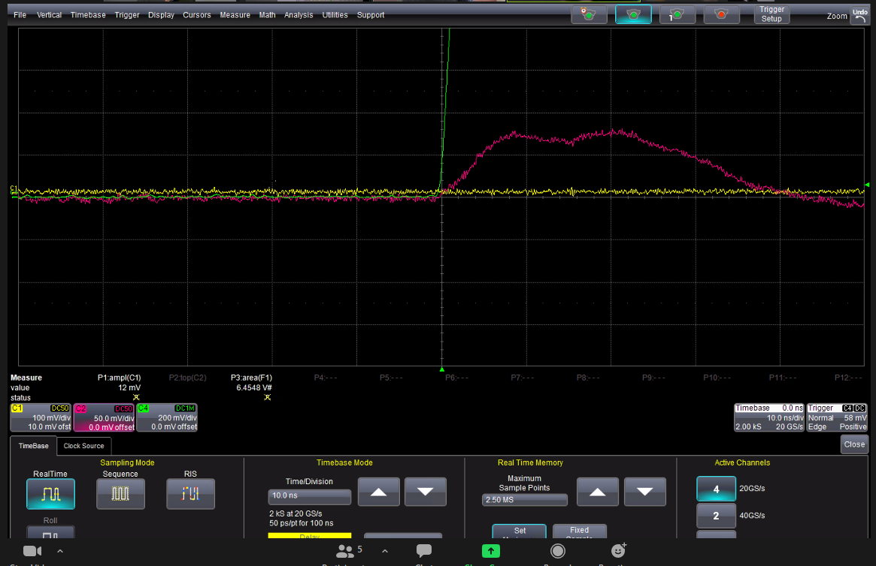
OTR signal tests in ACHIP chamber

Slide 8
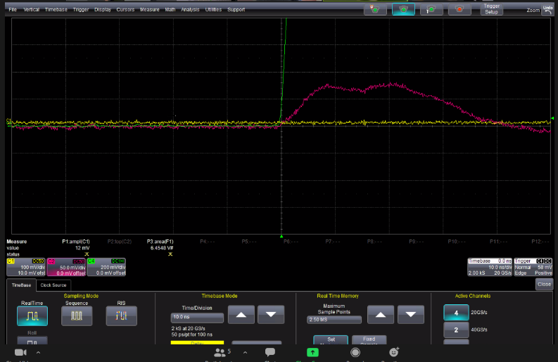
PMT timing tests with laser and UV light
Set up 800 nm or UV light to shoot at the PMT, used an Alfalas diode for the ‘trigger’ signal.
Set up a ‘delay’ measurement on a 4 GHz, 20 Gs/second scope to measure time between trigger and half-height of the PMT signal.
Repeated measurements for several different PMT gain settings. Laser power always set to ‘low’.
Unit | s
value | -2.75E-09
mean | -2.75E-09
min | -2.93E-09
max | -2.72E-09
sdev | 7.36E-12
num | 3.32E+04
7-8 ps standard deviation on arrival time measurement with over 30k pulses for 800 nm.
UV light yields about 17-20 ps std.
If OTR similar to 800 nm, it should be similar performance.
OTR

Slide 9
HERO Diagnostic concept
Timing box:
H10721-01-02 PMT, connected to C10709 power supply (Hamamatsu)
Special window to accommodate all frequencies.
Diag 1
YAG
Cromox
Al Mirror
HERO Modulator
Diag 2
YAG
Cromox
Holey Cromox
e-beam
Camera box 1:
Standard DSCR (50023.24.982) box
For Yag and Cromox
Camera box 2:
Standard DSCR (50023.24.982) box
For Yag and Cromox

Slide 10
DSCR

Slide 11
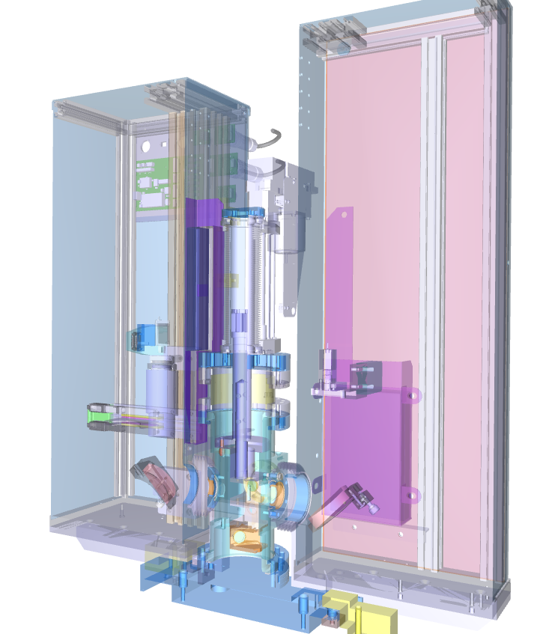
DSCR+timing
Seed Laser Lab
DSCR
Power supply
Manual operation
Oscilloscope
PMT
Ce: Yag (electrons)
Cromox (laser)
Al-coated Si (OTR mirror)
Mirror

Slide 12
Timeplan
November 2021: putting all components together, test motors.
February 2022: Alignment on the girder with other components, along with laser-based alignment.
April 2022: Installation in the SwissFEL tunnel, final alignment and commissioning with laser & e-beam.
Later in 2022: same for the HHG seeding undulator.

Slide 13
Outlook and conclusion
Expect about 20 um spatial resolution.
Should get better than 50 ps temporal resolution, if all works well.
Design seems robust, compatible with current PSI available tools and standards.
Future possible upgrades could be a better-resolution setup (see DSCR talks) and other timing diagnostics.

Slide 14
Wir schaffen Wissen – heute für morgen
My thanks go to
Rasmus Ischebeck, Peter Klopfer, Romain Ganter, Markus Baldinger, Marc Brugger, Andreas Dax, Alexandre Trisorio, Carlo Viccario, Eugenio Ferrari, and the HERO project team.

