Slide 1
Porthos
A Third Beam Line for SwissFEL
Rasmus Ischebeck, Thomas Schietinger

Slide 2
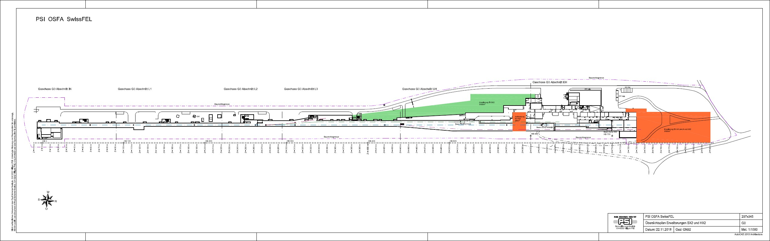
SwissFEL space reservations
In the original construction zoning provisions for both additional soft- and hard-X-ray line
Second soft-X-ray line
Porthos
Thomas Schietinger (PSI)
Porthos Machine Working Group – Kickoff Meeting 18 August 2020

Slide 3

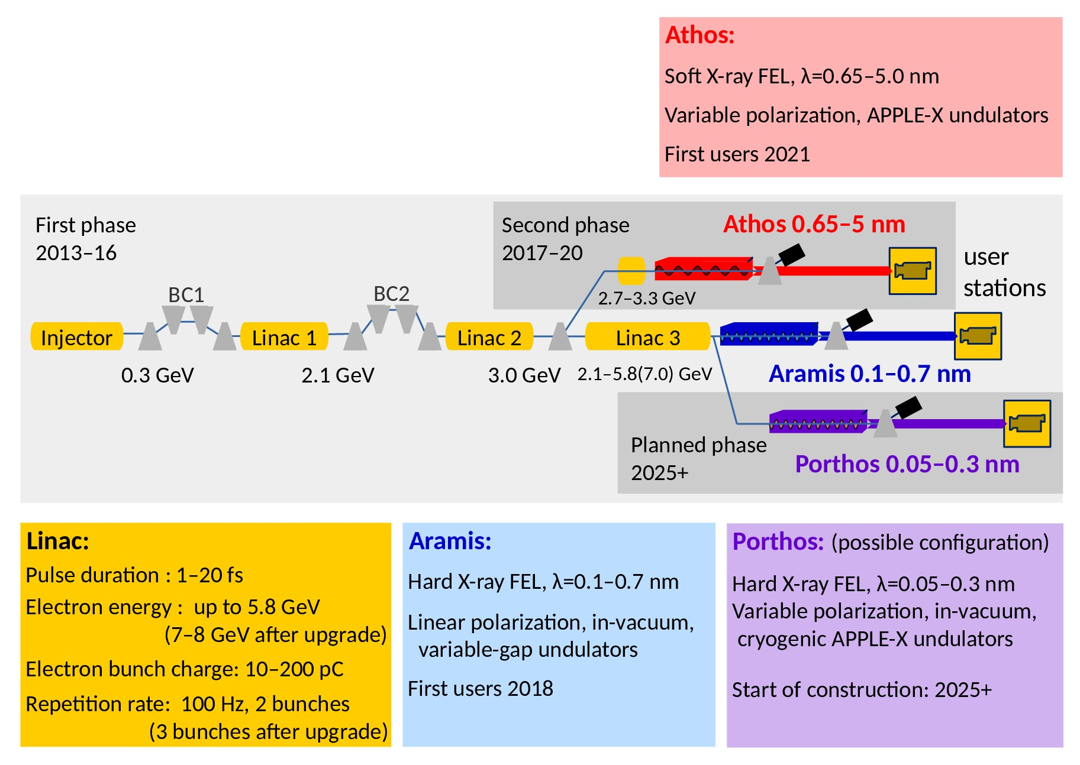
Porthos within SwissFEL
S. Reiche
Thomas Schietinger (PSI)
Status Report of the Porthos Machine Working Group, 27 April 2021

Slide 4
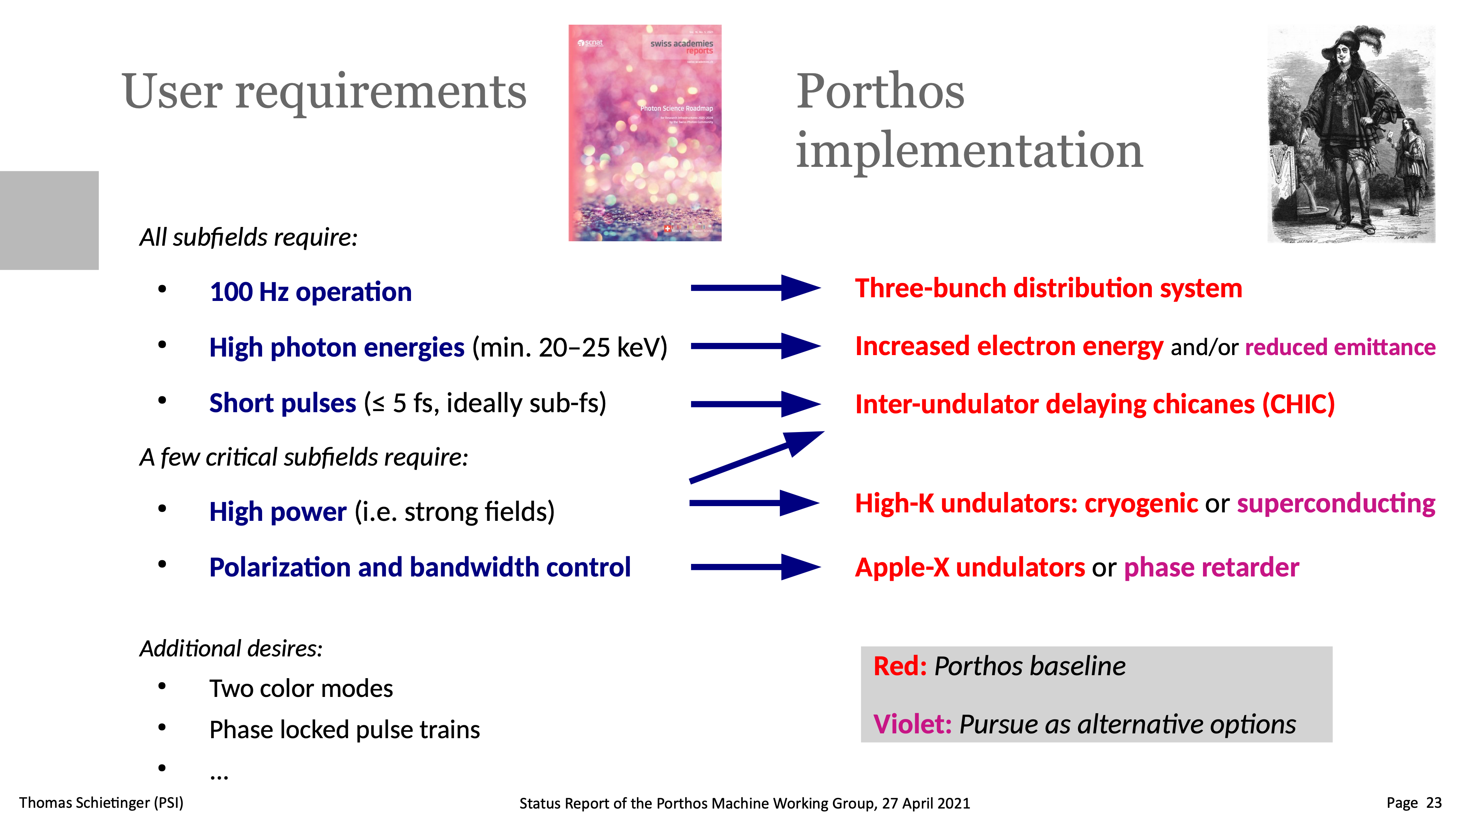
4

Slide 5

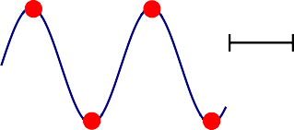

Resonant kicker upgrade options
Bunch spacing / allocation | Bunch placement at first kicker | Topology |  |  |  | Actual layout (schematic)
28 ns | 28 ns AR PO | Kicker: Half period & nominal beam energy | DA |  |  | Kicker: Half period & nominal beam energy |  | DA
Status quo with four bunches, all on-crest | AT DA | 28 ns @3 GeV | 56 ns @3 GeV AT 56 ns @6 GeV |  | AR | 28 ns | 56 ns @3 GeV | AT 56 ns | AR
 | 0° 180° 360° 540° |  |  |  | PO | @3 GeV |  | @6 GeV | PO
21 ns, fast kicker | 21 ns AR PO |  | DA |  |  |  |  | DA
Status quo with four bunches, but faster kicker | AT DA 0° 180° 360° 540° | 21 ns @3 GeV | 42 ns @3 GeV AT 42 ns @6 GeV |  | AR PO | 21 ns @3 GeV | 42 ns @3 GeV | AT 42 ns @6 GeV | AR PO
14 ns, inflection Using inflection points at zero crossings to go straight. | 14 ns AT AR _{DA} PO 90° | 28 ns @3 GeV + high. harm. | DA AT | 28 ns @6 GeV | AR PO | 28 ns @3 GeV + high. harm. |  | DA AT 28 ns @6 GeV | AR PO
Thomas Schietinger (PSI)
Status Report of the Porthos Machine Working Group, 27 April 2021

Slide 6
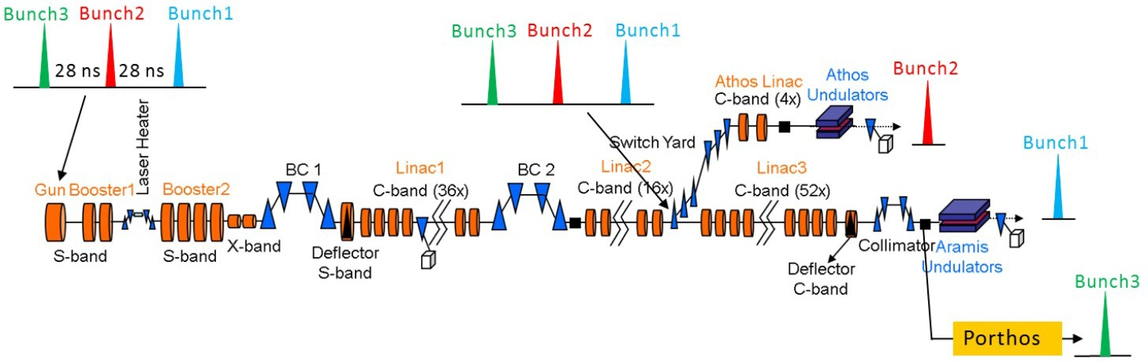
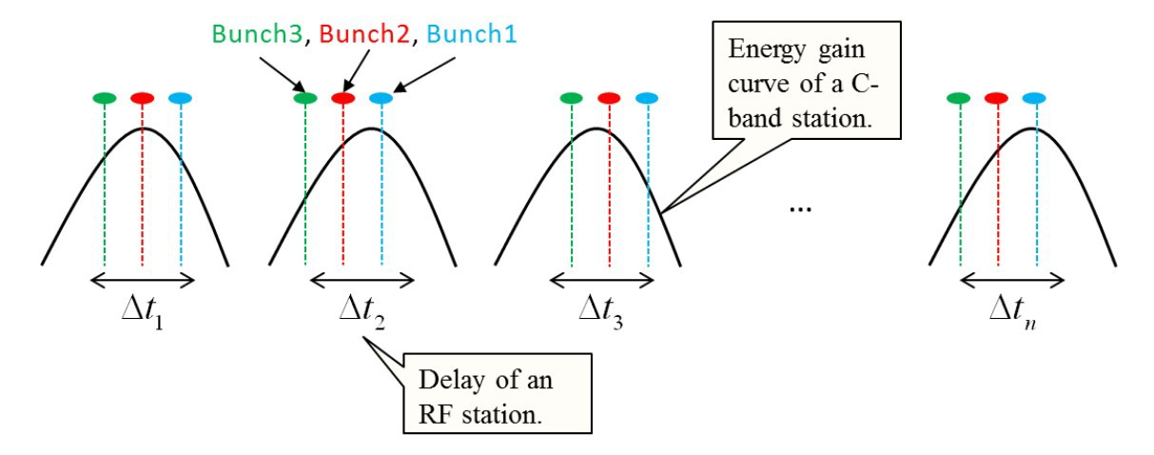
Low-level RF scheme for three bunches
Z. Geng
Expected energy loss (C-band overall), as a function of bunch spacing:
28 ns
–200 MeV
21 ns
–129 MeV
14 ns
–73 MeV
Porthos baseline
Thomas Schietinger (PSI)
Status Report of the Porthos Machine Working Group, 27 April 2021

Slide 7
RF upgrades I: injector/linac-1
Option A: S-band upgrade
(Preferred option for RF section)
Energy gain: +360 MeV Estimated cost: 2.6 MCHF
150 MeV
690 MeV
SINSB05+ SINXB01
660 MeV
E = 1110 MeV
SINSB03+
SINSB04+
BC1
SINDI01
S10CB01
S10CB02
S10CB03
SINEG01 SINSB01 SINSB02
Upgrade SINSB03/04, new station SINSB05:
X-band upgrade to cope with higher compression energy?
⇒ BD simulations needed...
No changes after BC1
New 3-m structures (FERMI type, 30 MV/m) S-band BOCs
180 MeV per S-band station
(1 HV modulator/klystron serving two structures)
●
●
PSI drawing
No. 2R-393601 (2019)
●
Option needs further study!...
Thomas Schietinger (PSI)
Status Report of the Porthos Machine Working Group, 27 April 2021

Slide 8
RF upgrades I: injector/linac-1
Option B: S-band and C-band upgrade
Energy gain: +480 MeV Estimated cost: 4.1 MCHF
E = 1230 MeV
(Preferred option for beam dynamics team)
150 MeV 330 MeV
SINSB03+ SINXB01
310 MeV
BC1
SINDI01
SINCB01
SINCB02 S10CB01 S10CB02 S10CB03
SINEG01 SINSB01 SINSB02
Upgrade SINSB03:
Move BC1 upstream by about 22 m
2 additional C-band stations in linac-1
●
New 3-m structures (FERMI type, 30 MV/m)
S-band BOCs
180 MeV from a single S-band station
(1 HV modulator/klystron serving two structures)
●
2 x 240 MeV = 480 MeV additional beam energy
Stay at current acc. gradient for klystron stability (30 MV/m)
●
Compression energy stays at
~330 MeV
No X-band upgrade necessary
Long shutdown!
●
PSI drawing
No. 2R-393601 (2019)
●
●
●
●
Option needs further study!...
Thomas Schietinger (PSI)
Status Report of the Porthos Machine Working Group, 27 April 2021

Slide 9
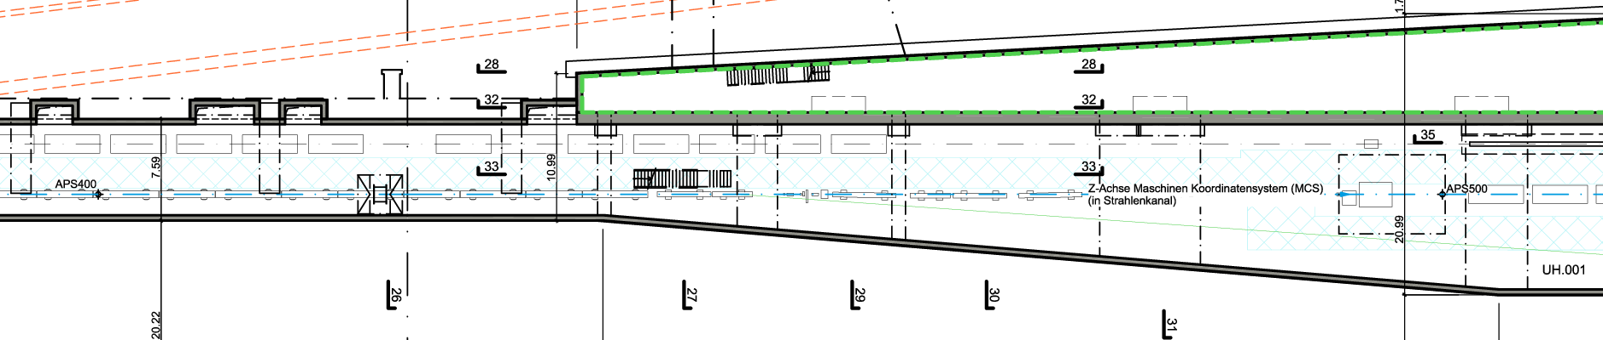
RF upgrades II: linac-3
X-band upgrade
Energy gain: +720 MeV Estimated cost: 10 MCHF
7200 MeV
S30CB12
S30XB01/02/03/04
in sections S30CB13 and 14
X-band linac:
●
4 X-band stations
240 MeV from each station
Use S30CB13–16 spaces in klystron gallery for HV modulators and klystrons.
S30CB14
●
PSI drawing
No. 2R-393601 (2019)
Transverse cavity to be moved to after undulator line
●
●
Some additional cost (not factored in yet)
Thomas Schietinger (PSI)
Status Report of the Porthos Machine Working Group, 27 April 2021

Slide 10
RF upgrades III: Porthos arm
Porthos C-band linac
Energy gain: +960 MeV Estimated cost: 8.2 MCHF (RF)
+ 2.5 MCHF (building)
7200 MeV
8160 MeV
Resonant-kicker–septum complex
S30CB12
S30XB01/02/03/04
in sections S30CB13 and 14
Branch point (~2°)
Second deflection (~2°)
Separating drift
SPOCB01 SPOCB02
SPOCB03 SPOCB04
Porthos C-band linac:
●
4 C-band stations giving 240 MeV each
Stay at current acc. Gradient for klystron stability
HV modulators and klystrons will require extension of klystron gallery!
PSI drawing
No. 2R-393601 (2019)
●
●
Thomas Schietinger (PSI)
Status Report of the Porthos Machine Working Group, 27 April 2021

Slide 11
Porthos Electron Beam Instrumentation
Diagnostics | Estimated time constant | Comments
DBAM
DBCM | ~ 1 ns
DBLM | ~ 5 ns
DBPM
DDRM | ~ 10 s
DICT (Turbo) | ~ 10 ns | readout not compatible with 3 bunches
DICT (Conventional) | ~ 1 µs
DLLM | ~ 1 µs
DSCR | ~ 10 µs
DSRM | ~ 10 ns | with fast camera
DWCM | ~ 10 ns
DWSC | ~ 5 ns | given by BLM

Slide 12
Diagnostics Projects
Overall upgrades: new bunch spacing, 3…4 bunch capability
      BPMs
      Charge measurement
Porthos branch instrumentation
      BPMs
      Compression monitor
      Loss monitors
      Profile monitors
      Laser overlap? —> Probably similar to HERO/HHG: see talk by Pavle
  Other instrumentation
      Positron production (P³) —> See talk by Pavle, Gian Luca and myself
      Plasma wakefield experiment??? —> Still up in the 🌥

Slide 13
Charge Monitors
Need a new system for 3 bunches
Opportunity to re-visit charge measurement in SwissFEL
      Improve stability and reliability
      Provide a solid measurement for BAG
      Provide a precise measurement for beam dynamics and BPM calibration
Choice of pickup
Choice of signal processing, digitization and controls
—> Gian Luca’s talk

Slide 14
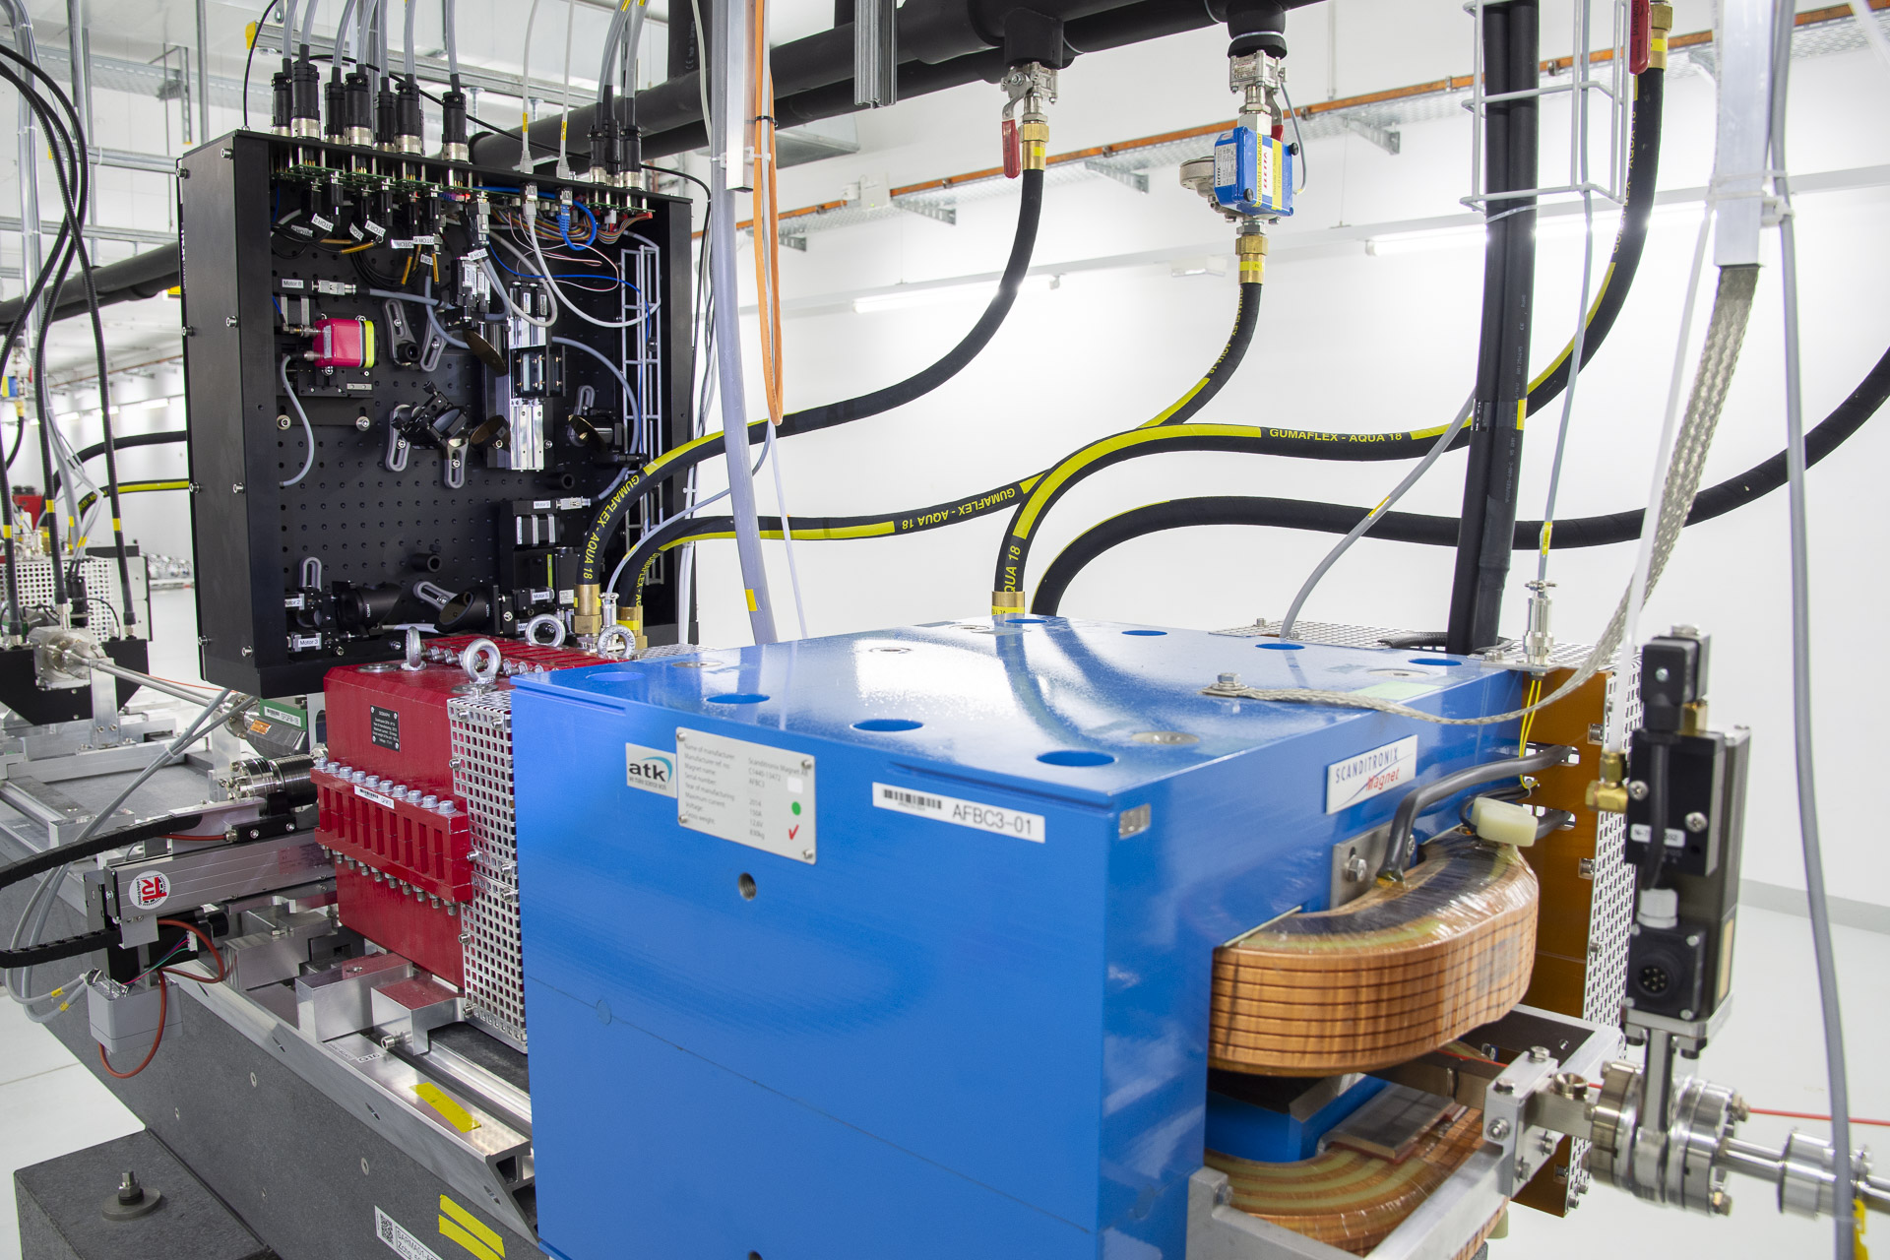
Compression monitor
Measurement of coherent edge radiation
Use single detector or spectrometer?

Slide 15
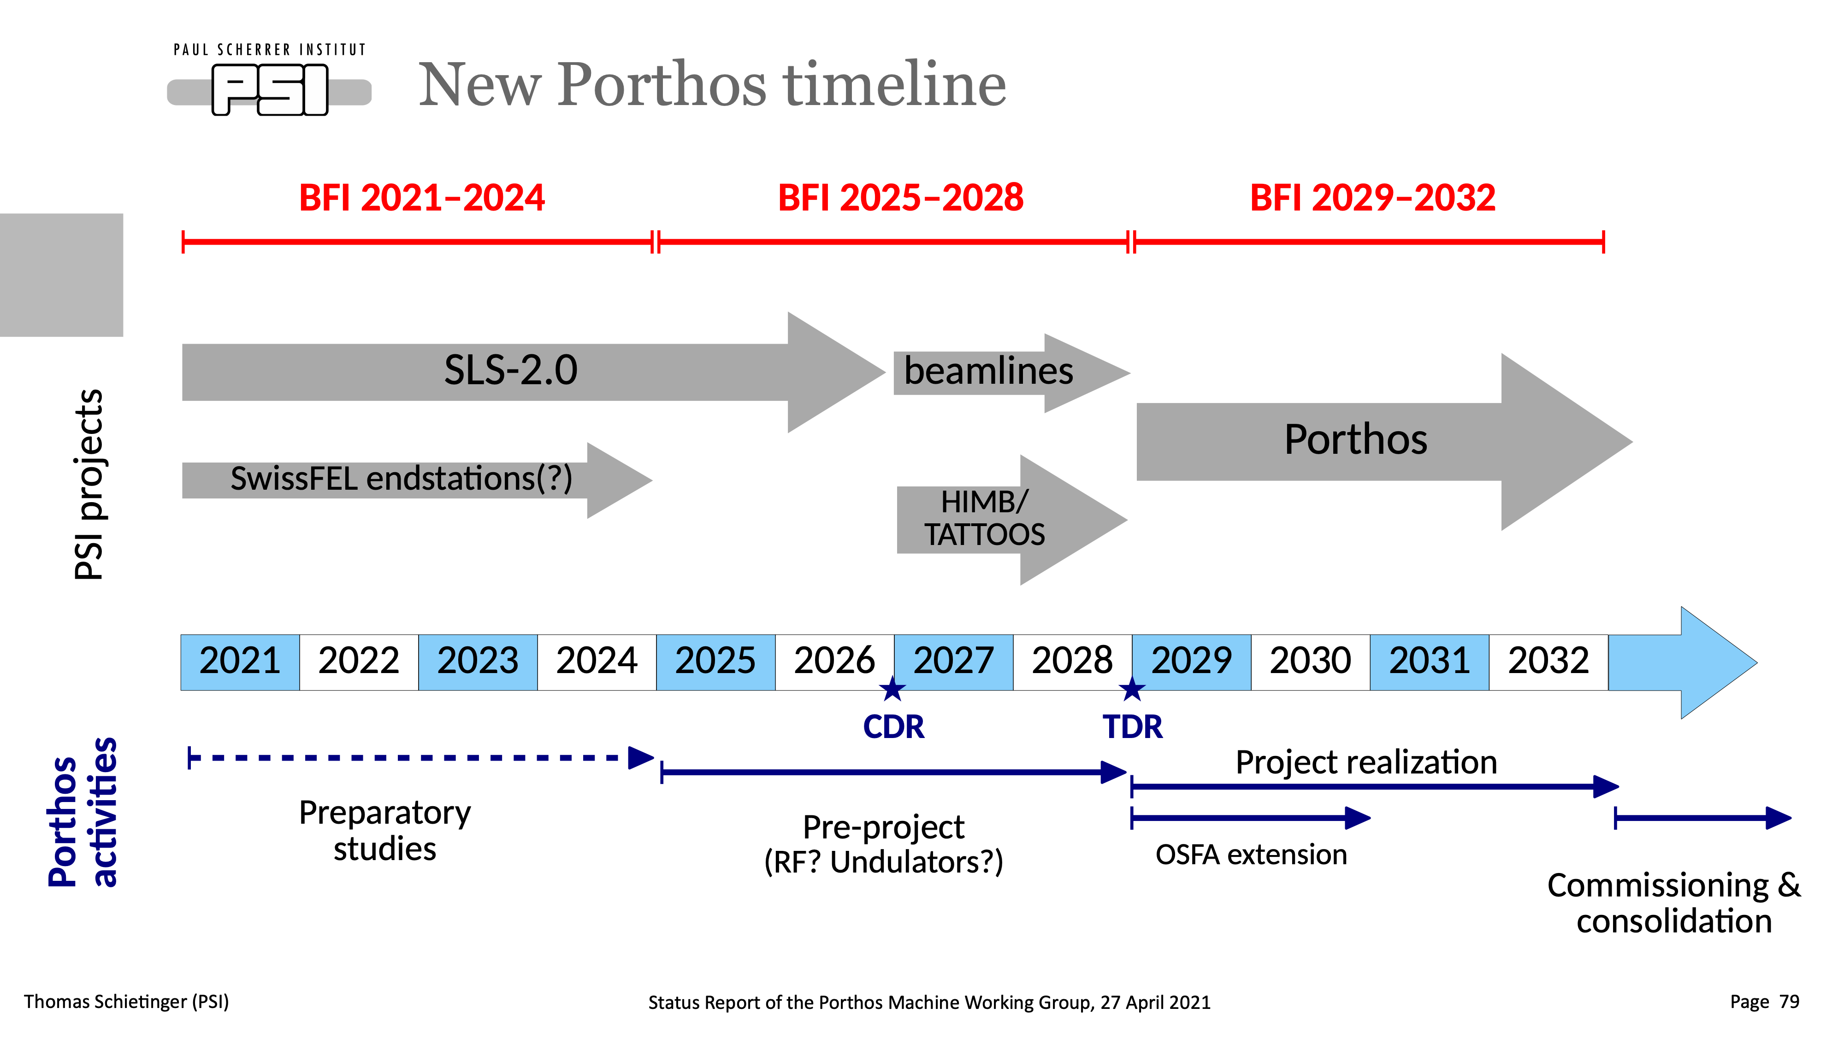
15

