Slide 1
Bunch Length Monitors: Transverse Deflection Structures
(in SwissFEL)
Paolo Craievich on behalf of RF, beam dynamics and operations :: Paul Scherrer Institut
SwissFEL Electron Diagnostics Review Workshop, PSI (Remote), 18-21 October 2021

Slide 2
Outline
Overview of the bunch length and longitudinal phase space measurements
Specifications and performances of S-Band and C-band TDSs
Post undulator passive streaking
PolariX-TDS in Athos
Summary and outlook

Slide 3
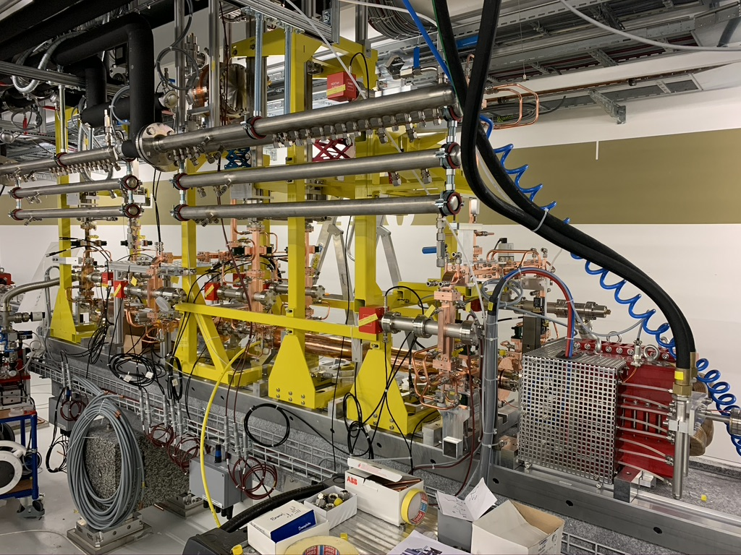
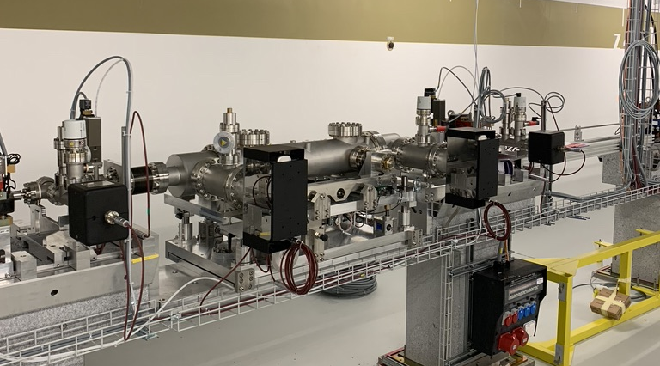
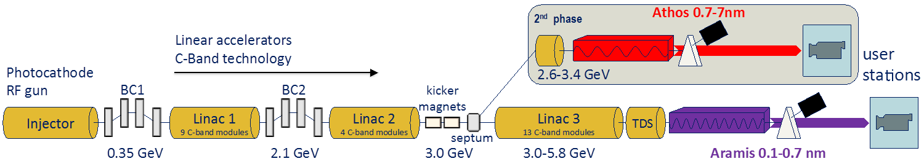
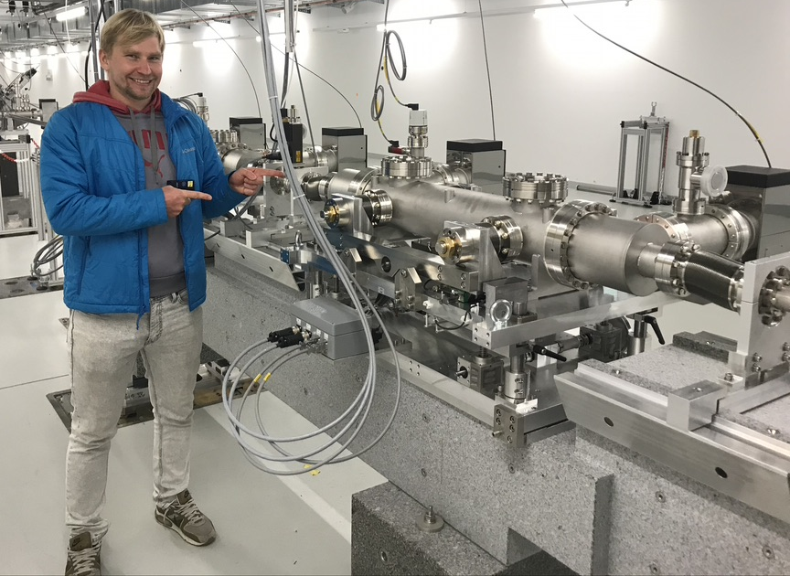
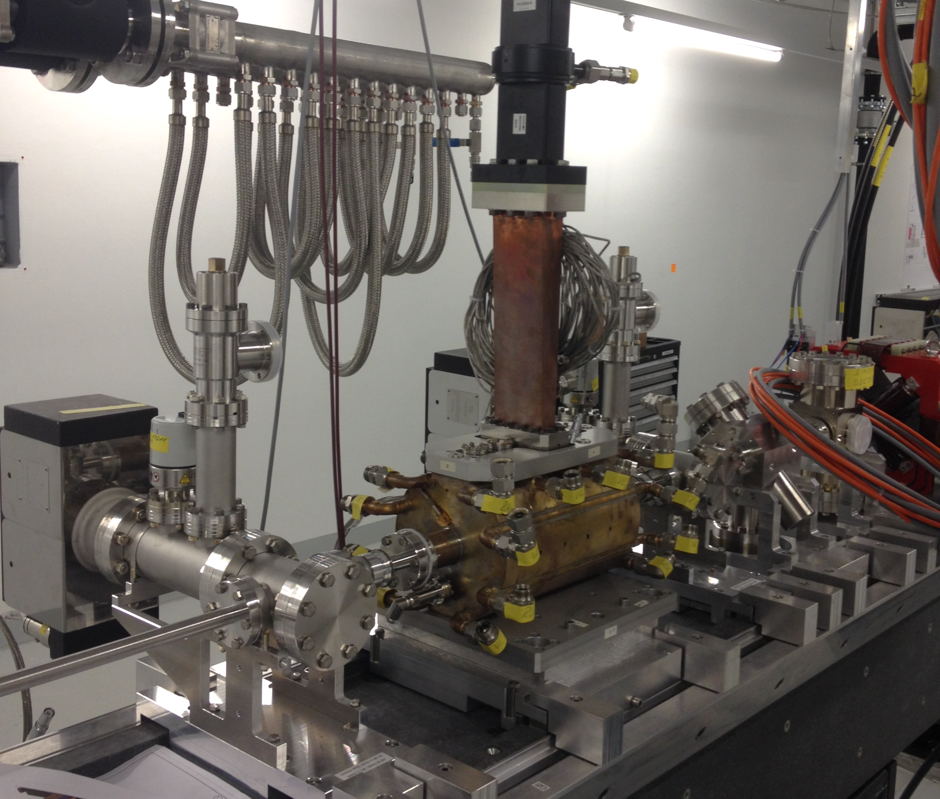
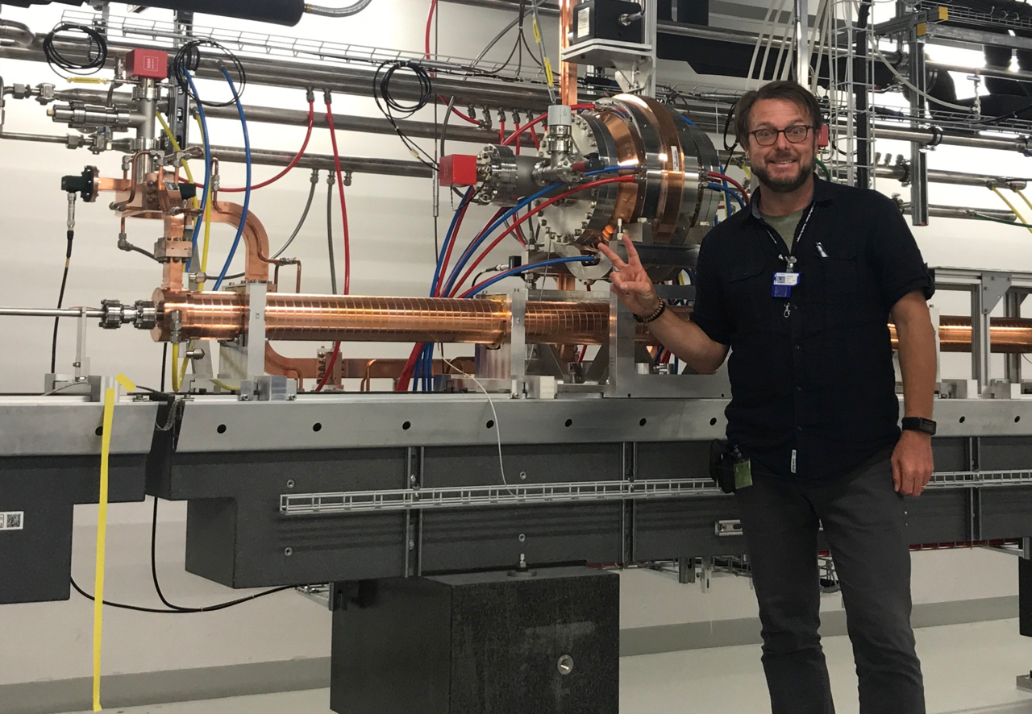
Overview of the bunch length and LPS measurements
Post-undulator passive streaking
PolariX-TDS system
Athos 0.7-5 nm
S-band TDS (5-cell SPARC/FERMI type)
C-band TDS
Post-undulator passive streaking

Slide 4
TDS as diagnostic tools – How we use them
Bunch length measurement (Method capable of fs and sub-fs longitudinal resolution)
Longitudinal charge profile measurement
Combined with dispersive section → longitudinal phase space (LPS) measurement
Combined with quadrupole scan → slice emittance measurement on the plane perpendicular to the streaking direction
Post-undulator (only with passive streaking until now): Measure of the FEL-induced lasing effects imprinted on the electron beam longitudinal phase space

Slide 5
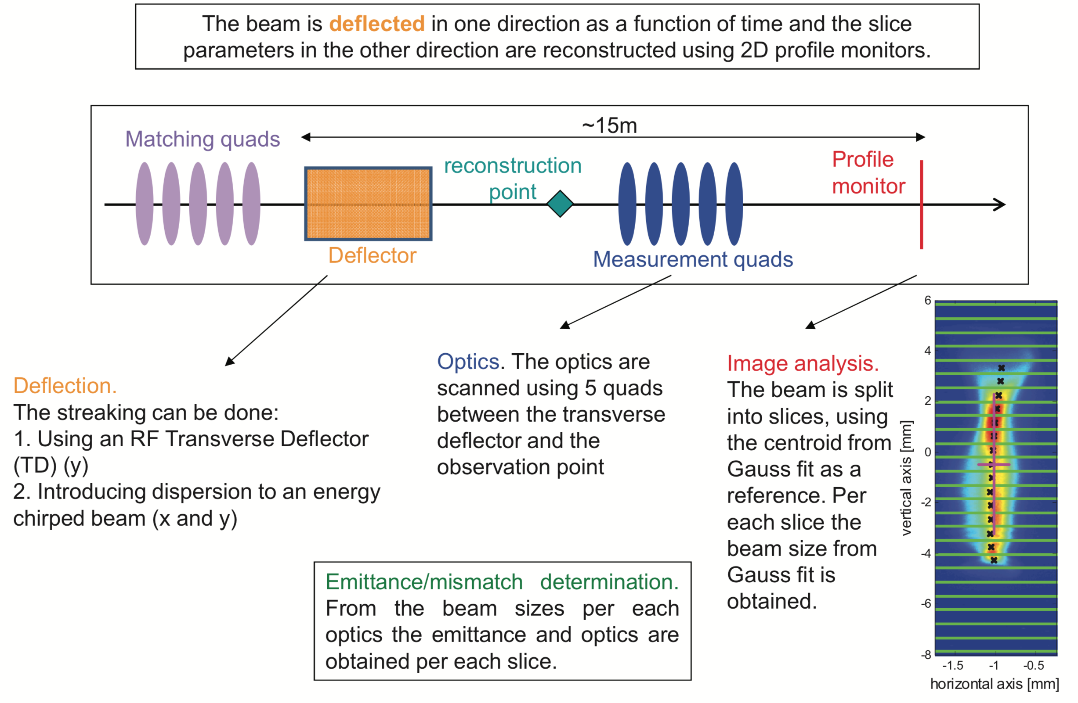
Slice emittance measurements at SwissFEL
Courtesy of E. Prat

Slide 6
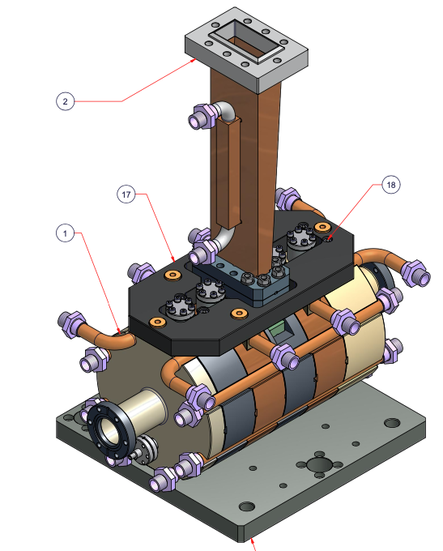
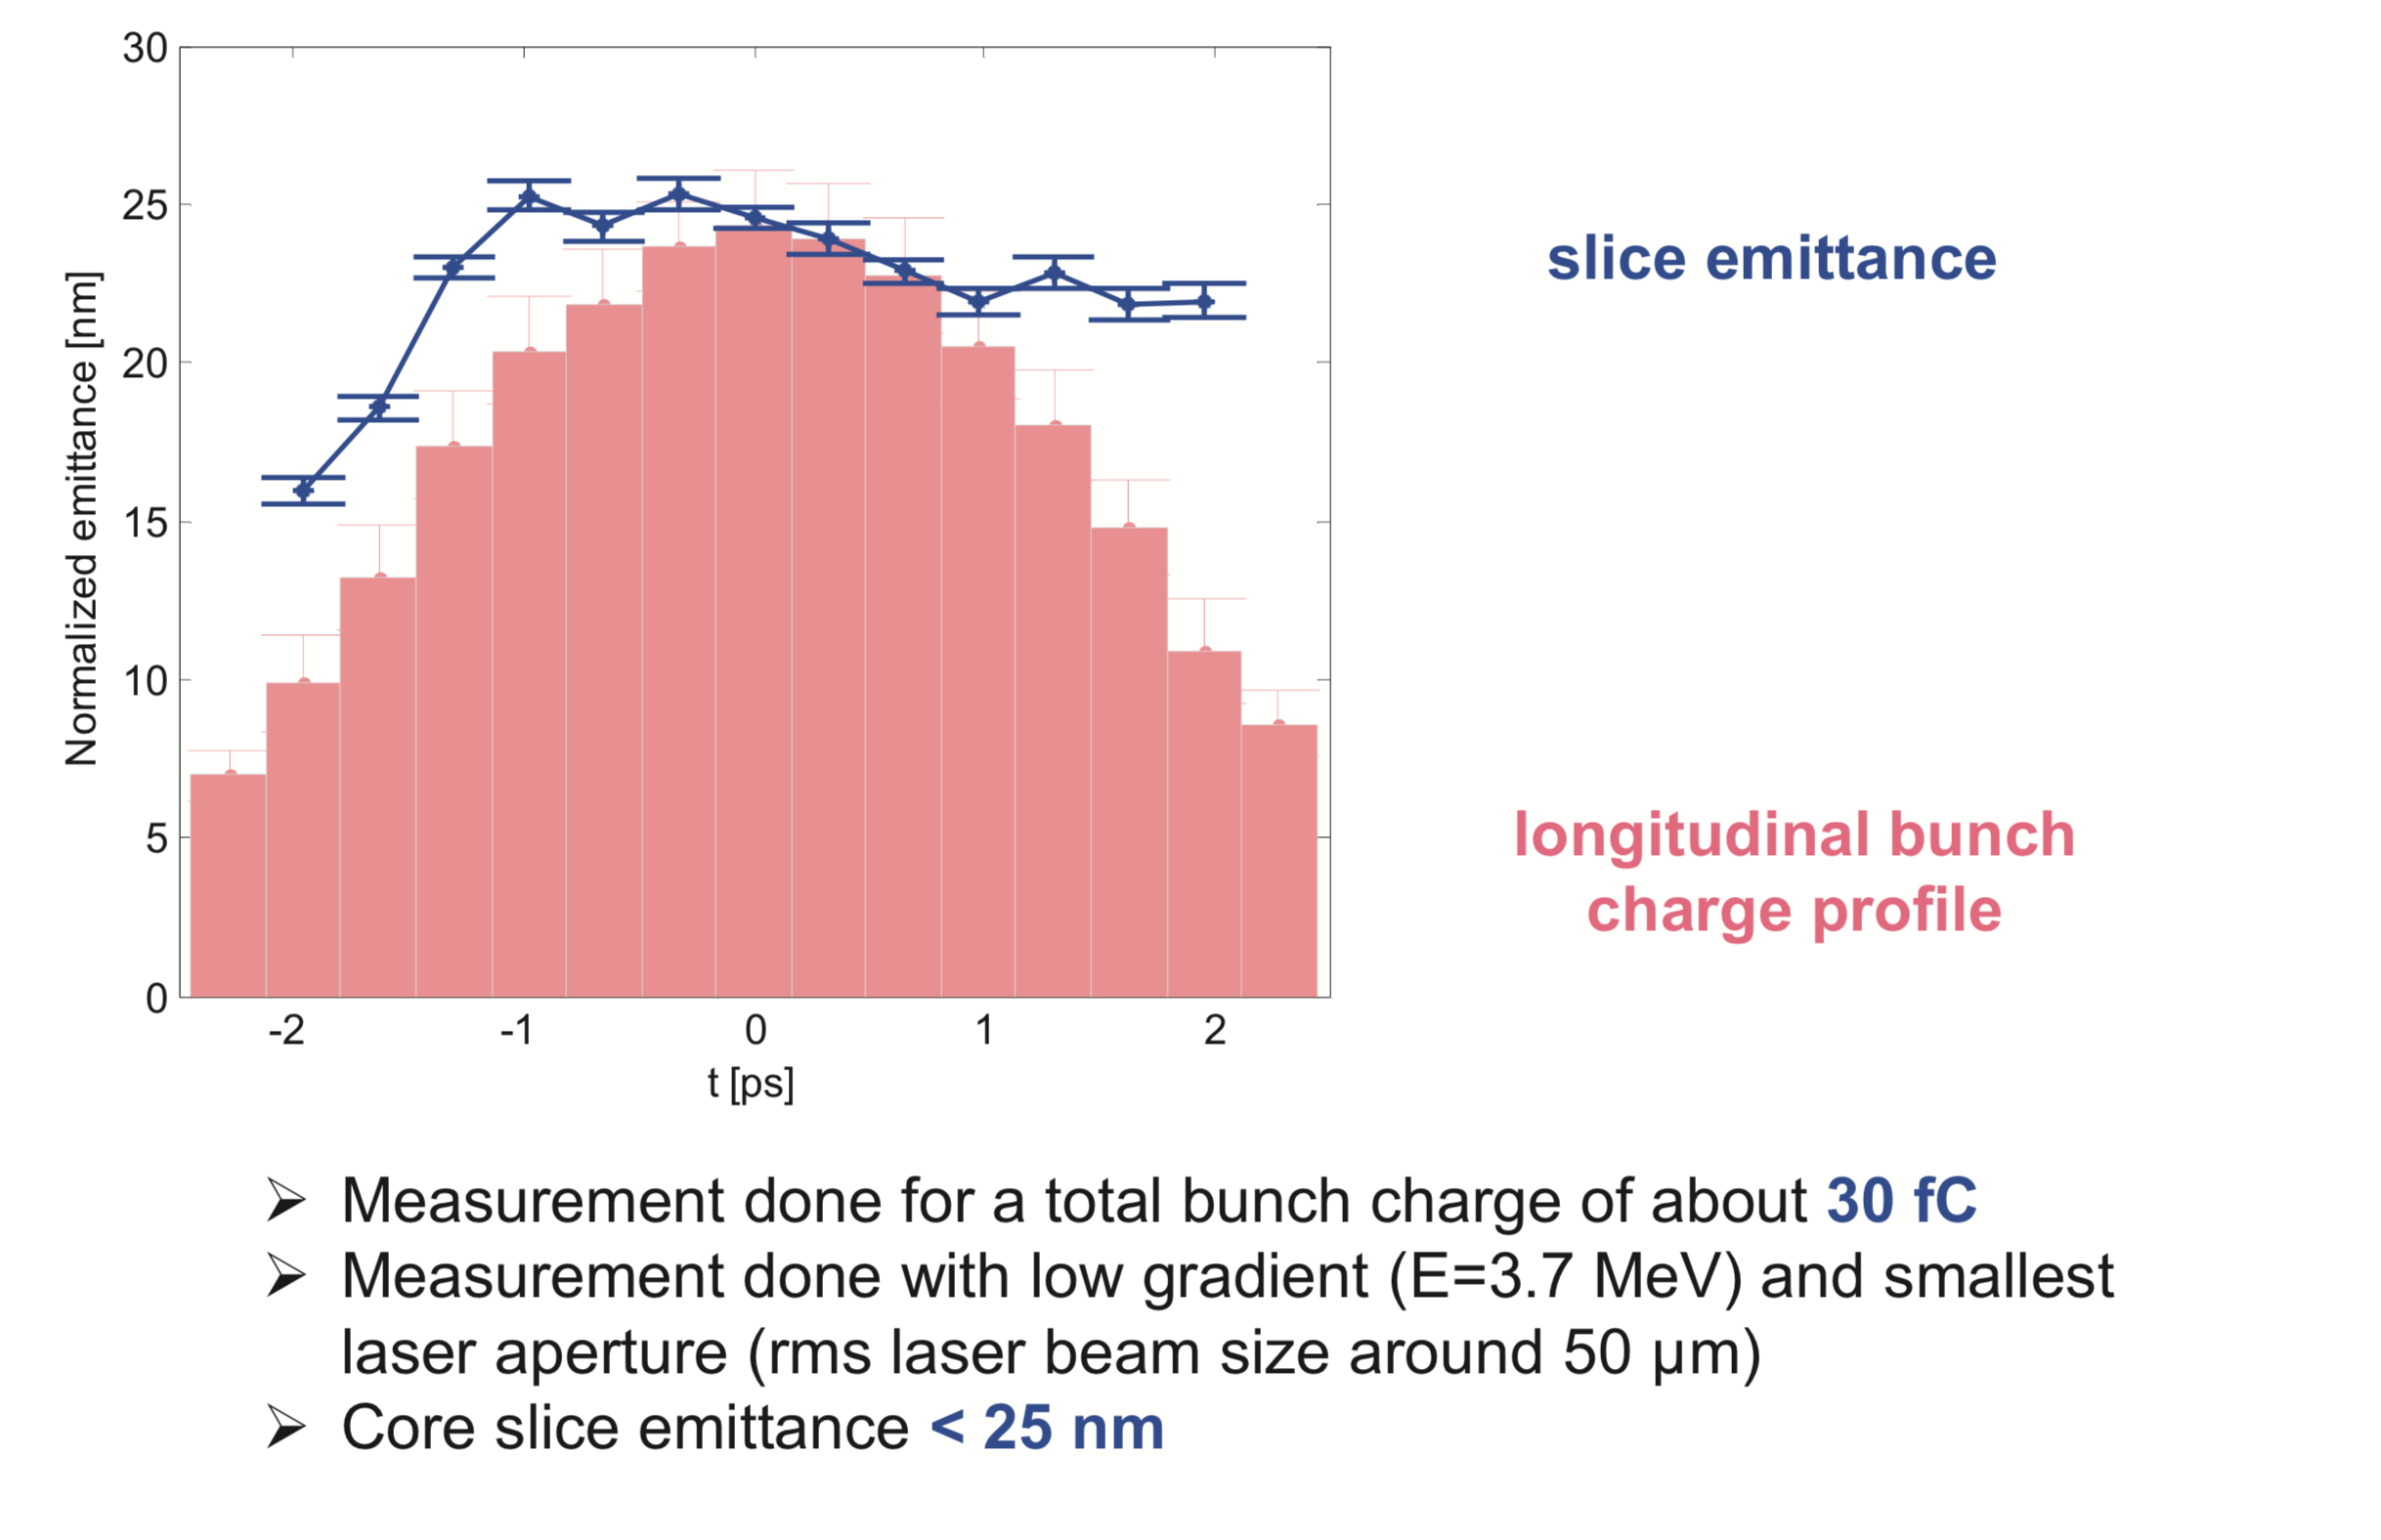
S-band TDS after BC1
RF system: Small scandinova modulator + 7 MW Klystron, 5-cell SW SPARC/FERMI type
Max integrated Deflecting voltage 5 MV, beam energy 300 MeV, Resolution ~10 fs
Essentially used for injector setup after shutdown, slice and energy spread measurements
A deep maintainance will be done in the next shutdown
Smallest measured emittance
Courtesy of E. Prat

Slide 7
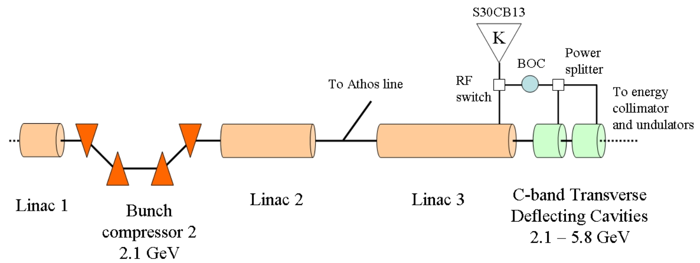
C-band TDS – end Linac 3 (before Aramis line)
ScandiNova modulator with 50 MW Canon klystron shared with the last module in linac 3 using a high power switch (by Nihon Koshua)
2 deflecting structures bought at Mitsubishi Heavy Industries (RF-Deflector developed for SACLA XFEL, H. Ego et al.)
Nominal integrated deflecting voltage 60 MV, beam energy 6 GeV
Characterization of the electron bunch before the undulator chain

Slide 8
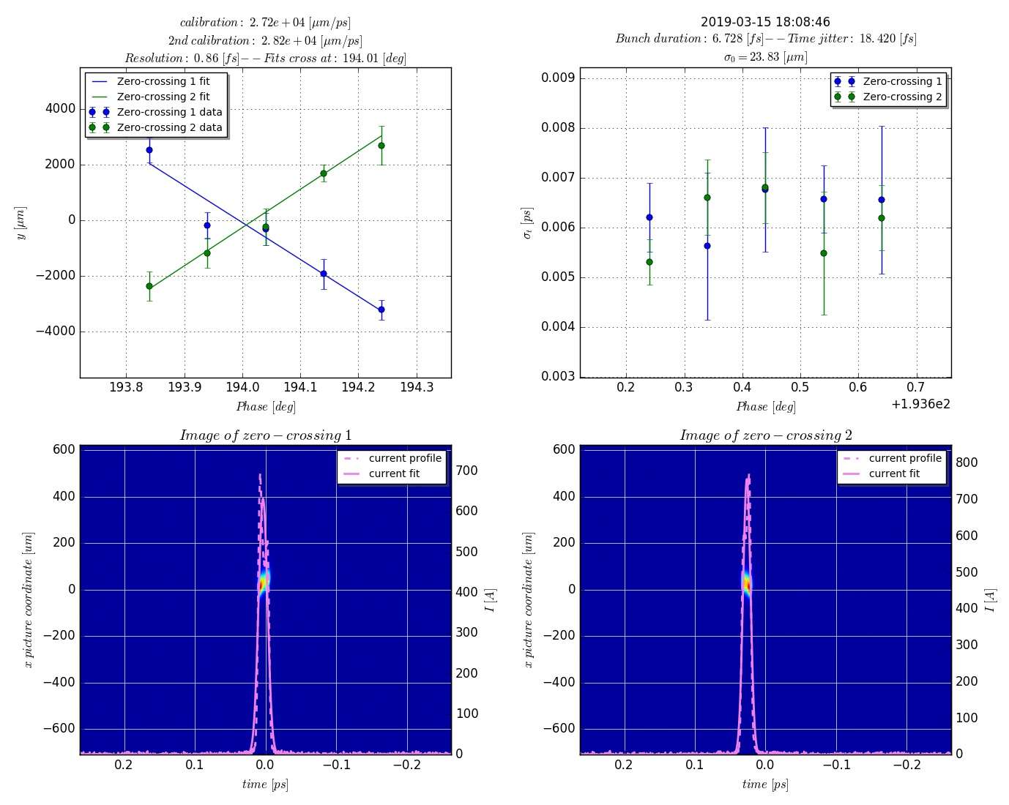
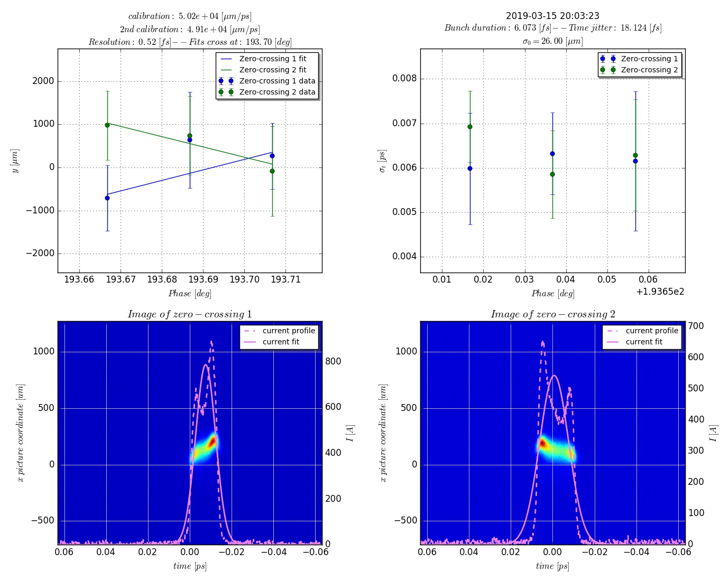
C-band TDS, short pulse and best resolution
Integrated deflecting voltage 83 MV (phase jitter seems to be the limiting factor at this voltage)
Pulse duration at 5.2 GeV: 6.7 fs rms, resolution: 0.86 fs
Pulse duration at reduced beam energy of 3 GeV: 6.1 fs rms, resolution 0.52 fs.
Beam jitter was quite high but after averaging enough we got an acceptable measurement
Resolution 0.86 fs at 5.2 GeV
Resolution 0.52 fs at 3 GeV
link to ELOG

Slide 9
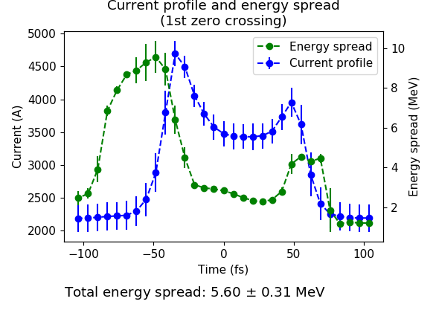
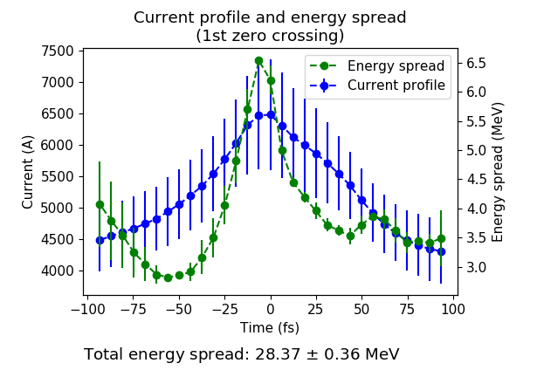
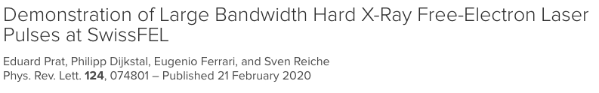
C-band TDS – LPS and slice emittance (two example)
Large-bandwidth mode
Final slice emittance ~250 nm for most of the bunch
Standard mode
FWHM dE/E = 0.15%
LB mode
FWHM dE/E = 1.54%
elog entry

Slide 10
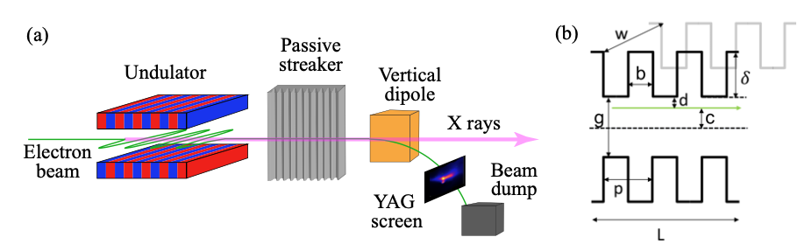
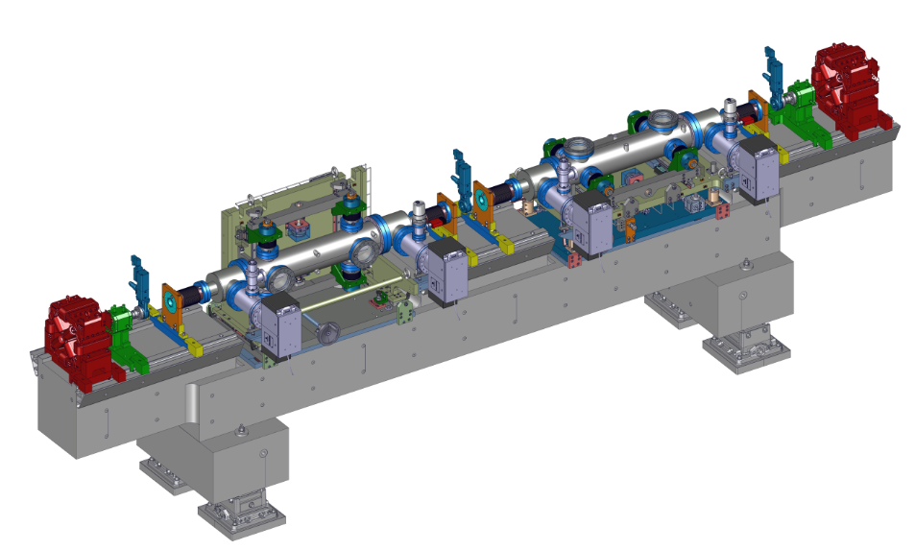
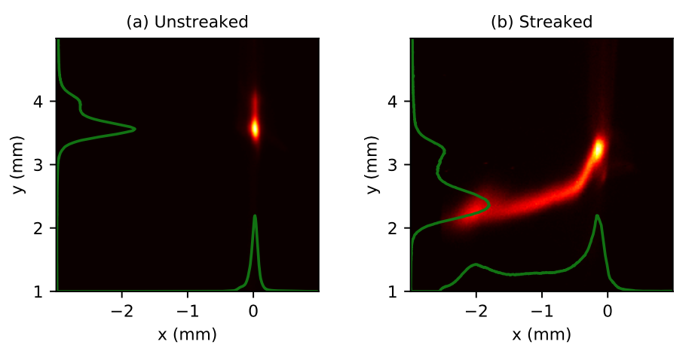
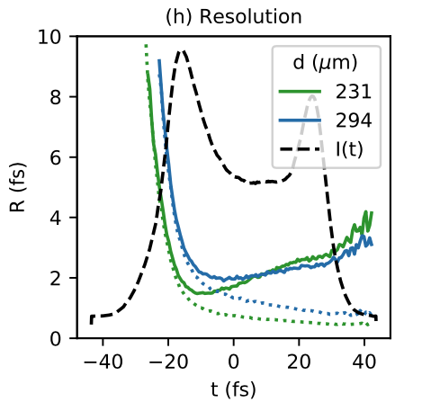
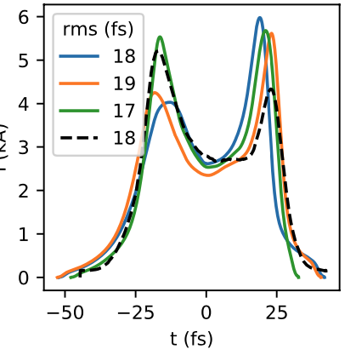
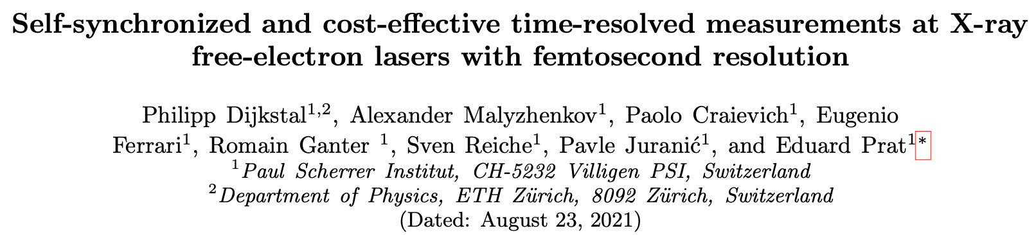
Post-undulator passive streaking (Aramis)
An electron beam traveling off-axis through such a device excites transverse wakefields, resulting in a time-dependent kick that streaks the electron beam.
submitted

Slide 11
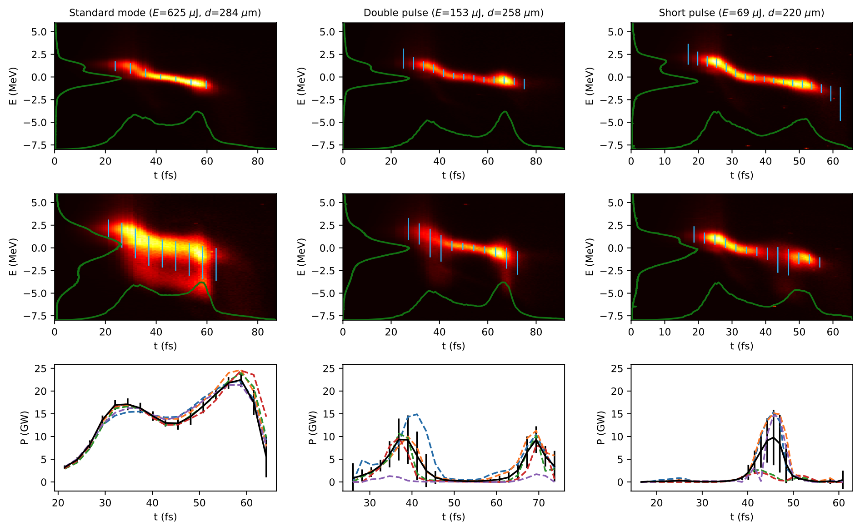
Post-undulator passive streaking – LPS
Single-shot temporal power profile measurement of XFEL pulses with femtosecond resolution

Slide 12
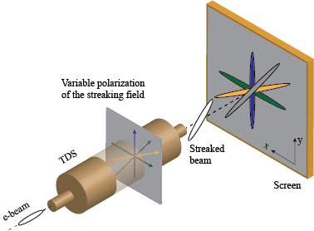
Next generation TDS – ATHOS post undulator
POLARIzable X-band Transverse Deflection Structure – POLARIX TDS
The possibility of changing the orientation of the streaking field of the TDS to an arbitrary azimuthal angle opens new opportunities for extended beam characterization which makes particular use of the variable streaking direction
Measurement of slice emittance on different transverse planes
For example, a five/six dimensional (5/6D) phase-space characterization becomes possible by streaking the beam horizontally and vertically
These types of measurements may reveal possible cross correlations between the different phase spaces that cannot be detected with the present measurements using a conventional TDS.
Another important application is to retrieve the three dimensional (3D) charge distribution (will see later the results of the first experiments at DESY)

Slide 13



DESY-CERN-PSI Collaboration
Development of a full X-band TDS RF system, comprising innovative X-band TDSs, high power waveguide components and any other required components
Experiments participating to the Project and specific needs:
  ATHOS: 2 structures post-undulator for optimization of the FEL process.
  FLASHForward (DESY): 1 structure (prototype) for fs-longitudinal diagnostics of driver/witness beams used in PWFA to optimize the acceleration process.
  FLASH2 (DESY): 2 structures for online longitudinal phase space measurement with fs resolution of e-bunches at the exit of the undulator for optimizing FEL emission process.
  SINBAD-ARES (DESY): 2 structures for sub-fs resolved phase-space characterization of ultra-short e-bunches for novel acceleration techniques.
Measurement of longitudinal bunch profile and slice beam properties (energy spread, emittance etc.) with sub-fs resolution
  Eu XFEL also part of collaboration but without commitment in purchasing the structures.

Slide 14
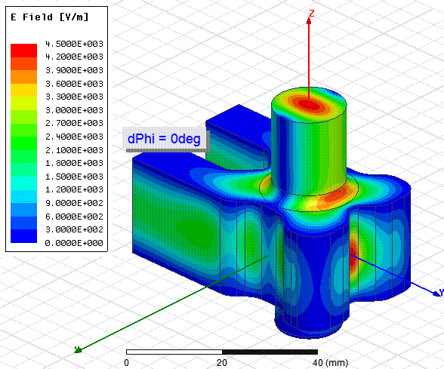
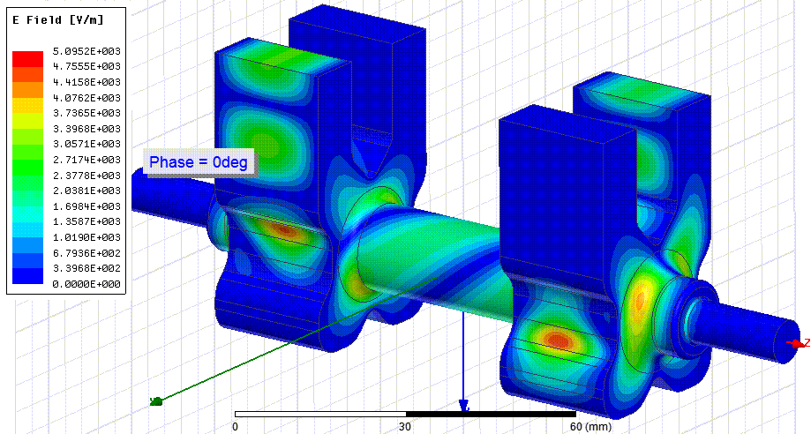
Novel Concept with Variable Polarization
Variable polarization circular TE11 mode launcher: E-rotator
Phase difference between port 1 and port 2:
0 degree -> vertical polarization
180 degree -> horizontal polarization
Full geometry for a face-to-face RF check of two E-rotators
A. Grudiev, CLIC-note-1067 (2016)

Slide 15

DESY-CERN-PSI Collaboration
After successful test of the prototype in FLASHForward, six other cavities have been produced for the experiments at DESY and SwissFEL:
2 TDSs installed in ATHOS (post-undulator)
2 TDSs installed in FLASH II, actually in operation (RF system shared with FlashForward)
2 TDS installed in SINBAD

Slide 16
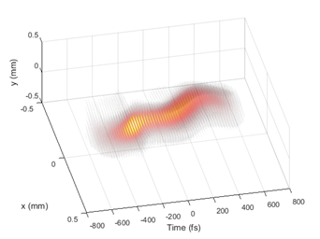
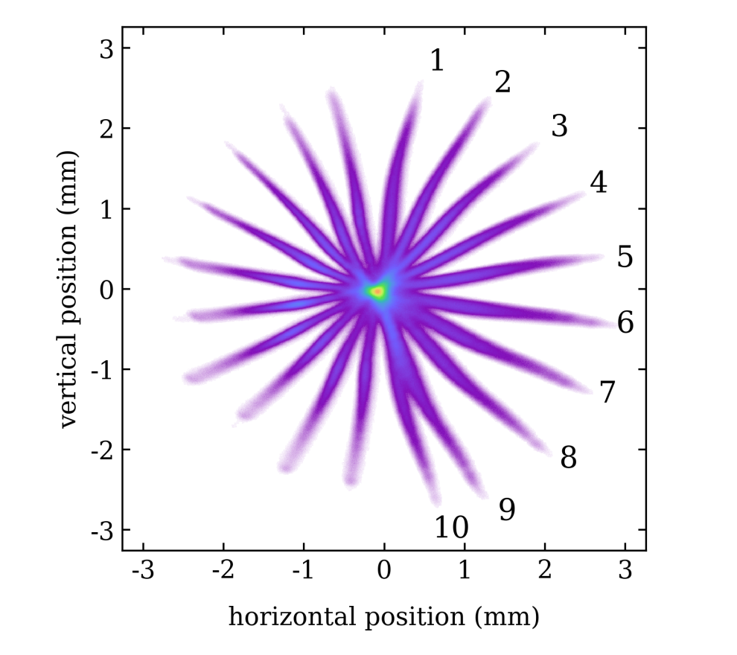

3D tomographic reconstruction at DESY – Experimental Results
3D-reconstruction of the electron bunch at FLASHForward
E= 680 MeV
Q= 300 pC
σ_{t}~ 280 fs rms
R_{t} < 32 fs
10 Projections collected
Courtesy of B. Marchetti

Slide 17
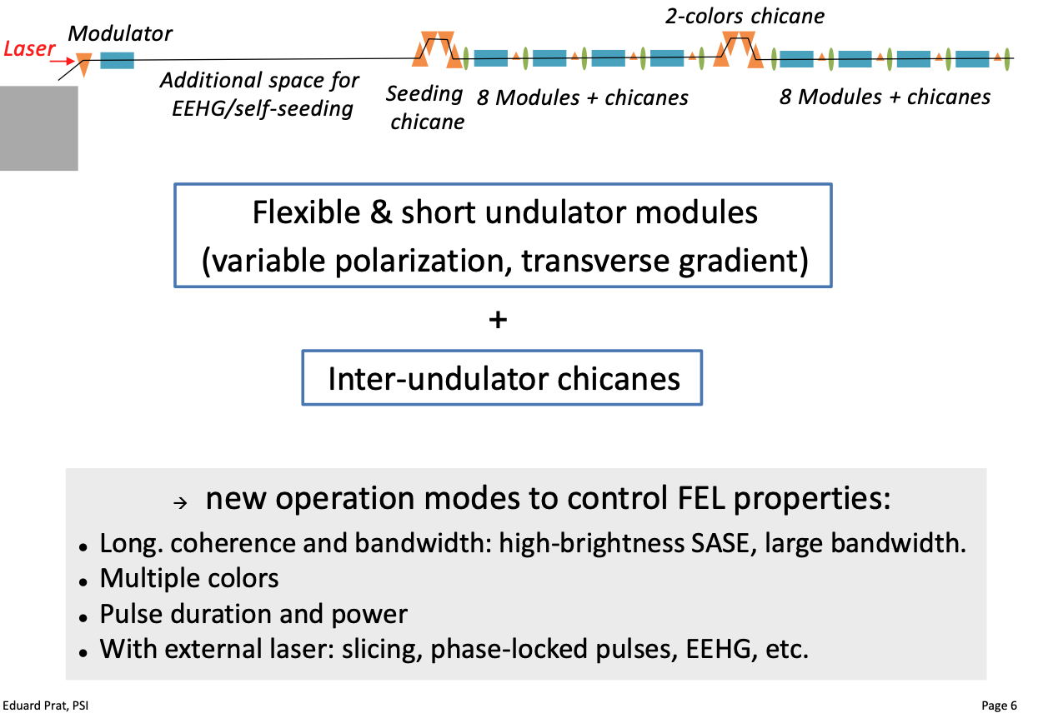
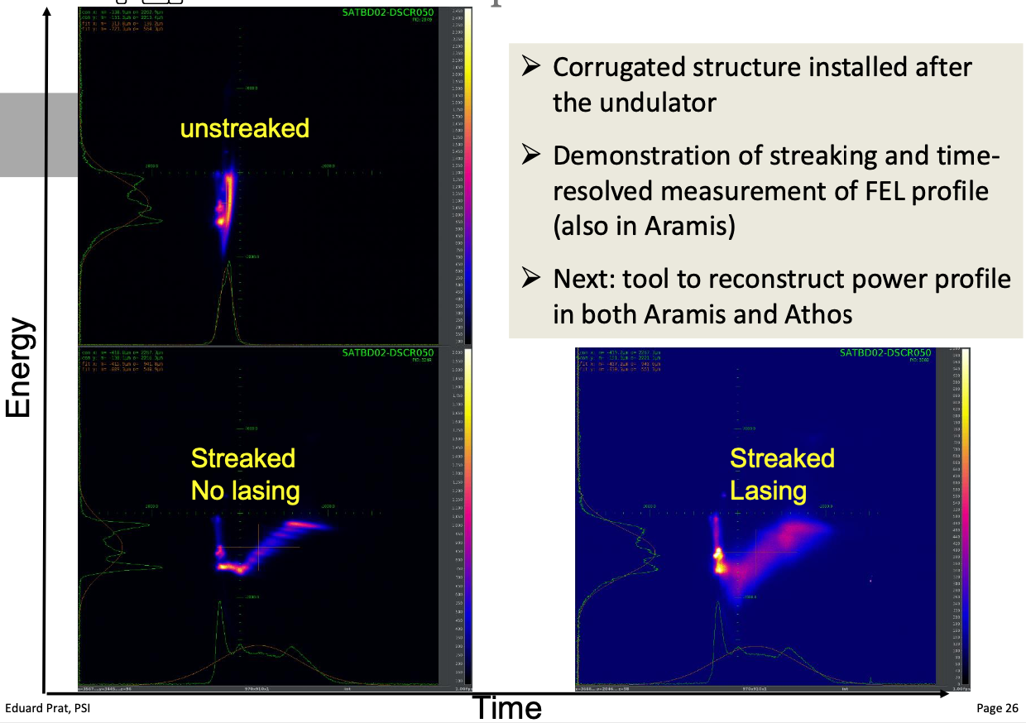
Requirements for the PolariX TDS in ATHOS
Requirements for Athos beamline
Characterize and optimize the electron beam quality (compression, slice emittance, beam tilt, etc.)
Time-resolved (i.e. longitudinal) information and control of these parameters
Measure and monitor shot-to-shot FEL performance and improvement of performances looking at the FEL power profile (Athos Special Features, see Eduard’s SPM talk on 24.11.2020 ):
Some of these schemes require a sub-fs resolution!!

Slide 18
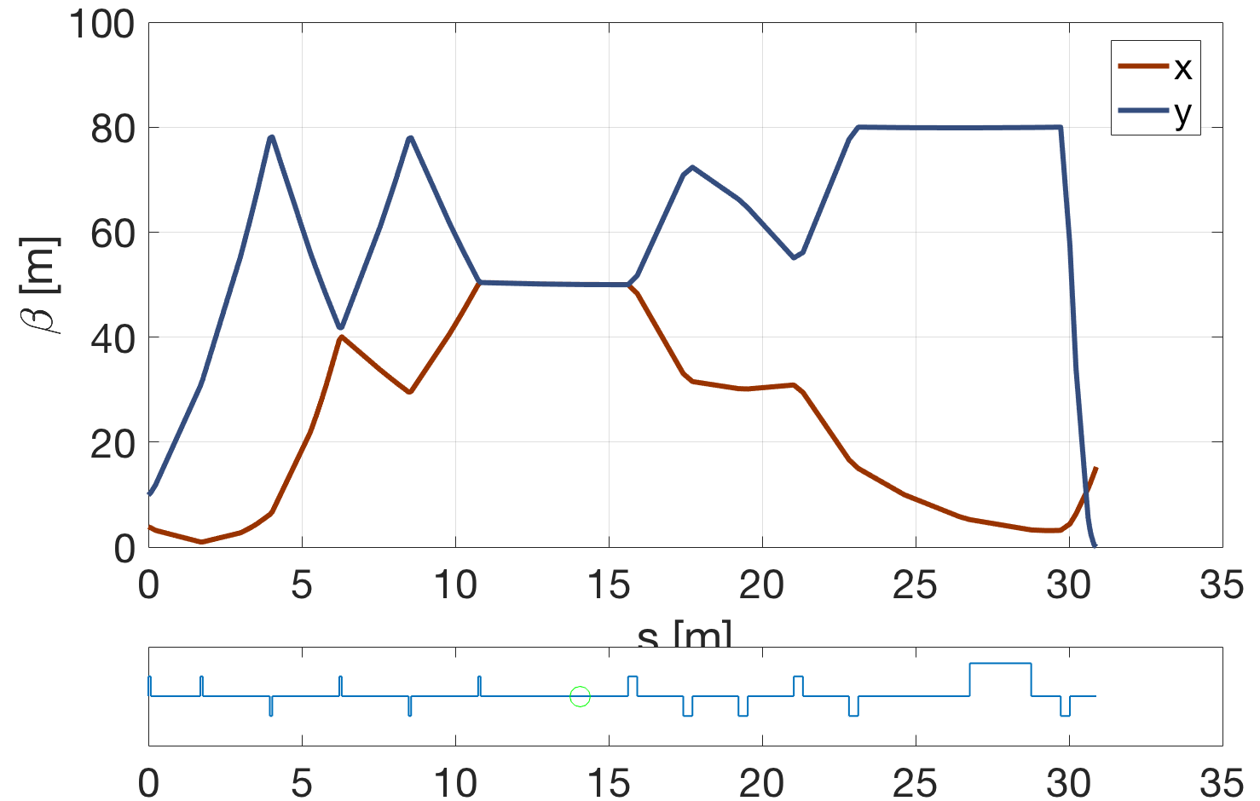
PolariX TDS diagnostic beamline in Athos @3GeV
Measurement concept
Profile monitor
Spectrometer dipole (vertical)
X-band TDC
Undulator end
Quad to get dispersion
Quads to match beta functions in the TDS
Quads to measure the beam
Profile monitor
β_{x} = β_{y} = 50 m → optics for both polarizations
Beam measurements:
Slice emittance on both planes
Projected emittance on both planes
Electron and photon pulse length
Energy spread induced by FEL process
courtesy of E. Prat

Slide 19
PolariX TDS – resolution in ATHOS @3GeV
Resolution 0.95 fs @45MV and β_{d} = 50 m
Resolution 0.7 fs @60MV and β_{d} = 50 m
β_{d} = 50 m
Jump on the screen ~3-5 mm
500-700 keV
Courtesy of A. Lutman

Slide 20
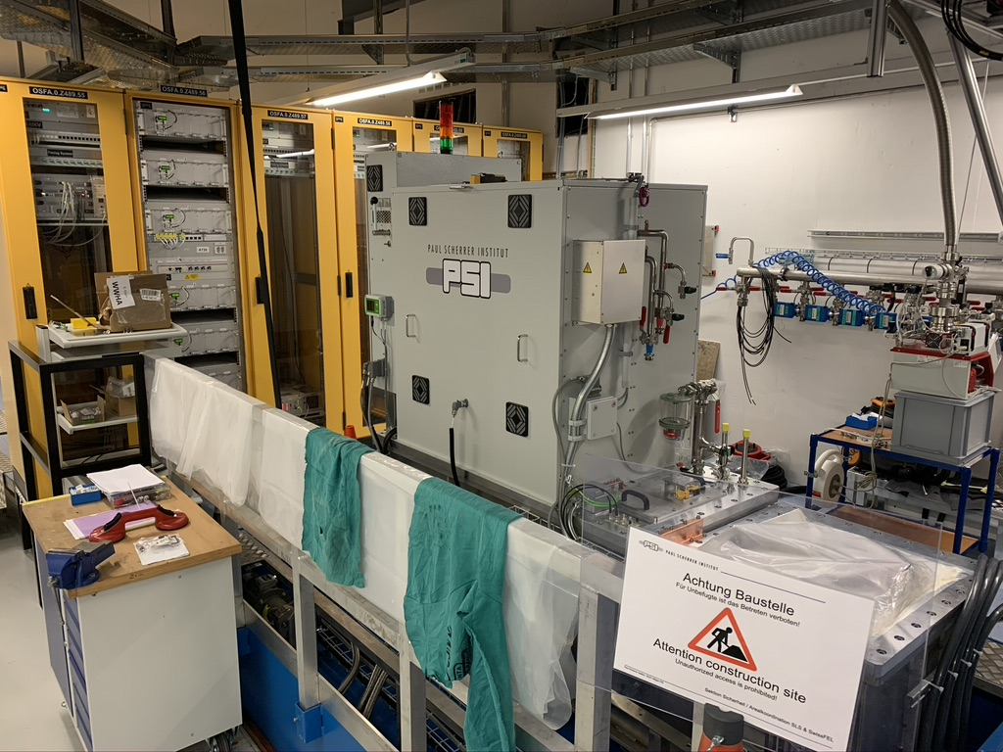
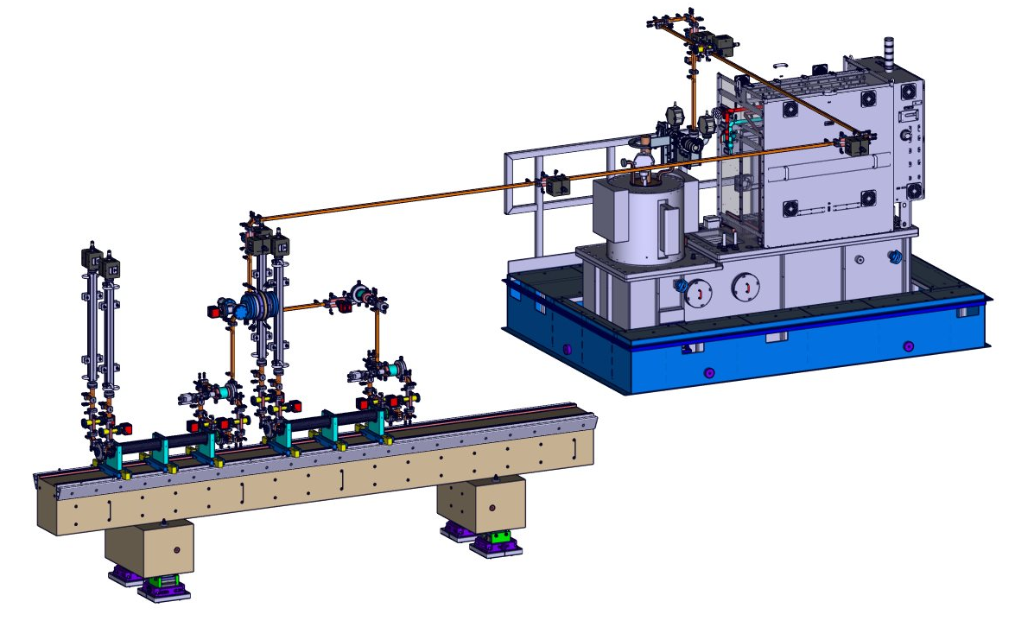
PolariX TDS – status
HV Modulator development:
PSI decided to build the X-Band modulator for Athos in house
new modulator is based on the Linac 1 and 2 design (Ampegon)
Status:
Software ready – tested on C-band module
Assembly of the modulator is on-going
Test of the charging units and boost converter one-by-one is on-going
Tests are done on a test load, klystron will be connected early next year
RF conditioning will start after April 22 shutdown (hopefully)

Slide 21
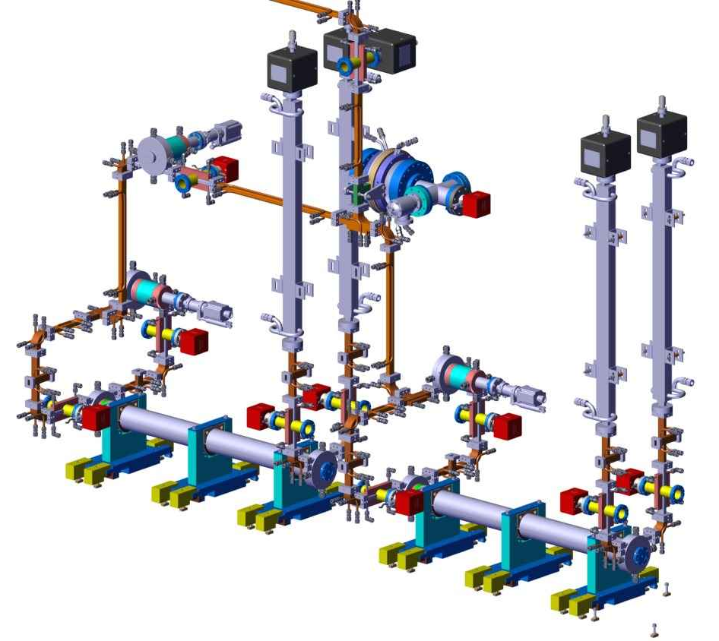
PolariX TDSs and RF components
Waveguide network, XBOC, TDSs are already installed and ready for the RF conditioning… waiting for the HV klystron modulator (all the RF components were designed and made at PSI!)

Slide 22

Summary
S-band TDS at the injector
    System was reliable until now, deep maintenance will be done in the next shutdown
C-band TDS at the linac end (in front of Aramis undulator chain)
  Routinely used for beam setup before the Aramis undulators, bunch length, slice emittance and energy spread measurements, set the large bandwidth mode
Post undulator passive streaking (Aramis and Athos)
    Self-synchronized and cost effective time resolved measurements (Aramis and Athos) but still something to understand
Post-undulator PolariX TDS for ATHOS
    Assembly of the HV klystron modulator is on-going
    2 TDSs and waveguide network installed in ATHOS
    RF conditioning will hopefully start after April shutdown (2022) and lasts at least 8 weeks (uncertainty about the behaviour of certain RF components during the conditioning)

Slide 23
Outlook
Aramis and Athos Post-undulator passive streaking: more studies necessary to fully understand the device. Still necessary support from experts to use them for the operations
For Operations (in general): “One button” TDS measurements would be great to have. Location change would be nice to have the option to have permanent, online measurements (Florian)
For Operations (in general): losses limit the use of the TDS systems for prolonged use. Additional shielding?
Athos Post-Undulator TDS: shot-to-shot online diagnostic requires a possibility to use a screen in the beam dump running with beam at 100 Hz. To be verified this possibility.
Further studies: Comparison between passive and active streaking will be systematically done in Athos.
Aramis active TDS system: two idea under discussion. Move the actual C-band TDS but requires a new HV modulator and klystron (pro: independent system), use two new PolariX-TDSs connected with a long waveguide to the X-band HV modulator under installation in Athos (cons: no parallel on-line Aramis and Athos post undulator system).

Slide 24

Wir schaffen Wissen – heute für morgen
That’s all from my side
Questions?

