Slide 1
SwissFEL Exchange Meeting
Machine report
Week 38/2021
Didier Voulot, SEM, 27 Sept. 2021

Slide 2
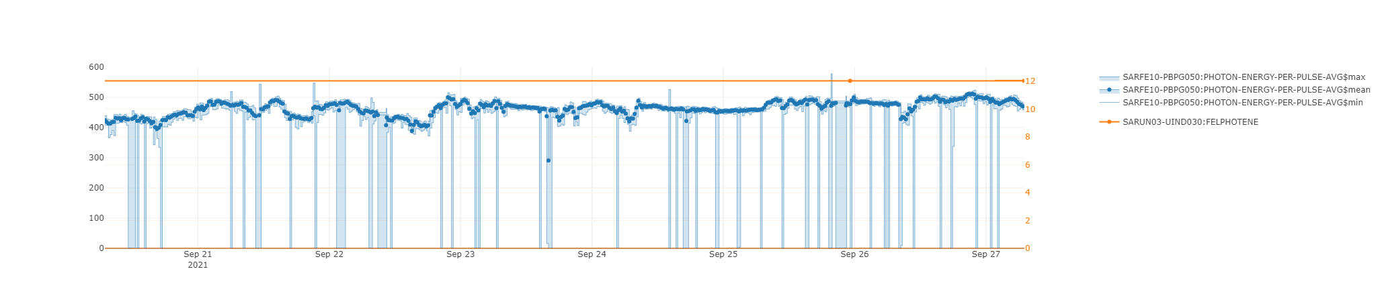
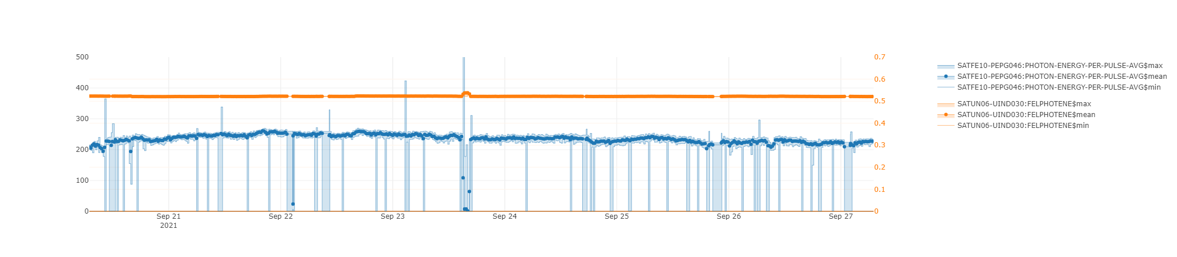
Aramis
Athos
Notes:
Maloja run, priority Athos

Slide 3
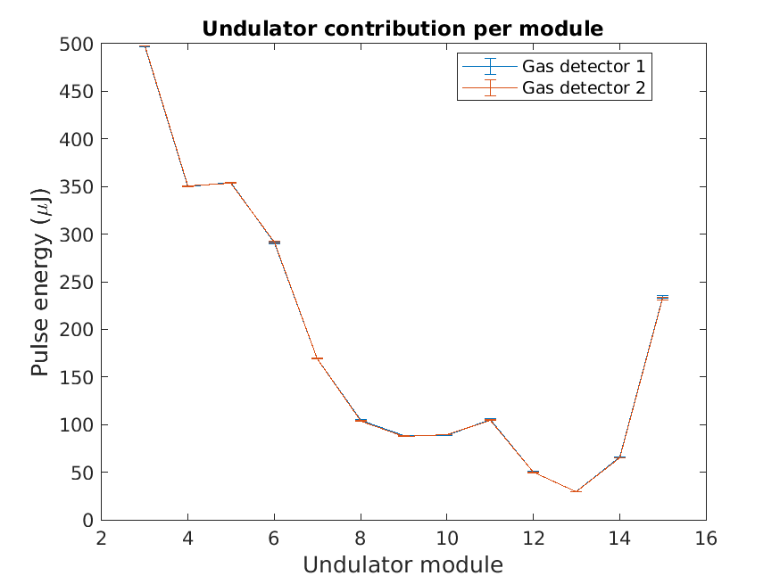
Set-up
No set-up this week (7-days user run, both lines!). Set-up was checked on Sunday 19.9.
Aramis, 12 keV 100 Hz
  PSICO running on Aramis undulator settings 400 -> 500 uJ.
  (We had 830 uJ at 11.3 keV in July)
  First undulators not contributing? maybe due to pointing?
Athos, 520 eV 25-50 Hz
  Using short pulse (chirped beam from dispersive quad in SATCL01)
  200-250 uJ at 520 eV, 50 Hz
  Need to reduce BLM/LLM sensitivity, DRMs are ok, limited by DRPS

Slide 4
Technical difficulties
python applications bug on SL6 machines -> many applications affected -> resolved now
Vacuum gauge failure -> tunnel access on Wed.
S10CB09 tripped after tunnel access -> mechanical problem with klystron socket, will be fixed during the service day
SINDI01: several IGBT are open-circuit, broken feedthrough? -> repair planned in the shutdown, need 1-2 days (station can be used at reduced power)
DRPS fault on Saturday (low data rate) -> 2h downtime

Slide 5
Lessons learnt
Should be more conservative with tunnel access: there is always a risk
We need to speed up transition to linux7, we cannot maintain different configuration of everything -> likely to cause problem in the future

