Slide 1
The Capture Solenoid for the new HiMB Muon Beam Lines
Alexander Gabard :: Magnet Section :: Paul Scherrer Institute
Sep 2, 2021

Slide 2
Topic
Explain the chain of constraints and decisions towards the final design

Slide 3
Starting parameters
Near target -> radiation resistant
Near target -> space issues
In Vacuum –> no air cooling!
Compact and light… SHORT!
«copy» of WSX

Slide 4
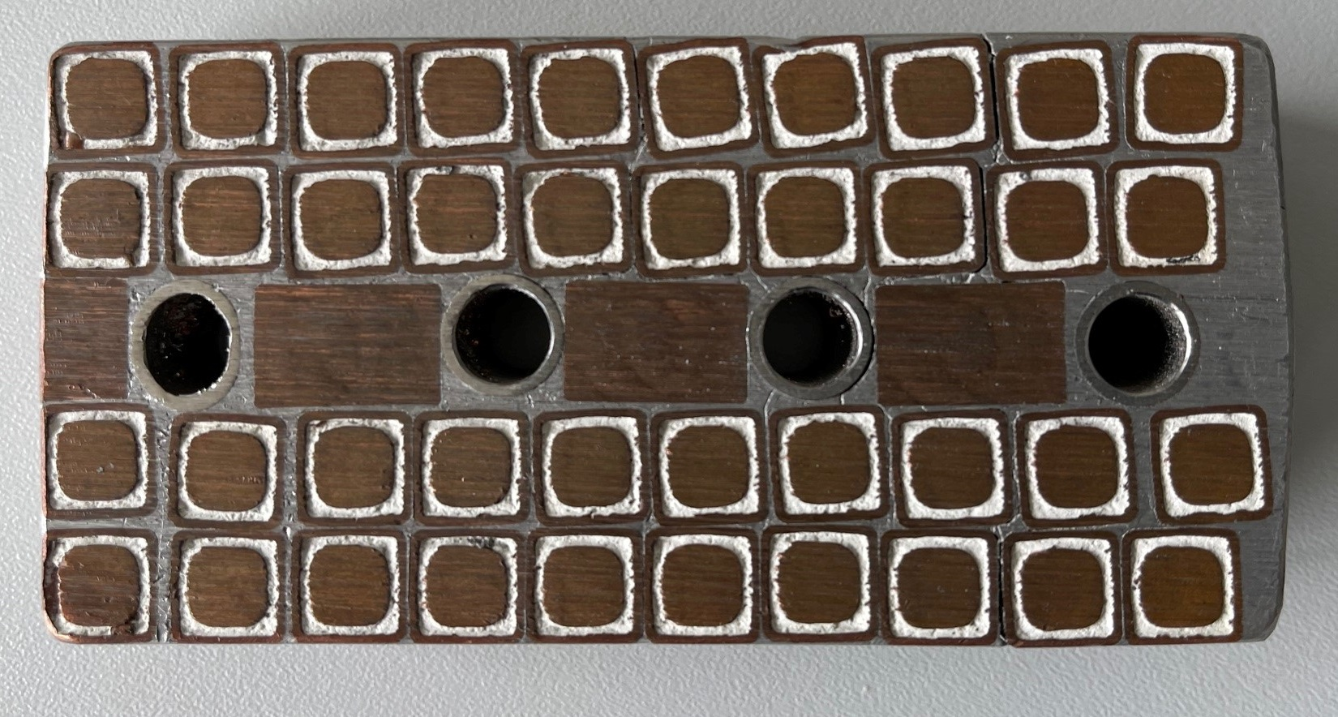
Radiation hard – what does it mean?
No organic materials
No direct contact between water and copper

Slide 5
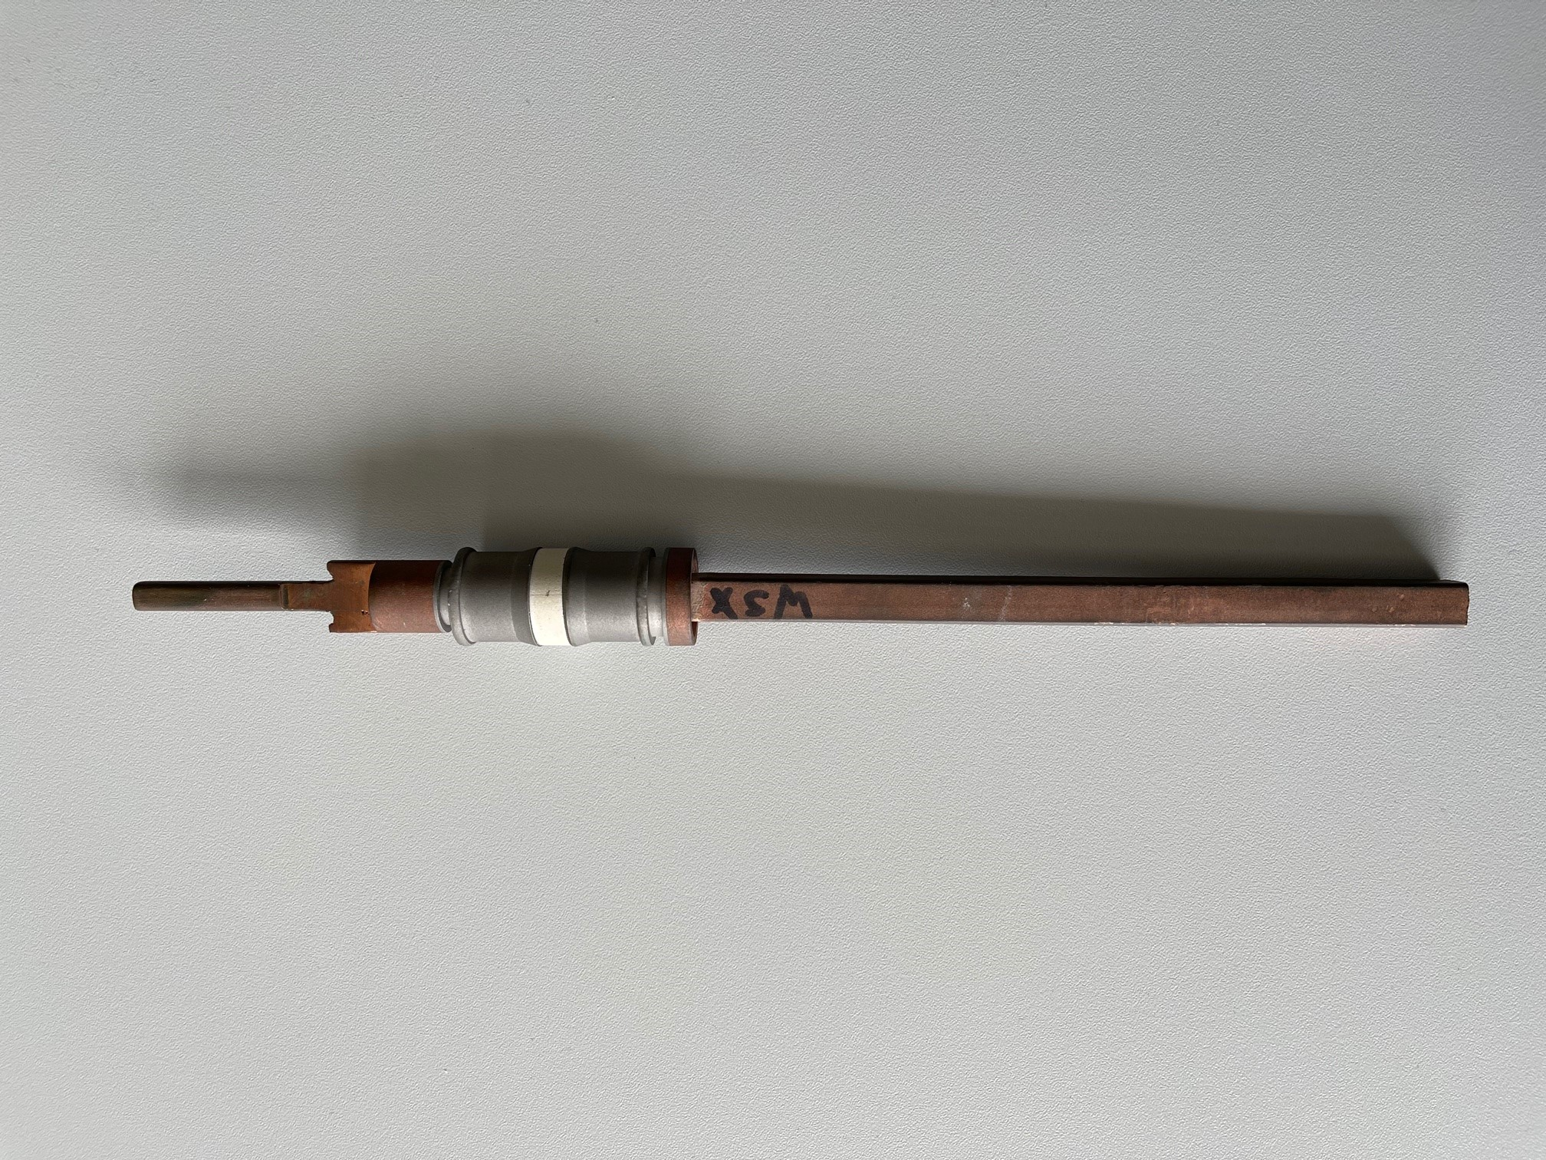
End connections

Slide 6
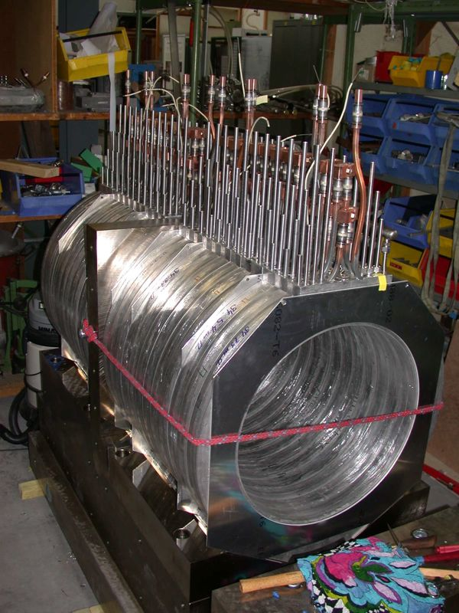
WSX

Slide 7
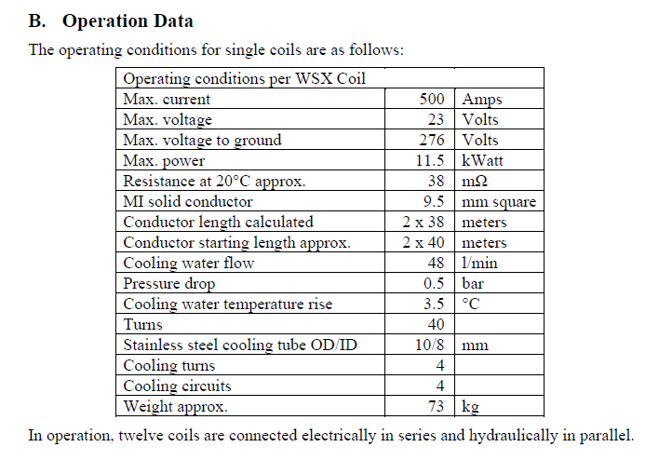
WSX

Slide 8
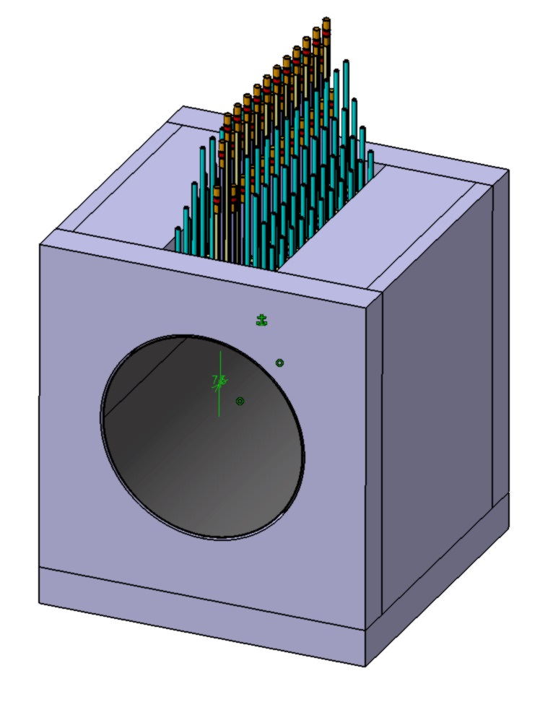
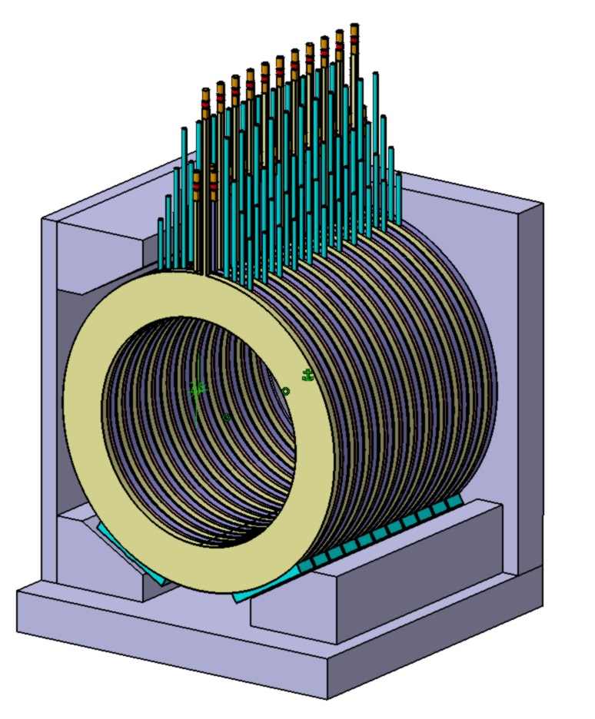
Capture Solenoid, December 16, 2020

Slide 9
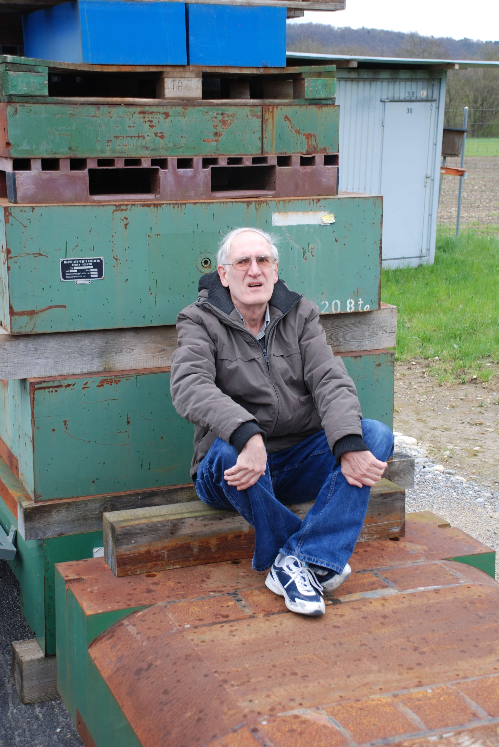
Dave George
500A not possible on WSX
300/375 A max
Problem: overheating
Leads are the problem

Slide 10
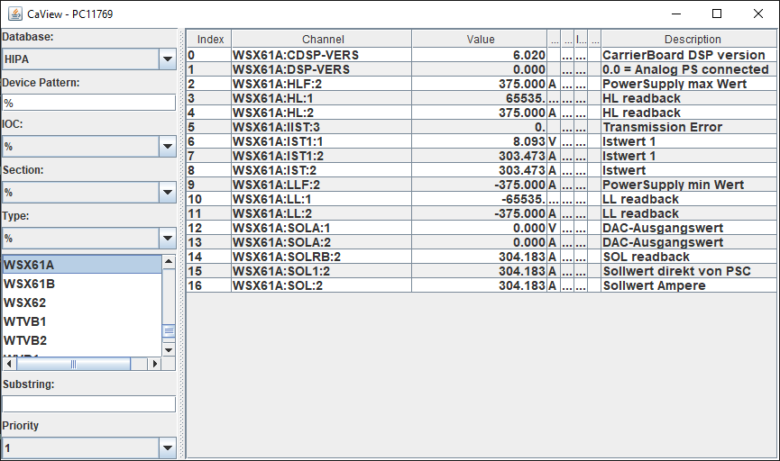
WSX

Slide 11
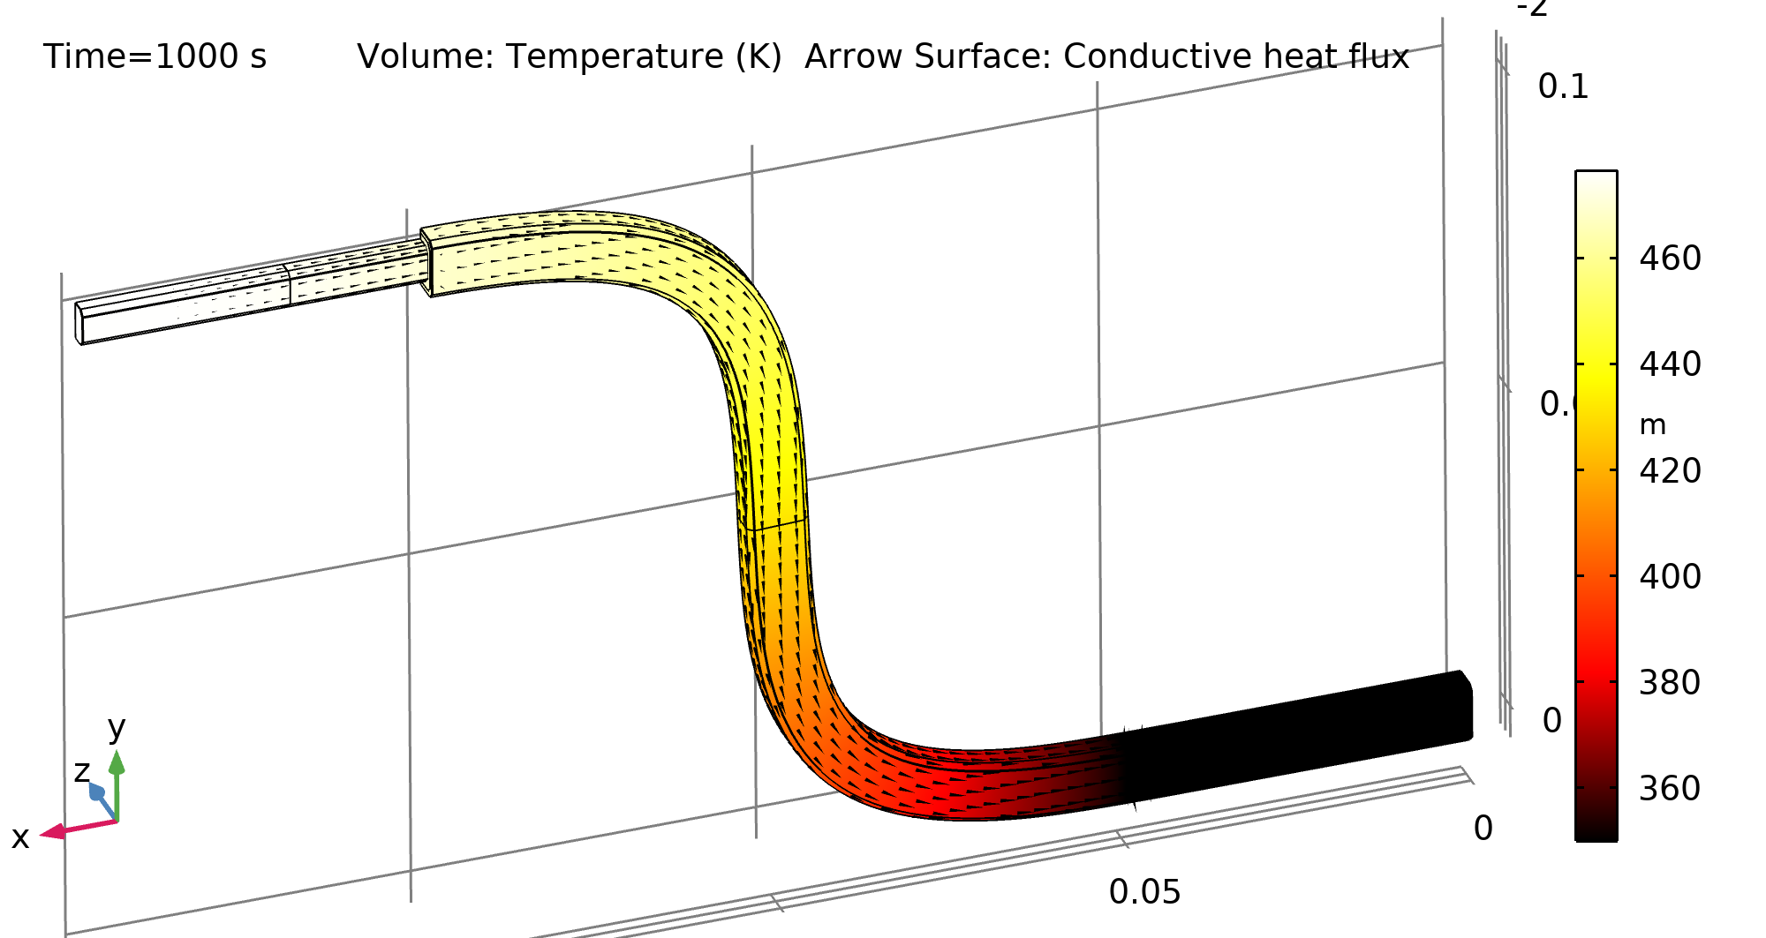
Leads

Slide 12
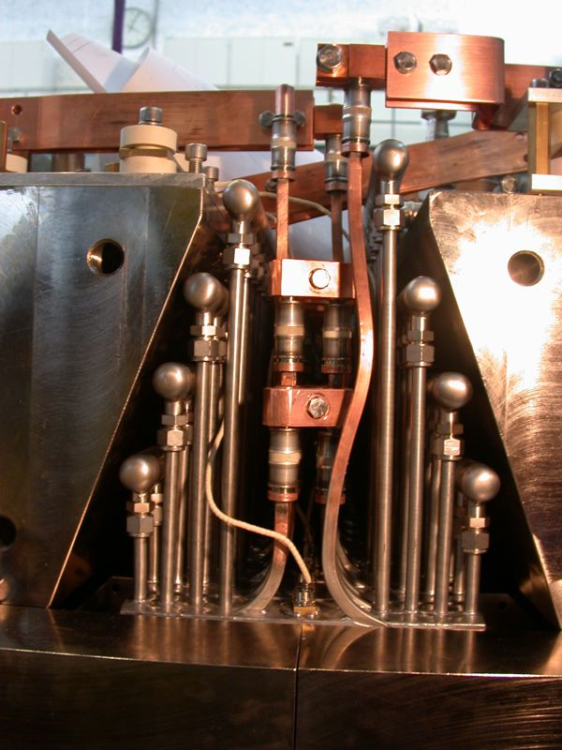
WSX
Conclusions:
- reduce length of leads by separating cooling and power connections
- increase number of turns to reduce current density

Slide 13
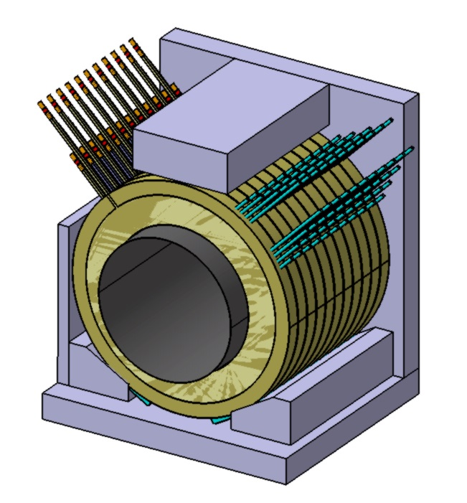
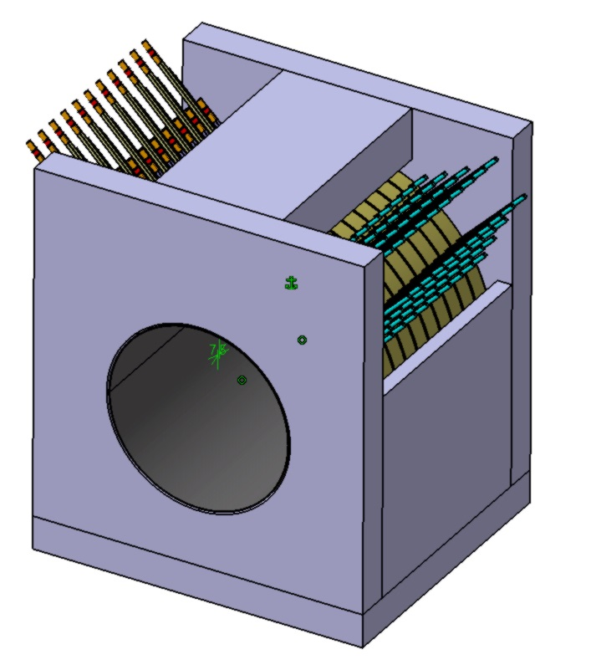
Capture Solenoid, May 10
200 A / cm² ?

Slide 14
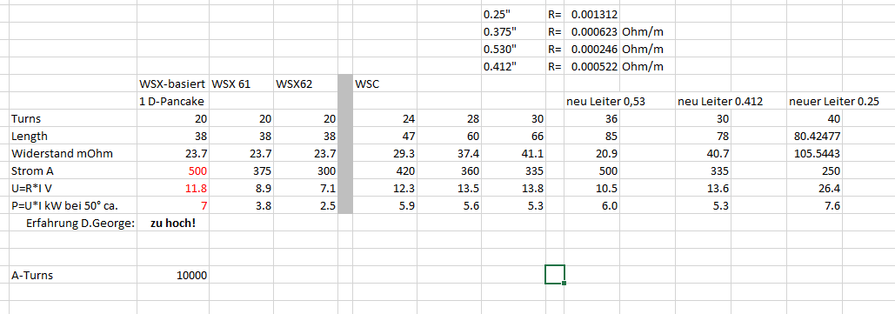
Calculating the details
Decision: 30 turns per d-pancake / 60 turns per coil unit
result: new max. current is 369 Amps (Sebastian)

Slide 15
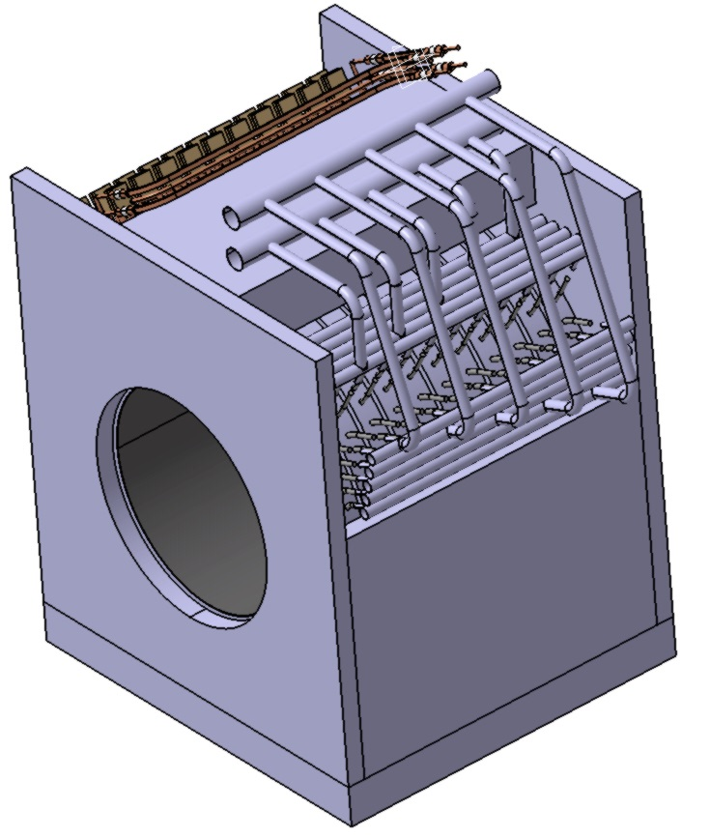
Capture Solenoid, August 2
40mm mirror plates
to create additional
room inside

Slide 16
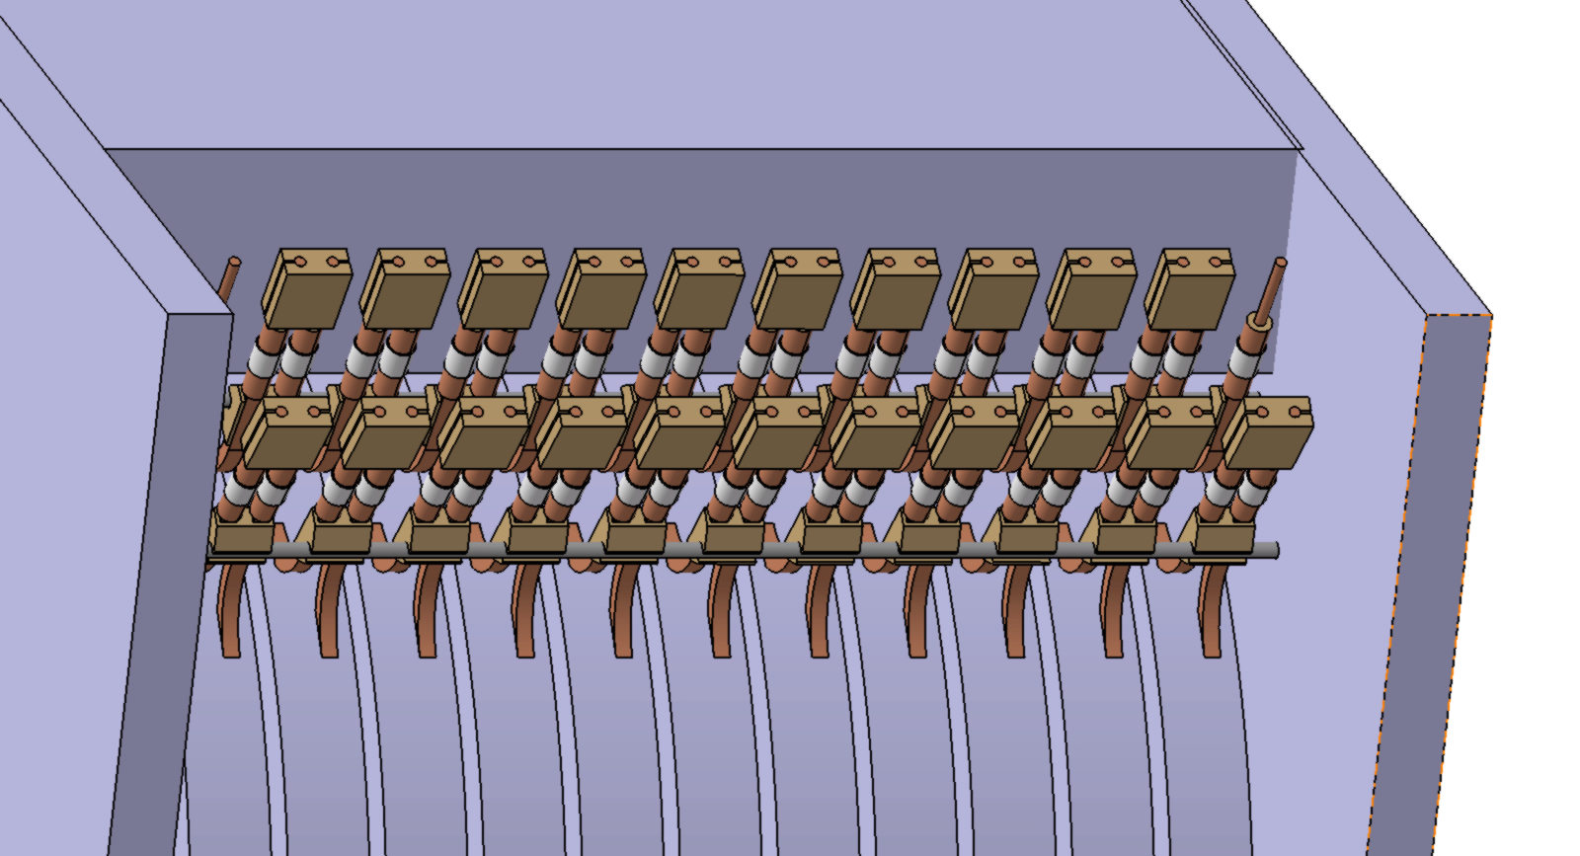
Capture Solenoid, August 2
10mm gap to keep distance between connectors

Slide 17
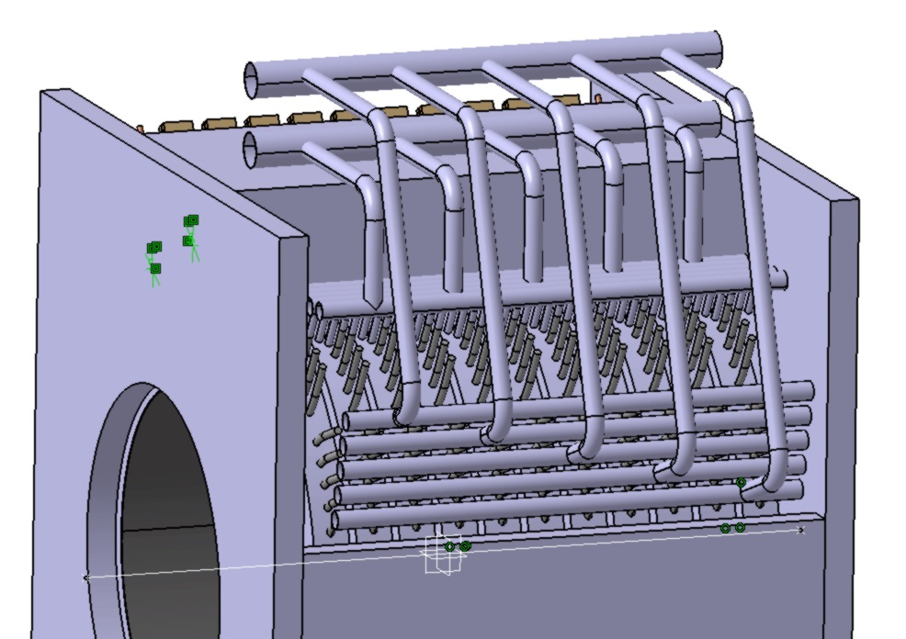
Capture Solenoid, August 2

Slide 18
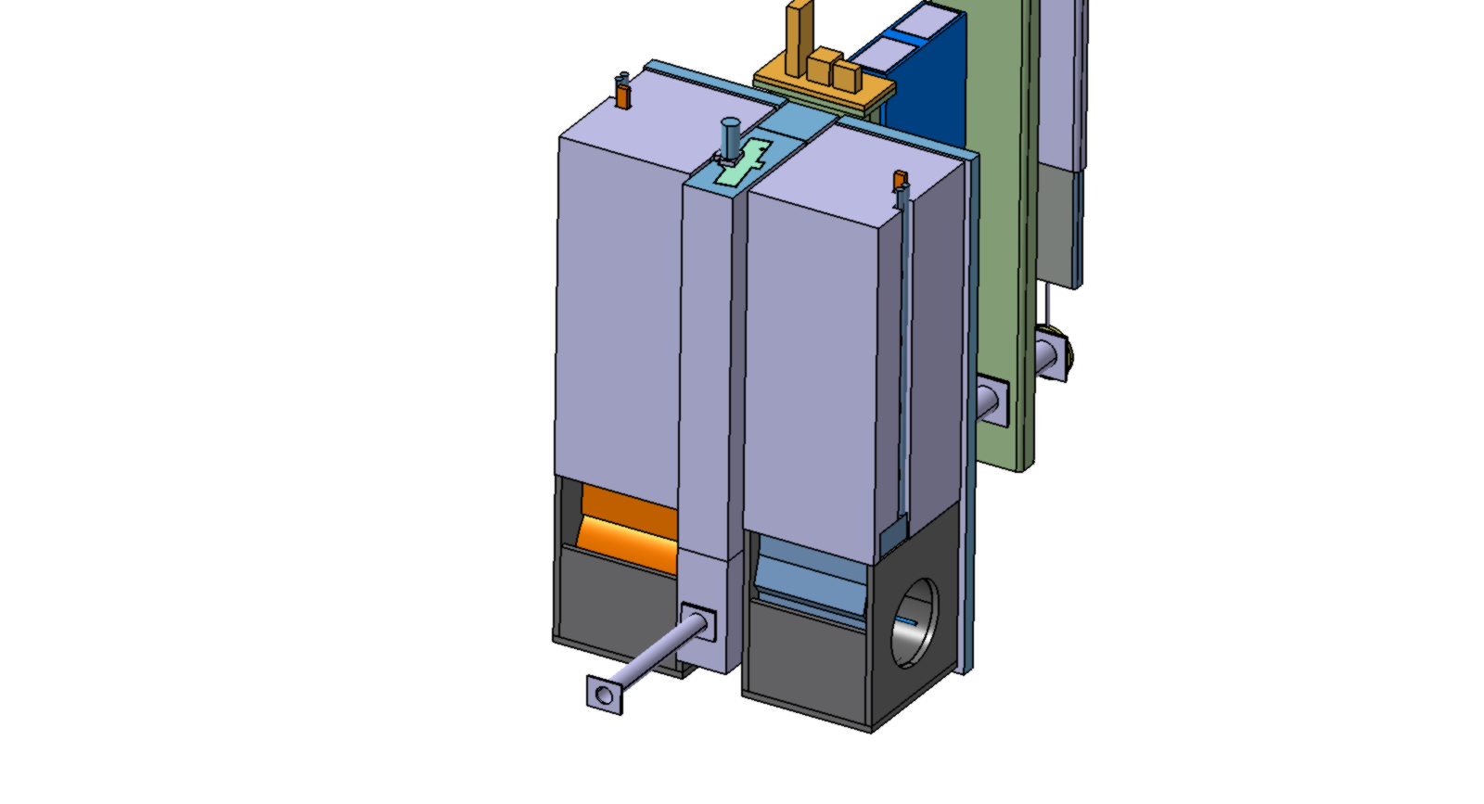
Tight space inside vacuum chamber, insert

Slide 19
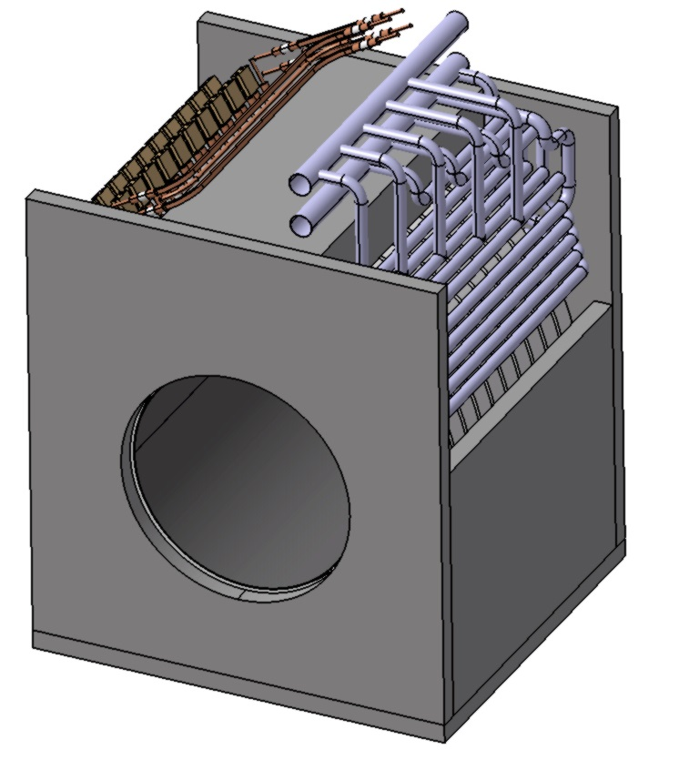
Capture solenoid, current version

Slide 20
Uncertainties
Not sure if we reach required current

Slide 21
Wir schaffen Wissen – heute für morgen
acknowledgements
Dave George
Sebastian Hellmann

Slide 22
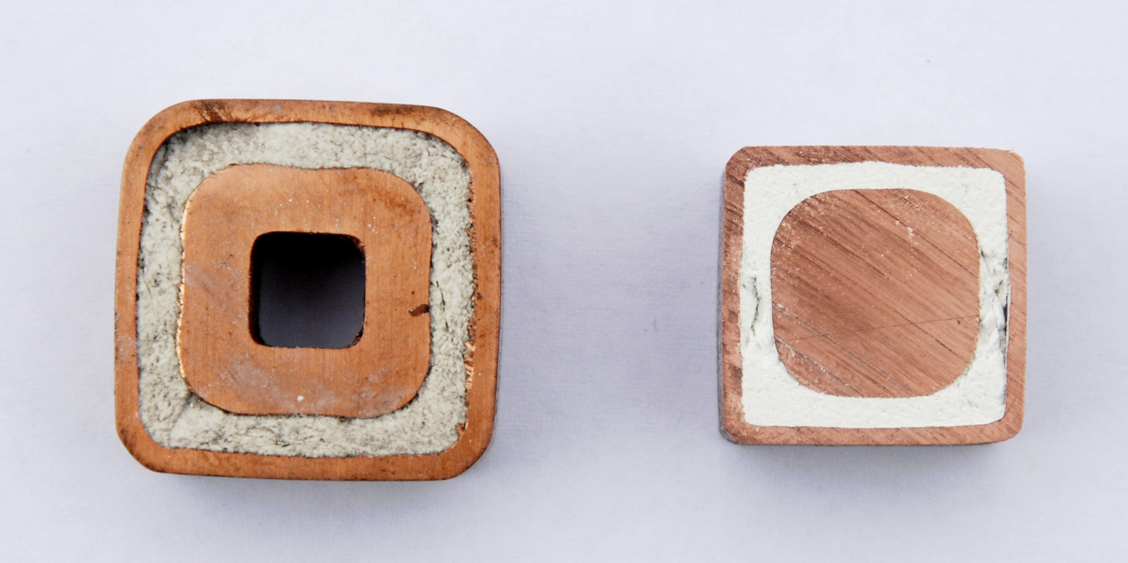
Cross section

Slide 23
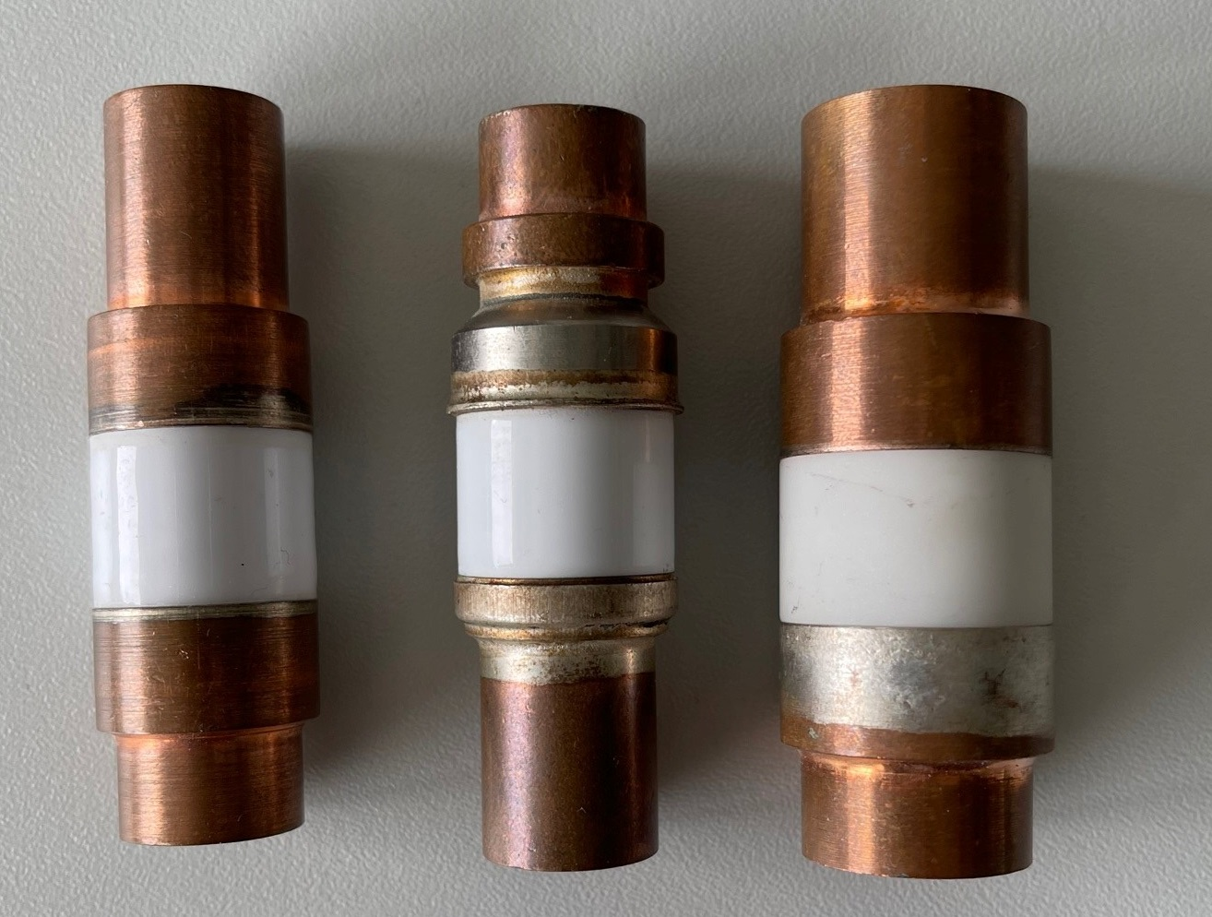
Ceramic end pieces

Slide 24
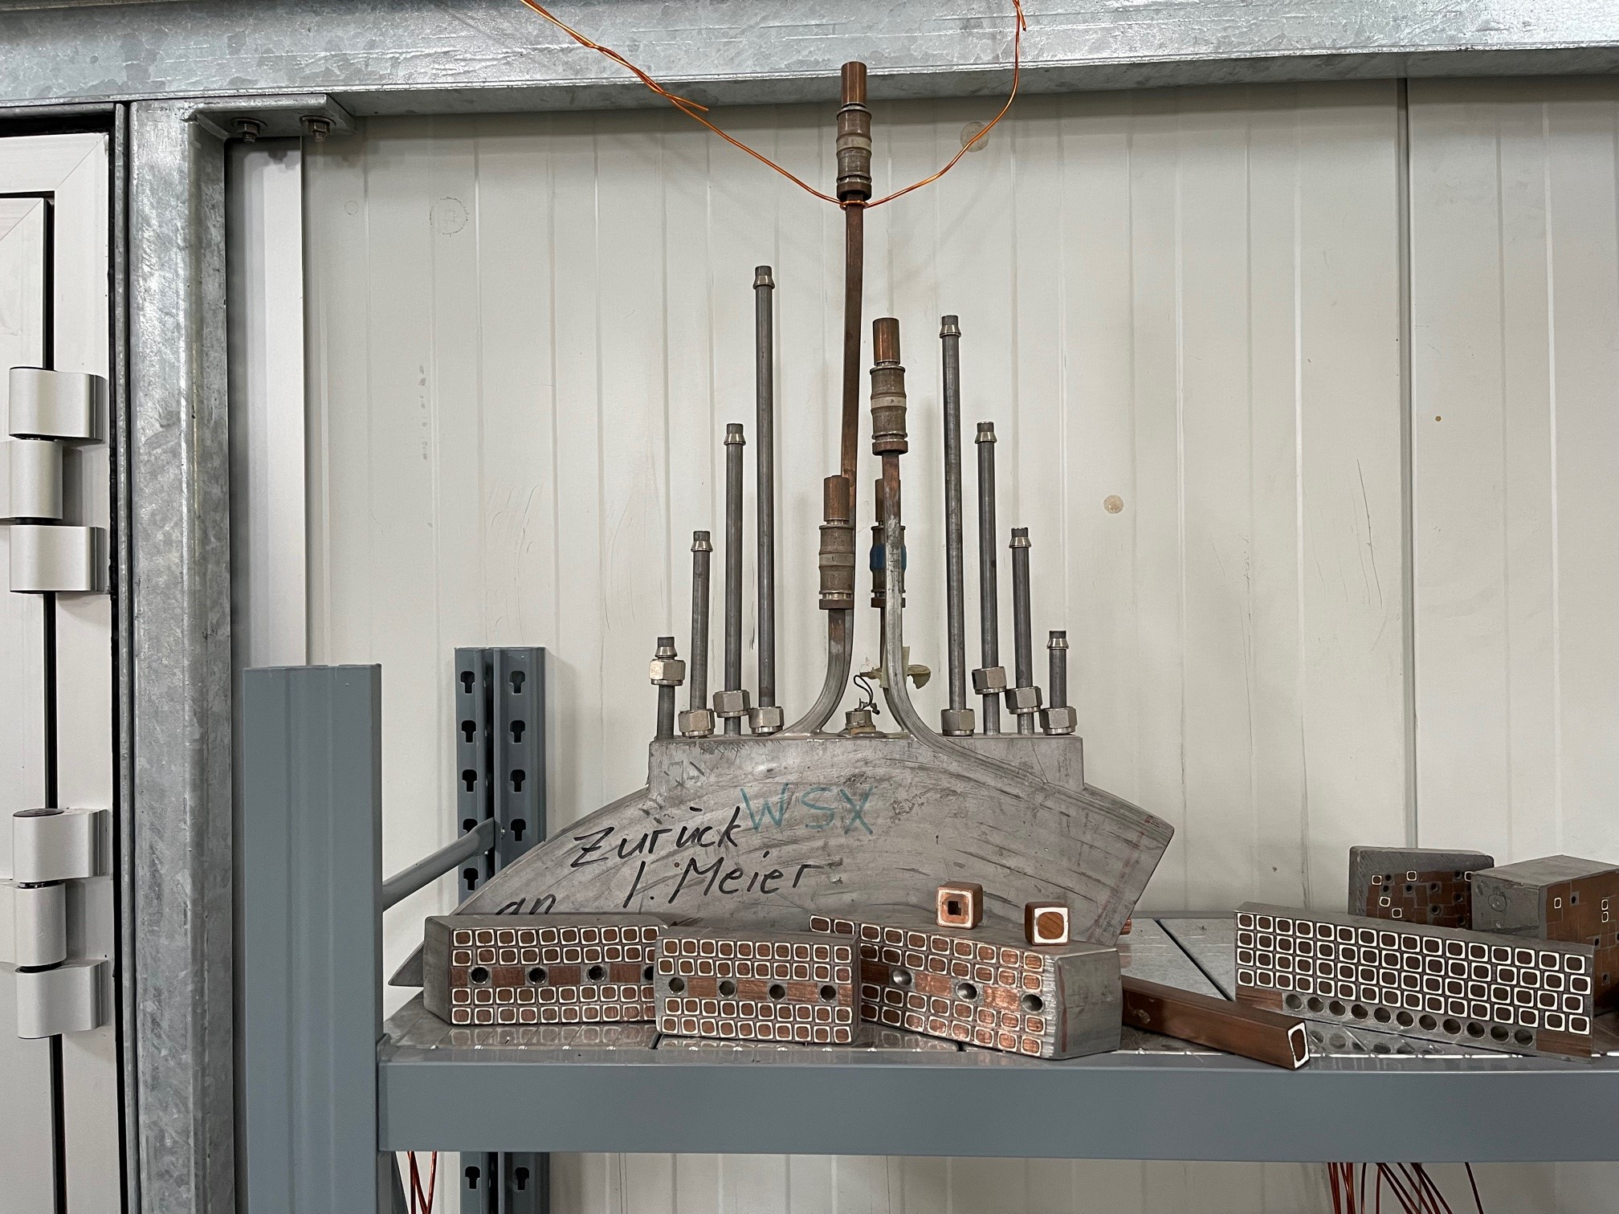
Display in WLHA

Slide 25
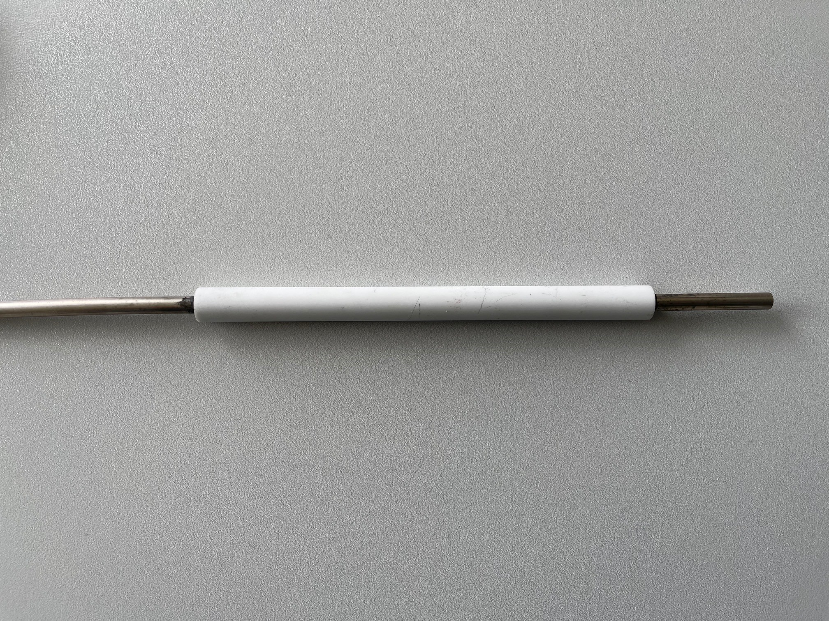
Ceramic cooling connector

