Slide 1
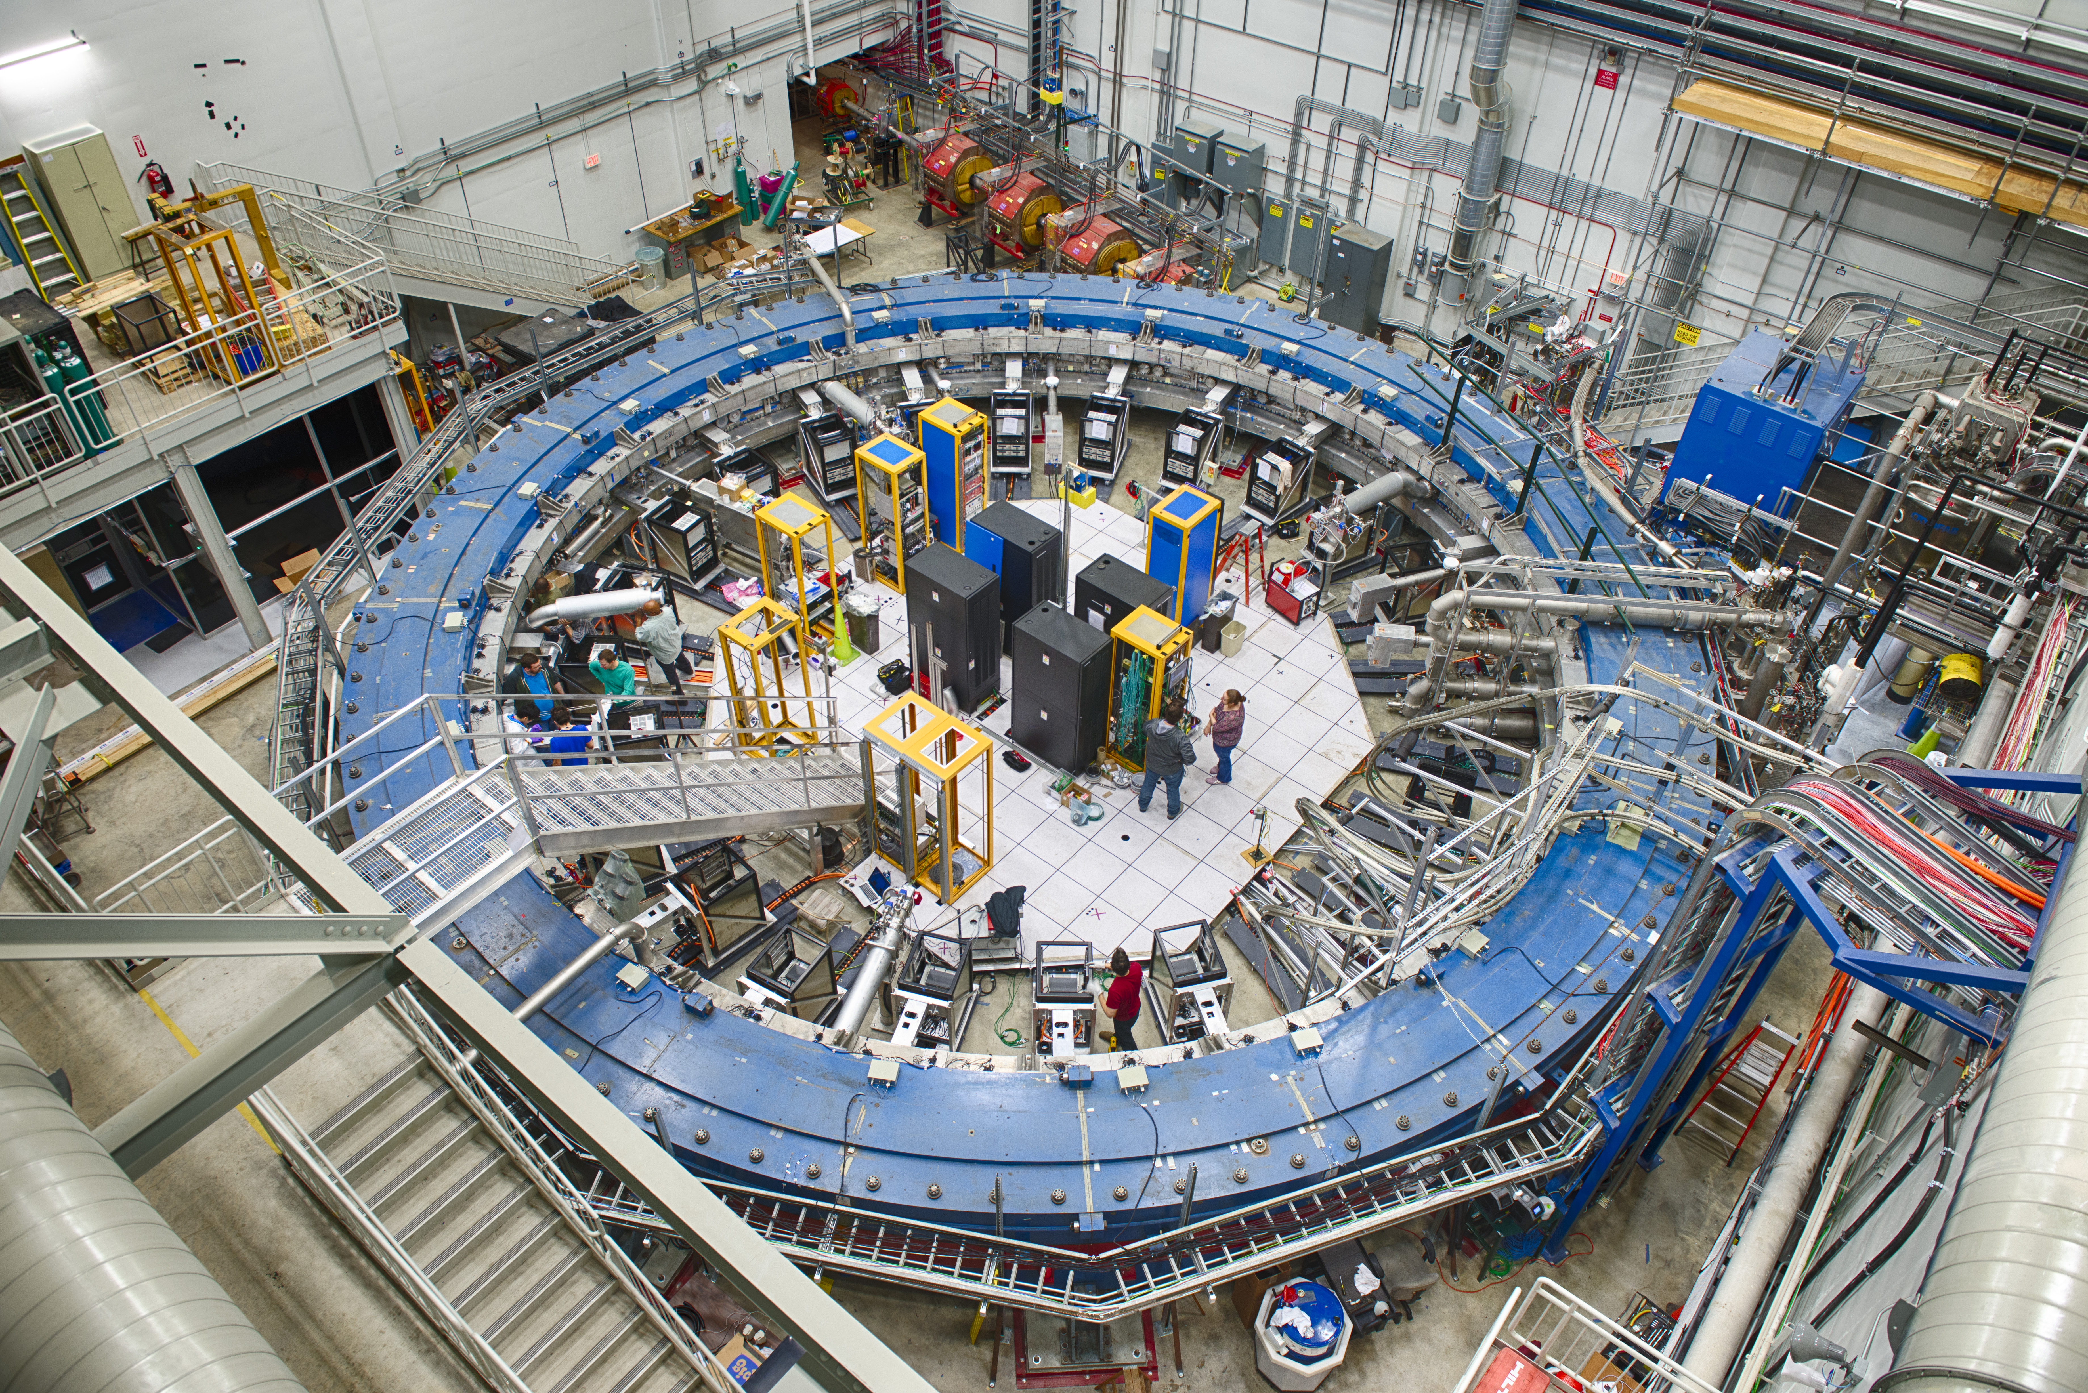
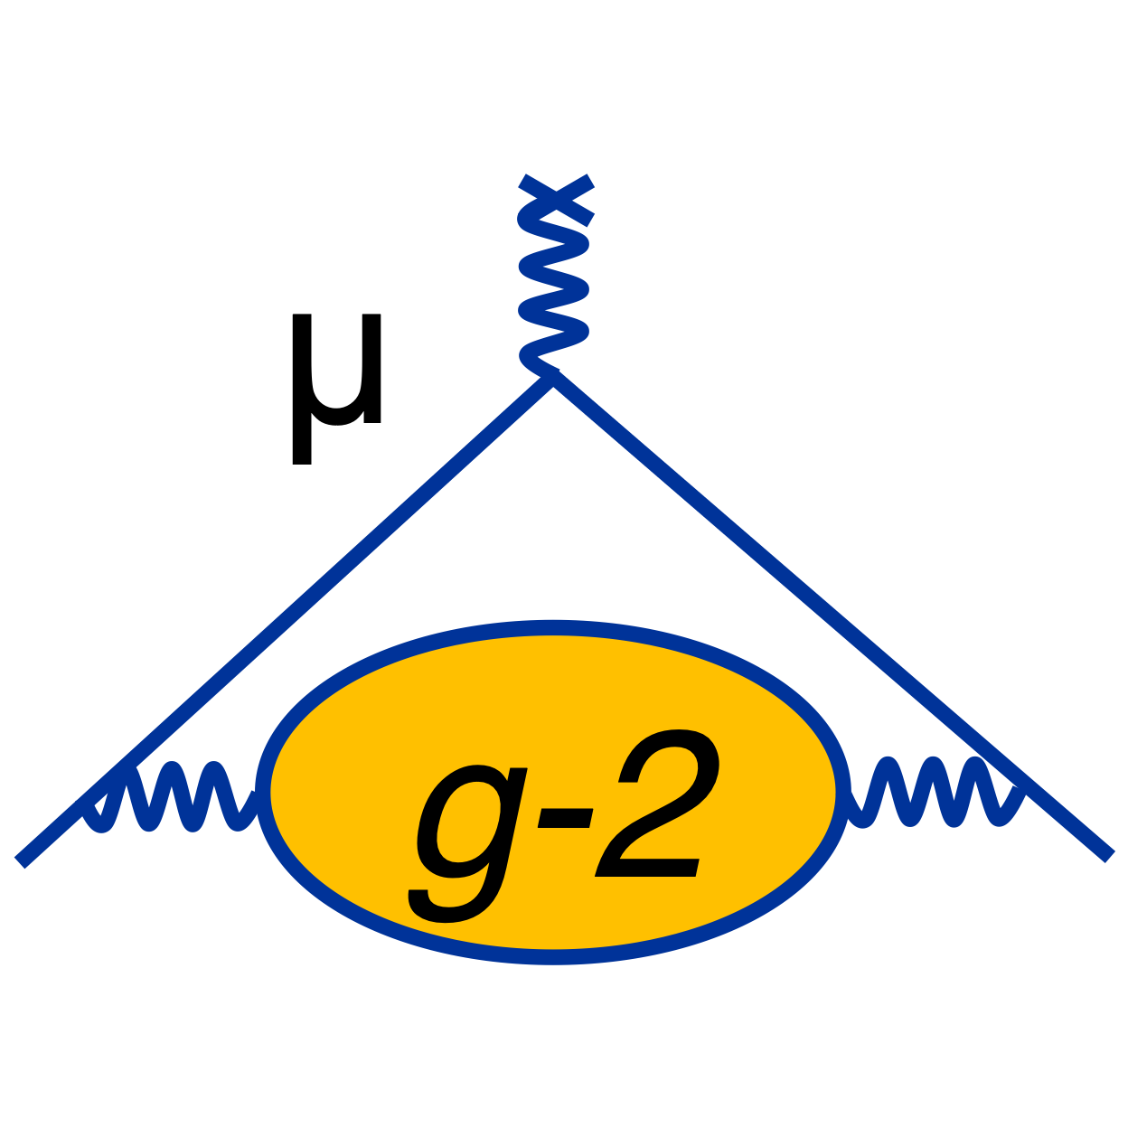
The Fermilab Muon g-2 Experiment
Status and Outlook
erhtjhtyhy
Simon corrodi
on behalf of the Muon g-2 collaboration
Argonne National Laboratory
PSI 2022
October 16 - 21, 2022

Slide 2
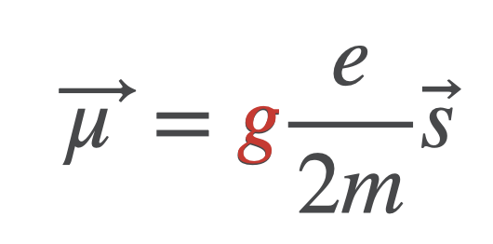
The magnetic Moment of the muon
$$g$$
Magnetic moment connected to spin via dimensionless factor g: gyromagnetic ratio
$$a_{μ}=\frac{g-2}{2}$$
the anomalous magnetic moment

Slide 3
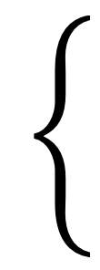
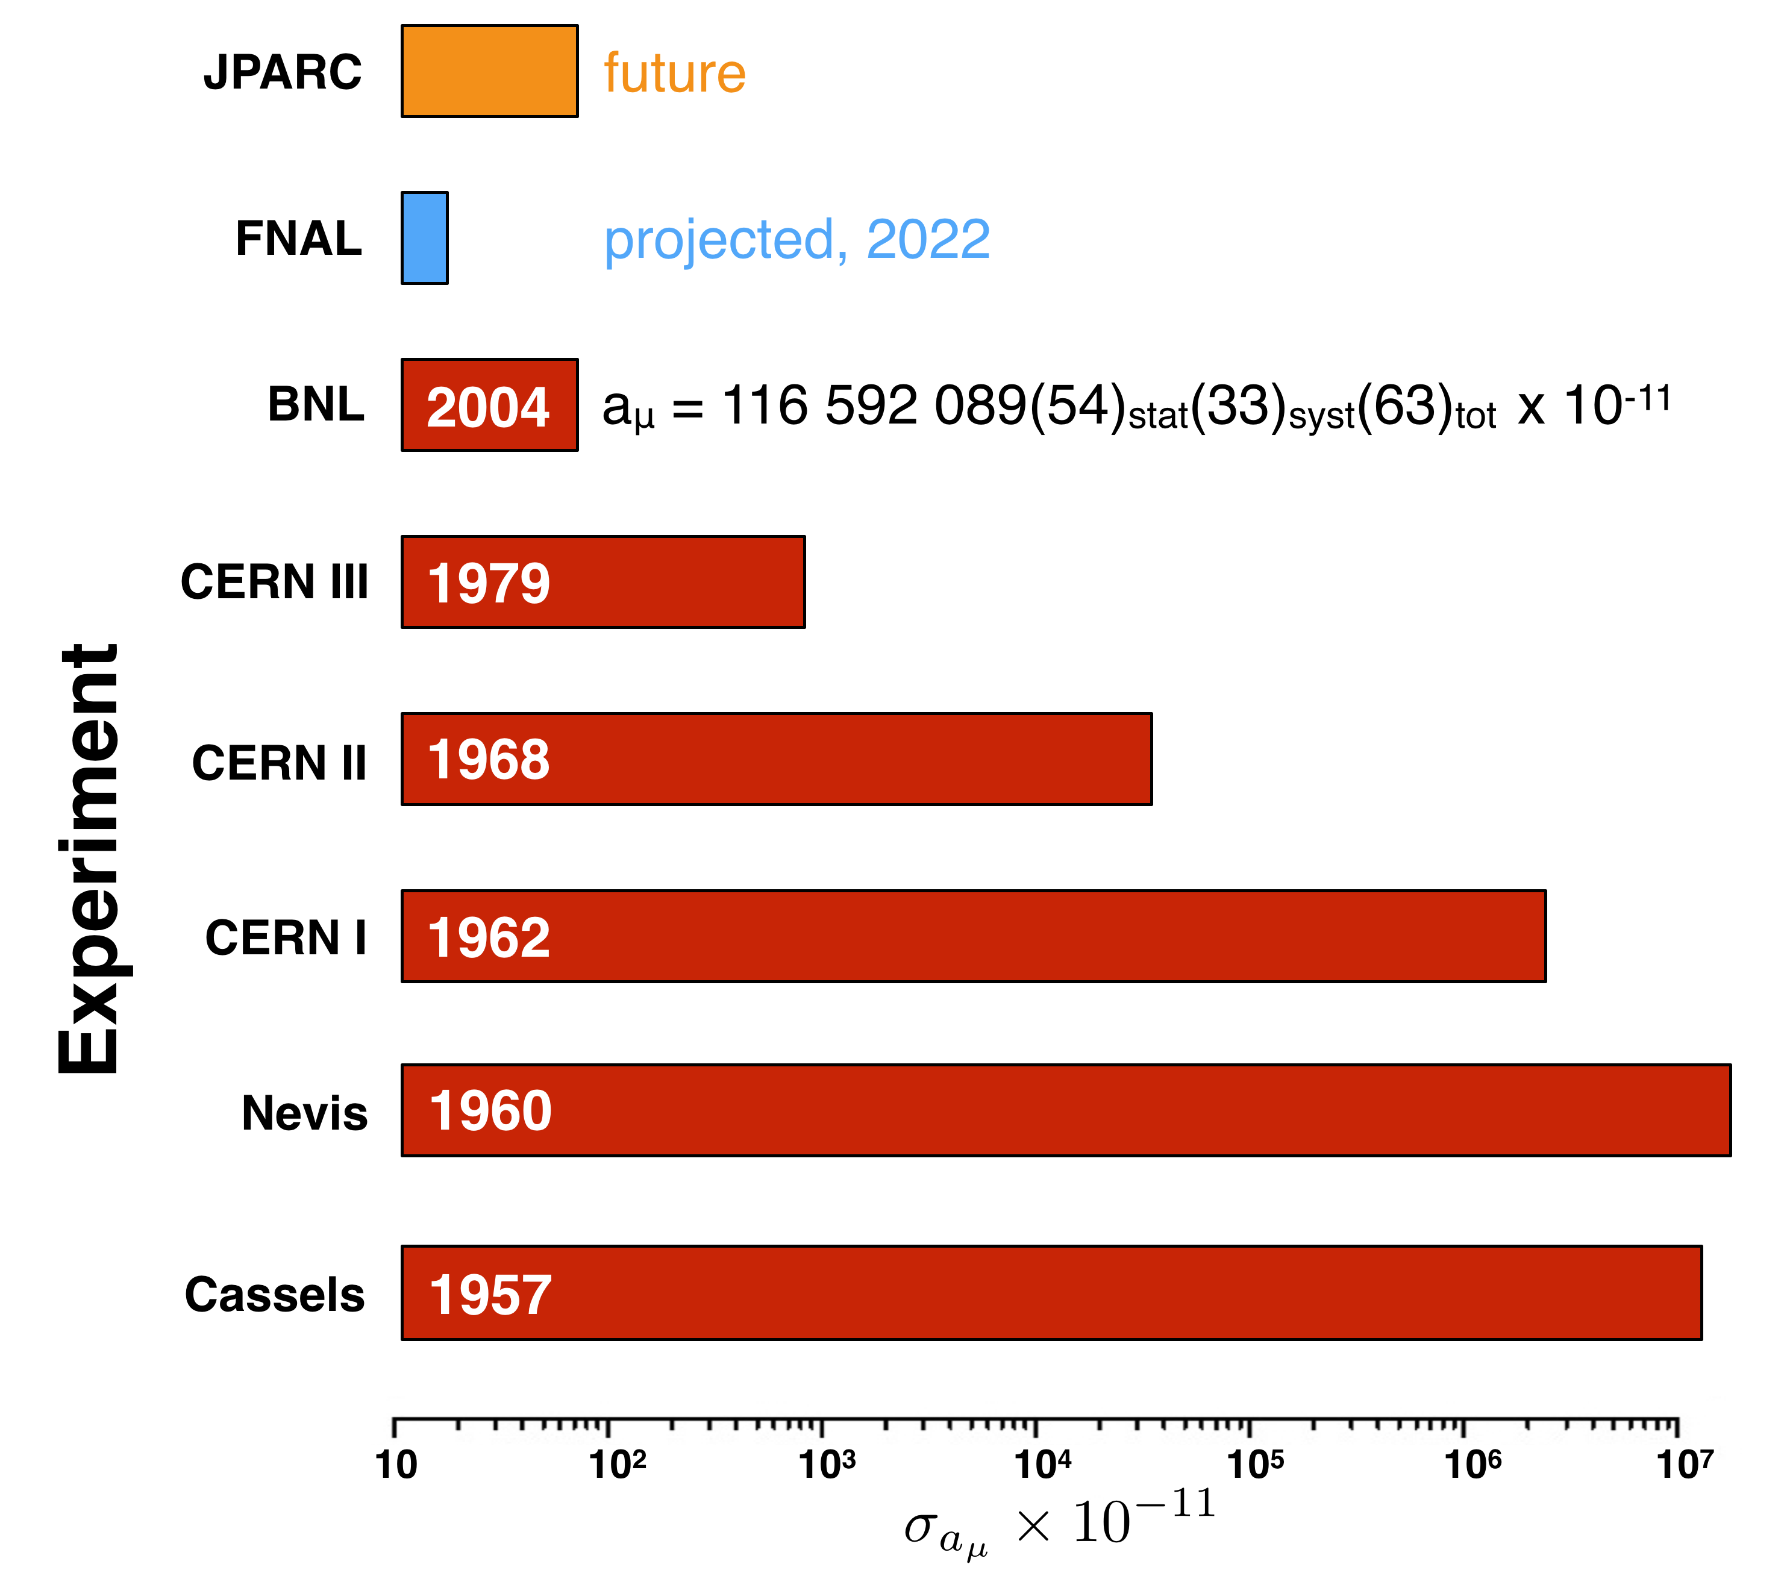
The magnetic Moment of the muon: history
Storage Ring
Dilated lifetime
measurement of $a_{μ}$, more precise
Stopped Muons
Stop muons in a magnetic field
measurement of $g_{μ}$ directly

Slide 4
The magnetic Moment of the muon: history
full stats
Run 1 (2021)
FNAL goal: 4 x improvement
Storage Ring
Dilated lifetime
measurement of $a_{μ}$, more precise
Stopped Muons
Stop muons in a magnetic field
measurement of $g_{μ}$ directly

Slide 5
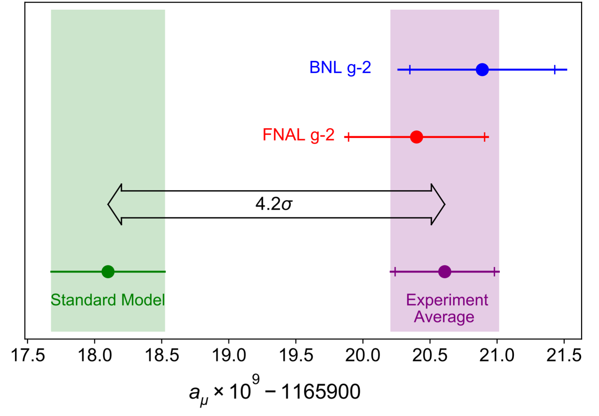
The bottom line up front… our run-1 result
WP20

Slide 6
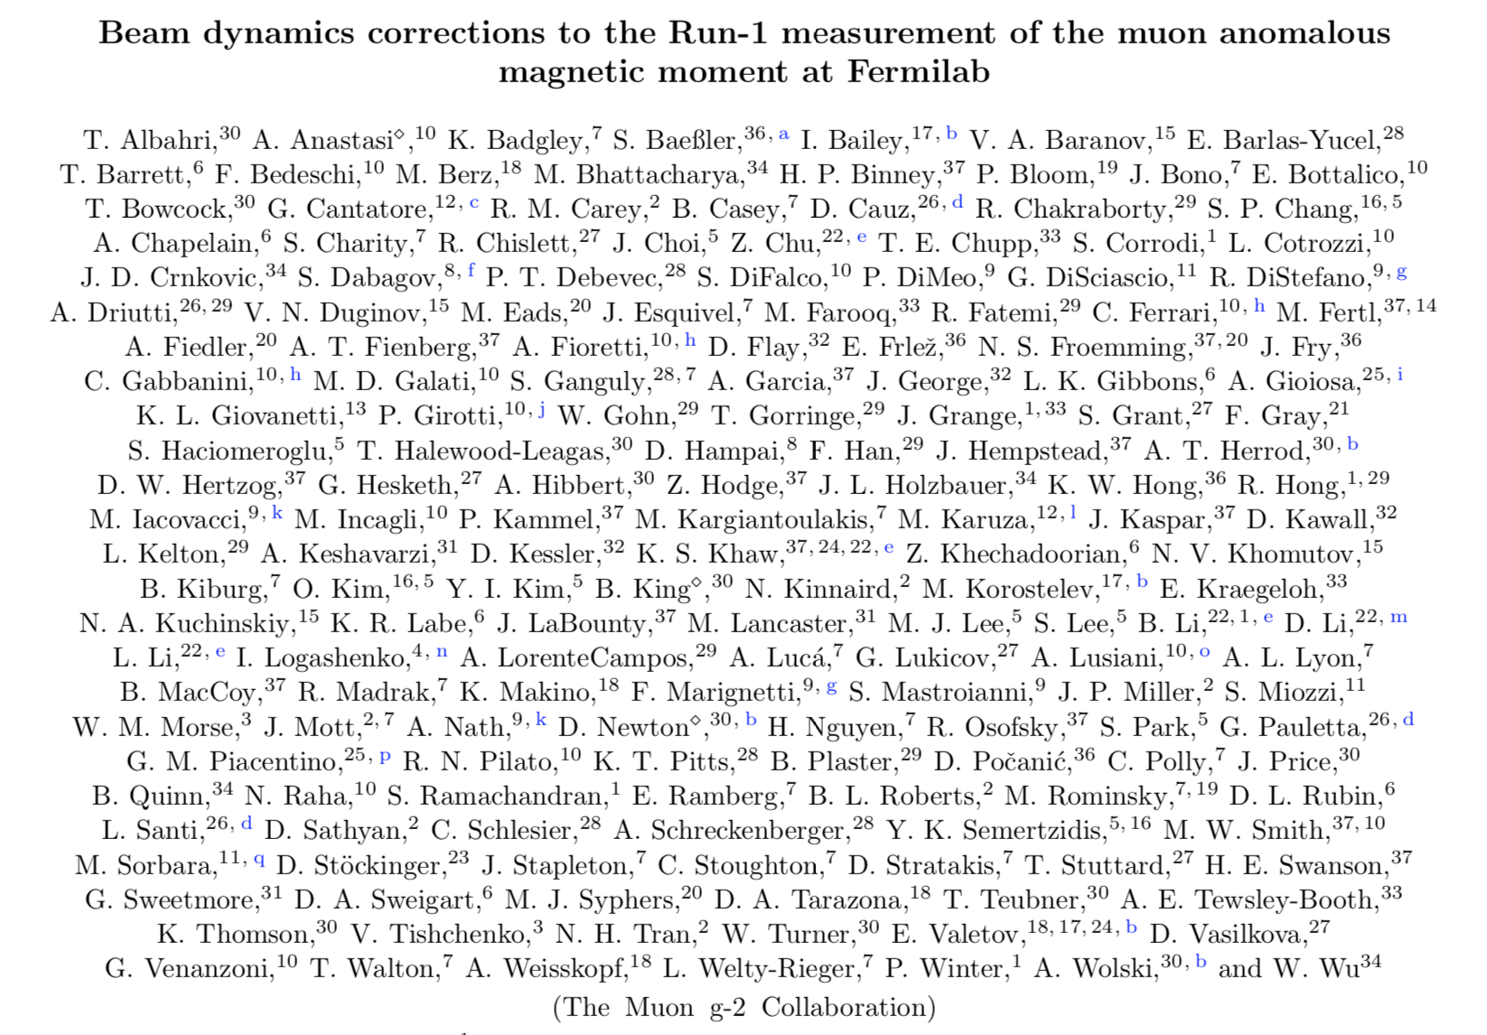
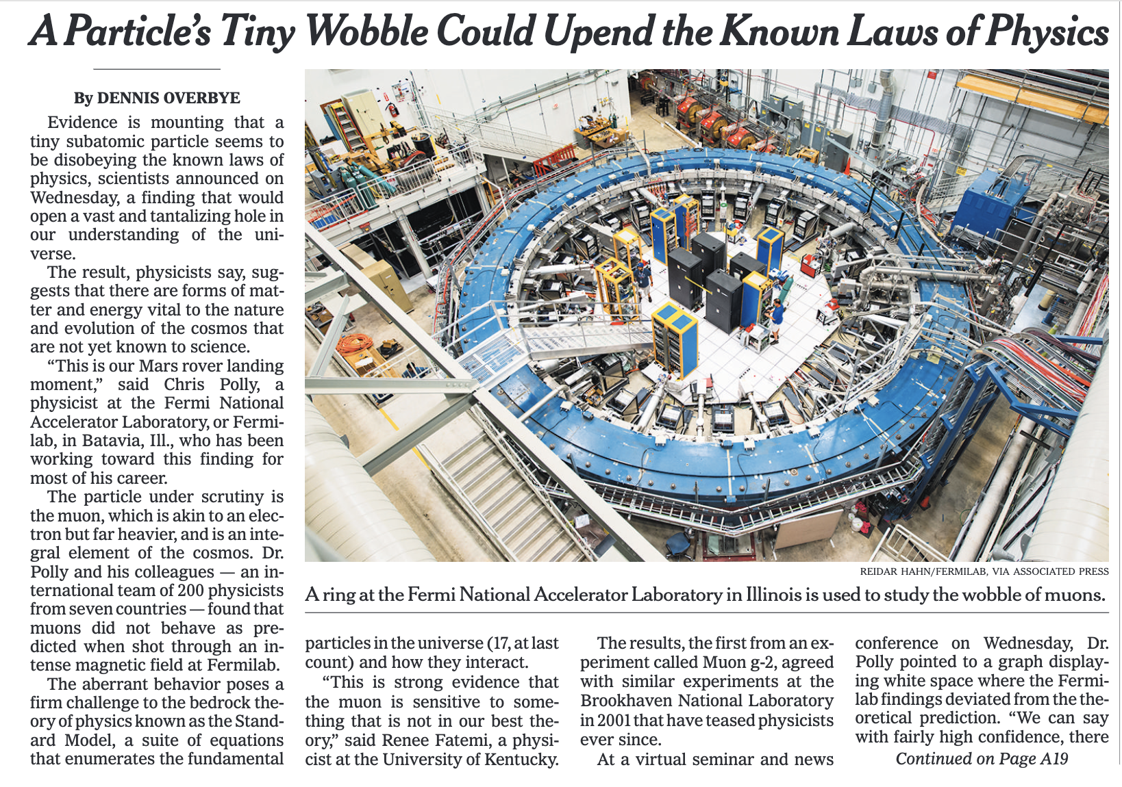
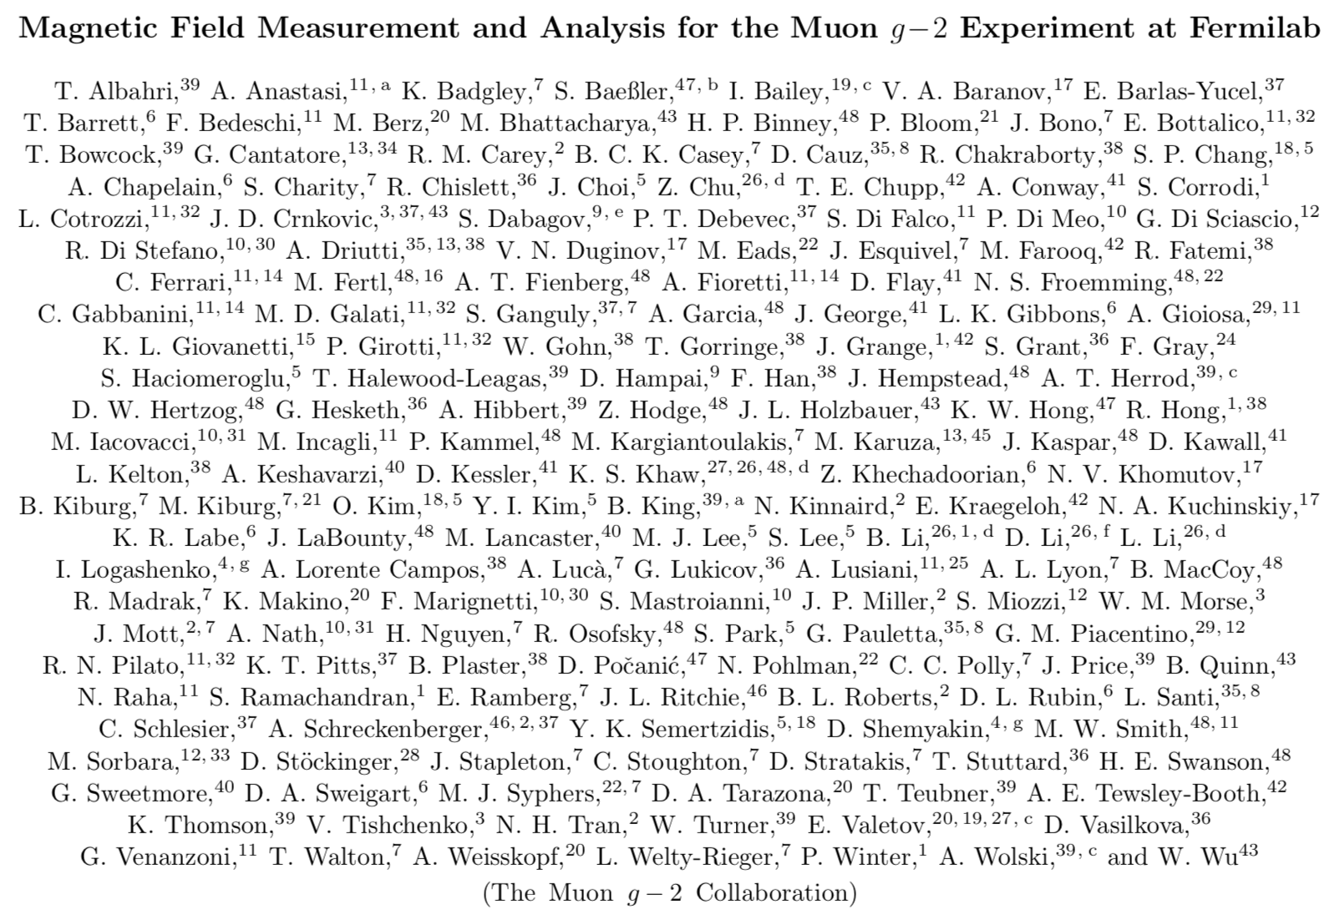
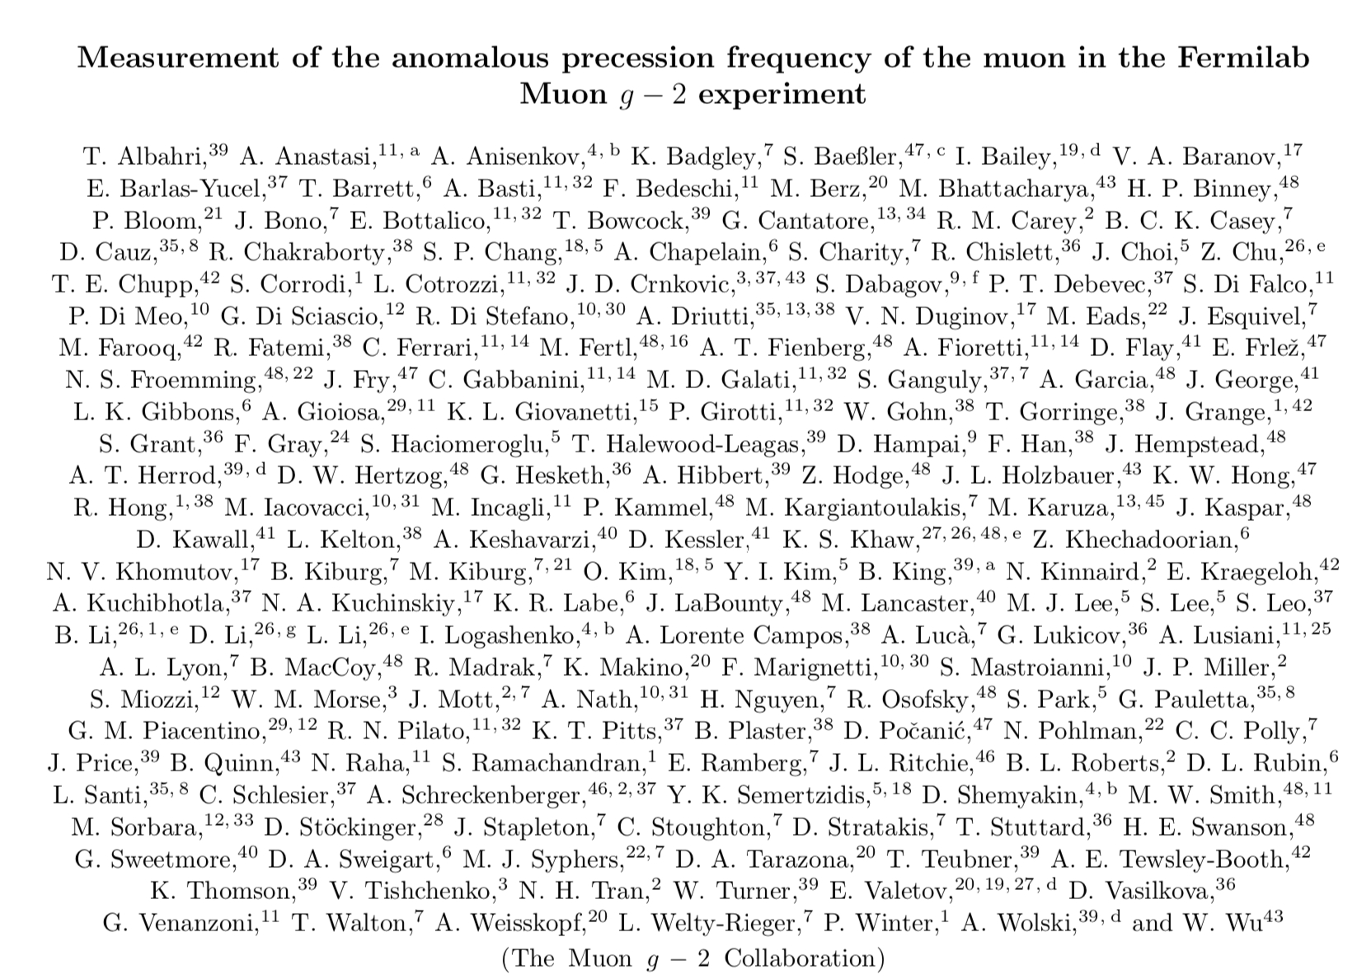
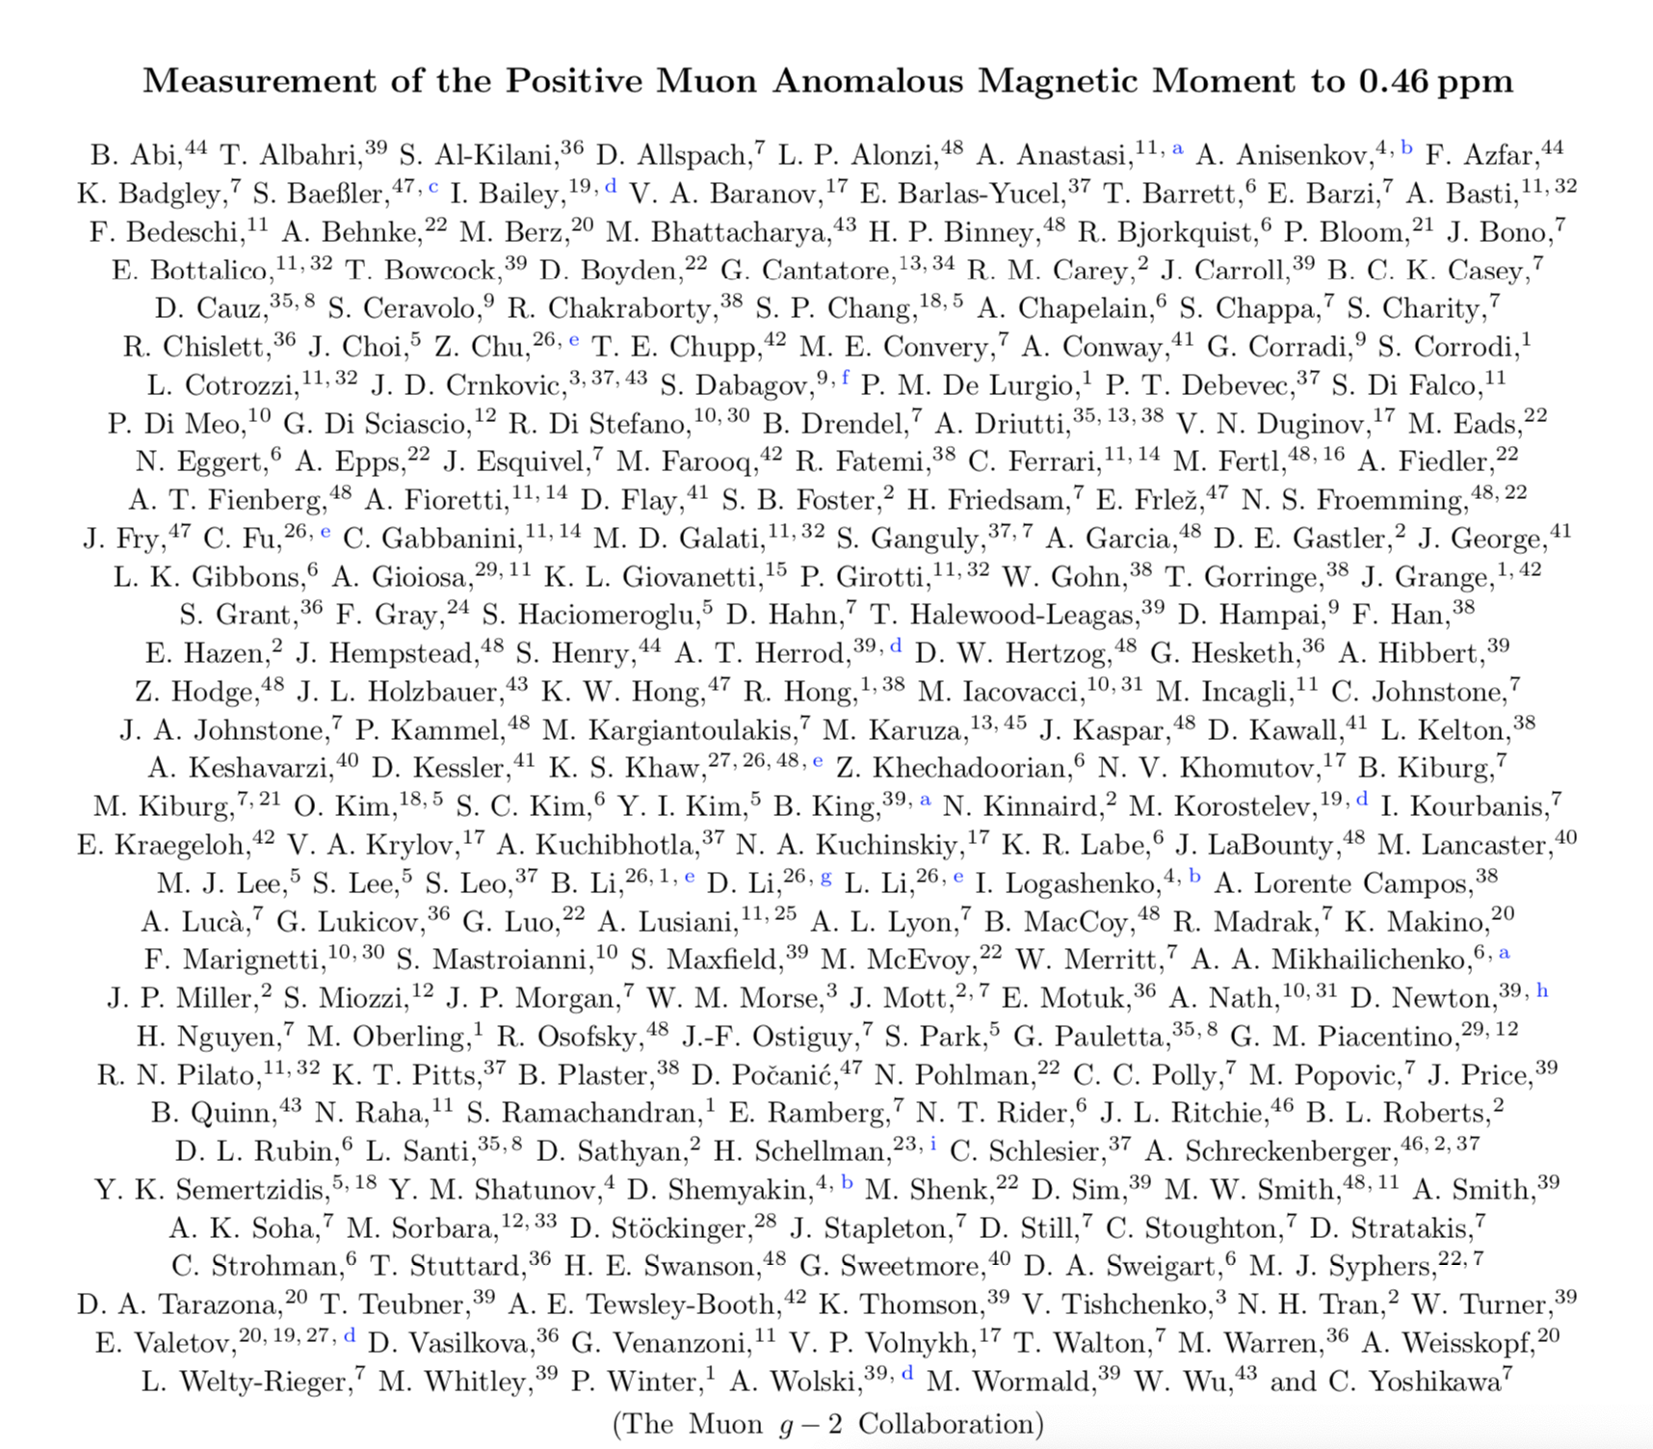
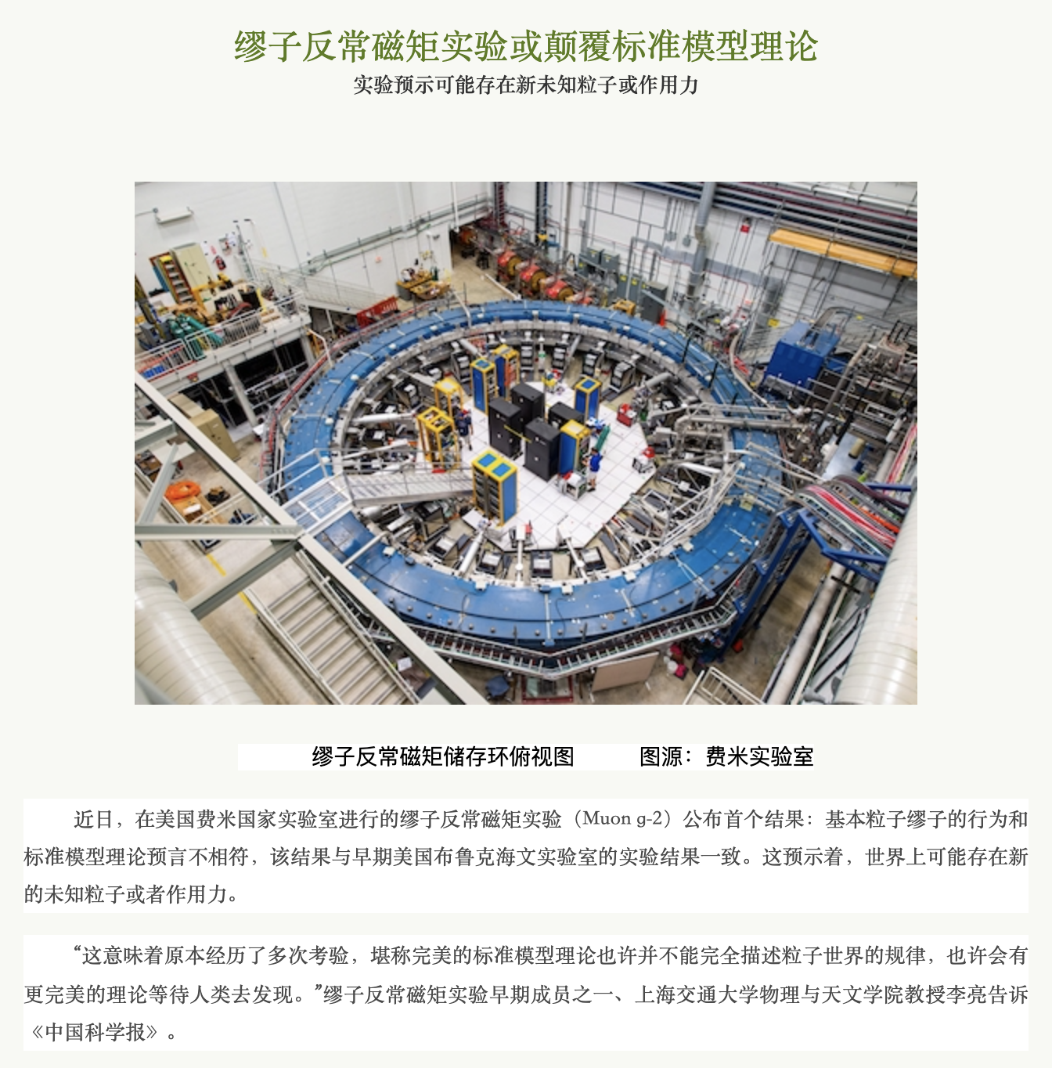
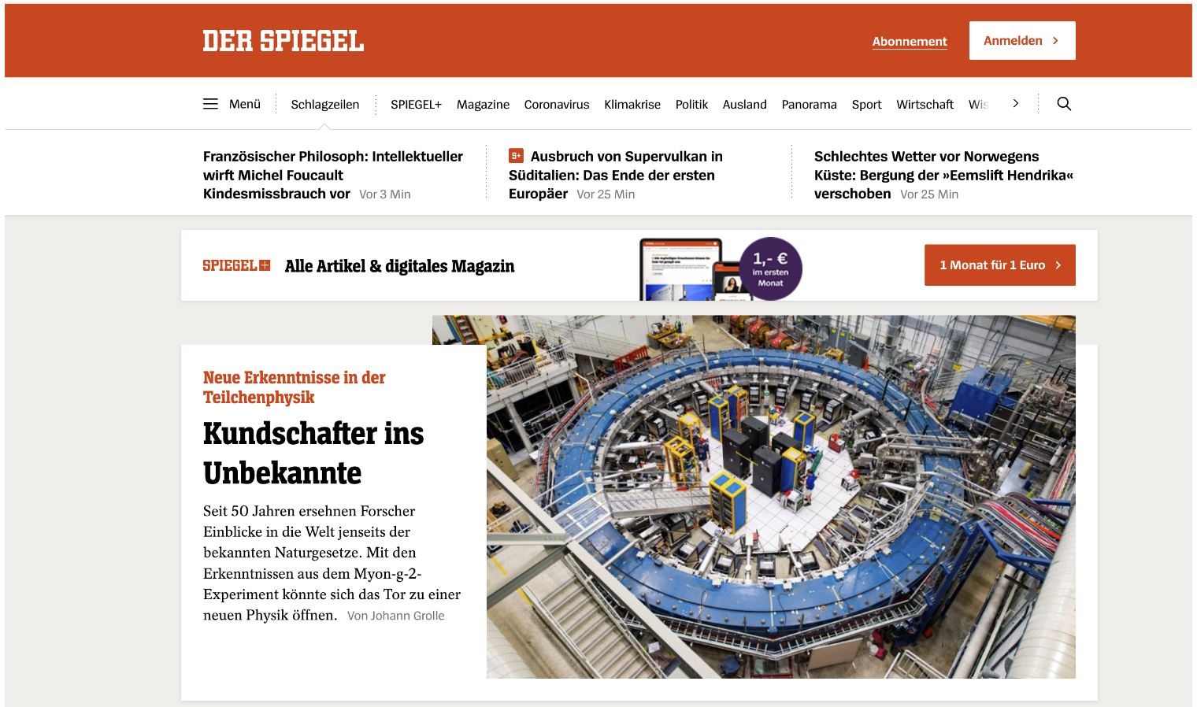
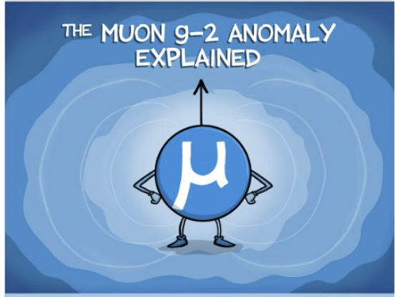
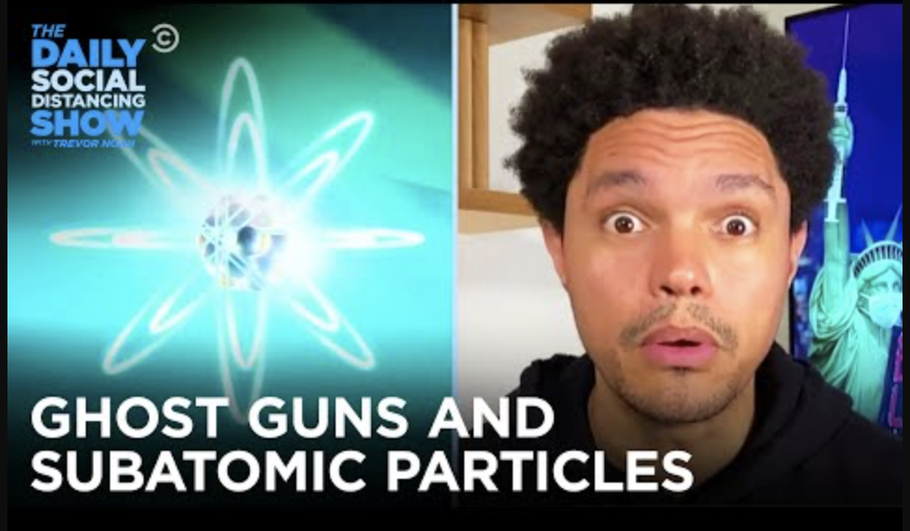
April 7th: Fermilab Muon g-2 experiment announced the first result
PRAB
PRA
PRD
PRL

Slide 7
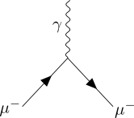
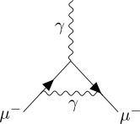
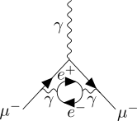
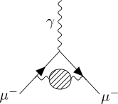
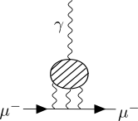
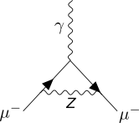
The magnetic Moment of the muon: from theory
Dirac g=2 (1928)
for s=1/2 particles
Muon g-2 Theory Initiative
(43) x 10⁻¹¹
116
810
aμ(SM)=
59
1
Schwinger (1948)
1st order QED
Vacuum polarizations
Higher order QED
Hadronic
HVP: 6845(40) x 10⁻¹¹
HLbL: 92(18) x 10⁻¹¹
Electroweak
153.6(1.0) x 10⁻¹¹
uncertainty: 0.1 x 10⁻¹¹
$$\frac{α}{2π}$$

Slide 8
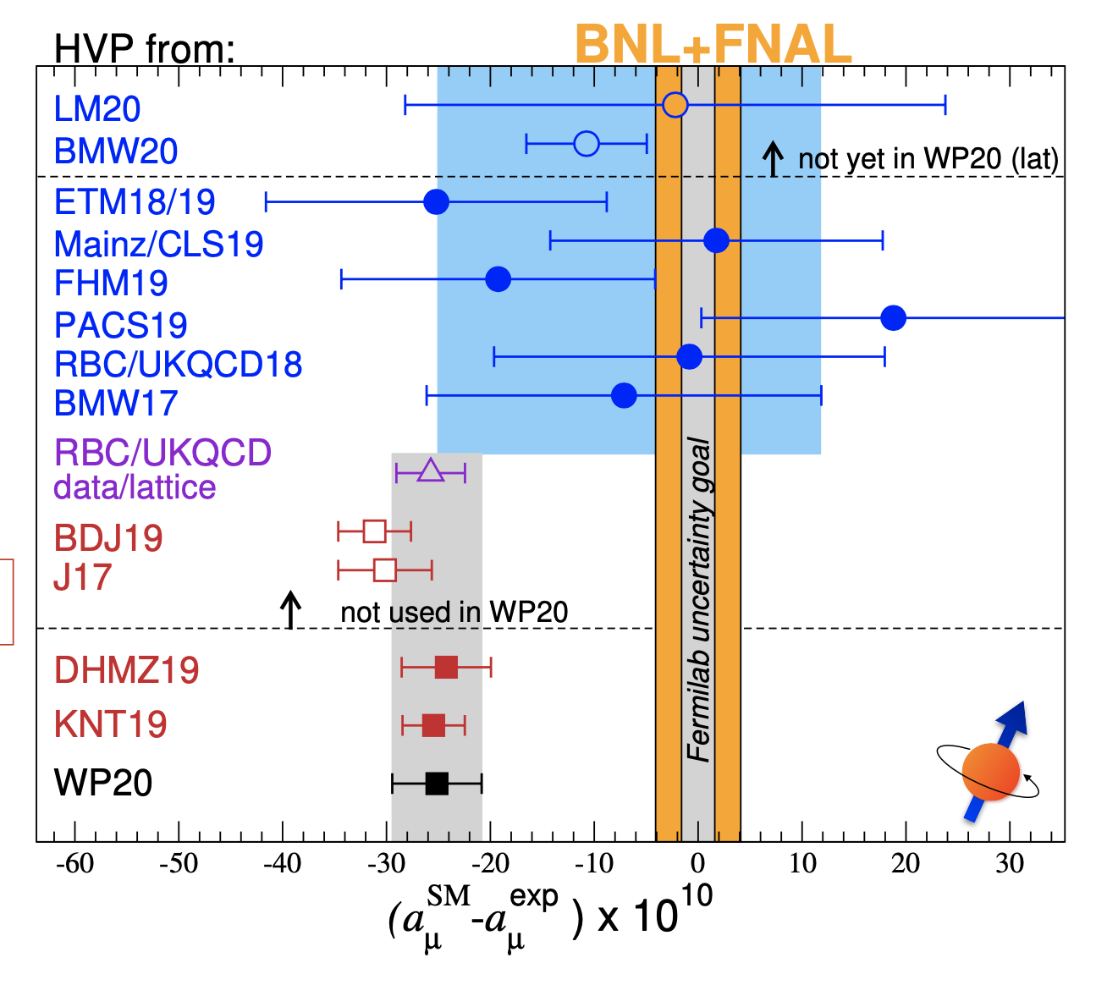
The magnetic Moment of the muon: from theory
Very active theory community
Lattice results:
lots of current work ongoing to understand possible discrepancy
comparison of intermediate windows
Lots of current work ongoing to understand possible discrepancy, comparison of intermediate time regions

Slide 9
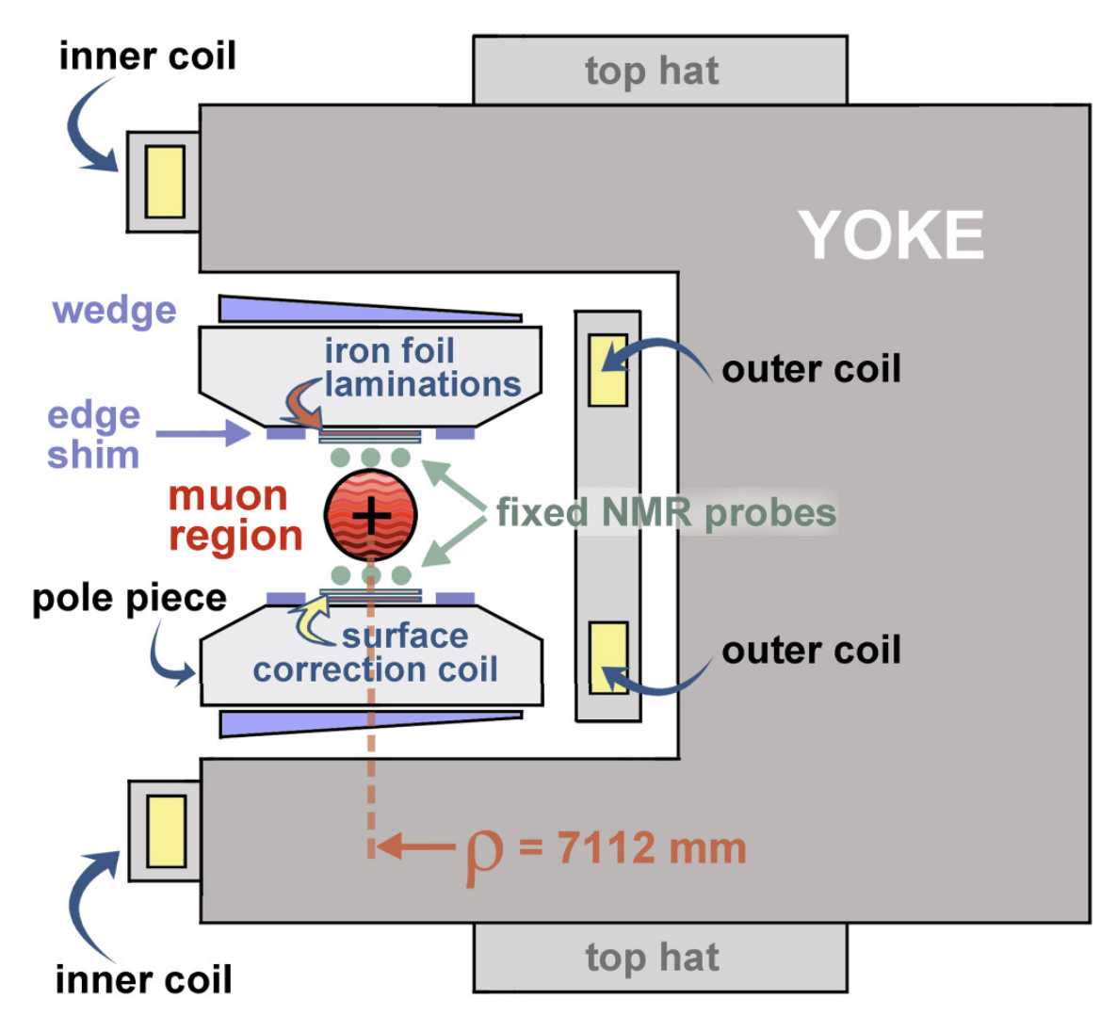
measure $a_{μ}$ in a storage ring
μ⁺
B=1.45T

Slide 10
measure $a_{μ}$ in a storage ring
Cyclotron frequency
Spin precession
$$ω_{a}≡ω_{s}-ω_{c}=\frac{eB}{m_{μ}}a_{μ}$$
$$B$$
$$ω_{C}=\frac{e}{mγ}B$$
$$ω_{S}=\frac{e}{mγ}B(1+γa_{μ})$$
$$ω_{a}$$
$$a_{μ}$$
NMR:
$$ℏω_{p}^{′}=2μ_{p}|B|$$
$$ω_{p}^{′}$$
$$B$$
$$g=2$$
momentum
$$g>2$$
$$a_{μ}=0$$
spin
$$a_{μ}>0$$

Slide 11
Storage ring: How we store the muons
pitch corrections: $C_{p}$
E-field corrections: $C_{e}$
$${\overset{⃗}{ω}}_{a}=-\frac{q}{m}\left(a_{μ}\overset{⃗}{B}-a_{μ}\frac{γ}{γ+1}\left(\overset{⃗}{β}⋅\overset{⃗}{B}\right)\overset{⃗}{β}+\left(a_{μ}-\frac{1}{γ^{2}-1}\right)\frac{\overset{⃗}{β}x\overset{⃗}{E}}{c}\right)$$
}
}
~0
~0
$$p=p_{magic}=\frac{mc}{\sqrt{a_{μ}}}=3.094GeV/c$$

Slide 12
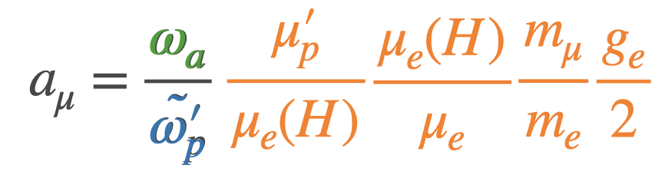
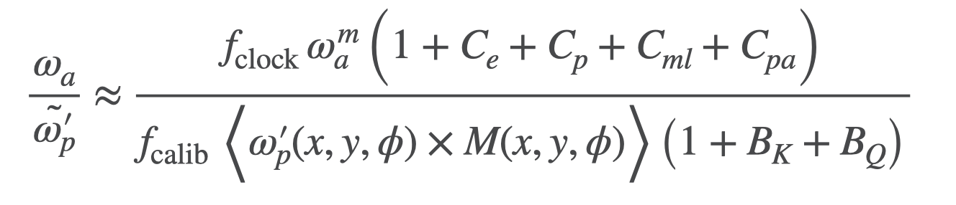
measure $a_{μ}$ in a storage ring
10.5 ppb uncertainty (hydrogen maser)
Metrologia 13, 179 (1977)
bound state QED calc., exact
0.28 ppt uncertainty
TDR goal:
140 ppb
(4 fold improvement
over the BNL result)
Phys. Rev. A 83, 052122 (2011)
2022: 0.13ppt, arXiv 2209.13084
22 ppb uncertainty
(Muonium hyper fine split.)
Phys. Rev. Lett. 82, 711 (1999)

Slide 13
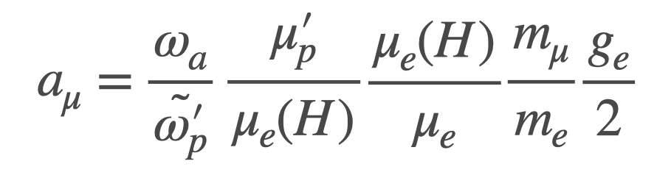
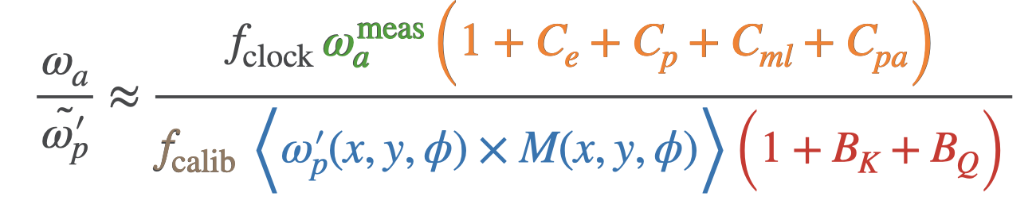
measure $a_{μ}$ in a storage ring
blinding factor
precession
beam dynamics corrections
absolute field
calibration
magnetic field sampled
by the muon distribution
Magnetic transients
corrections

Slide 14
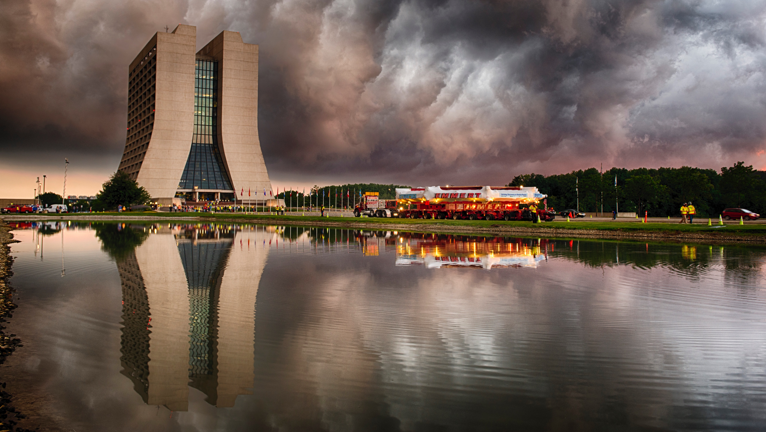
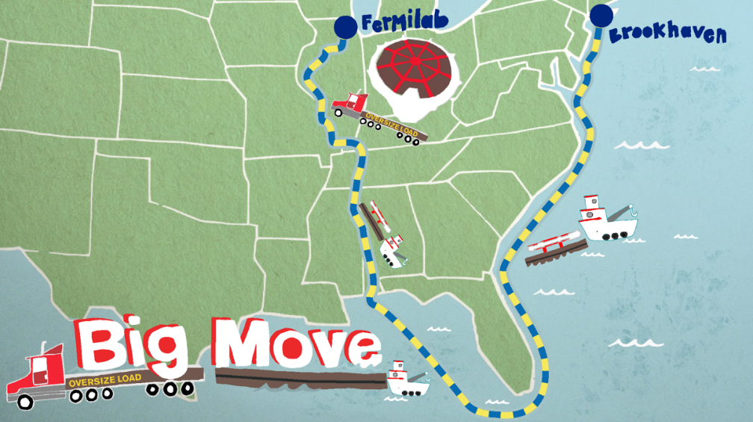
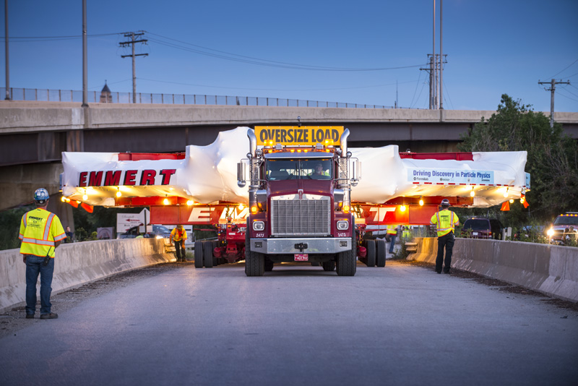
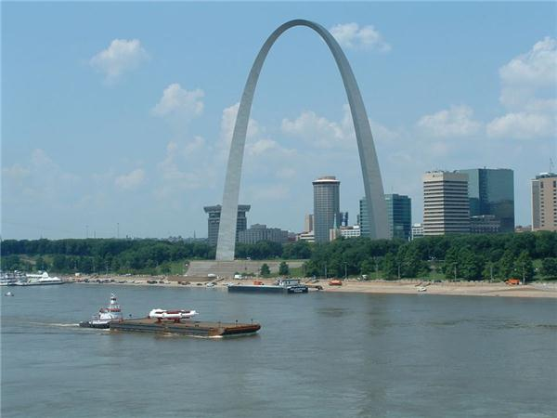
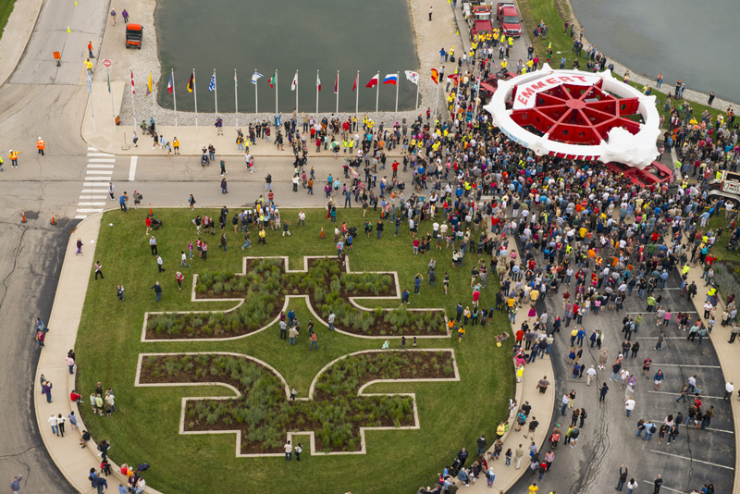
The magnet: the big move

Slide 15
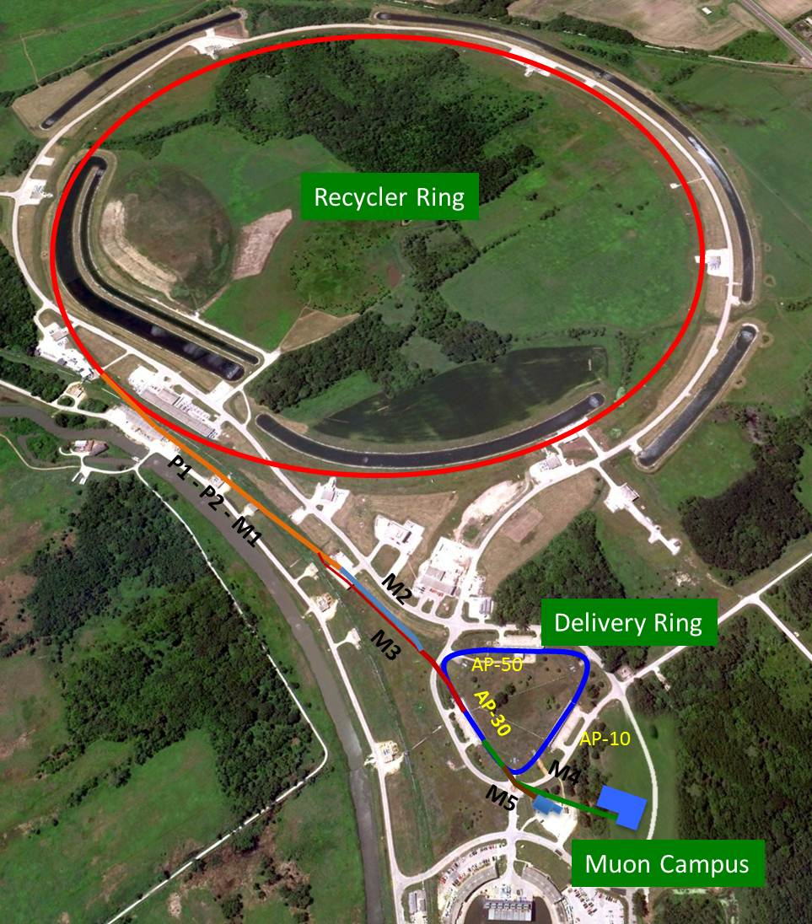
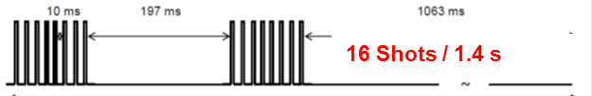
The muons
8 GeV protons in recycler
Target
2 x 8 shots
p/π/μ beam, p kicked away, π decay
$$π^{+}→μ^{+}ν_{μ}$$
95% polarized muons
$${\overset{⃗}{ω}}_{a}=-\frac{q}{m}\left(a_{μ}\overset{⃗}{B}-\left(a_{μ}-\frac{1}{γ^{2}-1}\right)\frac{\overset{⃗}{β}x\overset{⃗}{E}}{c}\right)$$
for
$$p=p_{magic}=\frac{mc}{\sqrt{a_{μ}}}=3.094GeV/c$$
Store muons for ~700us (~10 lifetimes)

Slide 16
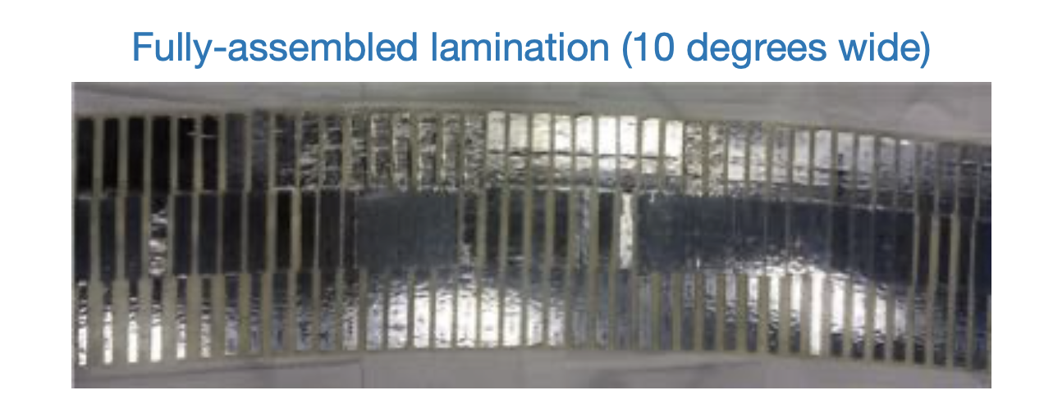
How to store muons: magnetic field
μ⁺

Slide 17
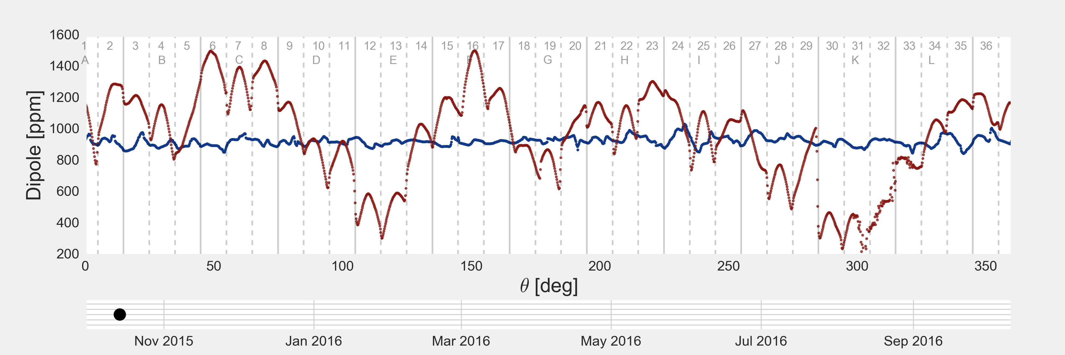
How to store muons: magnetic field
Fermilab: ~15 ppm RMS (~75 ppm peak-to-peak)
BNL E821: ~35 ppm RMS (~200 ppm peak-to-peak)
Shimming

Slide 18
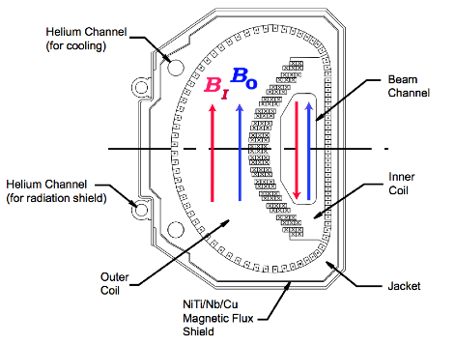
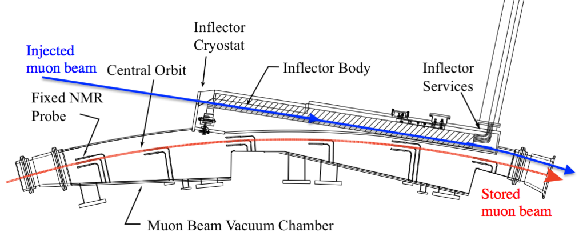
How to store muons: The inflector
μ⁺
Need to cancel field in beam channel
- prevents strong deflection of the beam
d=77mm

Slide 19
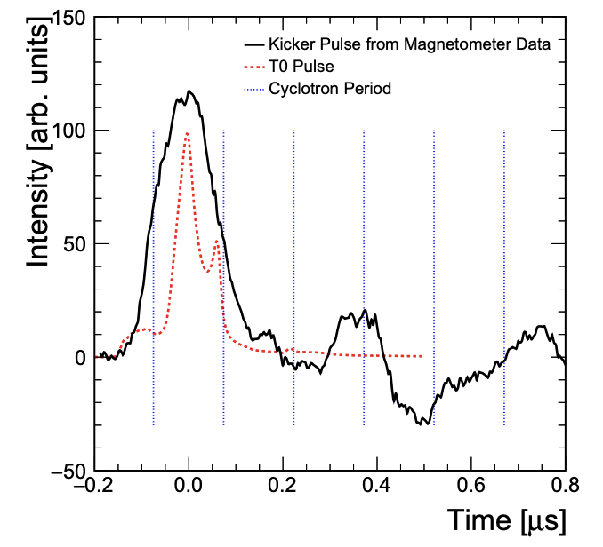
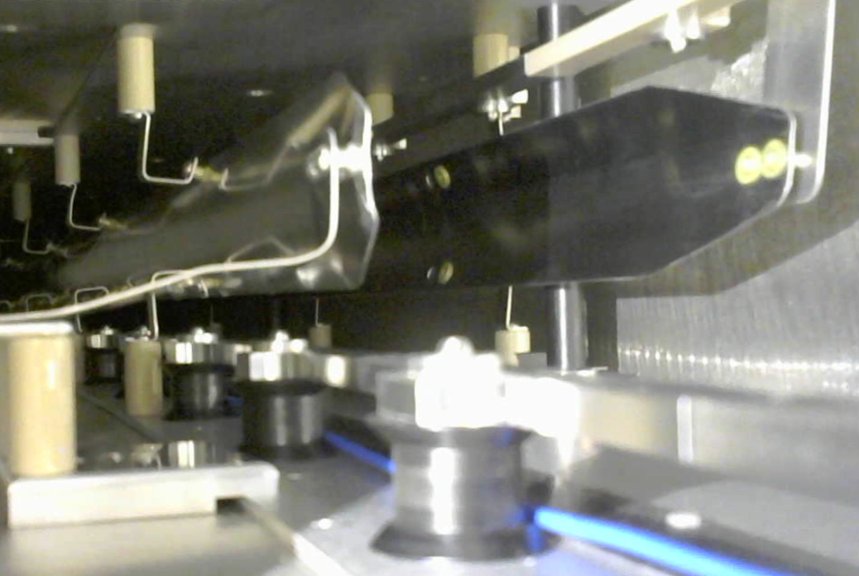
How to store muons: The kicker
μ⁺
Incident beam center 77 mm off from center
of storage region
- tears muon onto store orbit
μ⁺
d=77mm
Upgrade since run 1:
New kicker cable allow for proper kicker, reducing the equilibrium radius.

Slide 20
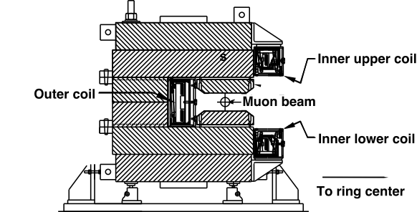
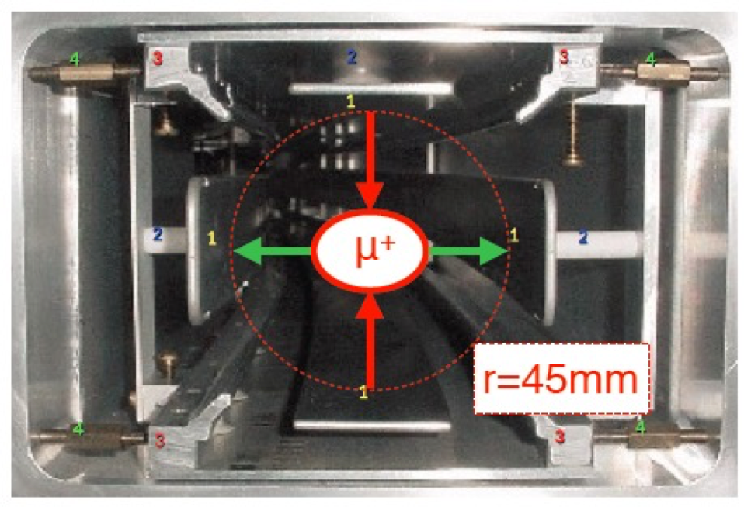
How to store muons: focusing
Radial focus:
1.45T vertical B field
μ⁺
Vertical focus:
electrostatic quadrupoles (43% of the ring)
+18kV
-18kV
-18kV
Upgrade since run 1:
Broken high voltage resistors in run 1 led to an additional early-to-late effects.
+18kV
$${\overset{⃗}{ω}}_{a}=-\frac{q}{m}\left(a_{μ}\overset{⃗}{B}-\left(a_{μ}-\frac{1}{γ^{2}-1}\right)\frac{\overset{⃗}{β}x\overset{⃗}{E}}{c}\right)$$

Slide 21
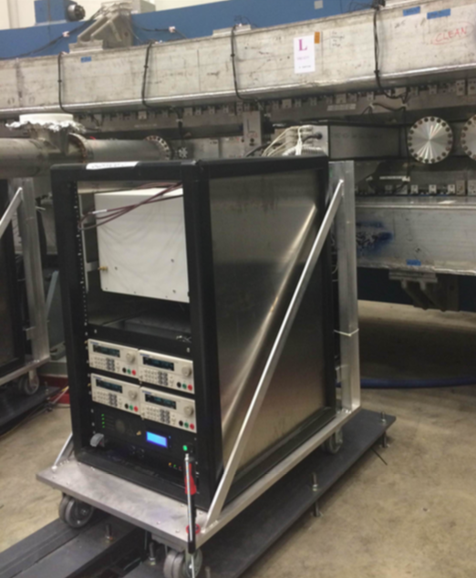
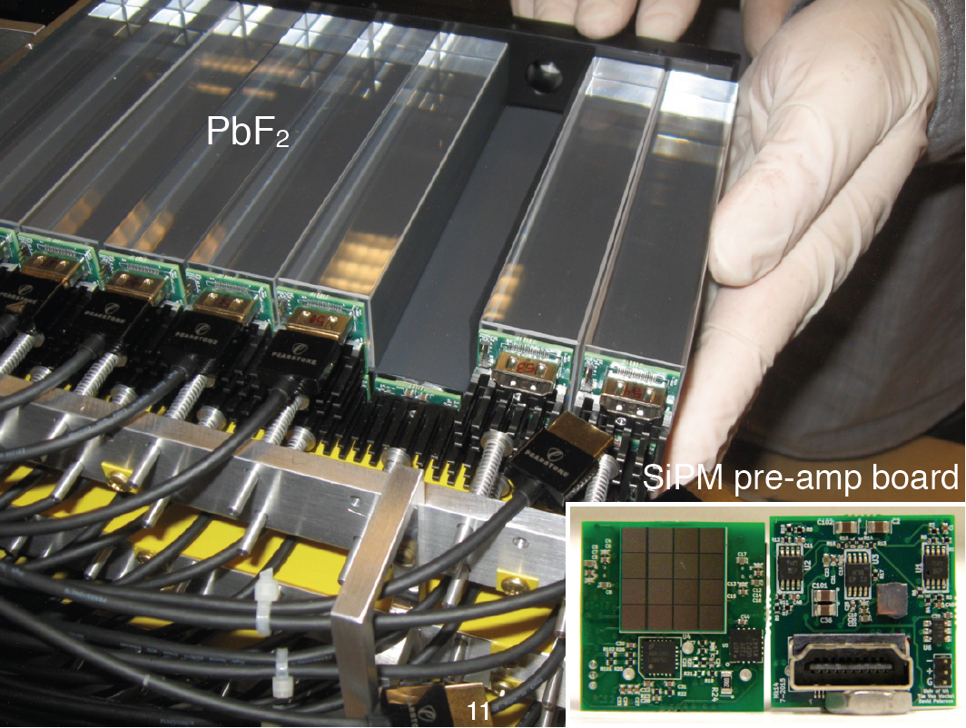
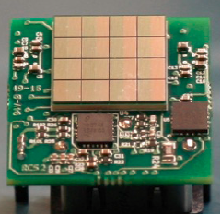
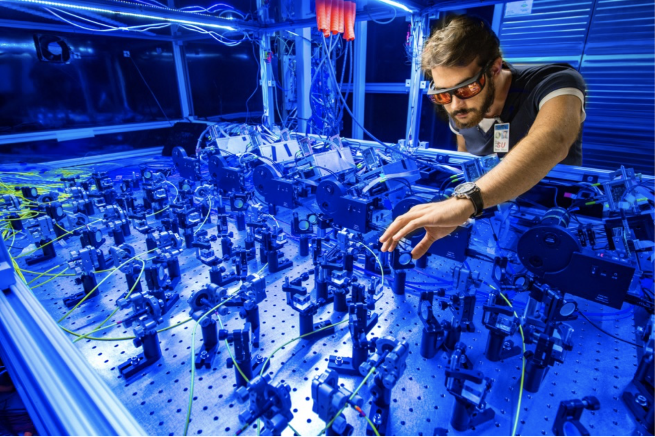
The measurements: calorimeters ( $ω_{a}^{meas}$ )
μ⁺
24 Calorimeters with 54 (9x6) Cherenkov
PbF2 crystals read out by SiPMs
arrival time (~100ps) & energy of e⁺ (~5% at 2GeV)
Laser system for gain response calibration
throughout data taking
(stability 10⁻³, rate difference 10⁴)

Slide 22
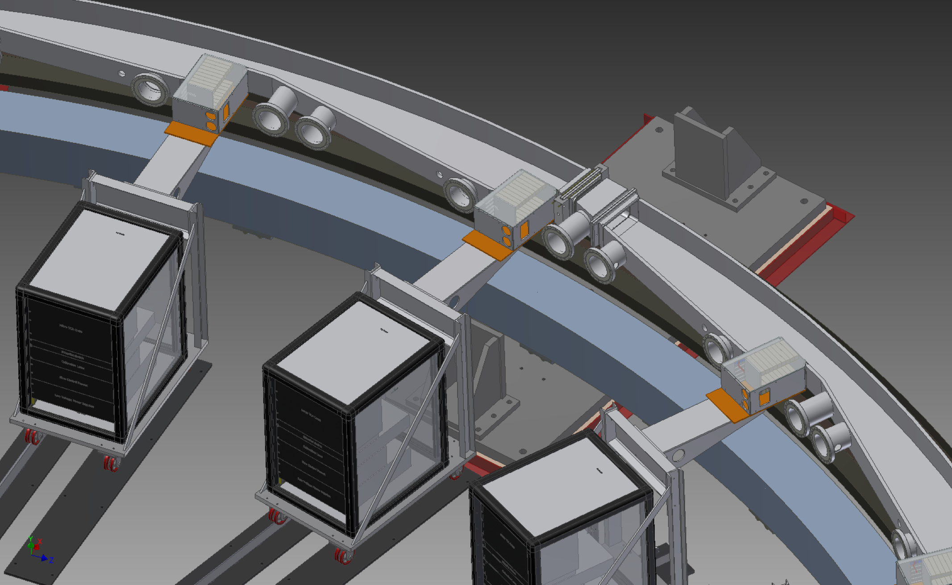
The measurements: calorimeters ( $ω_{a}^{meas}$ )
μ⁺
- Parity violating decay (Michel)
- Highest-energy e⁺ emitted
preferentially along muon spin
e⁺
⇒
⇒
    µ⁺
νe
⇒
    e⁺
ν̄µ
⇒

Slide 23
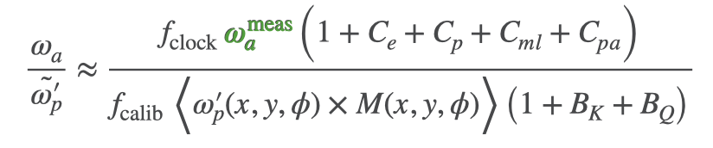
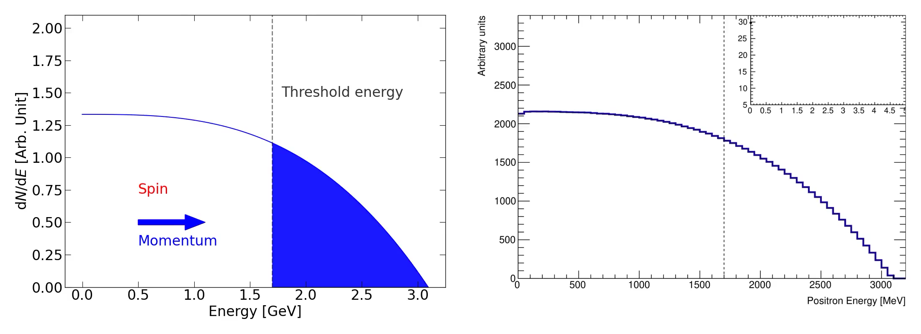
Measurements: $ω_{a}^{meas}$
time

Slide 24
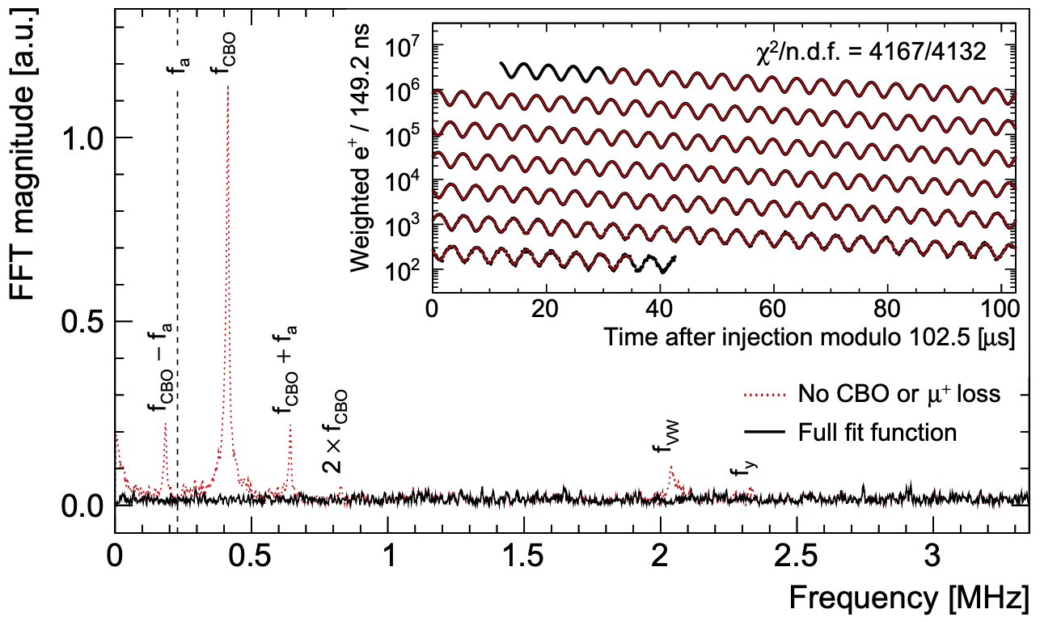
Measurements: $ω_{a}^{meas}$
Example from dataset 1d
$$N_{0}e^{-t/τ}\left[1-Acos(ω_{a}t+ϕ)\right]$$
22 parameter fit
*CBO:
Coherent Betatron
Oscillation

Slide 25





trackers: beam dynamics
μ⁺
2 straw-tracker stations
(each 8 modules, 4 layers of 32 straws, 50:50 Ar:Ethane, res ~100um)
Muon distribution + field maps:
Handle on beam dynamics

Slide 26

trackers: beam dynamics
Upgrade since run 1:
Additional RF on the ESQ since the end of run 4 allows to reduce the CBO.
*CBO: Coherent Betatron Oscillation

Slide 27


Nuclear magnetic resonance (NMR)
$$ω_{p}^{′}$$
$$ℏω_{p}^{′}=2μ_{p}|B|$$
$$B$$
- Flip spins of a sample
by delivering a π/2-pulse
- measure Free Induced Decay (FID)
Free Induced Decay (FID)
Petroleum Jelly probes
H20 calibration probe ($f_{calib}$)
time [s]

Slide 28





The Field measurement
Trolley
- inside the storage region, ~3 days
- 17 probes, moves around the ring
378 Fixed Probes
- Outside of the storage region
- 72 position, ~5deg apart
60mm
70 mm
35 mm
90 mm
2
90mm
154mm
Electronics
~49cm
NMR probes

Slide 29


The Field measurement
Trolley (every ~3 to 5 days)
Field inside the muon storage volume
378 Fixed Probes (from the outside)
Track the field between field maps
See poster: “The precision magnetic field in the Muon g-2 Experiment at Fermilab”
Upgrade since run 1:
Thermal insulation (run 2) and improved AC (run 3) increased the field stability.
Uncertainty: random walk model
(Brownian bridge)

Slide 30


Back to the master formula
beam dynamics
corrections
precession
unblinding factor
magnetic field sampled
by the muon distribution
absolute field
calibration
Magnetic transients
corrections

Slide 31


The run-1 result
Upgrade since run 1:
Extensive campaigns to measure the magnetic field transients more precisely.

Slide 32
More to come: the Beyond run 1 analysis
Run 4/5/6, aiming for another factor of ~2 reduction in error
Run 2/3 analysis in progress, aiming to
reduce experimental error by 2 by spring. Systematics on track for < 100 ppb.
results ~6% of full stats, 434 ppb stat ⊕ 157 ppb syst errors

Slide 33
Even More to come: run 6
Run 6 starts in ~2 weeks
- originally $μ^{-}$planned, canceled
- lower priority at FNAL than mu2e
Run 4/5/6, aiming for another factor of ~2 reduction in error
Run 2/3 analysis in progress, aiming to
reduce experimental error by 2 by spring. Systematics on track for < 100 ppb.
results ~6% of full stats, 434 ppb stat ⊕ 157 ppb syst errors

Slide 34








The collaboration
Run-1 unblinding ceremony
USA
  Boston
  Cornell
  Illinois
  James Madison
  Kentucky
  Massachusetts
  Michigan
  Michigan State
  Mississippi
China
  Shanghai Jiao Tong
Germany
  Dresden
  Mainz
Russia
  Budker/Novosibirsk
  JINR Dubna
Italy
  Frascati
  Molise
  Naples
  Pisa
  Roma Tor Vergata
  Trieste
  Udine
Korea
  CAPP/IBS
  KAIST
United Kingdom
  Lancaster/Cockcroft
  Liverpool
  Manchester
  University College London
  North Central
  Northern Illinois
  Regis
  Virginia
  Washington
USA National Labs
  Argonne
  Brookhaven
  Fermilab

