Slide 1
I.FAST Gun Developments at PSI
Dr. Thomas Geoffrey Lucas :: Research Fellow :: Paul Scherrer Institut
GFA Seminar: 29th November 2021

Slide 2
Contents
IFAST project
  IFAST Overview
  Task 7.4
  Starting point for SW RF Photogun and TW RF Photogun
Applications
  SwissFEL injector Upgrade
  Eupraxia SPARC
Theory for High Gradient RF Photoguns
  Space-Charge Effects
  Field Emission and Dark Current
  RF Breakdown
  Pulsed Surface Heating
  Multipacting
Project Status and Ongoing Tasks
  Dark Current and Radiation
  Thermal Simulations
  RF Design updates
  Test Stand Development
Timeline
Conclusions

Slide 3
Contents
IFAST project
  IFAST Overview
  Task 7.4
  Starting point for SW RF Photogun and TW RF Photogun
Applications
  SwissFEL injector Upgrade
  Eupraxia SPARC
Theory for High Gradient RF Photoguns
  Space-Charge Effects
  Field Emission and Dark Current
  RF Breakdown
  Pulsed Surface Heating
  Multipacting
Project Status and Ongoing Tasks
  Dark Current and Radiation
  Thermal Simulations
  RF Design updates
  Test Stand Development
Timeline
Conclusions

Slide 4

Innovation Fostering in Accelerator Science and Technology (I.FAST)
Aim is to investigate future accelerator technologies, particularly ones which are related to the size and performance of the machines.
49 partners, including 17 companies, all from 14 countries.
Budget 18.7 MEuro
May 2021 to April 2025
https://ifast-project.eu/

Slide 5
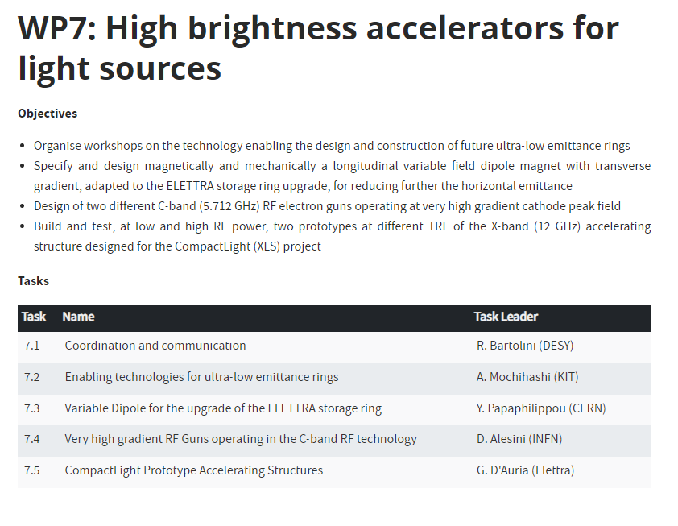
IFAST Task 7.4
PSI and INFN tasked with developing two high gradient RF photoguns.
Operating at American C-band frequency (5.712 GHz).
Two different technologies to be compared: Standing Wave RF photogun and Travelling Wave RF Photogun.
https://ifast-project.eu/

Slide 6
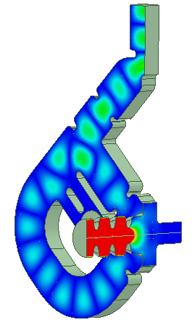
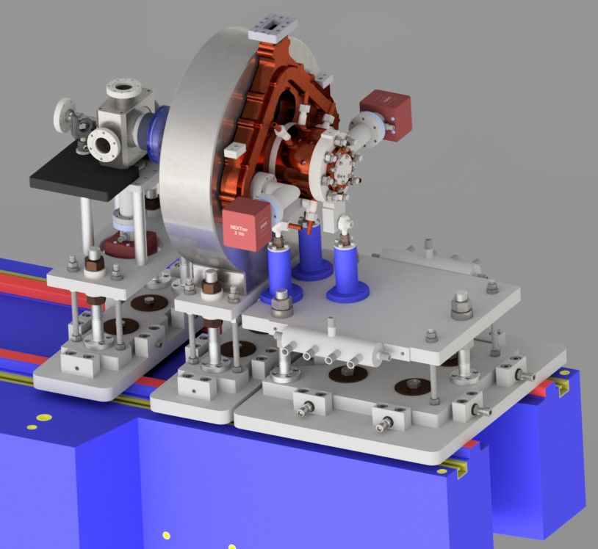
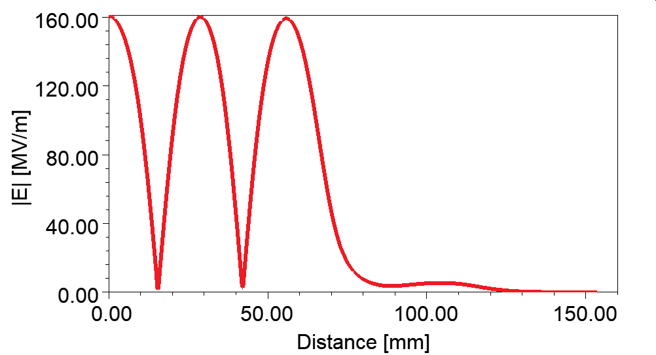
SW RF Photogun (INFN)
Parameter | value
Frequency [GHz] | 5.712
E_{cath}/√P_{diss} [MV/(m⋅MW^{0.5})] | 51.4
Peak input power [MW] | 18 | 23
Cathode field [MV/m] | 160 | 180
Cathode type | copper
Rep. rate [Hz] | 1000 | 100
Quality factor | 11900
Filling time [ns] | 166
Coupling coefficient | 3
RF pulse length [ns] | 300
E_{surf}/E_{cath} | 0.96
Mod. Poy. Vect. [W/μm²] | 2.5 | 3.1
Pulsed heating [ºC] | 16 | 20
Av.diss. Power [W] | 2300 | 300
Longitudinal electric field profile
Note: Some modifications added since the start of IFAST
Courtesy of INFN Group

Slide 7
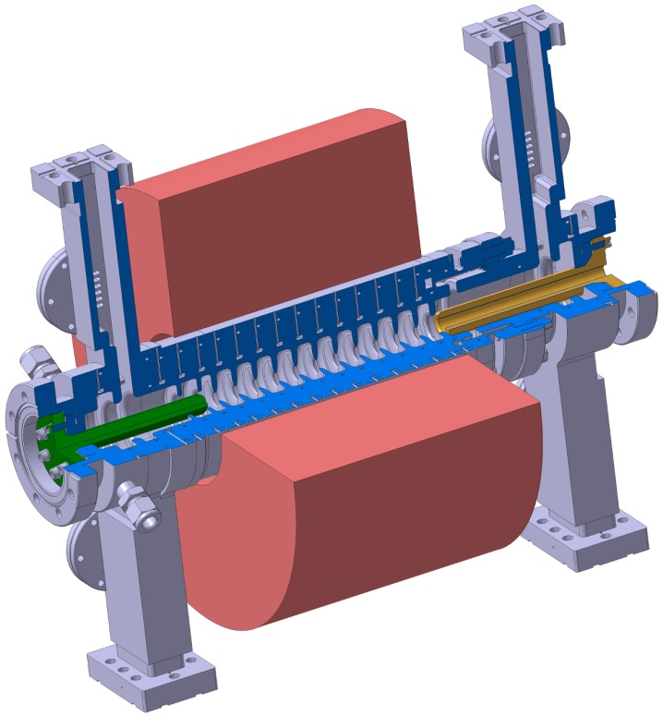
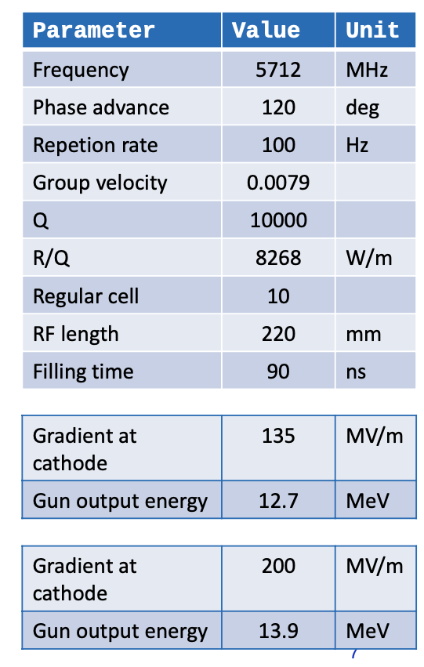
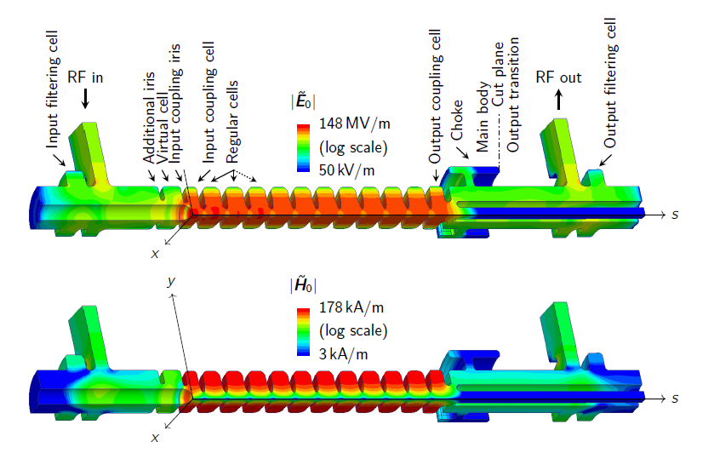
TW RF Photogun (PSI)
M. Schär’s PhD Thesis [1]

Slide 8
Contents
IFAST project
  IFAST Overview
  Task 7.4
  SW RF Photogun and TW RF Photogun
Applications
  SwissFEL injector Upgrade
  Eupraxia SPARC
Theory for High Gradient RF Photoguns
  Space-Charge Effects
  Field Emission and Dark Current
  RF Breakdown
  Pulsed Surface Heating
  Multipacting
Project Status and Ongoing Tasks
  Dark Current and Radiation
  Thermal Simulations
  RF Design updates
  Test Stand Development
Timeline
Conclusions

Slide 9
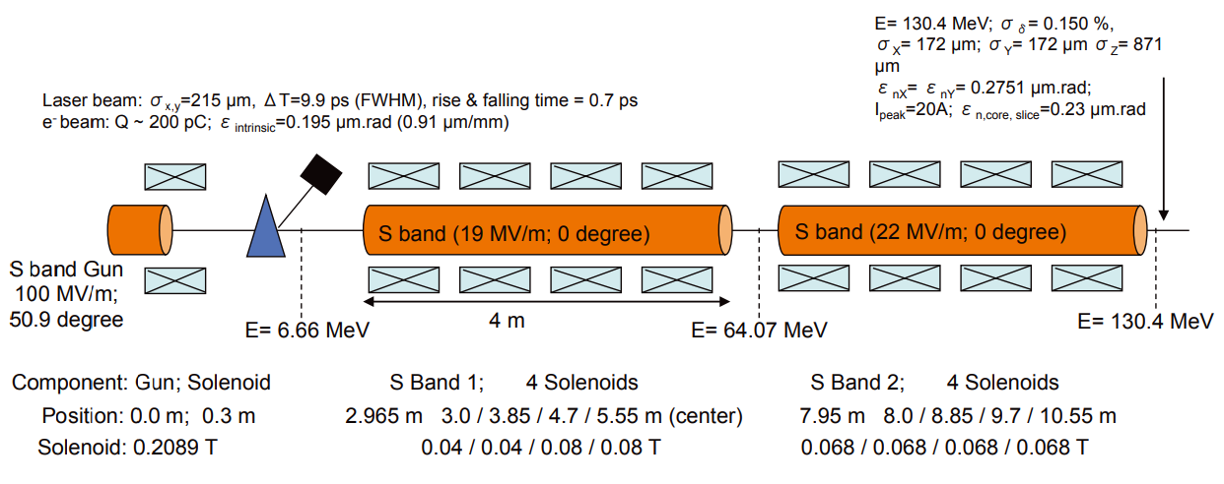
SwissFEL Injector: S-band to S-band Injector
SwissFEL CDR [2]

Slide 10

Possible Injector Upgrades
7-20 MeV
C-band
Gun
135-200 MV/m
Rep Rate <400 Hz
1. Change to C-band Gun
  Higher brightness machine.
2. Change to Full C-band linac
  Higher brightness machine.
  More compact injector
  Same technology as main linac (better for spare parts and redundancy).
  Lower correlated energy spread.
  A possible drawback is the linearisation so studies have to be performed.
S-band, 19 MV/m
S-band, 22 MV/m
Brightness [1]
$$B=\frac{I_{peak}}{ε_{x}ε_{y}}$$
7-20 MeV
C-band
Gun
135-200 MV/m
Rep Rate <400 Hz
C-band, 30-40 MV/m
C-band, 30-40 MV/m

Slide 11
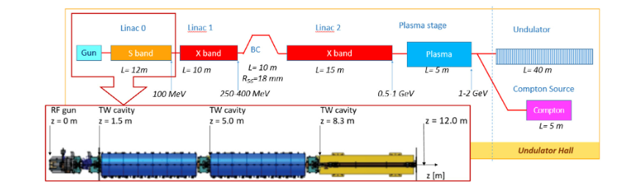
Eupraxia SPARC
Located in Frascati, Italy.
Compact Soft X-ray FEL using plasma wakefield technology (proof-of-concept machine).
Eupraxia SPARC Lab layout [3]

Slide 12
Contents
IFAST project
  IFAST Overview
  Task 7.4
  SW RF Photogun and TW RF Photogun
Applications
  SwissFEL injector Upgrade
  Eupraxia SPARC
Theory for High Gradient RF Photoguns
  Space-Charge Effects
  Field Emission and Dark Current
  RF Breakdown
  Pulsed Surface Heating
  Multipacting
Project Status and Ongoing Tasks
  Dark Current and Radiation
  Thermal Simulations
  RF Design updates
  Test Stand Development
Timeline
Conclusions

Slide 13
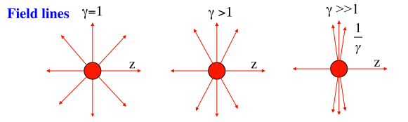
Space-Charge Effects
General term for forces induced by the bunch, including image charges.
Most effects are suppressed with an increase in the bunch energy therefore these are most problematic in the RF Photogun where the relativistic gamma is lowest.
And this is why we want high gradients!
Electric field lines at different energies [4]
So why not push as high as possible with the gradient?

Slide 14
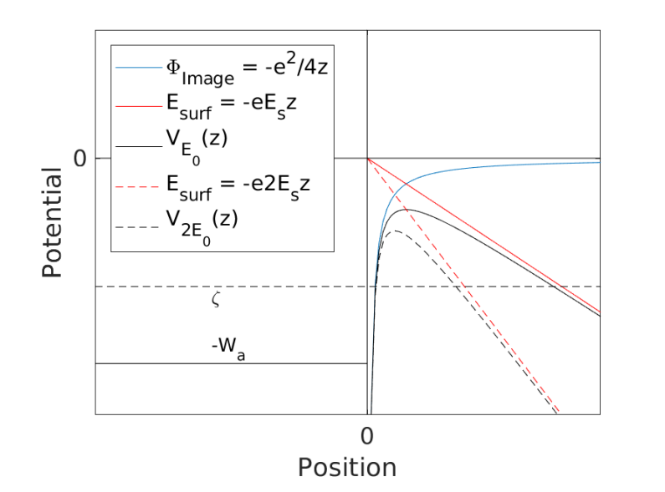
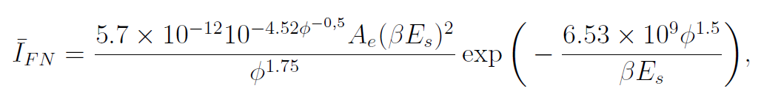
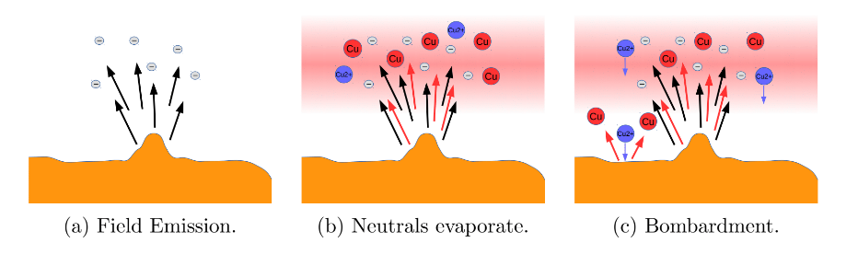
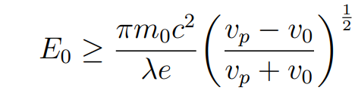
Field Emission and Dark Current
Emission of electrons due to strong electric field.
Local electric fields enhanced by microscopic surface features, leading to greater electron current emission.
Electrons emitted inside an accelerating structure or gun can be captured in accelerating fields and propagate along structure. This is called dark current [5].
Modification of potential barrier
by electric field
Microscopic emitter

Slide 15
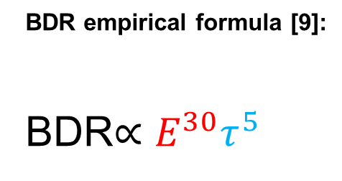
RF Breakdown
Spontaneous emission of large current from a local region.
Leads to short circuit in the structure and significant reflection of electromagnetic fields.
Mechanism which causes RF breakdown still under discussion:
  Explosive electron emission [6]
  Mobile dislocations [7]
Predicting high gradient behaviour
  Breakdown-loaded electric fields [8].
  Modified Poynting Vector (Sc) [9]
BDR empirical formula [9]:
BDR$∝E^{30}τ^{5}$
Process proposed to cause a
breakdown impact crator.

Slide 16
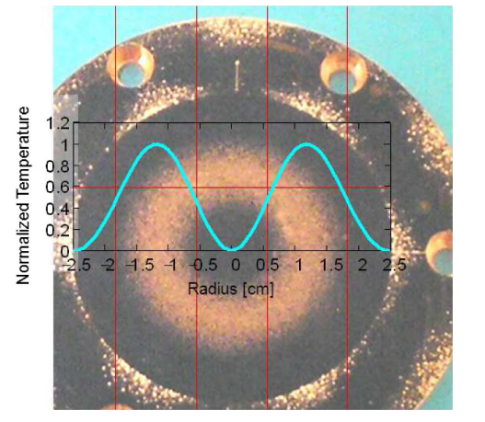
Pulsed Surface Heating
Magnetic fields lead to surface currents which experience ohmic losses.
Can cause cracking in the surface due to continual plastic deformation and fatigue due to pulsing.
Cracked regions can be more prone to RF Breakdown due to field enhancement around cracked regions.
Pulsed Surface Heating sample with
the plot of the PSH temperature
Expected [10].

Slide 17
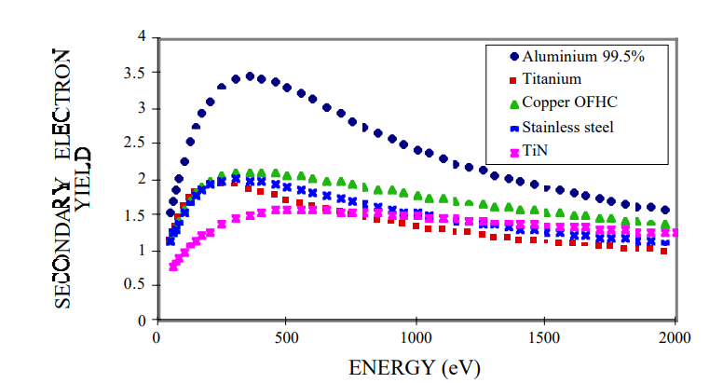
Multipacting
Generally associated with low electric fields not high electric fields unlike previous mechanisms.
Resonant condition based on two conditions:
  Electrons travelling between two surfaces with a time-of-flight equal to either a half integer (two point) or integer multiple of the frequency.
  Seconday emission yield is greater than 1.
e-
e-
e-
Amplification process
[13]

Slide 18
Contents
IFAST project
  IFAST Overview
  Task 7.4
  Starting point for SW RF Photogun and TW RF Photogun
Applications
  SwissFEL injector Upgrade
  Eupraxia SPARC
Theory for High Gradient RF Photoguns
  Space-Charge Effects
  Field Emission and Dark Current
  RF Breakdown
  Pulsed Surface Heating
  Multipacting
Project Status and Ongoing Tasks
  Dark Current and Radiation
  Thermal Simulations
  RF Design updates
  Test Stand Development
Timeline
Conclusions

Slide 19
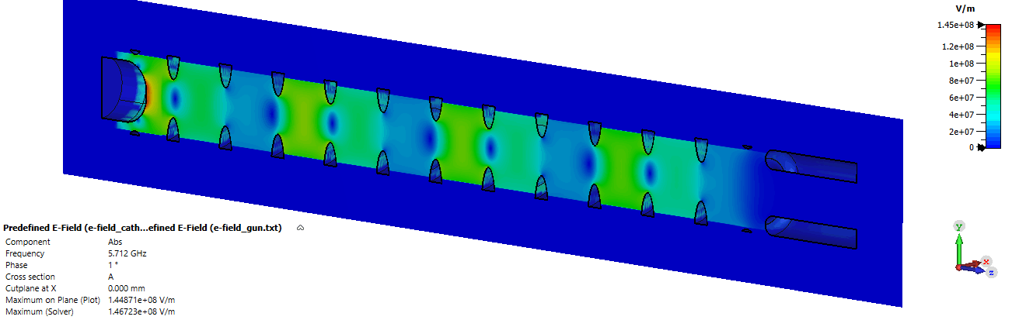
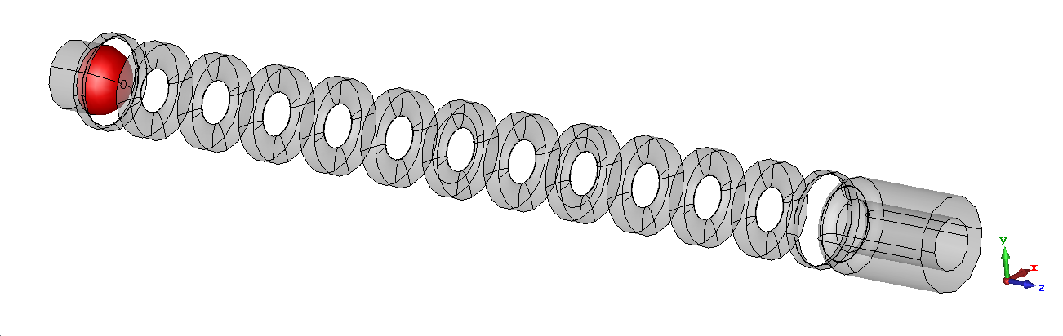
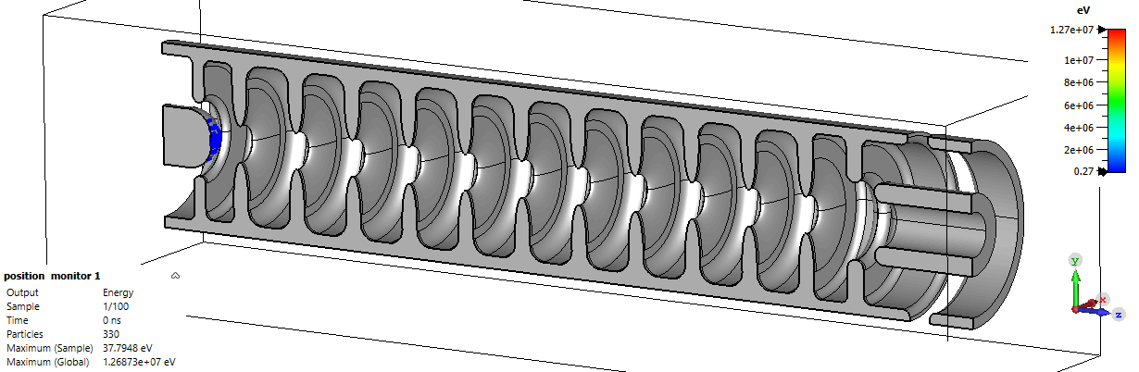
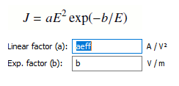
Dark Current Simulations
Performed completely in CST by coupling EM frequency solver to PIC.
Electromagnetic Fieldmap
Emission model

Slide 20
Dark Current Simulations
Field Enhancement Factor (β) | Effective area (A_{e}) [um^2] | Cathode Gradient [MV/m] | Charge arriving downstream (per 90ns RF pulse) [pC] | Capture Ratio | Total Field emitted charge (per 90ns RF pulse) [pC] | Peak Energy [MeV]
70 | 0.01 | 135 | 5.9 | 0.31 | 19.0 | 13.0
70 | 0.01 | 200 | 160.3 | 0.29 | 552.8 | 19.2

Slide 21
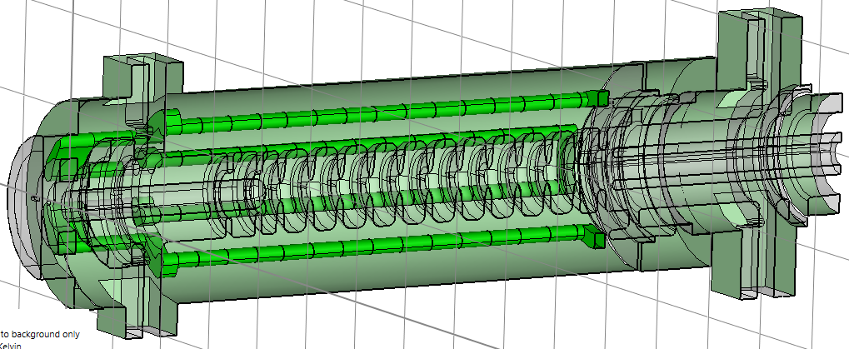
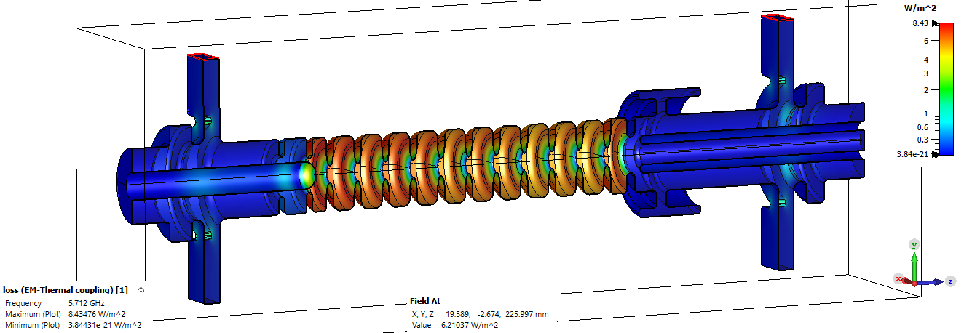
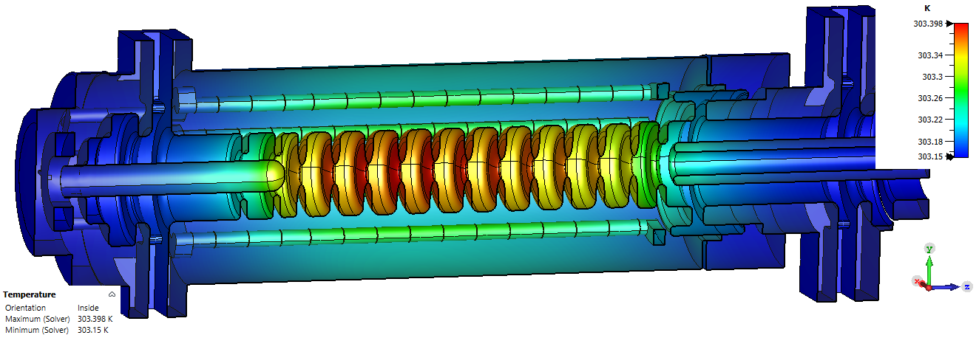
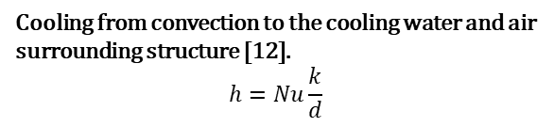
Thermal Simulations
Performed completey in CST by coupling the EM frequency solver to Thermal Solver
Electromagnetic model (heat source)
Thermo-Mechanical model (cooling)
Cooling from convection to the cooling water and air surrounding structure [12].
$$h=Nu\frac{k}{d}$$
Thermo-Mechanical model (Temperature)
Summer student Andrea Gianforte working on more detailed simulations

Slide 22
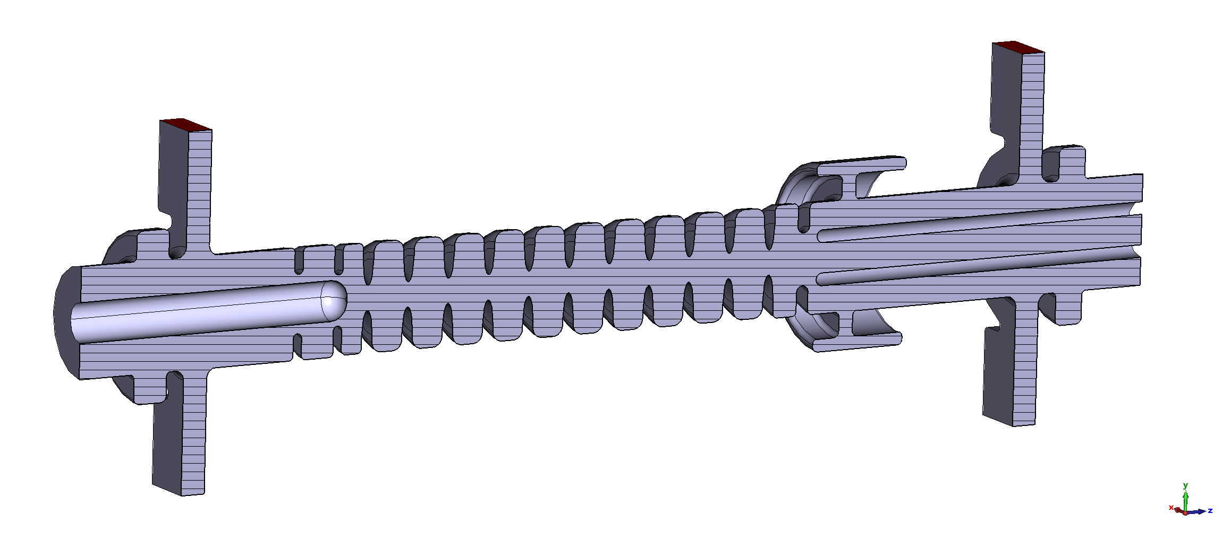
RF Design Considerations
Phase Advance per Cell
Multipacting
region?
Multipacting region?
Multipacting
region?
Multipacting
region?
Field profile on cathode
and cathode size
Alignment Tolerances
Alignment Tolerances

Slide 23
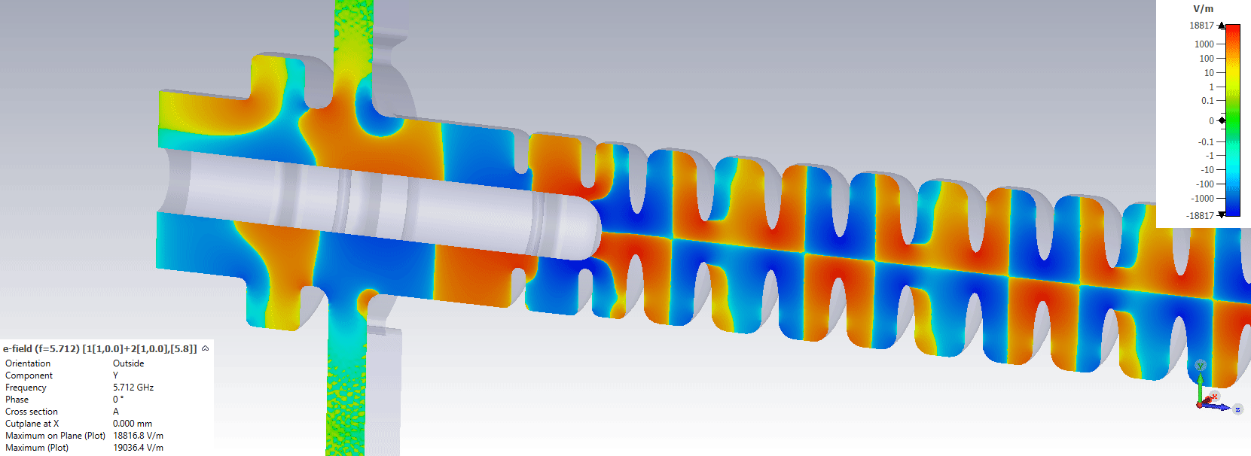
Alignment Conditions

Slide 24
Multipacting Regions
Three regions of interest:
  Output Coaxial
  Input Coaxial
  Choke filter
All regions may have multipacting which is a concern.

Slide 25
TW RF photogun cathode region
Cathode is arguably the most critical point for RF design in the whole of an FEL due to space-charge effects.
Criteria for design:
  Multipole Components
  High Electric field
  Field homogeneity on the cathode
  Ease of Fabrication
  High/low field effects of concern
  Position for Solenoid
  Compatible with Load Lock System
Note that for all designs presented these criteria given are not final but a general remark about the style. Various criteria can be changed through further modification.

Slide 26
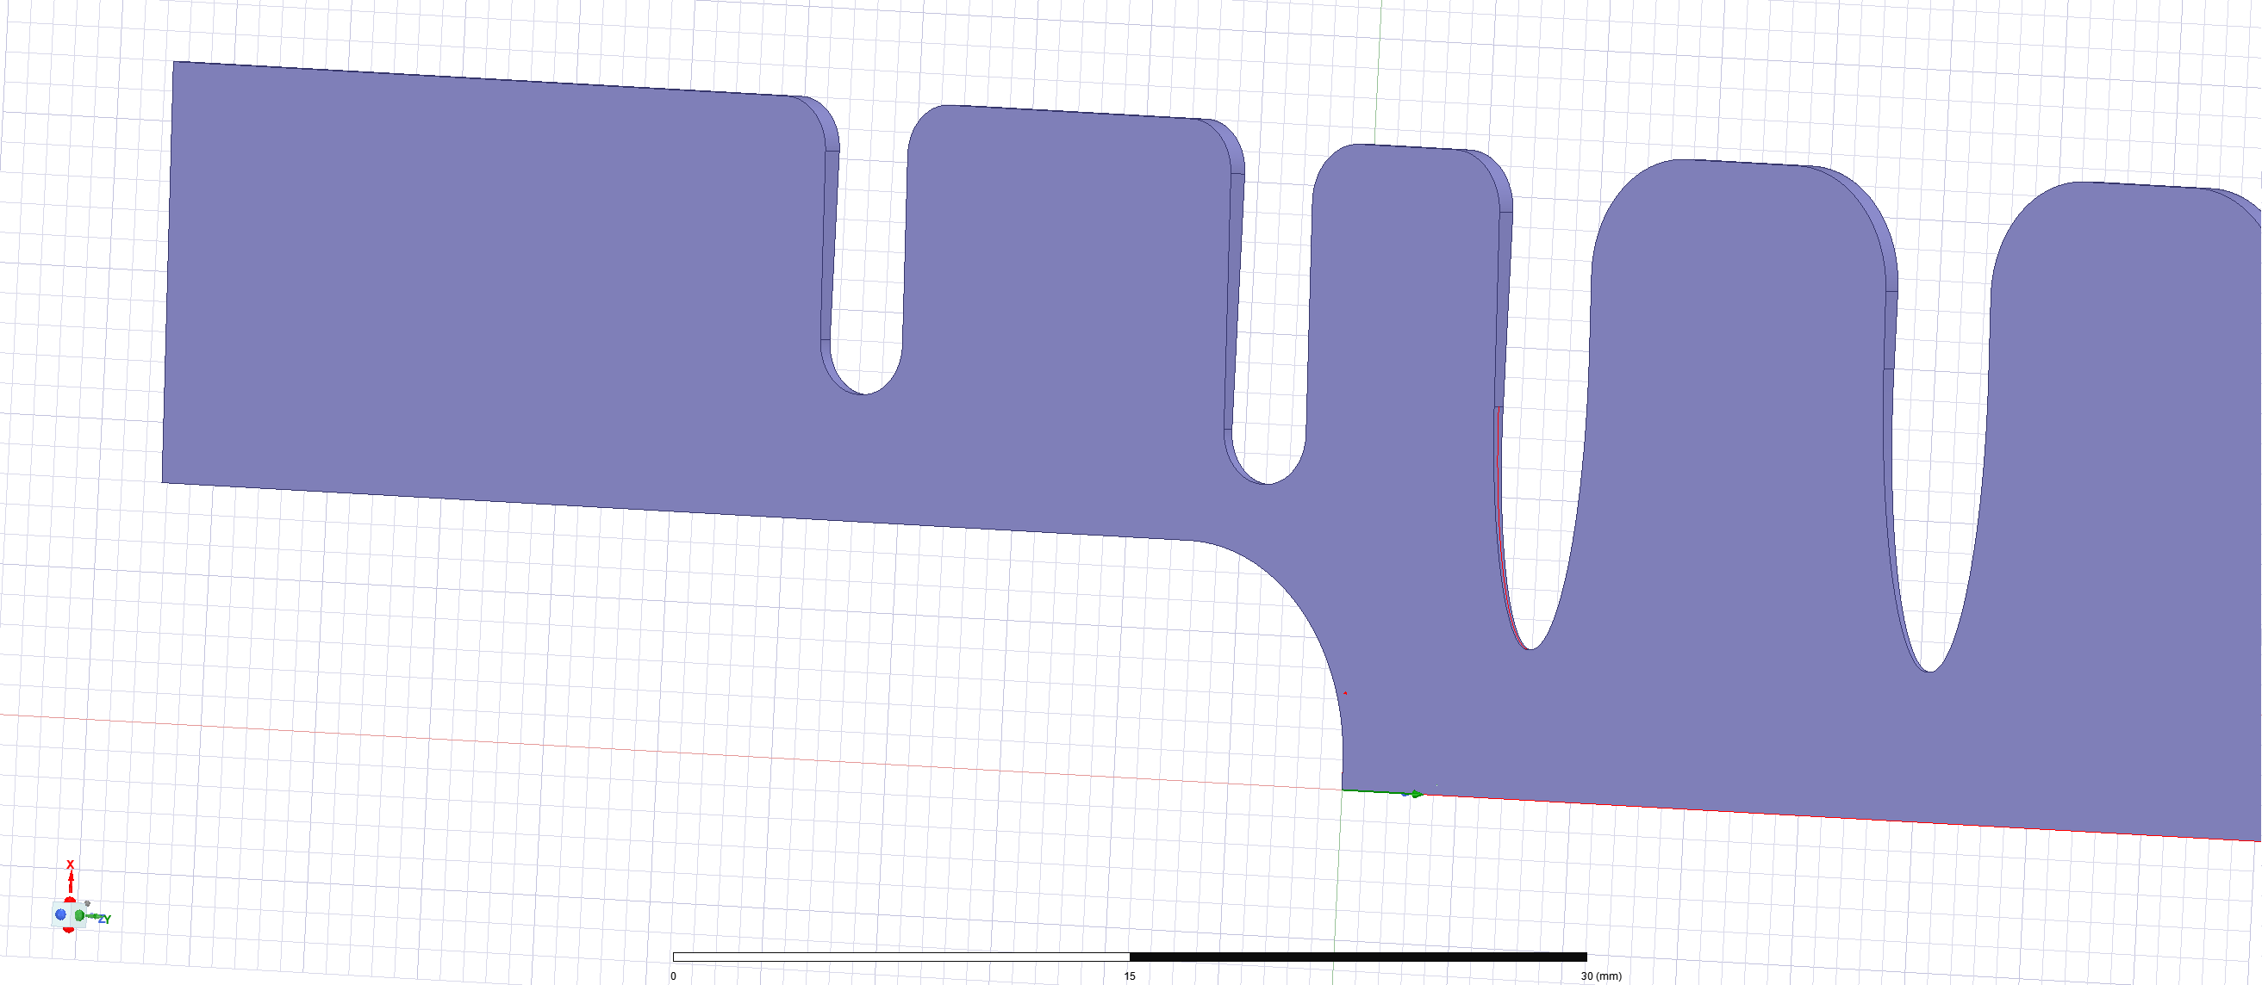
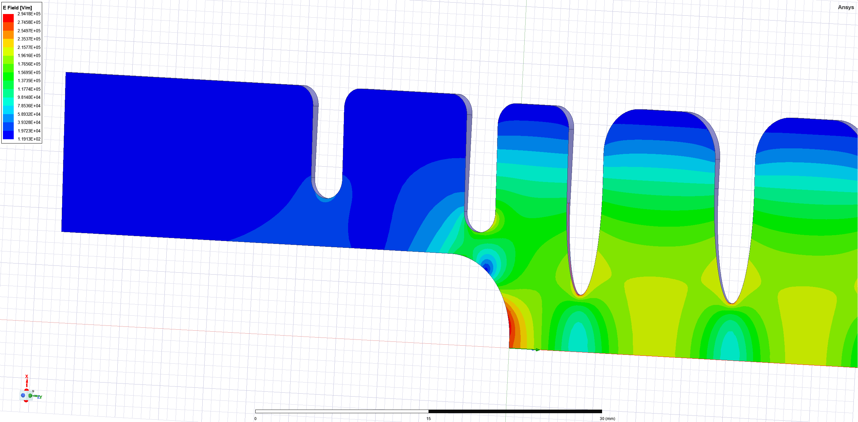
TW RF photogun cathode region
Type | Electrical Coupled Coaxial
Design Evaluation | Multipole components = Good High Electric field = Good Field homogeneity on cathode surface = Poor Ease of Fabrication = Poor High/low field effects of concern = Dark current, multipacting Position for Solenoid = Perfect Compatibility with Load-lock = Yes but very difficult!
Diagram and Electric field distribution
Comments | Original design proposed. This has very strict tolerance requirements and the peak field is off-axis.

Slide 27
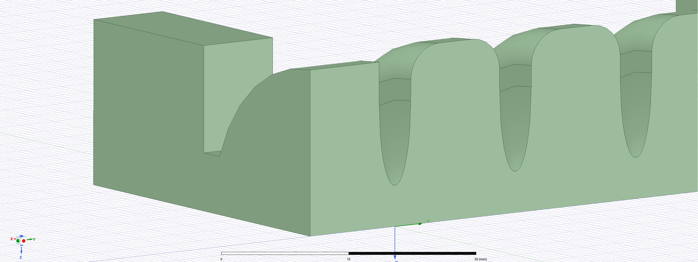
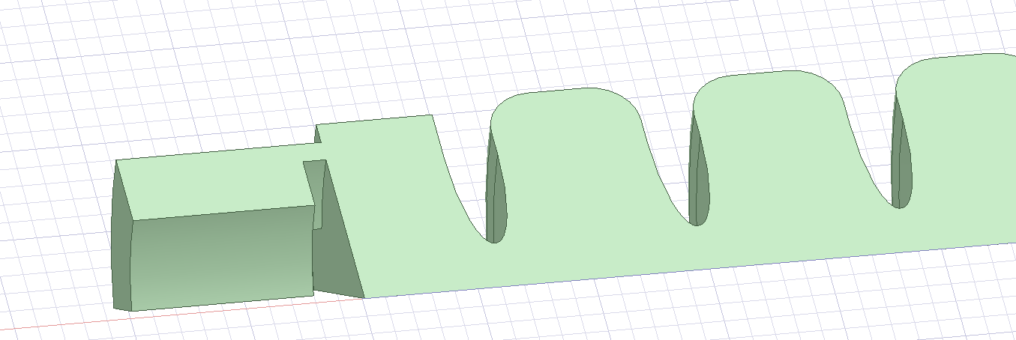
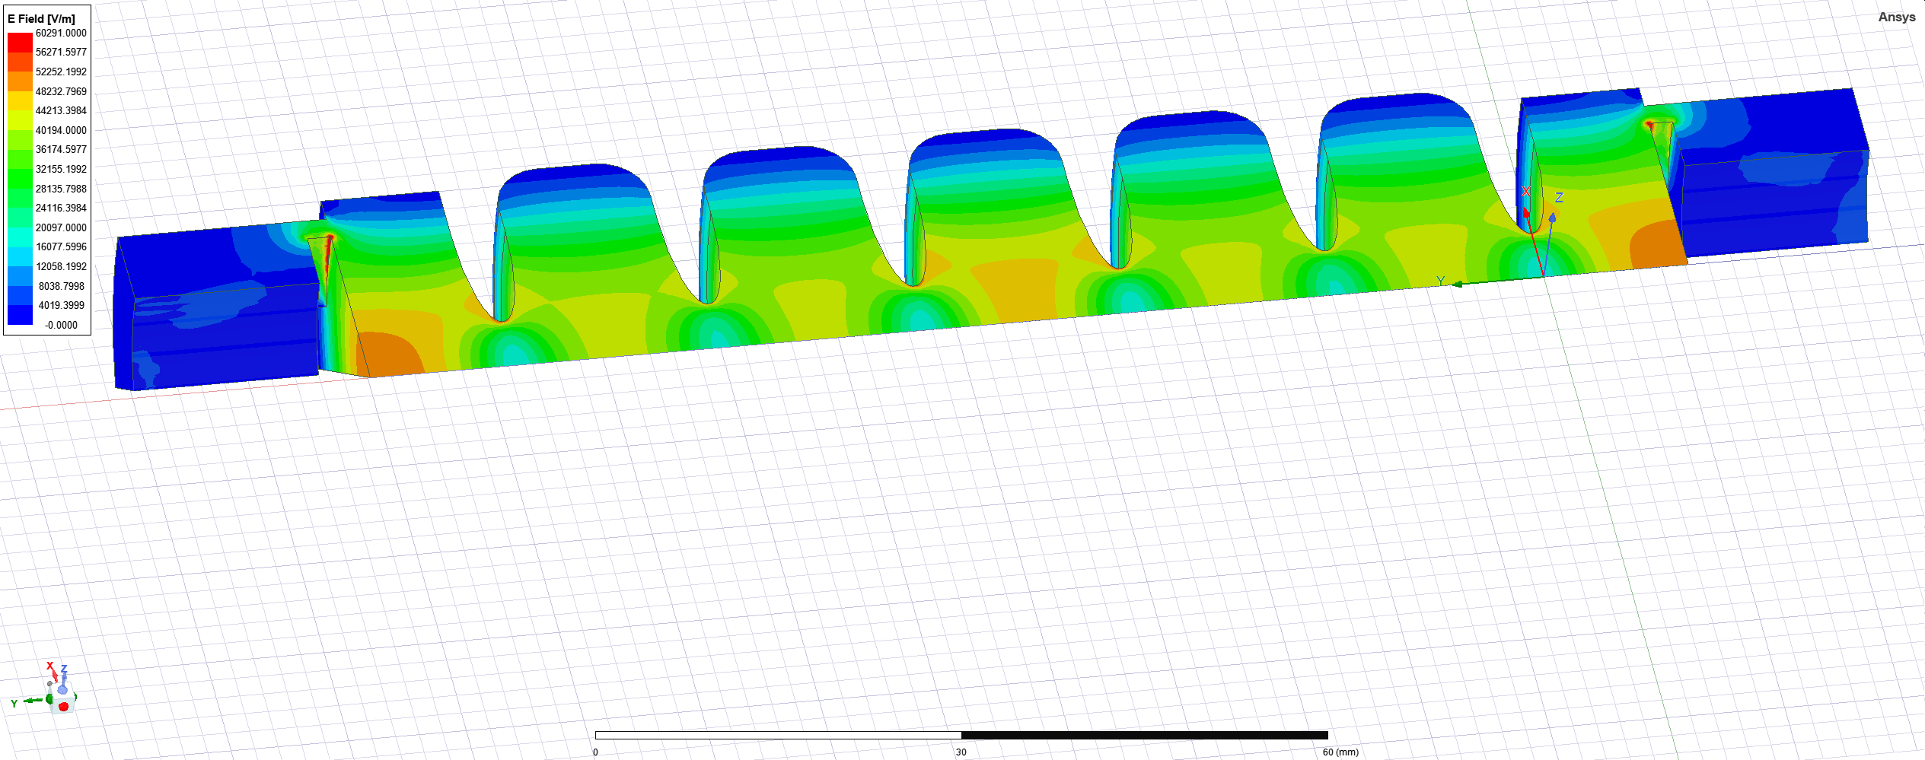
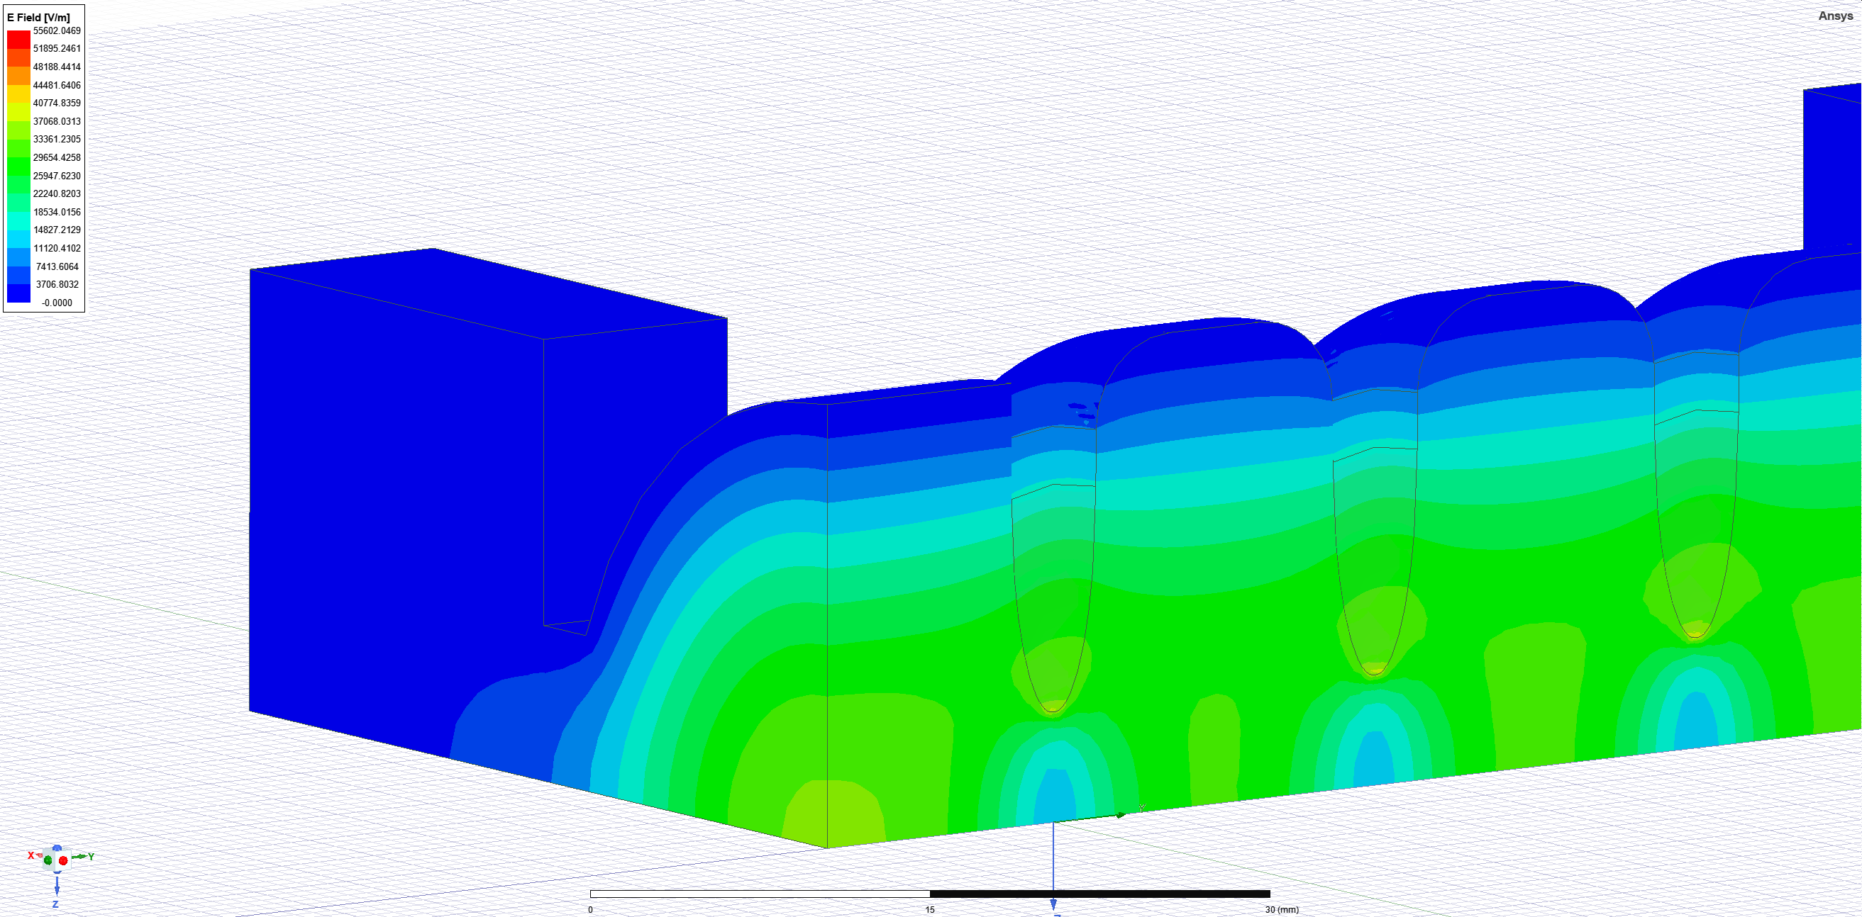
TW RF photogun cathode region
Type | Classic Magnetic Coupler | Magnetic Coupler four slots
Design Evaluation | Multipole components = Poor High Electric field = Poor-Moderate Field homogeneity on cathode surface = Moderate-Good Ease of Fabrication = Good High/low field effects of concern = Low concern for all. Position for Solenoid = Poor Compatibility with Load-lock = Yes, ‘relatively’ simple. | Multipole components = Moderate-Good High Electric field = Good Field homogeneity on cathode surface = Good Ease of Fabrication = Moderate-Good High/low field effects of concern = Pulsed surface heating Position for Solenoid = Perfect Compatibility with Load-lock = Yes, moderate complexity
Diagram and Electric field distribution
Comments | Higher order modes can be minimised through modification to the coupler and first cell. Sensible first TW RF photogun design.

Slide 28
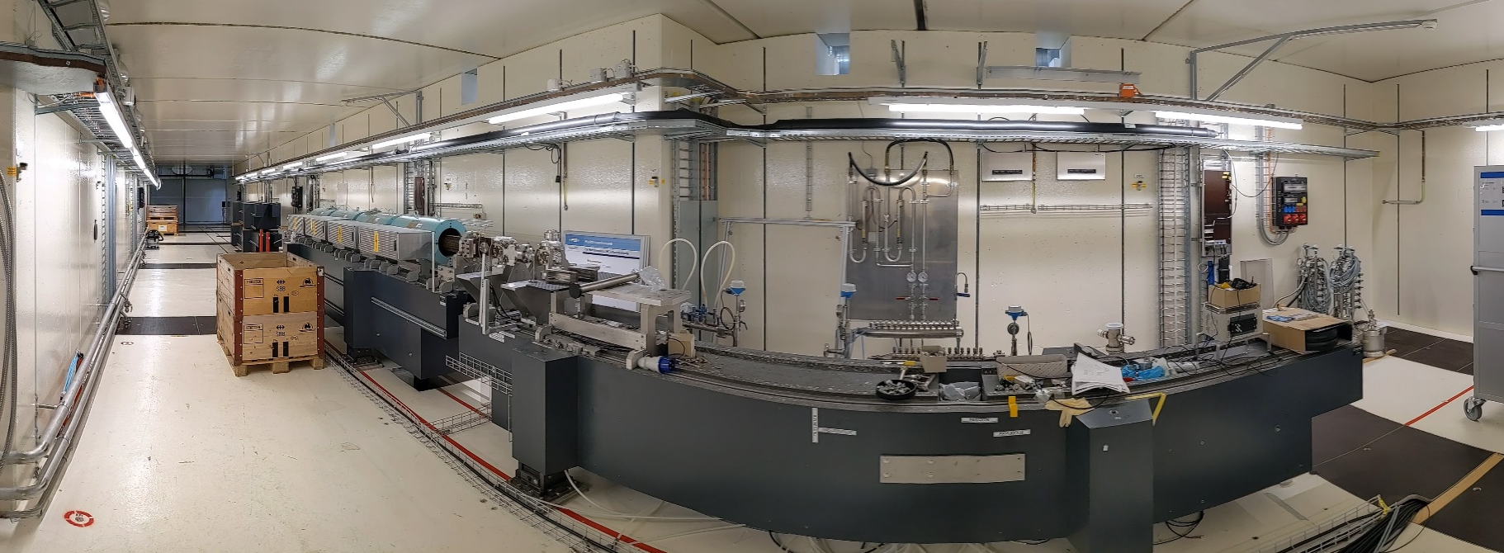
Bunker

Slide 29
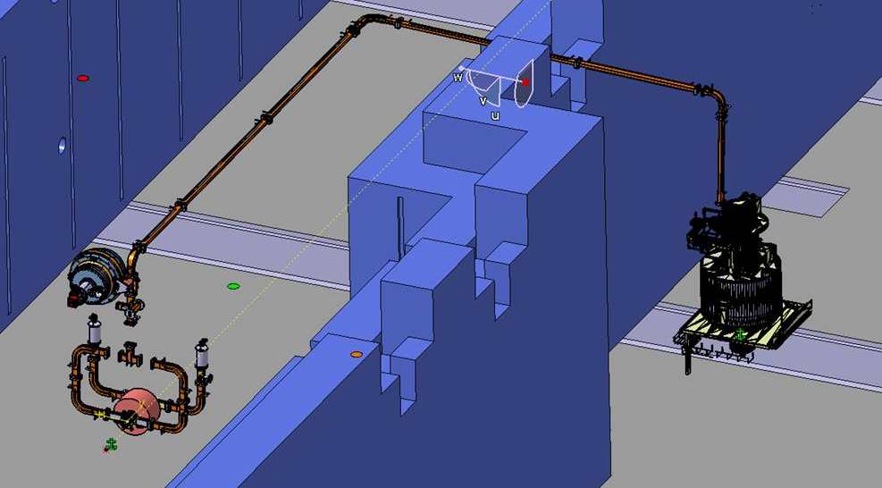
Waveguide Network

Slide 30
Contents
IFAST project
  IFAST Overview
  Task 7.4
  Starting point for SW RF Photogun and TW RF Photogun
Applications
  SwissFEL injector Upgrade
  Eupraxia SPARC
Theory for High Gradient RF Photoguns
  Space Charge Effects
  Field Emission and Dark Current
  RF Breakdown
  Pulsed Surface Heating
  Multipacting
Project Status and Ongoing Tasks
  Dark Current and Radiation
  Thermal Simulations
  RF Design updates
  Test Stand Development
Timeline
Conclusions

Slide 31
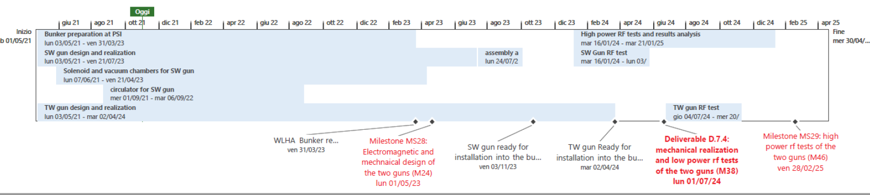
Timeline and Tasks

Slide 32
Conclusion
IFAST is a large collaborative project which aims to develop new technologies for future accelerators.
Our task is the development of two high gradient RF photoguns operating at C-band frequency.
TW RF Photogun follows on by work from M. Schär in his PhD Thesis.
Applications include a possible upgrade to SwissFEL and the new SPARC Lab project.
New RF Couplers are being designed to reduce mechanical complexity and shift peak Electric field on axis.
Dark current and thermal simulations suggest no significant problems.
Preparations for the high power testing are running concurrently to the design of the photoguns.

Slide 33
Acknowledgements
European funding commission.
PSI RF Group: Paolo Craievich, Riccardo Zennaro, Jean-Yves Raguin, Fabio Marcellini, Mattia Schär, Marco Pedrozzi, Wolfgang Tron.
Mechanical Group: Reto Fortunati, Andrea Gianforte.
INFN RF Group: David Alesini, Fabio Cardelli, Gianluca Di Raddo, Luigi Faillace.

Slide 34
References
M. Schär, RF traveling-wave electron gun for high brightness photoinjectors https://www.research-collection.ethz.ch/handle/20.500.11850/155921
SwissFEL CDR, https://www.psi.ch/swissfel_old/CurrentSwissFELPublicationsEN/SwissFEL_CDR_V20_23.04.12_small.pdf
A. Giribono et al. EuPRAXIA@SPARC_LAB: The high-brightness RF photo-injector layout proposal, Nuclear Instruments and Methods in Physics Research Section A: Accelerators, Spectrometers, Detectors and Associated Equipment, https://www.sciencedirect.com/science/article/pii/S0168900218303267
Space Charge Effects, CAS proceedings https://cds.cern.ch/record/1982426/files/331-356%20Ferrario.pdf
T.G. Lucas et al., Dependency of the capture of field emitted electron on the phase velocity of a high-frequency accelerating structure (2018).
S. A. Barengolts et al. Mechanism of vacuum breakdown in radio-frequency accelerating structures https://journals.aps.org/prab/pdf/10.1103/PhysRevAccelBeams.21.061004
Theory of electric field breakdown nucleation due to mobile dislocations Eliyahu Zvi Engelberg, et al. https://journals.aps.org/prab/pdf/10.1103/PhysRevAccelBeams.22.083501
J. Paszkiewicz, Studies of breakdown and pre-breakdown phenomena in high-gradient accelerating structures, PhD Thesis.
A. Grudiev et al. New local field quantity describing the high gradient limit of accelerating structures https://journals.aps.org/prab/pdf/10.1103/PhysRevSTAB.12.102001
L. Laurent et al. , Experimental study of rf pulsed heating, https://journals.aps.org/prab/pdf/10.1103/PhysRevSTAB.14.041001
Parodi, Renzo F, CERN Accelerator School 2010 RF for accelerators
K. Papke et al. Coupled RF-Thermo-Structural Analysis of CLIC Traveling Wave Accelerating Structures, https://cds.cern.ch/record/2730555?ln=en
THE SECONDARY ELECTRON YIELD OF TECHNICAL MATERIALS AND ITS VARIATION WITH SURFACE TREATMENTS, V. Baglin et al. Proceedings of EPAC 2000, Vienna, Austria

Slide 35
Links to relevant work and websites
M. Schär’s PhD Thesis: https://www.research-collection.ethz.ch/handle/20.500.11850/155921
Travelling wave RF photogun at X-band https://www.sciencedirect.com/science/article/pii/S0168900221006367
IFAST website: https://ifast-project.eu/home

Slide 36
Thank you! Questions?

