Slide 1

CHART HTS program at PSI
Jaap Kosse, Henrique Rodrigues, Michal Duda, Bernhard Auchmann, Stephane Sanfilippo
Paul Scherrer Institute
CHART2/MagDev Results and Roadmap - Technical Review
Work supported by the Swiss State Secretariat for Education, Research and Innovation SERI
13/12/21

Slide 2
Contents
Non-insulated solenoids
Non-insulated racetracks
x-insulated racetracks
1)
NI test coil program
3)
NI racetrack demos
4)
Racetrack demos
explore insulation
/cable concepts
2)
NI solenoid for
P3 experiment at PSI
2024
2)
NI solenoid for
FCC-ee positron source
3)
NI superbend for SLS
4)
Accelerator dipoles
time

Slide 3
Contents
Non-insulated solenoids
Non-insulated racetracks
x-insulated racetracks
1)
NI test coil program
3)
NI racetrack demos
4)
Racetrack demos
explore insulation
/cable concepts
2)
NI solenoid for
P3 experiment at PSI
2024
2)
NI solenoid for
FCC-ee positron source
3)
NI superbend for SLS
4)
Accelerator dipoles
time

Slide 4

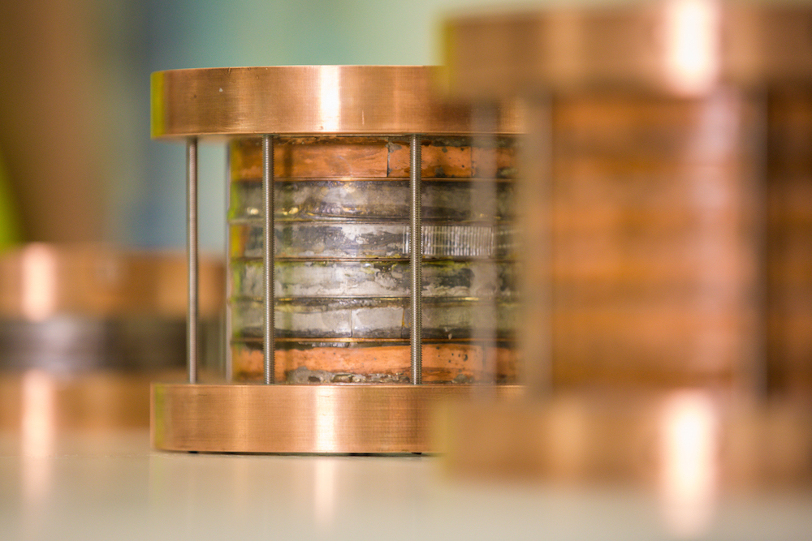
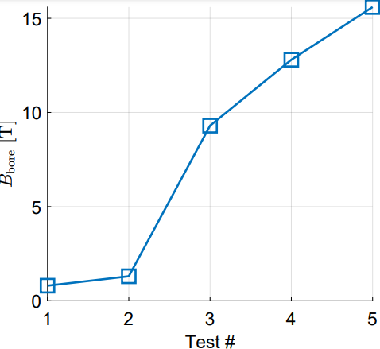
Test coil program
NI coil technology license agreement with Tokamak Energy
Rapidly develop infrastructure for HTS coil
manufacturing and testing
done
soon
Stacked pancakes approach
Modular!
Aim: 4-coil stack, 14 T
4 coils
Greg Brittles
3 coils
LN2
15 K
2 coils
2 coils
1 coil

Slide 5
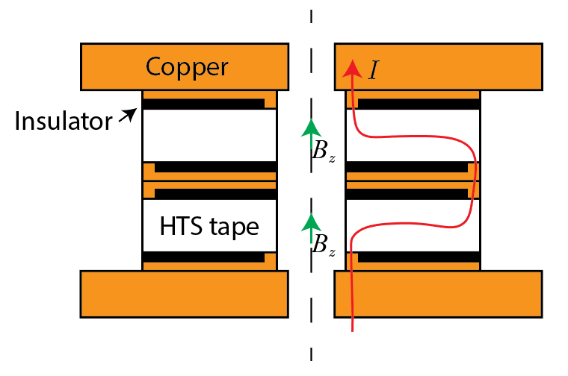
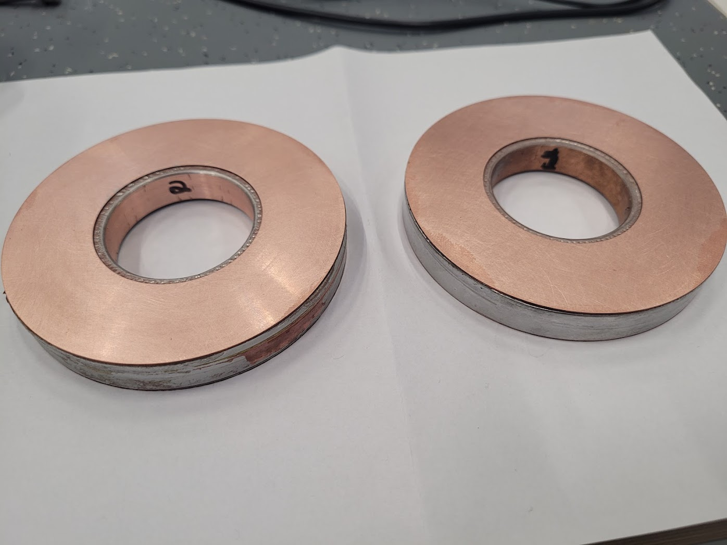
Test coil design
2-coil stack
Stacked, single layer pancakes
Axial joints to get current in and out
Patent G. Brittles WO2020/079412 A1

Slide 6
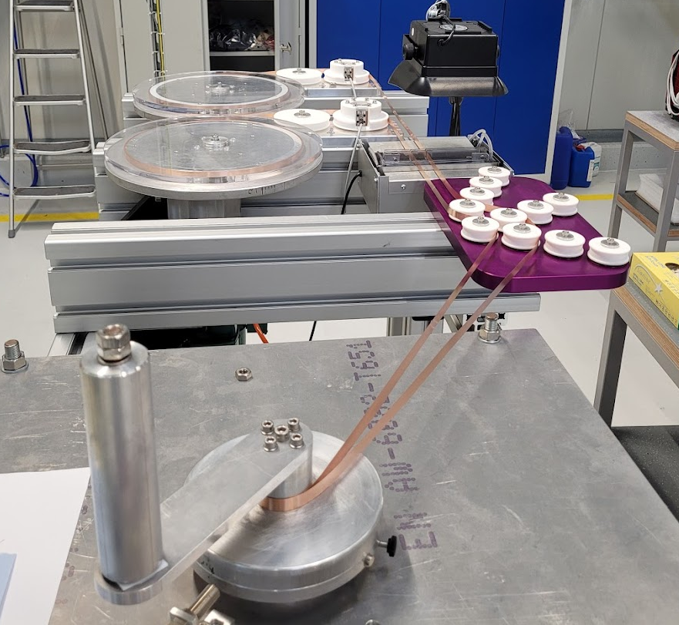
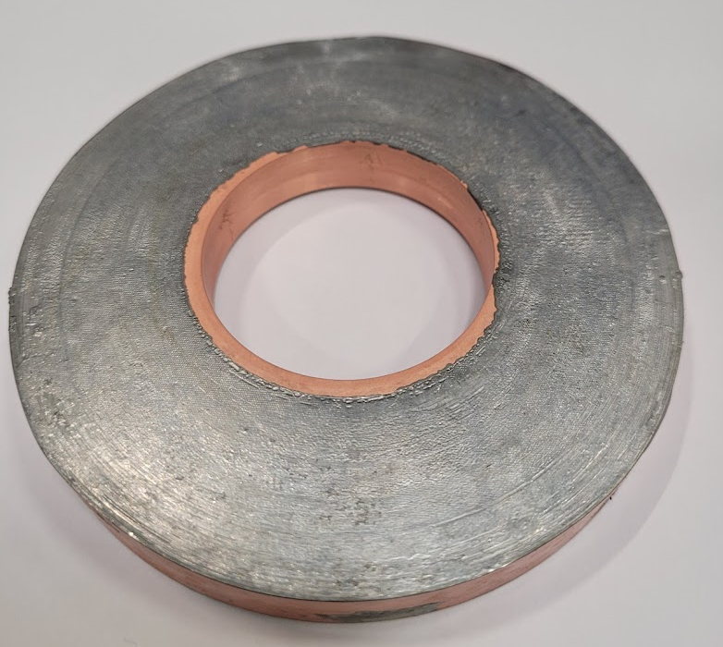
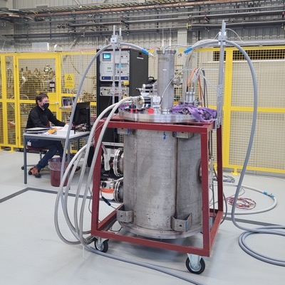
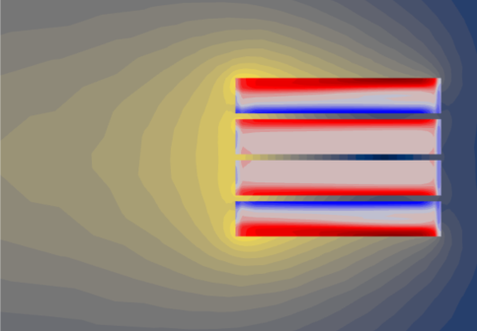
Test coil program
Commissioning of infrastructure at PSI
Winding
Soldering
Testing
Modeling
Tensioning system developed by
Francois-Olivier Pincot,
Jacky Mazet, CERN
Cryogen-free test station (2 kA)

Slide 7
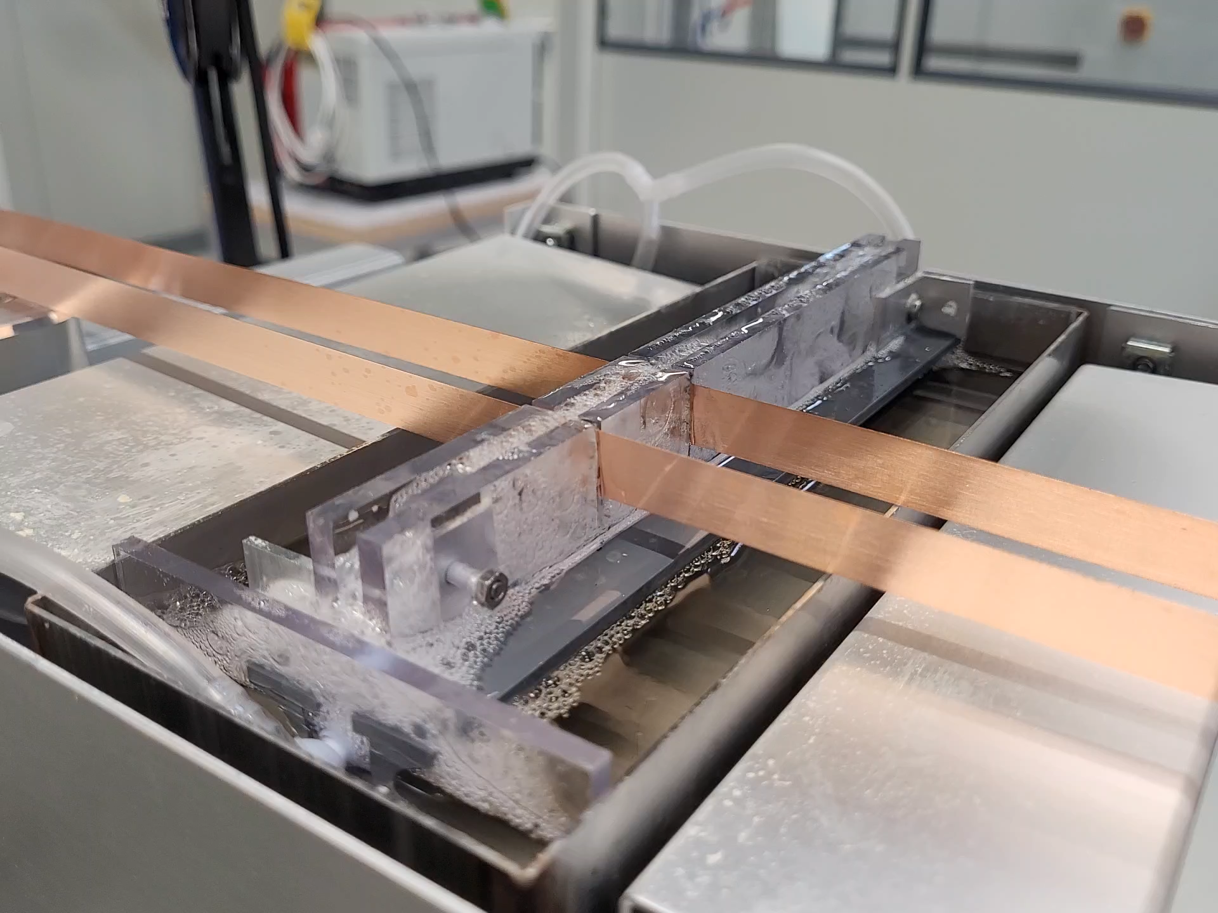
Winding
Feed spools
Flux bath
Winding table
Flux foamer
1980’s method to flux PCBs

Slide 8
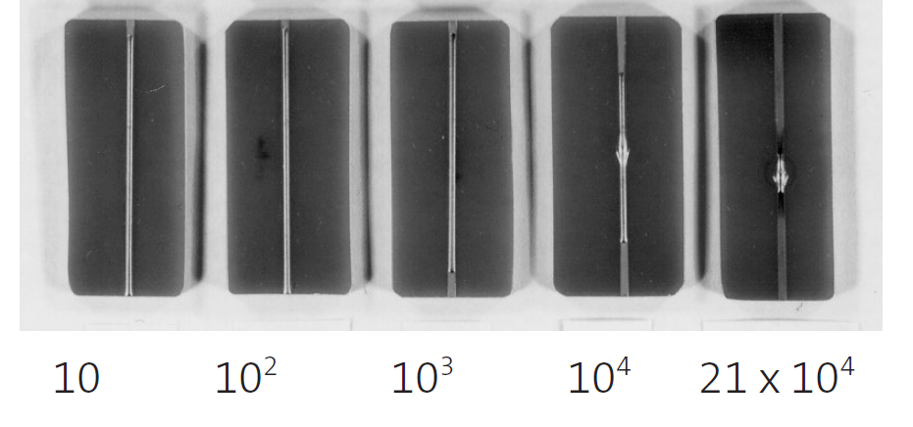
Soldering
Oxygen-free environment promotes solder wetting
Copper trace
Solder
PPM O2
J.C. Ivankovits

Slide 9
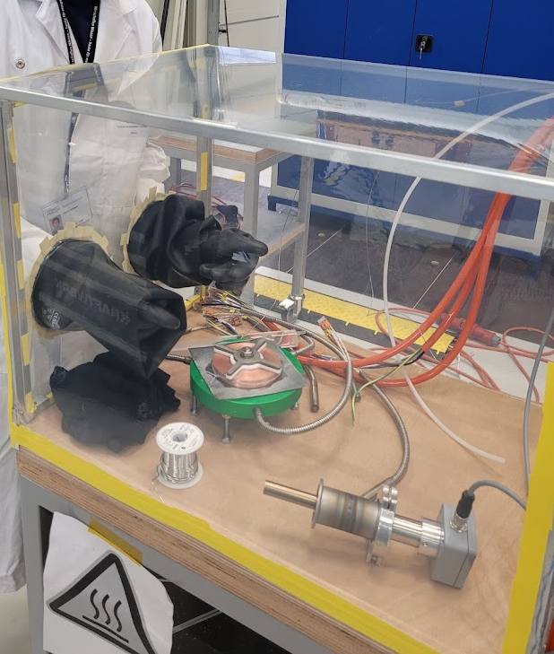
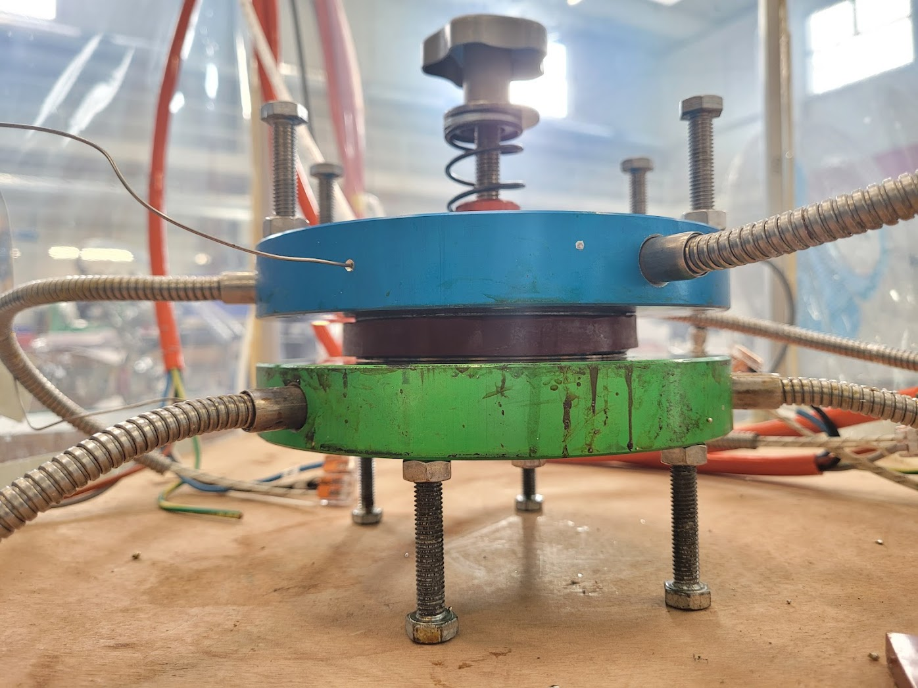
Soldering
Soldering in argon overpressure
<1 ppm O2

Slide 10
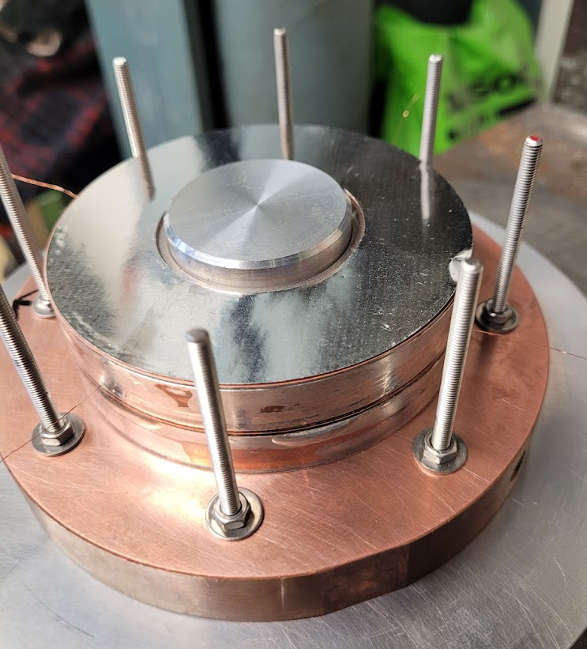
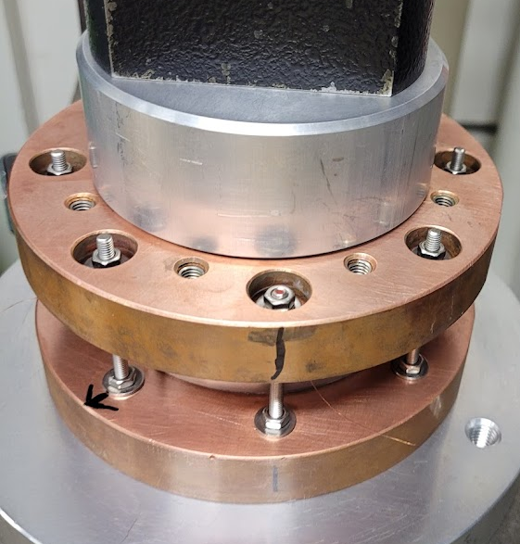
Manufacturing ready to go:
1 coil takes 2 days

Slide 11
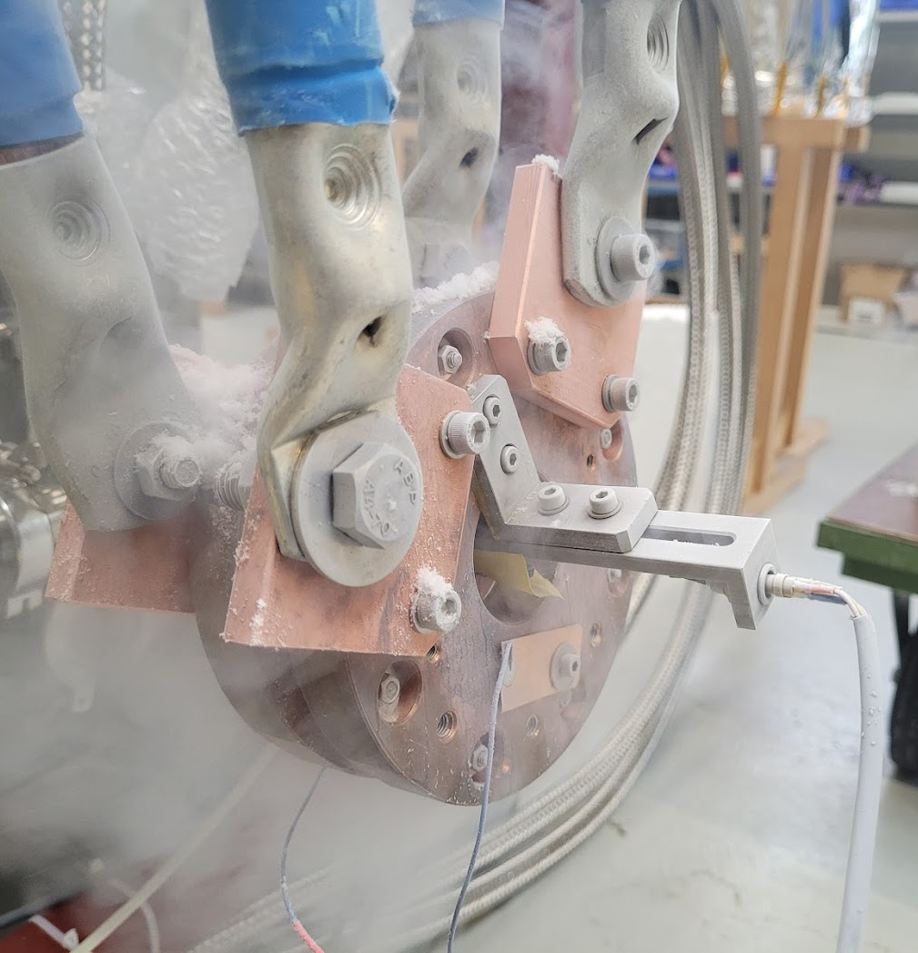
LN2 test results
So far:
Coil 1 0.8 T
Coil 2 0.8 T
Stack of coil 1 +2 1.3 T

Slide 12
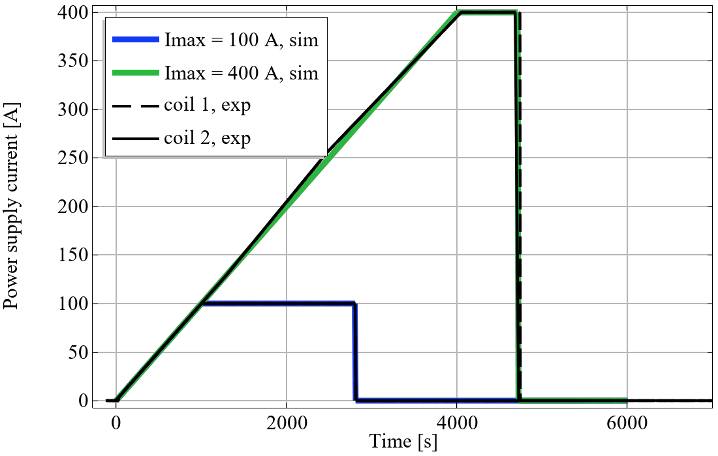
Single coil in LN2

Slide 13
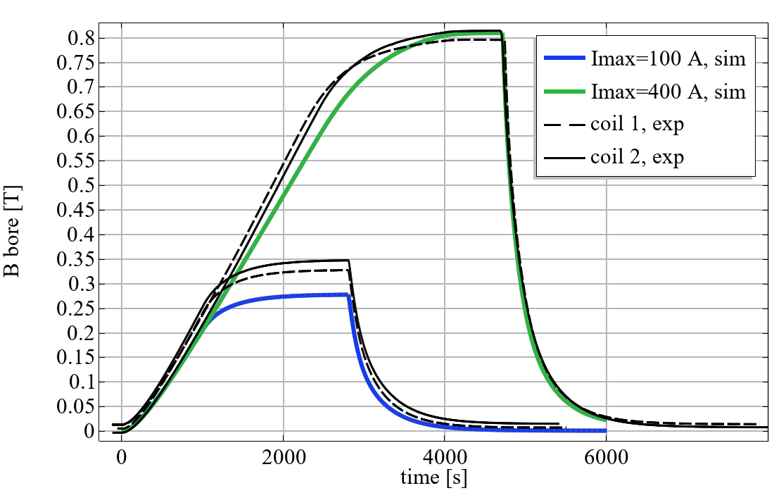
Single coil in LN2
1 fit parameter: turn-turn contact resistance. 1 ohm*cm2

Slide 14
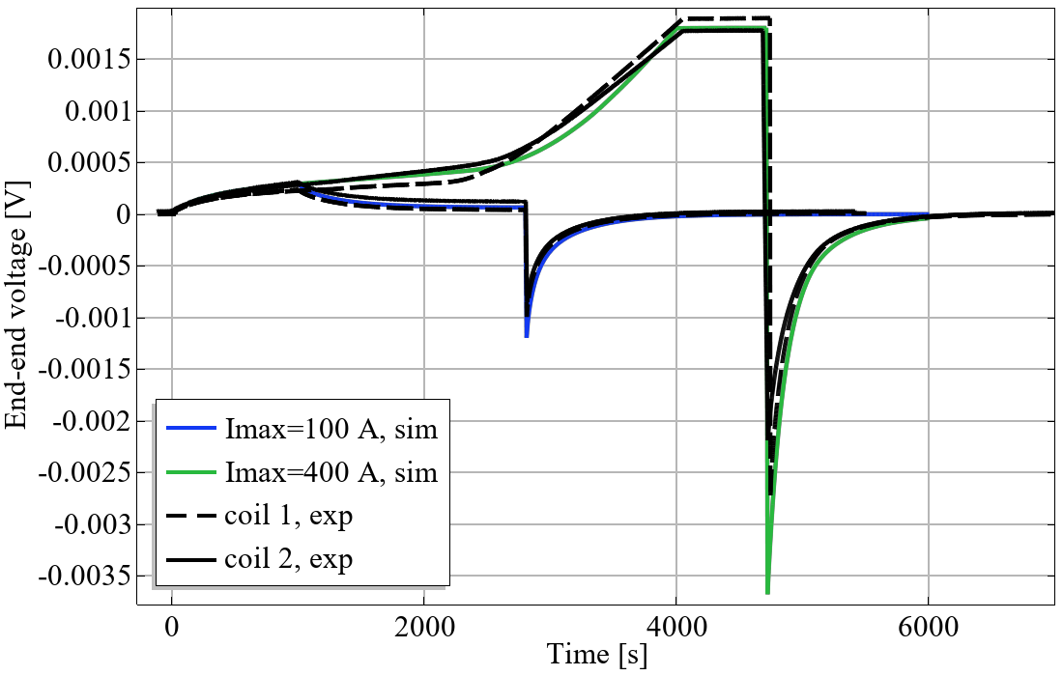
Single coil in LN2
Current partly driven in radial path
V=1e-5[V/m]*L
Coil fully
superconducting

Slide 15
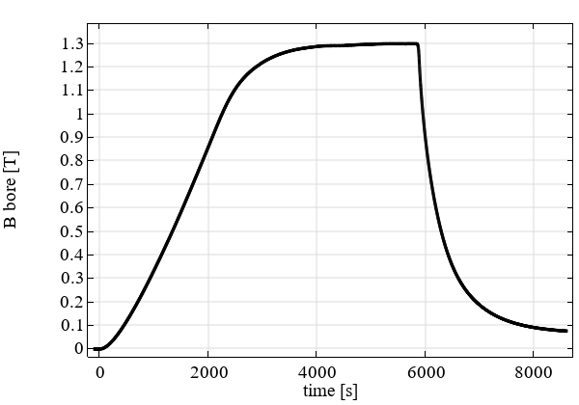
2-stack LN2 test
1.3 T reached
done
soon
3 coils
LN2
15 K
2 coils
2 coils
1 coil

Slide 16
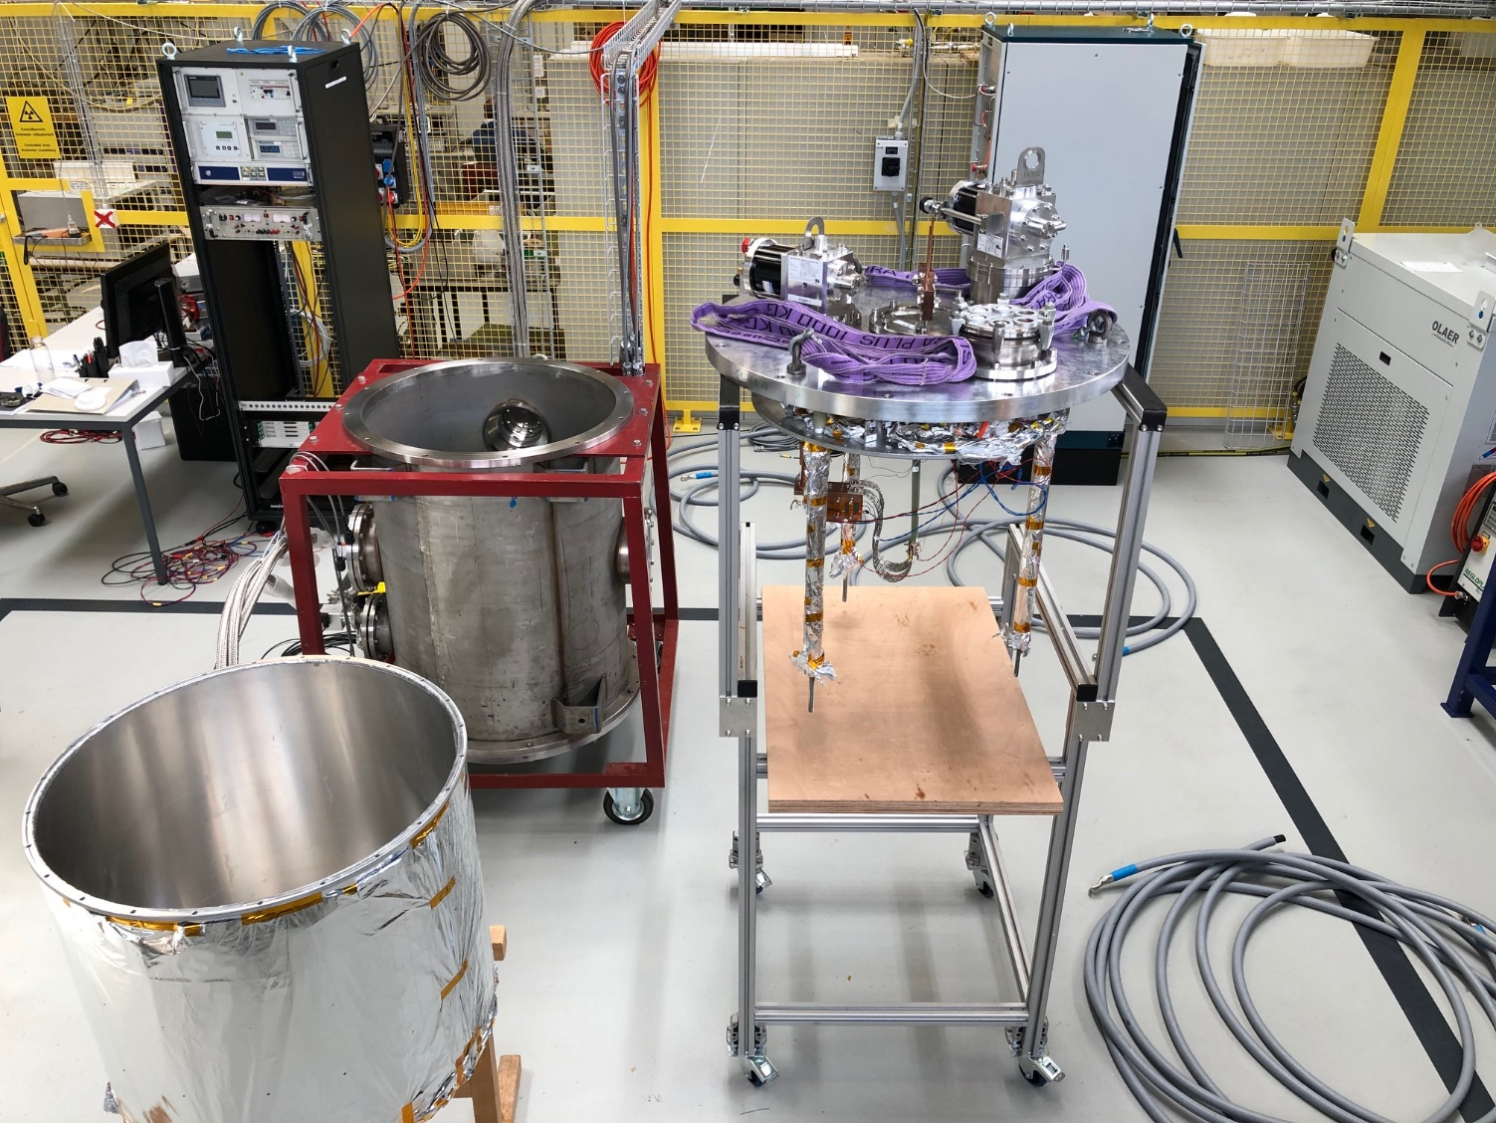
2 kA cryogen-free test stand at PSI
Electronic rack
vacuum control
temperature monitoring
voltage signals recording
quench detection system
2kA power converter
Water chillers
(for compressors and power converter)
Cryostat insert with two cryocoolers
Vacuum chamber
with pumps (not visible)
Power cables
(500A single cables)
Radiation shield
with MLI

Slide 17
Modeling
z
Modeling technique
COMSOL
based on Ratu Mataira 2020 Supercond. Sci. Technol. 33
Homogenized anisotropic winding pack
Time-dependent 2D axisymmetric
Electromagnetic + thermal coupled
Mechanics in separate step
Capabilities
Dynamic behaviour
Saturation
Screening currents
r

Slide 18
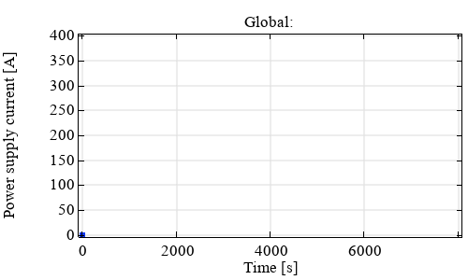
Modeling
z
Modeling technique
COMSOL
based on Ratu Mataira 2020 Supercond. Sci. Technol. 33
Homogenized anisotropic winding pack
Time-dependent 2D axisymmetric
Electromagnetic + thermal coupled
Mechanics in separate step
Capabilities
Dynamic behaviour
Saturation
Screening currents
r
movie

Slide 19
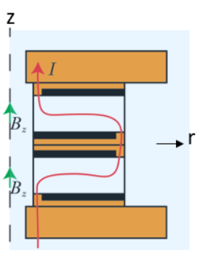
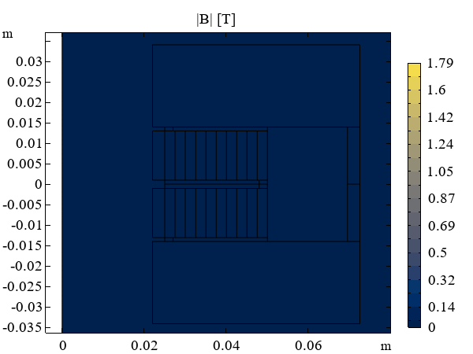
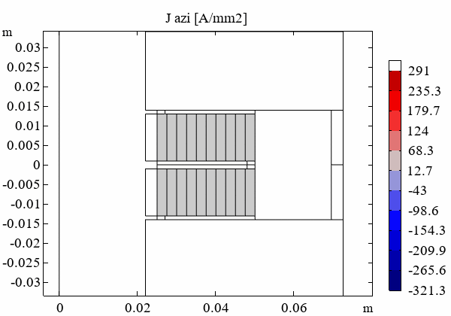
movies
z
z
r
r

Slide 20
Test coil program
Commissioning of infrastructure at PSI
Winding
Soldering
Testing
Modeling
Tensioning system developed by
Francois-Olivier Pincot,
Jacky Mazet, CERN
Cryogen-free test station (2 kA)

Slide 21
Contents
Non-insulated solenoids
Non-insulated racetracks
x-insulated racetracks
1)
NI test coil program
3)
NI racetrack demos
4)
Racetrack demos
explore insulation
/cable concepts
2)
NI solenoid for
P3 experiment at PSI
2024
2)
NI solenoid for
FCC-ee positron source
3)
NI superbend for SLS
4)
Accelerator dipoles
time

Slide 22
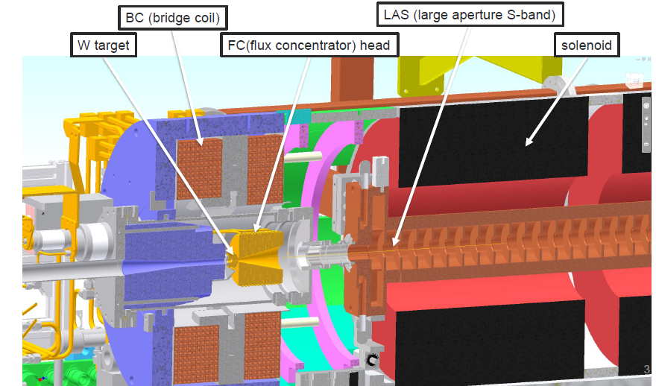
Positron source
State-of-the-art:
Pulsed NC magnet
FCC-ee injector studies
Option 1: improved pulsed NC magnet
Pavel Martyshkin et al, BINP
Yield ~2.4
Option 2: NI HTS solenoid
Yield 4+
DC
SuperKEKB, Y. Enomoto et al
NI magnet
Yield 0.58
Radiation

Slide 23
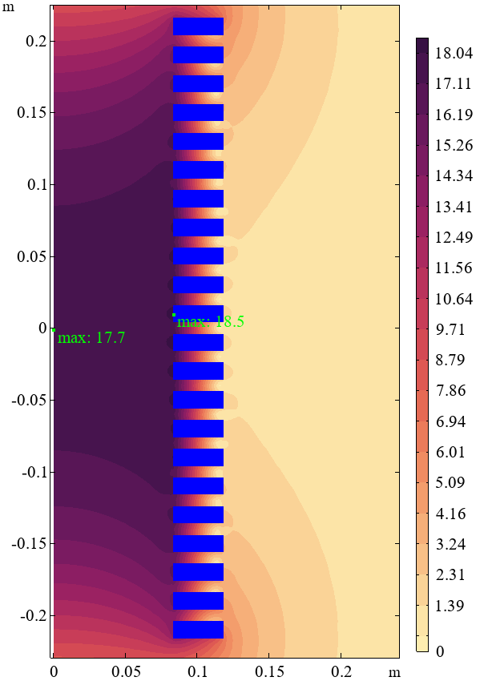
NI solenoid for positron source
e+
B [T]
target
22 coils
1500 A, 20 K
7 km tape
z [m]
e-
Stored energy ~ 1.6 MJ
Inductance ~ 0.7 H
Time constant ~1 h
Limited by axial compressive stress
Yield 4.7 (Y. Zhao, CERN)
Radiation load
Power acceptable (B. Humann , CERN)
Dose margins TBD
r [m]

Slide 24
Proof-of-concept positron source experiment
SwissFEL PSI 2024
Amorphous target
Fast detecting cavity
HTS solenoid
Spectrometer (horiz. Dipole)
3 GHz SW RF structures
Faraday cup / beam dump
NC solenoids
Shielding
Zrel = 0
Girder
R. Zennaro, PSI
L = 11.5 m
W = 3.6 m
1 m
1 m

Slide 25
Contents
Non-insulated solenoids
Non-insulated racetracks
x-insulated racetracks
1)
NI test coil program
3)
NI racetrack demos
4)
Racetrack demos
explore insulation
/cable concepts
2)
NI solenoid for
P3 experiment at PSI
2024
2)
NI solenoid for
FCC-ee positron source
3)
NI superbend for SLS
4)
Accelerator dipoles
time

Slide 26
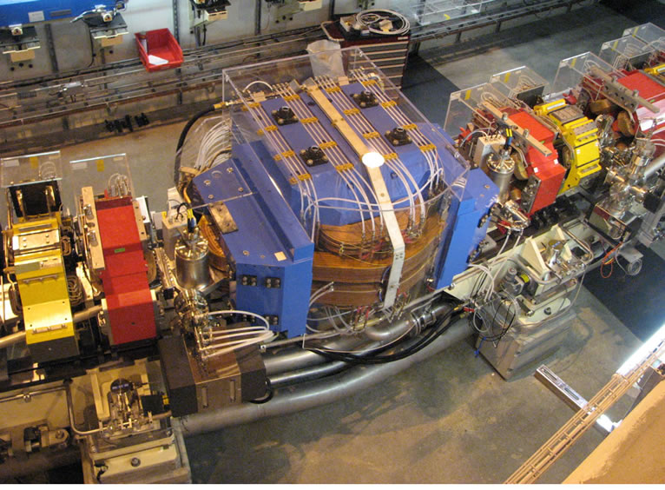
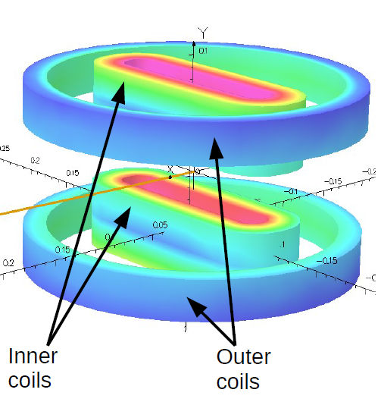
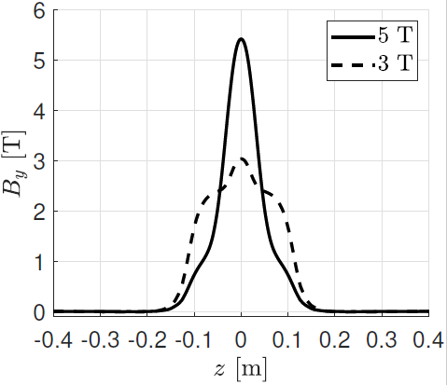
Swiss Light Source (SLS) superbends
Generate hard X-rays for TOMCAT beamline
SLS
2.9 T
SLS 2.0
5 T
LTS superbends under construction (C. Calzolaio, PSI)

Slide 27
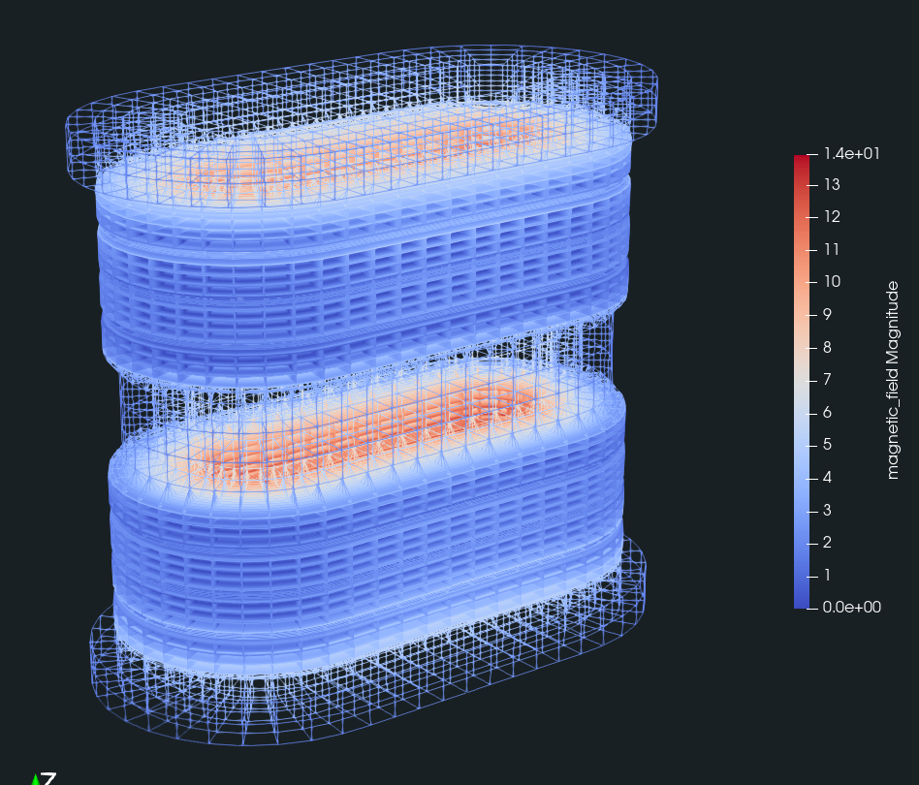

Swiss Light Source (SLS) superbends
SLS 2.0
SLS 2.x
NI HTS (or metal-insulated?)
5 T
4 K
8+ T
20 K
6 T
40 K
14 T
Jeroen van Nugteren

Slide 28
Swiss Light Source (SLS) superbends
Pancakes have nice dimensions (~130 m tape each)
for practical demo coils (test solenoids are ~80 m)
Field quality (field integral)
Mechanical support
Charging time
Quench behaviour
~1 km tape for both racetrack poles
14 T
Jeroen van Nugteren

Slide 29
Contents
Non-insulated solenoids
Non-insulated racetracks
x-insulated racetracks
1)
NI test coil program
3)
NI racetrack demos
4)
Racetrack demos
explore insulation
/cable concepts
2)
NI solenoid for
P3 experiment at PSI
2024
2)
NI solenoid for
FCC-ee positron source
3)
NI superbend for SLS
4)
Accelerator dipoles
time

Slide 30
Contents
Non-insulated solenoids
Non-insulated racetracks
x-insulated racetracks
1)
NI test coil program
3)
NI racetrack demos
4)
Racetrack demos
explore insulation
/cable concepts
2)
NI solenoid for
P3 experiment at PSI
2024
2)
NI solenoid for
FCC-ee positron source
3)
NI superbend for SLS
4)
Accelerator dipoles
time

Slide 31
Initial starting points
Cabling
Insulation

Slide 32
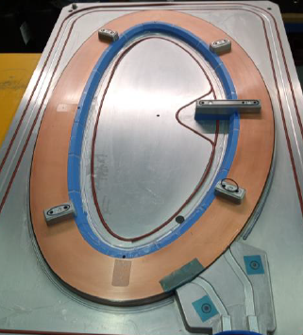
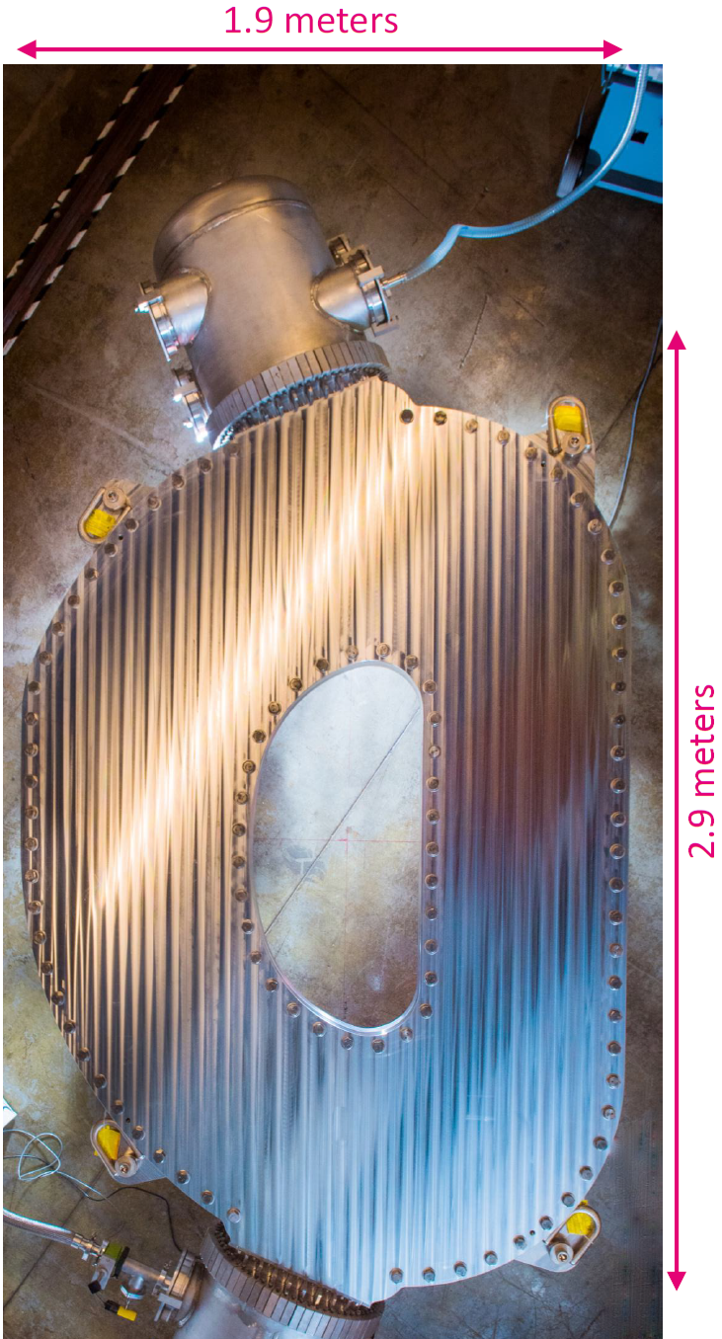

Non-twisted soldered tape-stacks
Both major HTS users are
choosing same approach
Zachary Hartwig
Greg Brittles

Slide 33
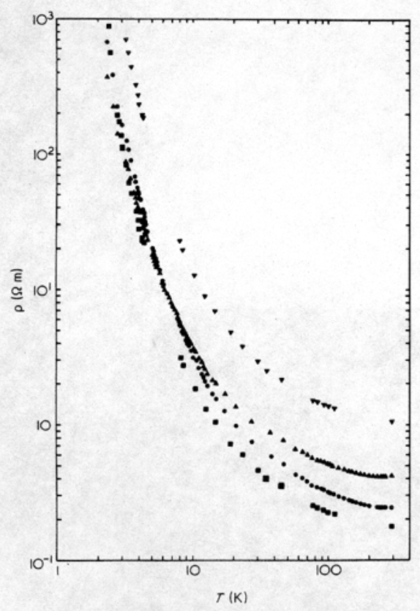
Smart insulation
Ramp time
Stability
resistivity
Best of both worlds by using
insulator/metal transition?
dx.doi.org/10.1016/0032-3861(83)90201-X

Slide 34
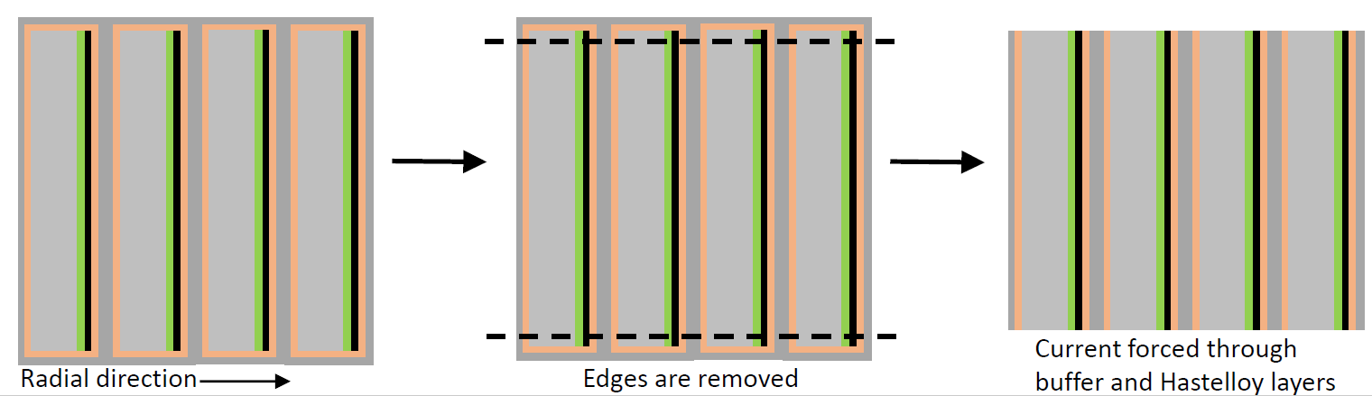
Smart insulation
Smart insulation
T. Mulder
500-1000x increase in resistivity
Idea: create axial bypass instead of radial
Combine
milled soldered NI coil
carbon-based smart insulation
Deposit flat layer on flat surface

Slide 35
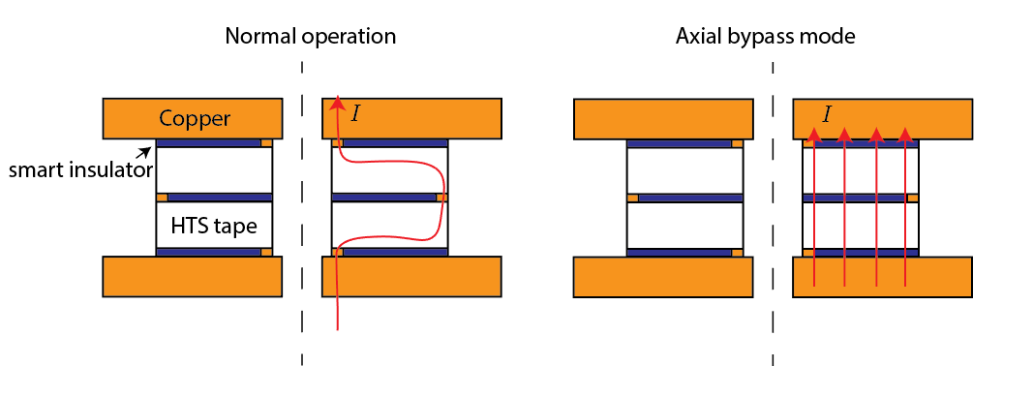


Smart insulation
$$T=T_{op}$$
$$T>T_{op}$$

Slide 36
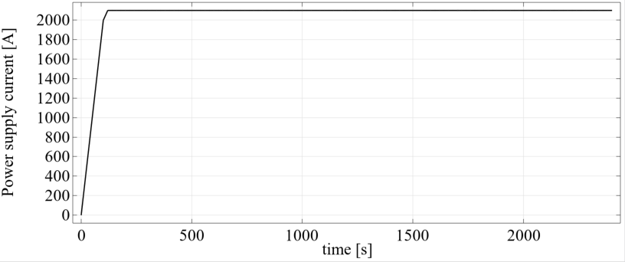
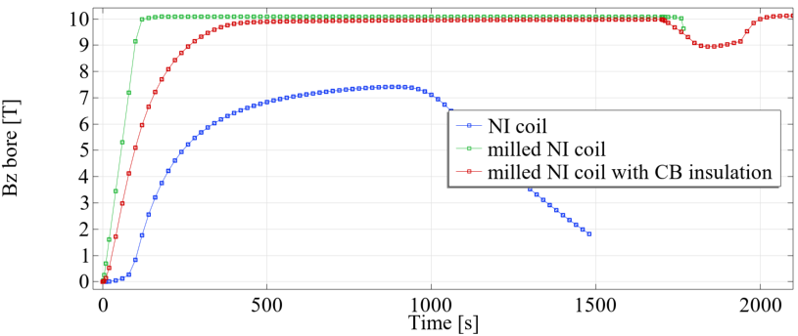
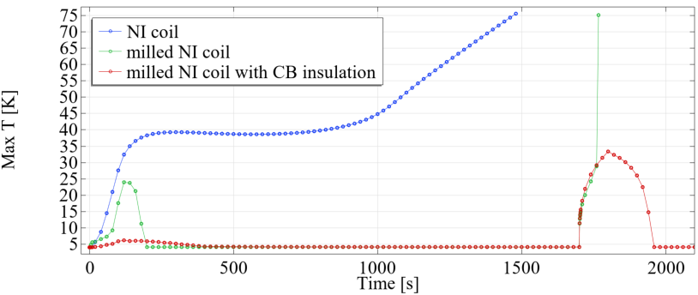
Heater activated
Quench
fast ramp stability
NI coil
Milled NI coil
Milled NI coil
with axial bypass
NO
YES
Thermal runaway
YES
NO
YES
YES

Slide 37
Smart insulation
Reproduce literature thin-layer resistivity
Small coils to demonstrate positive effect
Address mechanical issues (showstopper?)
Extrapolation to large dipoles (showstopper?)

Slide 38
Contents
Non-insulated solenoids
Non-insulated racetracks
x-insulated racetracks
1)
NI test coil program
3)
NI racetrack demos
4)
Racetrack demos
explore insulation
/cable concepts
2)
NI solenoid for
P3 experiment at PSI
2024
2)
NI solenoid for
FCC-ee positron source
3)
NI superbend for SLS
4)
Accelerator dipoles
time

