Slide 1
Ultrafast structural dynamics of a strong electromagnon resonance in multiferroic hexaferrite
Hiroki Ueda :: Paul Scherrer Institute
15.11.2021

Slide 2
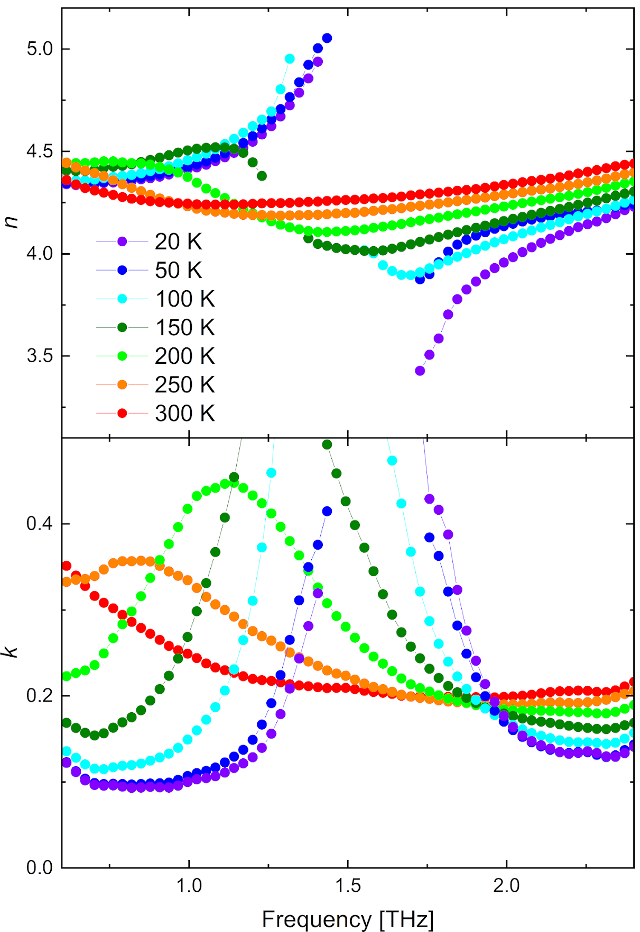
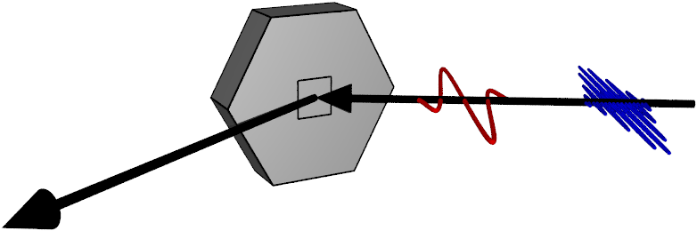
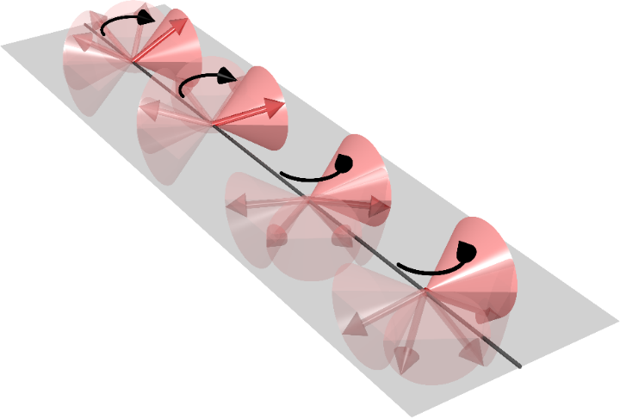
THz-pump x-ray diffraction probe experiments
Multiferroic Y-type hexaferrite (Ba,Sr)₂Me₂Fe₁₂O₂₂ (Me = Co, Zn…etc.)
Larger resonator strength more than 10 times larger than TbMnO₃
PRB 97, 134406 (2018).
THz time-domain spectroscopy
Probe (X-ray diffraction)
At resonance (magnon) & at non-resonance (polar phonon)
(a)
E_{THz} // [001]
Multiferroic material (hexaferrite)
THz (Pump)
X-ray
(Probe)
Δt
Domain 1
+M
(+P)
(b)
Spin
I(Δt)/I(0)
-M
(-P)
Δt
Domain 2

Slide 3
Preliminary results
Structural response at 1.7THz
Measured at different diffraction peaks
Response is relatively small
The ionic contribution to the dipole is small
(mostly electronic)
Temperature dependence to be evaluated

Slide 4
Feedback
DAQ
  Worked well throughout the beamtime
  Recorded reduced number of JF modules
  Used online analysis for visualization
Laser
  Twin topas was stable throughout beamtime
  Minor pointing tweaks were necessary to keep pump stable
Machine
  Parallel operation with Athos went well
  1mJ pulse energy reached at 7.5keV
  Pulse length was not measured (users were measuring)
  In the beginning, pointing drifts were observed → PSICO was turned off

Slide 5
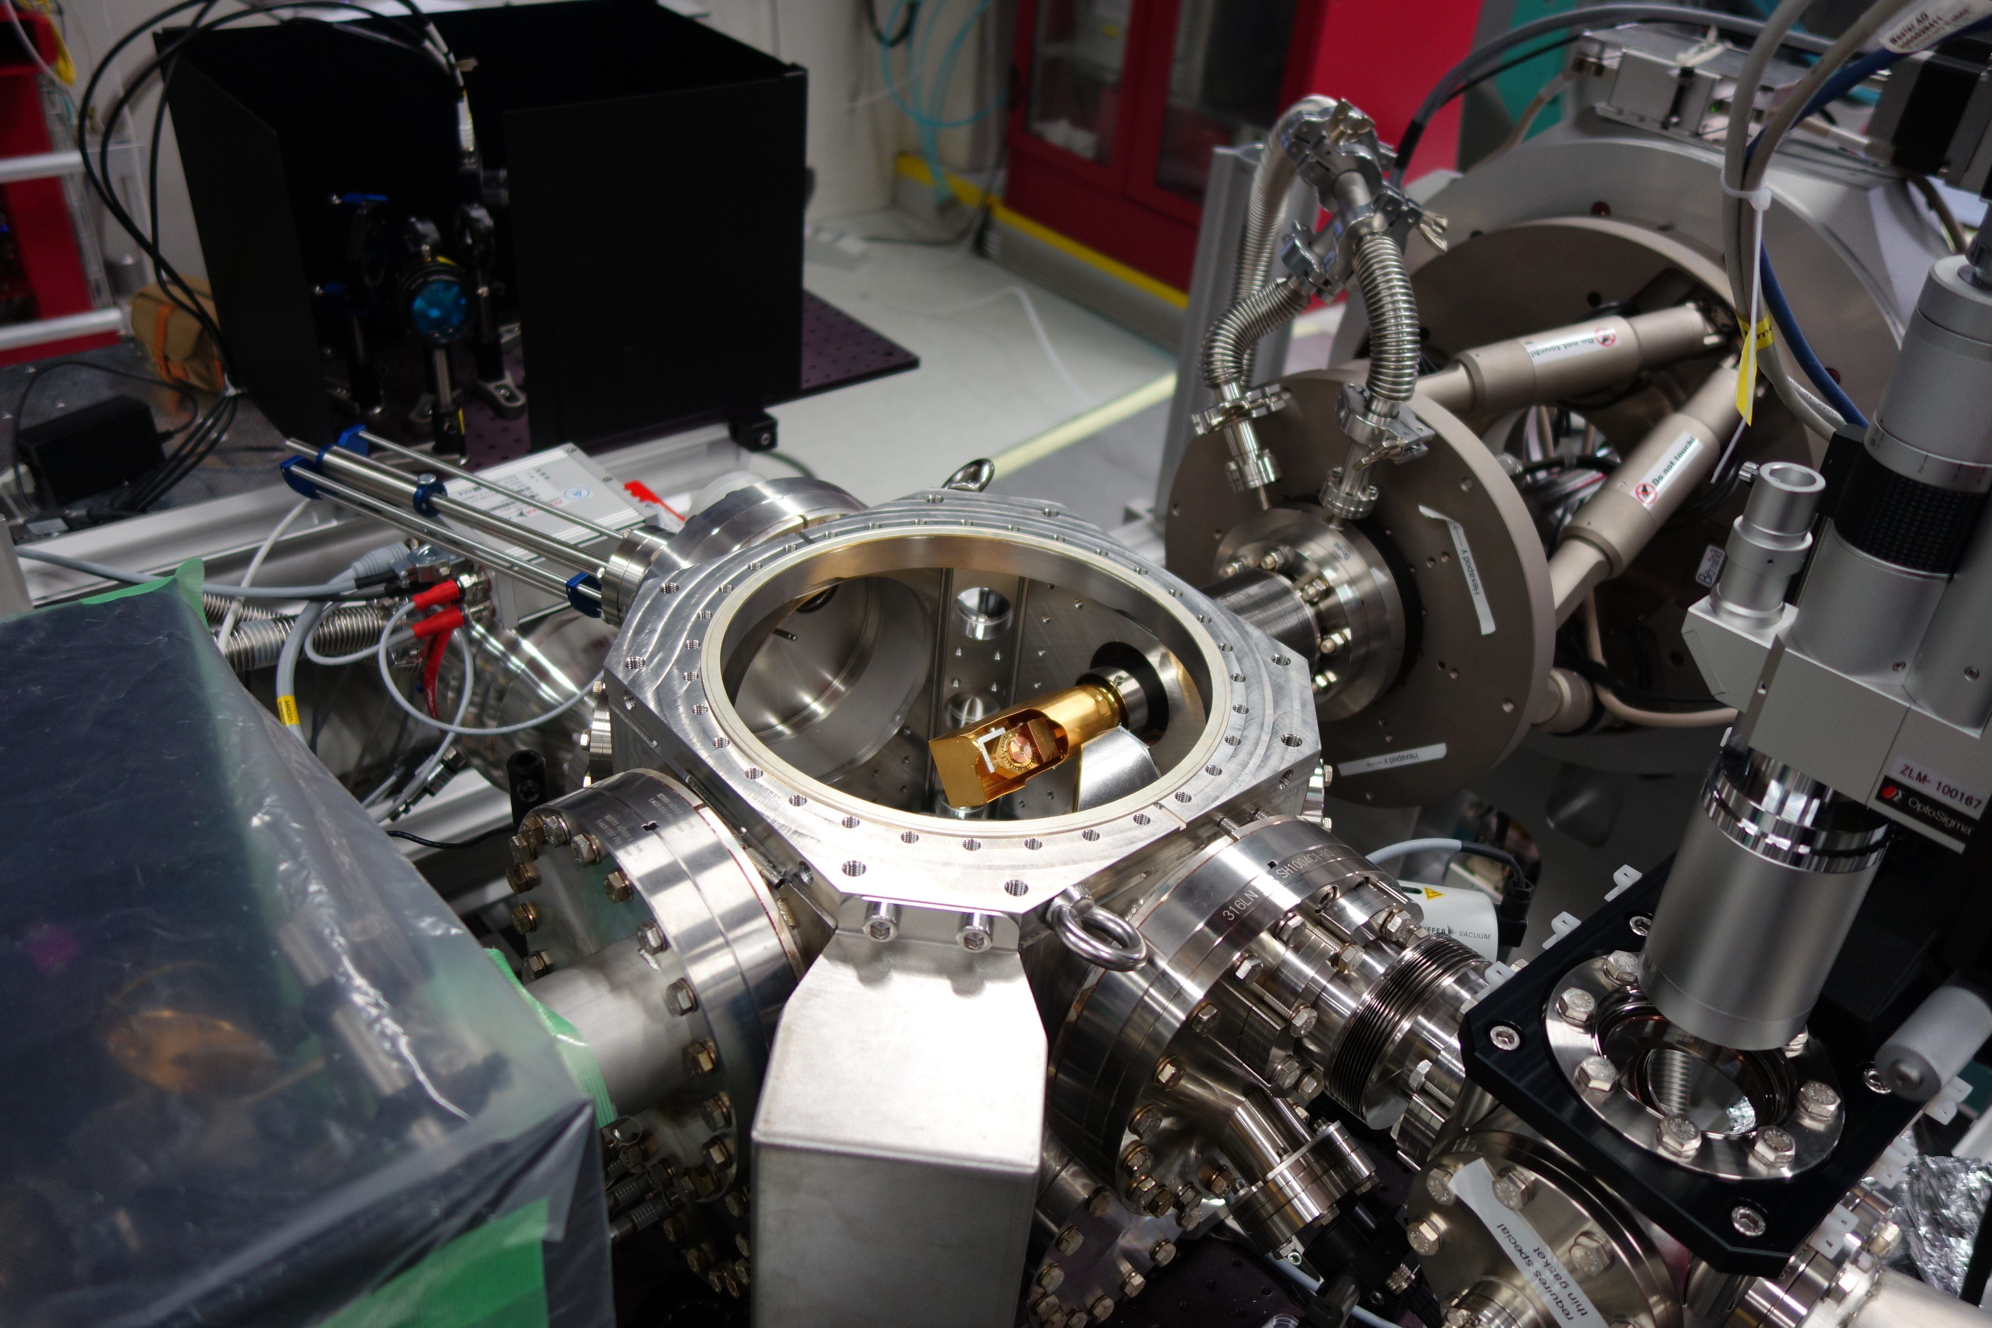
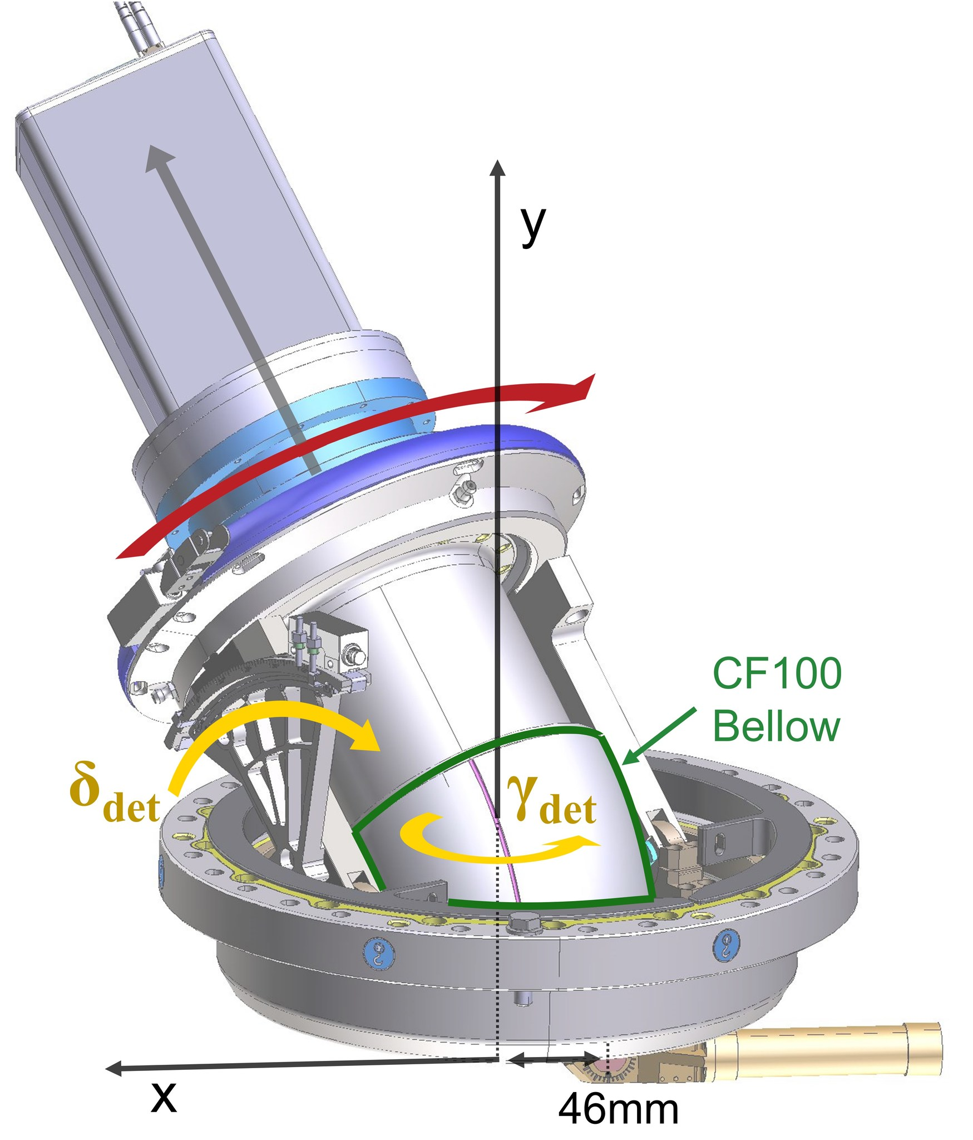
Next week: commissioning of motorized in-vacuum detector

Slide 6
Next week: commissioning of motorized in-vacuum detector
Motorized in-vacuum detector
  Will extend usable photon energy range of THz chamber down to 2keV
Chamber can then be used for experiments, which require:
  Stable and low temperatures down to 5K
  High electromagnetic excitation fields > 1MV/cm
  Tender to hard photon energies (2-12.7) keV

Slide 7
Next week: Requirements
DAQ
  0.5M in-vacuum detector
  1.5M as backup
Laser
  THz generated with DSTMS crystal
Machine
  7.55 keV, scanned +-100eV using undulators
  Reasonably short pulses (max 20fs RMS)
  Small bandwidth (< 0.15% )
  Pulse energy of 500uJ sufficient

