Slide 1
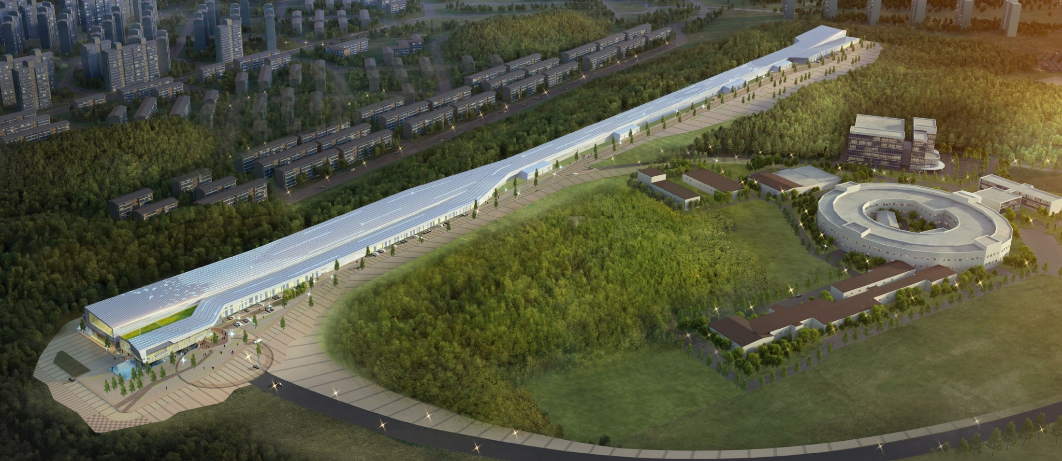
Current Status of PAL XFEL Project
Oct. 6, 2011 @ PSI
In Soo Ko
On behalf of PAL XFEL Team

Slide 2
Contents
Brief History of PAL and XFEL
Layout and Building Design
Lattice Design and S2E Simulation
Undulators
Diagnostics
Timing & RF System
Beamlines
Photocathode RF Gun
Injector Test Facility
Summary

Slide 3

PAL: Chronology
Past | I. PLS Project started Apr. 1 1988 Ground-breaking Apr. 1 1991 2-GeV Linac commissioning June 30 1994 Storage ring commissioning Dec. 24 1994 User’s service started Sept. 1 1995 1st PLS Upgrade Complete Nov. 1 2002 Energy ramping to 2.5 GeV Sept. 1 2000 2.5-GeV injection Nov. 1 2002
Present | II. 2nd Major Upgrade of the PLS (PLS-II) 3.0 GeV PLS-II Upgrade begin Jan. 2009
Future | 3.0 GeV PLS-II Upgrade Complete Dec. 2011 III. PAL XFEL (10GeV Linac & SASE Based 0.1 nm x-ray FEL) Project Approval 2010 Project Start 2011 (Anticipated) Construction Complete 2014

Slide 4
PAL XFEL History
2002: Start discussion
2004 : PAL proposed a 0.3 nm SASE-FEL.
3.0 GeV (upgraded from existing 2.5GeV linac), 3 mm in-vacuum undulator
0.1 nm radiation proposed using a third harmonic
But, potential users strongly demanded 0.1 nm fundamental.
2008 : A 0.1 nm SASE-FEL was proposed.
E_{e}=10.0 GeV
L~900 m (Linac : ~550 m, BTL: ~50 m, Undulator: ~100 m, PTL+Exp: ~200 m)
2009 : Government Preliminary Evaluation Started in Dec.
2010 : Evaluation completed
  Concluded as a feasible and important national project.
2011 : PAL XFEL project started
  Total budget of 400 M$ for 4-year construction
  20 M$ for FY2011 budget
  FY2012: 85 M$ , FY2013: 150 M$, FY2014: 145 M$

Slide 5
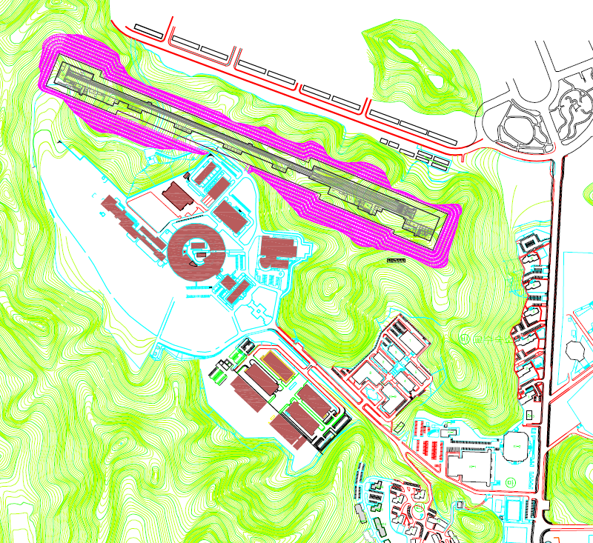
Proposed PAL XFEL Project
0.1-nm Hard X-ray 10-GeV XFEL
Project Period: 2011 ~ 2014
Commissioning: 2015
Total Budget: 400 M$
PAL XFEL Site
Building
Linac Hall |  | 830
 | 1. Assembly | 20
 | 2. Linac | 700
 | 3. BTL | 110
Undulator Hall |  | 200
XFEL Beamline |  | 80
 | 1. Front-end | 20
 | 2. Experiment hall | 60
Total Length [m] |  | 1110
3-GeV Linac
Pohang Light Source
(3 GeV /400 mA)

Slide 6
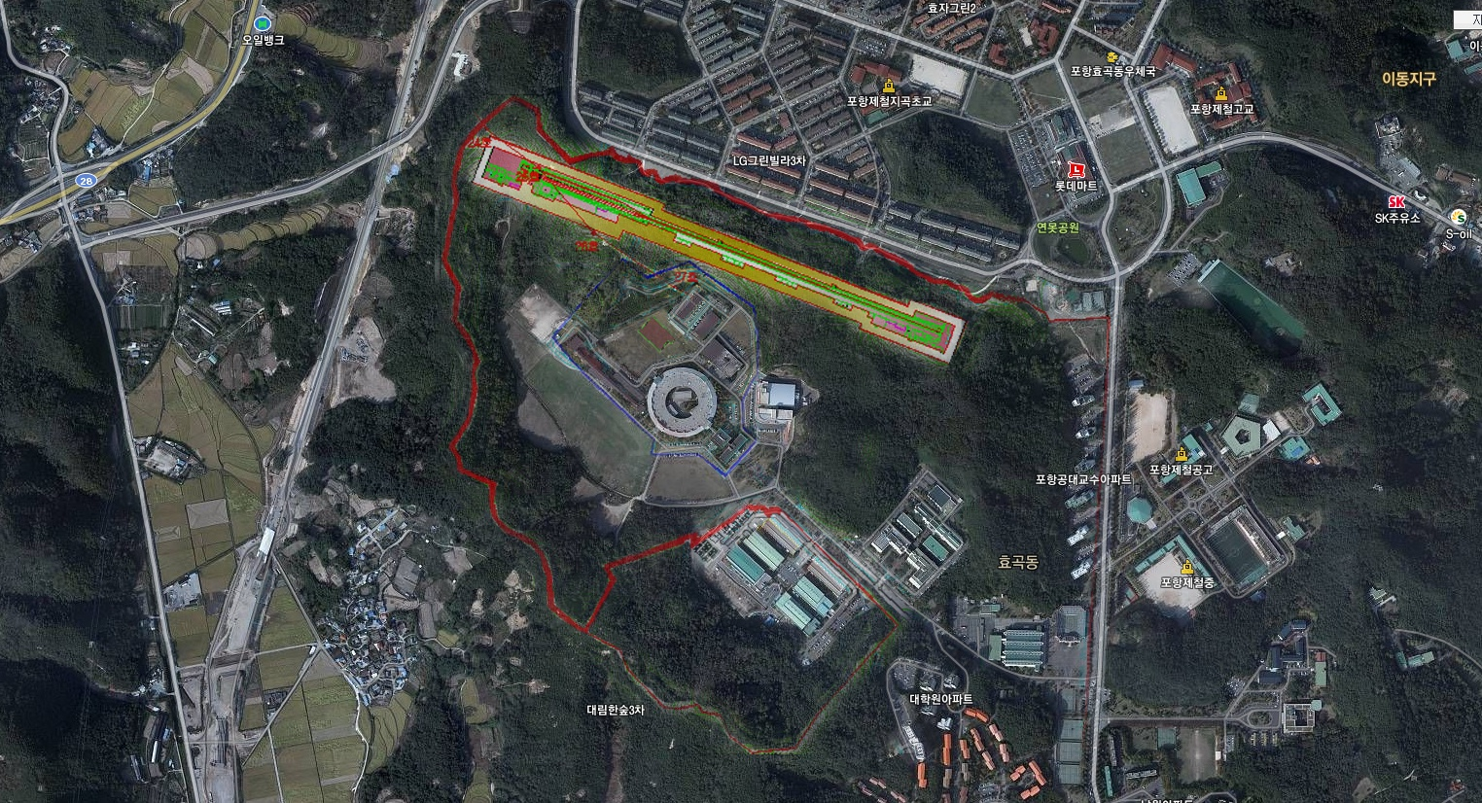

Slide 7
Major Parameters of PAL XFEL
Wavelength
  Soft x-ray: 1 nm ~ 10 nm
  Hard X-ray: 0.7 ~ 0.1 nm
    Extended to 0.06 nm
Photon beam Length
  Nominal : 30 ~ 100 fs (200 pC)
  Short : < 5 fs (20 pC)
  Ultra short: < 0.5 fs by ESASE scheme
Undulator Beamline
  :3 Hard X-ray / 2 Soft X-ray lines
 | FEL wavelength [nm] | 0.1
Electron Linac | Beam energy [GeV] | 10
 | Beam charge [nC] | > 0.2
 | Beam emittance [ mm-mrad] | < 0.5
 | Injector Gun | Photocathode RF-gun
 | Peak current at undulator [kA] | > 3
 | Repetition rate | 120 Hz
 | Number of Bunch | Single or Two
 | Linac Structure | S-band
Undulator | Undulator type | Out-vacuum
 | Undulator Period [cm] | 2.46
 | Undulator Gap [mm] | 6.8
 | Undulator parameter, K | 2.076
 | Saturation Length [m] | 56
FEL | FEL Radiation Power [GW] | > 29
 | Photon beam length [fs] | 60
 | FEL Photons/pulse | > 1.0 E+12
Radiation Power of 0.1 nm @Z=132 m
Untapered : 14 GW (4.7E+11 photons)
Tapered : 55 GW (1.8E+12 photons)

Slide 8
Undulators and Beamlines
One hard X-ray FEL undulator (HXFEL1) and one soft X-ray FEL undulator (SXFEL1)
APPLE II undulator in soft X-ray provides the capability of full polarization control
XFEL | HXFEL1 | SXFEL1
Beam Energy [GeV] | 10 | 3.0
Wavelength [nm] | 0.7 ~ 0.06 | 10 ~ 1
Wavelength tuning | Beam energy (Gap change possible) | Undulator gap
Undulator type | Planar | Planar (or APPLE)
Undulator period [cm] | 2.46 | 5.0
Undulator gap [mm] | 6.8 | 8.3 ~ 25.5

Slide 9
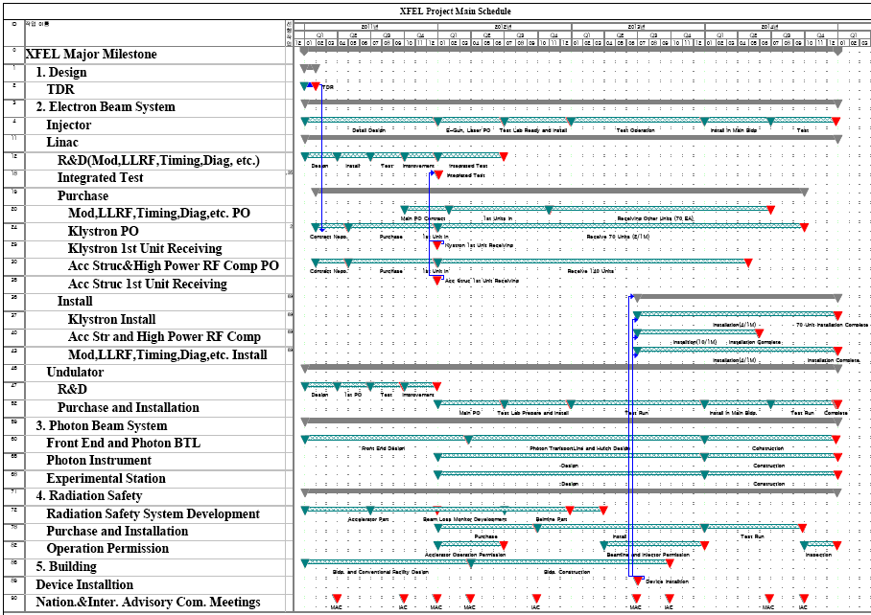
Schedule

Slide 10
Layout & Building Design

Slide 11
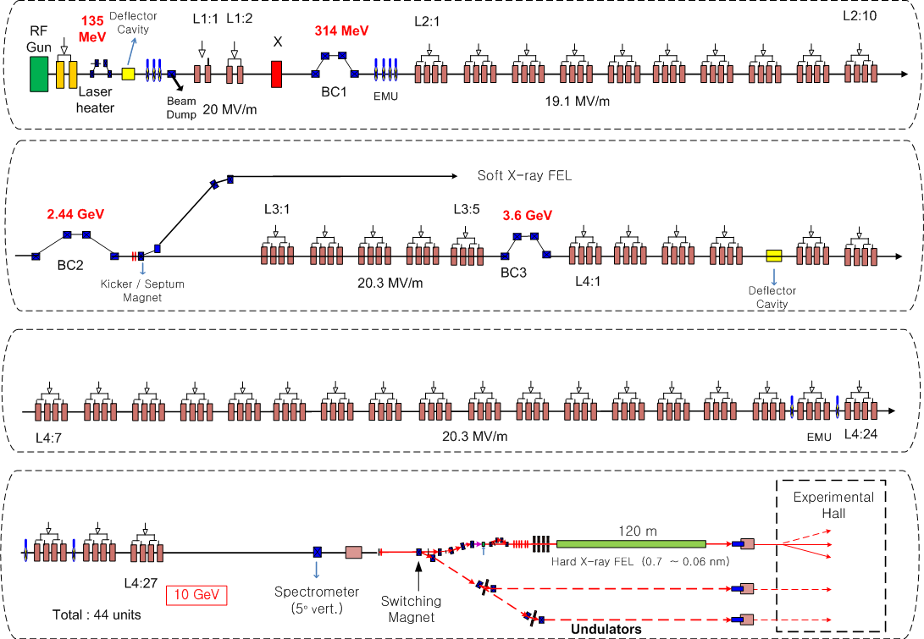
XFEL Layout

Slide 12
Specifications of PAL XFEL Main Devices
 |  | Specification
Photocathode RF Gun | Type | 1.6 cell
 | Beam Energy | > 6 MeV
 | Charge / Pulse repetition rate | 0.2 nC / 120 Hz
 | Laser | Ti-Sapphire, > 10 mJ @ 800 nm
Linac | Main Accelerating Structure | S-band Normal Conducting
 | Beam Energy (GeV) | 10
 | Beam Emittance (μm-rad) | < 0.5
 | Beam Current (kA) | > 3.0
 | Operating frequency | 2,856 MHz (S-band), 11.424 GHz (X-band)
 | No. of Acc. Columns | 178 ea (S-band) , 1 ea (X-band)
 | No. of Klystrons | 48 ea (S-band) , 1 ea (X-band)
 | Modulator | Voltage stability: < 100 ppm rms
 | Linac Microwave | Phase stability: <0.1 deg, 0.05% rf voltage Jitter
Undulator | Type | Out-vacuum (EURO-XFEL undulator design ))
 | Period (mm) / gap (mm) | 2.46 / 6.8

Slide 13
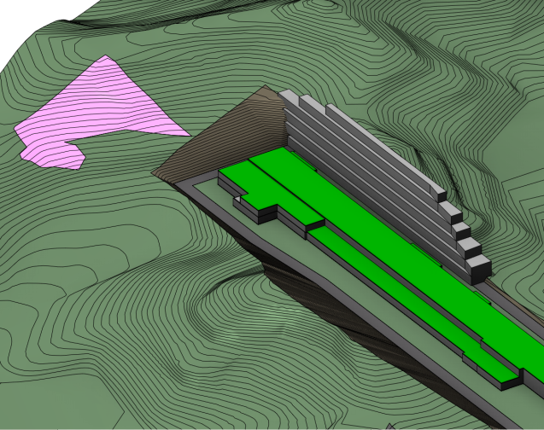
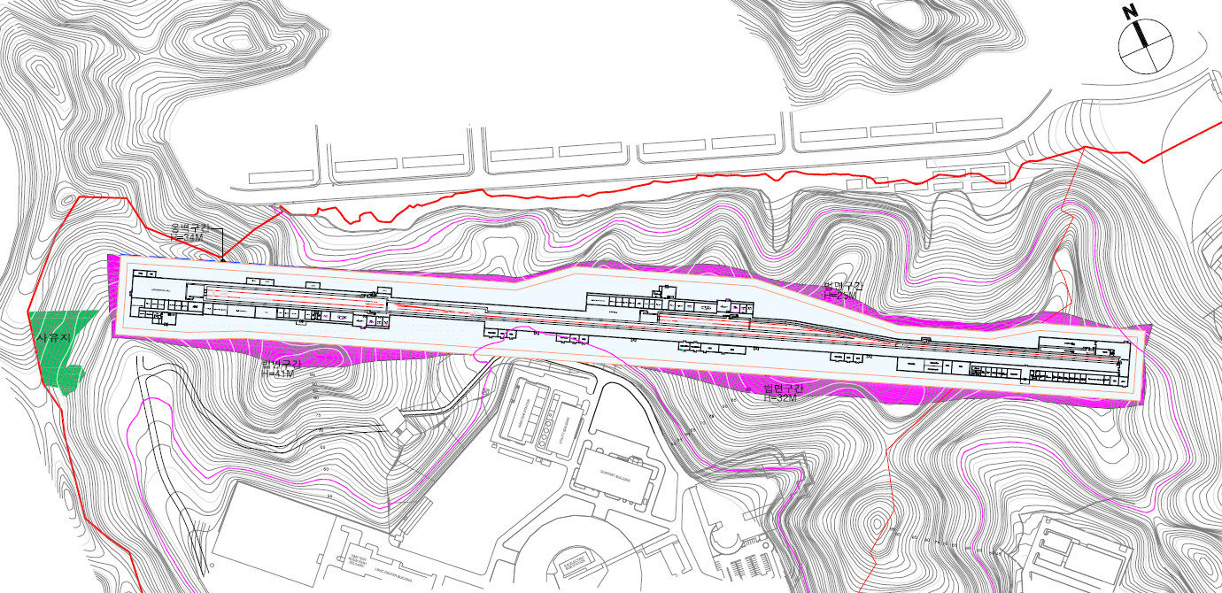
Site Plan (to be finalized)
대안 2
FH : 58
절토량 : 2,107,386.57 m³
성토량 : 7,164.94 m³
사토량 : 2,100,221.63 m³

Slide 14
Lattice design and
S2E Simulation

Slide 15
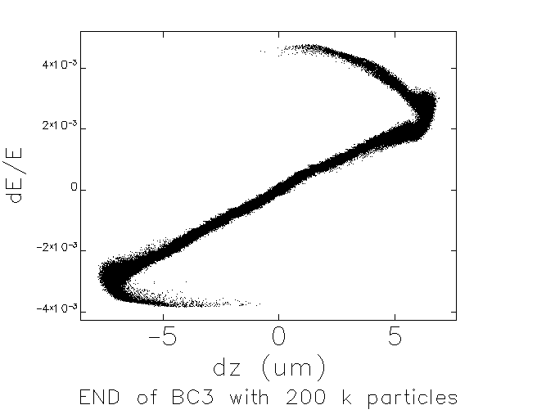
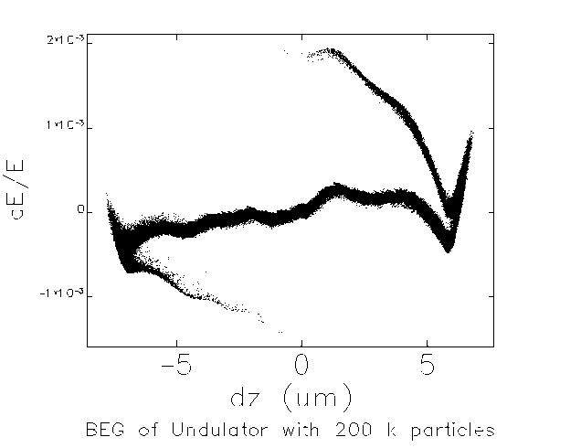
Wake in Accelerating Structures
Wake in Accelerating structures cancel energy chirp after compression
(Karl L.F. Bane, “Short-range dipole wakefields in accelerating structures for the NLC”)
5.0 x 10-4
tail
head
head
As the bunch current is given, typically 3 kA, the length of linac after compression determines the required energy chirp.
A short linac requires a smaller energy chirp than a long linac like LCLS, which means a short linac requires a larger R56 than a long linac. ( h x R₅₆ = constant. )
C-band or X-band structure provide enough wake for short linac (SwissFEL)

Slide 16
Three Bunch Compressor Scheme
A short Linac → small energy chirp → big R56 → big bend angle in chicane → large emittance increase due to CSR and ISR
“long linac” “short linac”
2ND BC in Two BC Scheme is splited into two.
3rd BC has a small R56 to minimize CSR effect
- weaker chicane BC3 → less CSR
h x R₅₆ = constant = h x R₅₆
3 Bunch Compressor layout
θ=2.6°, ΔL=8 m
R₅₆= -34.0 mm
θ=1.8°, ΔL=3.5 m
R₅₆ = -7.4 mm
BC1
BC2
BC3
Linac-1
X
Linac-2
Linac-3
Linac-4
18 MV/m
-22°
21.5 MV
-169.5°
19.0 MV/m
-21.8°
19.3 MV/m
-0.5°
19.3 MV/m
-0.5°
RF-gun Injector
135MeV
314 MeV
2.44 GeV
3.6 GeV
10.1 GeV

Slide 17
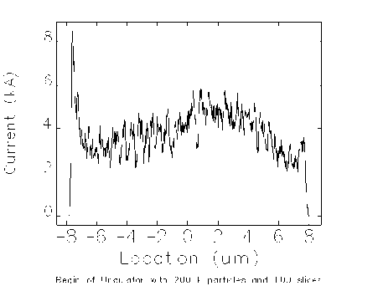
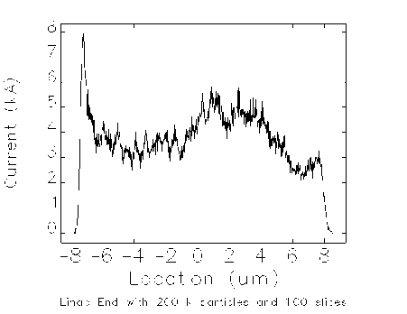
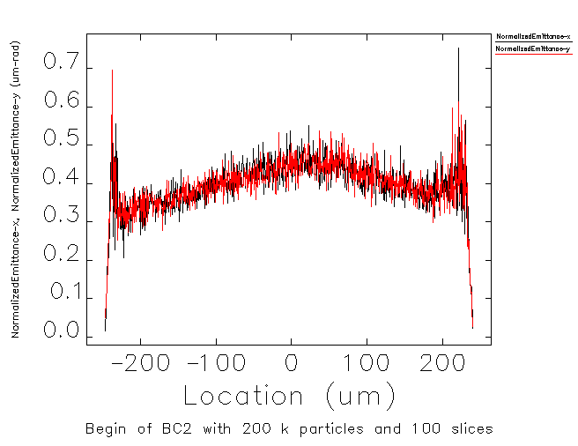
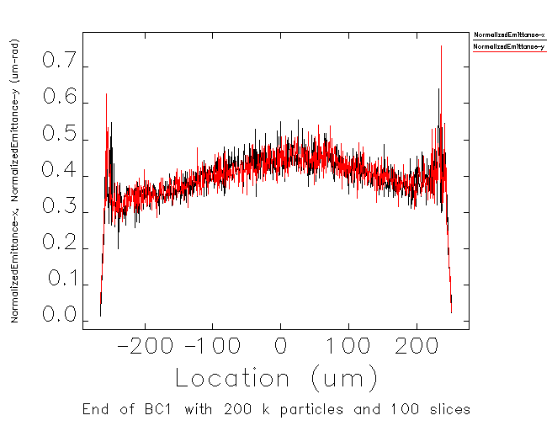
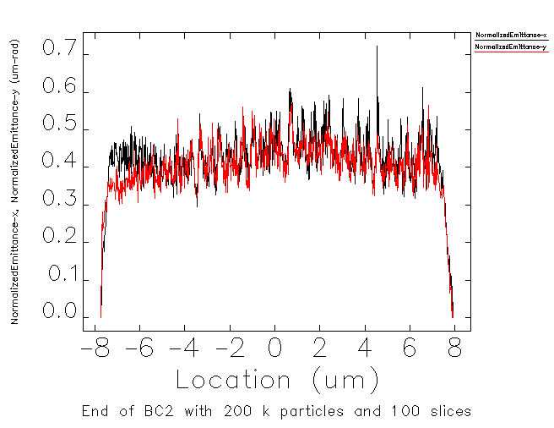
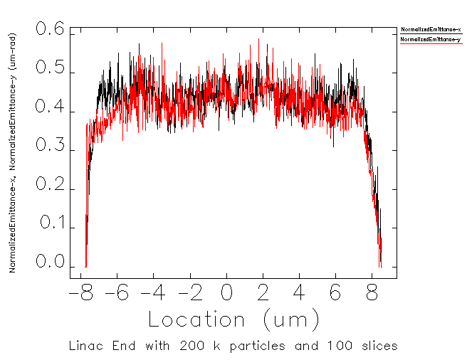
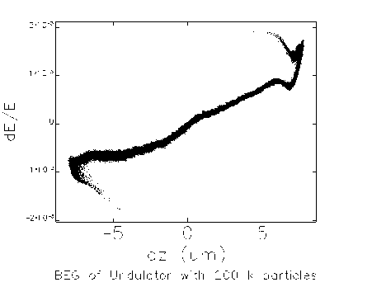
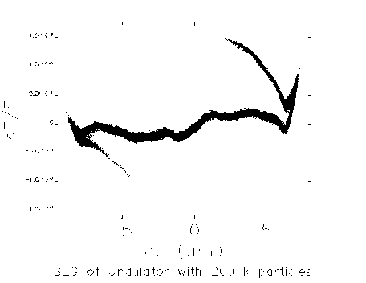
Comparison bet. 2BC and 3BC
2 BCs
3 BCs
 |  | Two Bunch compressors | Three BCs
BC1 (420 MeV) | Bend Angle [deg] | 4.5 | 4.5
 | Distance bet. Two dipoles [m] | 3.2 | 3.2
 | R56 [cm] | -4.11 | -4.11
BC2 (2.8 GeV) | Bend Angle [deg] | 2 | 2.6
 | Distance bet. Two dipoles [m] | 11 | 8
 | R56 [cm] | -2.75 | -3.4
BC3 (4 GeV) | Bend Angle [deg] |  | 1.8
 | Distance bet. Two dipoles [m] |  | 3.5
 | R56 [cm] |  | -0.74
L1 phase [deg] |  | -18 | -18
L2 phase [deg] |  | -27.5 | -18.6
X-band phase [deg] |  | -166 | -166
LTU (dogleg) dipole bend angle / length |  | 0.5 deg / 1.9 m | 0.3 deg / 0.5 m
Correlated energy spread |  | > 5 x 10-4 | < 5 x 10-4
Emittance increase by CSR |  | small | small
After BC1
After BC1
Linac End
Linac End
Before Undulator
Before Undulator
17

Slide 18
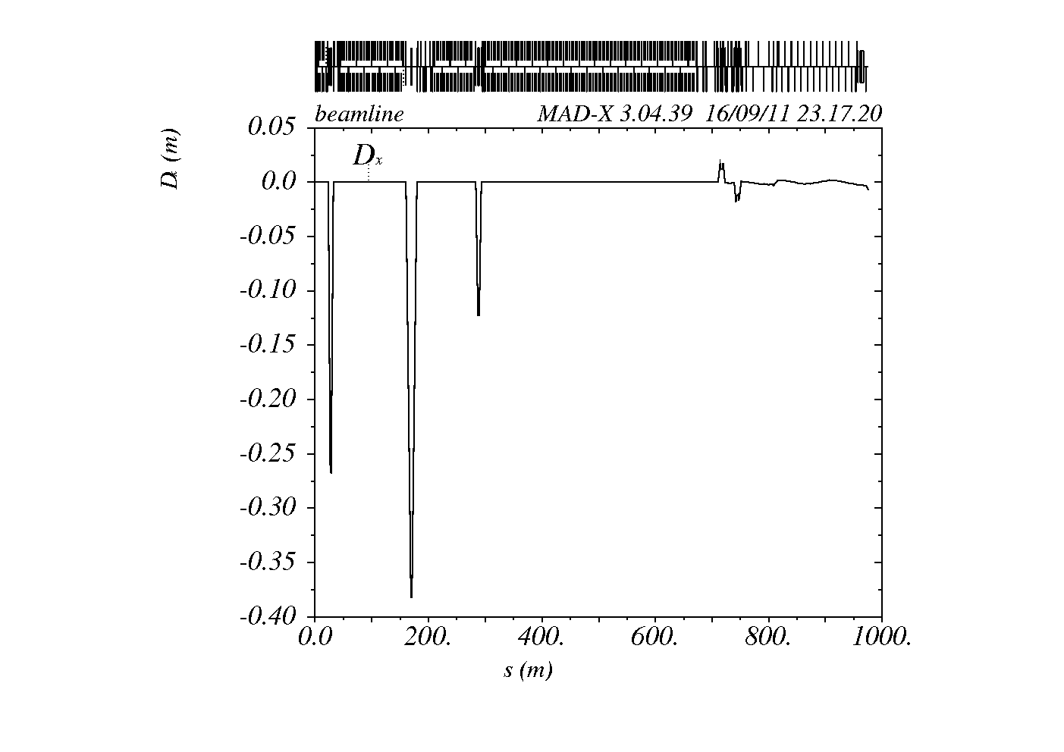
Three Bunch Compressor Scheme
LTU
(0.3 deg / 0.5 m)
BC3
(3.6 GeV)
BC1
(314 MeV)
BC2
(2.44 GeV)
3 Bunch compressor Scheme
- gives a better beam parameter than two bunch compressors

Slide 19
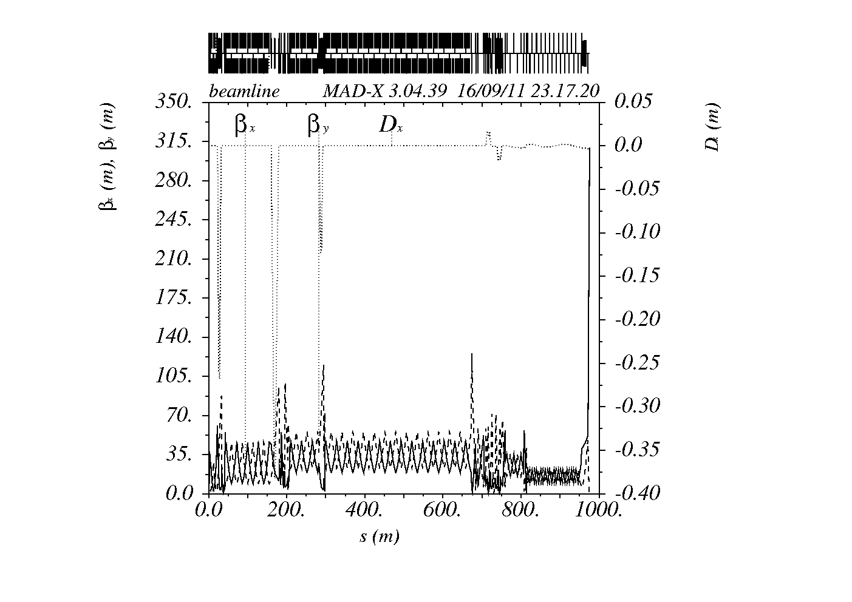
Linac & BTL Lattice
BC1
(314 MeV)
LTU
(0.3 deg / 0.5 m)
BC3
(3.6 GeV)
BC2
(2.44 GeV)
Undulator
(150 m)

Slide 20
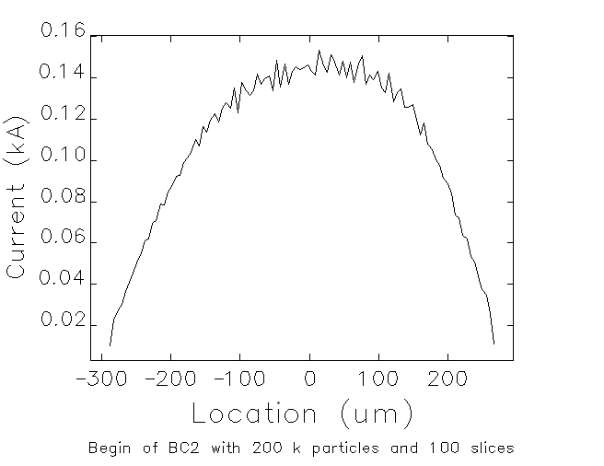
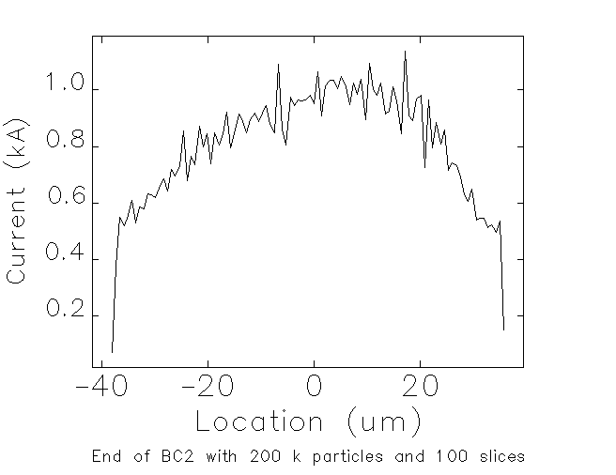
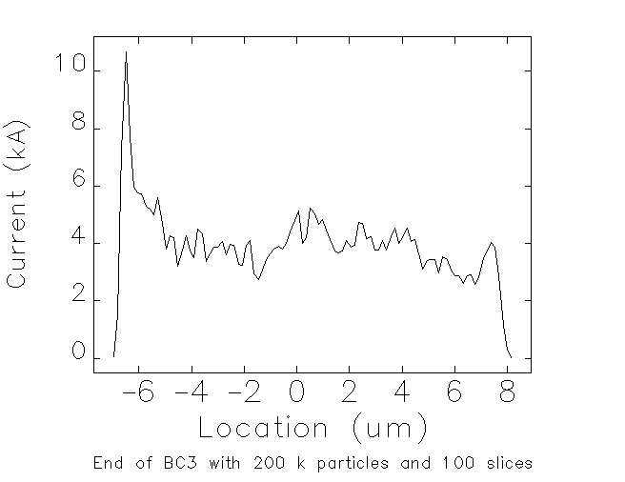
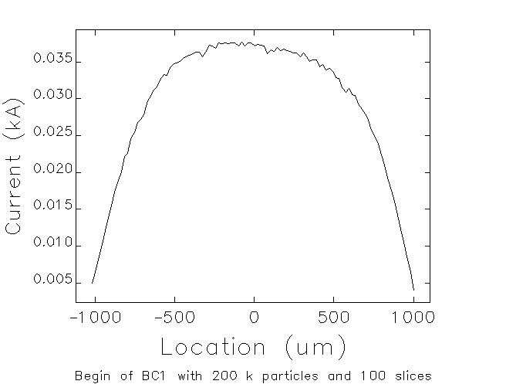
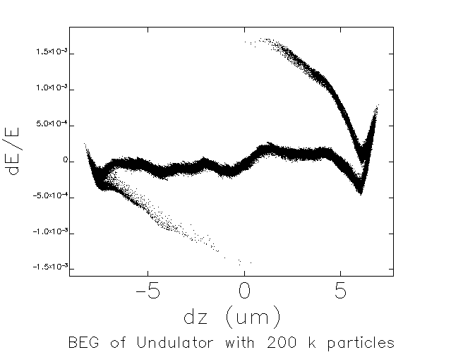
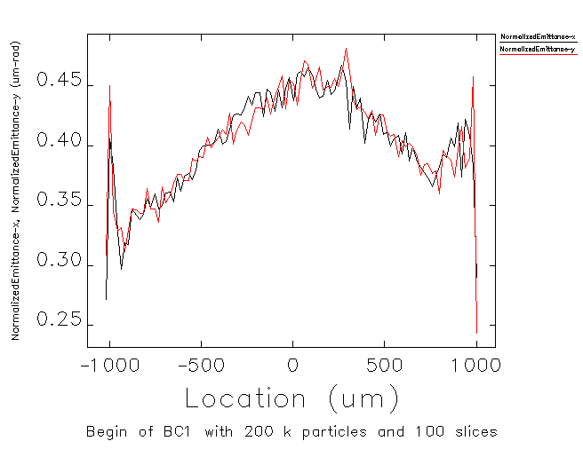
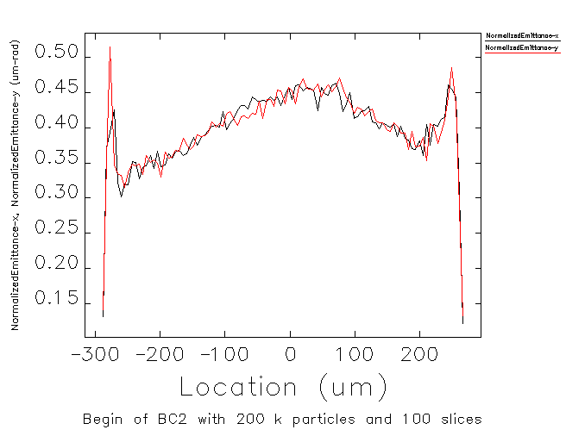
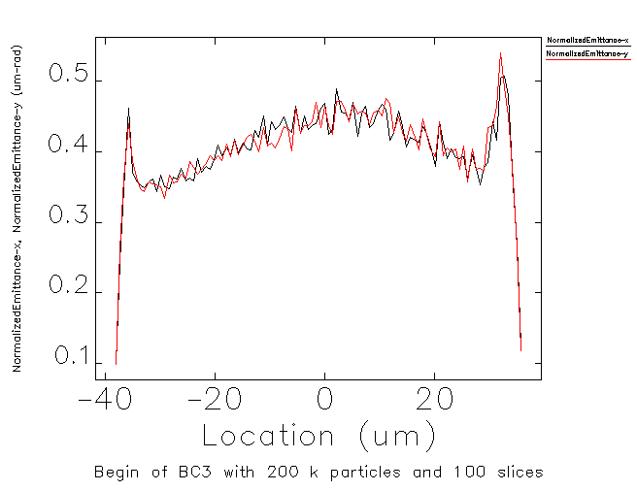
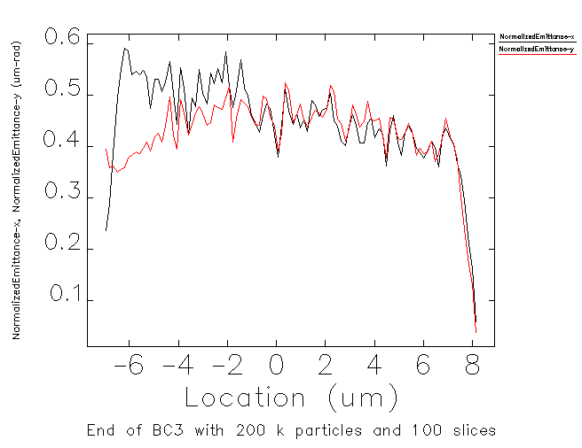
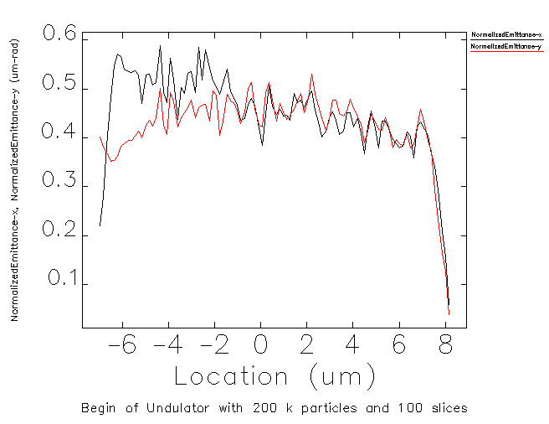
Start-to-End Simulation of Hard X-ray Line
θ=4.5°, ΔL=3.2 m
R₅₆=-41.1 mm
θ=2.6°, ΔL=8 m
R₅₆=-34.0 mm
θ=1.8°, ΔL=3.5 m
R₅₆=-7.4 mm
BC1
BC2
BC3
Linac-1
X
Linac-2
Linac-3
Linac-4
18 MV/m
-22°
21.5 MV
-169.5°
19.0 MV/m
-21.8°
19.3 MV/m
-0.5°
19.3 MV/m
-0.5°
135 MeV
314 MeV
2.44 GeV
3.6 GeV
10.1 GeV
Before BC1
After BC1
After BC2
After BC3
Begin of Und

Slide 21
TOLERANCE BUDGET
P_{sen} is value of sensitivity-individual table.
Parameter | # of klystron | symbol | ΔI/I0 = +10% (P_{sen}) | <ΔE/E₀> = +0.1%(P_{sen}) | ε_{nx} = +5% (P_{sen}) | Tolerance (rms) | unit
Mean L1 rf phase | 3 | φ₁ | -0.17 | 2.1 | -0.12 | 0.05 | deg.
Mean X rf phase | 1 | φ_{X} | 0.26 | -3.9 | 0.19 | 0.05 | deg.
Mean L2 rf phase | 11 | φ₂ | -0.33 | 1.46 | -0.23 | 0.1 | deg.
Mean L3 rf phase | 6 | φ₃ | -23.8) | 96.5 | -17.4 | 0.1 | deg.
Mean L4 rf phase | 26 | φ₄ | 87053.0 | 58.6 | -3938.99 | 0.1 | deg.
Mean L1 rf voltage | 3 | V₁ | 2.4 | 8.5 | 4.04 | 0.05 | %
Mean X rf voltage | 1 | V_{X} | 1.7 | -14.7 | 0.67 | 0.05 | %
Mean L2 rf voltage | 11 | V₂ | -57.7 | 1.43 | -12.6 | 0.1 | %
Mean L3 rf voltage | 6 | V₃ | -25.0 | 1.76 | -17.9 | 0.1 | %
Mean L4 rf voltage | 26 | V₄ | 18555.7 | 0.87 | -6455.36 | 0.1 | %
B.C.-1 angle | ₋ | θ₁ | 0.34 | -4.7 | 0.18 | 0.01 | %
B.C.-2 angle | ₋ | θ₂ | 0.2 | -3 | 0.17 | 0.01 | %
B.C.-3 angle | ₋ | θ₃ | 1.7 | 25.1 | 1.10 | 0.01 | %
Sum [Σ(tolerance)²/P_{sen}²] |  |  | 0.45 | 0.16 | 0.66
(0.44 is portion for unconsidered variable. It is determined by referring LCLS CDR)
Criterion:
(Emittance growth is most tough criterion.)

Slide 22
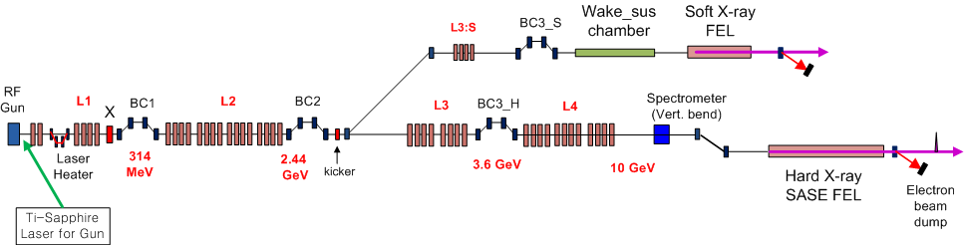
Branch line for Soft X-ray FEL
(proposed by K.J. Kim)
L1, X, BC1, L2, and BC2 has the same parameters as Hard X-ray
  Very flexible in control of bunch current by changing the BC3_S bend angle
  Switching by a kicker and a septum magnet for Soft X-ray FEL beamline
    Simultaneous operation is feasible for Soft X-ray and Hard X-ray FEL

Slide 23
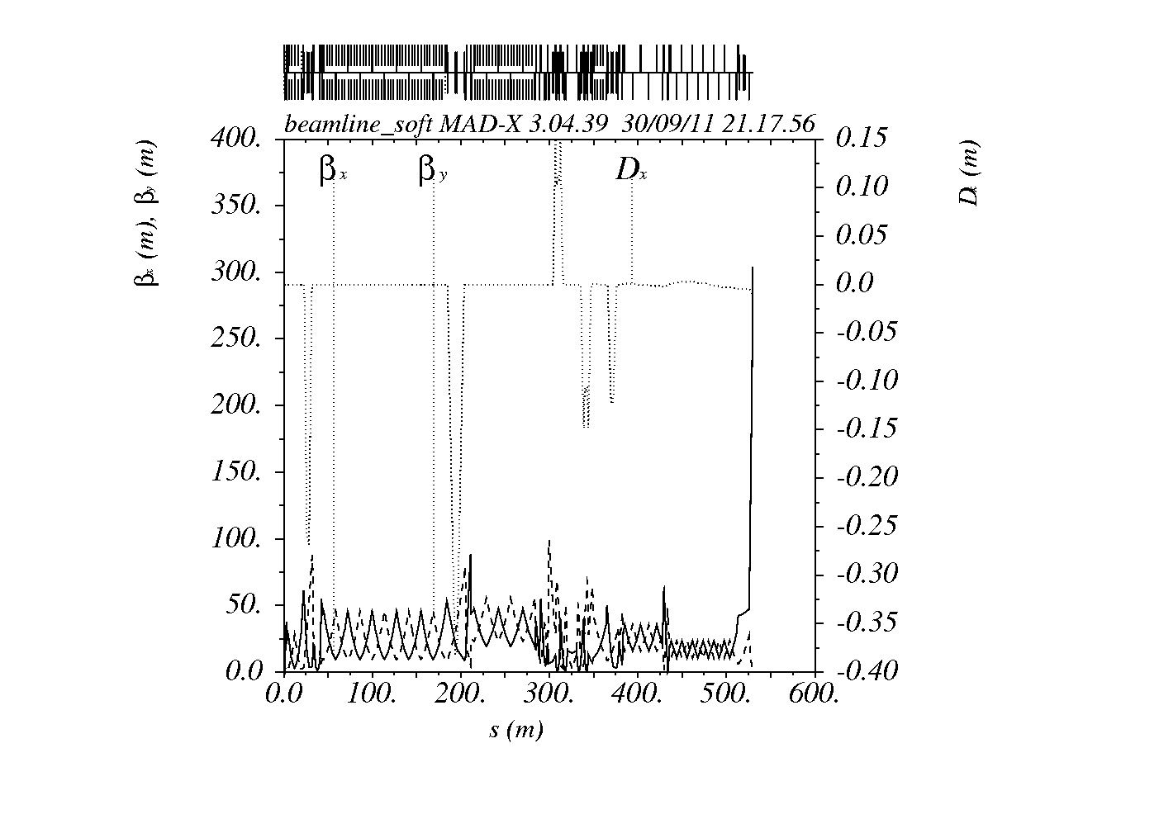
Lattice Design for Soft X-ray Line

Slide 24
Branch line for Soft X-ray at BC2

Slide 25
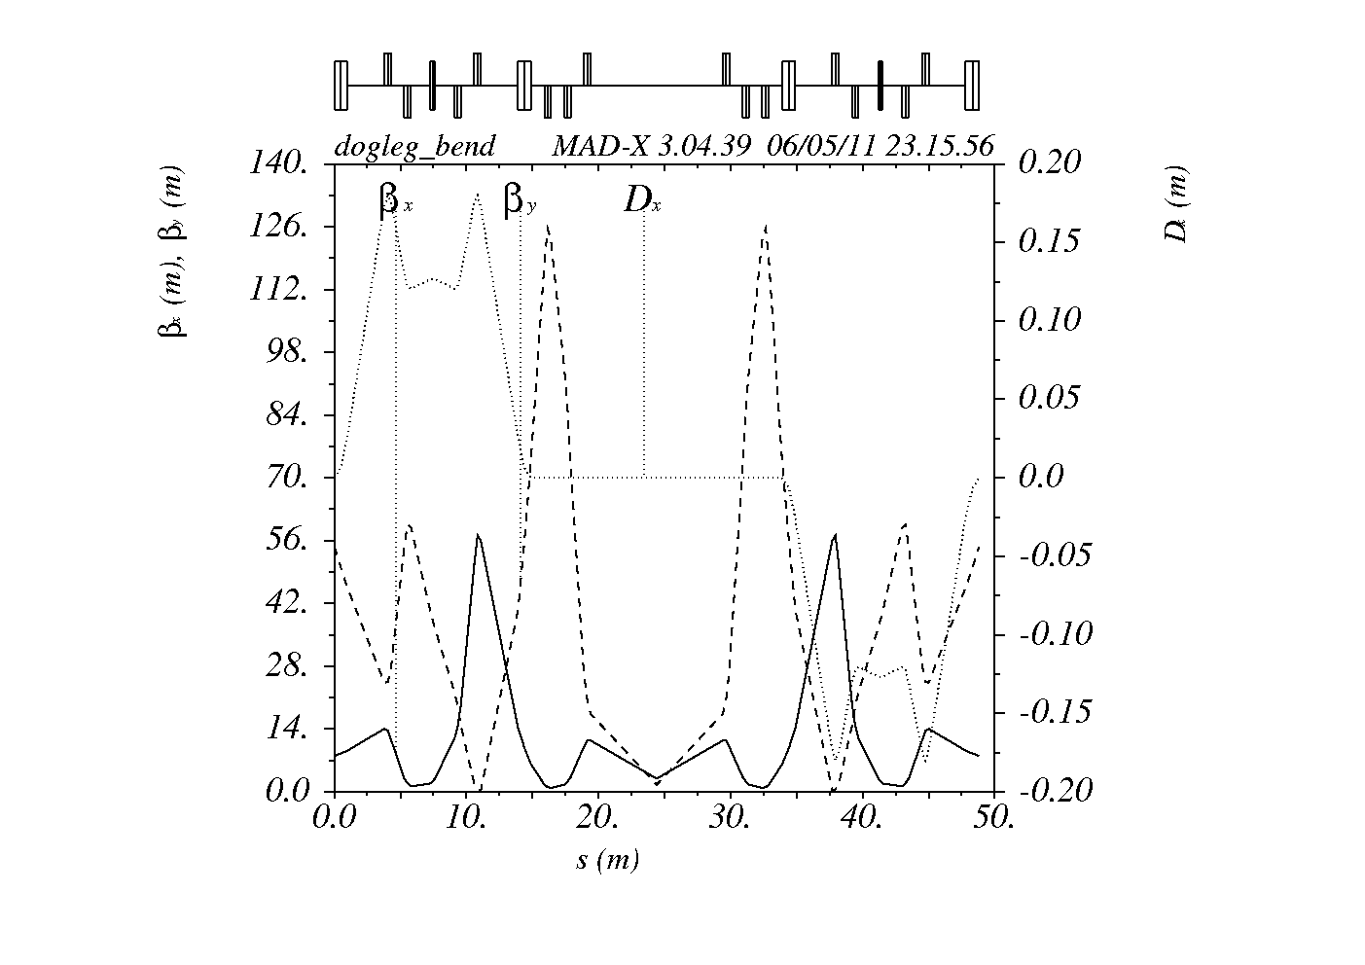
Tunable Dogleg Branch for Soft X-ray
Center dipole
3-degree bend
R56 tunable
Small betas in large angle dipoles
Bend angle [deg] | Bend angle of center dipole | R16 | R26 | R56
3 | 0.45 | 1.9 x 10-8 | -2.4 x 10-10 | -8.9 x 10-5
3 | 0.47 | 1.5 x 10-9 | -1.9 x 10-11 | -6.1 x 10-6
3 | 0.48 | -8.0 x 10-9 | 9.8 x 10-11 | 3.6 x 10-5

Slide 26
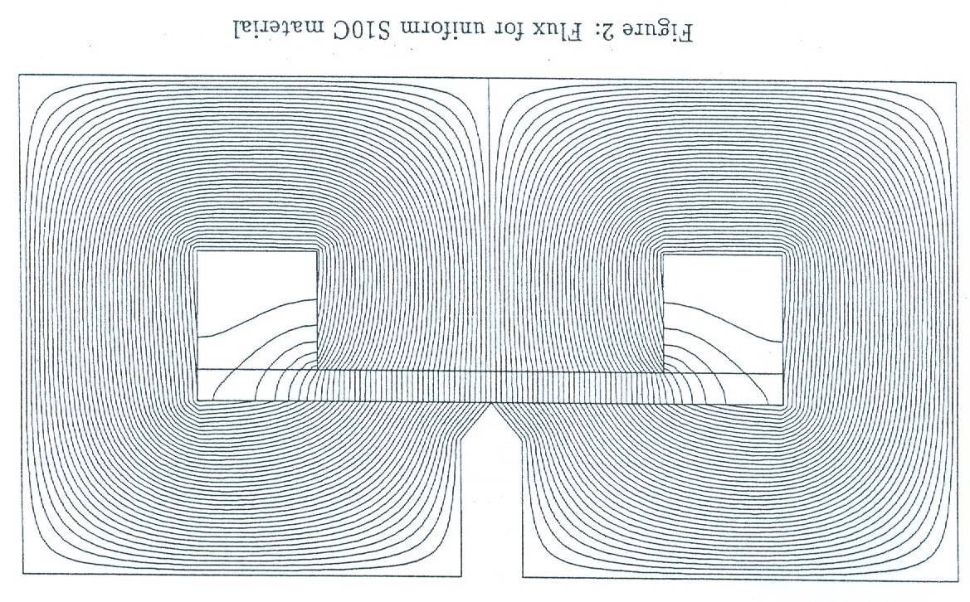
Kicker and Septum for Extraction at the Branch line
septum
y
kicker2
z
kicker1
10.5 mm
0.1°
0.6 m
6 m
1 m
1 m
Kick angle in LCLS-II : 0.0086°
( = 150 urad)
Beam energy [MeV] | 4,000 | 4,000
rigidivity [T-m] | 13.335 | 13.335
Magnet length [m] | 0.6 | 0.6
bending angle [rad] | 0.00175 | 0.00087
[deg] | 0.1000 | 0.0500
Bfield [T] | 0.039 | 0.019
Distance to septum [m] | 6 | 10
offset [mm] | 10.47 | 8.73
y
x
10.5 mm
A Fast kicker with 10-ns separation is necessary for Two Bunch Operation (10 ns spacing) to kick out the second bunch to the soft X-ray branch line.

Slide 27
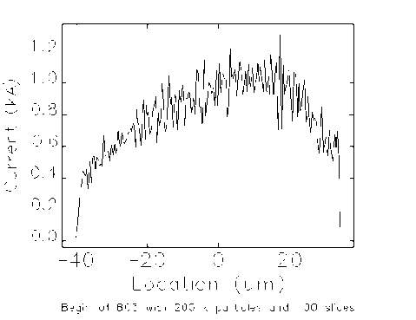
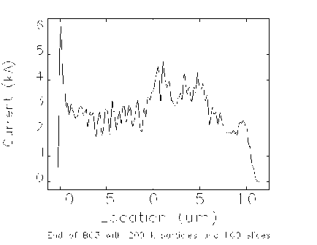
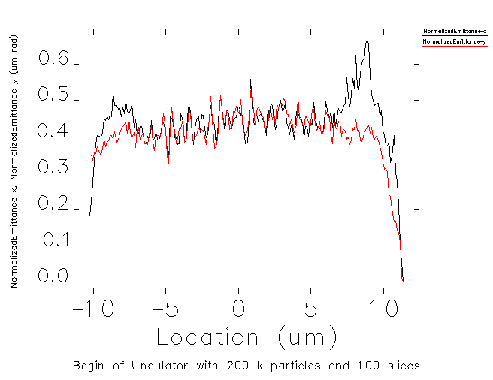
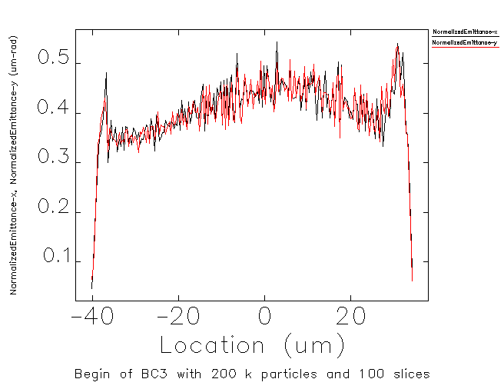
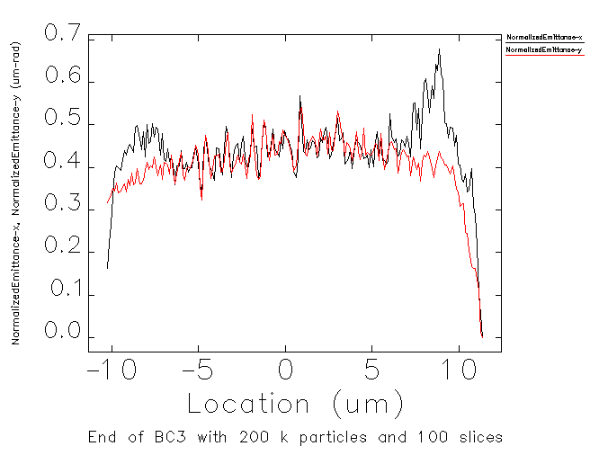
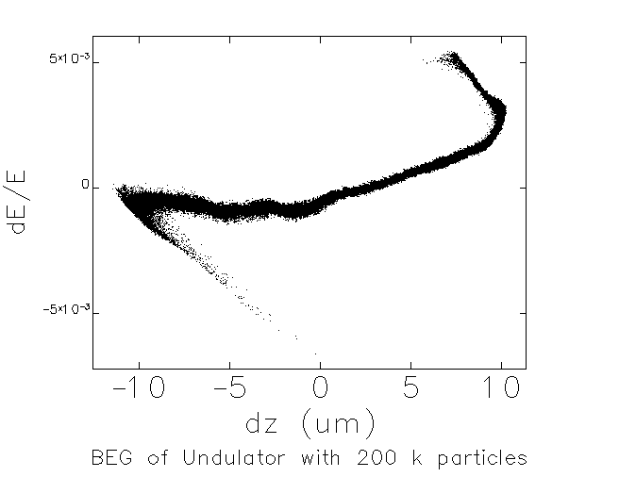
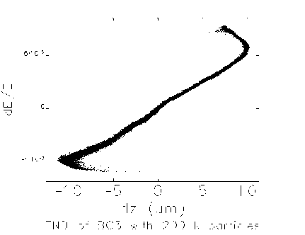
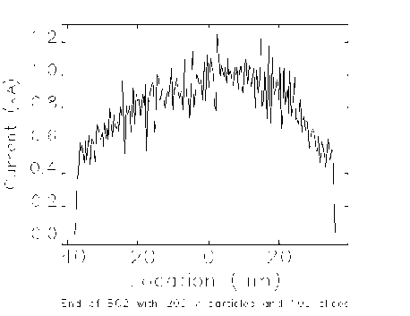
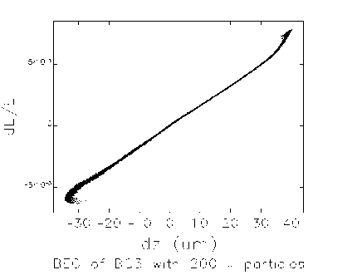
S2E simulation of Soft X-ray Line
After Dogleg
After BC3
Before Undulator
After BC2
BC3_S
Dog-log
SUS_wake Chamber
Soft X-ray
BC1
BC2
BC3_H
Linac-1
X
Linac-2
Linac-3
Linac-4
Hard X-ray
18 MV/m
-22°
21.5 MV
-169.5°
19.0 MV/m
-21.8°
19.3 MV/m
-0.5°
19.3 MV/m
-0.5°
135 MeV
314 MeV
2.44 GeV
3.6 GeV
10.1 GeV

Slide 28
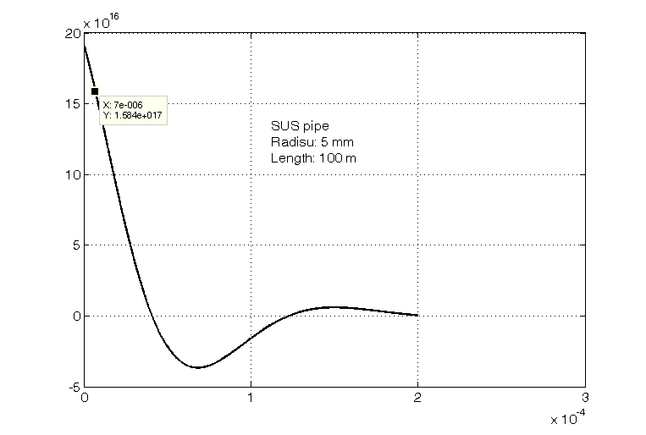
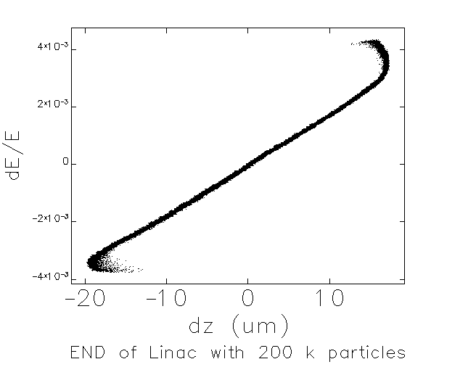
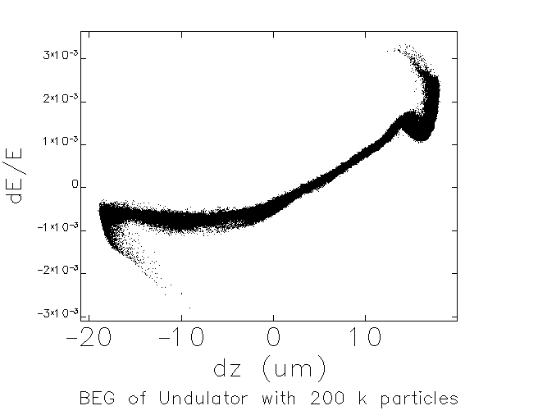
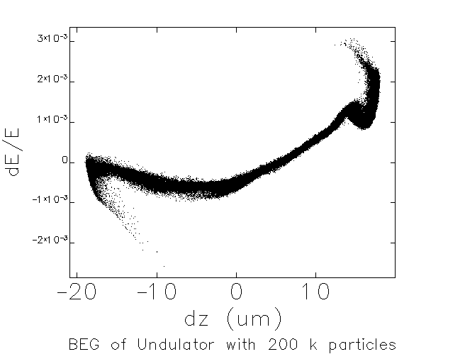
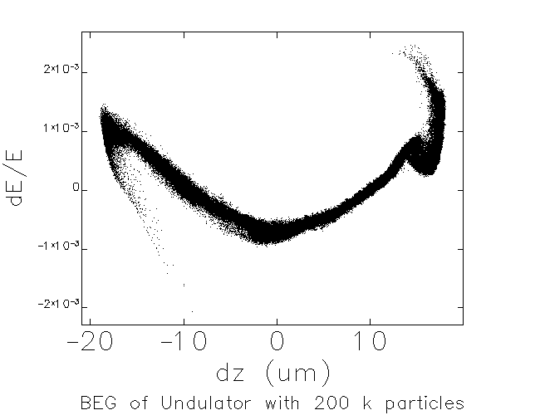
Reduction of Large Correlated Energy spread by Resistive Wall Longitudinal wakefield of SS pipe
Resistive Wall wake of 100-m long SS pipe (r=5 mm)
Large correlated energy spread needs to be reduced at the subsequent Stainless Steel vacuum pipes.
DC conductivity is only considered in the calculation.
After BC3
head
50-m SS pipe (r=5 mm)
65-m SS pipe (r=5 mm)
100-m SS pipe (r=5 mm)
1.1 x 10-3
tail

Slide 29
Undulator

Slide 30
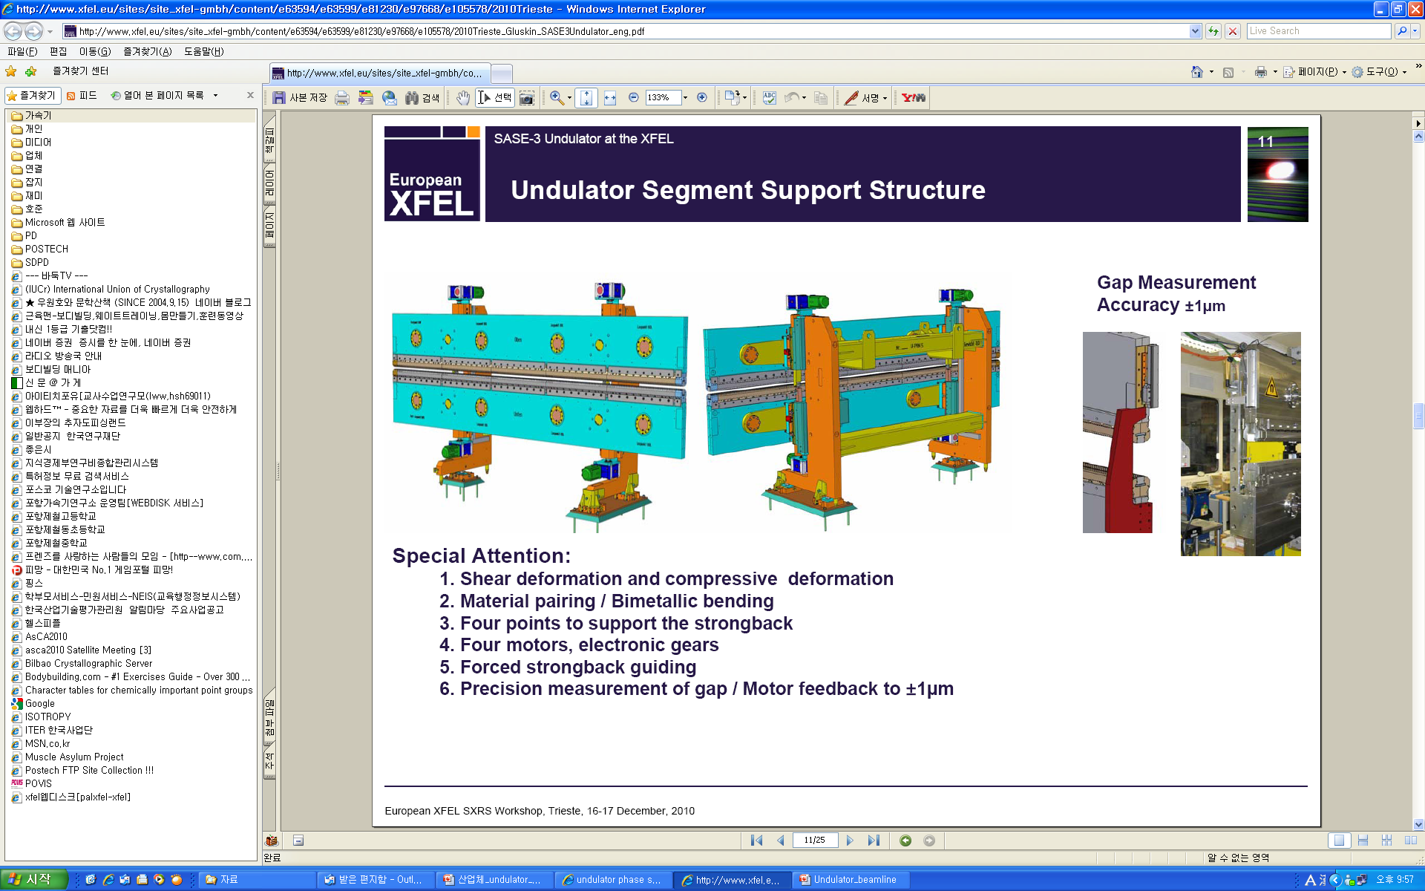
EURO-XFEL Out Vacuum Undulator
EURO-XFEL OVU
Materials Pairing and Bimetallic Bending
Four Points to support the strongback
Four motors and electronic gears
Forced strongback guiding
Precision Measurement of gap / feedback to ±1 μm

Slide 31
HXU1 Parameters (by Ming Xie’s formula)
 | Unit | HXU1
Electron Energy Undulator Period Photon Wavelength Photon Energy Gap Undulator Parameter Pierce Parameter Saturation Length Peak Power Spectral Bandwidth Photons/Pulse Peak Flux Peak Brilliance | GeV mm nm keV mm m GW % # #/sec. B | 10.0 24.6 0.10 12.4 6.85 2.06 5.3x10⁻⁴ 53.2 13.6 0.11 4.7x10¹¹ 5.8x10²⁴ 2.3x10³³ | 10.0 24.6 0.06 20.6 9.55 1.32 4.2x10⁻⁴ 93.7 5.0 0.09 1.1x10¹¹ 1.7x10²⁴ 1.9x10³³
B: photons/0.1%BW/sec./mm²/mrad²

Slide 32
HXU1 Lattice
Average Beta dependence of Saturation Length
QF
QD
QF
Undulator
Undulator
12 m
HXU1
 | Unit | HXU1
Average beta QF QD FODO period | m T/m T/m m | 16 43.2 -42.6 12.0

Slide 33
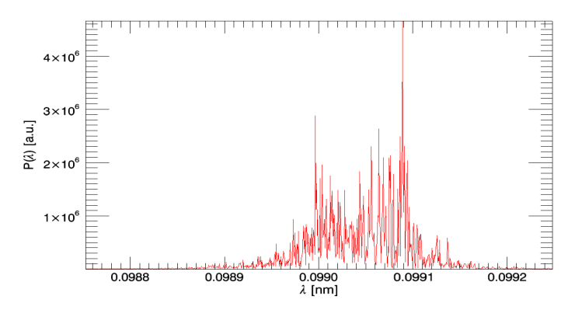
HXU1 Taper
1
22
Taper Profile : ~1% quadratic decrease from 40 m to 132m
For 0.1 nm
Averaged Power @Z=132 m (22modules)
Untapered : 14 GW (4.7E11 photons)
Tapered : 55 GW (1.8E12 photons)

Slide 34
SXU1 Outline
- Korean users group requests photon range from 10 nm to 1 nm.
- And also requests full polarization control from 3 nm to 1 nm.
5m module x 11
Planar Undulator (10~1nm)
EPU(3~1nm)
- linearly polarized
- 10 nm ~ 1 nm
Lmag=55m
Lmag=0m
- circularly polarized
- 3 nm ~ 1 nm
Lmag=40m
Lmag=20m

Slide 35
SXU1 Parameters (Linearly Polarized)
 | Unit | SXU1 (Planar Undulator)
Electron Energy Undulator Period Photon Wavelength Photon Energy Gap Undulator Parameter Pierce Parameter Saturation Length Peak Power Spectral Bandwidth Photons/Pulse Peak Flux Peak Brilliance | GeV mm nm keV mm m GW % # #/sec. B | 4.0 50.0 10.0 0.124 8.29 6.86 3.0x10⁻³ 21.3 33.8 0.62 1.1x10¹⁴ 2.6x10²⁶ 1.0x10³¹ | 4.0 50.0 3.0 0.413 15.8 3.56 2.0x10⁻³ 29.0 25.6 0.42 2.6x10¹³ 8.7x10²⁵ 3.9x10³¹ | 4.0 50.0 1.0 1.24 25.5 1.70 1.3x10⁻³ 46.3 14.0 0.28 4.7x10¹² 2.4x10²⁵ 9.4x10³¹
B: photons/0.1%BW/sec./mm²/mrad²

Slide 36
SXU1 GENESIS simulation (Linearly Polarized))
QF
QD
QF
Undulator
Undulator
12 m
SXU1
 | Unit | HXU1
Average beta QF QD FODO period | m T/m T/m m | 10 39.0 -29.1 12.0

Slide 37
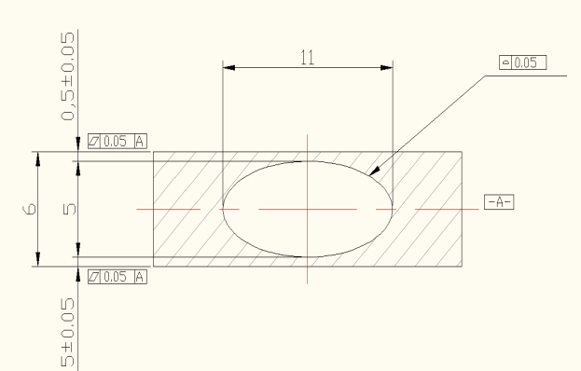

HXU1 & SXU1 Vacuum Chamber
0.5
0.5
6.8
4.8
 | LCLS | PAL present | PAL opt.1 | PAL opt.2
Undulator Length [m] Undulator Gap [mm] Saturation Length(0.06nm) [m] | 3.4 6.8 | 5.0 6.8 93.7 | 5.0 6.2 88.1 | 5.0 7.0 95.6
Quantity (required/fab.) Material Aperture (VxH) [mm] Thickness [mm] Flatness Clearance(pole to ch.) [mm] | 33/40 A6063-T5 5 x 11 0.5±0.05 < 50 0.4 | 33/40 A6063-T5/T6 4.8 x 11 0.5±0.05 < 50 0.5 | 33/40 A6063-T5/T6 4.8 x 11 0.4±0.05 < 50 0.3 | 33/40 A6063-T5/T6 5.0 x 11 0.7±0.1 < 200 0.3

Slide 38
Diagnostics

Slide 39

Layout of Diagnostic System
YAG
Beam stopper
Slice emittance measurement before undulator
  OTR is not feasible due to COTR
  YAG is feasible, but it needs radiation protection (beam stopper) for undulator magnet and low repetition operation (< 1 Hz)

Slide 40
Diagnostics
Beam position monitor for undulator
  Maximize the overlap bet. Photon beam and Electron beam along the 100-m long undulator
  BPM resolution : < 0.5 um
  cavity type BPM
Beam profile monitor
  OTR, YAG
  Wire Scanner
Bunch length monitor : ~ 10 fs
  Deflector cavity
  EO sampling
Electron beam phase-space monitor
  emittance & 6-dim. twiss parameters
  : betx, alfx, bety, alfy, delta p, delta t
  To adjust the real lattice according to the simulation
  Slice parameter should be measured

Slide 41

Beam Dump Magnet with Soft Bend
Soft Bend :
0.2 deg / 0.2 m
VBM : 15 deg / 6 m
To minimize the optical coherent edge radiation at dipoles which corrupts the FEL radiation at the beamline
OTR
Beam dump
 | Beam Dump | Beam Dump: Soft Bend
Energy (GeV) | 10,000 | 10,000
 | 33.335 | 33.335
Length (m) | 6 | 0.2
 | 0.262 | 0.003
Bending angle (deg) | 15.0000 | 0.2000
 | 1.455 | 0.582
Drift distance from BM | 10 | 4
Vertical Offset [mm] | 2617.994 | 13.963
Bending radius [m] | 22.918 | 57.296
Beam height at the beam dump
: -2.98 m
Energy spread after SASE process: 1.0 %
Dispersion function at OTR: 1 m
Beam size at OTR : 1 m x 0.01 = 10 mm
Dump-line Quad
Length: 0.5 m
K=0.636 (21.2 T/m)

Slide 42
EMU3 before Undulator
WS1
WS2
WS3
WS4
FODO lattice with 45-deg phase advance

Slide 43
Collimators
The high RF gradient in Linac may generate significant dark current which may need collimation so as not to damage the permanent magnet undulators.
Sufficient number of Collimators is included to block dark current from RF-gun and Linac.
Collimators
  energy collimation: maximum dispersion along the Beam transfer line
  transverse collimation: Straight, dispersion-free regions in the transfer line
    At high Betafunction point

Slide 44
Collimators along 10-GeV Line
Energy
Collimator
Energy
Collimator
Transverse Collimator
WS1
WS2
WS3
WS4
FODO lattice with 45-deg phase advance

Slide 45
Timing & RF System

Slide 46

Optical Timing and Synchronization Systems for PAL-XFEL collaborated with Prof. Jung-Won Kim in KAIST
Major components for timing systems
Optical master oscillator (OMO) – ultrafast Er-fiber laser
Timing-stabilized fiber link
Optical-to-optical synchronization unit
Optical-to-RF synchronization or extraction unit
Electron beam diagnostic unit
LRD: local RF-timing distribution unit.
ORS: optical-to-RF synchronization
OOS: optical-to-optical synchronization unit
Reliable sub-10 fs precision optical timing and synchronization is feasible.

Slide 47

Local optical-to-optical synchronization
Continuous synchronization between two ultrafast lasers with sub-fs residual jitter over 12 hours is possible.
Further R&D efforts for various wavelength ranges and improved mechanical stability are necessary.

Slide 48

Local optical-to-RF synchronization
Continuous synchronization between 1550-nm laser and RF VCO with sub-10-fs residual jitter over 10 hours is possible.
Further R&D efforts for reducing residual jitter to sub-fs range and new design of 800-nm Ti:sapphire laser-based system are necessary.

Slide 49
Number of Klystron
Accelerating gradient: 19.7 MV/m
4 A/C -- energy decrease | BC1 : 320, BC2: 2500, BC3: 3650
 | L2 |  |  |  |  |  | L3 |  |  | L4
Energy gain | 2180 |  | 2180 |  | 2180 |  | 1150 | 1150 | 1150 | 6350 | 6350 | 6350 | 6350 | 6350 | 6350
Number of 4AC | 8 |  | 9 |  | 10 |  | 4 | 5 | 6 | 23 | 24 | 25 | 26 | 27 | 28
Accelerating gradient on crest | 22.7 |  | 20.2 |  | 18.2 |  | 24.0 | 19.2 | 16.0 | 23.0 | 22.0 | 21.2 | 20.4 | 19.6 | 18.9
Accelerating gradient on -20 deg (L2) & -10 deg (L3) | 24.2 |  | 21.5 |  | 19.3 |  | 24.3 | 19.5 | 16.2 | 23.1 | 22.1 | 21.2 | 20.4 | 19.7 | 19.0
RF Power | 86.5 |  | 68.3 |  | 55 |  | 87.2 | 56.1 | 38.8 | 78.8 | 72.1 | 66.4 | 61.4 | 57.3 | 53.3

Slide 50

RF System for XFEL
Parameters | PAL-XFEL
Beam Energy | 10.0 GeV
Energy Spread | 0.01%
Phase Stability | 0.1º
Amplitude Stability | 0.01%
RF Repetition Rate | 120 Hz
Description | S-band | X-band
Operating Frequency(GHz) | 2.856 | 11.424
No. of Klystron | 48 | 1
No. of SLED | 44 | 0
No. of Accelerating section | 178 | 1
No. of SSA | 44 | 1
No. of PAD & PAC | 44 | 1

Slide 51


One Unit of Linac Section

Slide 52
Specification of SLED
Description | S-band(FEL)
Operating Frequency(MHz) | 2856 ±0.5
Output Peak Input Power(MW) | 400 (Input 80MW)
Cavity Mode | TE 0,1,5
Unloaded Q | 100,000
Coupling Coefficient | 5.0
Coupling Hole | Dual Iris
RF Pulse Width(us) | 4.0
PSK Time(us) | 0.83
Water Temperature(ºC) | 30±0.01
For S-band
Maximum surface gradient(Es); 120MV/m
Es=110MV/m @300MW
Two hole coupling to reduce Es(30%)
Phase shift; 10º/ ºC

Slide 53
Energy Gain of SLED
Parameter | PLS/PAL | SLAC | ATF/KEK By Hayano | KEKB/KEK By Kamitani
Frequency(MHz) | 2856 | 2856 | 2856 | 2856
Unloaded Q | 10^5 | 10^5 | 10^5 | 10^5
Beta | 4.8 | 4.8 | 4.8 | 6.4
RF pulse width(usec) | 4.0 | 5.0 | 4.5 | 4.0
PSK time(usec) | 3.17 | 3.17 | 3.5 | 3.5
A/C filling time(usec) | 0.83 | 0.83 | 0.83 | 0.46~0.56
A/C attenuation(neper) | 0.57 | 0.57 | 0.57 | 0.30~0.37
A/C Length(m) | 3 | 3 | 3 | 1.928
Energy Gain(M)_cal. | 1.67 | 1.78 | 1.73 | 1.98
Energy Gain(M)_meas. | 1.5 | 1.67 | 1.52 | 1.8~1.85
RF Power(MW) | 60 |  | 50 | 40
A/C Gradient(MV/m) | 19.4 |  | 25.5 | 21
Energy/Unit(MeV) | 232 |  | 153 | 160

Slide 54
LLRF System
2,856 MHz
Generator
Main Drive Line(optical cable, from timing system)
PAD
&
PAC
PAD
&
PAC
x4
PAD
&
PAC
PAD
&
PAC
ATT
ATT
ATT
ATT
SSA
SSA
ATT
PAD&
PAC
SSA
SSA
800 W Peak
SSA
K1
K2
K3
K44
XK

Slide 55
BeamlineS

Slide 56

1st Phase Construction: 2 Undulators & 4 Instrumentations
EH
OH
Undulator Hall
FE
Accelerator
40 m
1
2
3
200 m
20 m
20 m
Beamlines & Instrumentations
1. Front End
(1) Connection with the section of ultra-high vacuum undulator
(2) Elimination of off-axis spontaneous radiation
(3) Monitoring X-ray beam properties for accelerator operation
(4) Radiation safety/protection components
2. Optical Hutch
(1) Connection Points between Front End & Experimental Hutch
(2) Optical Element (Mirror System/Monochromator)
(3) Beam Diagnostic components (Screen, Position, Intensity, Timing, Spectrum)
(4) Radiation Shielding
3. Experimental Hall
(1) Four Experimental Hutches
(2) Instrumentations: 2 (XPP, XCS/CXI) for Hard X-ray & 2 for Soft X-ray (XPP, XCS/CXI)

Slide 57
PAL-XFEL Instrumentations
(1) Hard X-ray XFEL Beamline (Planar Undulator) with 2-instrumentations
1. XPP (X-ray Pump Probe)
Dynamics of photo-induced phase transitions
Studies of intense laser-matter interactions
Time-resolved studies of chemical dynamics in solution
Dynamics of photoactive proteins
2. CXI/XCS (Coherent X-ray Imaging)
Imaging of reproducible biomolecules
Protein Nanocrystallography
Imaging of nanoparticles
Imaging of hydrated living cells
Pump-probe imaging
Coherence and Correlations
Studies of Glassy Dynamics
Phonon Spectroscopy
Time-resolved Magnetic Scattering
Non-Equilibrium Dynamics
(2) Soft X-ray XFEL Beamline (APPLE-II Type Helical Undulator) with 2-instrumentation
1. XPP (Ultrafast Science) 2. CXI/XCS (Coherent Science)
Pump-Probe Ultrafast Chemistry Ultrafast Coherent Imaging
Clusters as new Materials Magnetic Imaging
Strongly Correlated Materials

Slide 58
PhotocatHode RF Gun

Slide 59
What we have done for Gun Development
Collaboration with Dr. Xijie Wang at BNL (~ 2006 10/E)
  Received a set of drawings for the BNL Gun-IV
  Fabricated one gun
  Processed and commissioned up to 3.7 MeV
  Performed high-brightness beam experiments
Developed modified BNL gun for use in fs-THz facility in PAL (~ 2008)
  Simpler and more reliable cathode sealing
  Simpler tuner at full cell and not necessary for gun tuning
  Beam energy reached > 4.5 MeV
  Very small dark current
Developed new gun with 4-hole field symmetry and dual couplers (~ 2011)
  Keeping cathode seal design as used in THz gun
  Machined with normal-grade lathes
  Provided enough roundings (R4.5) in coupling-hole edges
  As the result beam energy of > 5.5 MeV is expected
  Fewer arcings in spite of relatively high dark current

Slide 60


RF Gun Design

Slide 61




Low-Power Test - Field Profile (θ-scan) -
Tuner Position
* ρ=10 mm

Slide 62

High-Power Conditioning
RF Gun
Faraday Cup

Slide 63

Gun Processing History
Date | RF Power to the Gun
5/24 ~ 6/12 | 0 MW → 2 MW (20days), 0.8 μs, 10 Hz
6/13 ~ 7/3 | 2 MW → 10.93 MW (21days)
7/3 | pulse width … 0.8 μs → 1.5 μs
7/3 ~ 7/18 | 2 MW → 10.86 MW (16days)
7/18 | repetition rate … 10 Hz → 30 Hz
7/18 ~7/21 | 0.75 MW → 5.485 MW (4days)
7/21 ~ 8/11 | Modulator Maintenance.
8/11 ~ 8/21 | 4 MW → 10.49 MW (11days)
Power_1 … RF power calculated from klystron current.
Power_2 … RF power calculated from forward RF signal.

Slide 64
Injector test facility

Slide 65

PAL XFEL Injector Schematic
(Only for ITF)

Slide 66


ITF Location

Slide 67
ITF Layout
(UNIT = mm)
Building Inner Space : 13.7 m(W) x 30.5 m(L) x 7.9 m(H)
Tunnel Inner Space : 3 m(W) x 18.5 m(L) x 2.2 m(H)
Laser & Control Room Size : 13.7 m(L) x 6.5 m(W) x 3 m(H)
O/H Crane : 5 tons, Lifting Height > 3.5 m
Doors : 4 m(W) x 4.5 m(H), 3 EA
LCW: Stand-alone type
AHU : Package Aircon 2 – 3 EA

Slide 68
Summary
PAL XFEL Project: 2011-2014
Total Cost: 400 MUSD
Geological investigation underway (by Oct. 31).
  The result will determine floor level, location, and length of the building.
  Lattice will be finalized accordingly.
Building design underway.
Ground breaking expected on Feb. 1, 2012.
RF gun being developed by in-house team.
Injector Test Facility will be ready by Summer 2012.
We need active collaborations among XFEL labs around the world.

