Slide 1
Expert Group for Services & Infrastructure:
Measures 2 & 4
Spencer Bliven & Leo Sala :: Science IT Infrastructure and Services :: Paul Scherrer Institute
2021-12-02 Update for PSI stakeholders

Slide 2
Measures
# | Measure | Budget (kCHF)
1 | Call for Field-Specific Actions | 10’000
2 | Coordination of Access to Research Data Management Services and Infrastructure | 3800
3 | Development of Online Course Material | 100
4 | Information on Legal Questions | 150
5 | Career Paths for ORD Professionals | 100
 |  | 15’000

Slide 3
Expert Group for Services and Infrastructure
Expert Group for Services and Infrastructure (EG-SI): its emphasis is on improving the availability and interoperability of ORD services and infrastructure; it focuses on Measures 2 and 4.
  PSI represented by Leo Sala, Nicola Marzari, Spencer Bliven
Immediate focus is measure 2: Research data management (RDM) services and infrastructure

Slide 4
Measure 2 Goals
Identification of existing research data management (RDM) services within the ETH Domain
Standardization, federation, or mutualization of existing services across institutions of the ETH Domain where this is efficient and leads to added value by contracts between the providing and adopting institution
Identification of limitations of interoperability of the existing services and gaps in existing services
Improvement of interoperability of existing services and filling of gaps in services.

Slide 5
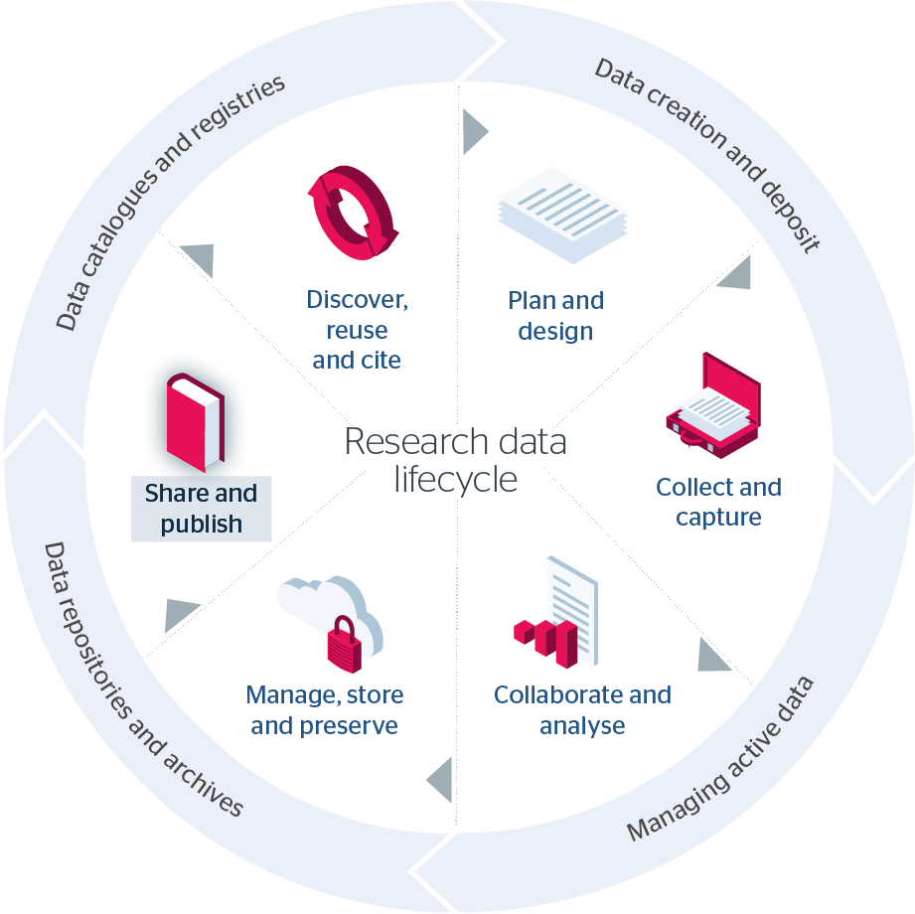
Data Lifecycle
Alfresco
limsophy
EPICS
DUO
DORA
Crystallization database
Electronic Lab Notebooks
OpenBIS
Biovia ELN
ELOG
SciLog
Data Catalog
SciCat
Petabyte archive
Online/offline analysis clusters
Parallel file systems
AFS
SwitchDrive
Gitlab
Jupyterhub

Slide 6
EG-SI Activities
Summarize existing services & tools at each ETH institution
Identify gaps in existing ORD services & infrastructure
Identify synergies/overlaps within ETH domain
Suggest projects
  3.8 MCHF budget
  Matching funds from institutes
  Will likely be a closed call based on institute priorities

Slide 7
Measure 4: Information on Legal Questions related to ORD – handled by EG-SI
Goal
Develop a consolidated legal document, which can be used as a common reference and guidance in understanding the legal situation of ORD within the ETH Domain.
Objectives and tasks
Collection of a question catalogue for legal questions related to ORD. Questionnaire to be answered by experts in digital law (i.e. https://ccdigitallaw.ch, swissuniversities P5 program or EMPA legal team).
Legal document to be drafted (in accordance with ETH Regulation) and harmonized with each institution. Training material to be elaborated for the onboarding of new employees.

Slide 8
Call to action
Consider the vision of how to make PSI science more open and fair in the future.
Provide feedback to the PSI committee regarding PSI needs, priorities, and potential projects
  The earlier the better, but the expert group report is planned for late March/April

