Slide 1
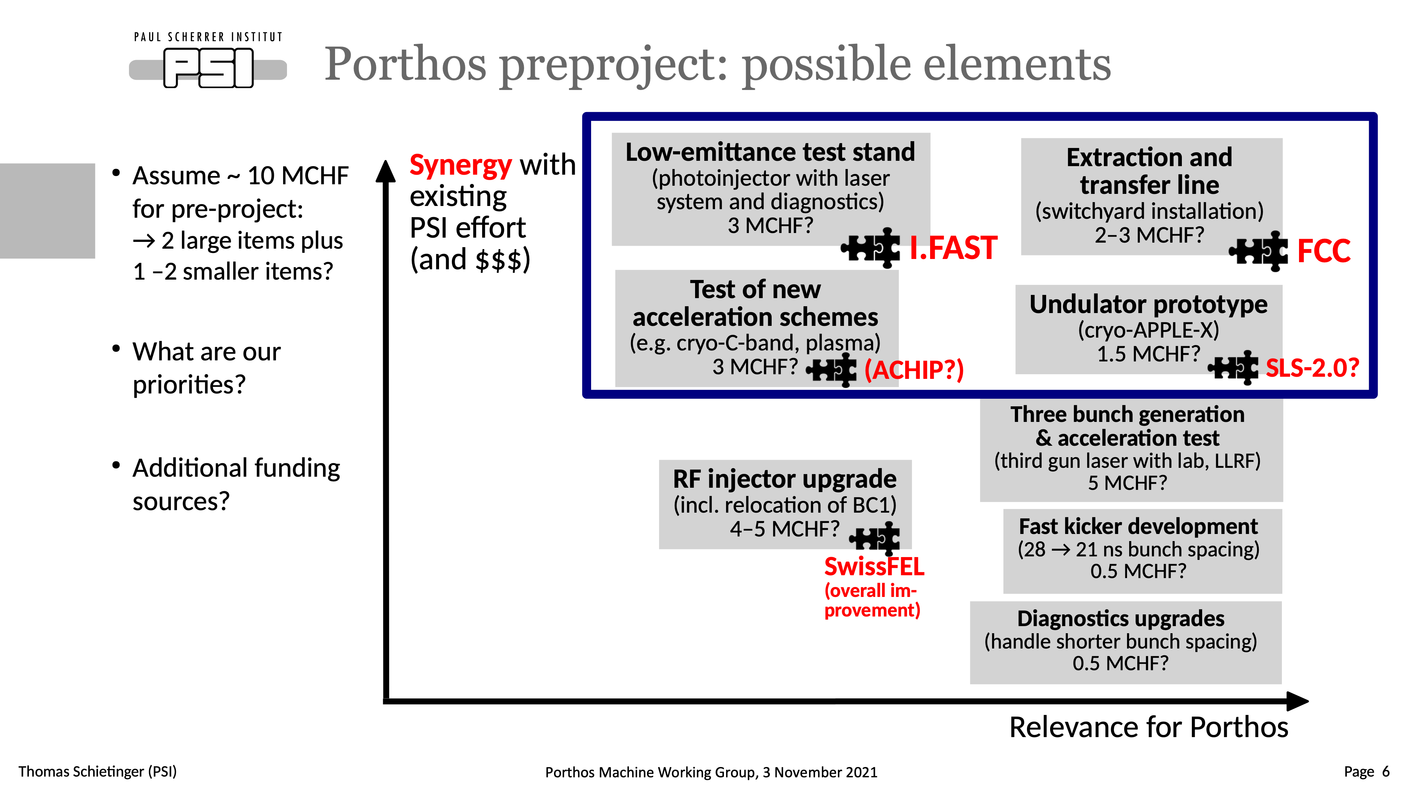

Slide 2


Test of New Acceleration Schemes
Opportunities for international collaborations
Rasmus Ischebeck

Slide 3
Test of New Acceleration Schemes
Opportunities for collaborations with other PSI divisions
Rasmus Ischebeck

Slide 4
Opportunities
Radio frequency
Plasma accelerators
Dielectric laser accelerators
Applications
Rasmus Ischebeck

Slide 5
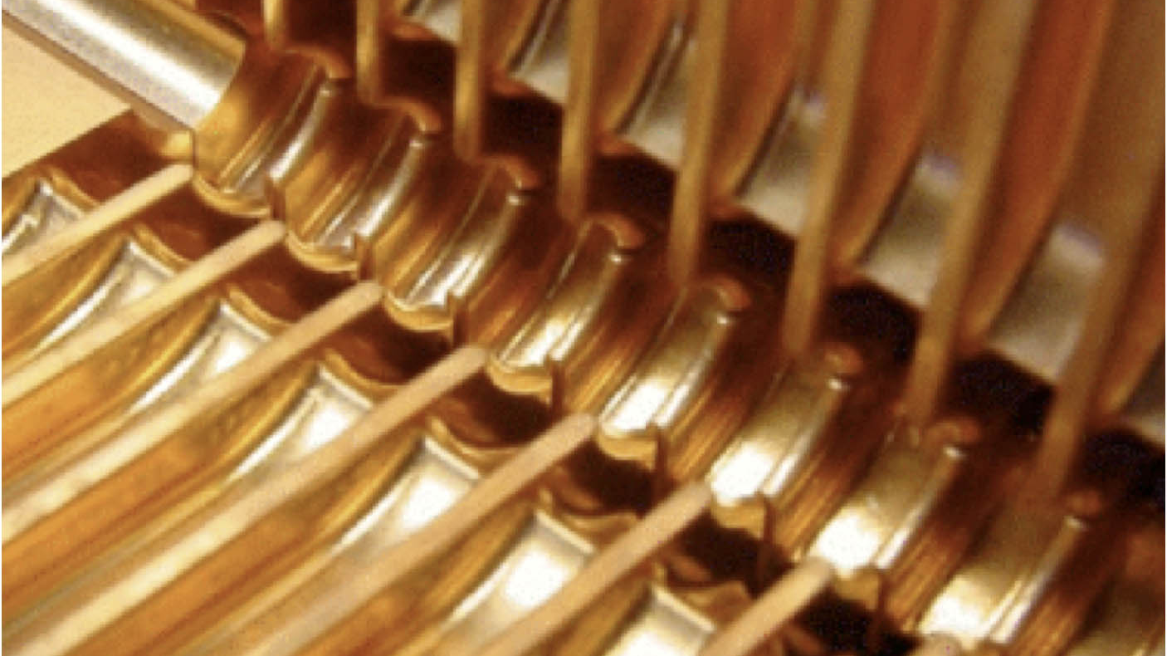
Radio Frequency
Rasmus Ischebeck

Slide 6
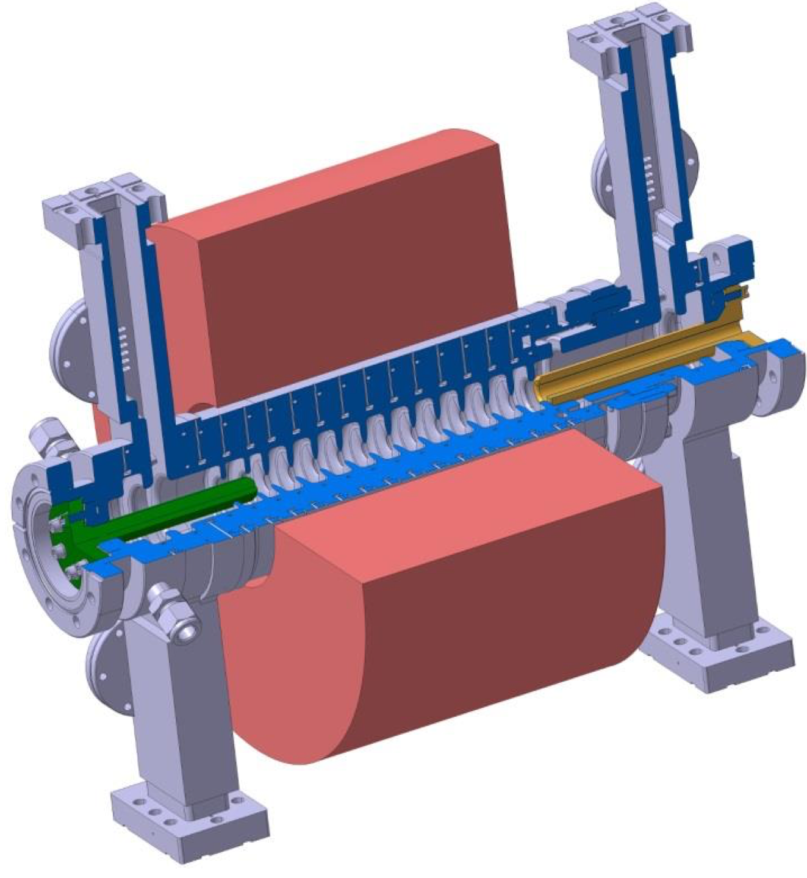
iFAST C-Band Gun
M. Schaer et al. PR AB 19, 072001, 2016
See Simona’s presentation
Rasmus Ischebeck

Slide 7
Cryo-Cooled Radio Frequency Structures
Significant effort in cooling a normal-conducting structure to 27 K
Effort may be justified to achieve lower emittance in the gun
Rosenzweig et al., Phys. Rev. Accel. Beams 22, 023403
Rasmus Ischebeck
Jamie Rosenzweig

Slide 8
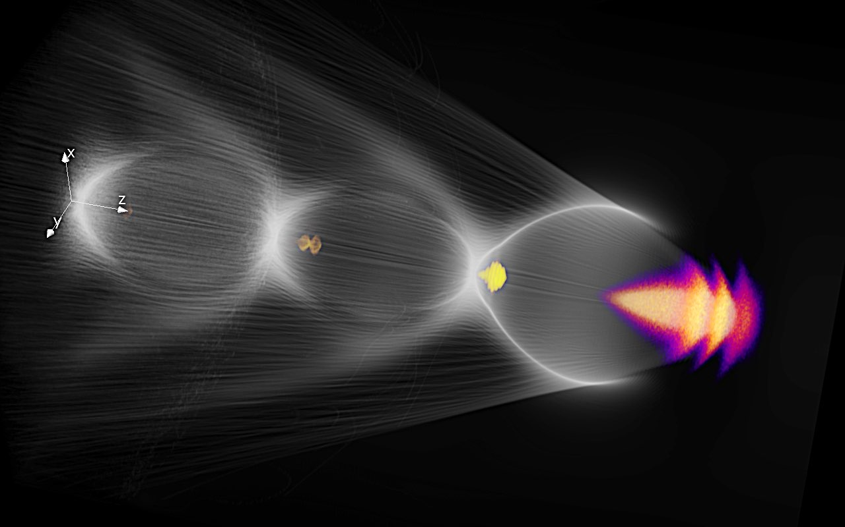
Plasma
Rasmus Ischebeck

Slide 9
Plasma Wakefield Accelerators
Building a competitive plasma wakefield accelerator: significant effort
Opportunities to collaborate with EuPRAXIA:
    Electron and X-ray instrumentation
    Beam dynamics simulations
    Longitudinal phase space manipulation
Rasmus Ischebeck

Slide 10
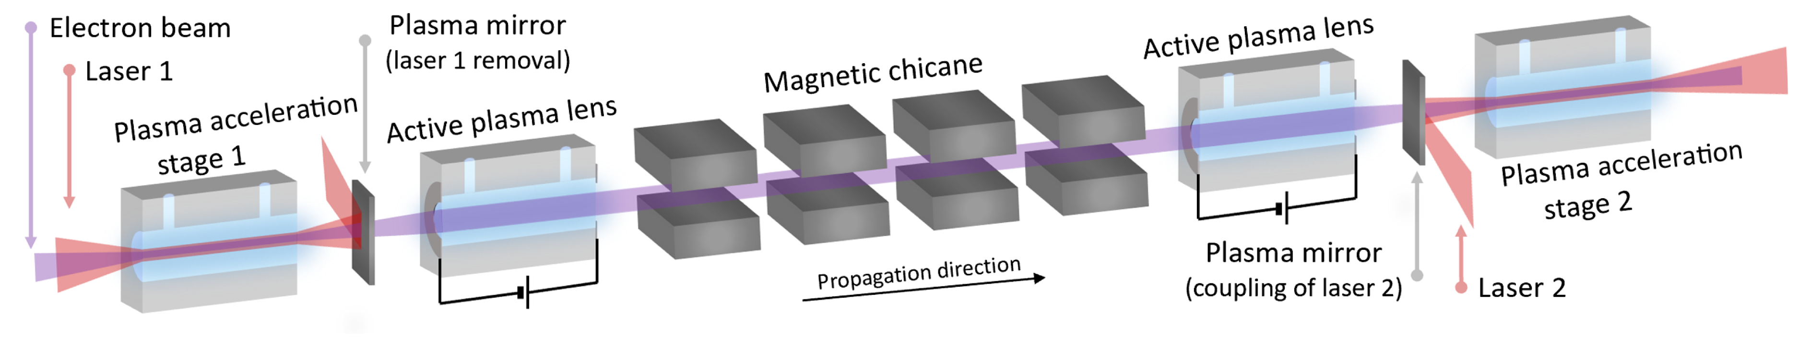
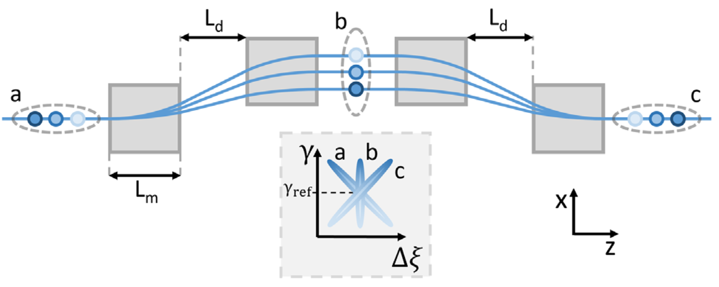

Energy Spread Control for Plasma Wakefield Accelerators
Rasmus Ischebeck
Pousa et al., PRL 123, 054801 (2019)

Slide 11
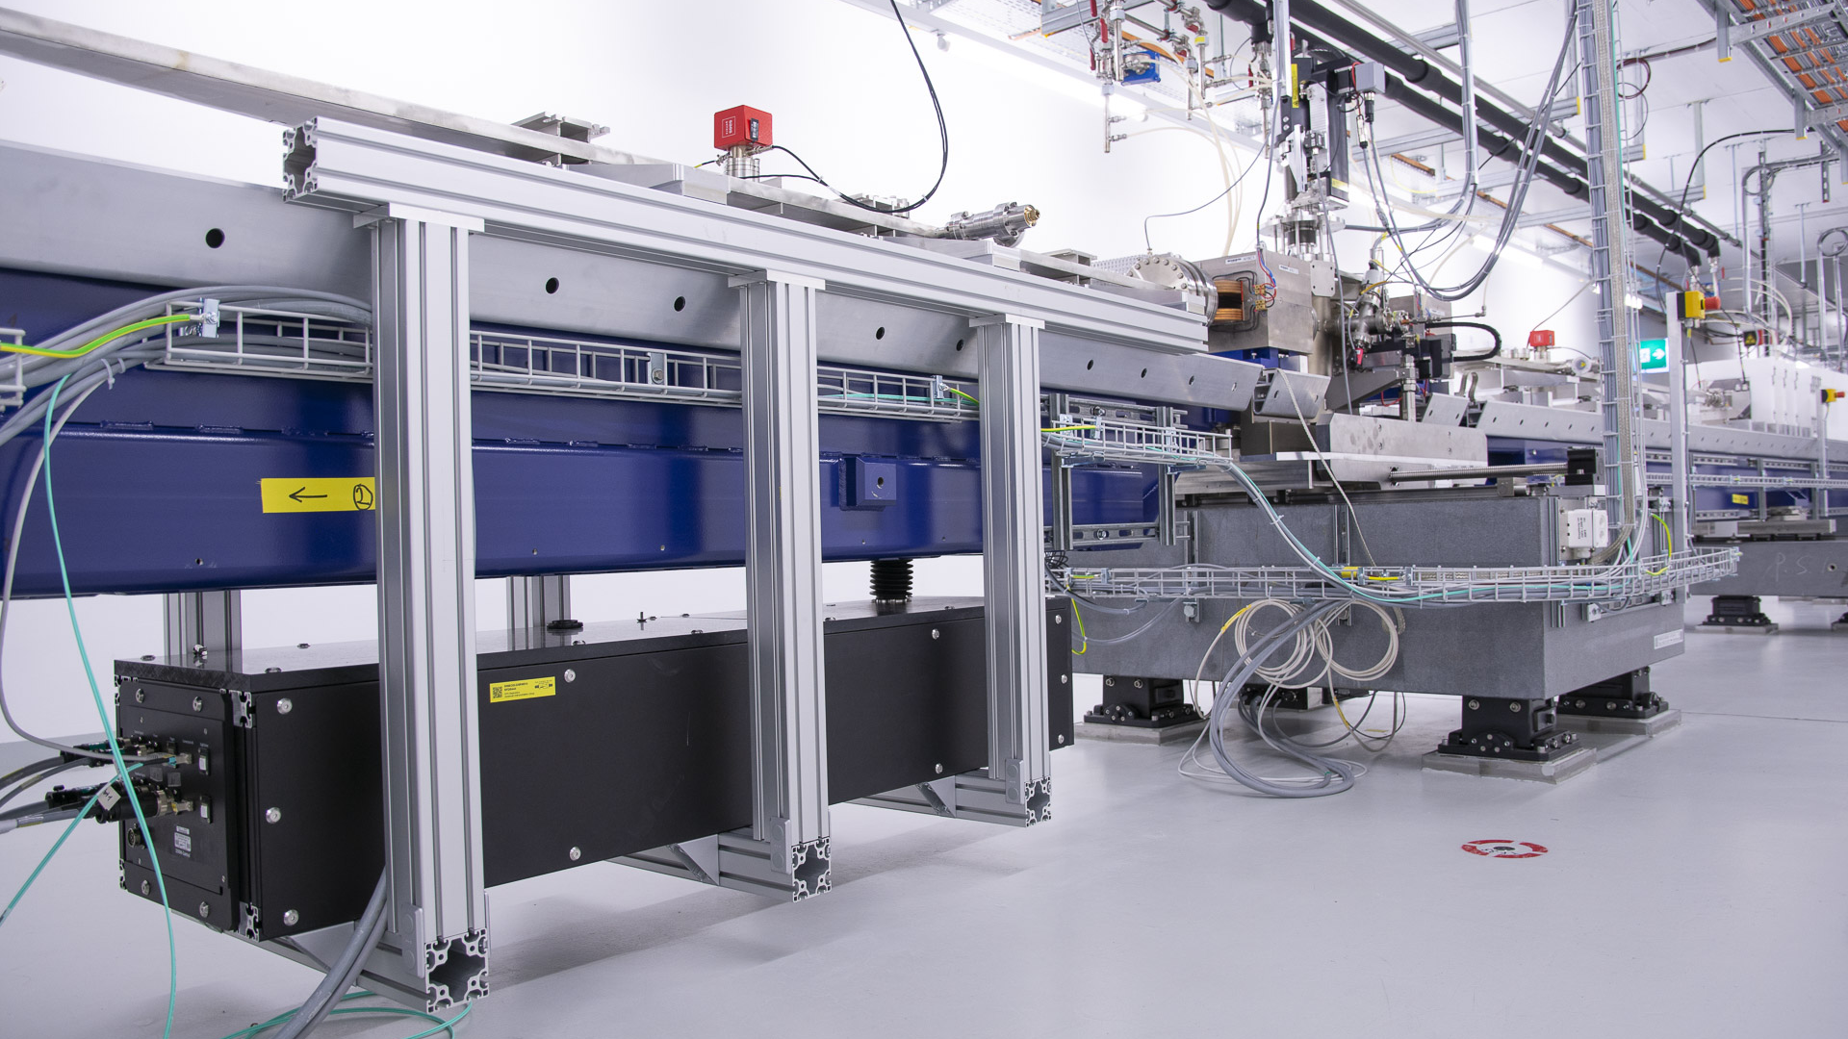
Chicane in SwissFEL
Rasmus Ischebeck

Slide 12
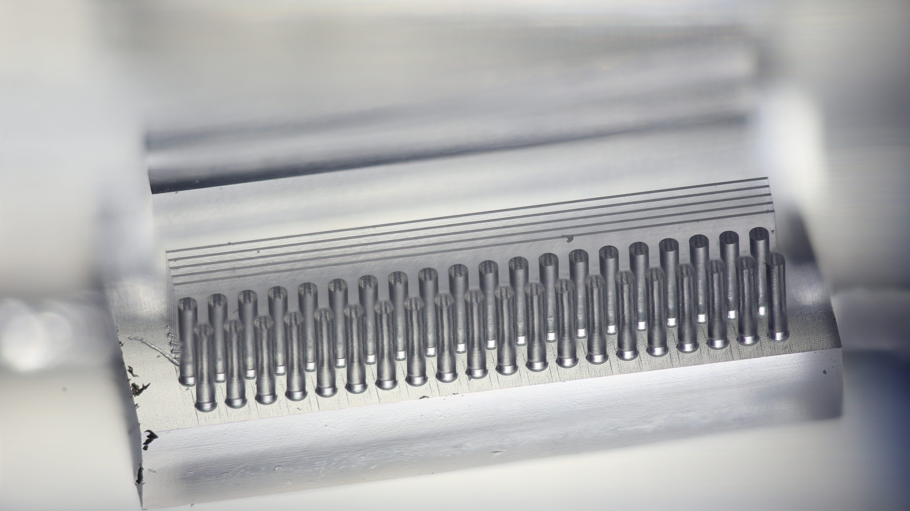
Dielectric Laser Accelerators
Rasmus Ischebeck

Slide 13
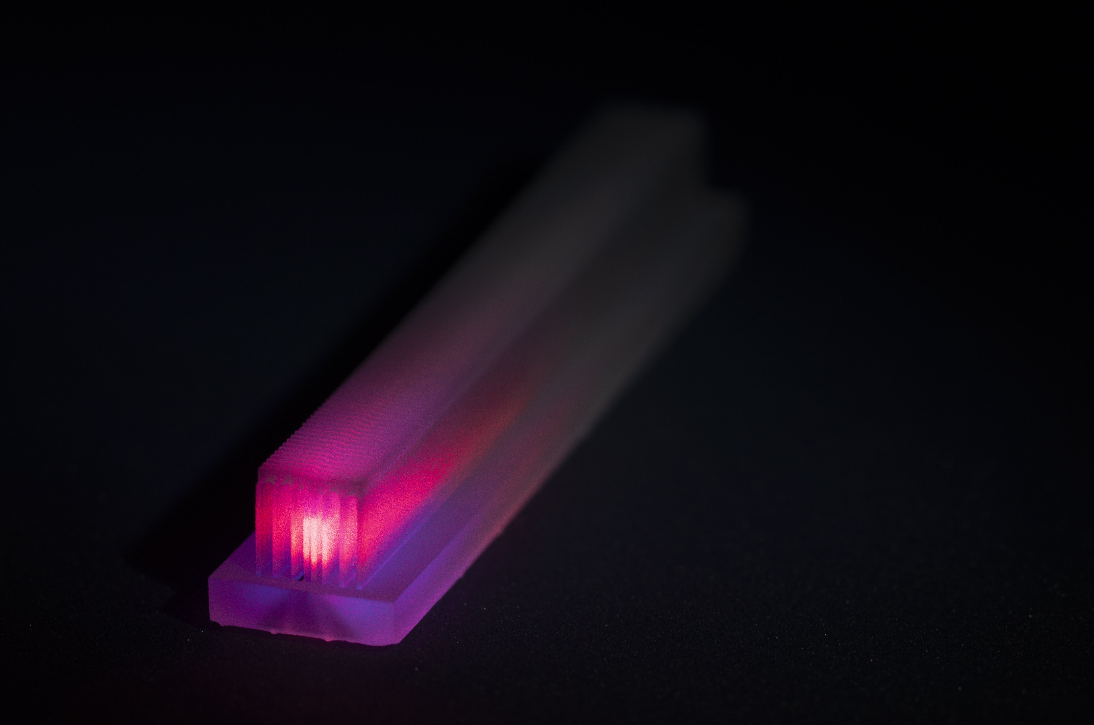
Dielectric Laser Accelerators
Possibilities to test dielectric structures at PSI:
  Beam-driven structures for beam shaping and radiation generation
  Laser-driven structures require a synchronized laser
Rasmus Ischebeck

Slide 14
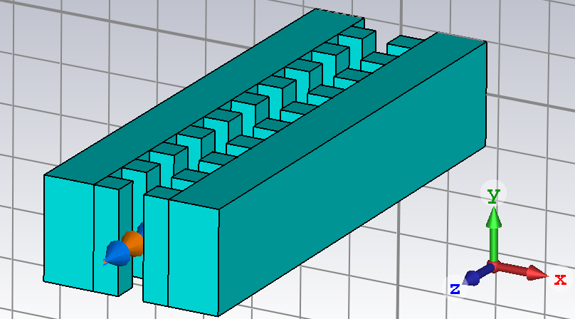
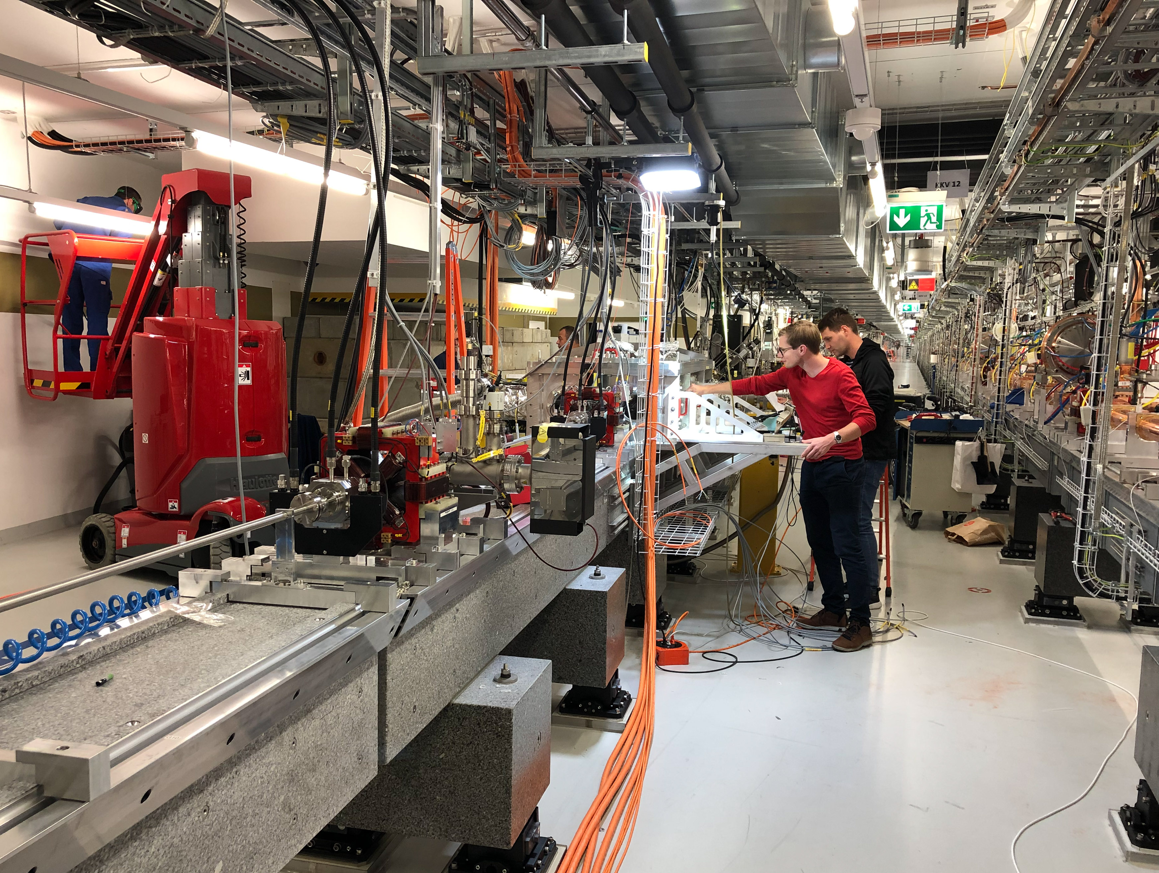
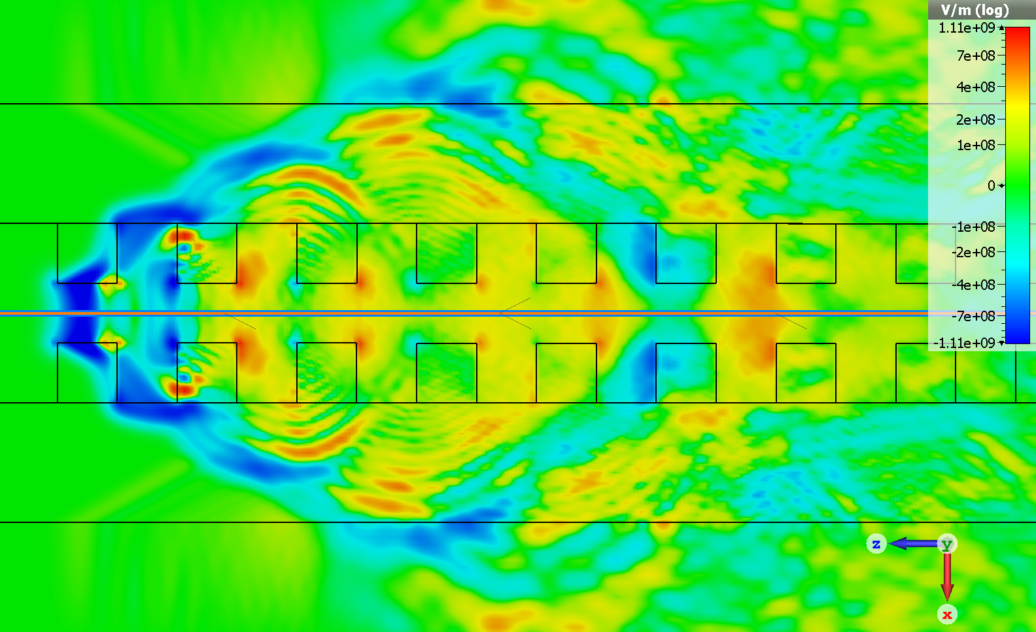
Wake Fields
Rasmus Ischebeck

Slide 15
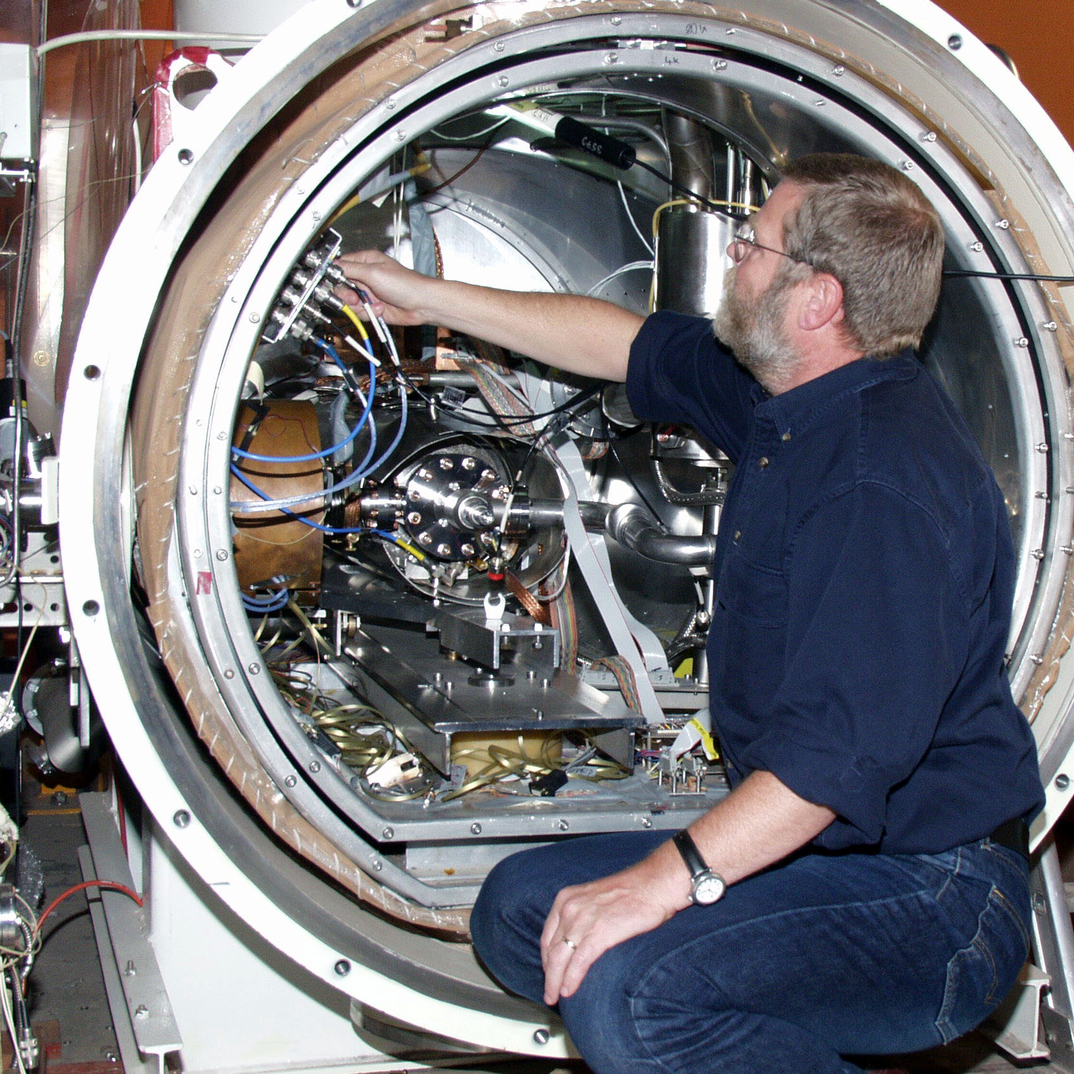
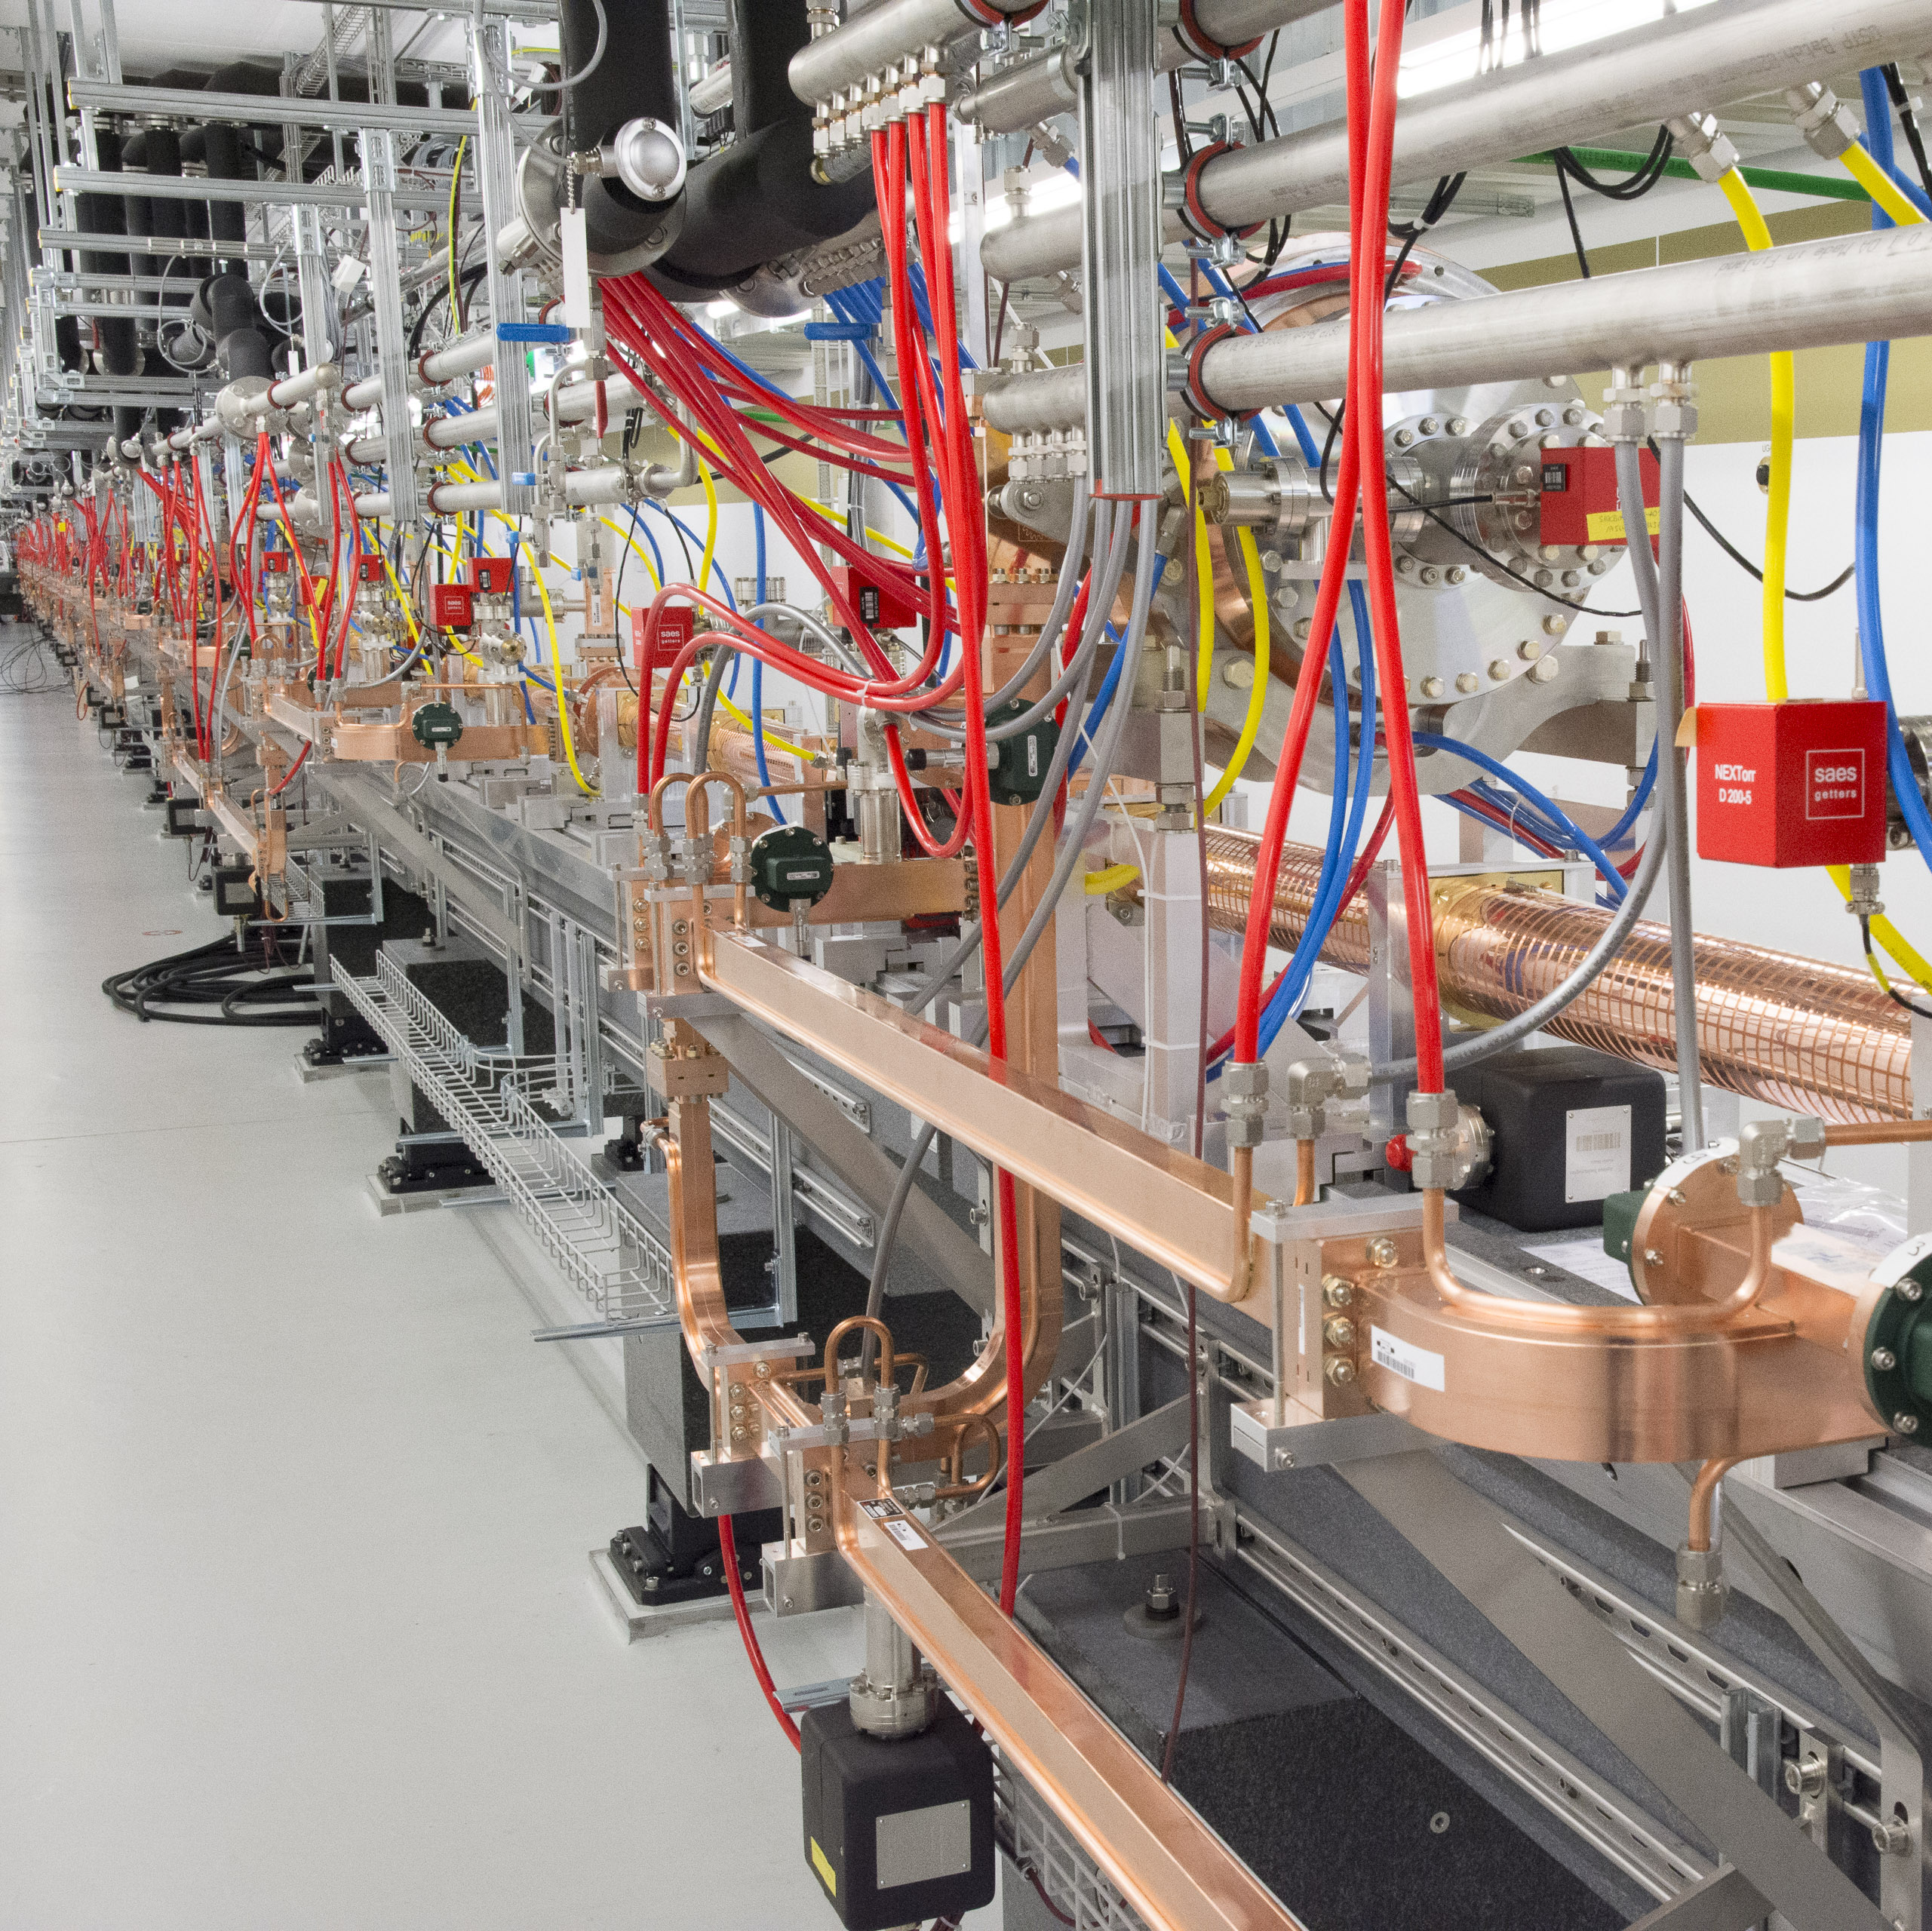
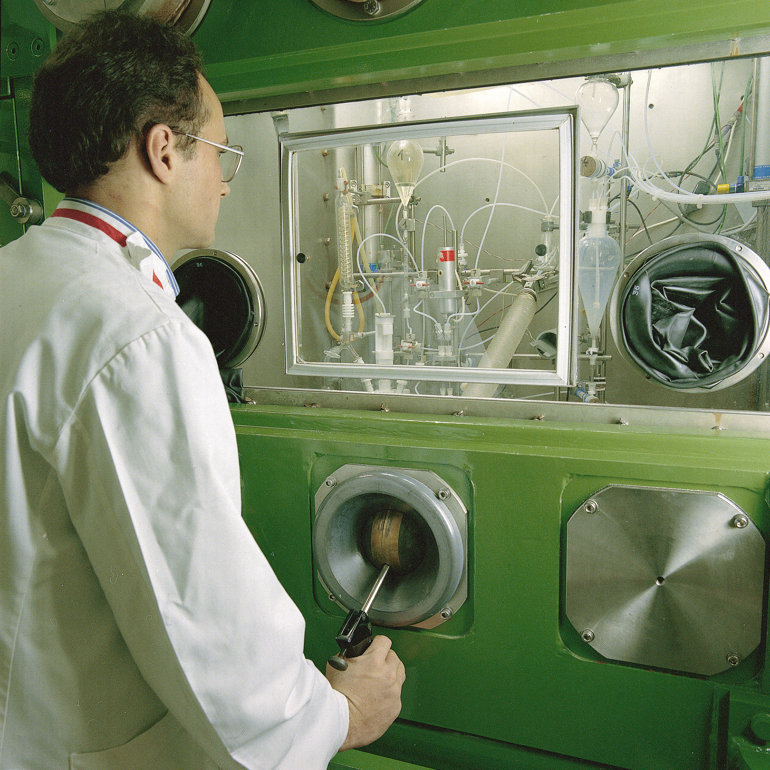
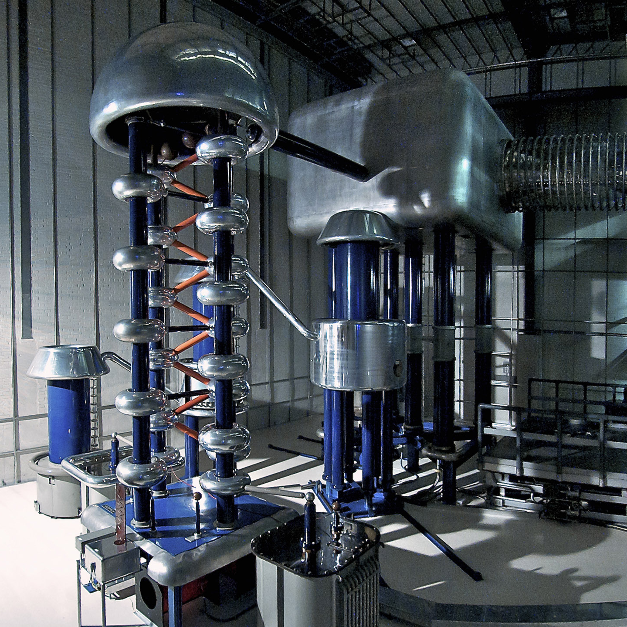
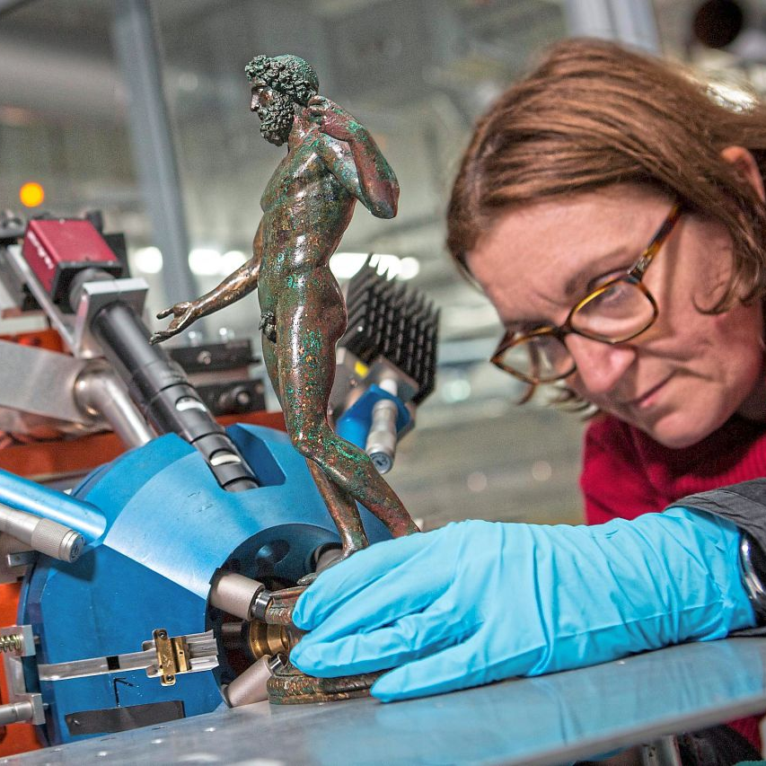
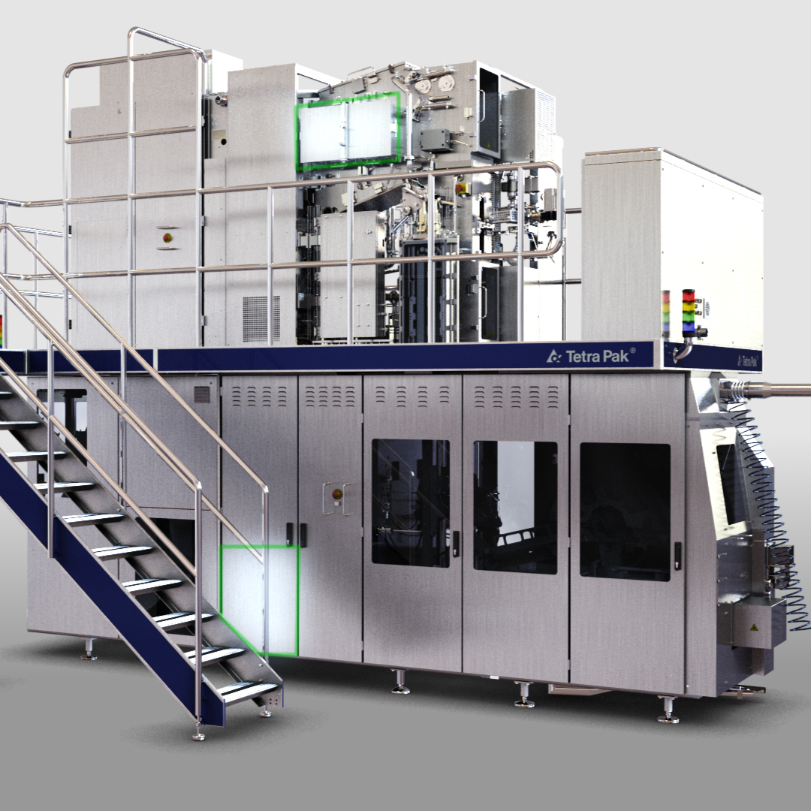
Applications of Technologies
and Beams
Rasmus Ischebeck

Slide 16
Laser / THz Bunch Length Diagnostics
Zhang et al., Nature Photon 12, 336–342 (2018).
Rasmus Ischebeck

Slide 17
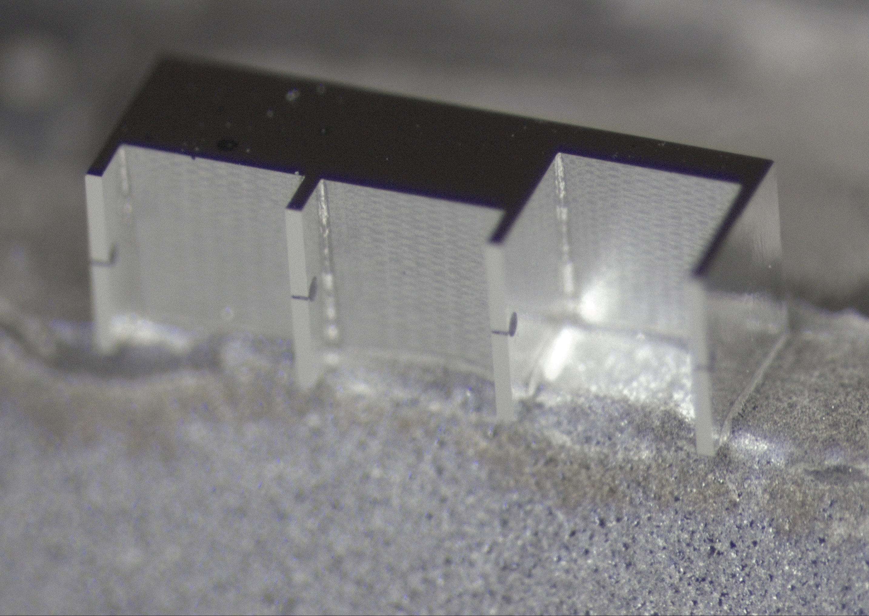
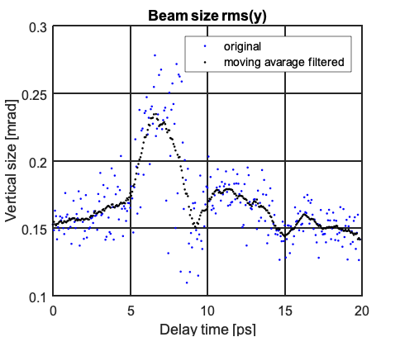
Laser / THz Bunch Length Diagnostics
Rasmus Ischebeck

Slide 18
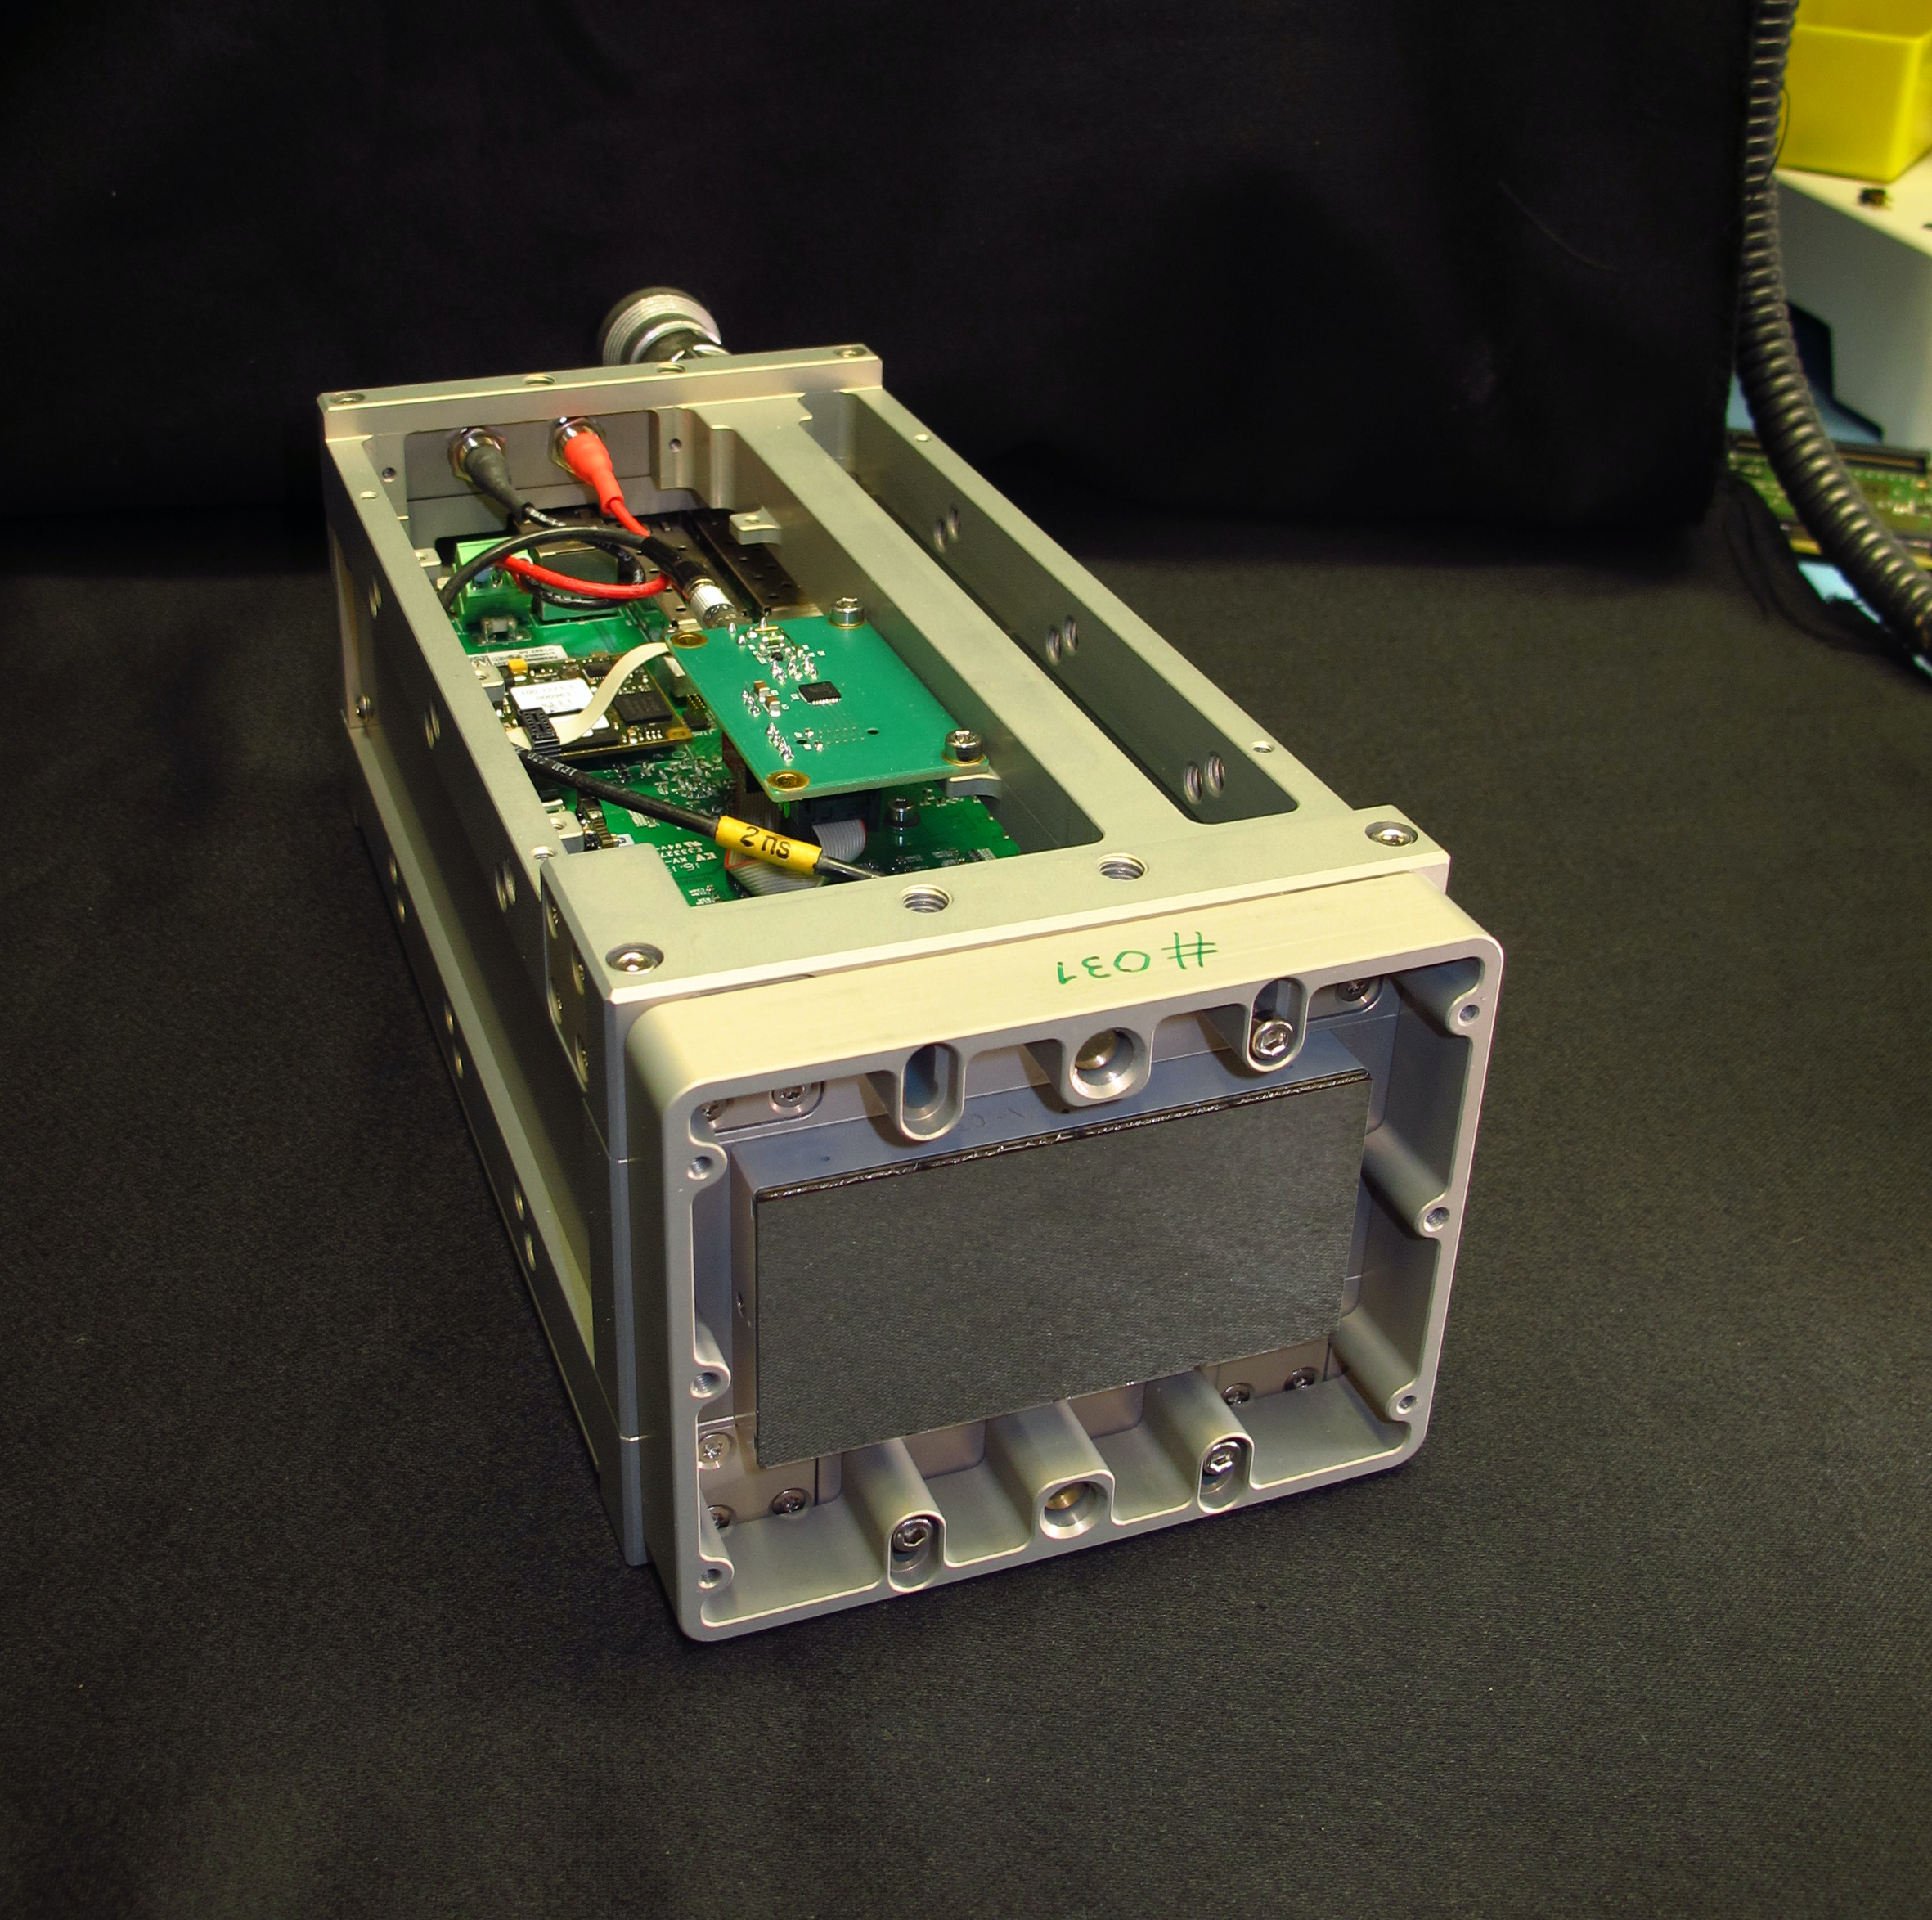
Detector Development
Direct electron detection
Rasmus Ischebeck

Slide 19
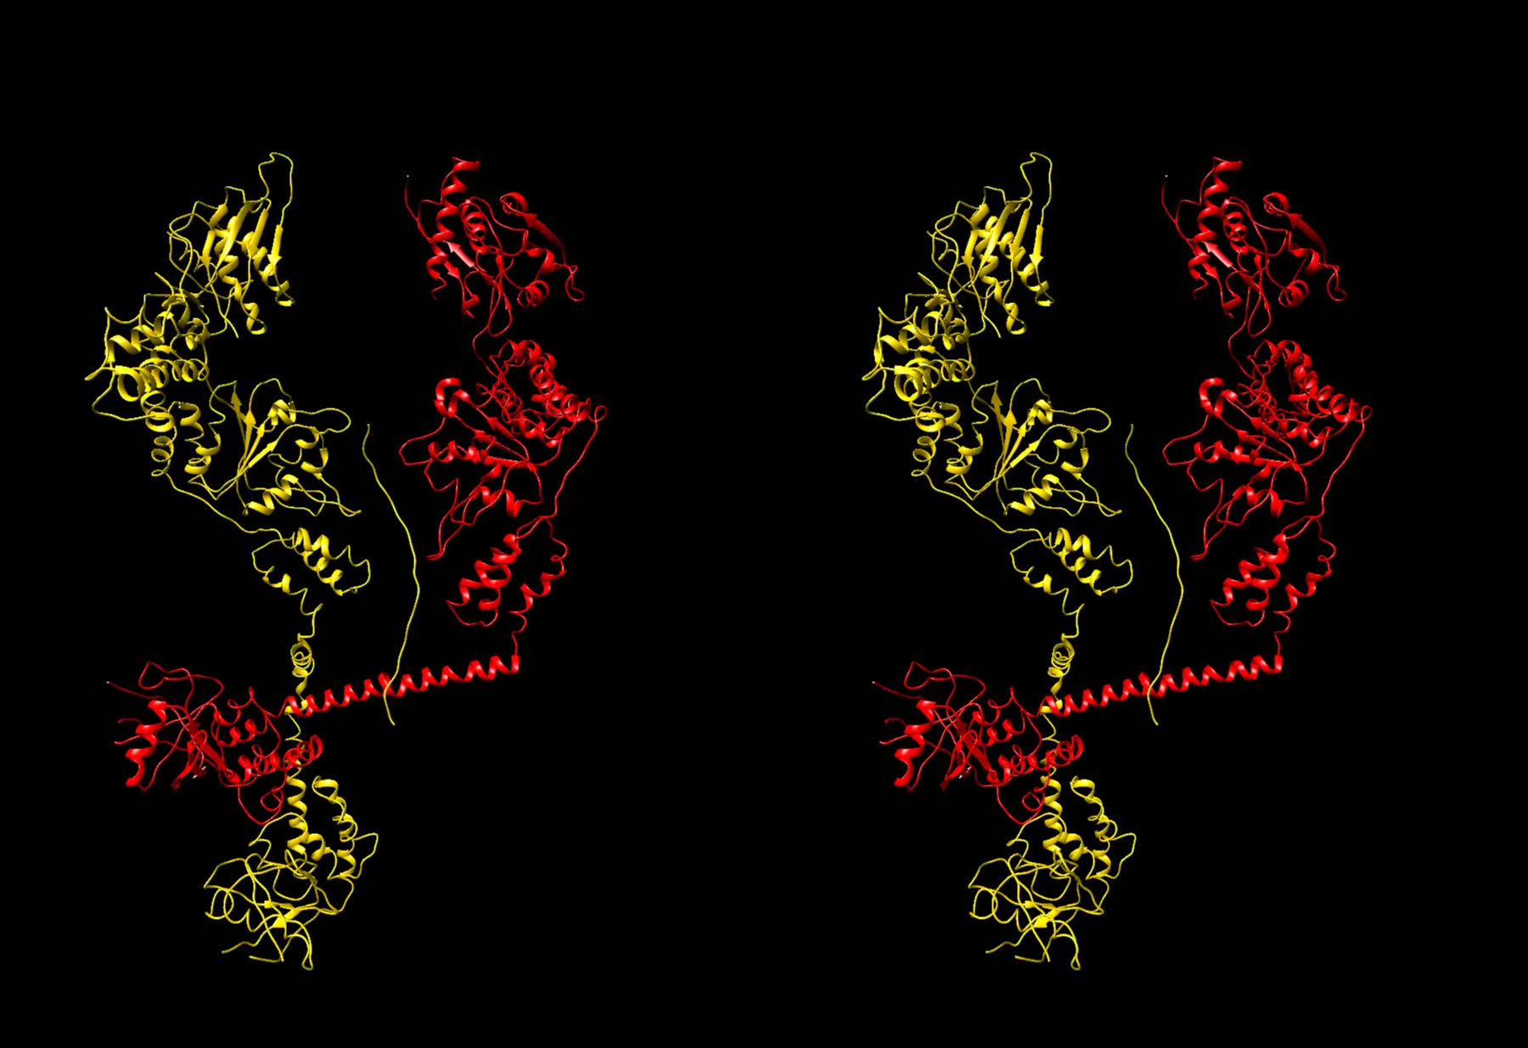
Electron Diffraction
Rasmus Ischebeck

Slide 20
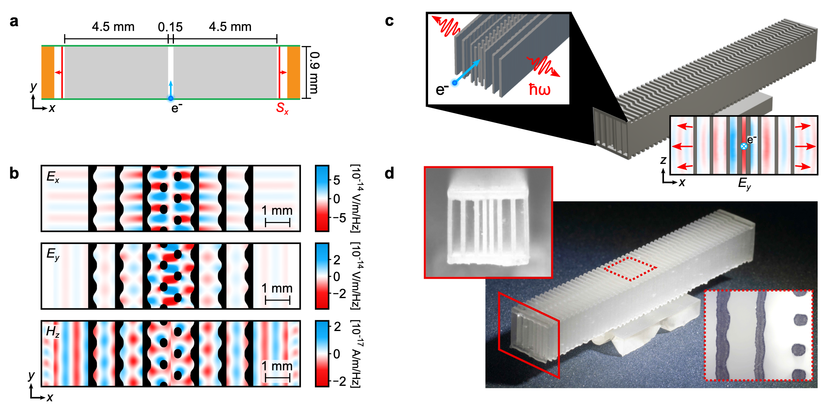
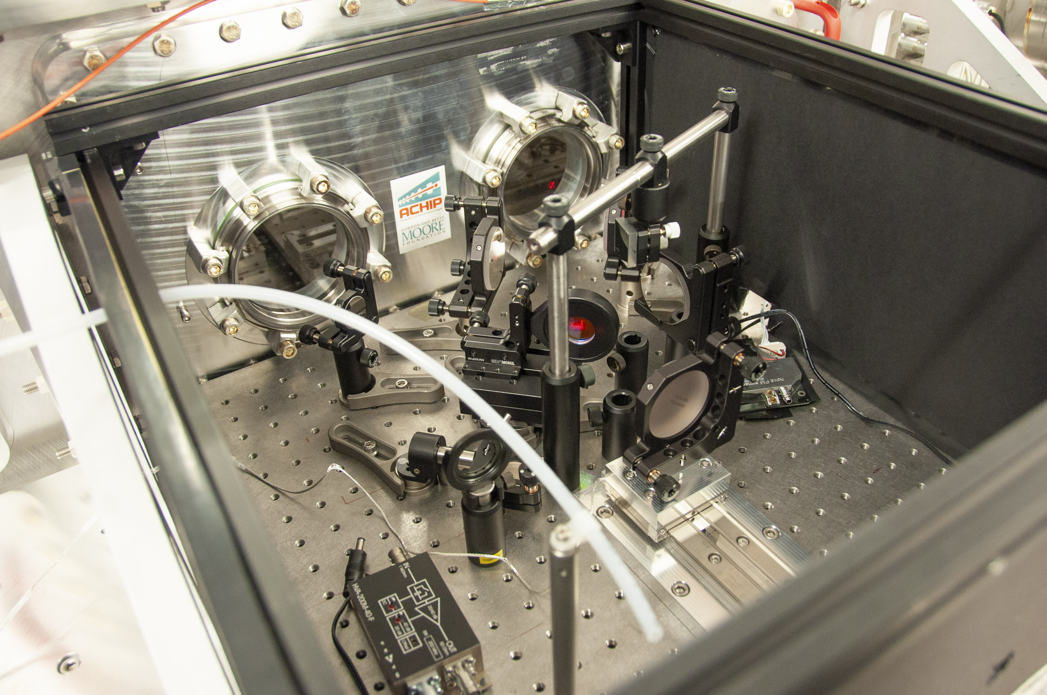
Terahertz Generation
Rasmus Ischebeck

Slide 21
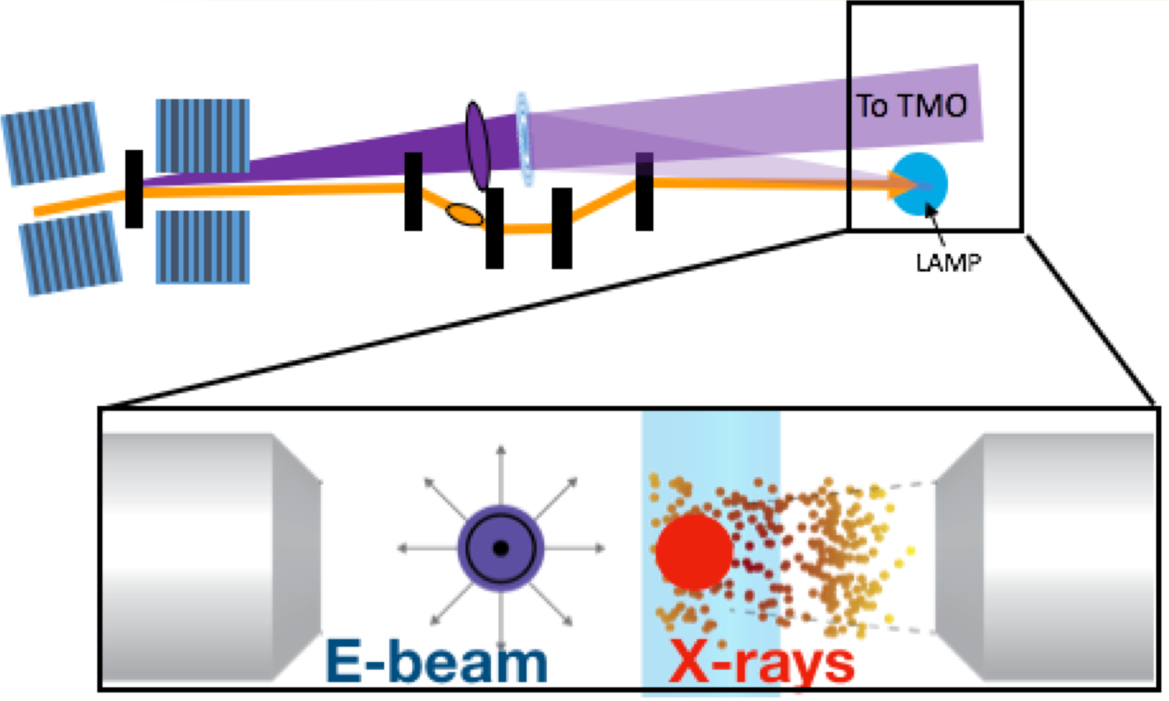
THz Fields from Electron Beam
Gas-phase experiments using the beam directly
D. Caesar, A. Marinelli
X-Ray Generation in a Plasma / Hard X-Ray Seeding
Rasmus Ischebeck

