Slide 1
SwissFEL Exchange Meeting
Machine report
Week 5/2022
Didier Voulot, SEM, 7 Feb. 2022

Slide 2
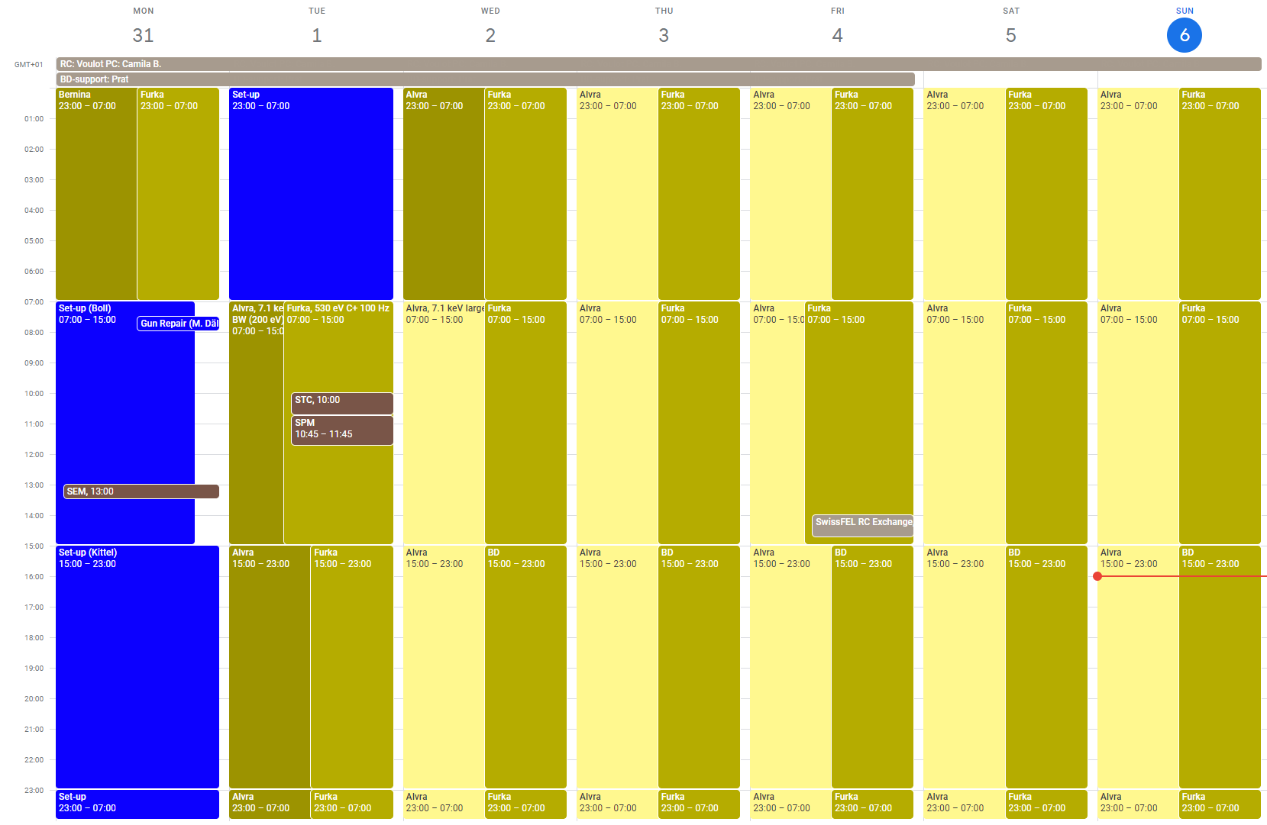

Slide 3
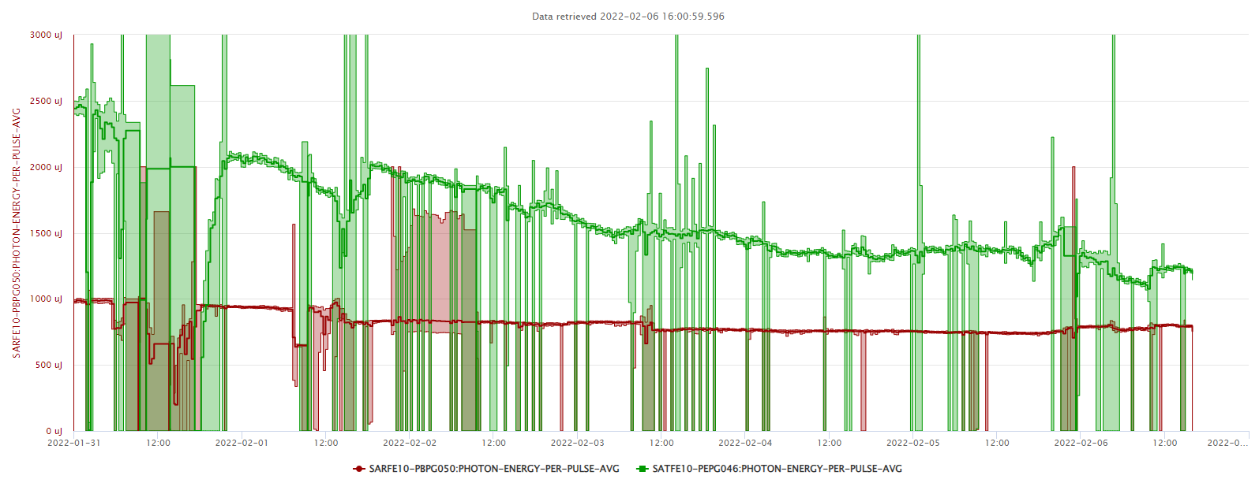

Slide 4
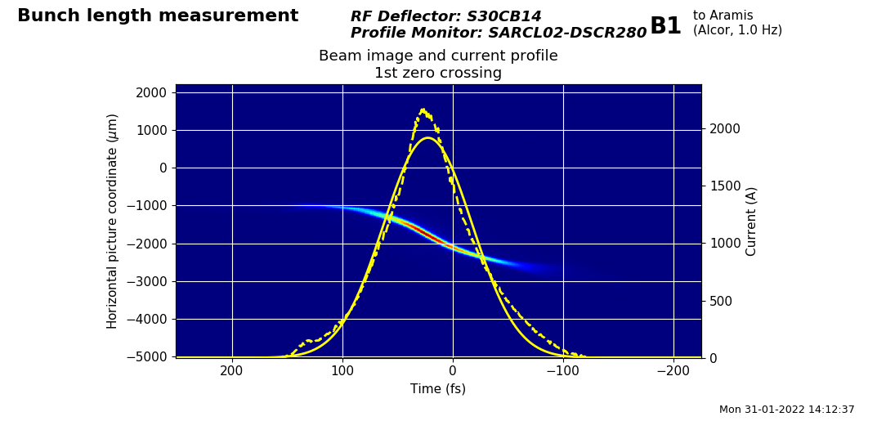
Set-up
Difficult set-up with conflicting requests:
  Alvra 7.1 keV, large BW
  Furka 530 eV, narrow BW
Attempt at changing BC2 energy (2.3 -> 2 GeV) and BC2 angle and retuning the Athos dog-leg to increase the energy spread: some difficulties with optics scaling and retuning of Athos optics -> it seems the dipole momentum does not take correctly into account the BC2 angle
Finally simply change linac1 phase to over-compress bunch1, thanks to the difference in compression between the two bunches in the injector, bunch2 can remain with a standard compression
A BW of 2-3% can be achieved for Aramis

Slide 5
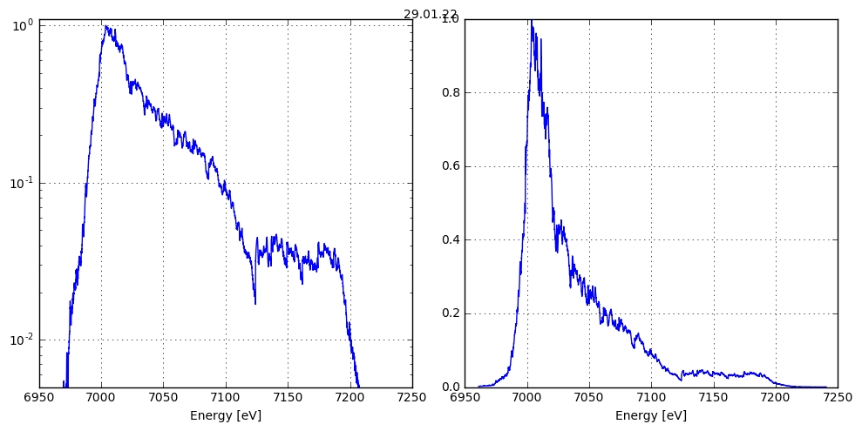
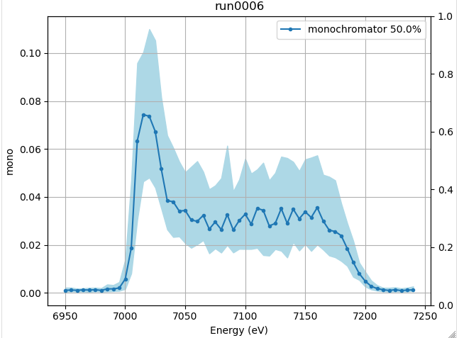
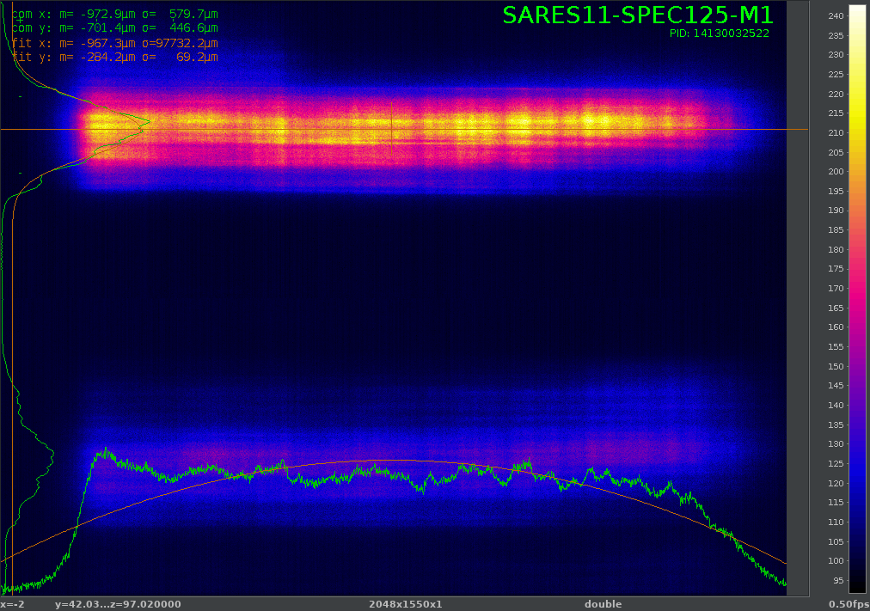
Aramis BW
Very asymmetric profile, large spike at low energy
Difficult to tune without fast diagnostics i.e. PSSS scan and monochromator scans
Finally manage a nice pulse shape, correcting for spatial tilt in ECOL, thanks to Alvra’s single shot spectrometer

Slide 6
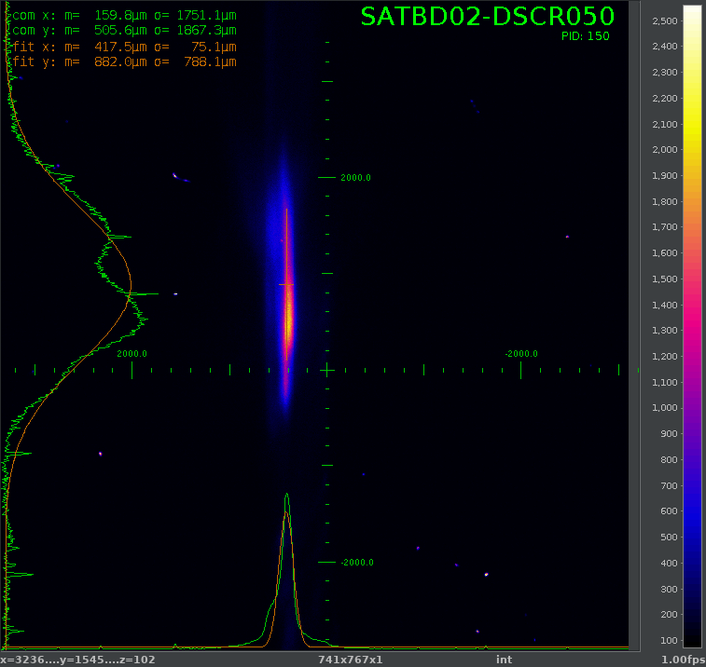
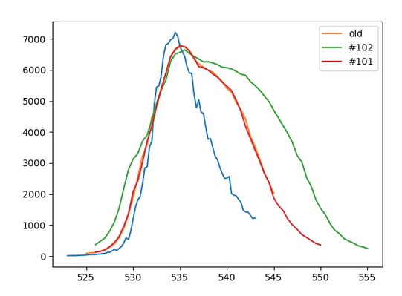
Athos
Sub-optimal BW in Athos: a factor of two larger than in previous runs
This can probably be explained with the special mode on Aramis
Some discrepancy in BW estimation from the machine and end station:
  0.5% electron energy spread in Athos BD => 1% BW in photon energy
  2 to 3 % BW according to Furka’s mono-scan
Large drifts in pulse energy for Athos, starting from 2 mJ down to 1.2 mJ
Suspect Mizar drifting (Aramis was stable at 700-800 uJ the entire week) but could not recover initial lasing with delay optimization or pointing correction
Not clear if Mizar delay locking on Alcor brings much improvement?

Slide 7
Technical difficulties
Still too many interruptions from false charge integral alarms
Gas detector Aramis turbo pump controller failure (tunnel access on Wednesday morning), another problem on a SATCL01 vacuum controller
SATUN20 quad mover stuck -> power cycle
SATUN07 CHIC mover stuck -> power cycle
Problem on water cooling station for S30CB10, controller replaced without affecting the beam
Furka data storage quota limit

