Slide 1
SwissFEL Exchange Meeting
Machine report
Week 11/2022
Didier Voulot, SEM,21 Mar. 2022

Slide 2
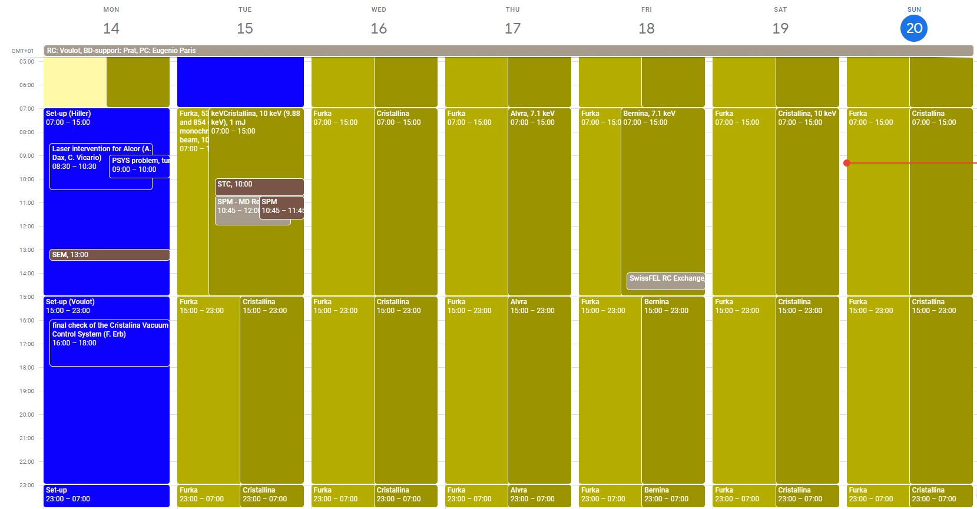

Slide 3
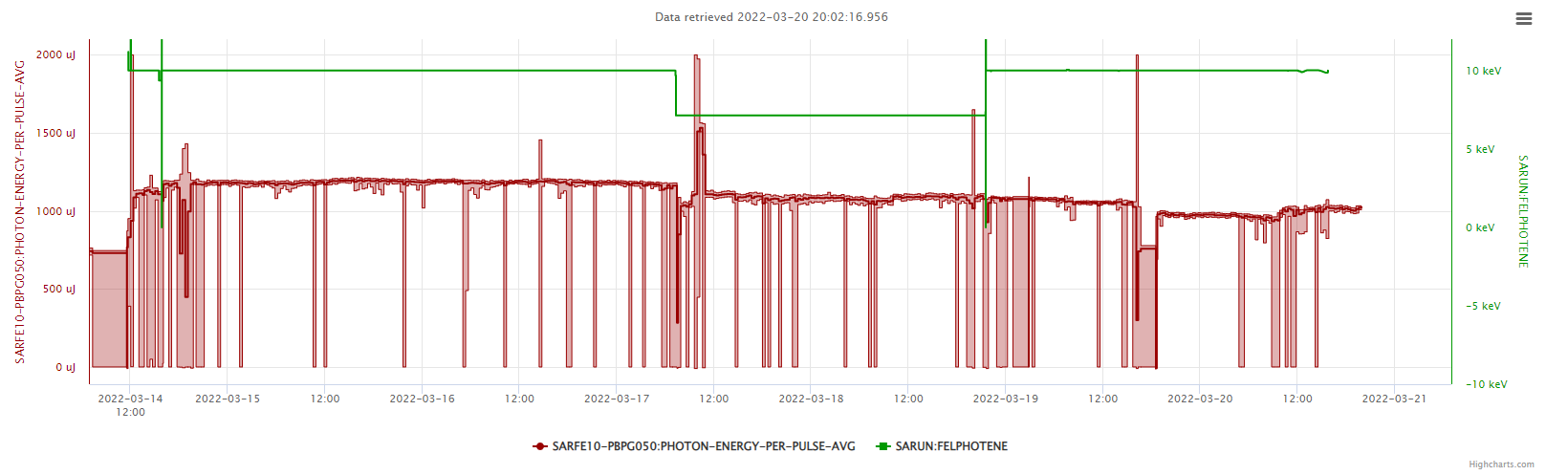
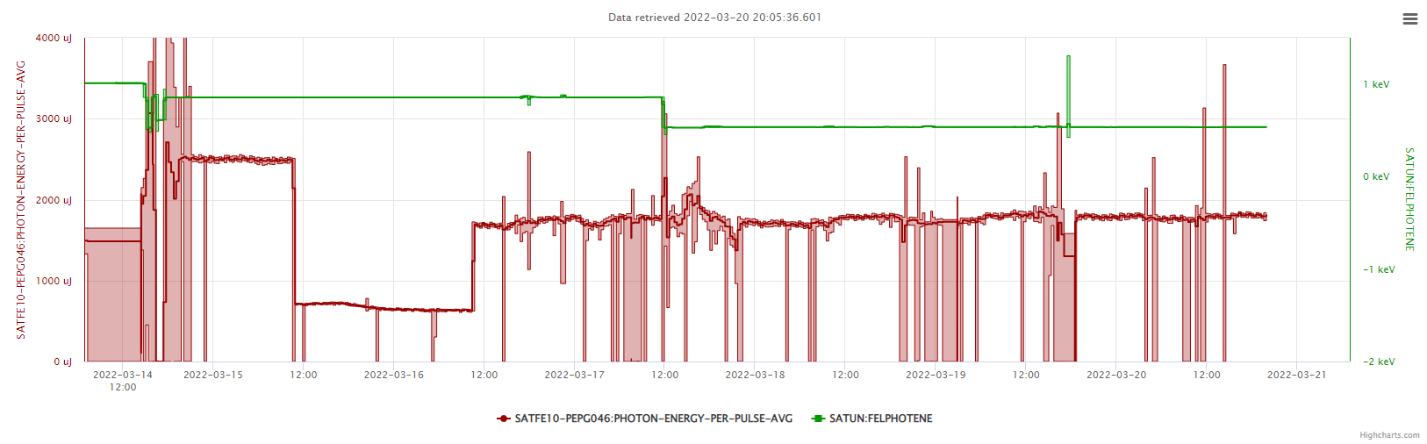
Cristallina 10 keV
Cristallina 10 keV
Alvra/Bernina 7.1 keV
854 eV
532 eV
Aramis very stable first half of the week (1.2 mJ 10 keV), slightly worse during the weekend (laser drifting?)
Athos 2.56 mJ at 854 eV (new record), detune undulators to stay below 2 mJ

Slide 4
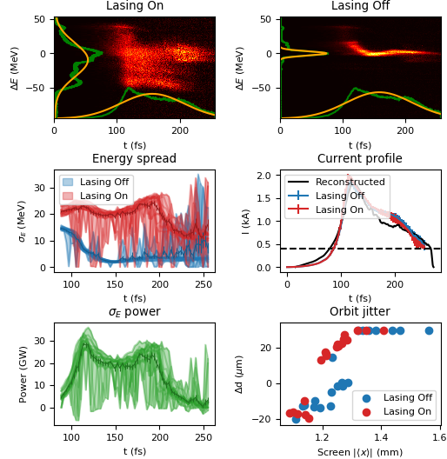
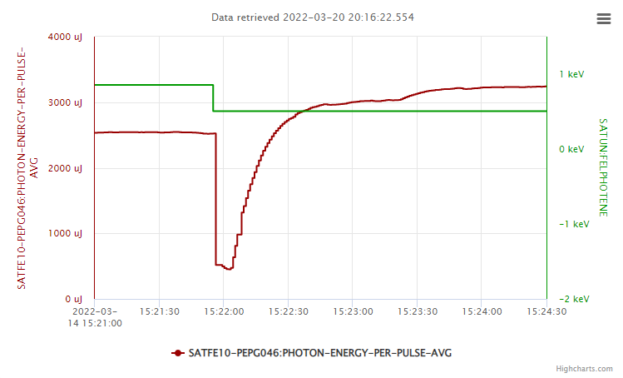
Set-up
Tunnel access for PSYS repair
Last checks of Cristallina vacuum controls (F. Erb)
Laser checks: optimize alignment and recalibrate wave plates
Prepare settings for 10 keV for Aramis and 854 and 532 eV for Athos
Measure Athos bunch length with passive streaker method (P. Dijkstal, E. Prat) -> 100 fs FW
Beam to end station at 19h
Settings reproducibility:
Restore settings from snapshot, 6.3.2022, 3190 uJ 500 eV, restore K settings and phase shifters => 3 mJ !

Slide 5
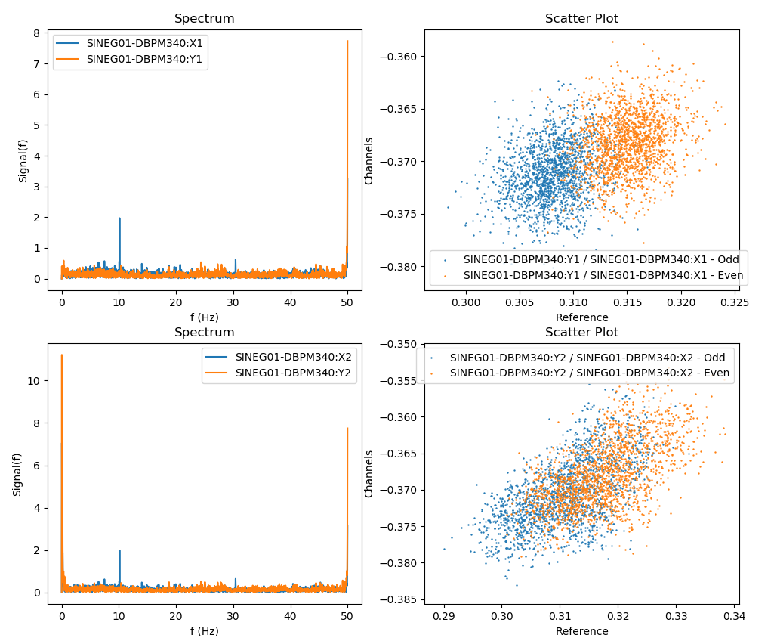
Orbit stability in the injector (Sven)
Beam synchronous data of the very first BPM in the SwissFEL beamline. The scatter plot separates even and odd shots by color. There is already a clear split in the signal at this BPM. It shows also in the strong 50 Hz frequency component in the orbits. The charge reading shows also this fluctuation at 50 Hz.
See elog: https://elog-gfa.psi.ch/SwissFEL+commissioning/23826

Slide 6
Technical Issues
Downtime
ACHIP quad mover alarm position (Monday morning): kept blocking the MPS on Monday, difficult to debug
S10CB08 down (Saturday 2am): an EVR is down and prevent the station from restarting, problems with synchronization (probably caused by the investigation itself), 2h downtime
Losses after S10CB07 trip (Saturday 15h) : notice some collimators are out of position, try to home them and get them stuck in the beam, 1h downtime
Other problems
SATUN06 stuck
SATUN17-MQUA080 tripping to OFF
Aramis GD invalid reading, Keythley reset
S30CB15 dechirpers not responding (Friday night), not in the beam decide to wait until Monday, got fixed on Saturday afternoon

