Slide 1
Notes:
Slide 1: Company Logo Full Page
Before you start editing the slides of your talk change to the Master Slide view:
Microsoft Office :Menu: View > Slide Master;
Macintosh – View > Master > Slide Master
Edit the following items:
On the Slide Master (first master slide) – lower area
a) On the left Delete the text and write the title of the event/Conference, Location
b) On the right delete the text and write the name and surname of the speaker and the date (day, month , year)
Close Master View

Slide 2
Elettra 2.0
Synchrotron Radiation Profile Monitor

Slide 3
Introduction
The Elettra 2.0 project will be the successor of Elettra, the 2/2.4 GeV Italian synchrotron radiation facility in Trieste.
It will be a Diffraction Limited Light Source and the storage ring lattice is a symmetric enhanced 6 bend achromat (S6BA-E). The lattice has 12 long straight sections for insertion devices and 12 short straights, some of them equipped with short insertion devices.
Elettra 2.0 will have a bare emittance of 212 pm rad, 49 times lower than of the present machine, it will provide more than two orders of magnitude higher brilliance and about 60 larger coherent flux.
The new machine will operate mainly at 2.4 GeV with an intensity of 400 mA (some 25% of the user beamtime is planned at 2 Gev).
A short pulse option of about 1 ps (fwhm) by using crab cavities is under study.
The majority of the long straight section beamlines will be at the same position as today. Some will be shifted due to new bending source position.

Slide 4
Main characteristic comparison
 | Present Lattice (Elettra) | New Lattice (Elettra 2.0)
Lattice type | DBA | S6BA-E
Circumference [m] | 259.2 | 259.2
Beam Energy [GeV] | 2.0 | 2.4
Beam current [mA] | 310 | 400
Fill patterns | Multi-bunch, hybrid, single or few bunch | Multi-bunch, hybrid, fill every other bunch, single or few bunch
# of dipoles per achromat | 2 | 6
Nominal RF Frequency [MHz] | 500 | 500
Harmonic Number | 432 | 432
The new lattice reduces the present bare emittance by a factor of 49 greatly increasing the brilliance and coherence of the X-ray beam. It will operate with a 1-5% coupling.

Slide 5
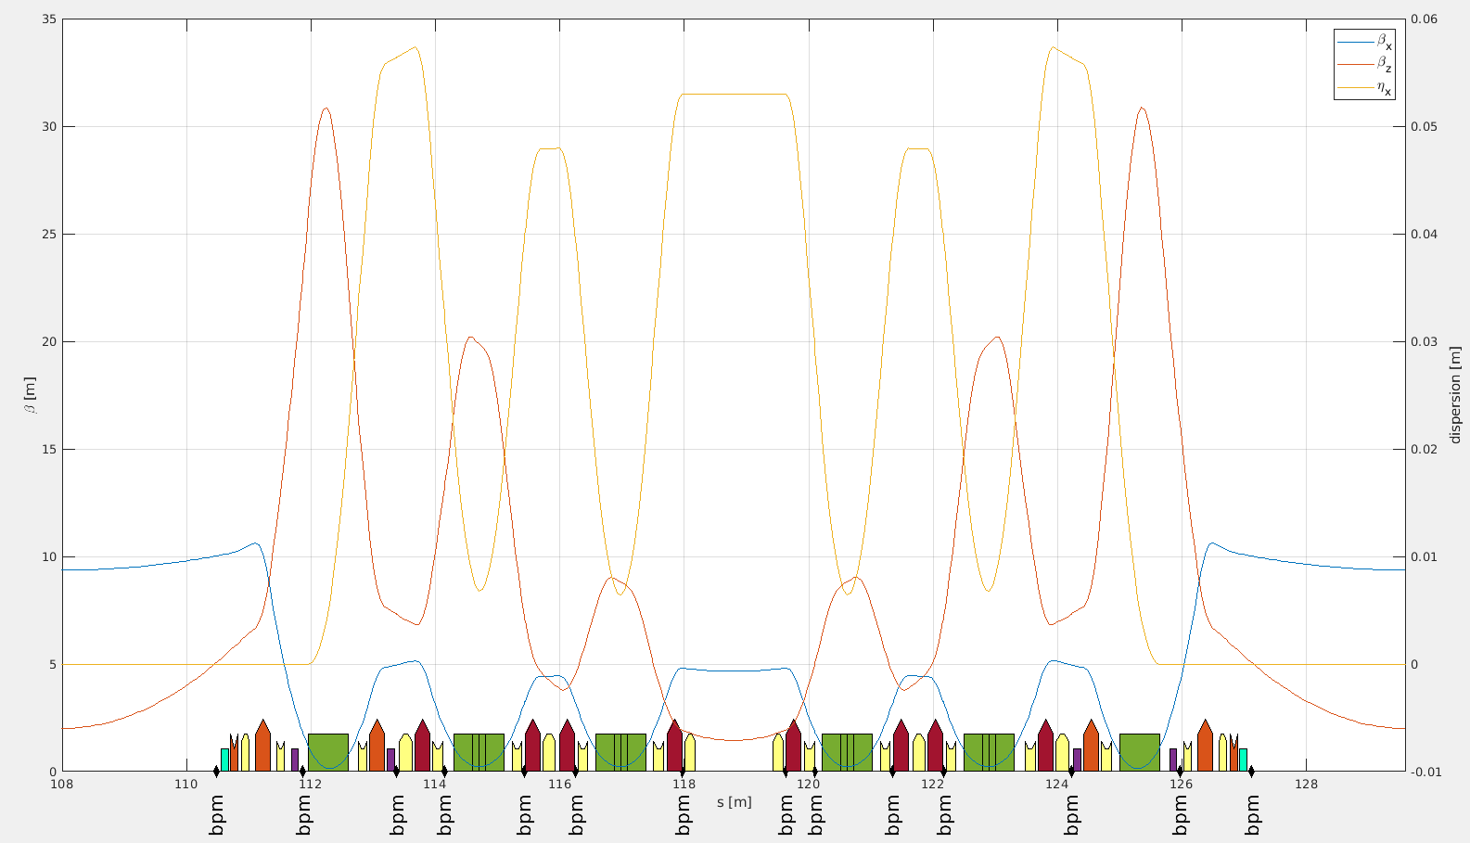
Achromat layout
Source Point

Slide 6
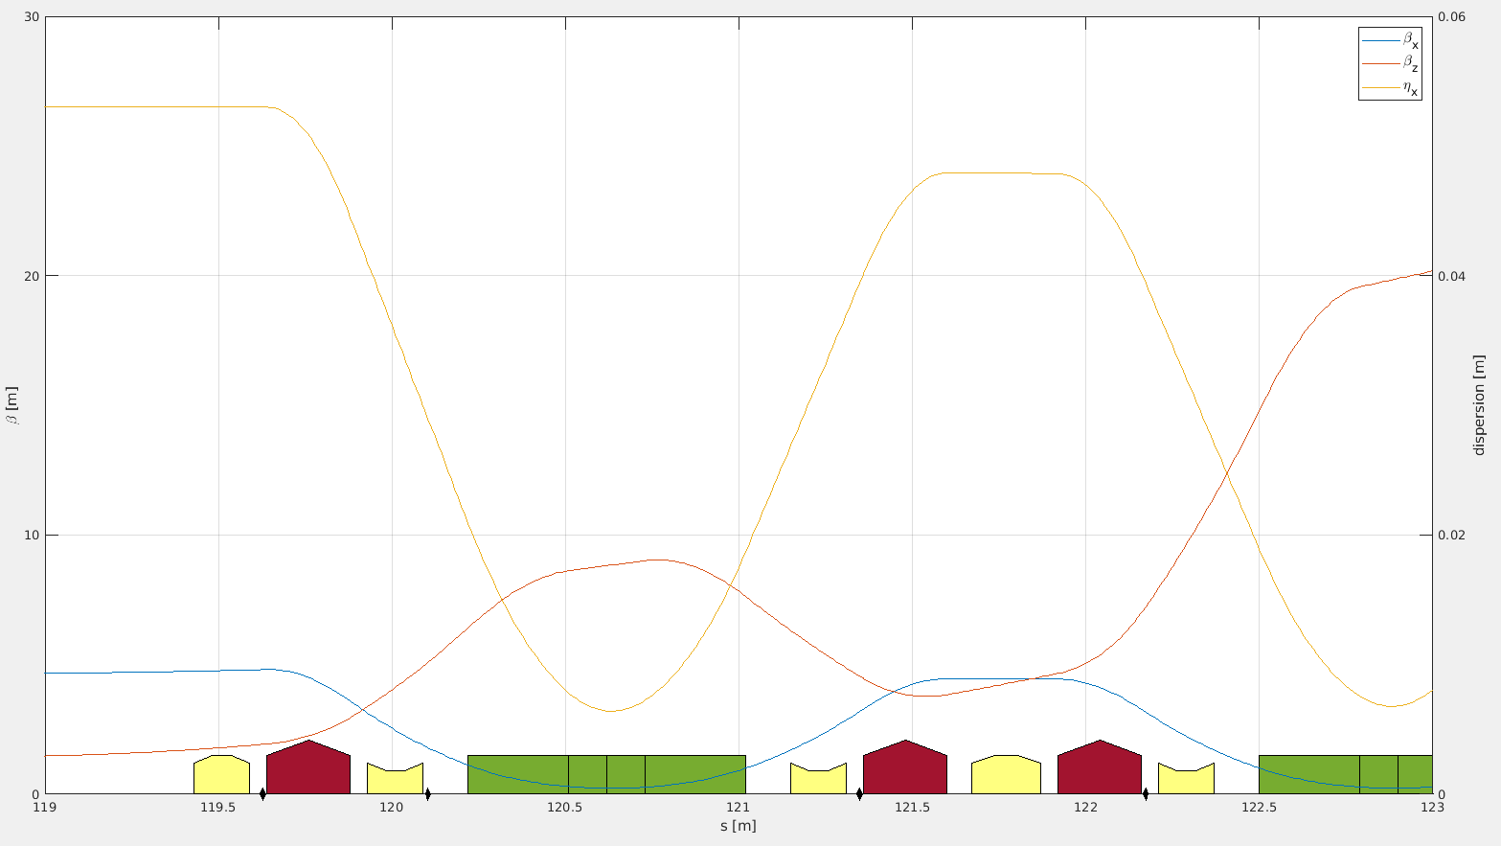
Achromat layout

Slide 7
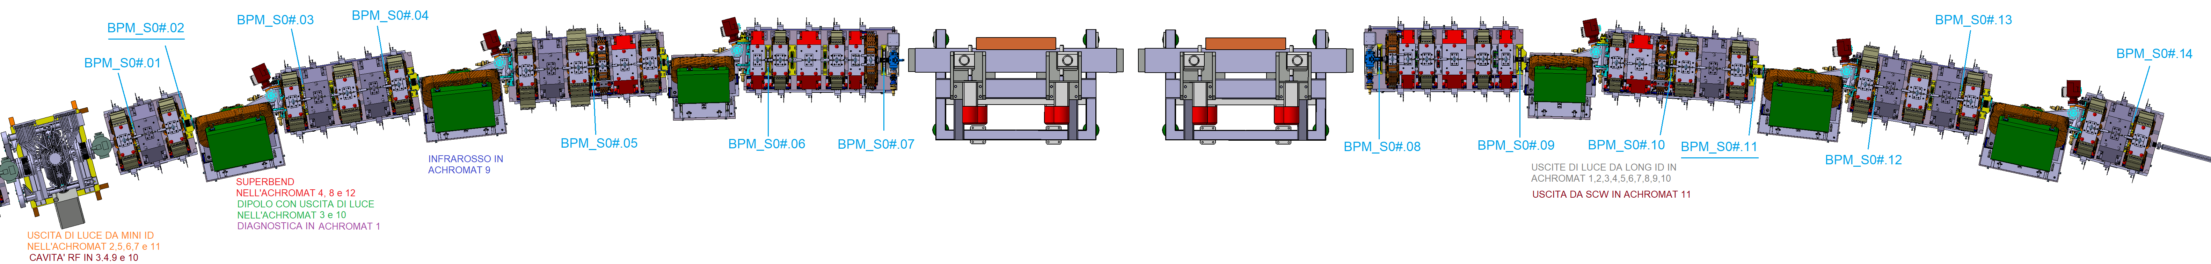
Achromat layout
Sizes of the electron beam at the photon source points
Beam size and divergence | Dipole
 | Elettra 2.0 | Elettra
σ_{x} (μm) /σ’_{x}(μrad) | 9/34 | 77/215
σ_{y} (μm) /σ’_{y}(μrad) | 4.5/0.56 | 60/5
Bending Magnet | Length [m] | Bend Angle [°] | Field [T] | Ec [keV]
B1 | 0.64 | 3.6 | 0.786 | 3,01
B2 | 0.80 = 0.29+0.22+0.29 | 6.5 = 2.1+2.3+2.1 | 1.012+1.4613+1.012 | 5,59
B3 | 0.80 = 0.29+0.22+0.29 | 6.5 = 2.1+2.3+2.1 | 1.012+1.4613+1.012 | 5,59
Source Point

Slide 8
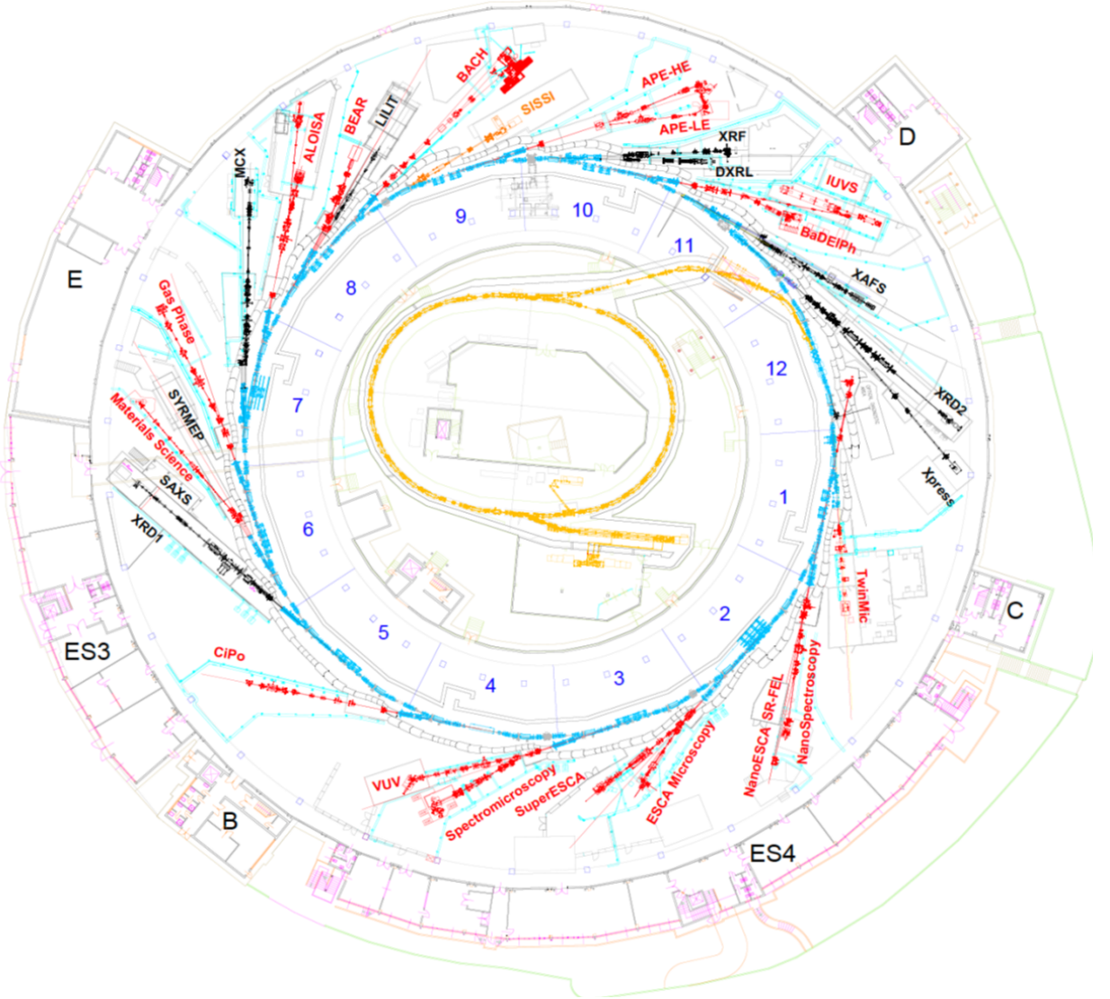
Elettra layout
Machine and beamlines layout.
At present we use BS12.2 bending as source for transverse and longitudinal beam diagnostics.
Circled in red the current dedicated Optical Laboratory is equipped with:
two optical tables;
a CCD camera used as beam stability monitor;
a Synchroscan Streak Camera for longitudinal analysis;
a fast acquisition camera to detect fast transverse beam oscillations;
Optical Diagnostics
Laboratory

Slide 9
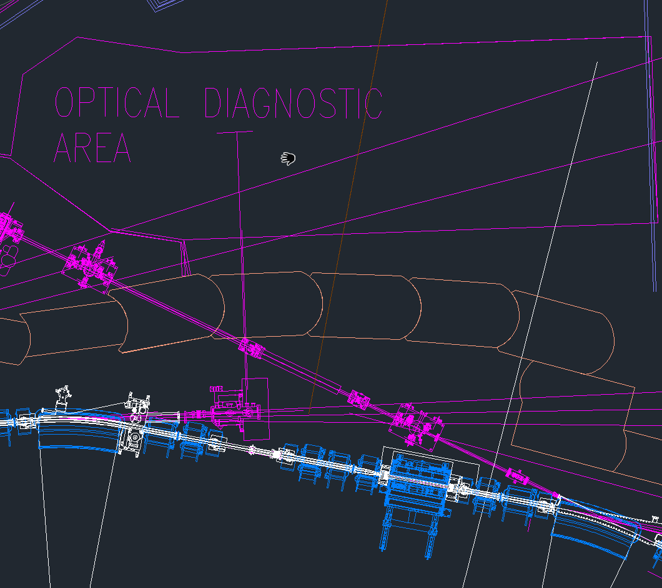
3.
Elettra Optical Diagnostic Area
1. The bending magnet B12.2 is the radiation source of the actual Synchrotron Radiation Profile Monitor.
2. The light is partalized by an absorber then hits an in-vacuum glidcop mirror that reflects one polarized component of visible and near-UV light.
3. The light reaching the Optical Diagnostic Area is split to be used by Transverse and Longitudinal Measurement Systems.
2.
1.

Slide 10
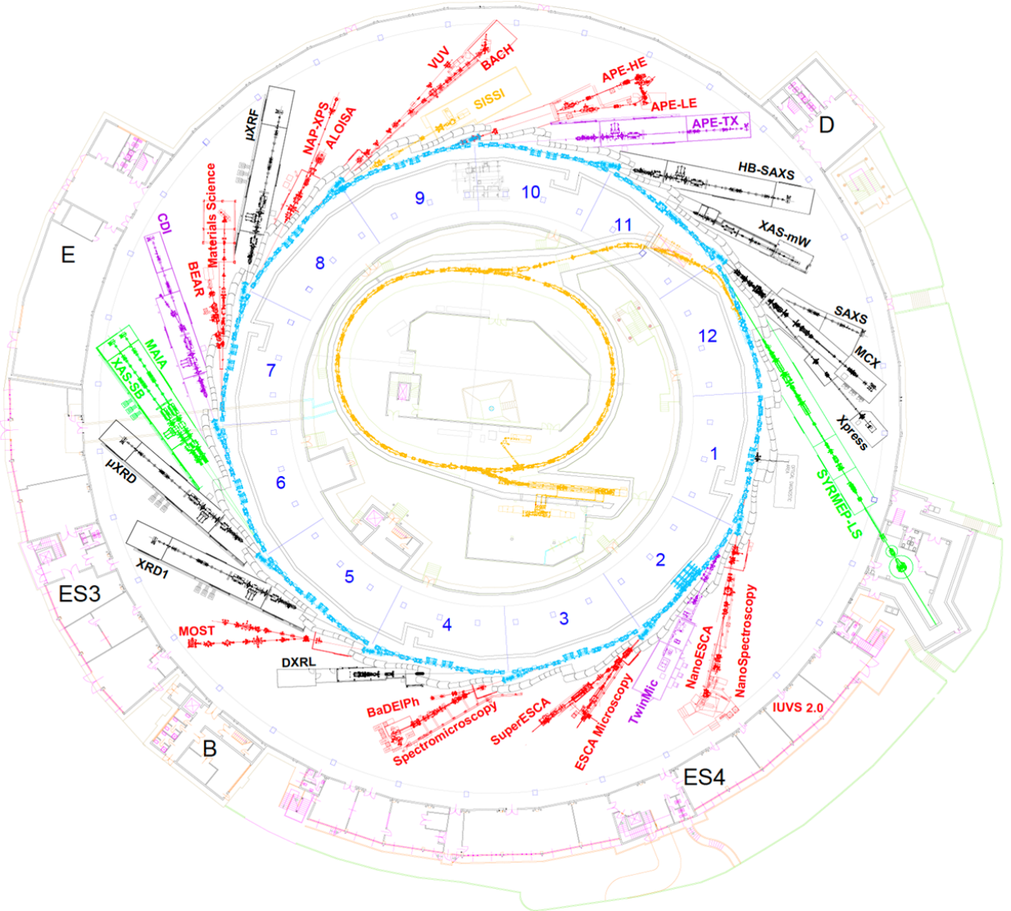
Elettra 2.0 layout
Machine and beamlines layout.
The new source for the diagnostics beamline will be B03S01.01, the first bending magnet just after the short straight section between S12 and S1.
The old SRPM hutch position will be used by the SYRMEP-LS beamline and a new hutch has to be designed and built in a new position.
Actual
Optical Diagnostics
Laboratory
Available Space for new
Optical Diagnostics
Laboratory

Slide 11
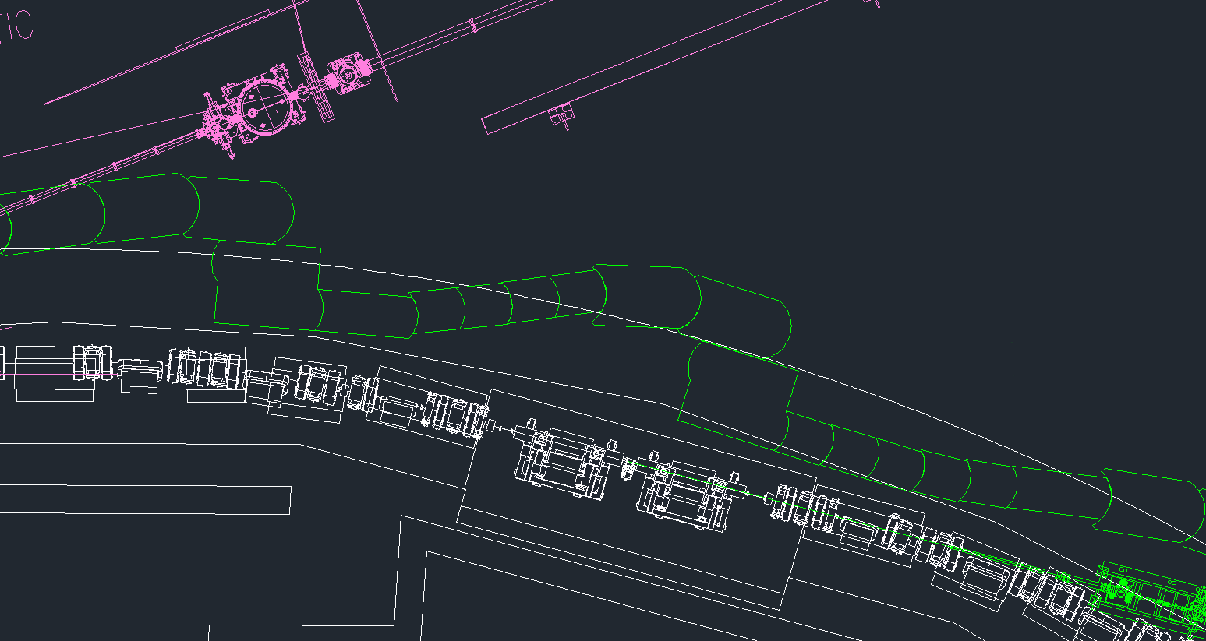
2.
Elettra 2.0 layout
Machine and beamlines layout
1. The new source for the diagnostics beamline will be B03S01.01, the first bending magnet just after the short straight section between S12 and S1.
2. The old SRPM hutch position will be used by the SYRMEP-LS beamline.
3. A new hutch has to be designed and built in a new position.
3.
1.

Slide 12
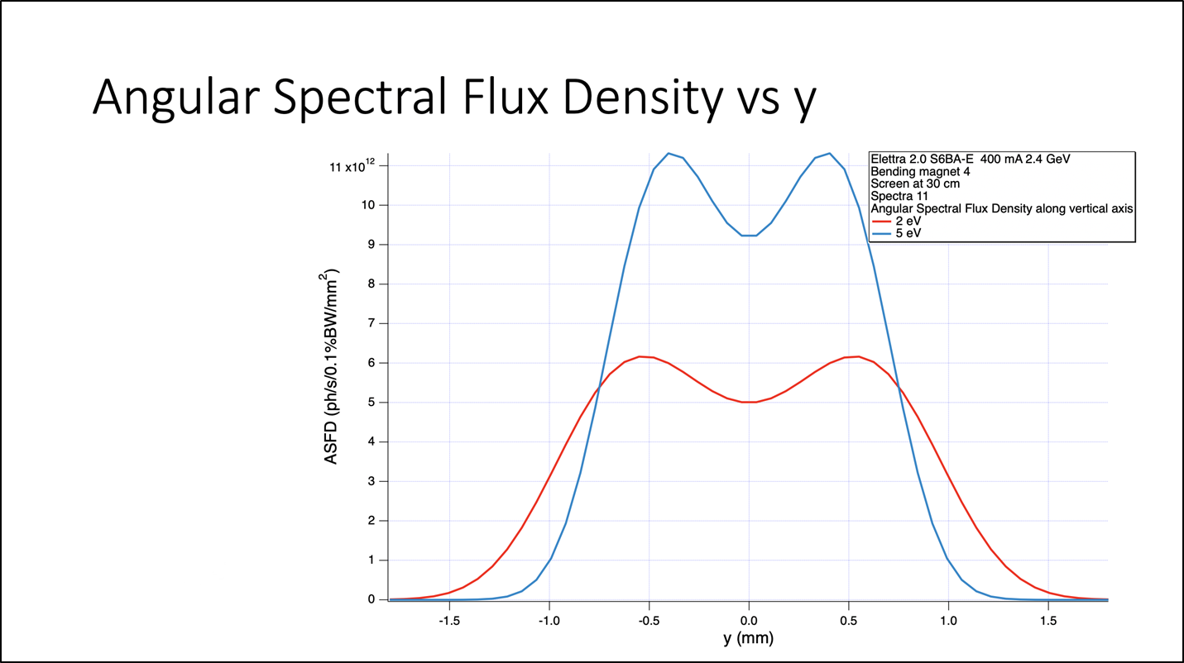
Visible and UV radiation from Bending
Here is the angular spectral flux density calculated with respect to y on a screen 30 cm downstream of the source point.
The two curves on the graphs refer to photons at different energy.
Photon Energy [eV] | 2 | 5
Wavelength [nm] | 620 | 250
HWHM divergence [mrad] | 3,33 | 2,33

Slide 13
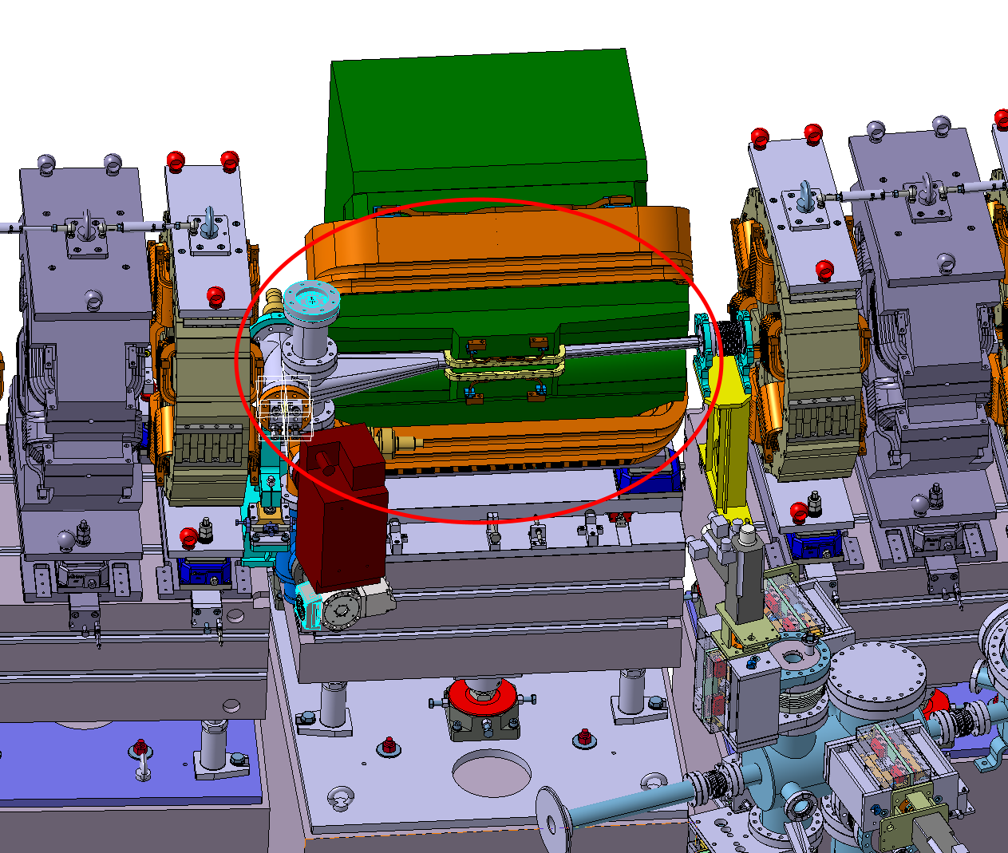
Bending magnet source
Standard vacuum chamber B03S01.01.
This vacuum chamber can host an X-ray light source .
The vacuum chamber that propagates the radiation passes through the body of the following magnets and for this reason it has a very small diameter (internal diameter 6X11 mm) not suitable for transmitting the visible part which, if necessary, must be extracted from the bending part with appropriate modification.

Slide 14
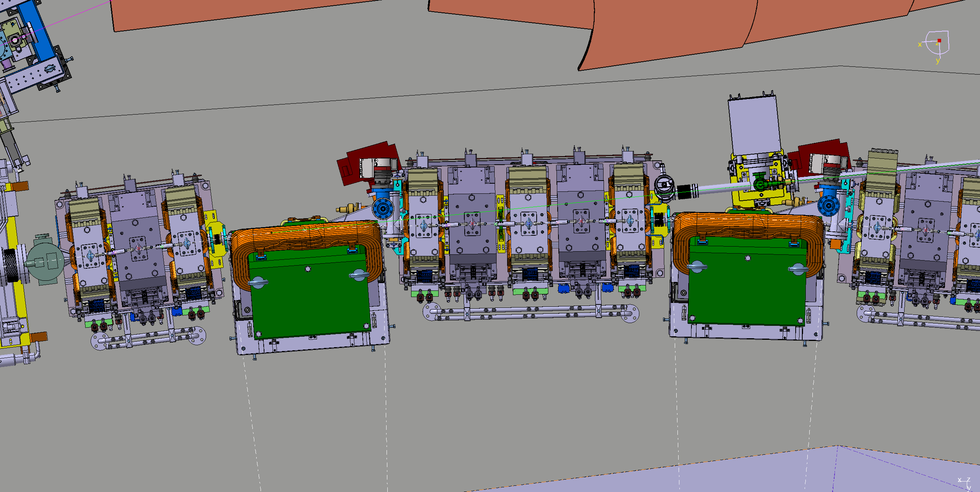
Bending magnet source
Standard B3S1.1 vacuum chamber to be modified to match SRPM purposes raggio curvature dei magnetii
0,8 m
3,2 m

Slide 15
Optical Diagnostic Measurements
The planned measurements are:
Transverse beam dimensions (expected value ~ 10 μm resolution 0,5 μm)
Emittance , Coupling.
Energy spread
Longitudinal Beam Profile and Dynamics
Beam Stability
High frequency transverse beam oscillations

Slide 16
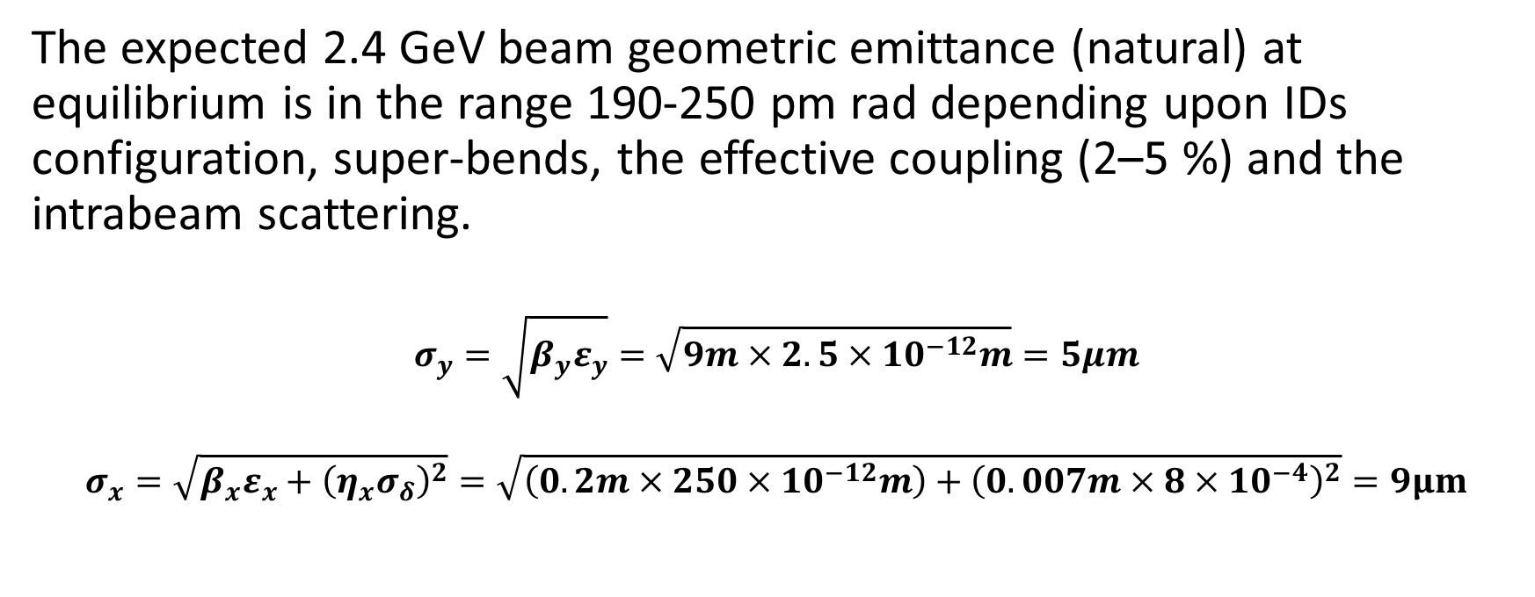
Emittance Measurements
The expected 2.4 GeV beam geometric emittance (natural) at equilibrium is in the range 190-250 pm rad depending upon IDs configuration, super-bends, the effective coupling (2–5 %) and the intrabeam scattering.
$$σ_{y}=\sqrt{β_{y}ε_{y}}=\sqrt{9m×2.5×{10}^{−12}m}=5μm$$
$$σ_{x}=\sqrt{β_{x}ε_{x}+{\left(η_{x}σ_{δ}\right)}^{2}}=\sqrt{\left(0.2m×250×{10}^{−12}m\right)+{\left(0.007m×8×{10}^{−4}\right)}^{2}}=9μm$$

Slide 17
Longitudinal Beam Profile / Dynamics
A Synchro Scan Streak Camera will be used to measure the longitudinal beam profile and to monitor the longitudinal beam dynamics.
In addition to dedicated measurement sessions, we would like to have the capability to monitor the beam stability by automated measurements.

Slide 18
Beam Stability Monitor
A simple image of the visible light is useful to have a feedback of the beam stability status.
This image is always displayed in control room and is used by the operator as an intuitive indication of the beam stability
The same light acquired by a fast acquisition camera able to acquire image at maximum frame rate of 1 Mframe/s (16*16 pixel) is presently used to measure transverse fast beam oscillations not visible from BPM analysis due two limitation of the actual BPM acquisition system.

Slide 19
Notes:
Last Slide 1: Thanks to the audience

Slide 20
Notes:
Last Slide 2: Aerial Photo of Elettra

