Slide 1
Beam size monitoring at SLS (2.0)
Cigdem Ozkan Loch :: Electron Beam Instrumentation :: Paul Scherrer Institute
23.03.2022

Slide 2
Thank you!!
We have a habit in writing articles published in scientific journals to make the work as finished as possible, to cover up all the tracks, to not worry about the blind alleys or describe how you had the wrong idea first, and so on. So there isn’t any place to publish, in a dignified manner, what you actually did in order to get to do the work.
—Richard P. Feynman, Nobel lecture 1996
When art critics get together, they talk about style, composition, and technique.
When artists get together, all they talk about is where to get the best turpentine.
—Pablo Picasso

Slide 3
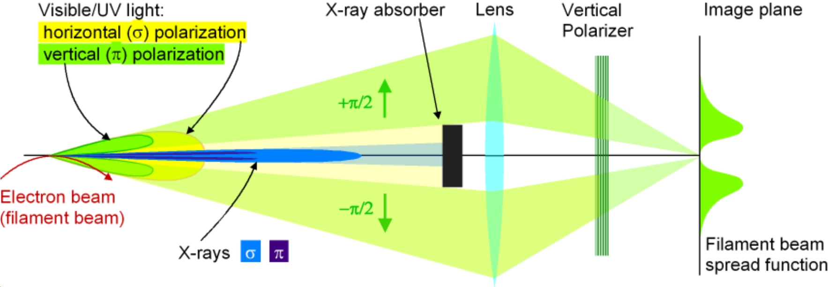
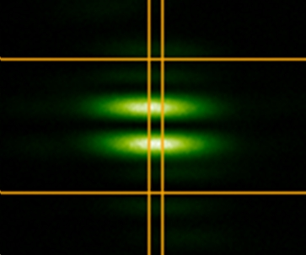
Source Size measurement at SLS
Smallest beam measured with 𝜋-polarization (at 364nm) = 3.6±0.6um
Sources: several PSI presentations/reports

Slide 4
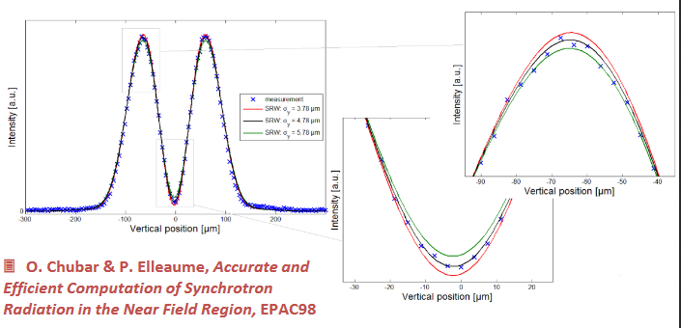
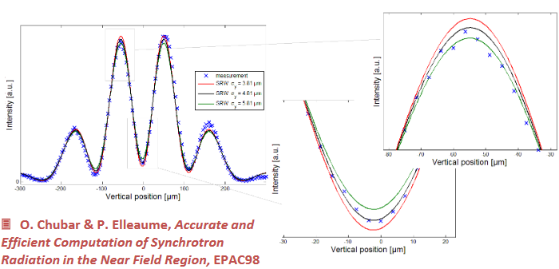
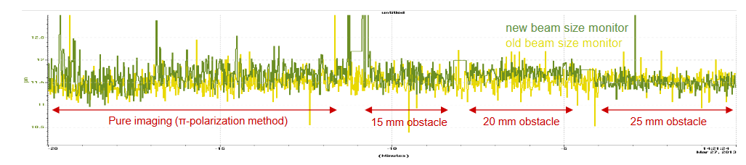
π-polarization & interferometry @ SLS
The pi-pol simulation with SRW-IGOR and experimental results at SLS match very well
Both pi-pol measurement results are consistent with each other
Figures from: https://indico.cern.ch/event/306551/contributions/705064/attachments/583692/803462/12_SAA-ALERT2014.pdf

Slide 5
Lessons learned at SLS
Only vertical beam size measurement
Radiation damage on vacuum window means measuring only once in half hour
When beam size measurement isn’t working everyone has a collective heart attack (yet, the machine still runs)
Easy to align
Beamline vibrations, due to cooling water, are amplified on mirror chamber >>> spatial oscillations and bad beam size readings
Mirrors do age in the UV light
Lens did not need replacing but mirror did
Vacuum window needs replacement once in 18 months
Have not been able to corroborate beam size so far >>> more on this later
Radiation will eventually dry out the grease of the linear stages which can cause loss of steps in case of alignment
Cameras age, servers die

Slide 6
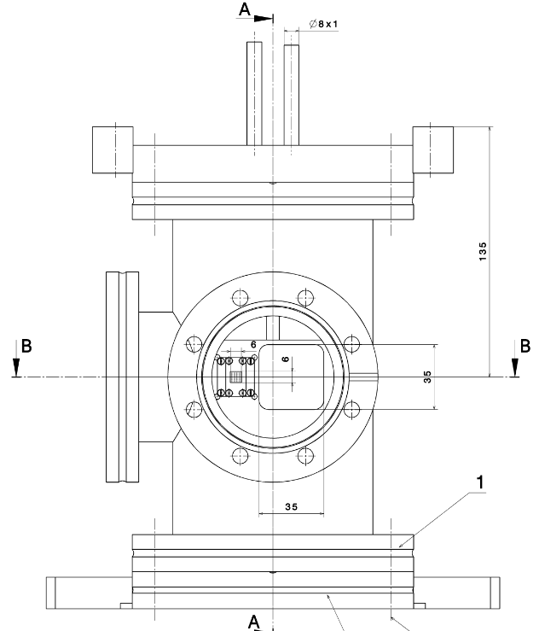
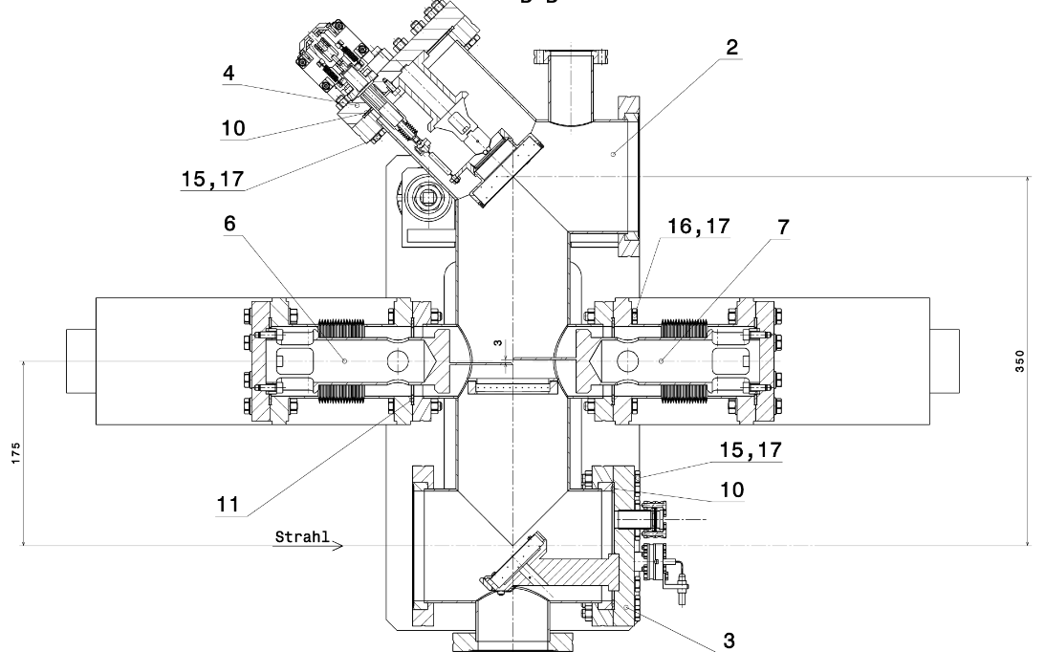
SLS Pinhole/π-pol chamber

Slide 7
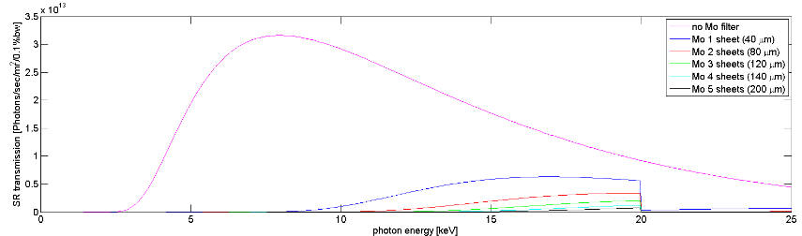
X-ray Pinhole
Pinhole
Vacuum
Air
S = M · s
Dipole magnet
s
mirror
Mo filters
Ce:YAG
Electron beam
Diamond window
Camera & objective
d
D
Pinhole magnification: M = D / d

Slide 8
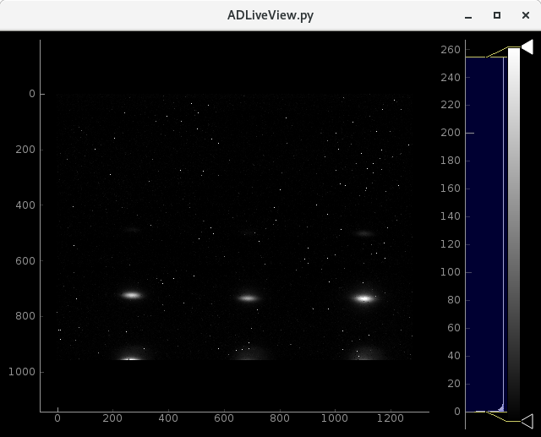
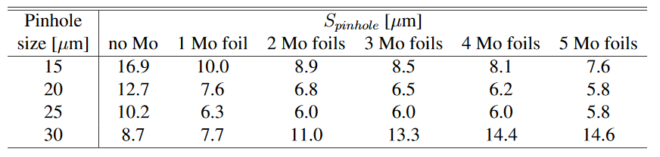
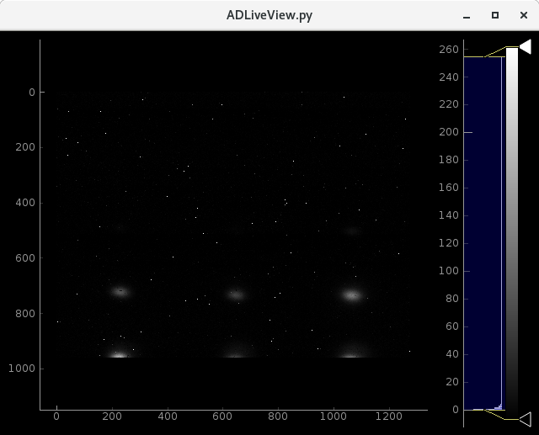
X-ray Pinhole: Point Spread Function
PSF of the pinholes for the 2.4 GeV (N. Milas, A. Saa Hernandez, 2013)

Slide 9
Lessons learned at SLS
Pinhole is not well designed at SLS, not in use
Smallest beam size is always 20um (without de-convolving for pinhole size)
Only good for visuals: see beam tilt, beam blow up
Beamline vibrations not seen here as no components in between
Ozone is damaging: Have you ever broken a diamond vacuum window?
Optics turn brown
Cameras age

Slide 10
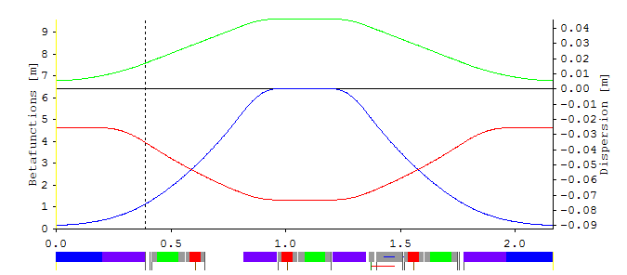
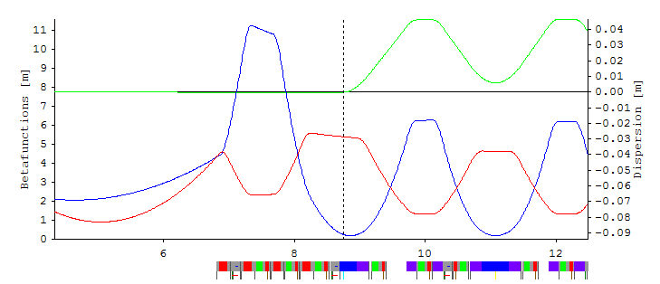
SLS 2.0
My means are sane, my motive and my object mad.
—Captain Ahab, Moby Dick by Herman Melville
Energy | 2.7 GeV
Vertical emittance | 10 pm.rad
Horizontal emittance | 157 pm.rad
Energy spread | 0.001145
Dispersion dominated
Horizontal emittance | Open IDs, low current | 150 pmrad
 | Closed IDs, 400mA | 136 pmrad
 | Nominal | 157 pmrad
Vertical emittance | 1-2% coupling | 2-3 pmrad
 | Nominal | 10 pmrad
 | Range of operation | 8-12 pmrad
BN VB
Emittance dominated
Nominal rms beam size (HxV) = 8.5um x 6.8um
Vertical emittance change of 1pmrad ~ 400 nm
Horizontal emittance of 7pmrad ~ 250nm
BE

Slide 11
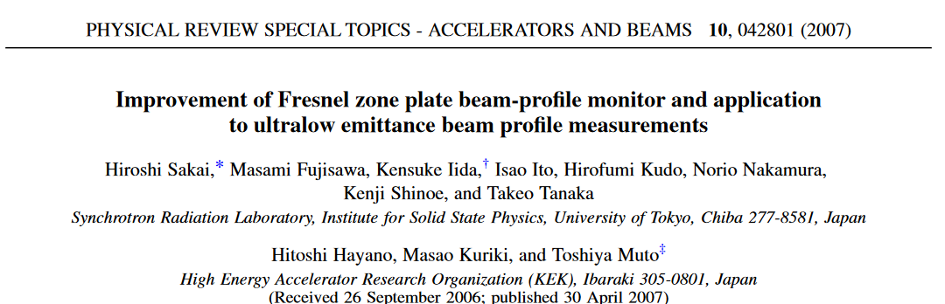
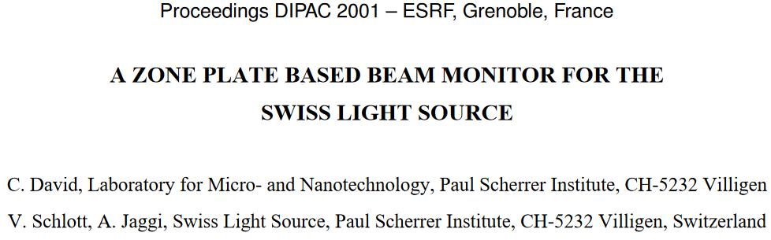
SLS 2.0: Fresnel Zone Plates
Fresnel zone plates (FZPs) are used to build x-ray microscopes
Spatial resolution depends on the outermost-zone width of FZPs (100 nm is technologically achievable)
KEK-ATF damping ring uses FZPs in arrangement below to measure ultralow emittance electron-beam profile

Slide 12
FZP: single vs. double
microscope setup
monochromator
Transmission ZP
Dipole magnet
mirror
CS
Ce:YAG
Electron beam
LC1
LC2
microscope setup
monochromator
Transmission ZP
Magnifying ZP
Dipole magnet
mirror
CS
Ce:YAG
Electron beam

Slide 13
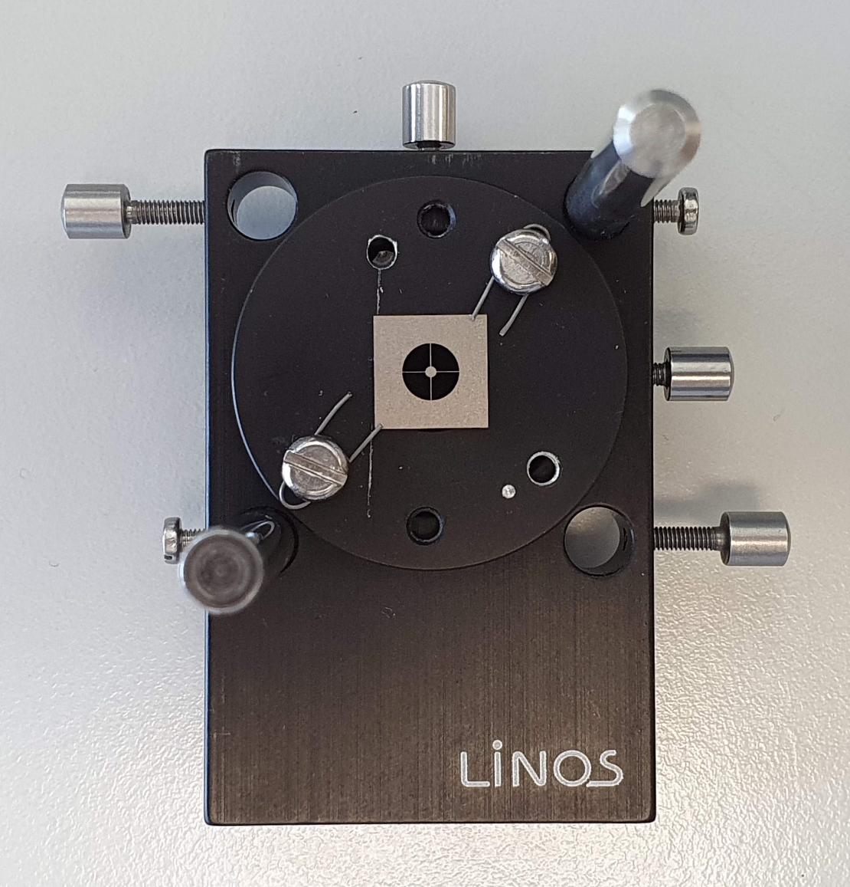
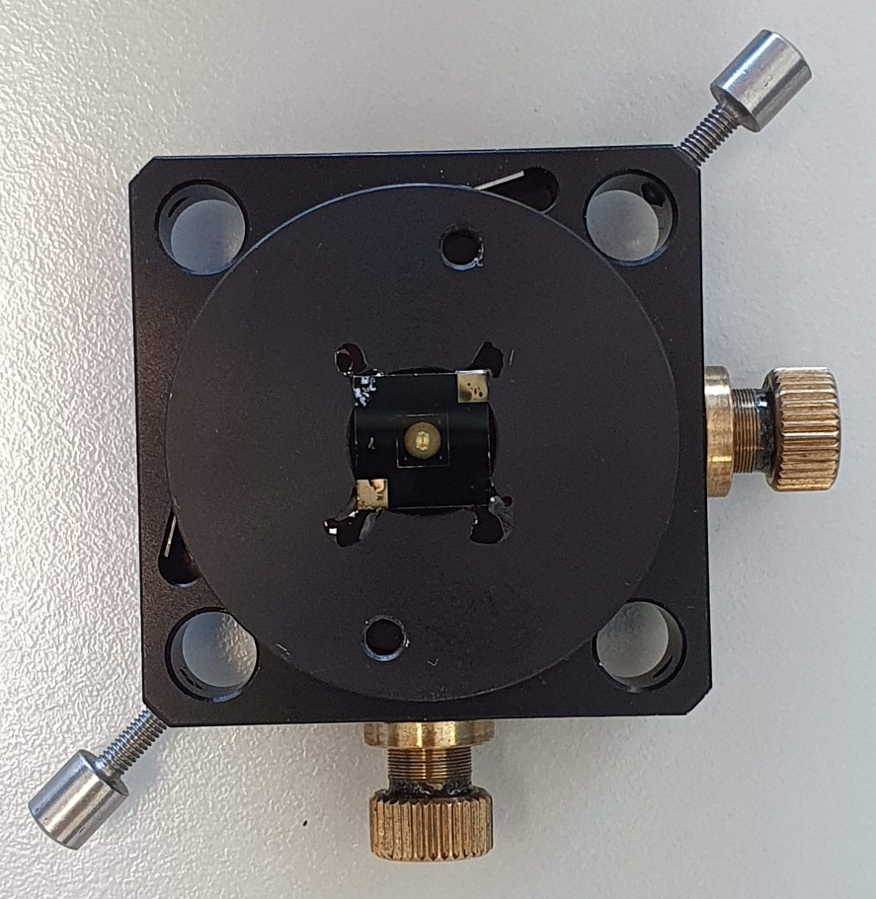
Central Stop and FZP Alignment
CS diameter = 1 mm
ZP diameter = 2.5 mm
ZP outermost zone width = 125 nm
ZP focal length = 2772 mm at 11keV
ZP height = ~ 2500 nm in Au

Slide 14
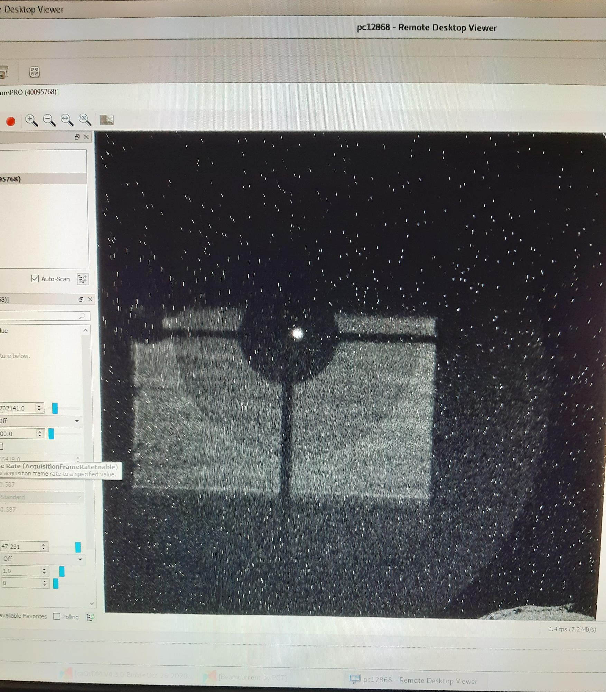
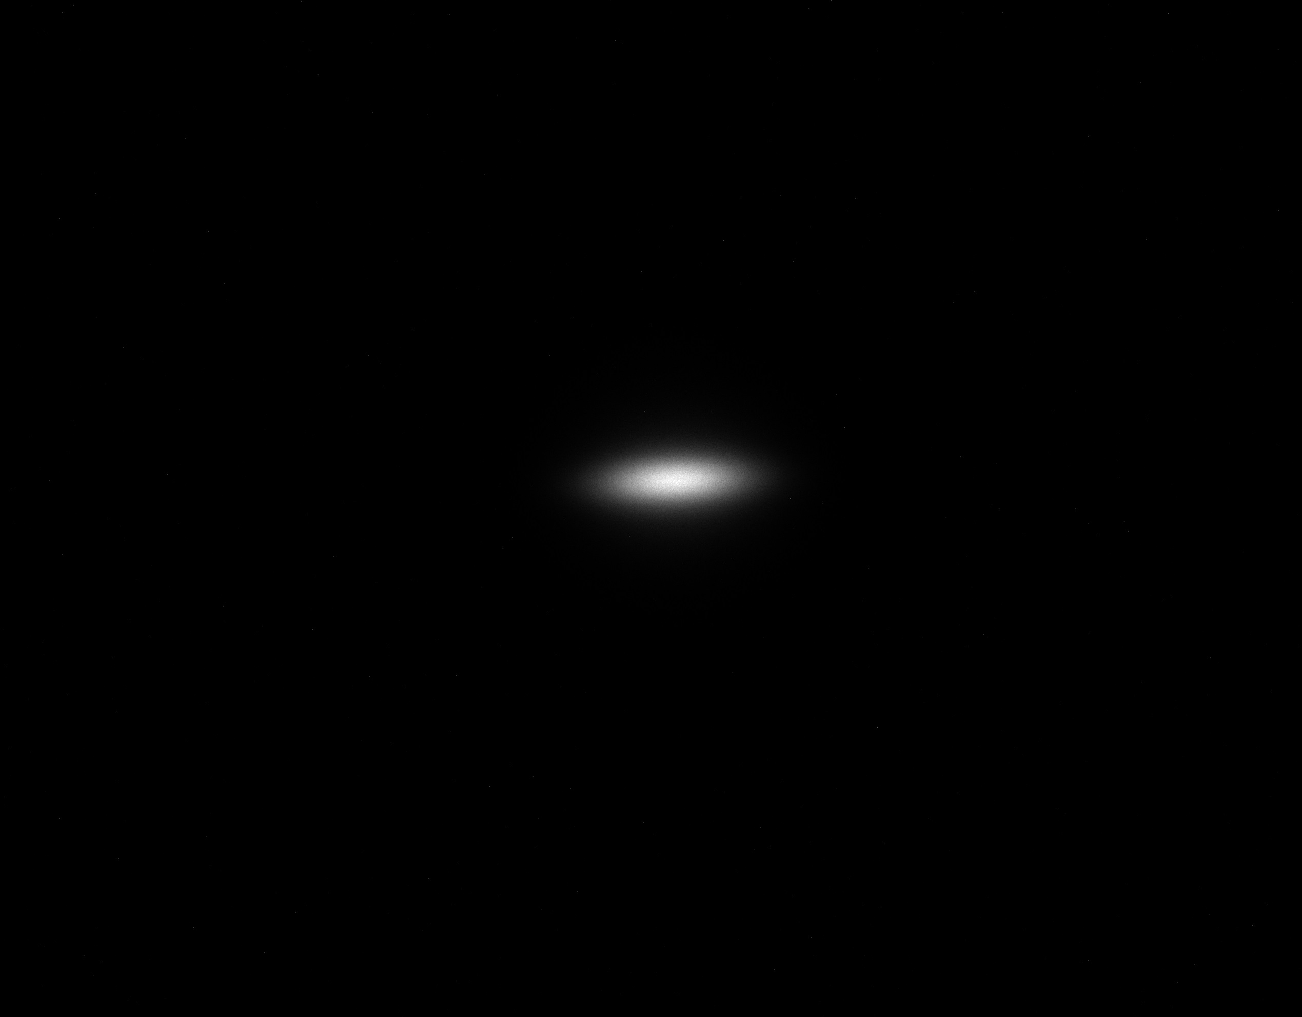
FZP measurements at SLS
In theory, theory and practice are the same. In practice, they’re different.
—Anonymous
Setup:
Monochromator set to 11keV
Source to FZP = 16.3m; microscope to FZP = 3.36cm
Zone plate f=2.77m, 2.5mm diameter, outermost width 125nm
µ-scope: Basler a2A-4504-18um PRO + 2x Mitutuyo lens + 5um Ce:YAG
First image of ZP: simple placement into beam
- Zone plate clearly visible along with central stop
- Central high intensity spot is focused beam
@ FZP focus, M = 0.205
µ-scope magnification = 20x
beam size = 22µm x 61µm

Slide 15
~30umx63um
Flipped YAG: ~23umx55um
Ask producer to mark the scintillating side

Slide 16
Skew Quad current scan changes beam size
Pi-pol gives sigma_y ~ 9um
Scintillator doesn’t allow improvement
Use different substrate for 5um Ce:YAG? Glass?
How about AR coating?
>>> Trying a “wire scan”
Beam size on the scintillator ~6um

Slide 17
FZP measurements at TOMCAT
TOMCAT beamline
@ 11.5keV, water cooled monochromator
Distances:
Source-FZP1: 17027mm
FZP1-det= 3510mm
min. horizontal beam size (rms) = 59.8um (optics 55.9um)
min. vertical beam size (rms) = 17.86um
Many thanks to my colleagues
A. Bonnin (TOMCAT)
N. Samadi (TOMCAT/X-ray Nano-optics)
J. Vila Comamala (X-ray Nano-optics)

Slide 18
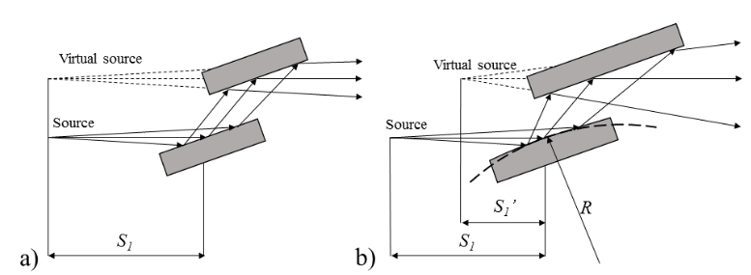

Effect of monochromator thermal deformation
Thermal deformation of the first crystal monochromator is a concern. If downstream beam focusing is planned, the lensing effect of the monochromator must be considered even if thermal deformations are small. The X-ray beam power results in an effective change of the focal distance; this is due to a lensing effect of the distorted monochromator that results in the creation of a virtual source downstream of the actual source.
On the influence of monochromator thermal deformations on X-ray focusing
https://doi.org/10.1016/j.nima.2016.02.103

Slide 19
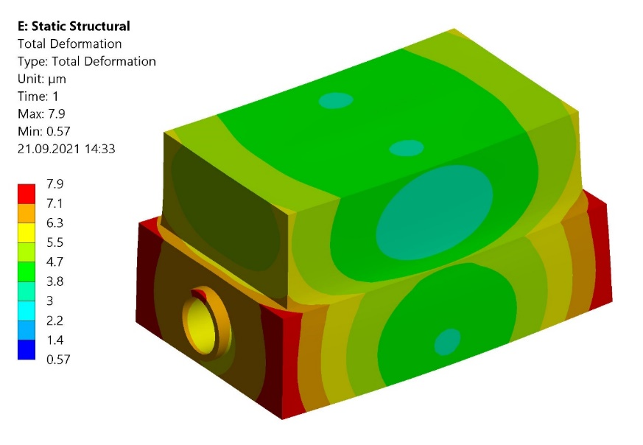
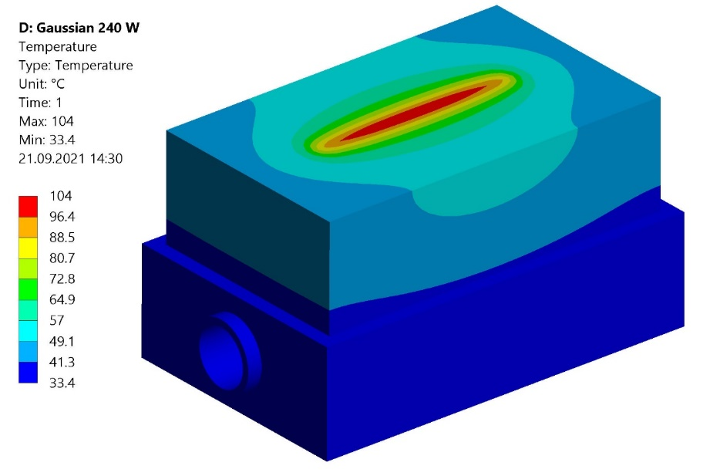
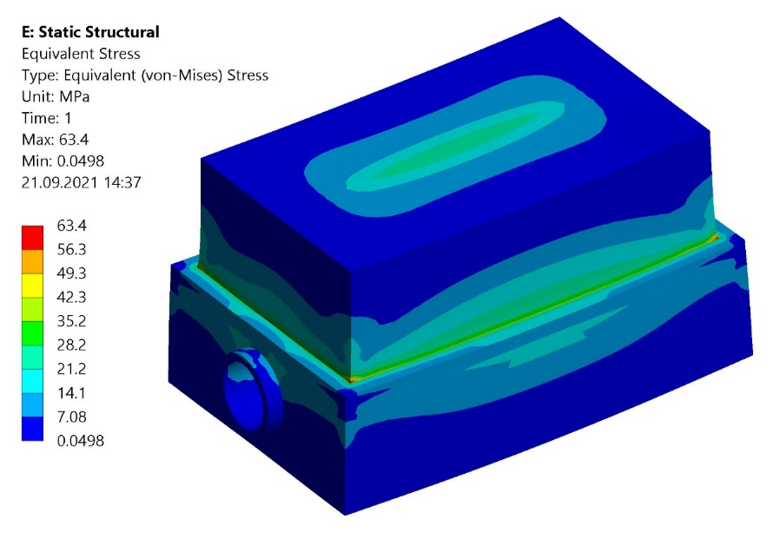
Thermal deformation ANSYS
Many thanks to Dr. X. Wang
Heat load 240 W

Slide 20
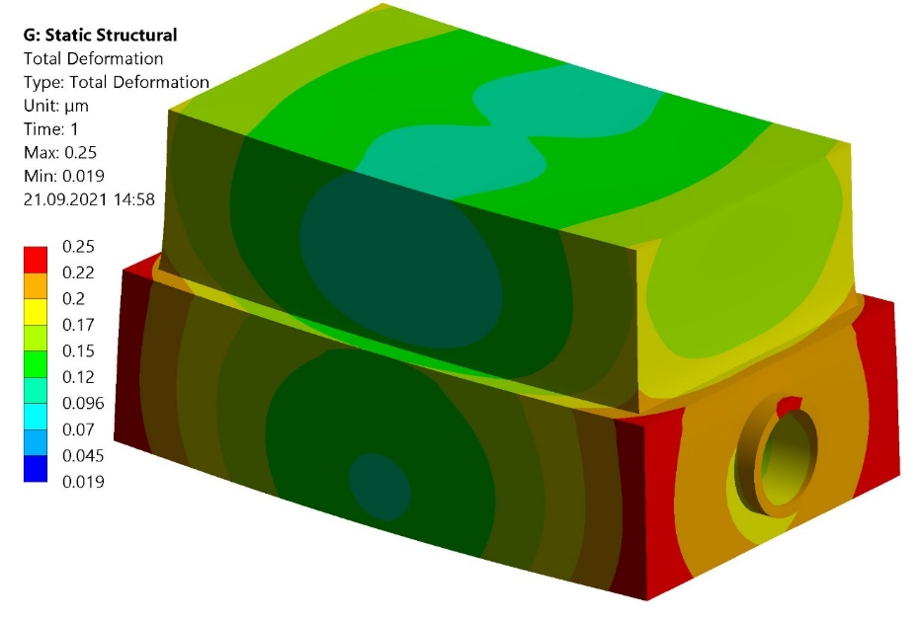
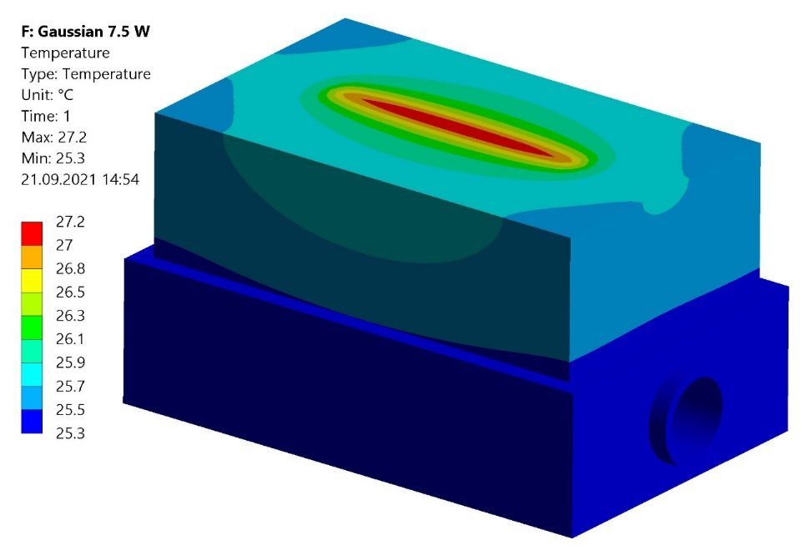
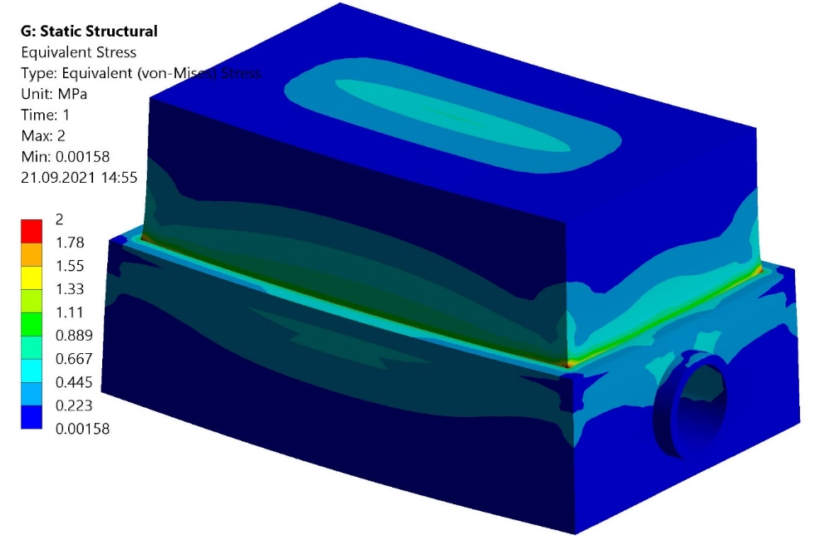
Reduce heatload upstream
Good, fast and cheap: pick any two.
—Anonymous
Heat load 7.5 W

Slide 21
2 zone plate setup
3313 mm
155 mm
932 mm
X-ray source to Condenser FZP distance is 17 m
The 1st FZP de-magnifies the source about 5x.
Use the 2nd FZP to produce a magnified image. The FZP can have a diameter of 150 um and outermost zone width of 100 nm. Its focal length is 133 mm.

Slide 22
Non-optimal TXM Setup
A failed experiment can be more important than a trivial design.
—Verner Panton
Image 21
Flat
Flat subtracted
Min x not reached
Difficult to subtract flat for the out of focus positions
Image 1
Image 50
@ 11.5keV
Source-FZP1: 17027mm
FZP1-det= 3510mm
focus1-FZP2: 119mm
FZP2-Detector: 413.1mm
min. horizontal beam size (rms) = 75.1um
min. vertical beam size (rms) = 20.6um
Need larger Central Stop
>>> Do again with suitable optics

Slide 23
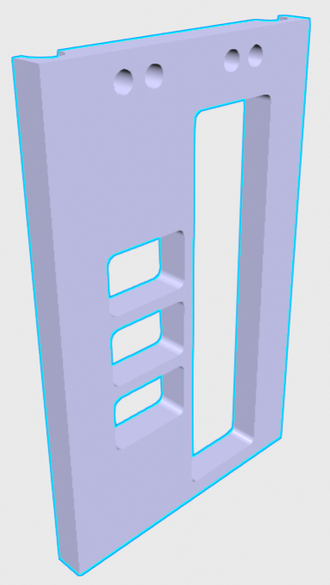
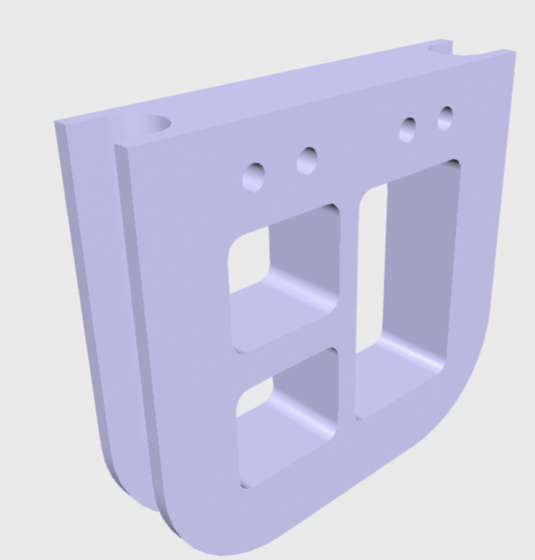
Beamline design
There is more madness to my method than method to my madness.
— Salvador Dali
Pressure
FE-CSWP1
TC
FE-CSTC1
FE-CSVE1
AB1
Kühlwasser Vorlauf
Kühlwasser Rücklauf
Flow
FE-AB1WW
Flow
Flow
Flow
Flow
FE-CSVE2
Pressure
FE-CSWP2
TC
FE-CSTC2
Pressure
FE-APAB1
Mechanical
Vacuum
Water Cooling
Thermal
Pressurized Air
Druckluft

Slide 24
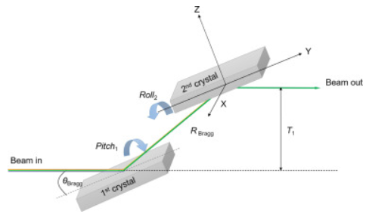
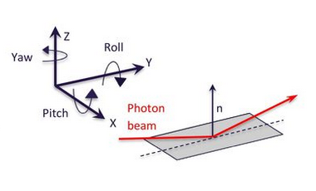
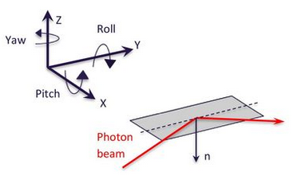
Monochromator
1st Crystal
 | Actuator | Resolution | Reproducibility | Range
X | Remote controlled Move with chamber | 1um | 2um | 45mm
Y | Remote controlled Move with chamber | 5um | 20um | 50mm
Z | Remote controlled Move with chamber | 1um | 1um | ±5mm
Pitch | Remote controlled For wavelength/energy change | 0.1urad | 0.5urad | 8º to 12º
Roll | Not needed | NA | NA
Yaw | Not needed | NA | NA
 | Actuator | Resolution | Reproducibility | Range
X | Move with chamber | 1um | 2um
Y | Move with chamber | 5um | 20um
Z | Move with chamber | 1um | 1um
Pitch | Move with 1st Crystal Fixed distance from 1st Crystal = 8mm | 0.1urad | 0.5urad | 8º to 12 º
Roll | Remote controlled For optimization | 0.1urad | 0.5urad | ±5º
Yaw | Not needed | NA | NA
2nd Crystal

Slide 25
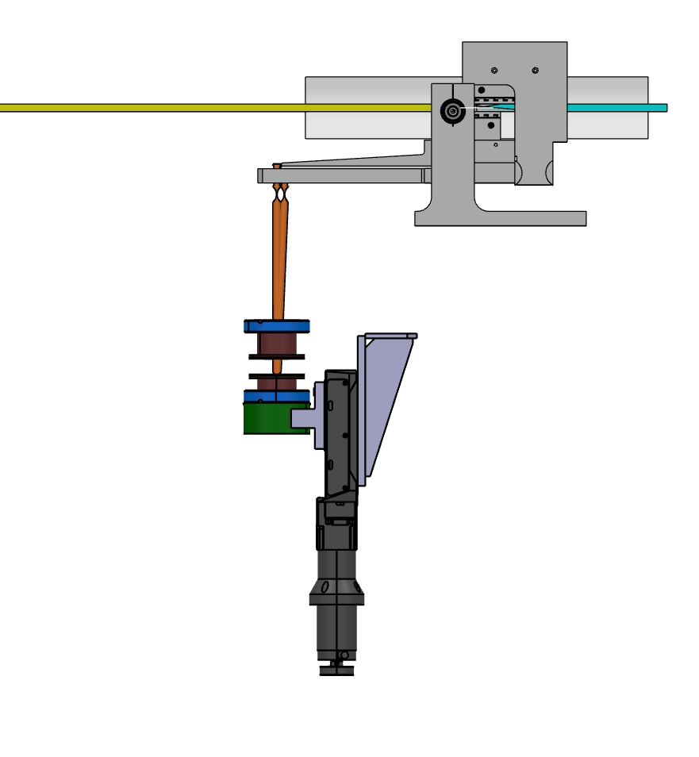
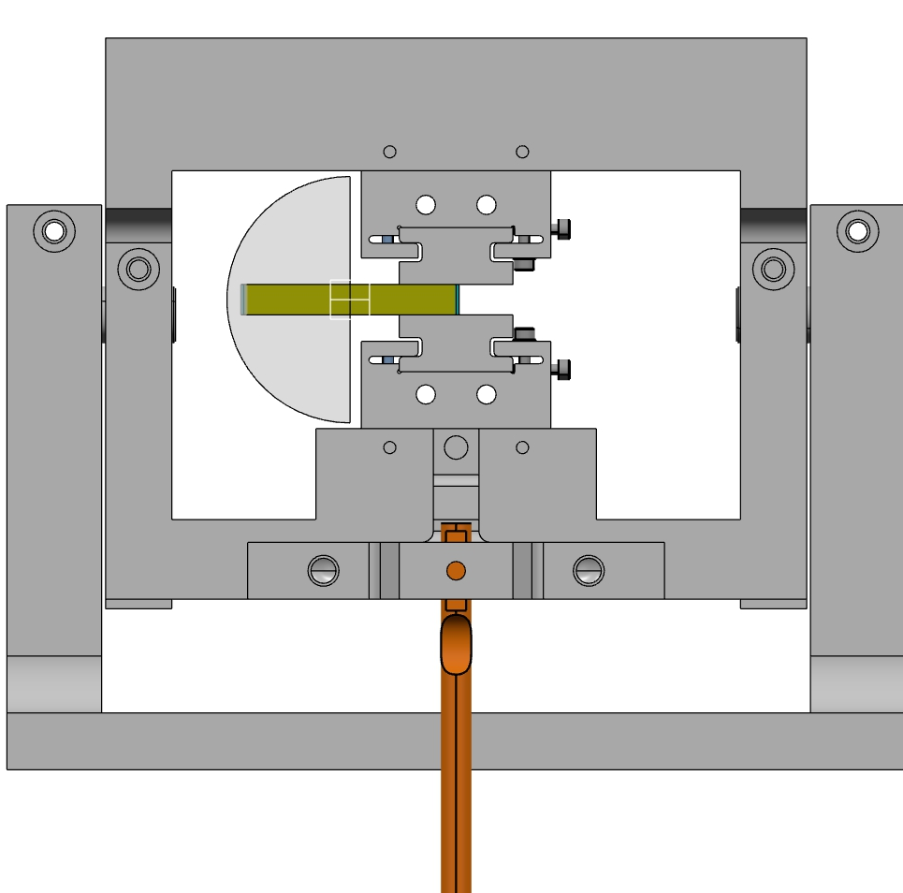
Monochromator
X-ray beam
8mm x 56mm
Mirror center of rotation
Beam height center (Z=0),
5mm behind the front edge
of lower mirror
Visible light
diameter = 56mm
1st crystal: 70x30x15
2nd crystal: 105x30x15
Distance between crystals fix 8mm
Page 25

Slide 26
Summary
You can please some of the people all of the time, you can please all of the people some of the time, but you can't please all of the people all of the time.
—John Lydgates
Visible light for pi-polarization and bunch length measurements using streak camera
X-ray pinhole camera is easy to accommodate but PSF suggests not possible to measure small source size
Fresnel Zone plates for small source size measurements and for observing relative size changes
SLS tests with 2 zone plate design to be tested with suitable 2nd zone plate and central stop
Wire scanner to confirm the beam spot from the first zone plate
Does anyone know how to simulate thermal deformations and their effects in OASYS?

Slide 27
But, that’s just what I think.
What do you think??!?!?
Thank you for your time, feedback and attention.

