Slide 1
Monitoring Beam Emittance and Beam Relative Energy Spread at MAX IV
Åke Andersson, Jonas Breunlin, Robin Svärd
Elettra 2.0 Workshop on Optical Diagnostics for Low-Emittance Storage Rings, March 23-24, 2022

Slide 2
Outline
Mission and basic concepts
Diagnostic BLs description
Results
Limitations, Improvements
Summary

Slide 3
Mission and basic concepts:
Continuously extract and monitor three fundamental beam properties, Vertical emittance, Horizontal emittance and Relative energy spread, from two beam size measurements at different locations.
Don’t use any straight sections, since they are too valuable! ==> Bending magnet SR
Utilize the inherent properties of the synchrotron radiation (SR) emission and focussing. Preserve the SR coherence properties through the diagnostic beam lines. Evaluate the beam size through the incoherent contribution.
Stay close to the visible range SR, since there exists off-the-shelf, high quality, optical components and detectors. Not too expensive!
Bonus: “Stray” light used for time structure and bunch lengths monitoring

Slide 4
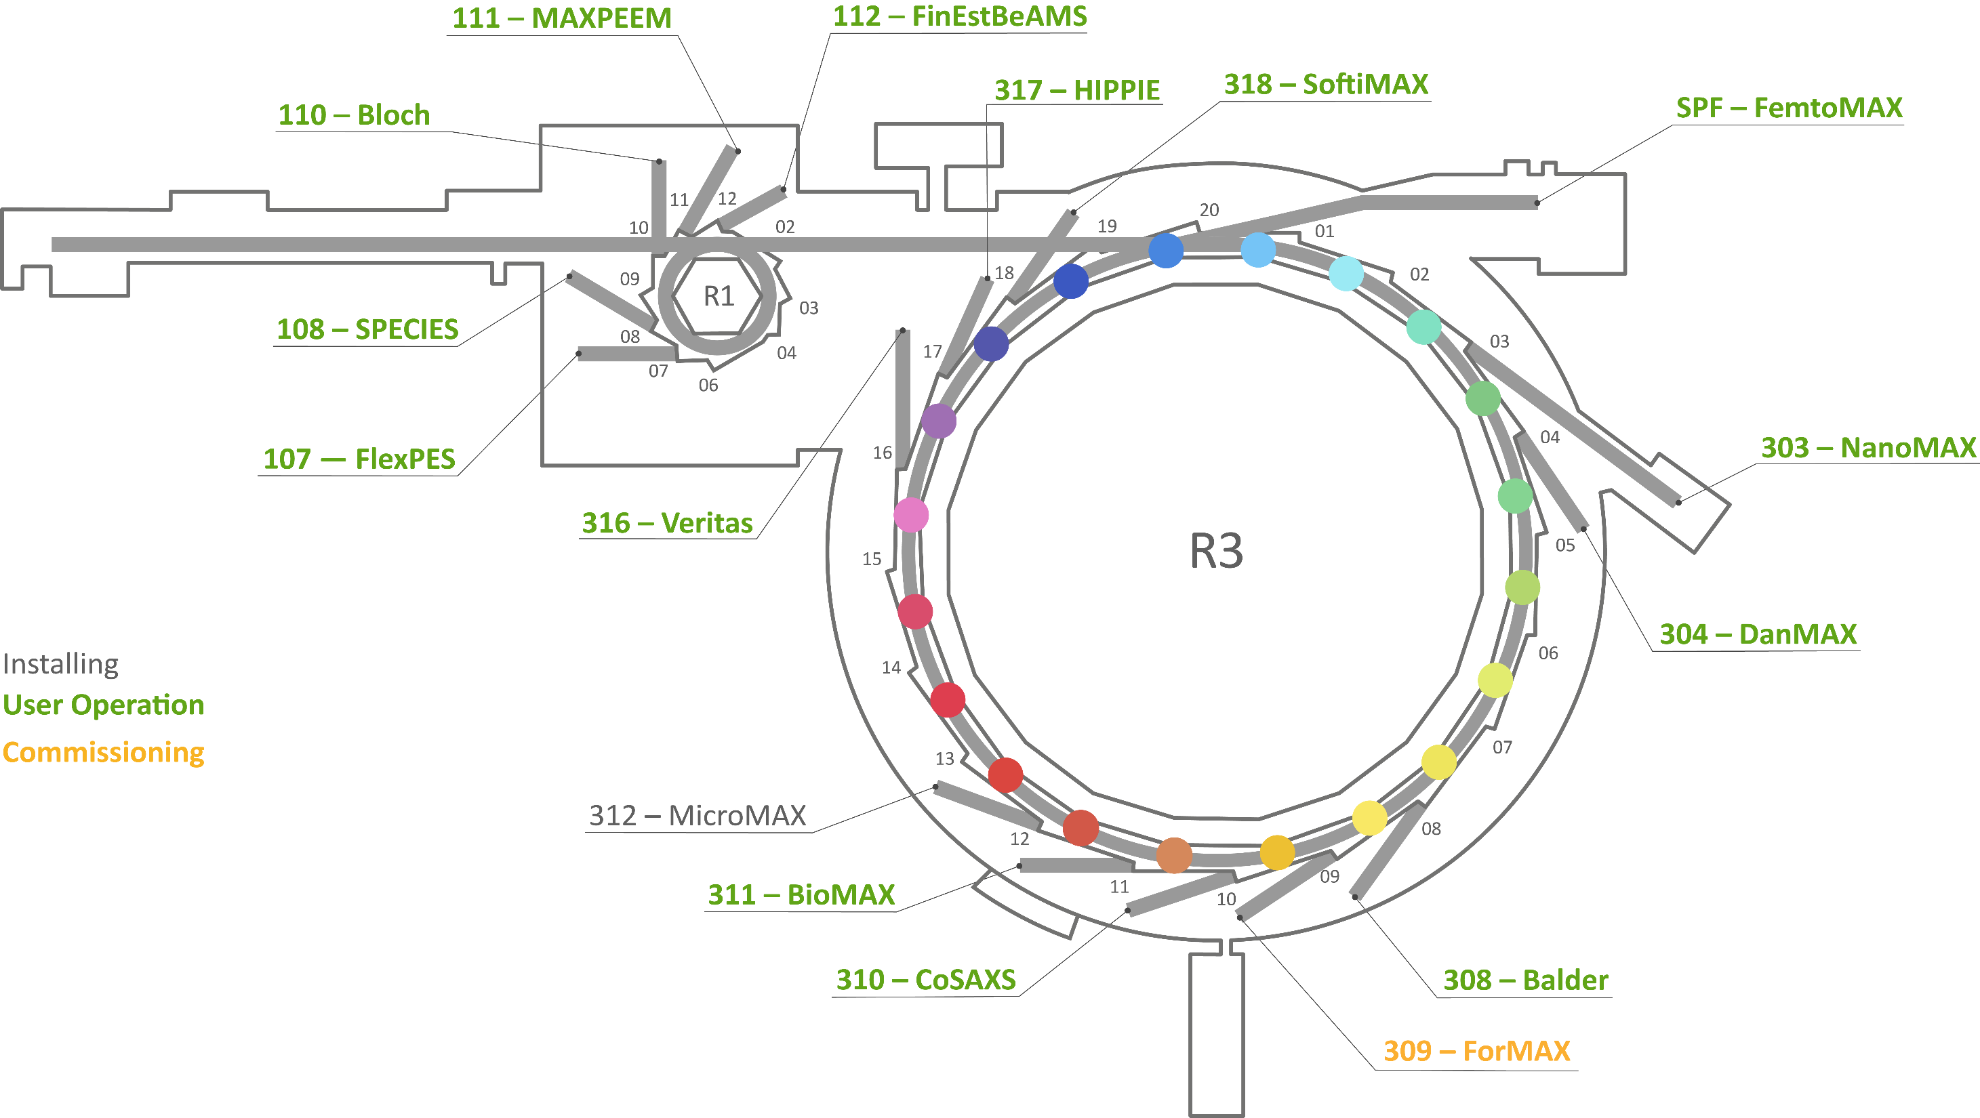
Facility Map
E = 1.5 GeV
E = 3 GeV
C =528 m
All IDs open:
ε_{x} = 330 pmrad (0 mA)
σ_{δ} = 0.77E-3 (0 mA)

Slide 5

Facility Map
Bend magn diagBLs:
B320B
B302B
E = 1.5 GeV
E = 3 GeV
C =528 m
All IDs open:
ε_{x} = 330 pmrad (0 mA)
σ_{δ} = 0.77E-3 (0 mA)
Two beam lines, because we search two unknowns, Horizontal emittance $ε_{x}$ and Relative energy spread $σ_{δ}$, from two measured horizontal beam sizes $σ_{x1,2}$.
$$σ_{x1,2}=\sqrt{ε_{x}∙β_{x1,2}+{\left(η_{x1,2}∙σ_{δ}\right)}^{2}}$$
Vertical emittance simply from:
$$σ_{y1}=\sqrt{ε_{y}∙β_{y1}}$$

Slide 6
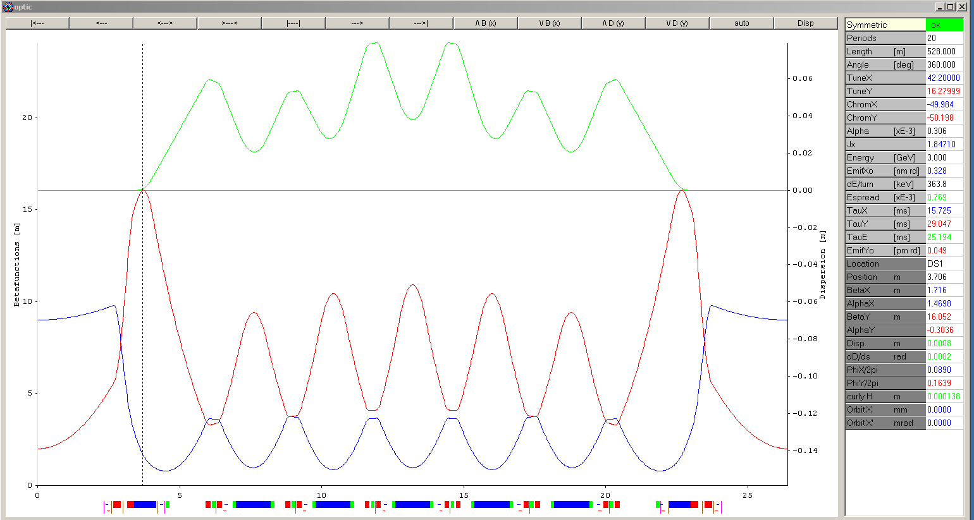
Locations in the lattice
B320B
B302B
η_{x} = 23 mm
η_{x} = 1.9 mm
β_{y} = 16.0 m
β_{y} = 8.6 m
β_{x} = 1.45 m
β_{x} = 1.2 m

Slide 7
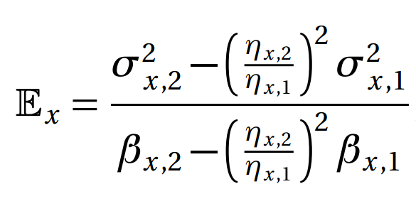
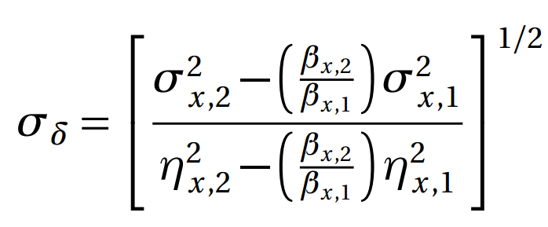
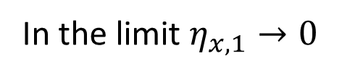
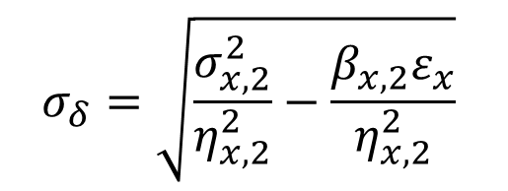
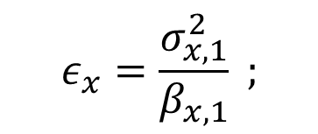
Derivation of the quantities:
ε
$$σ_{δ}=\sqrt{\frac{σ_{x,2}^{2}}{η_{x,2}^{2}}−\frac{{β_{x,2}ε}_{x}}{η_{x,2}^{2}}}$$
$$ε_{x}=\frac{σ_{x,1}^{2}}{β_{x,1}} ;$$
In the limit $η_{x,1}→0$
However, we derive according to the exact formulae
Also, we measure both dispersion and sigma, at each beam line
Only the two beta-functions are provided by LOCO

Slide 8
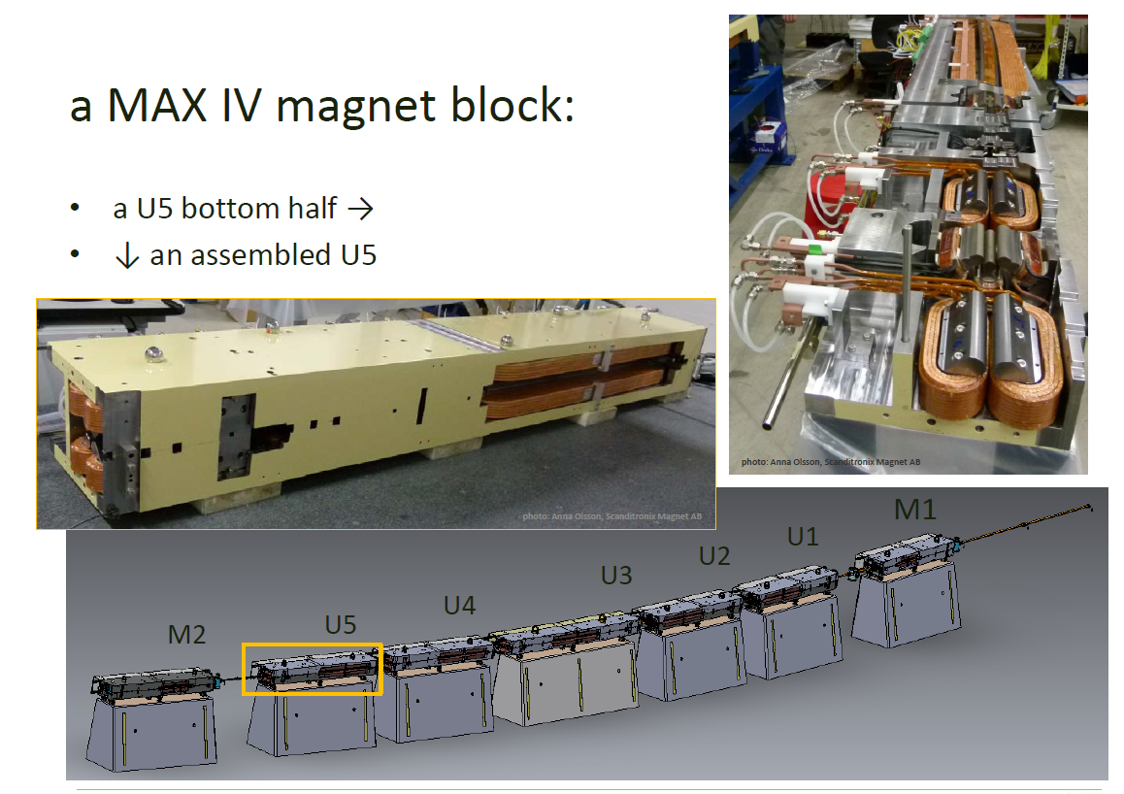
MAX IV 3 GeV ring DC magnets
• Each cell is realized as one mechanical unit containing all magnet elements.
•Each unit consists of a bottom and a top yoke half, machined out of one solid iron block, 2.3-3.4 m long.
Slide by Martin Johansson

Slide 9
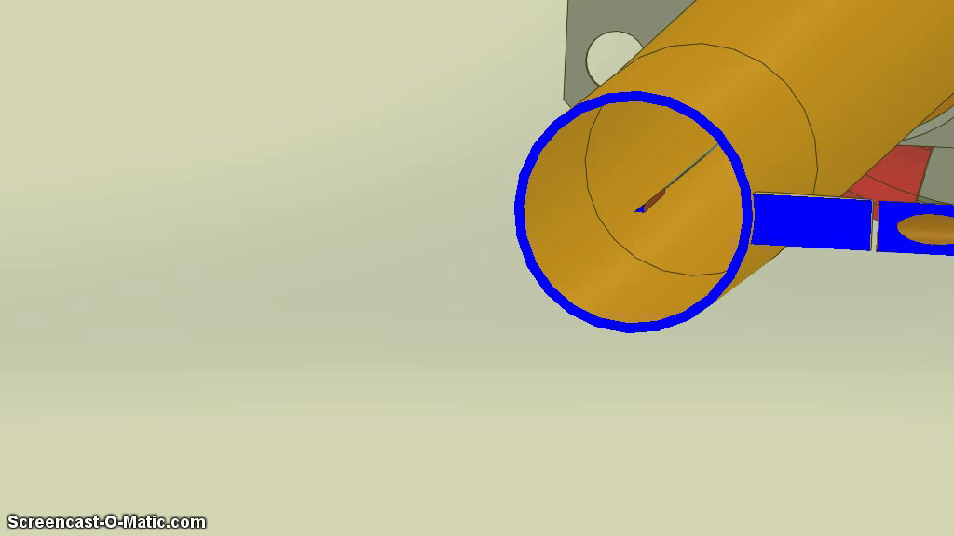

Extracting +/- 3.5 mrad_{V} and 12 mrad_{H}
Courtesy Karl Åhnberg, Research engineer & CAD designer

Slide 10
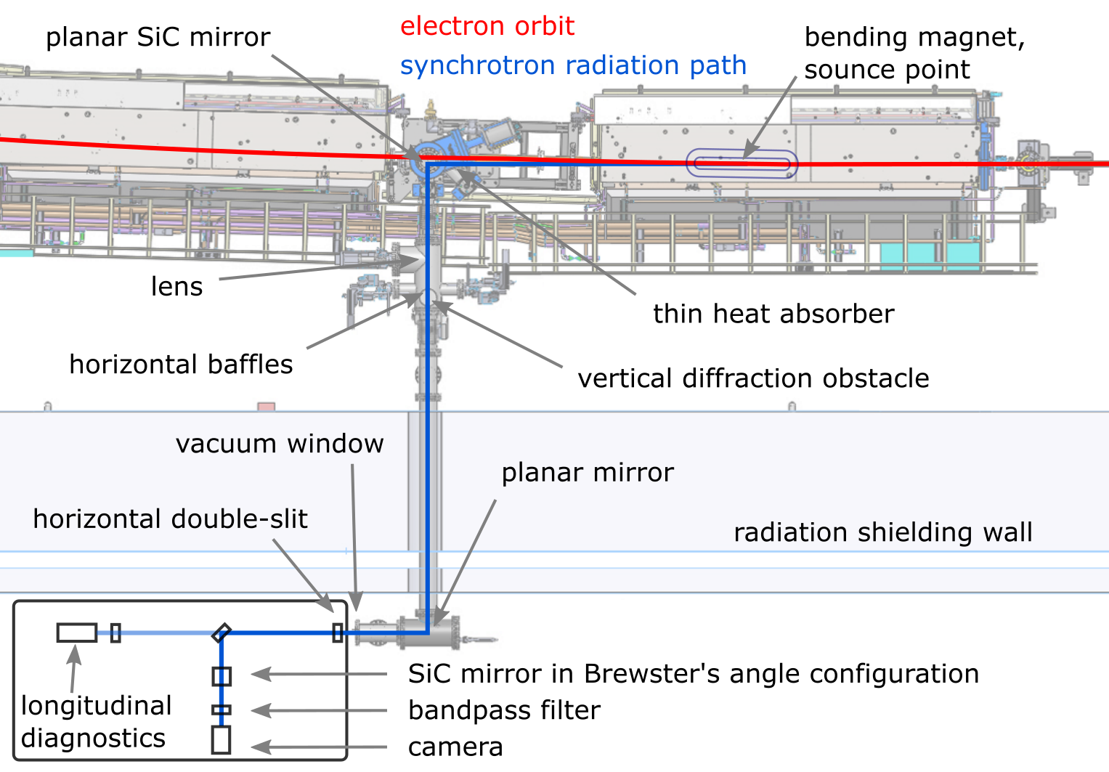
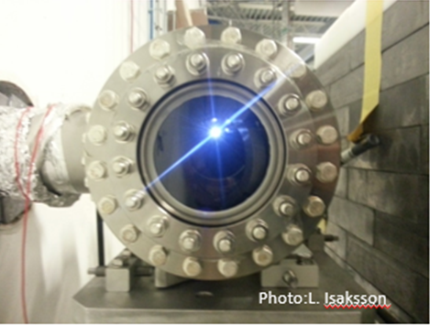
Detailed top view of B320B

Slide 11
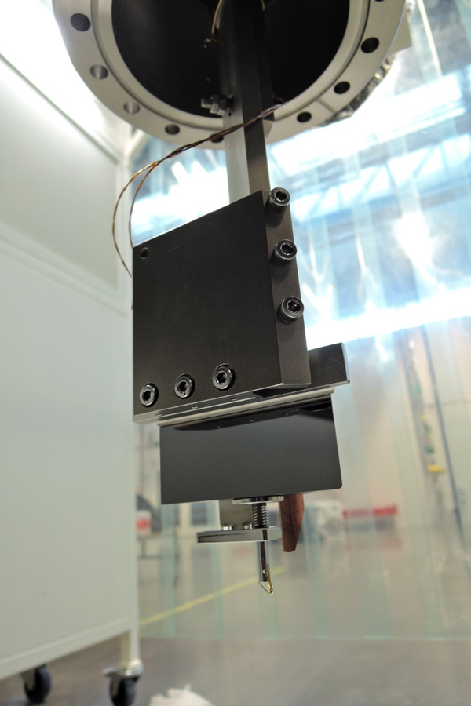
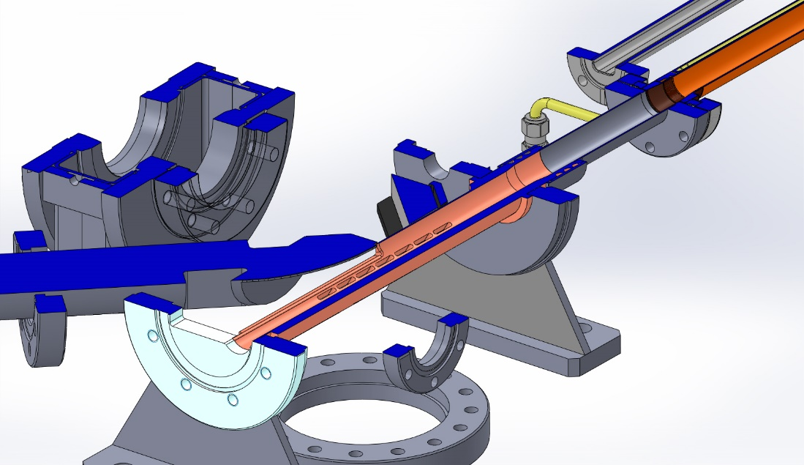
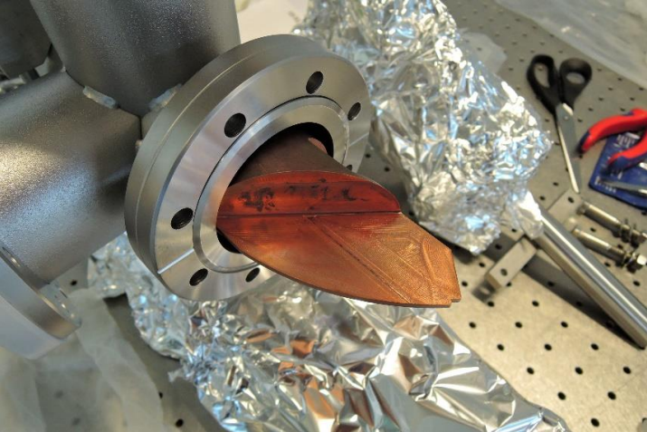
B320B ”Cold Finger” Absorber & Mirror
Planar SiC-Mirror
Top view
SR fan
E-beam
Cold Finger Absorber

Slide 12
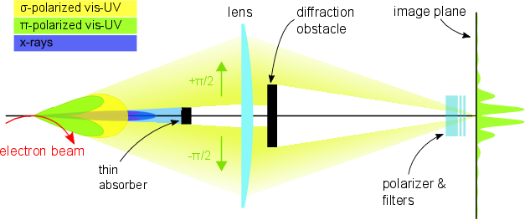
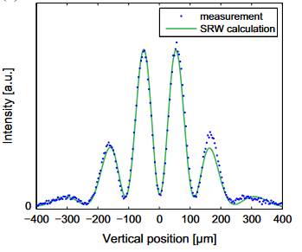
Resolving a vertical beam size < 5 μm
Diffractometer Method:
The diffractometer method was implemented at the SLS (TIARA collaboration): σ_{y} = 4.7 ± 0.1 μm
J. Breunlin et al, "Methods for measuring sub-pm rad vertical emittance at the Swiss Light Source", Nucl. Instrum. Meth. A 803, 55-64 (2015).

Slide 13
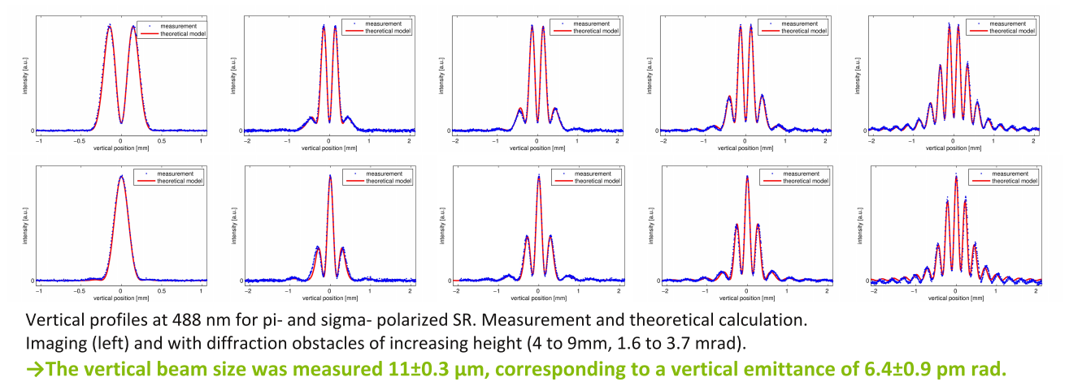
The same method at MAX IV, during first commissioning year.
J. Breunlin et al, “Emittance diagnostics at the MAX IV 3 GeV storage ring", IPAC 2016.

Slide 14
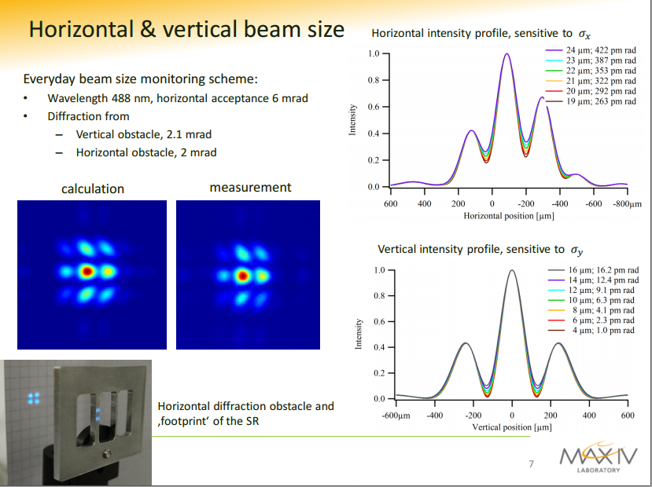
Courtesy J. Breunlin

Slide 15
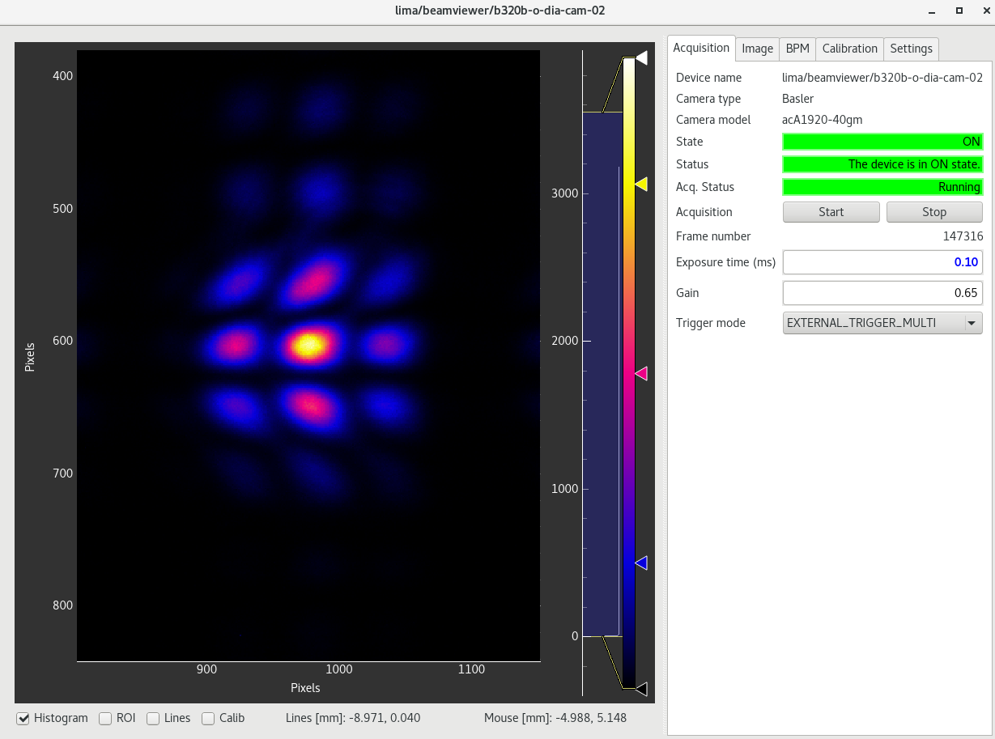
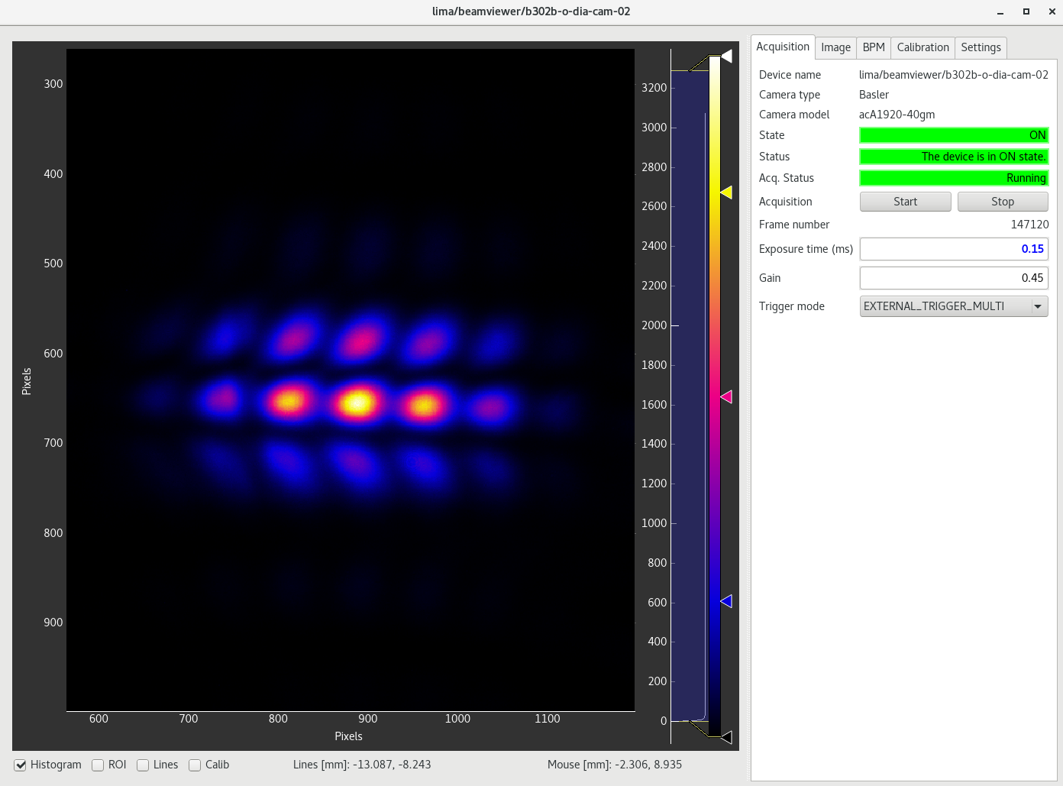
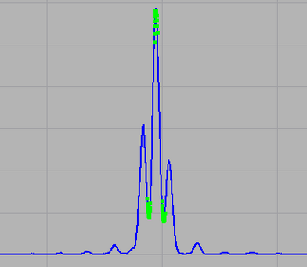
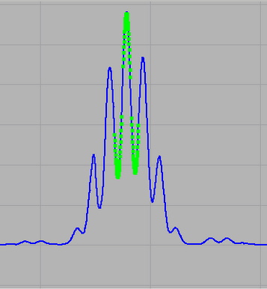
Beam Line B320B
Beam Line B302B
Over the 6 years of operation, the horizontal profiles keep stable, according to theory.

Slide 16
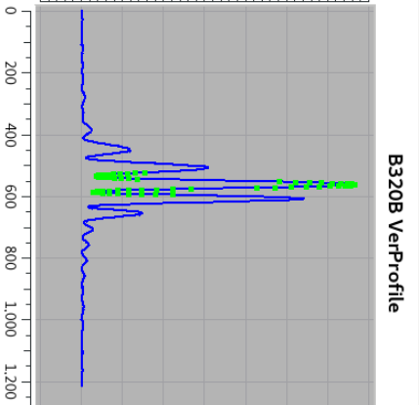
Beam Line B320B
However, the vertical profile deteriorated over time. Modelling attempts tell that the resulting Valley/Peak ratio is fairly well reflecting the true vertical beam size, anyway.

Slide 17
Outline
Mission and basic concepts
Diagnostic BLs description
Results
Limitations, Improvements
Summary

Slide 18
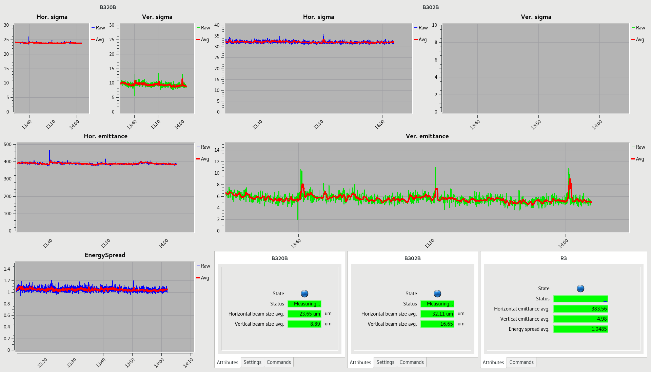
Control Room GUI: Results 300 mA, All ID gaps are closed
Units are:
Sigmas [μm]
Emittances [pmrad]
EnergySpread [1E-3]

Slide 19
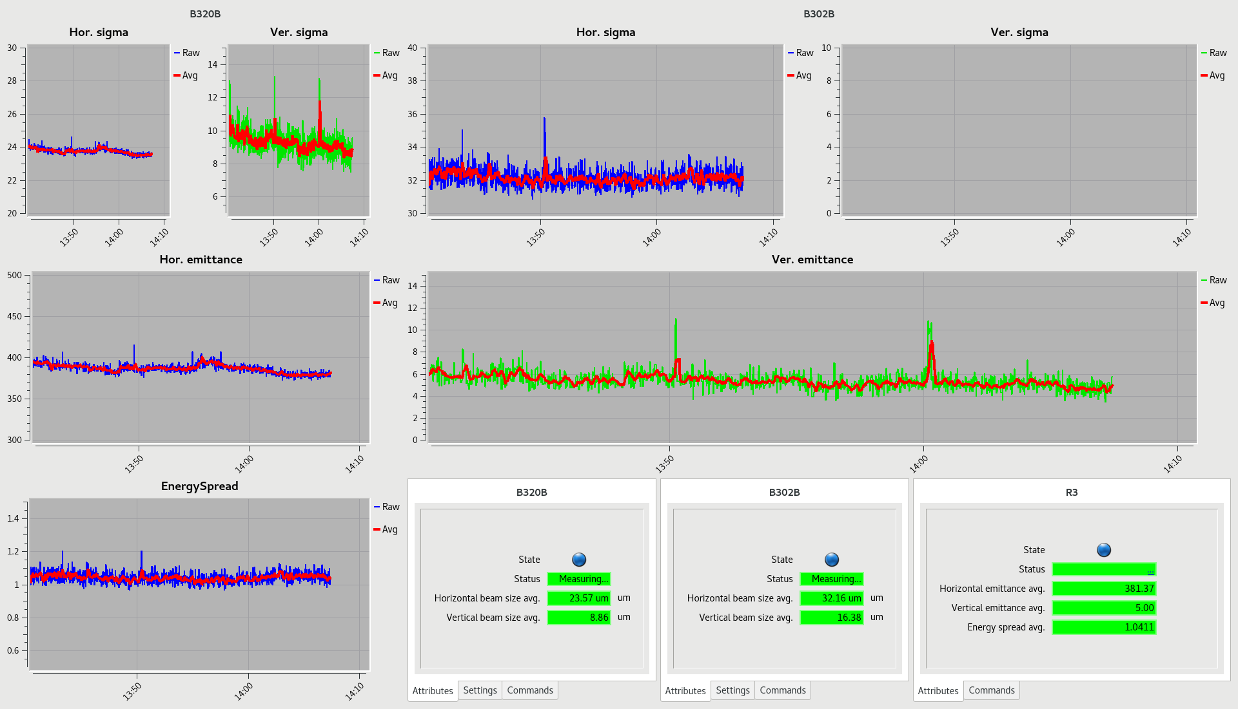
Control Room GUI (vertical scales changed): Results 300 mA; All ID gaps are closed
Units are:
Sigmas [μm]
Emittances [pmrad]
EnergySpread [1E-3]

Slide 20
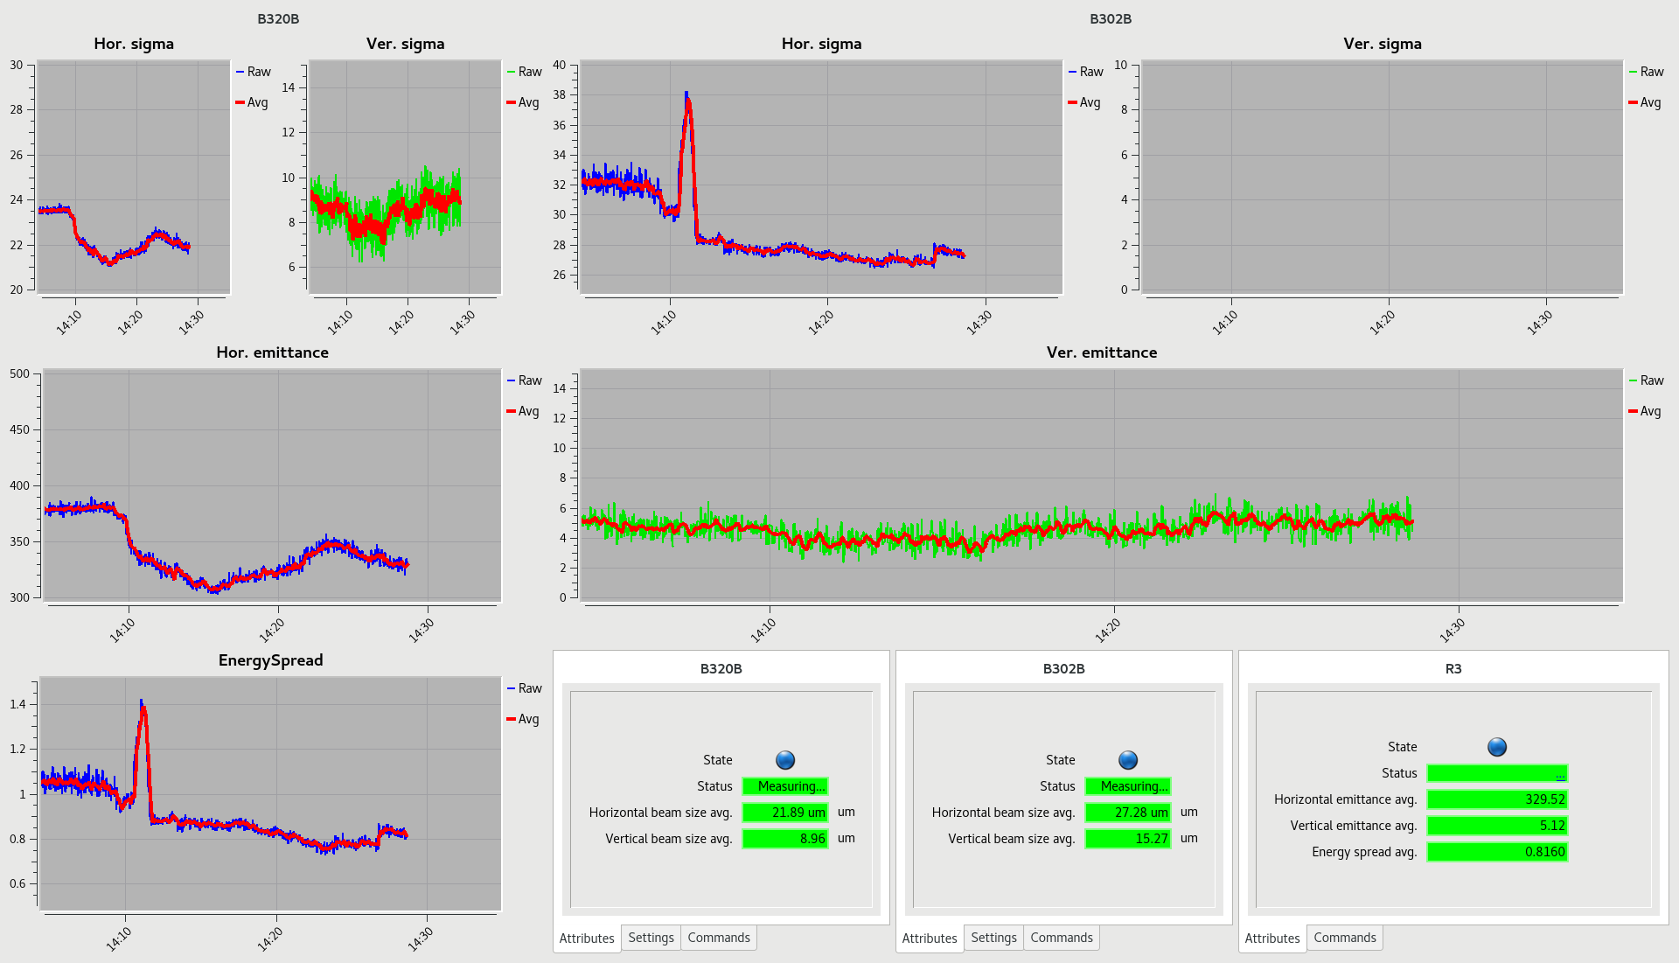
Control Room GUI: “Stress test” 300 mA down to 3 mA; All ID gaps are closed
Black rectangle indicate the transition from 300 mA to 3 mA. The succeeding variations indicate uncertainties in results:
Δε_{x} : +/-6% relative (max) error
Δε_{y} : +/-30% relative (max) error
Δσ_{δ} : +/-9% relative (max) error
pmrad
pmrad
1E-3

Slide 21
Outline
Mission and basic concepts
Diagnostic BLs description
Results
Limitations, Improvements
Summary

Slide 22
Limitations (as partly seen in the above data):
Temperature changes in the BLs will alter the optical beam path slightly. Thus, the optical properties of different items must be uniform over a certain area.
We have identified need for the following items to be improved: The Glan-Taylor Polarizer, The Bandpass Filter, The Lens (after several years of exposure to SR), The Vacuum Exit Window (after some year of SR exposure)

Slide 23
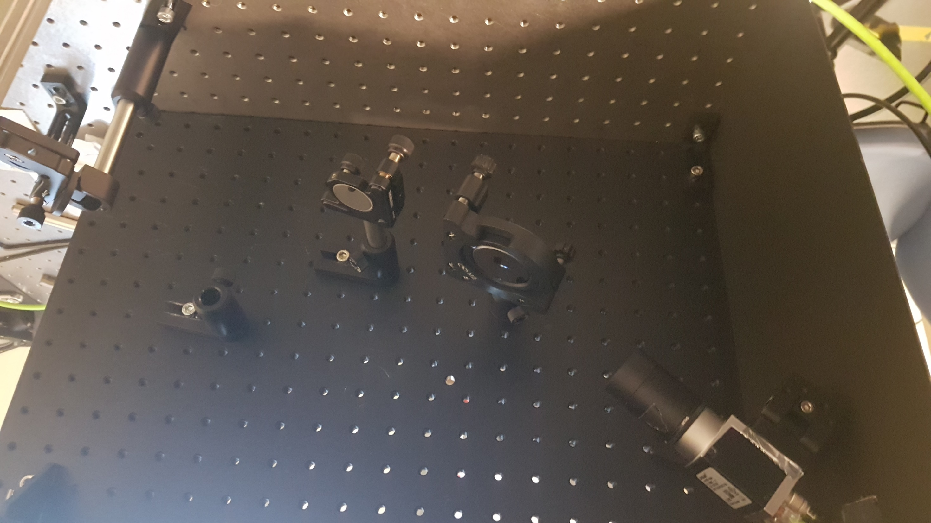
Limitations ➔ Improvements:
The Vacuum Exit Window: We regularly change the relatively small light transit area, by moving the whole beam line end part.
The Polarizer:
We introduced in one BL a Brewster’s angle polarisation with a flat SiC mirror. Thus, only one polished surface instead of four in the G-T polarizer!
θ_{B}
Diam= 90 mm

Slide 24
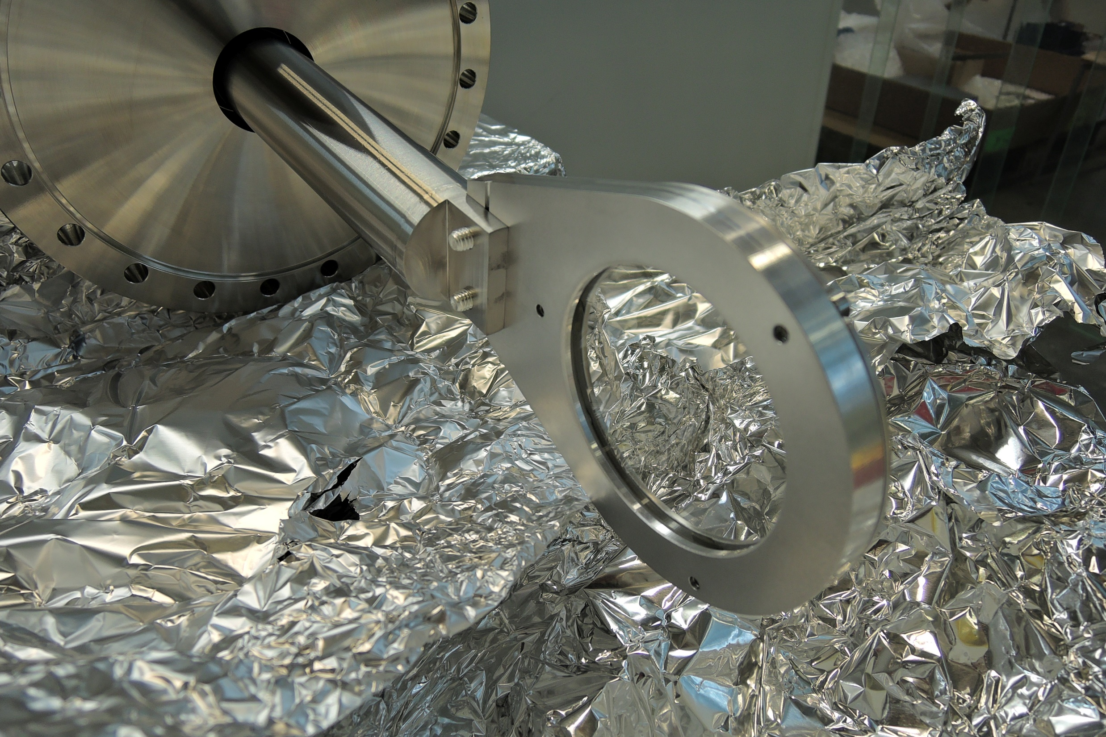
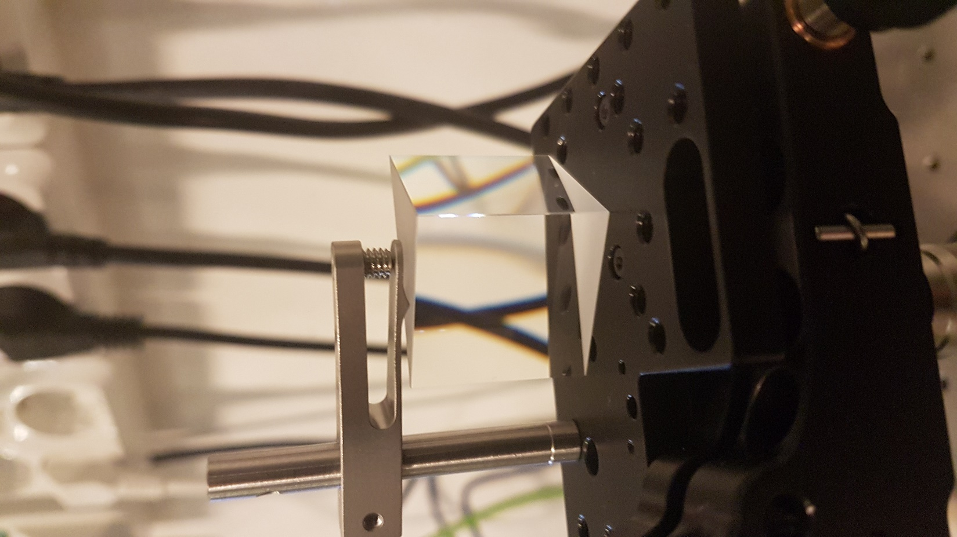
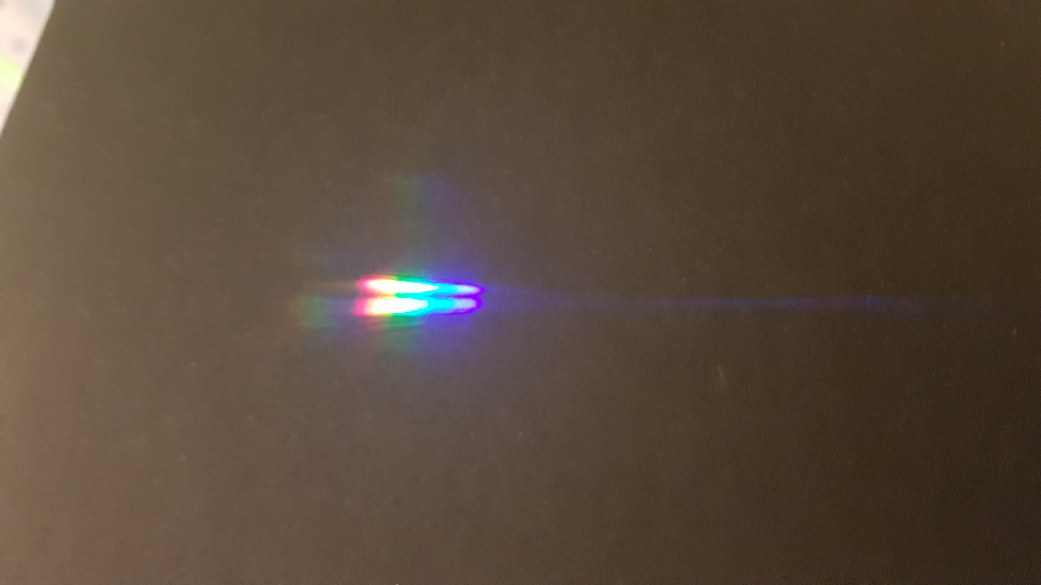
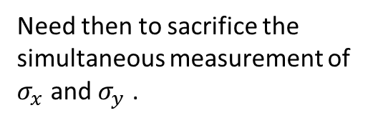
Limitations ➔ Improvements:
The Bandpass filter: “Back to basics”: We are investigating a simple prism dispersion of the wavelengths:
The Lens:
We will change the lens this summer shutdown (after 6 years of operation)
Need then to sacrifice the simultaneous measurement of $σ_{x}$ and $σ_{y}$ .

Slide 25
Summary
Uncertainties in results:
Δε_{x} : +/-6% relative (max) error
Δε_{y} : +/-30% relative (max) error (@4.5 pmrad)
Δσ_{δ} : +/-9% relative (max) error
However, far more minute changes of the beam properties are detected, if they are relatively fast.
Work in progress to lower all the errors (fewer and better optical surfaces), and to improve the vertical emittance measurement (using prism and shorter wavelengths).

Slide 26
Extra slides:

Slide 27
Some improvements over the last years:
New camera types; software developed by Robin Svärd
Pre-programmed exposure times; Jonas Breunlin
Precise measurement of the BL magnification, by exact movement of the lens (Å. Andersson)
Feed-back beam steering by last in-vacuum mirror (J. Breunlin)
Optical table re-arrangement; simultaneous longitudinal diagnostics (J. Breunlin)
Optical filter improvements (J. Breunlin, Å. Andersson)
Polarization improvement, using SiC mirror in Brewster angle (J. Breunlin, Å. Andersson)
On-line emittance and energy spread calculation (R. Svärd)
Remote control of last up-right obstacle at B320B (R.Svärd)
Etc.
One exchange of vacuum window at B320B (Esa Paju, Marek Grabski, Michael Gilch)

Slide 28
For reference:
 | Beam size monitor 1 | Beam size monitor 2
β_{x} [m] ; η_{x} [mm] | 1.45 ; 1.9 | 1.19 ; 23.0
β_{y} [m] ; η_{y} [mm] | 15.98 ; <0.2 | 8.63 ; <0.2
Dipole B-field [T] | 0.53 | 0.53
Tot. Accept. Ang. (delivery settings) H ; V [mrad] | 6 ; 7 | 4 ; 7
First (fixed) mirror ; Wave front Distorsion | SiC ; λ/20 (P/V) | SiC ; λ/20 (P/V)
Plano-Convex Lens ; Diam ; WfrontD | Fused Silica ; 75 mm ; λ/15 (P/V) | Fused Silica ; 100 mm ; λ/15 (P/V)
Dist. Source to Lens [m] | 2.61 | 3.67
Magnification | -2.15 | -2.91
# Additional Mirrors ; WfrontD | 2 ; λ/20 (P/V) | 4 ; λ/20 (P/V)
Vacuum window ; WfD | Fused Silica ; λ/10 (P/V) | ?
Polarizer ; WfrontD | SiC in Brewster’s angle ; λ/20 (P/V) | Calcite Glan-Taylor Prism ; λ/8 (P/V)
Polarization | horizontal | horizontal
Bandpass filter | 488 nm ; 3 nm FWHM | 488 nm ; 3 nm FWHM
Camera | Basler ; pix.size 5.86 μm | Basler ; pix.size 5.86 μm

