Slide 1

Emittance Diagnostics at PETRA IV
Elettra 2.0 Workshop on Optical Diagnostics for Low-Emittance Storage Rings
Marco Marongiu
Hamburg, 2022.03.24

Slide 2
Outline
01 PETRA IV Project
Main Characteristics
02 Emittance Diagnostics
Requirements
Beam Parameters
Radiation Sources
03 Measurement Techniques
Pinhole Camera (XPC)
Fresnel Diffractometry (XFD)
04 Conclusion and Future Developments

Slide 3
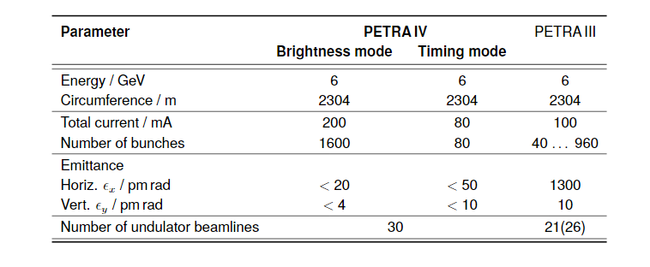
PETRA IV Project
The PETRA IV project will be the successor of PETRA III, the 6 GeV synchrotron radiation facility in Hamburg.
It will be a Diffraction Limited Light Source with an emittance of 20/4 pm rad, instead of the 1300/10 pm rad currently obtained in PETRA III.
The new machine will operate at the same beam energy (6 GeV) of PETRA III with an intensity of 200 mA (twice the value of PETRA III).
The machine will be installed in the same tunnel of the current operating one, but a new experimental hall will be build increasing the number of available beamlines.

Slide 4
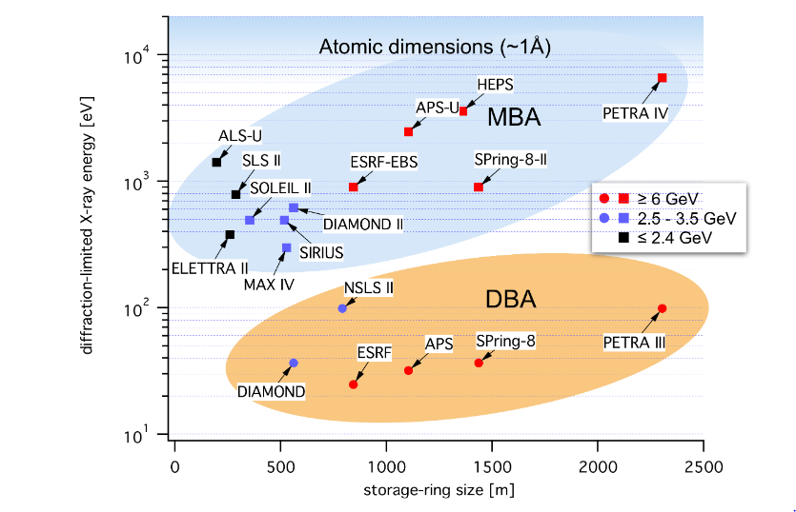
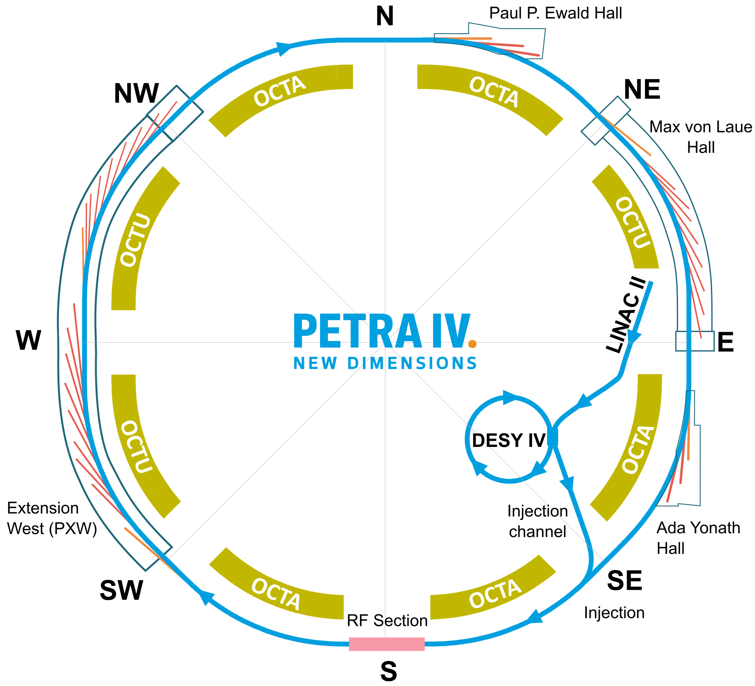
PETRA IV Project

Slide 5
Emittance Diagnostics Requirements
Two X-Ray beamlines for measuring emittance and energy spread:
  Low Dispersion contribution
  High Dispersion contribution
Emittance Resolution of 0.5 pm → Beam size resolution of 100 nm
High Dynamic Range:
  A measurement for beam size in the range1-18 µm (i.e. Fresnel Diffractometry: XFD)
  A measurement for beam size above 15 µm (i.e. Pinhole Camera: XPC)
Screen outside the accelerator tunnel → Beamline length around 45-50 m

Slide 6
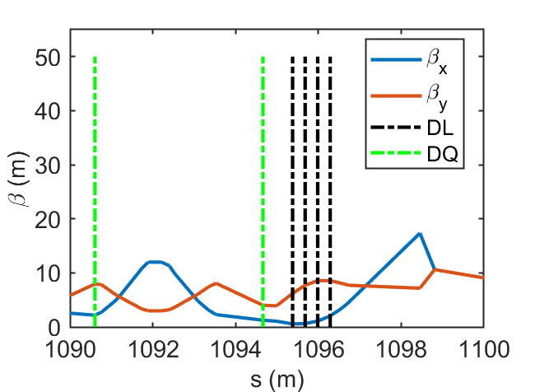
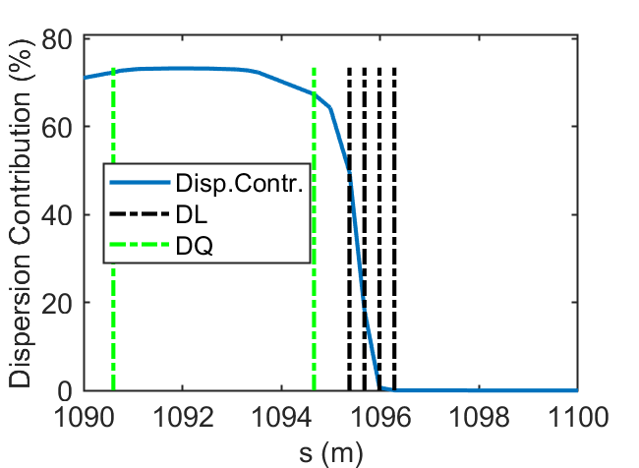
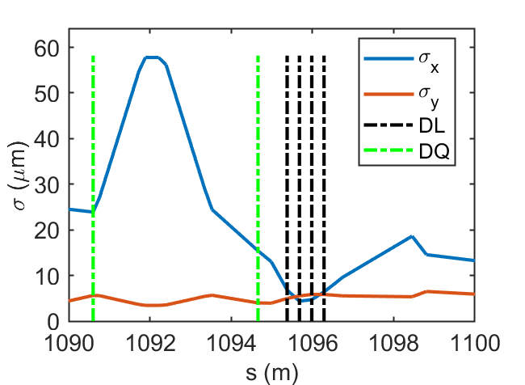
Beam Parameters
Emit_x=20pm; Emit_y=4pm;
E_spread=1e-3
ID | L [m] | B [T]
DL | 0.303 | 0.28
DQ | 1.84 | 0.19
ID | S [m] | BETX [m] | BETY [m] | DX [m] | spot_x [µm] | spot_y [µm] | Dispersion Contribution [%]
DL | 1096.287 | 2.07 | 8.57 | -0.0001 | 6.4 | 5.8 | 0.01
DQ | 1090.6 | 2.19 | 7.96 | 0.02 | 23.9 | 5.6 | 72.3
Difficulties of extraction of the photon beam from DQ
  Canting solution under study:
    3 Pole Wiggler as a radiation source

Slide 7
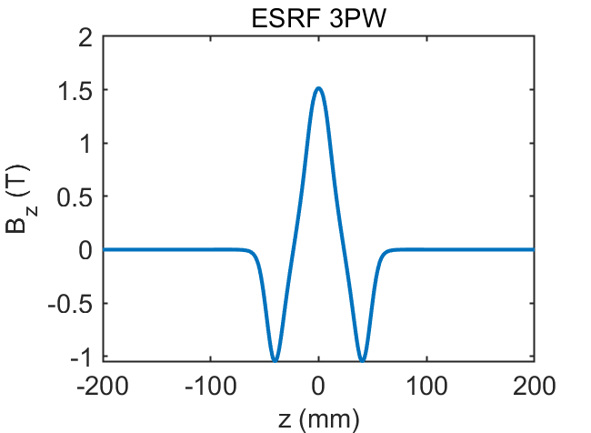
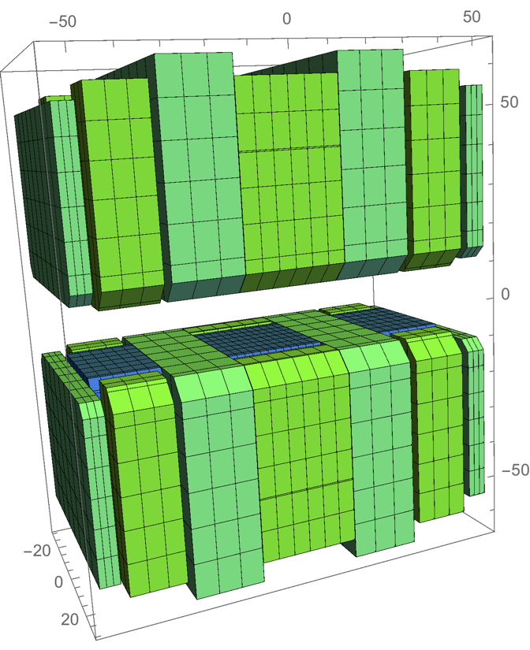
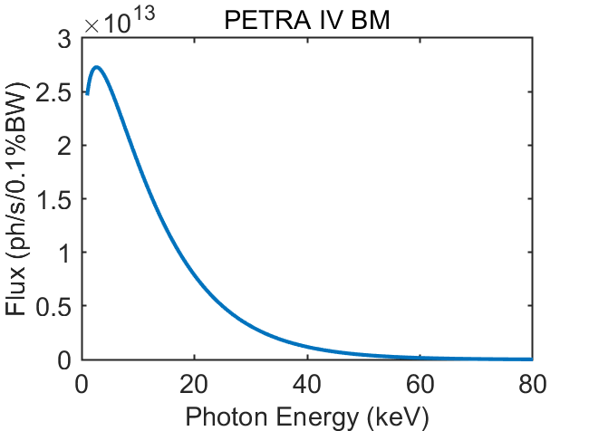
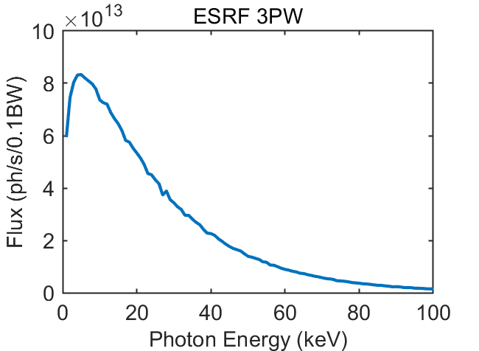
3 Pole Wiggler
Compared to BM:
Higher intensities
Same resolution
Magnetic gap 22mm
Peak field: 0.86 T
PM material: Sm2C017
Magnetic length: 108mm
Taken from J. Chavanne, DLSR2016
Courtesy of G. Le Bec (ESRF)

Slide 8
X-Ray Beamlines Sketch
Overall length of ~50 m → Screen outside the accelerator tunnel
Pinhole (XPC) for the high dynamic range (beam above 15 µm)
Diffractometry (XFD) for small beam (1-18 µm)
  Monochromator (i.e. Si₍₃₁₁₎) is required for the XFD measurement
X-Ray Source
XPC
(d~1.5 mm; A~20 µm)
XFD
(d~1.5 mm; A~80 µm)
Monochromator
(~16 keV)
Scintillator
Screen
~10 m
~20 m
~20 m

Slide 9
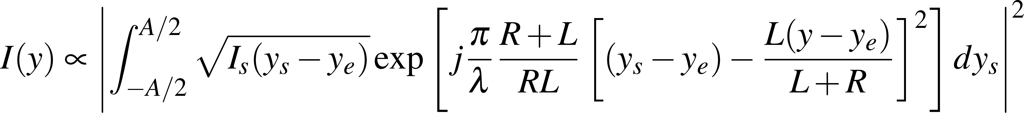
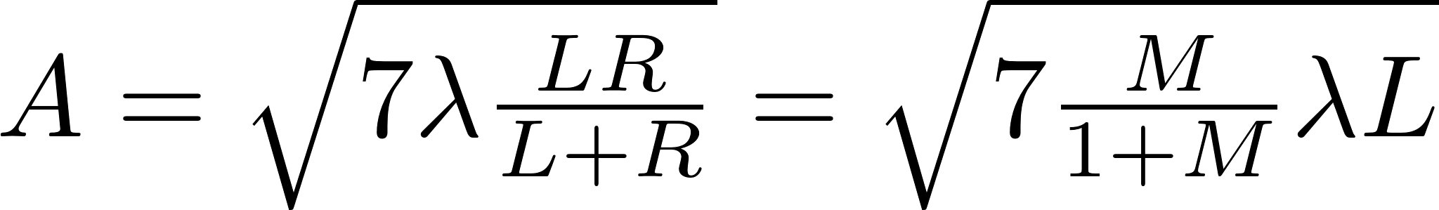
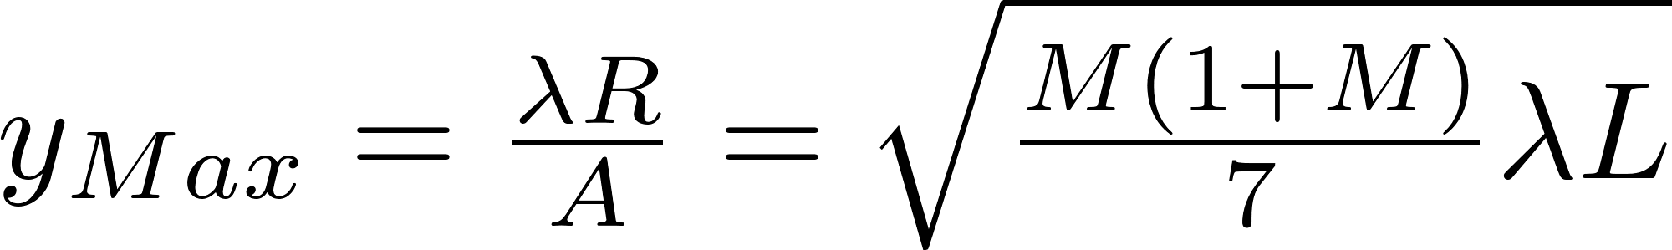


XFD Theory
If A is optimized after each variation of wavelength, L or R:
Ratio is constant (~0.38).

Slide 10
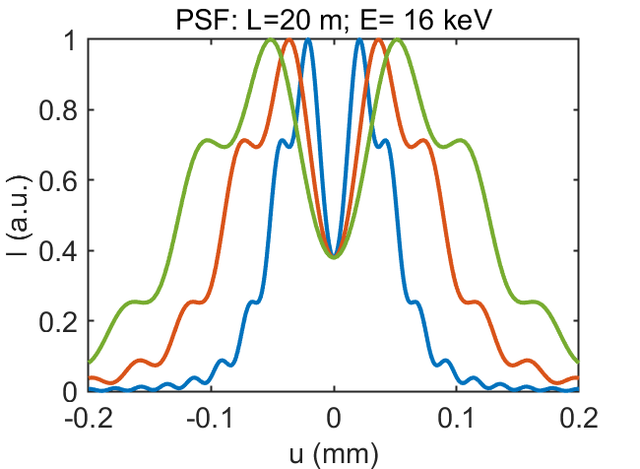
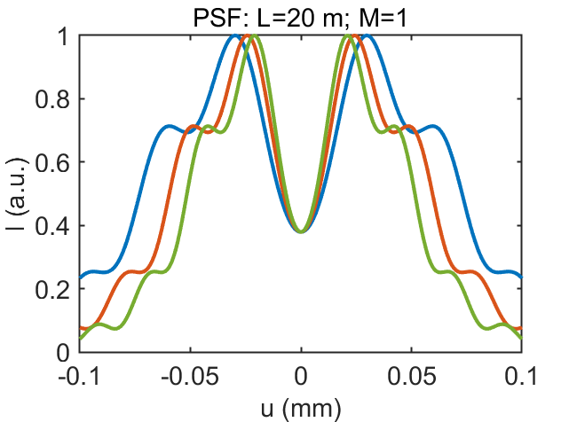
XFD PSF
M=1
E=8 keV
M=2
E=12 keV
M=3
E=16 keV
Reoptimize the aperture for each value change.

Slide 11
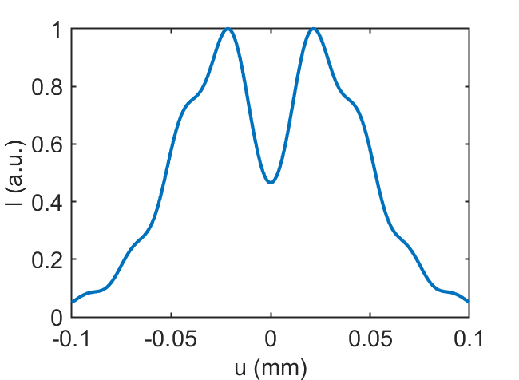
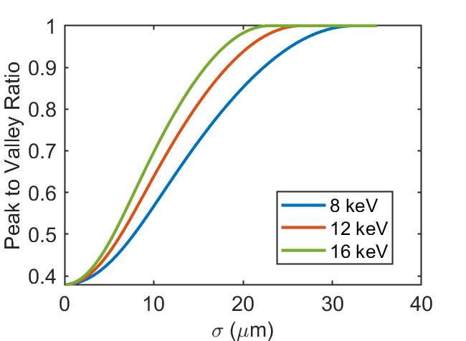
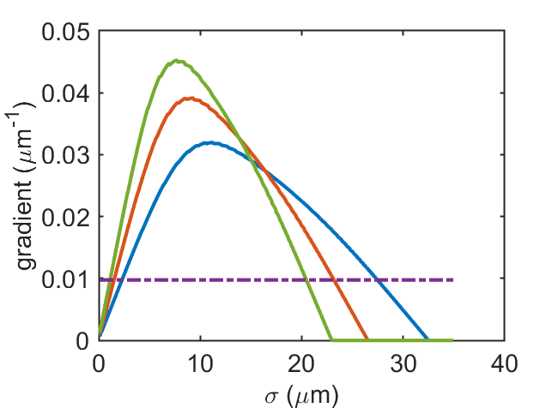
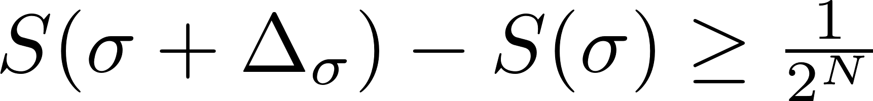
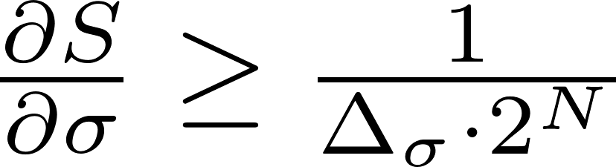
XFD Resolution vs photon energy
σ=8 µm
Peak to Valley Ratio = S; #bit = N
10 bit
Different Pinhole Position
M = 1
Reoptimize the aperture for each E value.

Slide 12
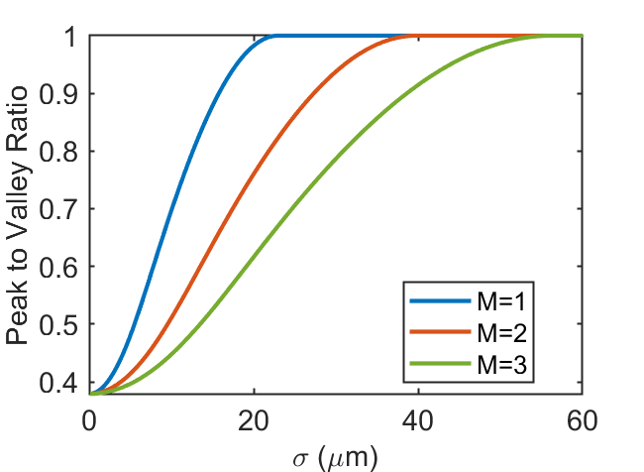
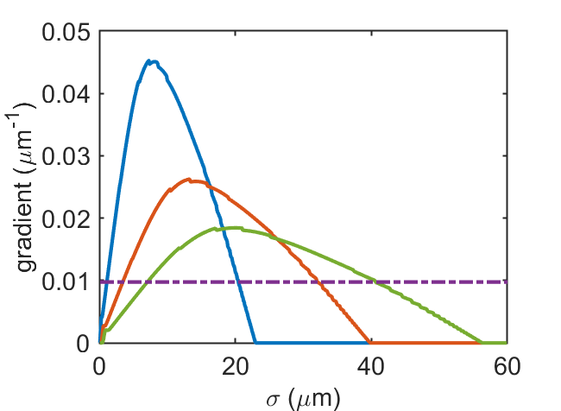
XFD Resolution vs magnification
σ=8 µm
Peak to Valley Ratio = S; #bit = N
10 bit
Different Pinhole Position
E = 16 keV
Reoptimize the aperture for each M value.

Slide 13
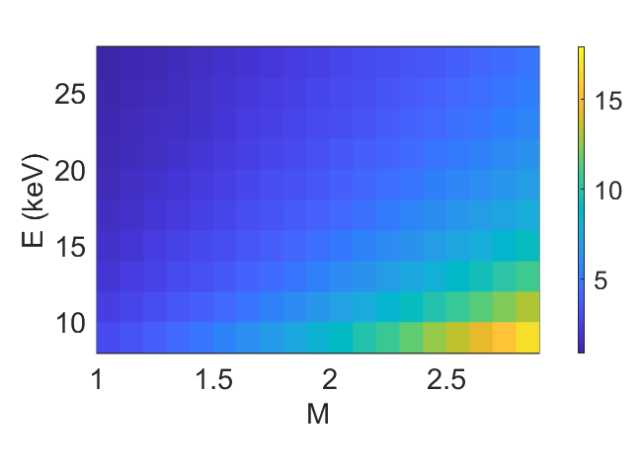
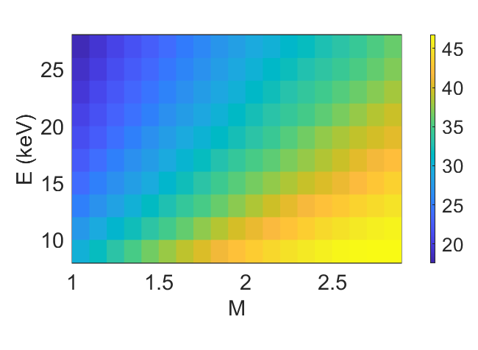
XFD Resolution (10 bit CCD) L=25m
Different Photon Energy
Different Magnification
Reoptimize the aperture for each Energy and Magnification value.
Minimum beam size resolvable (µm)
Maximum beam size resolvable (µm)

Slide 14
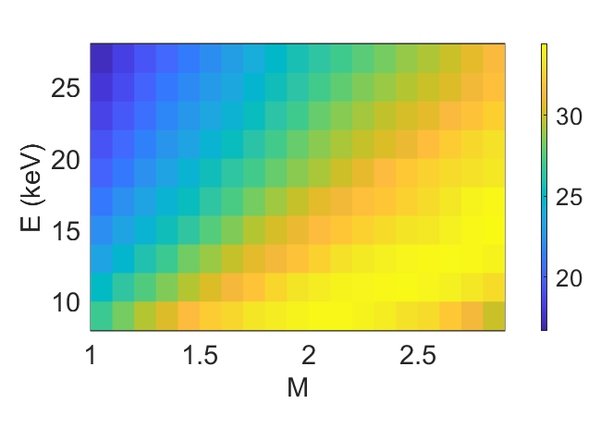
XFD Dynamic Range(10 bit CCD) L=25m
Different Photon Energy
Different Magnification
Reoptimize the aperture for each Energy and Magnification value.
Minimum beam size resolvable (µm)
Dynamic range(µm)

Slide 15
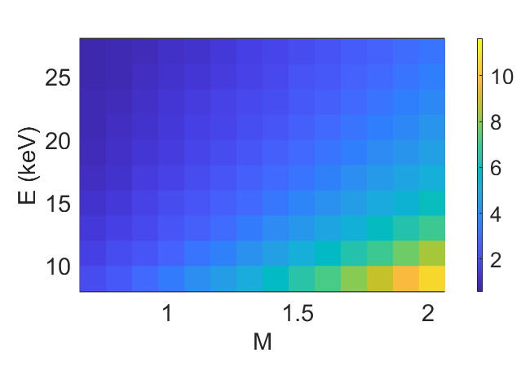
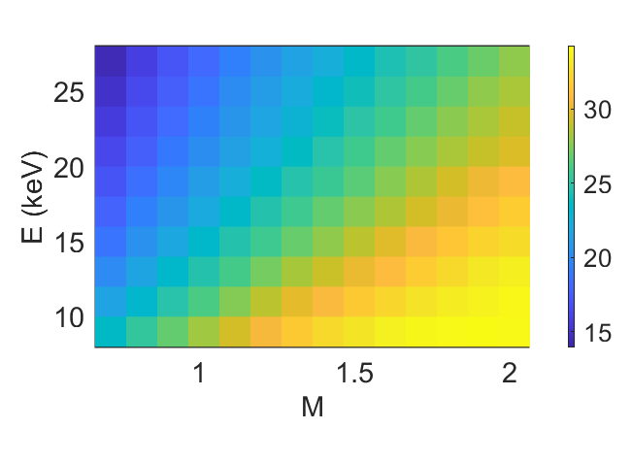
XFD Dynamic Range (10 bit CCD) L=30m
Different Photon Energy
Different Magnification
Reoptimize the aperture for each Energy and Magnification value.
Minimum beam size resolvable (µm)
Dynamic range (µm)

Slide 16
XFD: Beamline length of 50m
8 keV Case
L (m) | M | Min Spot (µm) | Max Spot (µm) | Peak Distance (µm) | Aperture size (µm)
25 | 1 | 3 | 30 | 67 | 116
30 | 0.6 | 2 | 25.5 | 55 | 114
35 | 0.4 | 1.3 | 21.1 | 43 | 107
40 | 0.25 | 0.8 | 16.6 | 25 | 93
L=30; M=0.6; E=16 keV:
min=1, max=18.9, peak distance=40, A=81 µm
12 keV Case
L (m) | M | Min Spot (µm) | Max Spot (µm) | Peak Distance (µm) | Aperture size (µm)
25 | 1 | 2 | 25.4 | 55 | 95
30 | 0.6 | 1.4 | 21.4 | 45 | 93
35 | 0.4 | 0.9 | 17.6 | 37 | 87
40 | 0.25 | 0.5 | 13.8 | 23 | 76
16 keV Case
L (m) | M | Min Spot (µm) | Max Spot (µm) | Peak Distance (µm) | Aperture size (µm)
25 | 1 | 1.5 | 22.6 | 48 | 82
30 | 0.6 | 1 | 18.9 | 40 | 81
35 | 0.4 | 0.7 | 15.4 | 32 | 75
40 | 0.25 | 0.4 | 12 | 22 | 66

Slide 17
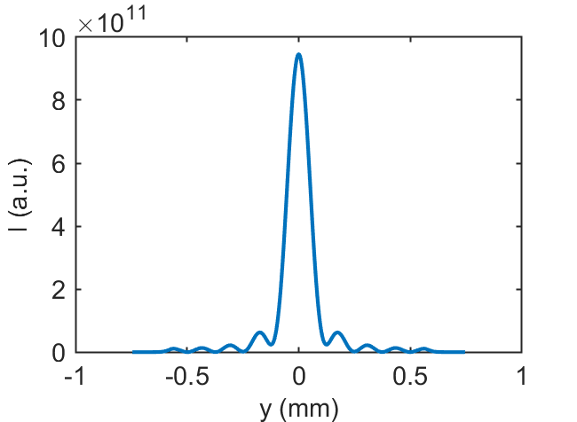
XPC: D=50m
L=25 m; R=25m; E=16 keV → A=30µm; PSF=24µm
L=10 m; R=40m; E=16 keV → A=24µm; PSF=11µm
Higher photon energies and higher magnifications means better resolution.
But the aperture becomes small and too difficult to manufacture.

Slide 18
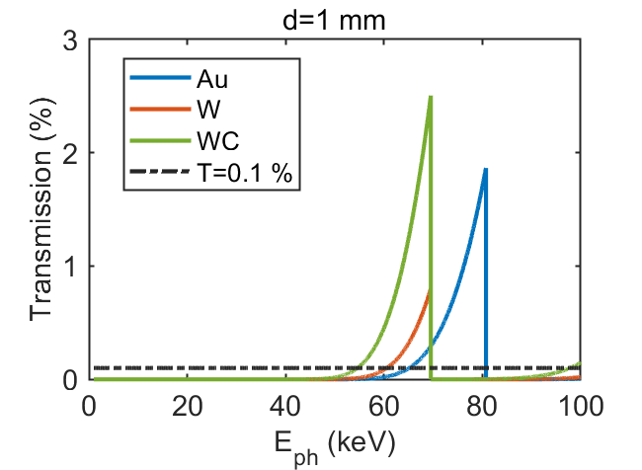
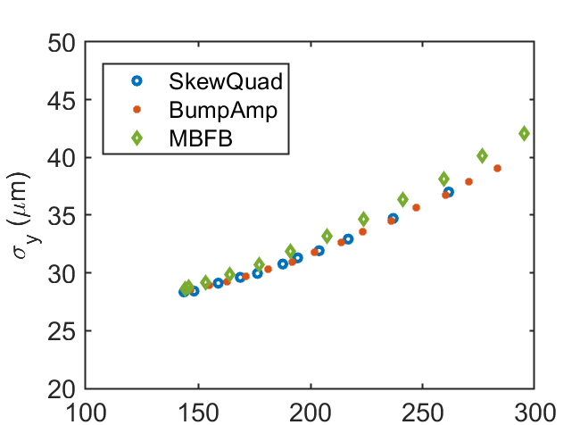
Pinhole Manufacturing
High aspect ratio (thickness > 1mm; aperture~25µm):
LIGA techniques (DIAMOND)→ thickness~200nm
Laser Drilling → Prototype testing foreseen
Different Material to be tested:
Tungsten (i.e. PETRA III)
Tungsten Carbide (i.e. ESRF)
Gold (DIAMOND)
Experimental PSF evaluation (i.e. in Touschek dominated beams the vertical size is proportional to the beam lifetime)
Condition Number (h⁻¹ mA⁻¹)

Slide 19
Conclusion
XFD for high resolution measurement and XPC for high dynamic range
Overall length of ~50 m → Screen outside the accelerator tunnel
Bending magnets and 3PW are under consideration as radiation source
Future Developments
Pinhole characterization:
  Quality of the pinhole (aspect ratio, materials, manufacturing techniques)
  Experimental PSF evaluation:
    Further test at PETRA III
XFD beam test
Optical Interferometer
Streak Camera for longitudinal measurements

Slide 20
Thank you

Slide 21
Marco Marongiu
MDI
marco.marongiu@desy.de

