Slide 1
SwissFEL Exchange Meeting
Machine report
Week 18/2022
Didier Voulot, SEM, 9 May 2022

Slide 2
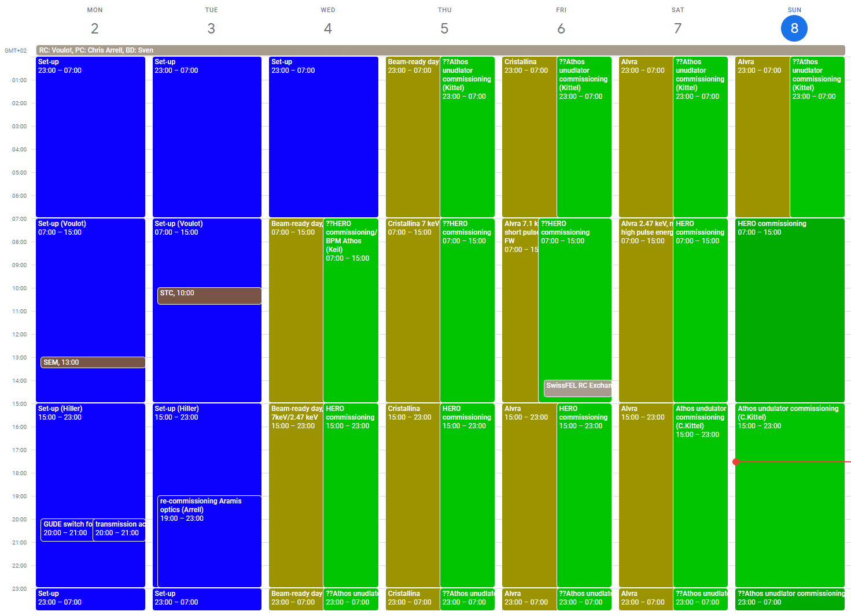

Slide 3
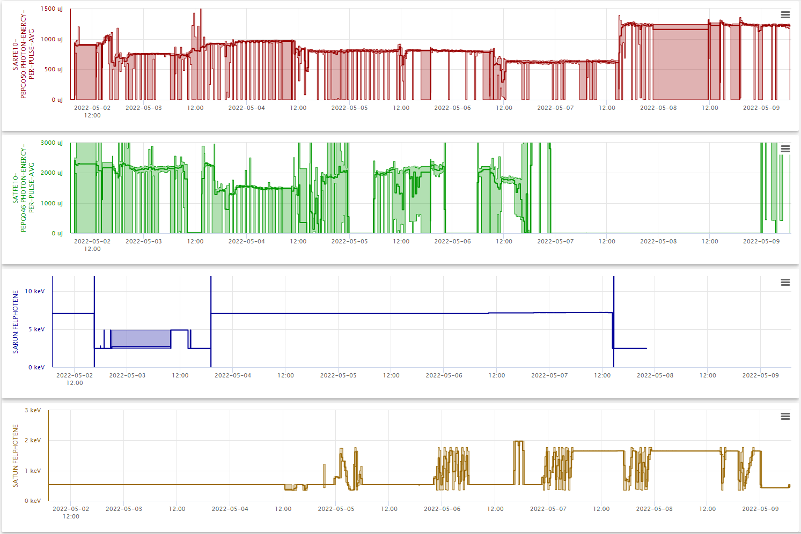
Set-up
Beam-ready day
Alvra
DRPS
DRPS
DRPS
DRPS
DRPS
DRPS
DRPS
Set-up
HERO commissioning / Athos undulator commissioning

Slide 4
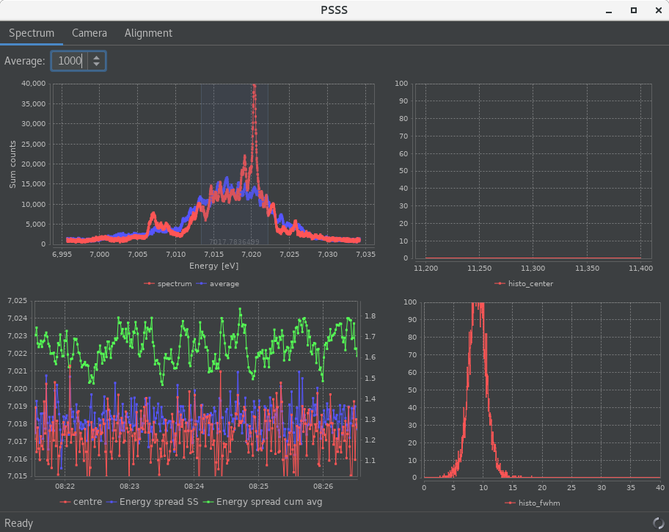
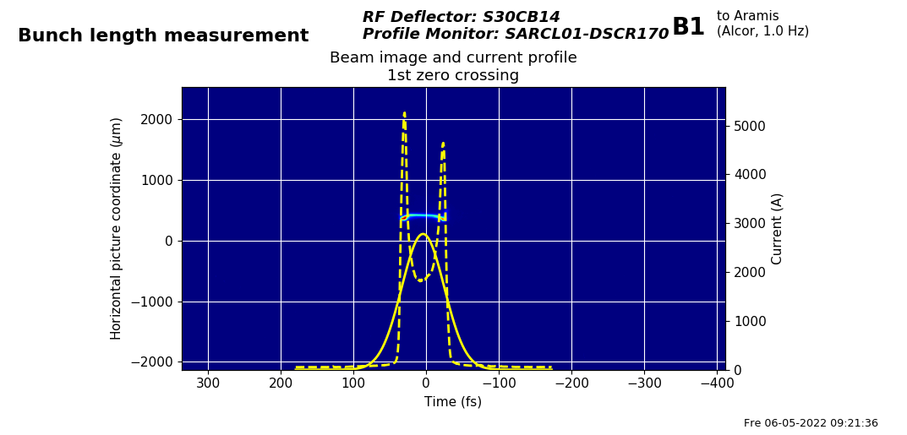
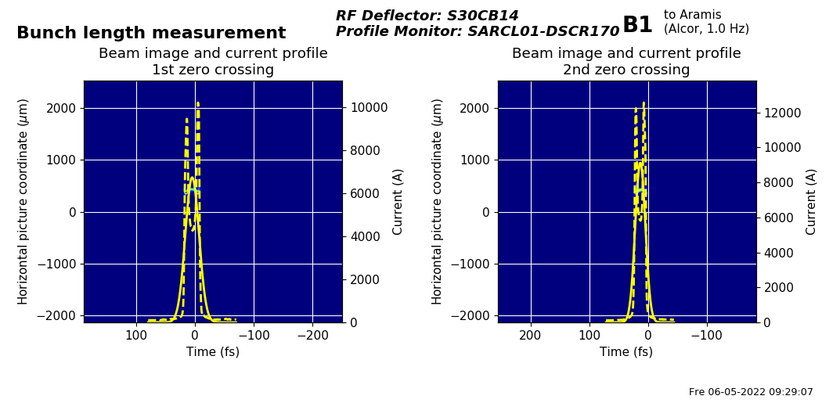
Start-up
Smooth start-up
Transmission through the gas attenuator, achieved on Thursday
Transmission problems in or in front of the HERO modulator. Tunnel access on Monday for vacuum chamber realignment (2-3 mm vertical position error) => the beam can be transmitted without orbit bumps after realignment
Set-up for 7 and 2.5 keV on Aramis
Optimize bunch length for the 7 keV beam, keeping a reasonable pulse energy and BW
Optimize BW at 2.47 keV with PSSS on third harmonic (next slide)
Athos set-up at 0.530 keV

Slide 5
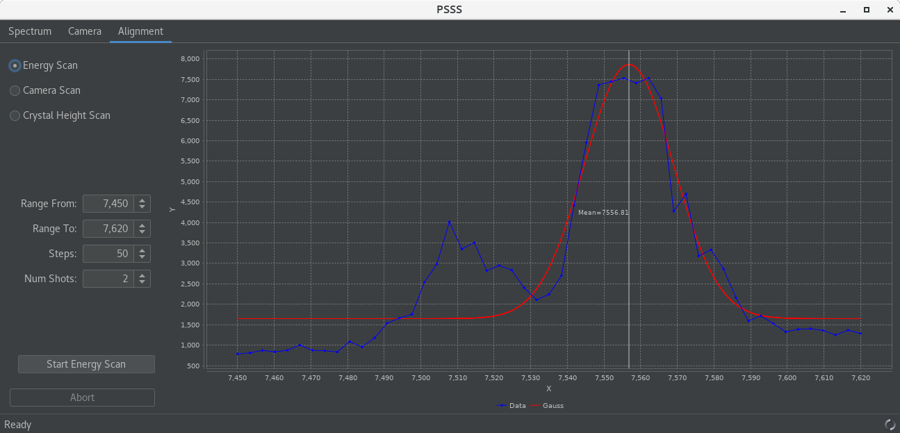
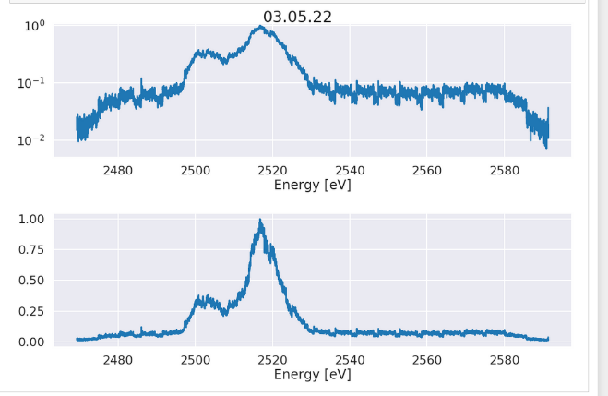
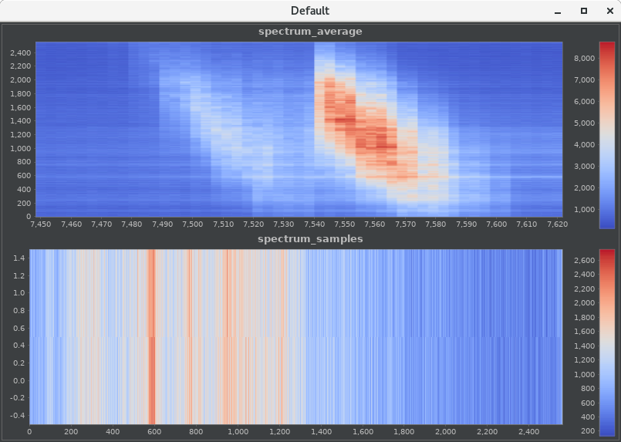
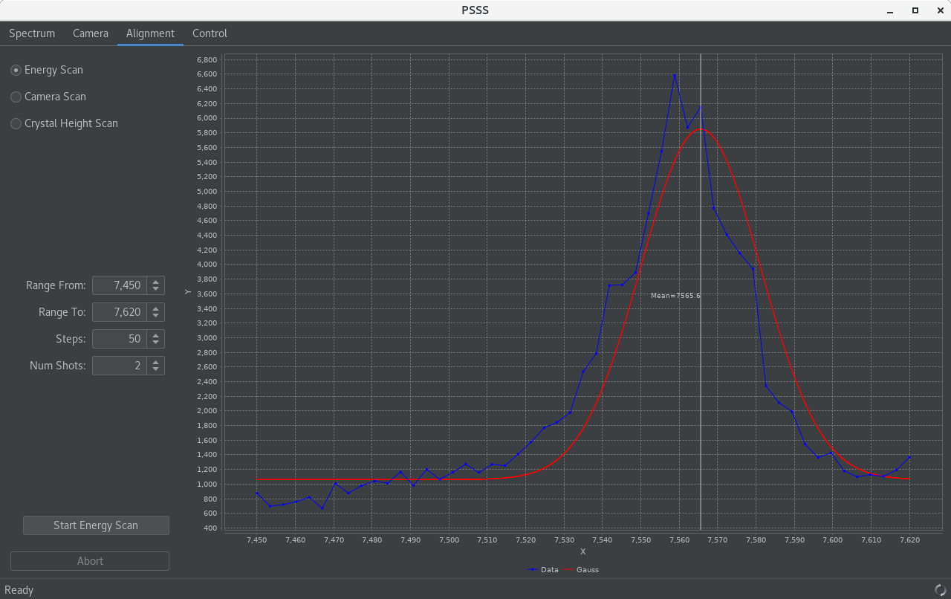
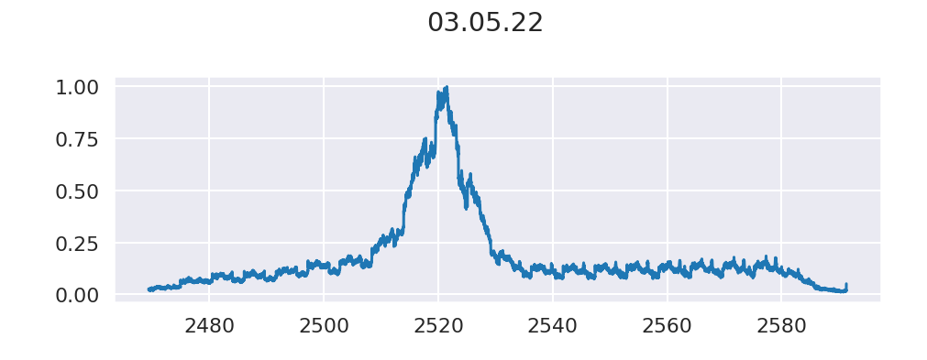
BW at 2.47 keV
PSSS set-up on third harmonic, new energy scanning feature
The spectrum has a double peak
After optimization we get one peak, BW ca 0.4%
Unfortunately when restoring the settings on Saturday the BW is much worse
Will be checked on Monday

Slide 6
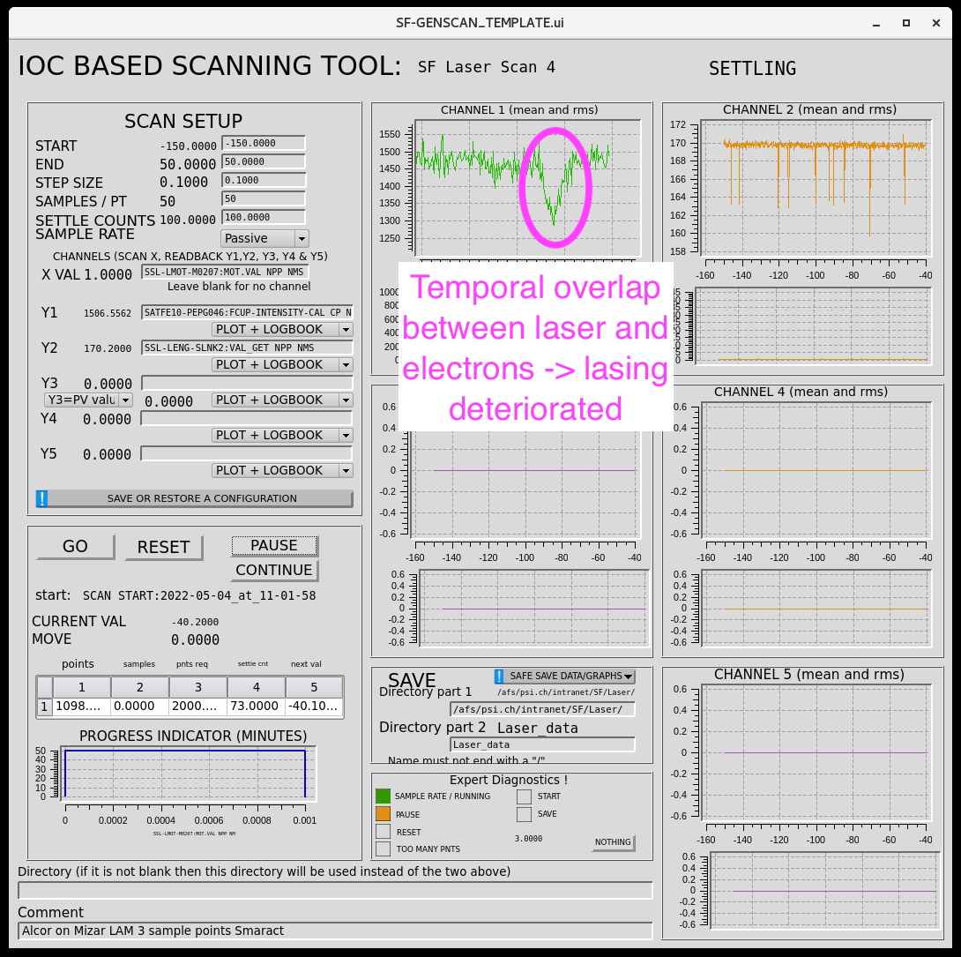
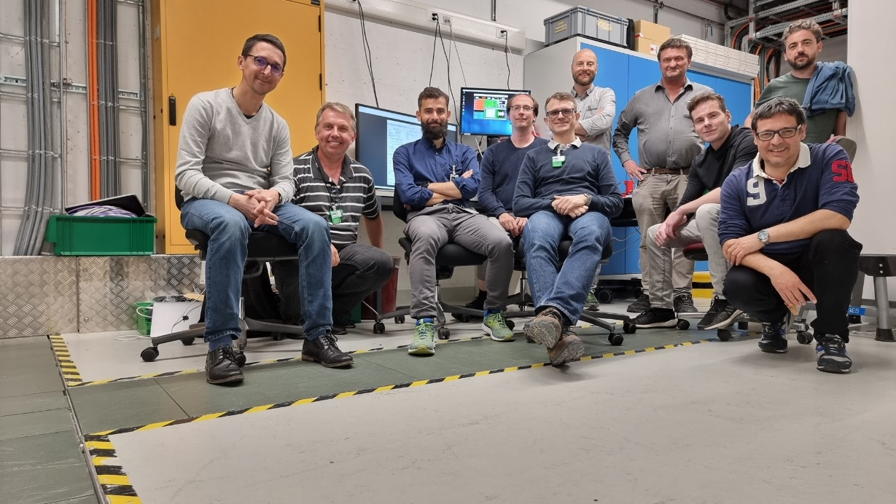
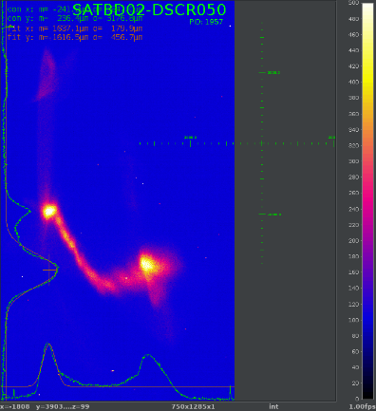
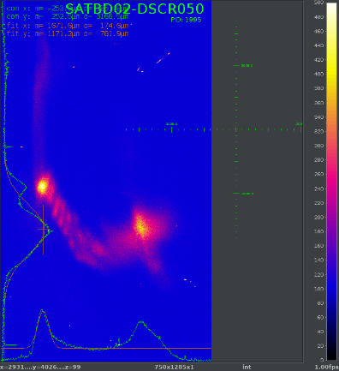
HERO success
Transverse alignment of laser and beam
Temporal overlap found
First indication of beam modulation
Happy team!

Slide 7
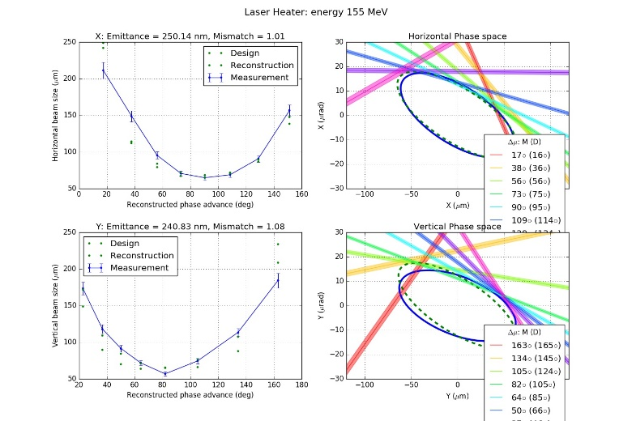
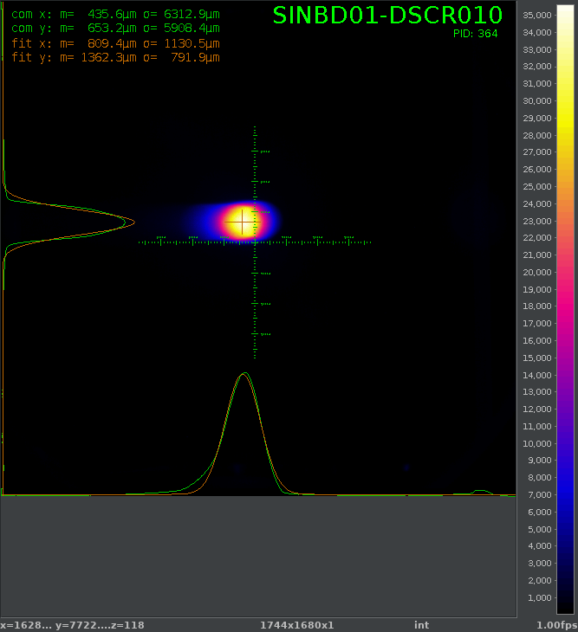
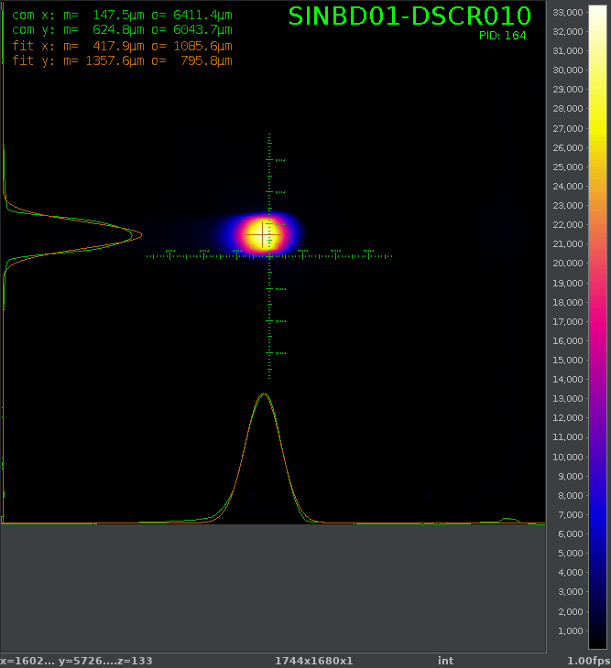
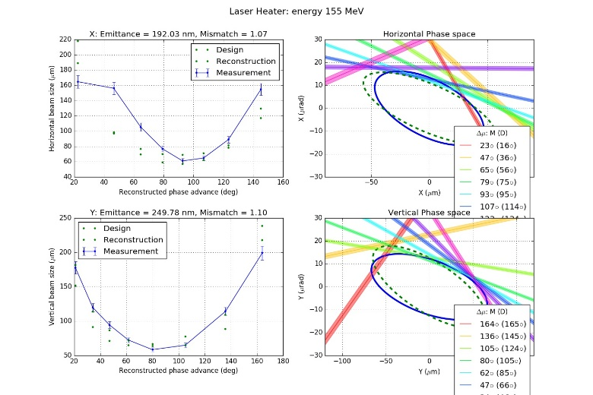
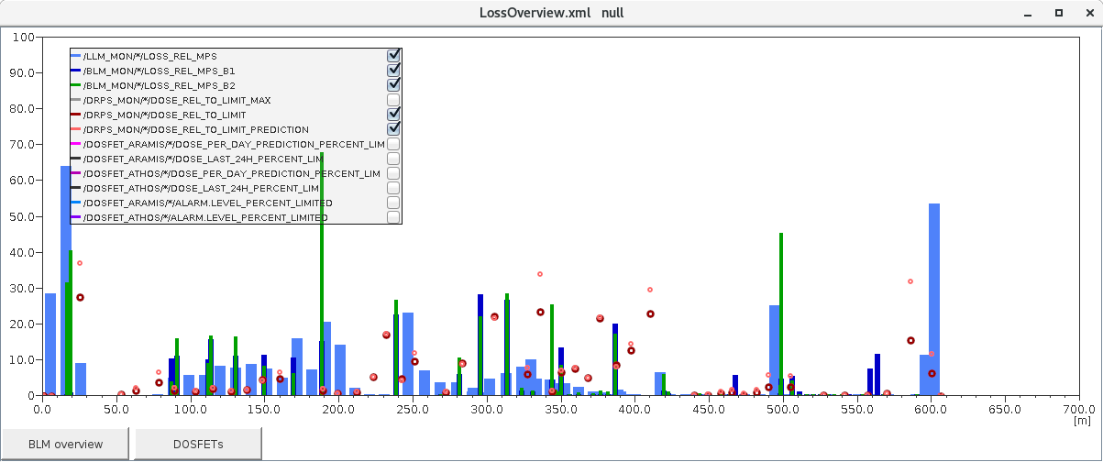
Losses in LH
Losses are associated with bunch2 only
Both bunches appear identical in the gun spectrometer, emittances are very similar, checked LH chamber position, Mizar was checked, same orbit up to BC1… problem not understood
Possibly the cause of the DRPS issues

Slide 8
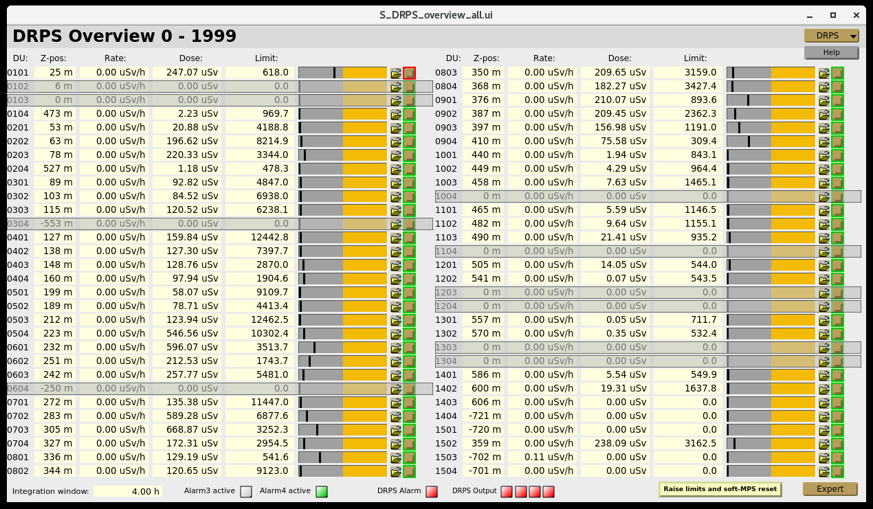
DRPS alarms
With high losses n the LH the DRPS monitor 0101 (z = 25 m) is at a higher level than usual: about 40-50%
Six DRPS system alarm during the week: the dose rates are ok but the systems detects a problem
First problem on Thursday was associated with a failure of a PLC card
SU investigating…

Slide 9
Technical Issues
Downtime
DRPS alarms 6x
S30CB02 tripped to black-heating
S30CB04 filament power supply fault
S30CB11 multipactoring
Other problems
Losses in LH
Control issues with ICT crates
SARUN undulators are drifting again, this time it seems something is changing the set-points
Some S-band stations have a longer heating-time (1h instead of 20 min)
SARFE10-OAPU044 position was changed. Caused some problem for the pointing. The reference position is: x/y = -0.05/0.35 mm
ICTs seems to have lost there calibration

