Slide 1
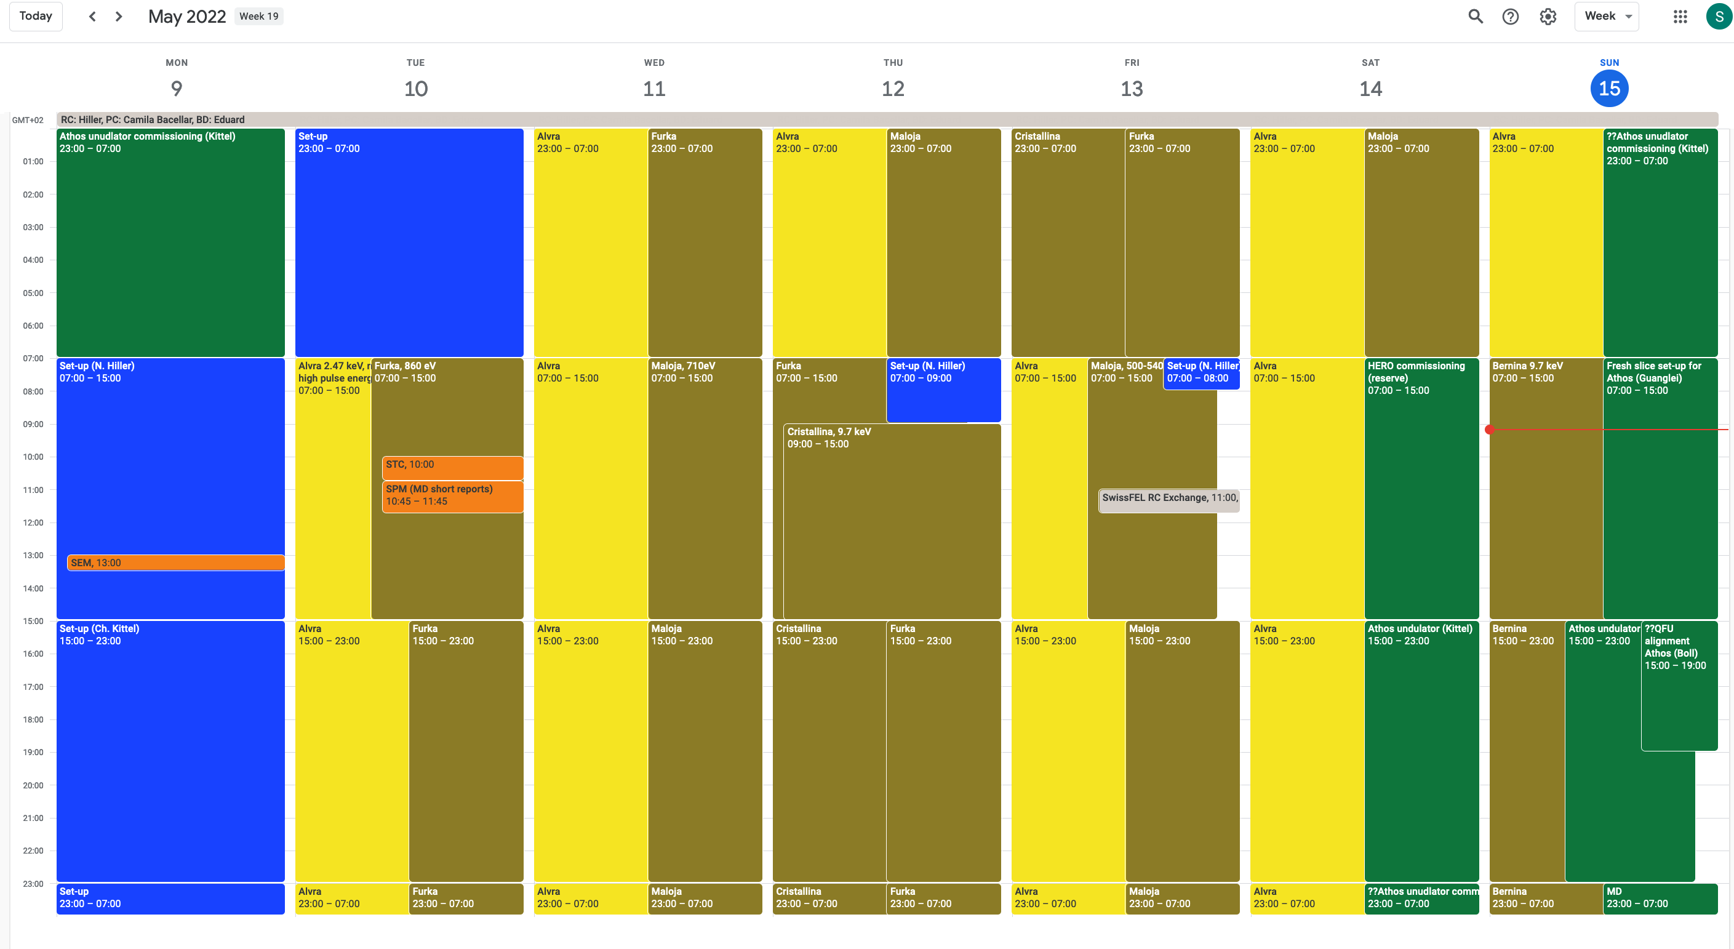
RC Report 2022 week 19 9.-16.5.2022
3x changing the energy completely for Aramis 2.48 -> 9.7 -> 2.48 -> 9.7 keV
Athos was swapping between 860 & 710 eV -> works very well with undulator K scaling
Furka 860 eV
Furka 860 eV
Alvra 2.48 keV
Alvra 2.48 keV
Alvra 2.48 keV
Alvra 2.48 keV
Maloja 710 eV
Maloja 710 eV
Bernina 9.7 keV
Cristalina 9.7 keV

Slide 2
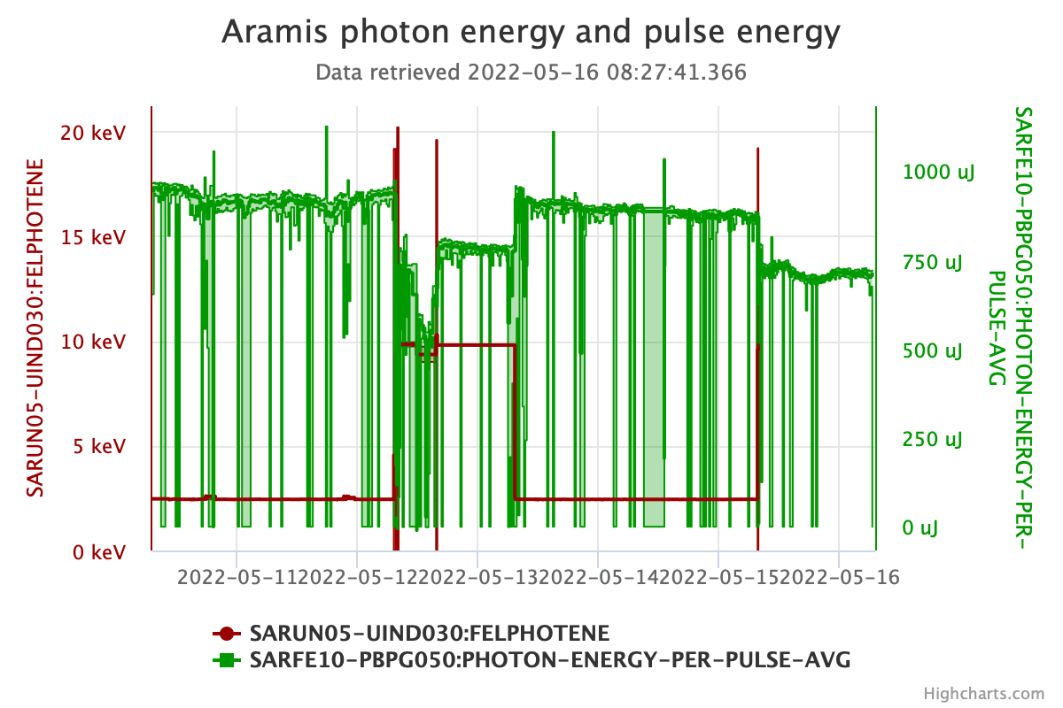
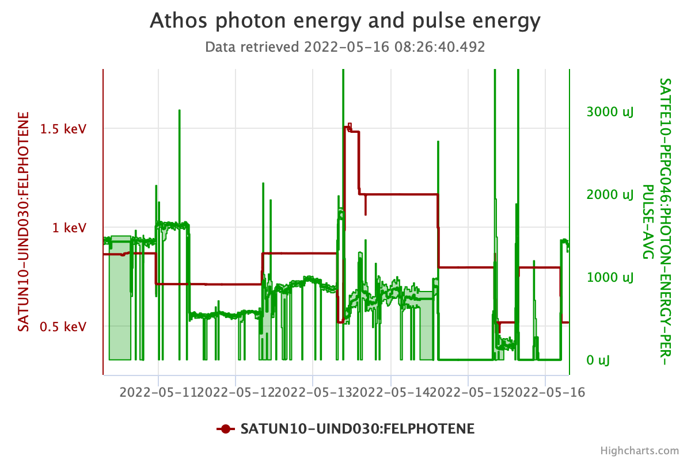
The week
Alvra UO
2.48 keV
Cristallina
9.7 keV
Alvra UO
2.48 keV
Bernina
9.7 keV
Aramis
Pulse energy in µJ
Photon energy in keV
Athos
Opened undulators to reduce pulse energy
Furka
Maloja
Athos MD
Furka
Photon energy in keV
Maloja
Pulse energy in µJ
Archiving issue

Slide 3
(Selected) Issues
Setup on Monday
  lost a lot of time due to DRPS issues. -> luckily resolved now (malconfiguration of detectors caused timing troubles in the analysis chain)
  we had to cut short on a systematic setup and could only achieve “OK”-performance (Many thanks to Eduard & Chris for staying so long on Monday!)
Both lines are not at their optimum performance -> big concern! Will address this during the setup today
  Aramis: pointing changes in y affect lasing heavily, pulse energy relatively low -> we have triggered an offline-discussion to refine the procedure
  Athos: pulse energy relatively low, could be caused by having the U200 modulator on, but maybe we also have other issues.
Stability issues: mostly the machine ran stably, but we had some issues originating from the gun/laser area that caused losses and a loss of performance -> under investigation
Large energy changes require a lot of changes, also the common part (compression, tilt, optics) -> this is not decoupled, so a big change in Aramis currently requires changes to Athos. This week the requirements in Athos were relatively low, so we managed, but this will not work (yet) when Athos requires top performance
RF: Thursday: S30CB02 -> switch unit had to be replaced. Luckily we could compensate with the undulators. Saturday: SINEG01 & SINSB04 needed modulator restarts that require on-site work

Slide 4
Some comments
Large energy changes in Aramis are done by experts at the moment, generate around 1 h downtime in both lines & require re-adjustments in Athos as well -> would it make more sense to run tender x-rays in an uninterrupted block?
typically machine stability over the weekend is very good, but if there are complex technical failures that require piketts to come on-site, the downtimes are longer than during the week -> bear this in mind for the scheduling
We have all 4 accelerators at PSI back in operation and when there is not setup, only 3 people are on shift -> things can get rather busy in the control room, especially in the mornings. What you can do to help:
  keep the beamline status & message up to date -> CR needs to know whom to inform and if the beam is being used
  say who you are and which endstation you’re at when calling the control room & use the SwissFEL number 5101
  bear in mind that the control room gets alarms when the pulse energy drops (e.g. when you move slits) -> please communicate this, so the shift crews know when the drop is caused by a real problem that needs to be looked into.
  If you’re scanning the photon energy yourself, please also let them know
  bear in mind that on Thursday at 6 AM a new shift crew starts and the previous early & late crews rotate to late & night -> we try to have experts for SwissFEL available from 7 AM, but there might be hiccups
We will be very happy when the Athos gas attenuator is used to reduce the photon flux in Athos, so we don’t have to open undulators any more -> when will it be commissioned?

